Slide 1

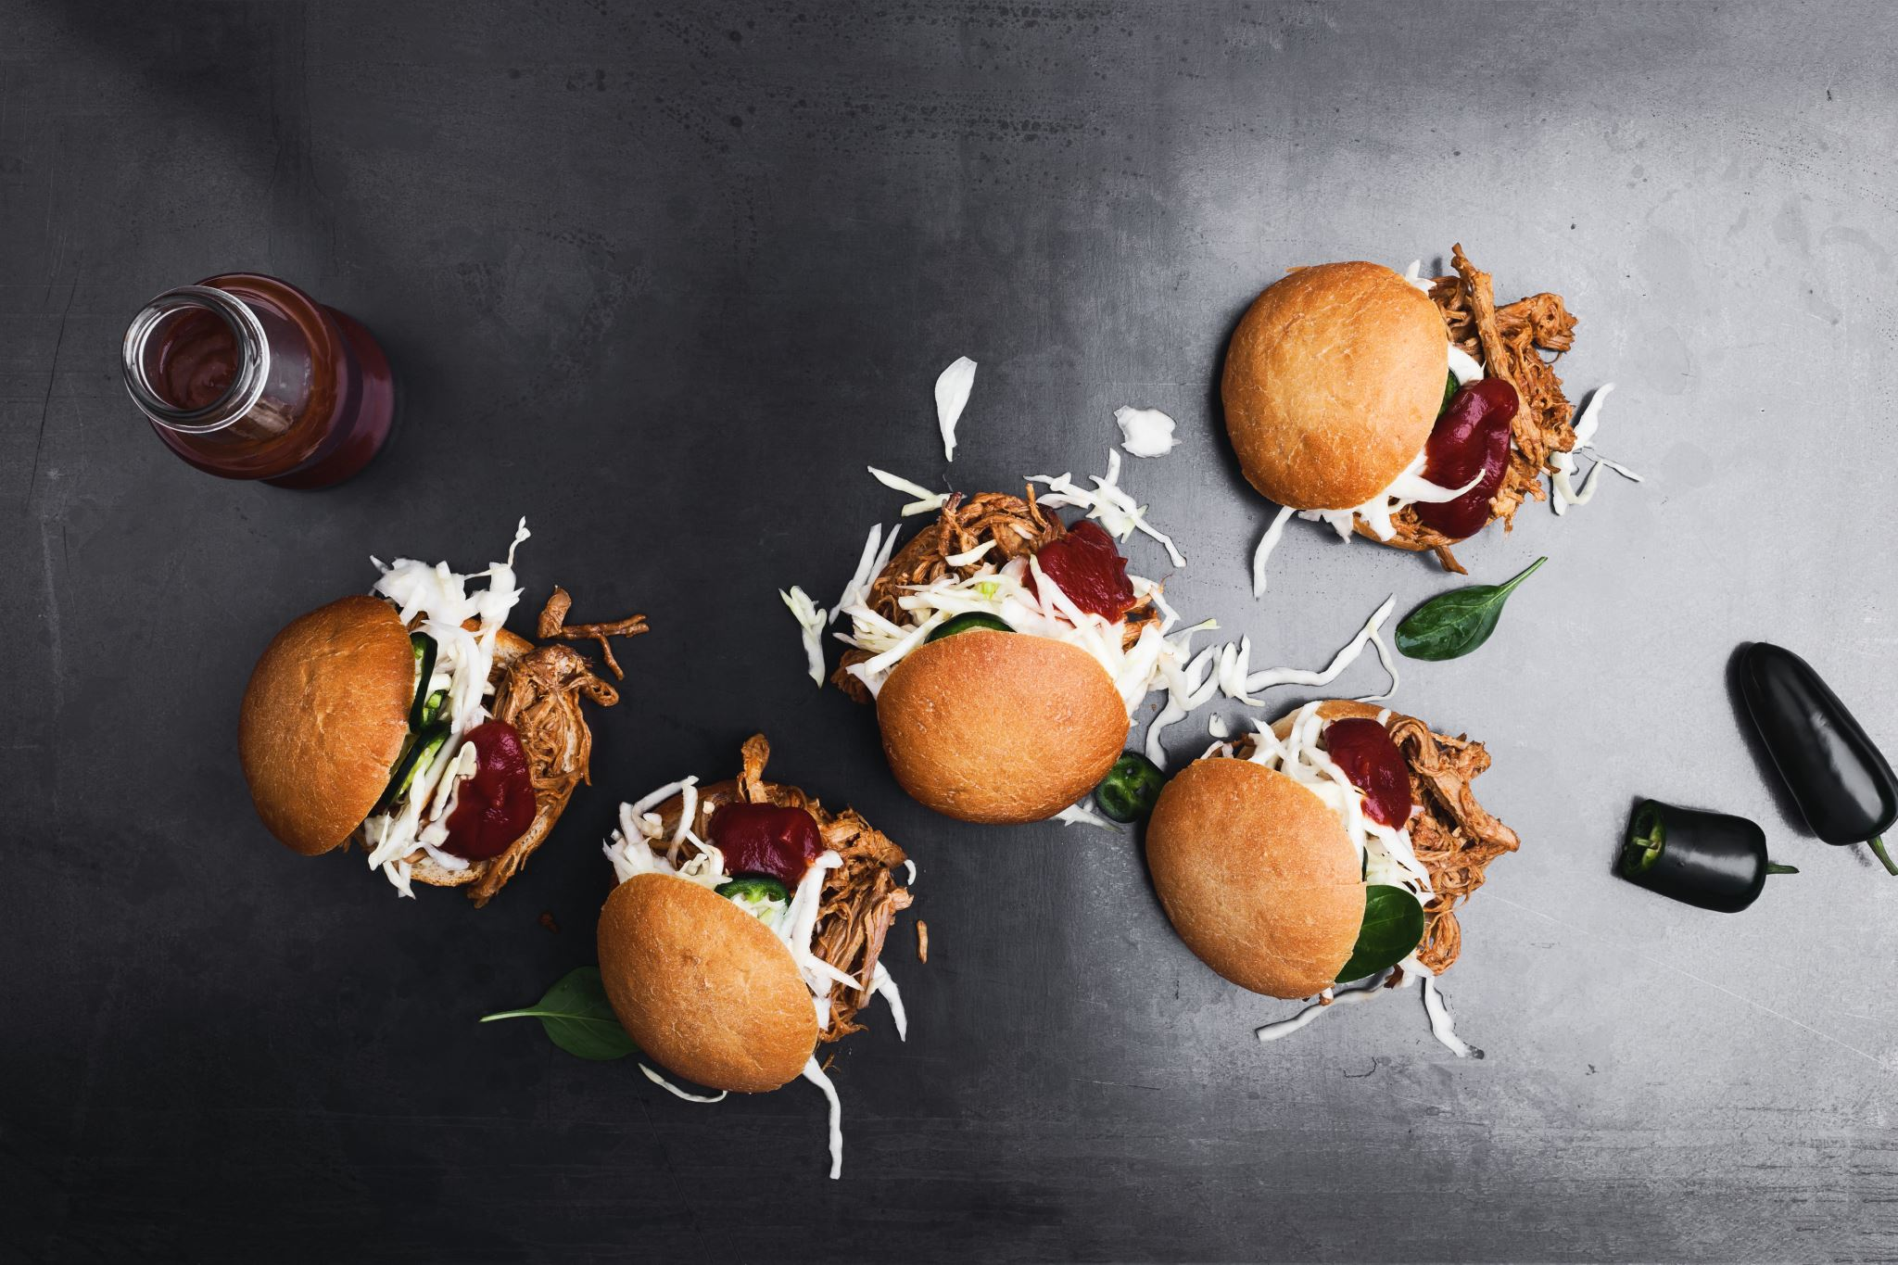
Food Future: Beyond Sustenance to Strategy
“In the next 10 years, the emerging field of ‘personalized nutrition’ will offer healthy eating guidance tailored to the individual. Through selective breeding, genetics, biomolecular science, & intensive farming practices, food will be more nutritious. And different from anything you have tasted before.”
BBC Science Focus
https://www.sciencefocus.com/future-technology/the-future-of-food-what-well-eat-in-2028

Slide 2
Diverse Audiences – Not Really a Problem
Gen Z craves the novel, nostalgic and “weird”
Older generations often lean into stability, value and familiarity
However, third-culture cooking, which melds global food traditions with American ingredients and practices, pleases all
Tells the story behind the food
Satisfies a desire to “live boldly”
Enter Newstalgia: blending international cuisines with nostalgic comfort foods reimagined in healthier formats
Appeals to diverse workforces
Enhances employee satisfaction
Cross-generational imperative: authenticity in flavor creation –– keeping it real
https://trilogyflavors.com/talkin-bout-my-generation-food-beverage-preferences-by-generation/

Slide 3
Consider These Facts
Consumer Demand: 70% of consumers prefer authentic flavors over artificial ones.
Cultural Influence: 65% of respondents say cultural heritage influences their food flavor preferences.
Health Consciousness: 58% of people associate authentic flavors with healthier, natural ingredients.
Social Media Impact: 80% of millennials are influenced by social media trends when choosing authentic food options.
Willingness to Pay: 55% of consumers are willing to pay more for dishes made with authentic ingredients.
Consumer Demand: 70% of consumers prefer authentic flavors over artificial ones.
Market Growth: The market for authentic ethnic foods has grown by 25% in the last five years. (Food Navigator USA)
Authenticity in food refers to the genuine representation of a particular cuisine, dish, or cooking technique. It’s about staying true to the traditional methods, ingredients, and cultural heritage that define a specific type of food. Authentic cuisine is often characterized by its simplicity, honesty, and transparency, reflecting the values and traditions of the people who created it.

Slide 4
2026 and Beyond
Adaptive Pricing
European operators are successfully implementing sophisticated systems that not only adjust prices but also optimize menu offerings based on demand levels
During low-demand periods, expanded menus attract customers, while high-demand times feature streamlined menus focusing on high-margin, quick-preparation items
Targeted Functionality
70% of consumers agree that what’s healthy for one person may not be for another
Customization is no longer a luxury, it’s a must-have
62% of operators already accommodate custom orders
30% design menus to encourage them
Functional foods (like probiotics for gut health or adaptogens for stress support) offer a targeted way to meet rising demand, helping 57% of consumers who want to eat healthier do so in a way that nourishes their unique needs
Bowls will still be booming. They’re endlessly customizable
and perfect for health-conscious diners. Dinner bowls are
projected to grow +17%, veggie bowls +51%, and grain bowls +91%.

Slide 5
Food Personalization
Food as Identity Connection – an act of expression over sustenance
Hyper-regionality – vertical farming delivering year-round harvests
Networks of small-scale & suburban farms forming cooperative systems
“Doing the right thing” in terms of ingredient sourcing (and remembering to tell the story)
Shift back to meat (protein interest growing 3X faster in meat category)
Plant forward growing but not as rapidly in the USA
Food Tailored to Your Genome
‘Personalized nutrition’ will use genetic tests to offer healthy eating guidance tailored to the individual
Some companies, so-called ‘nutrigenetics services’, already test your DNA and offer dietary advice
Simultaneously food will be engineered to be more nutritious
Food will be different from anything we’ve tasted before
64754afaf50bbd0ca3b7a2ff_Synthesis Futures_ Menu 2033 – The Future of Food Report.pdf

Slide 6
Beyond Filling the Stomach
Emotional Branding | Personalized Nutrition
Bridging the gap between product functionality & consumer identity =drives relevance, trust, loyalty
Portion options: not about restriction but freedom to eat in a way that fits the moment
One size (food) doesn’t fit all; it’s about what I need
Phone apps will house the personalized data & then connect that to what can be chosen in a Café that suits their profile
The New Body Operating System | Lifestyle Power Plays
Pantries rebuilt around protein, fiber, and stability
Drinks with electrolytes or added botanicals
Non-coffee digital fuel: drinks with L-theanine, magnesium, and mushrooms are now common and promise clarity without the crash
Sensory Maximalism – beyond flavor while doing the body good

Slide 7

Milk Is In Again
Dirty sodas, affogatos, floats, cold foams, cream caps, Asian milk teas, lassi-style drinks, horchatas with cream foams
Gen Z, Alpha & Millennials love layered textures, visual drama & nostalgic familiarity with a twist
Dairy has become a flavor and texture enhancer that adds richness and indulgence—and creates a sensory experience
Customization of these drinks. Think protein add-ons and functional layering with collagen, probiotics and adaptogens
Functional Foam

Slide 8
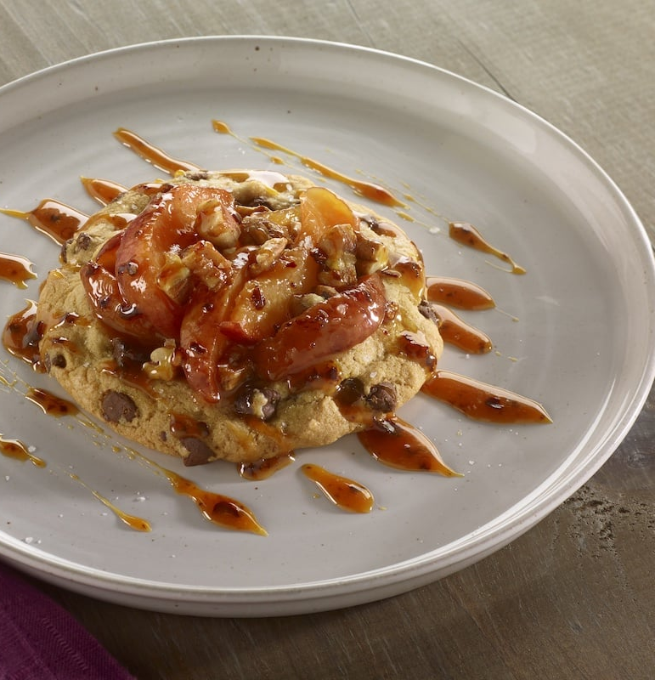
2026
Balance between indulgence and intention, comfort and consciousness
Bold flavors – Swicey and Swalty (the new umami) – Salted Caramel Peach Chili Crisp Crumble Cookie
Innovative formats and flexible dining formats
Traditional cafeterias are being replaced or supplemented by micro-markets, pop-up kitchens, and grab-and-go stations
These formats cater to hybrid work schedules and reduce overhead
Balance between health-conscious choices, global culinary influences, visually appealing desserts
A deep-seated desire to experience the world through a variety of cuisines
Personalized hydration, such as smart water and beverages infused with certain electrolytes or supplements

Slide 9
2026 and Beyond: Ideas for Operators
Functional Food Pantries
Seasonal menu kiosks based on climate-adaptive ingredients (adaptive cuisines)
Hybrid-friendly food programs for remote workers
Hydration Kiosks featuring various enhanced waters & energy drinks
Smaller, more intimate “restaurant” spaces available where people are
Kiosk or phone checkout page used not as a static payment portal, but as a dynamic real estate capable of delivering a unique experience to each single customer
Bolder global breakfast bowls
Hot “made or assembled to order” meals all day
Varied seating styles and décor elements to allow experience customization

Slide 10
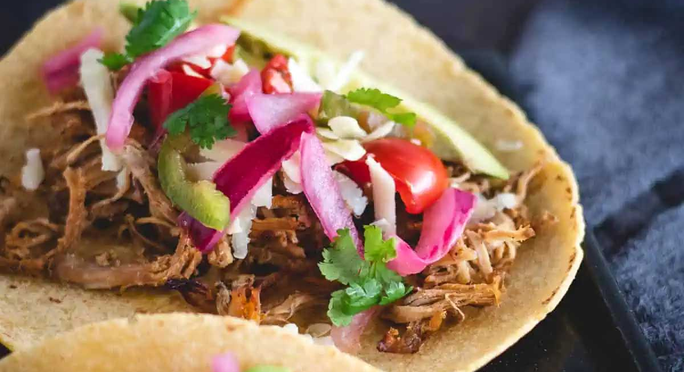
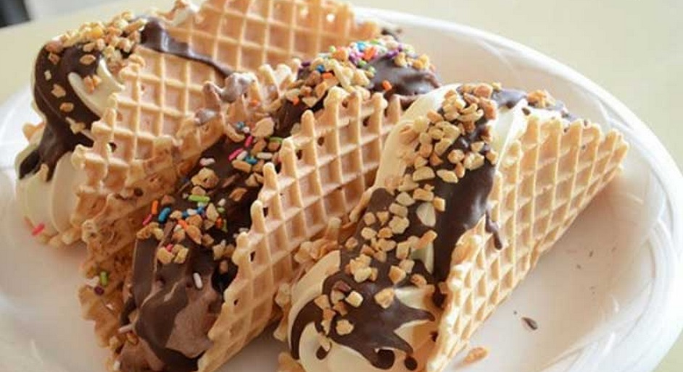
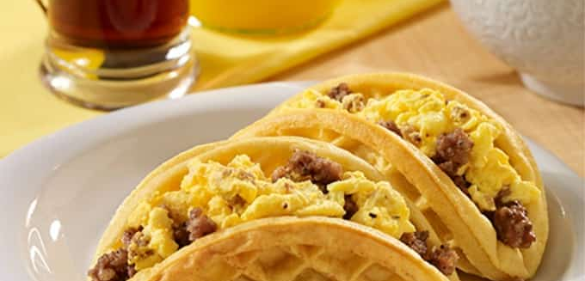
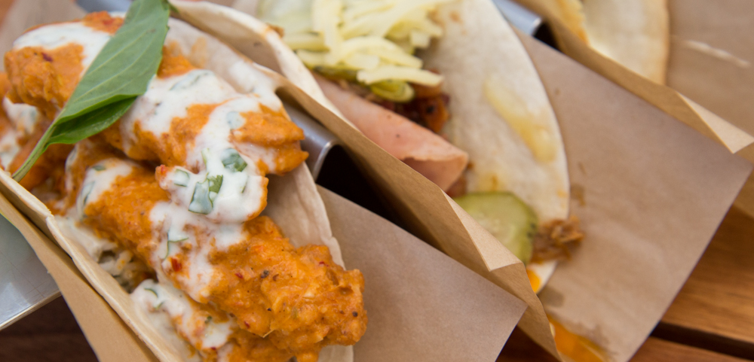

Slide 11
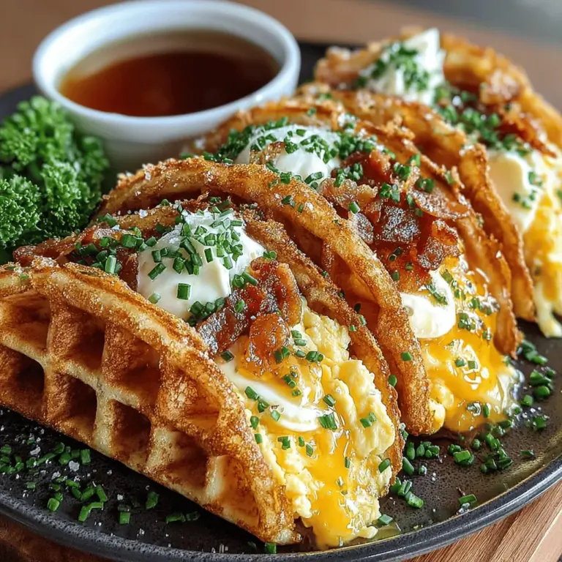
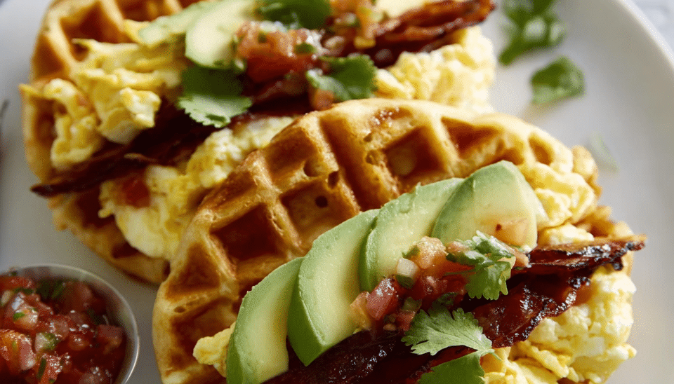
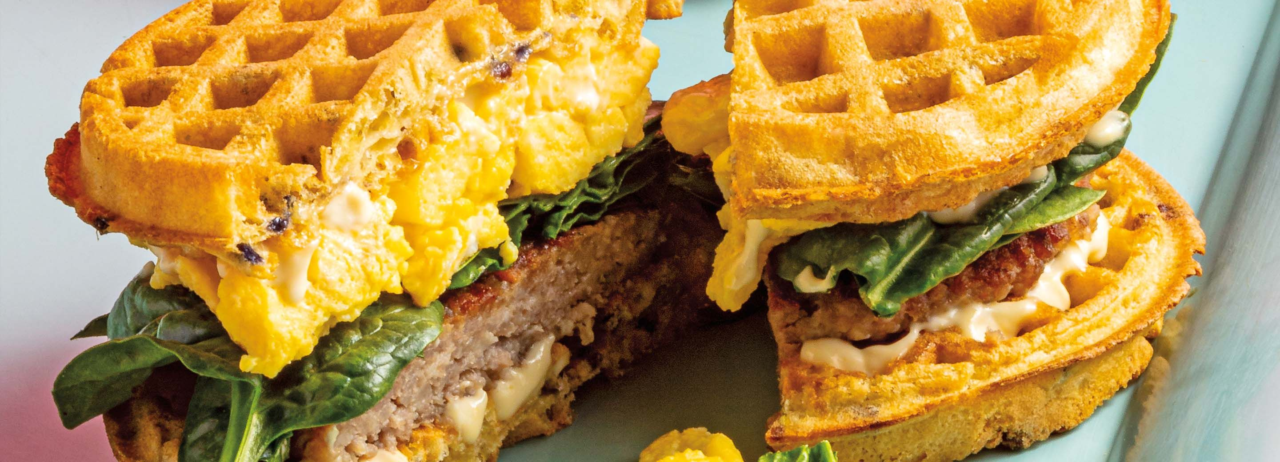

Slide 12
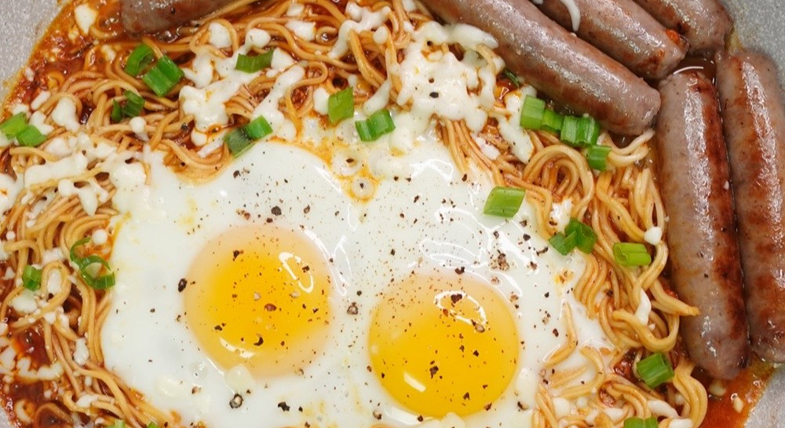
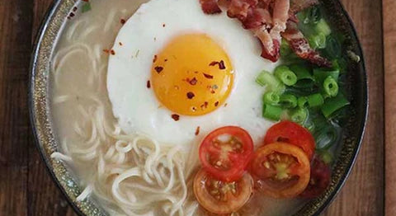
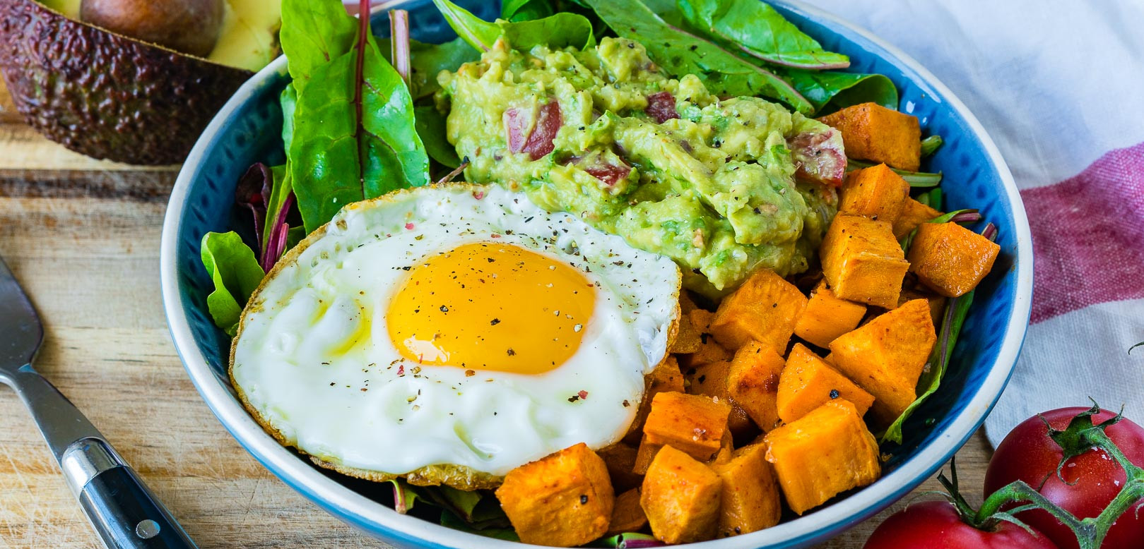
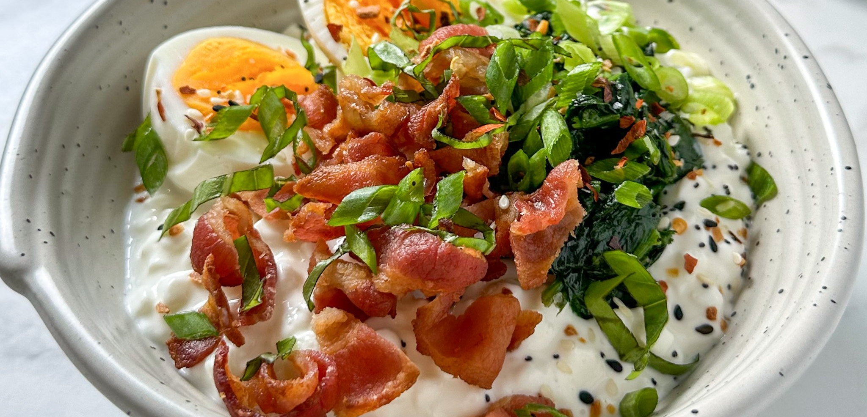

Slide 13
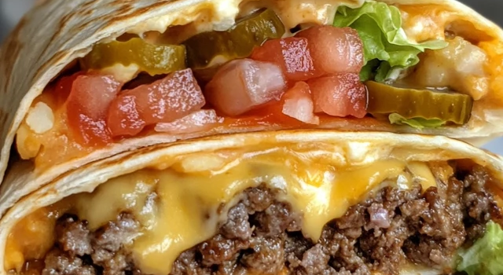
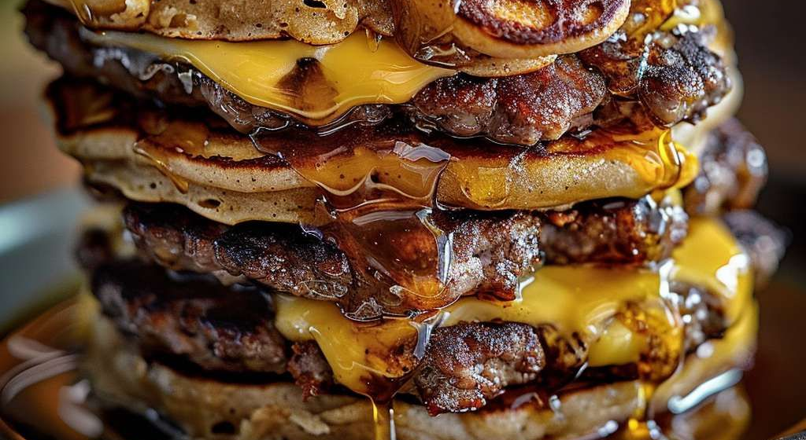
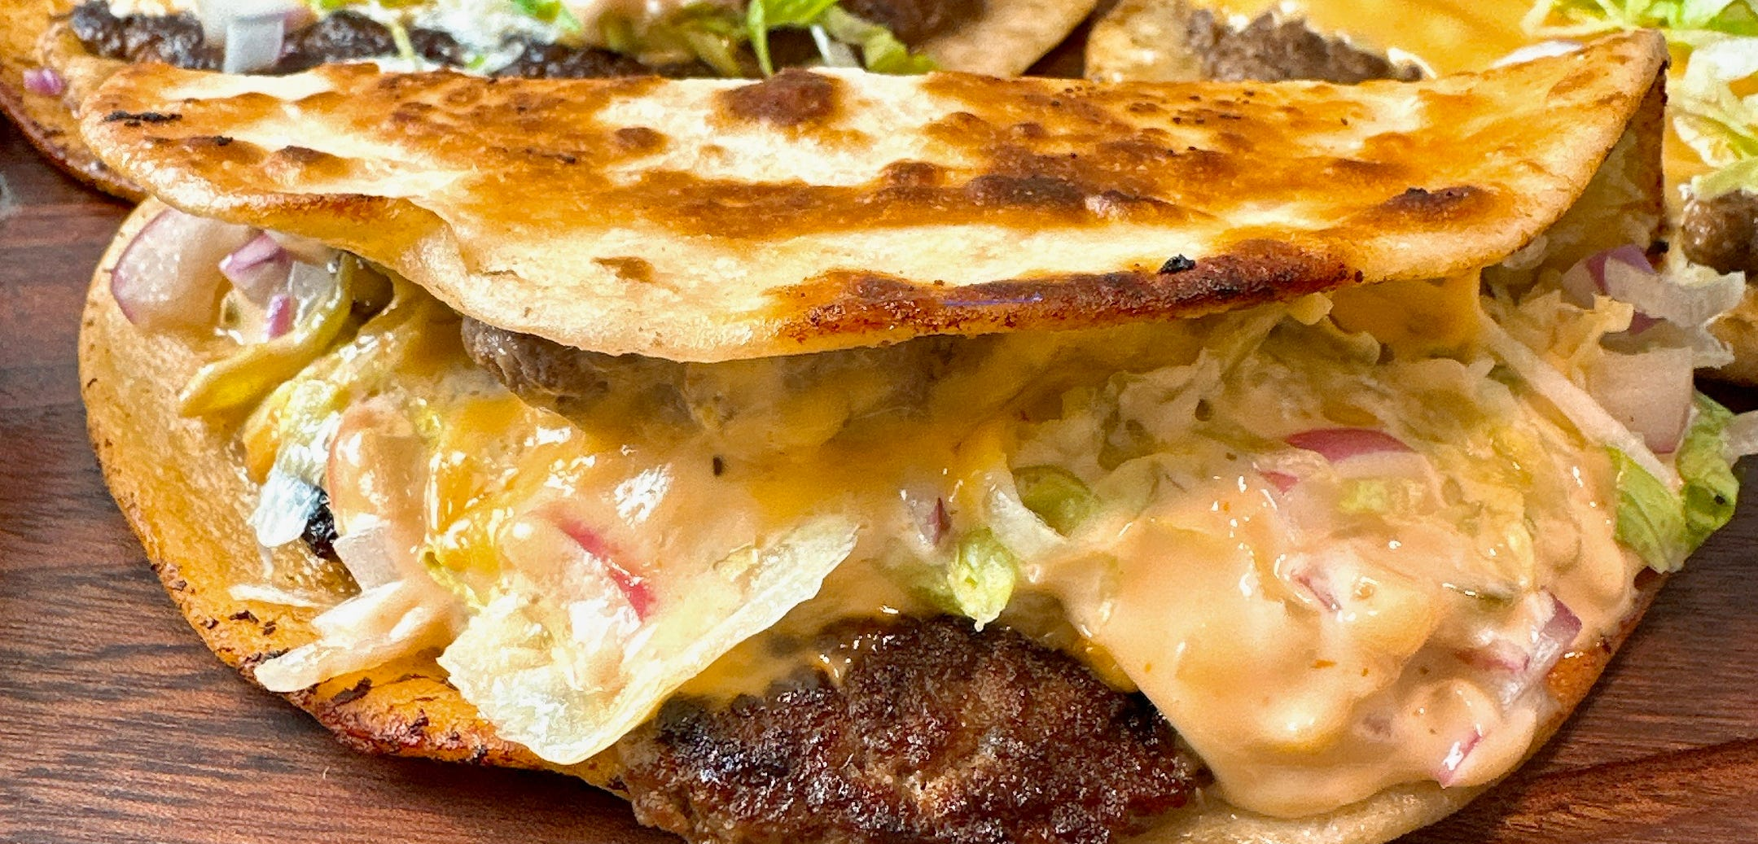
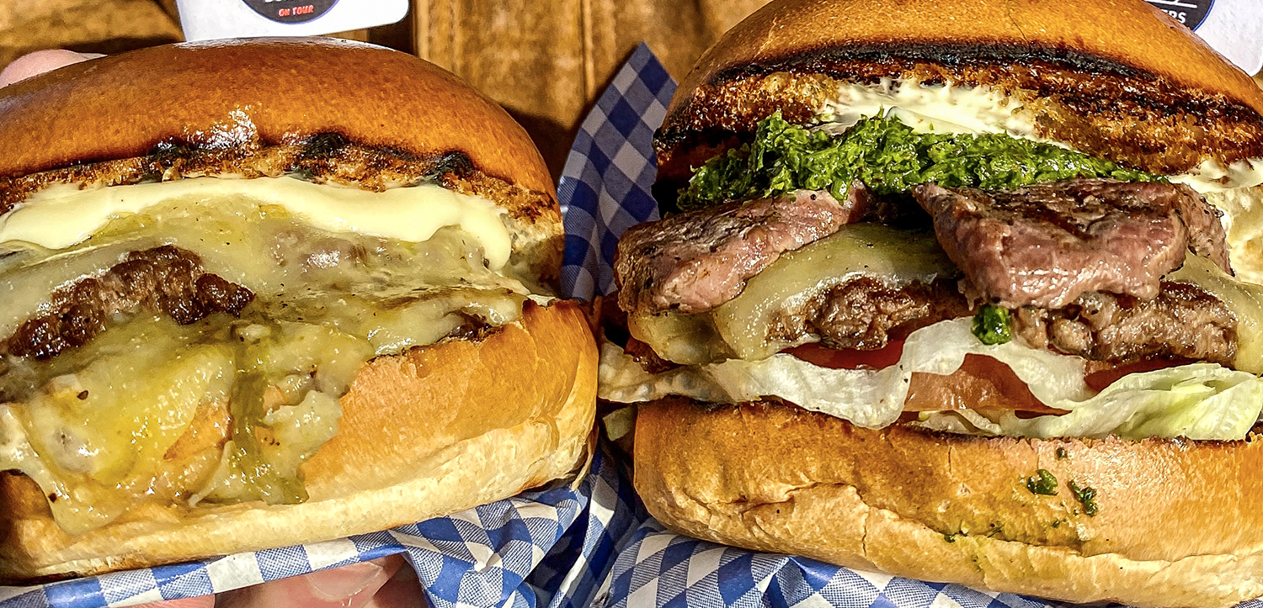

Slide 14
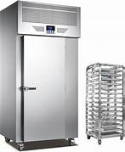
Equipment 2026 and Beyond
Smart, Connected Kitchens
Induction Adoption Rises, Kitchens Go Hybrid
Refrigeration shifts to Low GWP
Efficiency First, ENERGY STAR keeps paying
Ventless & Flexible Cooking Widen Site Options
Combi & Speed Ovens Power Smaller, Multi-daypart Menus
Digital Food Safety (HACCP) Becomes the Default
PFAS-free Momentum Affects Cookware and Packaging Choices
Ghost & Hybrid Formats Reward Modular, Mobile Gear
The Used & Refurbished Market Stretches Budgets

Slide 15

Equipment 2026 and Beyond
Smart, Connected Kitchens
Less downtime, cleaner audit trails, reduced waste
Ask for open integrations (APIs or export formats) so that your data isn’t trapped
Look for remote diagnostics and role-based access (helpful for multi-unit ops)
Fold HACCP-grade probes & refrigeration sensors into the same platform

Slide 16
Equipment 2026 and Beyond
Induction Adoption Rises, Kitchens Go Hybrid
Choose modular hobs that slide into existing lines; confirm electrical service
Speed, precise control, cooler lines, and easier cleanup, especially for high-turn stations & tight footprints
Verify cookware compatibility and keep a few backup pans labeled “induction”
Ask about board protection and service access for heavy-use environments

Slide 17
Equipment 2026 and Beyond
Refrigeration Shifts to Low-GWP
HFC “allowances” ratchet down each year, operators are planning replacements around low-GWP refrigerants like R-290.
Expect more units labeled for hydrocarbon use, along with training needs for handling and leak detection
Map older boxes and phase replacements over the next 24 months The entire next generation of new reach-ins, prep tables, and walk-ins is already built around these highly efficient and compliant hydrocarbon systems
Review sector and tech-transition context with your service partner
Implement continuous monitoring for walk-ins and high-risk cases
https://wellri.com/types-of-refrigerants-environmental-impact

Slide 18
Equipment 2026 and Beyond
Efficiency First, ENERGY STAR keeps paying
Models in categories such as fryers, ovens, steamers, dishwashers, griddles, hot holding units, refrigerators/freezers, and ice machines deliver meaningful utility savings, often in double-digit percentages, depending on the category and duty cycle.
The ENERGY STAR Commercial Food Service portal consolidates specs, calculators, and qualifying product lists

Slide 19
Equipment 2026 and Beyond
Ventless & Flexible Cooking Widen Site Options
“Ventless” speed/combi solutions can unlock tough sites, kiosks, or menu extensions but ventless isn’t hoodless in every case
Coordinate with your AHJ and verify listings (e.g., UL 710B for recirculating systems) and menu limitations, especially for grease-laden vapors
Confirm UL listing and any protein restrictions in the submittal
Document cleaning intervals and filter maintenance to maintain the listing
Align with NFPA 96 (2024) and local code adoption; keep inspection records tidy .

Slide 20
Equipment 2026 and Beyond
Combi & Speed Ovens Power Smaller, Multi-daypart Menus
Recent market trackers peg combi growth around ~9% CAGR through 2030; high-speed ovens also show steady expansion on throughput and energy performance.
Offers menu agility, higher yields on proteins, labor relief

Slide 21
Equipment 2026 and Beyond
Digital Food Safety (HACCP) Becomes the Default
With modern Food Code adoption, wireless probes and continuous refrigeration sensors are replacing paper logs
Automatic records, instant alerts, easier audits, fewer toss-outs after a temp excursion
Pick a platform that:
Covers receiving > storage > prep > hot hold/service
Exports clean HACCP reports
Plays well with KDS/POS for one source of truth

Slide 22
Equipment 2026 and Beyond
PFAS-free Momentum Affects Cookware and Packaging Choices
States have tightened PFAS restrictions in food packaging for years; now, California’s SB 682 (2025) would extend these restrictions to cookware
If signed, large suppliers may shift national assortments. Ask for materials disclosures and alternatives from vendors, especially if you operate in multiple states

Slide 23
Equipment 2026 and Beyond
Ghost & Hybrid Formats Reward Modular, Mobile Gear
The “ghost kitchen” wave didn’t vanish, it matured. 2025 data and trade coverage show off-premises now represents about three-quarters of restaurant traffic, and operators are blending dine-in with delivery/pick-up in hybrid footprints
Favors plug-and-play cooking, holding, and refrigeration that you can reconfigure as channels swing. Modular prep stations help micro-kitchens scale

Slide 24
Equipment 2026 and Beyond
The Used & Refurbished Market Stretches Budgets
With new purchases earmarked for compliance and efficiency, many operators backfill the rest of the line with pre-owned pieces to keep openings and remodels on budget
Use pre-owned for non-critical items, or as a bridge while you wait for long-lead models

Slide 25
Checklist: How to Spec 2026 Upgrades
Map refrigeration replacements to AIM Act milestones: Plan for R-290 units and train on hydrocarbon basics and leak response.
Stack efficiency + rebates: Shortlist ENERGY STAR models first, then check AEP Texas, Oncor CHEF, Austin Energy, and the ENERGY STAR rebate finder.
Plan hybrid cooklines: Use induction where it cools the line and speeds service; keep gas where it suits your menu, HB 17 preserves that choice.
Verify hood/ventless approvals early: “Ventless” depends on unit listings, menu, and local adoption of NFPA/IMC. Align with your AHJ before you buy.
Bake in connectivity: For big-ticket pieces, ask about data exports, remote diagnostics, and security posture (connected gear expands your attack surface).

