Slide 1





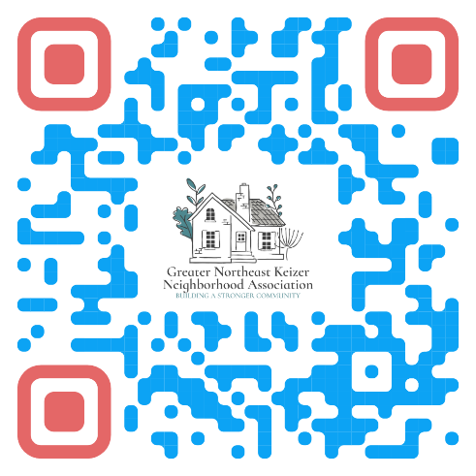

Greater Northeast Keizer Neighborhood Meeting
Want to stay informed and connect with your neighbors?
Join us for our upcoming neighborhood meeting! We are offering a hybrid format attend in person or join virtually via Zoom starting September 15, 2026.
930 Chemawa Rd. NE Keizer Or 97303
Questions or want to get involved?
Contact: Tammy Kunz Email: nekna2022@gmail.com
Website: gnekna.com
Phone: 503-991-1671
Join Zoom Meeting
https://us06web.zoom.us/j/82240780565?pwd=9EJ3BMgi9tJ0uNyJ9UUOOgGKE1Xwco.1
Meeting ID: 822 4078 0565 Passcode: 087191
"Building a Stronger Community, One Neighborhood at a Time."
"Working Together for a Safer, Vibrant Keizer."
Meeting the 3rd Tuesday of each month from 6;00 @ 930 Chemawa rd... NE / Keizer City Hall/ Community Center/ Event center

