Slide 1





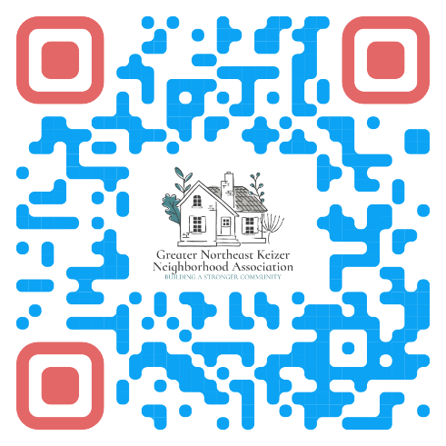
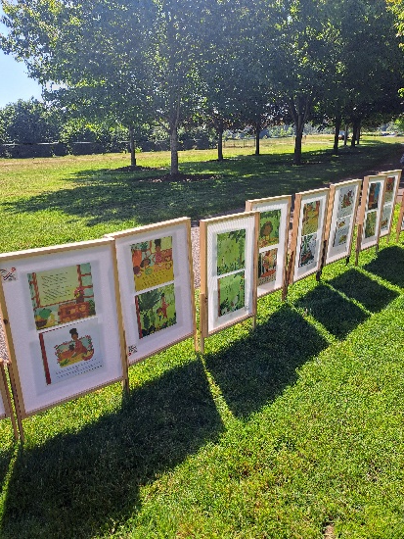
Greater Northeast Keizer Neighborhood Meeting
We need you are you looking to learn what is going on or get to know your neighbors!
We'll discuss the election of officers and updates on what it is going on in our community Reach out to Tammy Kunz nekna2022@gmail.com
or
gnekna.com 503-991-1671 with any questions.
Meeting the 4th Tuesday of each month from 6;00 @ 930 Chemawa rd... NE / Keizer City Hall/ Community Center/ Event center

