Slide 1

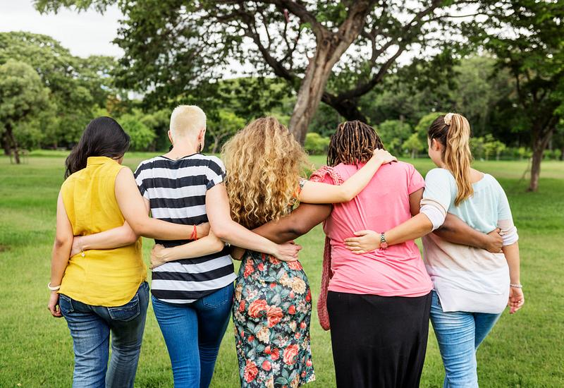



Greater Northeast Keizer Neighborhood Meeting
Join us the 1st Tuesday of each month @ 6:00 pm Join Zoom Meeting https://us06web.zoom.us/j/89485136753?pwd=kd4H21M7Q24jFbrKFccloPK2m35bCY.1 Meeting ID: 894 8513 6753 Passcode: 934295
971-701-3008 or nekna2022@gmail.com
Building a Better Tomorrow!
Serving 4500+ families

