Slide 1
ENTREPRENEURS COLLECTIVE

Slide 3
Founders Helping Founders

Slide 4
Our Members…
The Goal…
Our Events…
will bring together quality Founders and investors.
is to build successful companies.
will be value-added, practical events which inspire and connect.

Slide 5
AGENDA
14:05 – 14:10 || Opening remarks by Michael Blakeley
14:10 – 14:45 || Panel Discussion: 5 Tips & tools from HR, Legal and Accounting professionals
14:45 - 15:10 ||Questions from audience
15:10 – 15:15 || Closing Remarks

Slide 6
EC Coronavirus Tools & Tips
Very resourceful website: https://www.ggvc.com/ggv-capital-covid-19-operational-tactics-for-startups/
Working from home:
Zoom’s tips for working from home: https://blog.zoom.us/wordpress/2020/03/09/working-from-home-tips-to-meet-like-a-pro/
Gitlab’s resources for remote working: https://about.gitlab.com/blog/2020/03/06/resources-for-companies-embracing-remote-work/
18 Tips used by remote teams: https://www.groovehq.com/blog/remote-team-tools
Funding:
Fundraising during coronavirus article: https://sifted.eu/articles/startup-fundraising-coronavirus/
Investor tips during coronavirus: https://sifted.eu/articles/investor-coronavirus-advice/
Government support for startups during epidemic: https://sifted.eu/articles/coronavirus-support-startups/
Gov UK advice for self-employed: https://www.gov.uk/guidance/help-and-support-if-youre-self-employed
Government support for startups during epidemic: https://sifted.eu/articles/coronavirus-support-startups/
European Investor status: https://docs.google.com/spreadsheets/d/1Z3cGCZuDRrHznW4AvC41CnirNd5PDSBEQ0gVm4Zt5P0/edit?usp=sharing
Webinars:
London Business School webinars about coronavirus: https://www.london.edu/campaigns/executive-education/pandemic-webinars
Tech industry daily coronavirus updates: https://technation.io/news/covid-19-updates-tech-industry-resources-and-how-to-help/
Startup events taking place despite virus: https://sifted.eu/articles/mwc-european-tech-events-corona/
COVID-19 Online Hackathon: https://forms.gle/xYEDjZA8UpUtHmYYA
Tools:
Employer’s Coronavirus Checklist: https://www.hrexaminer.com/employers-coronavirus-checklist/
Covid19 HR & Operations prep document: https://docs.google.com/document/d/1PhtKhFRE96lzx7fUQe91lPJp3_UWDjua-35HRgTO1hQ/edit#
Legal articles about coronavirus actions: https://www.goodwinlaw.com/minisites/corona-virus
Coronavirus (COVID-19) FAQs & Response Plan: https://docs.google.com/document/d/1emsdSKNYtAl_7gPF8s2nuSgdLjFQ-Kkfk8BO9YrK8uo/edit#heading=h.hxyc9vhqjyxf
Ideas for startups: https://www.eu-startups.com/2020/03/8-ideas-for-startups-to-give-back-in-the-time-of-coronavirus/
Leading business through Coronavirus: https://hbr.org/2020/02/lead-your-business-through-the-coronavirus-crisis
Advice from a CEO: https://www.venturelab.ch/Wulf-Glatz-CEO-of-greenTeg-Gives-Advice-to-Entrepreneurs-During-COVID19
Online courses: https://www.udemy.com

Slide 7
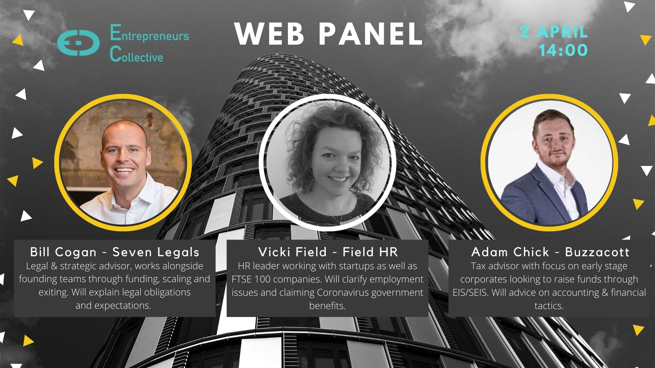

Slide 8
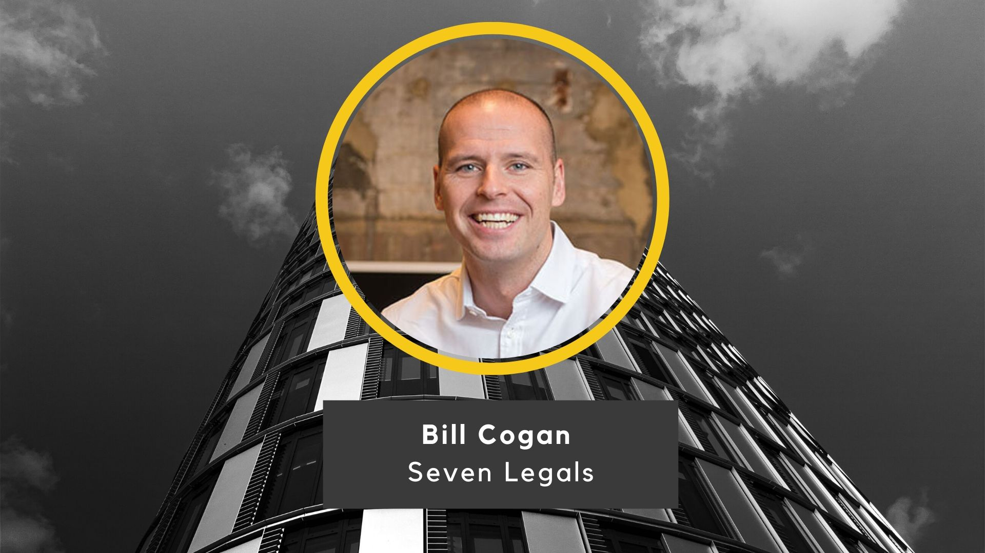

Slide 9
Legal Considerations
Fast Funding
Review contracts (offensive)
Review contracts (defensive)
Landlords / Premises
Administration

Slide 10
Funding – Fast ways of taking on investment
Advanced Subscription Agreements
Take in funds now and issue equity later
S/EIS friendly
Convertible Loan Notes
Debt instrument
Not S/EIS friendly
Subscription Letters and Deeds of Adherence
Use existing docs

Slide 11
Force Majeure (1) What is it and how can it help
Force Majeure (FM)
Contractual clause which alters parties' obligations and/or liabilities under a contract when an extraordinary event or circumstance beyond their control prevents one or all of them from fulfilling those obligations.
The applicability of the clause is a contractual matter (rather than general rule of common law) so it will depend on (1) if a force majeure clause in included; and (2) how that clause is drafted.
FM itself then has no technical legal meaning under English law so clauses typically list
specific events (e.g. war, terrorism, earthquakes, act of government); and/or
open ended broader criteria (e.g. ‘events outside of the parties reasonable control’).
Burden of proof lies on the party trying to enforce the clause.

Slide 12
Force Majeure (2) – Offensive use to terminate
Review contracts for FM clause and whether performance may be excused – highly fact sensitive so consider from both sides.
Consider alternatives for performance / delay (increased costs are not sufficient to excuse performance).
If you feel there is a clearly defensible justification then serve notice correctly under the relevant contract.
Keep a documentary record of why FM applied and why performance was not possible.
FM causes normally a suspension of performance rather than a termination unless FM continues for a set a period.

Slide 13
Force Majeure (3) – Defensive use to avoid termination
Review contract for FM clause and whether performance may be excused – highly fact sensitive so consider from both sides
Consider alternatives for performance / delay or methods of performing (increased costs are not sufficient).
If you feel there is not clearly defensible justification respond accordingly.
Keep a documentary record of why FM did not apply and suggest how performance is possible.

Slide 14
Frustration
Unforeseen subsequent events outside of the control of the parties has made the performance impossible or so radically different from what the parties intended it would be unfair to hold parties to their obligations.
IMPOSSIBLE – not just difficult or more costly.
RADICALLY DIFFERENT e.g. a war with government confiscating equipment.

Slide 15
Termination / Negotiation
Offensive:
Review termination notice periods and automatic renewal under contracts and plan accordingly.
Conduct without prejudice conversations (i.e. off the record conversations which may not be used in evidence were a subsequent claim for breach to go to court).
Defensive:
Review terms and conditions / contracts for termination notice periods.
Reach out to customers to understand their position and ways to work together to avoid termination.

Slide 16
Landlords / Premises
Coronavirus Act
Protected from eviction for at least 3 months
Termination for frustration highly difficult to prove – temporary access to premises unlikely to be sufficient
Examine break clauses
Rent reductions may be negotiated but landlords may not be receptive
Examine turnover clauses
If a building is closed rent is likely still due

Slide 17
Insolvency / Administration
Wrongful Trading
Rules relaxed for 3 months from March 1 for directors of private limited companies.
Previously directors could become personally liable for continuing to trade when uncertain a business can continue to meet its debts.
Reasonable director test – specific skill, knowledge and experience of the director in question.

Slide 19
People Considerations
Don’t panic. But do plan.
Give /Gather Info
Be Law Aware
People foc’d BCP
Wellness/ H&S
Be Forward Thinking

Slide 20
Give / Gather Information
Calm voice of authority.
People data
Business reporting
Regular messaging
Temperature checks
Ensure all data is accurate
Who? Why?
How long?
Company specific
Gov’t guidelines
What are people’s issues?

Slide 21
Be Law Aware
Don’t panic. But do plan.
Furlough
Parental leave
Maternity
Annual leave
Redundancy

Slide 22
People focused Business Continuity Planning
Keep the company running.
ER
A whole range of potential people issues
.
Roleplay a range of scenarios to test your approach
Scenarios
Design and rollout policies which suit your business
Flexible Working
Identify your key people and plan
Key People

Slide 23
Wellness / H&S
Don’t panic. But do plan.
High Risk
Office based
Mental Wellbeing
PMI / OH / GP
What happens next?

Slide 24
Be forward thinking
Don’t panic. But do plan.
“To handle yourself, use your head; to handle others, use your heart.”
– Eleanor Roosevelt
“I've learned that people will forget what you said, people will forget what you did,
but people will never forget how you made them feel.”
- Maya Angelou

Slide 25
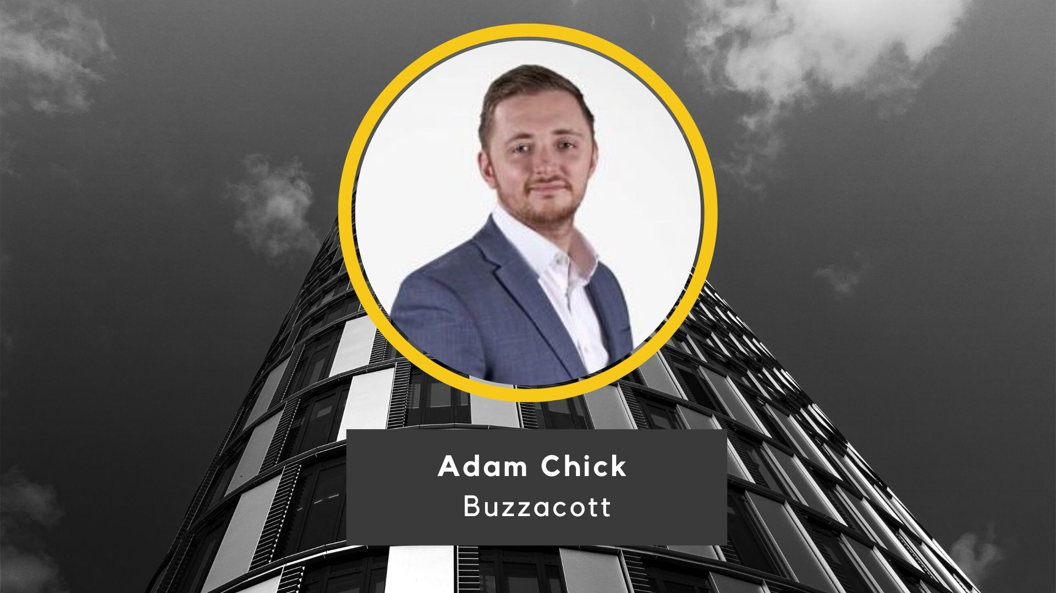

Slide 27
Buzzacott is a top 25 UK accountancy and business advisory firm in London.
Our Technology & Media specialists provide a one-stop-shop to innovative scale-ups and their owners from start-up to exit.
Claire Collins
Cliff Carter
Partner
Senior Manager
T: +44 (0)20 7556 1238
T: +44 (0)20 7556 1419
E: collinsc@buzzacott.co.uk
E: carterc@buzzacott.co.uk

Slide 28
Innovation doesn’t have to be scary, expensive, or slow.
www.studiographene.com
hello@studiographene.com

Slide 29
Seven Legal
Central Working Victoria
25 Ecclestone Place
London
SW1W 9NF
For further information, please contact bill@sevenlegal.co.uk or vicki@sevenlegal.co.uk
This presentation has been prepared for informational purposes only. This presentation is confidential and is intended exclusively for the use of the person to whom it has been delivered. It is not to be reproduced or redistributed to any other person without prior written consent.
© Seven Legal 2020

Slide 30
Legal & HR Concierge Service
Everyday legal and HR problems solved, just pick up the phone.
Corporate / Commercial / Employment / HR
Legal
Lawyers with transactional and in-house operational experience working with Magic and Silver Circle firms as well as top class in-house teams.
Immediate access to specialist lawyers providing answers, advice and sound-boarding on everyday and ad hoc queries, for example, short form NDA, contract enforcement, employment and HR issues.
Dedicated transaction specialists can be seconded to your team to manage complex matters, handle external advisors and ensure deal execution, so you can focus on running your business.
HR
HR advisors with extensive corporate experience working with organisations ranging in size from FTSE listed to high-growth early stage businesses.
Your HR advisor can provide advice on sourcing, hiring, managing and exiting the largest cost in most businesses - talent.
Full suite of HR services available providing policies, procedures, contracts, compensation structures and team communications.

Slide 31
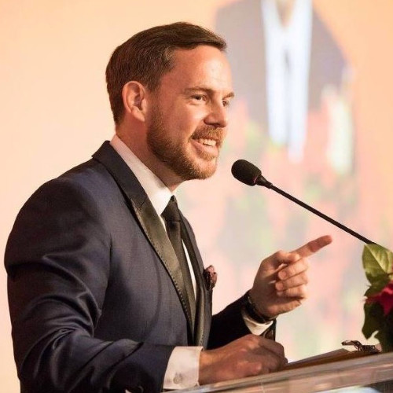
Our Next Webinar:
Post-Coronavirus reflections from South Korean start-ups and investors
Sean Blakeley - CEO of British Chamber of Commerce in Korea
Korean Start-up - TBA
8 April
Tickets: Bit.ly/SKwebinar

Slide 32
Michael Blakeley
Founder & CEO
+44 (0)7852 115490
mike@entrepreneurscollective.biz
Jessica Turner
Business Development Exec
+44 (0)7476646777
jess@entrepreneurscollective.biz

