Slide 2
ORGANISERS
MICHAEL BLAKELEY
SUSAN KABANI
NIMISHA BRAMHBHATT
BENJAMIN CAREW
Lawyer & Founder of Entrepreneurs Collective
Co-Founder & CEO
UGENIE
Lawyer & Founder of Entrepreneurs Collective
Legal & Strategic Advisor
7Legal

Slide 3
FUTURE FUND OVERVIEW
MICHAEL BLAKELEY
MEERA SHAH
NIMISHA BRAMHBHATT
BILL COGAN
Lawyer & Founder of Entrepreneurs Collective
Corporate Finance Expert
Buzzacott
Lawyer & Founder of Entrepreneurs Collective
Legal & Strategic Advisor
7Legal

Slide 4
Future Fund - Summary
Launching May 2020 in partnership with British Business Bank
CLN between £125,000 - £5,000,000
8% interest rate for maximum 3 year term
Eligibility:
UK based
Match funding from third party investors
Previously raised at least £250k in equity investment in last 5 years
MFN + Conversion to senior shares (+6 months)
Administration / Governance – BBB?
Transfer Rights - ??

Slide 5
Future Fund - Shortcomings
Non Qualifying Companies:
Raised less than £250k in last 5 years previously; and
Companies who investors will not back in the current market.
Convertible Loan Notes:
Debt instrument
Not S/EIS friendly

Slide 6
Future Fund - Strategy
Rationale: Survival of the fittest (and funded)
Government is not an investor
Public funds in an extremely risky sector
Private investors either:
have triaged businesses who have not raised £250k; or
will triage businesses by not backing them to survive in the current climate
Attract investors

Slide 7
Future Fund - Solution?
Conversion:
20% discount to next round (unless higher % agreed with matching investor)
Automatic if a Qualifying Round / Optional if Non-Qualifying
Qualifying Round: Equity round raising at least amount raised under CLN (both FF + Matching)
Sale / IPO: conversion at discount to Non-Qualifying round or redeemed at 100% premium

Slide 8
Future Fund - Solution?
Conversion:
20% discount to next round (unless higher % agreed with matching investor)
Automatic if a Qualifying Round / Optional if Non-Qualifying
Qualifying Round: Equity round raising at least amount raised under CLN (both FF + Matching)
Sale / IPO: conversion at discount to Non-Qualifying round or redeemed at 100% premium
Principle only converts with discount

Slide 9
Future Fund - SOS?
Panel discussion

Slide 11
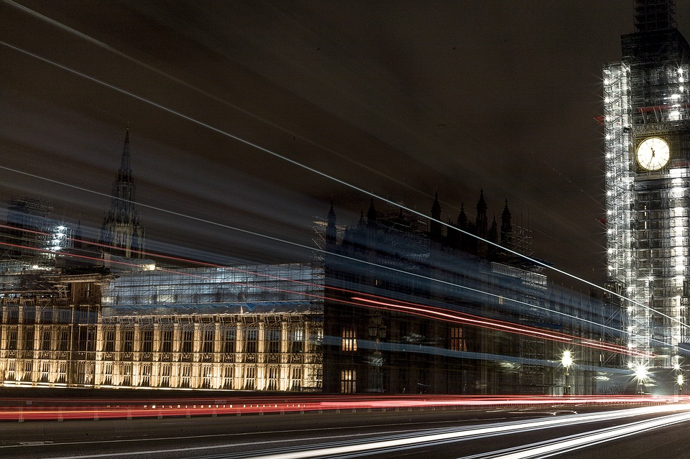
Very resourceful website: https://www.ggvc.com/ggv-capital-covid-19-operational-tactics-for-startups/
Working from home:
Zoom’s tips for working from home: https://blog.zoom.us/wordpress/2020/03/09/working-from-home-tips-to-meet-like-a-pro/
Gitlab’s resources for remote working: https://about.gitlab.com/blog/2020/03/06/resources-for-companies-embracing-remote-work/
18 Tips used by remote teams: https://www.groovehq.com/blog/remote-team-tools
Funding:
Fundraising during coronavirus article: https://sifted.eu/articles/startup-fundraising-coronavirus/
Investor tips during coronavirus: https://sifted.eu/articles/investor-coronavirus-advice/
Government support for startups during epidemic: https://sifted.eu/articles/coronavirus-support-startups/
Gov UK advice for self-employed: https://www.gov.uk/guidance/help-and-support-if-youre-self-employed
Government support for startups during epidemic: https://sifted.eu/articles/coronavirus-support-startups/
European Investor status: https://docs.google.com/spreadsheets/d/1Z3cGCZuDRrHznW4AvC41CnirNd5PDSBEQ0gVm4Zt5P0/edit?usp=sharing
Webinars:
London Business School webinars about coronavirus: https://www.london.edu/campaigns/executive-education/pandemic-webinars
Tech industry daily coronavirus updates: https://technation.io/news/covid-19-updates-tech-industry-resources-and-how-to-help/
Startup events taking place despite virus: https://sifted.eu/articles/mwc-european-tech-events-corona/
COVID-19 Online Hackathon: https://forms.gle/xYEDjZA8UpUtHmYYA
Tools:
Employer’s Coronavirus Checklist: https://www.hrexaminer.com/employers-coronavirus-checklist/
Covid19 HR & Operations prep document: https://docs.google.com/document/d/1PhtKhFRE96lzx7fUQe91lPJp3_UWDjua-35HRgTO1hQ/edit#
Legal articles about coronavirus actions: https://www.goodwinlaw.com/minisites/corona-virus
Coronavirus (COVID-19) FAQs & Response Plan: https://docs.google.com/document/d/1emsdSKNYtAl_7gPF8s2nuSgdLjFQ-Kkfk8BO9YrK8uo/edit#heading=h.hxyc9vhqjyxf
Ideas for startups: https://www.eu-startups.com/2020/03/8-ideas-for-startups-to-give-back-in-the-time-of-coronavirus/
Leading business through Coronavirus: https://hbr.org/2020/02/lead-your-business-through-the-coronavirus-crisis
Advice from a CEO: https://www.venturelab.ch/Wulf-Glatz-CEO-of-greenTeg-Gives-Advice-to-Entrepreneurs-During-COVID19
Online courses: https://www.udemy.com
Michael Blakeley
Founder & CEO
+44 (0)7852 115490
mike@entrepreneurscollective.biz

Slide 12
SURVIVING WITHOUT FUNDING
SUSAN KABANI
BENJAMIN CAREW
Co-Founder & CEO
UGENIE
Co-Founder & Director
WeCoffee

Slide 13
NOT EVERYONE WILL SURVIVE.

Slide 14
BUT THAT DOESN'T MEAN
YOU CAN'T EVOLVE.

Slide 15
YOUTUBE
SLACK
GROUPON
SHOPIFY
Started as a dating platform.
“Tune in, hook up.”
Game was focused on socialization and exploration
A social platform where people could get together to rally behind social and charitable causes.
Started as the one e-commerce store for founders. That business didn't succeed.

Slide 16
THE DIFFERENT WAYS
YOU CAN PIVOT.

Slide 17
CUSTOMER RETENTION &
KEEP SELLING.

Slide 18
CASH FLOW IS KEY.

Slide 19
CASHFLOW
SUPPLIERS
STAFF
CLOSE

Slide 20
USE YOUR COMMUNITIES.

Slide 22
Workshop 4: A deep dive into building communities and conducting webinars.

Slide 23
Define the objective and goals
of your community.

Slide 24
Join other communities who may fill this need, observe and learn.

Slide 25
Choose the right platform.

Slide 26
Create and introduce guidelines.

Slide 27
Stay organised and have a content plan.

Slide 28
Encourage networking, not selling.

Slide 29
Monitor closely and respond quickly.

Slide 30
Analyse user data to better serve your community without the need for feedback.

Slide 31
Show gratitude and recognise
community leaders.

Slide 32
Be consistent and give yourself time.

Slide 33
HOW TO RUN WEBINARS AND
WHY THEY CAN GENERATE LEADS.

