Slide 1
ENTREPRENEURS COLLECTIVE

Slide 3
Fear of failure
No one to talk to
Unable to find investment
Fear of discovery from investors and F&F
Bad referrals
Bad events
Lack of Community

Slide 4
Founders Helping Founders

Slide 5
Our Members…
The Goal…
Our Events…
will bring together quality Founders and investors.
is to build successful companies.
will be value-added, practical events which inspire and connect.

Slide 6
AGENDA
8:30 – 8:40 || Opening remarks by Michael Blakeley
8:40 – 9:10 || Panel Discussion: South Korean post-coronavirus lessons & experience
9:10 - 9:25 ||Questions from audience
9:25 – 9:30 || Closing Remarks

Slide 8
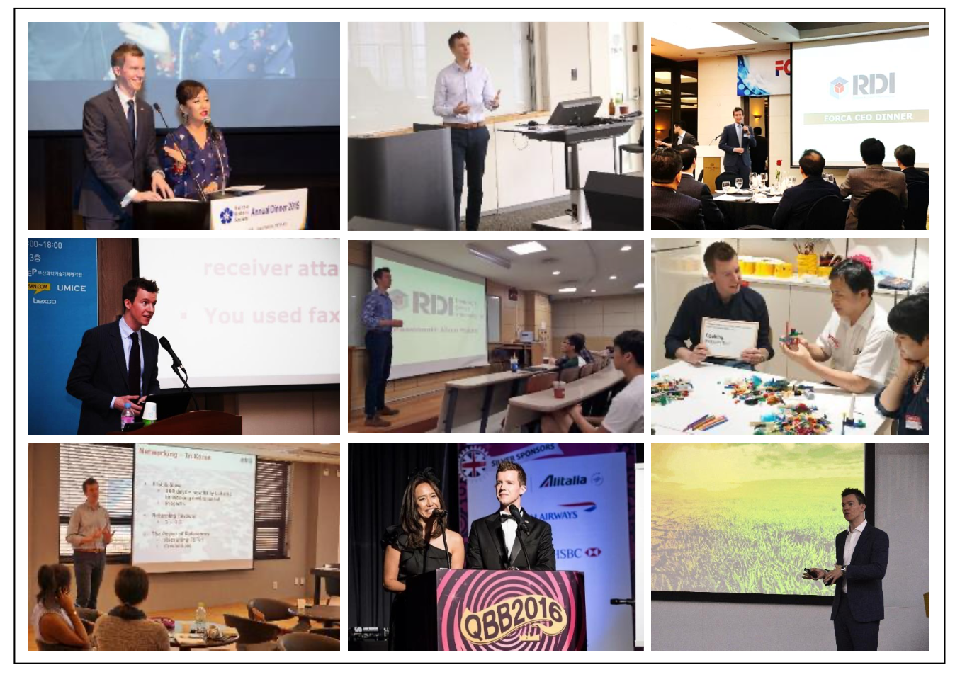

Slide 9
Sean Blakeley CEO of

Slide 10
COVID-19 Overview: Outbreak in Korea
Flattening Trend of COVID-19 in Korea
Source: Worldometers.info
Notes:
For the last two months, Korea has been at the center of the COVID-19 crisis. On Feb 29, the number of new confirmed cases surged by 909 cases in a day from 2,022 cases to 2,931 cases, mainly due to an outbreak within a single religious group called Shincheonji. In just four weeks, however, on March 30, the number of new daily cases dropped to 78. So far, Korea is the only country with a population over 50 million that has slowed the spread of the virus and flattened the curve of new infections without shutting down the country or imposing any orders of quarantine or border closure.

Slide 11
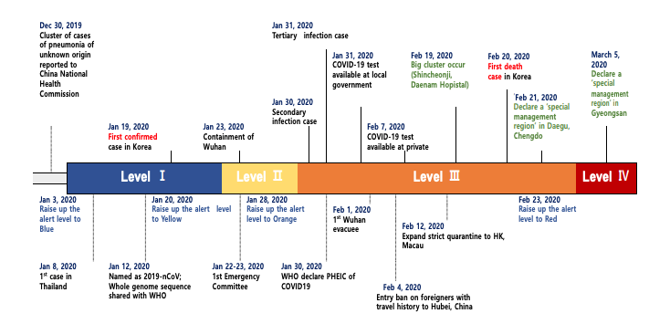
COVID-19 Overview: Outbreak in Korea
Source: Tackling COVID-19: Health, Quarantine and Economic Measures: Korean Experience. Ministry of Economy & Finance. 31 March, 2020.
Notes:
For the last two months, Korea has been at the center of the COVID-19 crisis. On Feb 29, the number of new confirmed cases surged by 909 cases in a day from 2,022 cases to 2,931 cases, mainly due to an outbreak within a single religious group called Shincheonji. In just four weeks, however, on March 30, the number of new daily cases dropped to 78. The fatality rate is at 1.64%, with most of the deaths found among the elderly or those with underlying medical conditions. So far, Korea is the only country with a population over 50 million that has slowed the spread of the virus and flattened the curve of new infections without shutting down the country or imposing any orders of quarantine or border closure.

Slide 12
COVID-19 Overview: Outbreak in the UK
Source: Worldometers.info

Slide 13
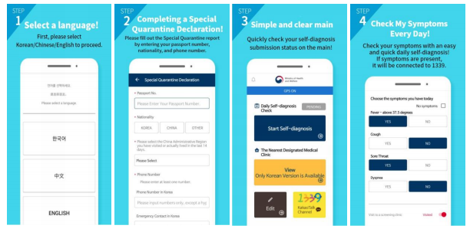
Government Response to COVID-19
3T: Testing – Tracing - Treating
Self-Diagnosis Application
Source: Tackling COVID-19: Health, Quarantine and Economic Measures: Korean Experience. Ministry of Economy & Finance. 31 March, 2020.
Notes:
Since raising the national infectious disease crisis level to “serious” on Feb 23, 2020, the Korean government put together a Central Disaster and Safety Countermeasures headquarters, headed by the Prime Minister to stem the spread of the virus. The Korean government banned the entry of travelers from Hubei soon after the initial outbreak in China and expanded its special entry procedures to all travelers since March 19, which requires a 14-day self-quarantine or isolation. During the 14 days of quarantine, travelers ought to use the self-diagnosis app to update their health issues and download a self-quarantine safety app for government authorities to check symptoms, their location and compliance with the quarantine guidelines. In addition, the Korean government began testing all travelers from Europe and those showing symptions are tested in quarantine facilities at Incheon International Airport.

Slide 14
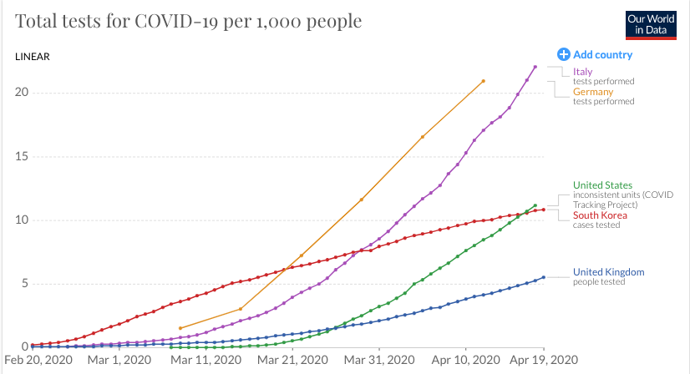
Government Response to COVID-19
3T: Testing – Tracing - Treating
COVID-19 Tests per 1,000 People
Source: Out World in Data
Notes:
The South Korean government has successfully detected infection cases early through screening clinics and diagnostic testing. On Feb 4, the South Korean government granted a fast-track approval for testing and began shipping the kits. As of April 18, 554,834 tests had been conducted within a short period of time to diagnose patients and to stem the spread of the virus. People can call the 1339 call center to get information about the nearest screening center, and also they could search for COVID-19 screening center in popular local map apps such as Kakao Map and Tmap.

Slide 15
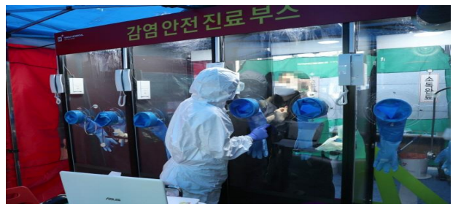
Government Response to COVID-19
3T: Testing – Tracing - Treating
Walk-through Testing Facilities
Source: Tackling COVID-19: Health, Quarantine and Economic Measures: Korean Experience. Ministry of Economy & Finance. 31 March, 2020.
Notes:
The Korean government has also set up screening clinics at public health centers and has been collecting testing specimens through approximately 50 drive-through centers, mobile facilities and door-to-door visits to ensure easy access to diagnostic testing and also to ensure greater efficiency and safety.

Slide 16
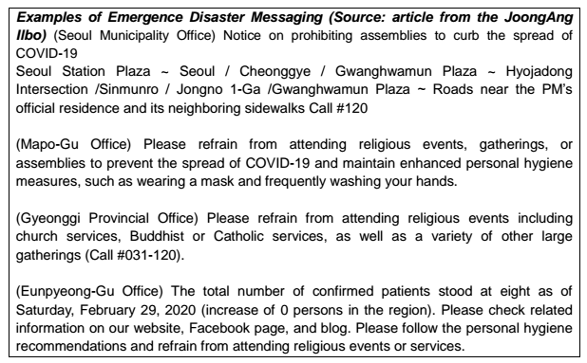
Government Response to COVID-19
3T: Testing – Tracing - Treating
Cellular Broadcasting System
Source: Flattening the Curve on Covid-19: How Korea responded to a pandemic using ICT. The Government of the Republic of Korea. 15 April, 2020.
Notes:
The Korean government has leveraged a number of hi-tech solutions to facilitate social distancing across the country. The cellular broadcasting service which enables government agencies to transmit emergency alert text messages to cell phones is one chief example of that. Municipalities throughout Korea use the CBS to inform the public of the itineraries taken by confirmed individuals.

Slide 17
Government Response to COVID-19: Korea
Workplace Guidelines
Designate an exclusive division or manager for business maintenance and operation continuity and establish a preparedness and response plan.
Strengthen workers’ hygiene control and maintain cleaning and disinfection care.
Prevent the spread of disease within business sites by wearing masks and strengthening control of workers before and after business trips.
Build a business continuity plan to prepare for a high number of employees taking leave.
Allow employees to take leave or temporarily close businesses while taking advantage of government subsidy for employee retention.
Adopt flexible working hours and working from home.
Source: Ministry of Trade, Industry & Energy

Slide 18
Government Response to COVID-19: UK
Financial Rescue Package for Businesses & Workplace Guidelines
£330 billion for coronavirus business loan package
80% of salary for staff in employment, wages up to £2,500 a month
Deferred VAT payments between 20 March 2020 and 30 June 2020
Deferred self-assessment payments on account
Financial support for businesses with sickness absences due to COVID-19 up to 2 weeks
Adopt flexible working hours and working from home.
Source: https://www.gov.uk/government/publications/guidance-to-employers-and-businesses-about-covid-19/covid-19-support-for-businesses

Slide 19
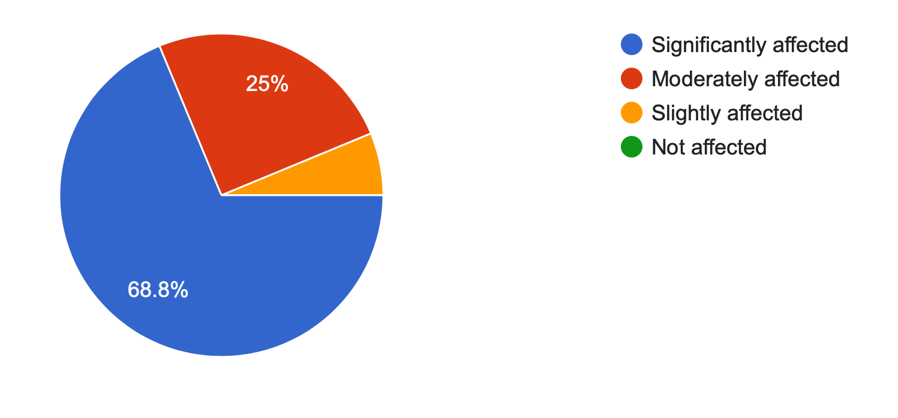
Private Sector Response to COVID-19
BCCK Member Companies: Business Impact
Source: 1st BCCK COVID-19 Business Impact Survey 2020

Slide 20
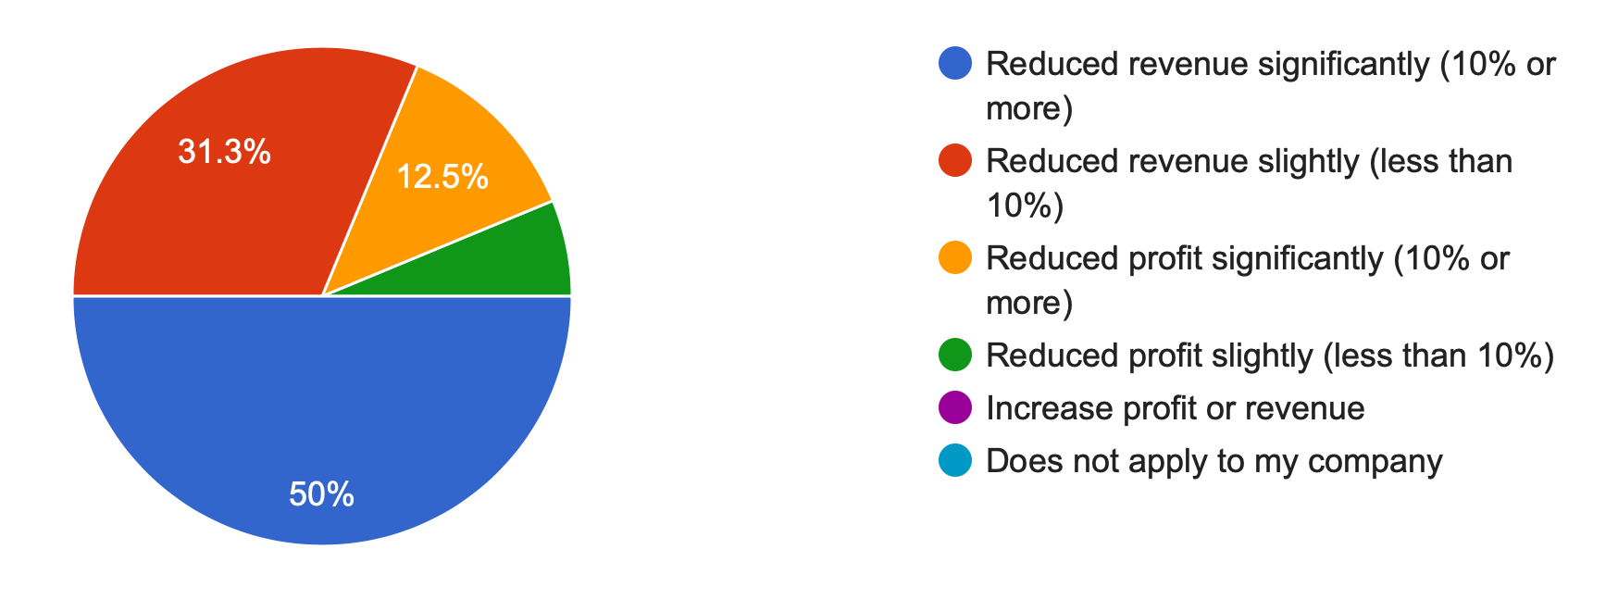
Private Sector Response to COVID-19
BCCK Member Companies: Business Impact
Source: 1st BCCK COVID-19 Business Impact Survey 2020

Slide 21
Private Sector Response to COVID-19
BCCK Member Companies: Business Impact
Source: 1st BCCK COVID-19 Business Impact Survey 2020

Slide 22
Private Sector Response to COVID-19
BCCK Member Companies: Business Recovery
Expected Time to Recover from COVID-19 Outbreak
Source: 1st BCCK COVID-19 Business Impact Survey 2020

Slide 23
Private Sector Response to COVID-19
BCCK Member Companies: Financial Response
Measures Taken to Offset Financial Impact from COVID-19
Source: 1st BCCK COVID-19 Business Impact Survey 2020

Slide 24
Private Sector Response to COVID-19
BCCK Member Companies: Best Practices
Daily check-in calls within teams at start and end of day when remote working
Split up teams and rotate for remote working
Social distancing protocols in the workplace
Initial supply of masks to staff & clients
Focus on mission & brand value
HR onboarding process through Skype & Webinars
Reinvent event experiences for product launches
Limit meetings with external guests
Temperature checks at every entrance
Disinfect office areas on a daily basis
Source: 1st BCCK COVID-19 Business Impact Survey 2020

Slide 26
Helping innovative businesses to grow and achieve their aims
Running your business effectively
Attracting investment
Enabling business cash flow
https://www.buzzacott.co.uk/

Slide 27
Innovation doesn’t have to be scary, expensive, or slow.
www.studiographene.com
hello@studiographene.com

Slide 28
Our research has also
been featured in:

Slide 29
30 April
Workshop: Managing remote product teams - from a founder who's been doing it for five years already

Slide 30
Seven Legal
Central Working Victoria
25 Ecclestone Place
London
SW1W 9NF
For further information, please contact bill@sevenlegal.co.uk or vicki@sevenlegal.co.uk
This presentation has been prepared for informational purposes only. This presentation is confidential and is intended exclusively for the use of the person to whom it has been delivered. It is not to be reproduced or redistributed to any other person without prior written consent.
© Seven Legal 2020

Slide 31
Legal & HR Concierge Service
Everyday legal and HR problems solved, just pick up the phone.
Corporate / Commercial / Employment / HR
Legal
Lawyers with transactional and in-house operational experience working with Magic and Silver Circle firms as well as top class in-house teams.
Immediate access to specialist lawyers providing answers, advice and sound-boarding on everyday and ad hoc queries, for example, short form NDA, contract enforcement, employment and HR issues.
Dedicated transaction specialists can be seconded to your team to manage complex matters, handle external advisors and ensure deal execution, so you can focus on running your business.
HR
HR advisors with extensive corporate experience working with organisations ranging in size from FTSE listed to high-growth early stage businesses.
Your HR advisor can provide advice on sourcing, hiring, managing and exiting the largest cost in most businesses - talent.
Full suite of HR services available providing policies, procedures, contracts, compensation structures and team communications.

Slide 32
EC Coronavirus Tools & Tips
Very resourceful website: https://www.ggvc.com/ggv-capital-covid-19-operational-tactics-for-startups/
Working from home:
Zoom’s tips for working from home: https://blog.zoom.us/wordpress/2020/03/09/working-from-home-tips-to-meet-like-a-pro/
Gitlab’s resources for remote working: https://about.gitlab.com/blog/2020/03/06/resources-for-companies-embracing-remote-work/
18 Tips used by remote teams: https://www.groovehq.com/blog/remote-team-tools
Funding:
Fundraising during coronavirus article: https://sifted.eu/articles/startup-fundraising-coronavirus/
Investor tips during coronavirus: https://sifted.eu/articles/investor-coronavirus-advice/
Government support for startups during epidemic: https://sifted.eu/articles/coronavirus-support-startups/
Gov UK advice for self-employed: https://www.gov.uk/guidance/help-and-support-if-youre-self-employed
Government support for startups during epidemic: https://sifted.eu/articles/coronavirus-support-startups/
European Investor status: https://docs.google.com/spreadsheets/d/1Z3cGCZuDRrHznW4AvC41CnirNd5PDSBEQ0gVm4Zt5P0/edit?usp=sharing
Webinars:
London Business School webinars about coronavirus: https://www.london.edu/campaigns/executive-education/pandemic-webinars
Tech industry daily coronavirus updates: https://technation.io/news/covid-19-updates-tech-industry-resources-and-how-to-help/
Startup events taking place despite virus: https://sifted.eu/articles/mwc-european-tech-events-corona/
COVID-19 Online Hackathon: https://forms.gle/xYEDjZA8UpUtHmYYA
Tools:
Employer’s Coronavirus Checklist: https://www.hrexaminer.com/employers-coronavirus-checklist/
Covid19 HR & Operations prep document: https://docs.google.com/document/d/1PhtKhFRE96lzx7fUQe91lPJp3_UWDjua-35HRgTO1hQ/edit#
Legal articles about coronavirus actions: https://www.goodwinlaw.com/minisites/corona-virus
Coronavirus (COVID-19) FAQs & Response Plan: https://docs.google.com/document/d/1emsdSKNYtAl_7gPF8s2nuSgdLjFQ-Kkfk8BO9YrK8uo/edit#heading=h.hxyc9vhqjyxf
Ideas for startups: https://www.eu-startups.com/2020/03/8-ideas-for-startups-to-give-back-in-the-time-of-coronavirus/
Leading business through Coronavirus: https://hbr.org/2020/02/lead-your-business-through-the-coronavirus-crisis
Advice from a CEO: https://www.venturelab.ch/Wulf-Glatz-CEO-of-greenTeg-Gives-Advice-to-Entrepreneurs-During-COVID19
Online courses: https://www.udemy.com

Slide 33
Michael Blakeley
Founder & CEO
+44 (0)7852 115490
mike@entrepreneurscollective.biz
Jessica Turner
Business Development Exec
+44 (0)7476646777
jess@entrepreneurscollective.biz

