Slide 1
Power Lead System Business Model

Slide 2
Home based business explosion (side hustle)
With this pandemic, so many people have been financially effected.
More people then ever are now looking to work from home as a primary income or a side hustle
Many see the value of creating a leveraged income instead of just trading time for money
ARE YOU INTERESTED IN CREATING AN ADDITIONAL INCOME STREAM ??

Slide 3
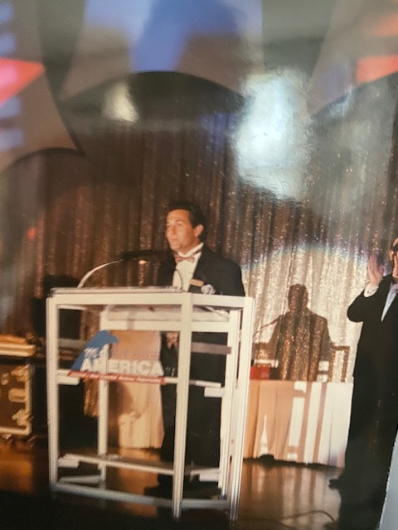

Slide 4
Logic of this direct sales model (not considered mlm) but it does employ systems of time leveraging
THE MASSES WANT TO MAKE A SECOND INCOME STREAM
Concept - Everybody just doing a little bit
Build a sales team with like minded people- products/business
Part time gig you build around your current career
Extremely low capitalization to get started
leverage Earn 1% of 100 people efforts instead 100 % of your own)

Slide 5
Earning from the Referral Program
10+ years old program without missing a single commission
5 revenue streams
In over 180 countries

Slide 6
WHAT IS POWER LEADS BUSINESS MODEL?
A complete system that appeals to all types of business people to help them grow their business thru lead generation/ getting traffic….. with a price point that everyone can afford
And /Or
People who are excited about making quick and generous income for sharing the business reguardless if you choose to use the system yourself or not

Slide 7
Power Leads System Product Overview
We train you through live/online training Build your business using sales funnels/video sales pages/digital posts/link your sales campaigns to all social media pages.

Slide 8
$53 package per month
Two ways to get paid!
Mary Tony Jen Rhonda
What you earn monthly $20 $20 $20 $20
Personals earnings $200 $460 $680 $720
You get 50% check match $100 $230 $340 $360

Slide 9
Start or upgrade adding $105 monthly package = Total of $158 month
Earn an additional whopping monthly commission of $90 month on all recurring sales on everybody except persons #2 and 4 in addition to the $20 per month.
Passing up just two sales creates an insane 2 person pass up allowing you to earn $90 a month on endless amounts of people from every personal referral and their team!

Slide 10
$90 direct/pass up $
Your team 1 2 3 4 5 6 7 8 9..
direct $ $ 90 X $90 X $90 $90 $90 $90 $90
Person 2,4 (2) $90 $90
Their 2,4 (4) $90 $90 $90 $90
Their 2,4 (8) $90 $90 $90 $90 $90 $90 $90 $90
Their 2,4 (16) (32) (64) (128) (256) (512).........

Slide 11
POWER Of The 2 Person PASS UP
You enroll 10 people who enroll or upgrade with the $105 plan= 8x$90 = $720mn
Assume those 8 pay lines with unlimited pass up potential just produce 10 total pass up commissions each ---- 8 x 10 = 80 people x $90 month = $7,200 month
Add in the $20 per month program /50% check match
This would bring your income to most likely $10,000+ month

Slide 12
One-time commissions on the purchase of bigger packages purchased by your enrollees
1st Tier $147 = $100 $495 = $400 $1500 = $1000
Their Sales $25 $50 $200
*You must purchase that package amount to earn*

Slide 13
Logic
Use funnel to promote your primary business or just use it for this business
Start at your chosen level of $53, $158, or more! Upgrade when you want!
This is enormous $$ if we just do it, everyone can find a few people who want a better lifestyle or want to use the product!

Slide 14
Don’t overthink it everyone can afford $53 a month ($13 per week) to have this potential, as long as you are willing to work with us.
Ask yourself do you currently have this unlimited earning potential in your life right now?

Slide 15
Next Steps!
The video below (8 minutes) explains the platform
Click on my marketing link made for us by Frank Calabro one of the top company earners.. you can use this funnel or create your own!
1st video his funnel contains an opening video 44 min video …. He shows his income for validation/ shows the compensation plan little different style than I just showed you
2nd video shows you how to get started
3rd video goes into detail on how to market your business
Weekly live webinar schedule
My training document and getting started video

Slide 16
Get started ----- Get back to the person who sent you to this marketing site and enroll with their link. If you are my contact register in my funnel by starting at whatever level you are comfortable with starting as low as 53 per month (13 per/wk)

