Slide 2
Company
Started in 2016 overseas
Launch in the U.S. only a few short years ago located in salt lake city
One of the fastest growing companies in the home based business industry
70+ yr 100 billion + worldwide industry

Slide 3
understanding the logic is more important than understanding the details of the plan
Everybody want long lasting health / millions and millions take supplements
With this pandemic, so many people have been financially effected.
More people then ever are now open to working from home as a primary income or a side hustle
No financial risk work this business around your busy lifestyle
Extra income 6 figure potential Time freedom
Many see the value of working to create a leveraged income instead of just trading time for money in the 45 year plan

Slide 4
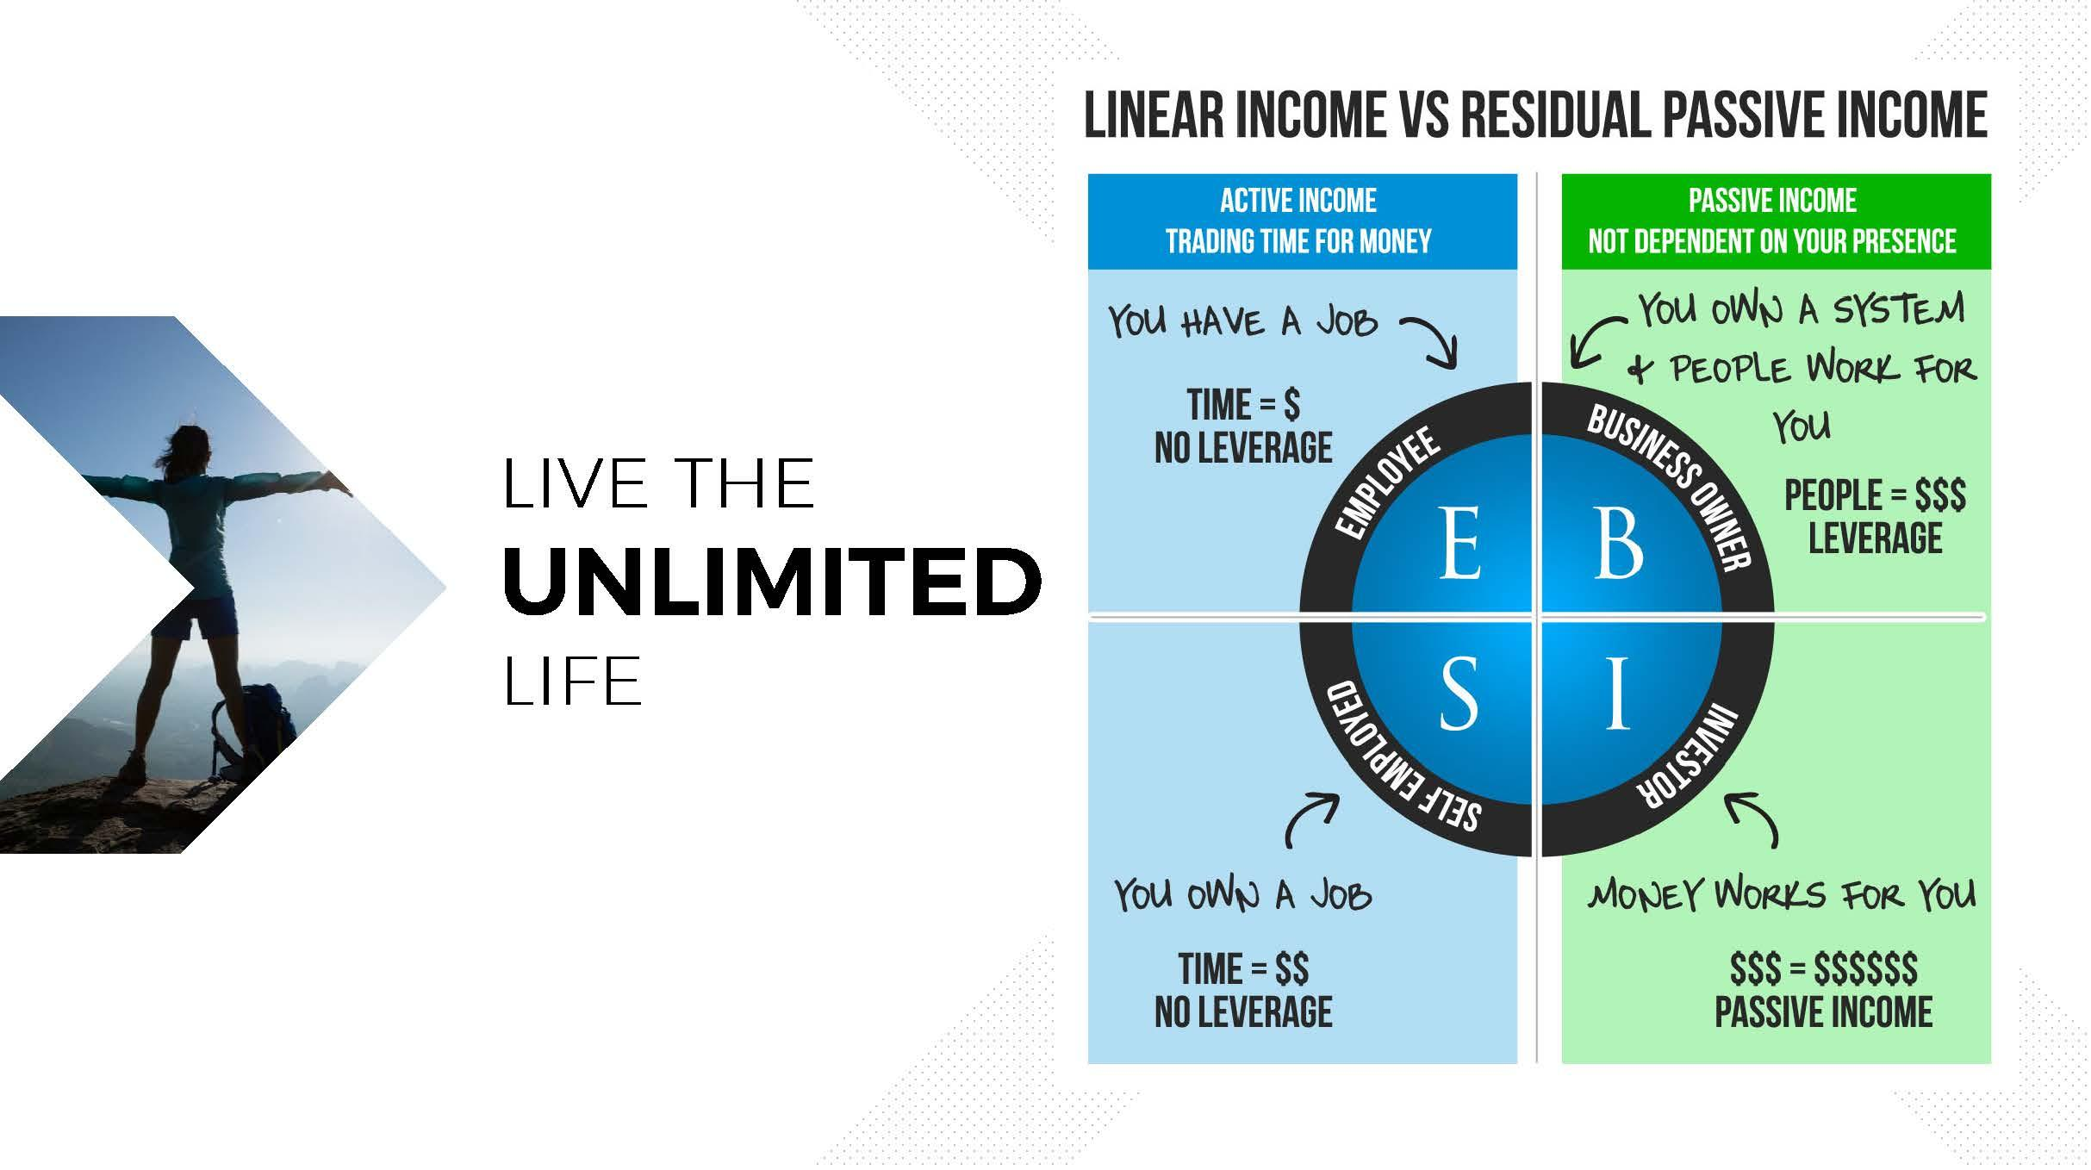

Slide 5
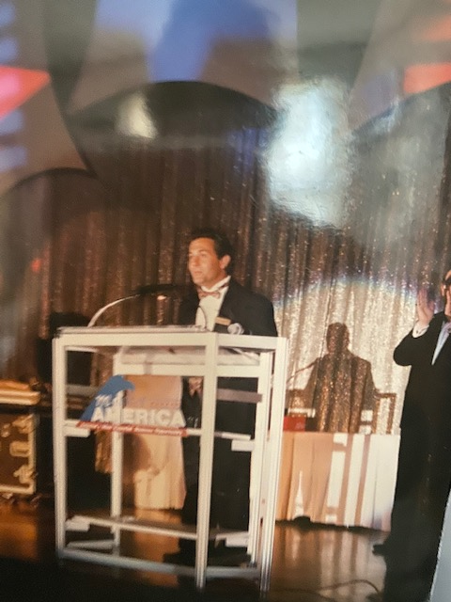

Slide 6
SIMPLE CONCEPT
Everybody doing a little
1 product per month min as low as $25
70 volume or $89 month to earn all bonuses
Find a handful of like minded people who enjoy the products or making money

Slide 7
Products we use and market

Slide 11
B-KETO
Fuel Your Body
With Ketones!
Ultra-Fast Ketosis Supplement
BENEFITS MAY INCLUDE:
• Facilitates Ketosis and Ketogenesis
• Accelerates Fat Burning and Weight Loss
• Suppresses Appetite and Cravings
• Provides Lasting Natural Energy (with no jitters)
• Improves Mental Clarity and Focus
• Boosts Physical Stamina, and
Endurance (great pre-workout)

Slide 14


Product Details:
Support Healthy Immune and Anti-Inflammatory
Responses
Provide Fast Relief from Symptoms
Boost Immune System and Improve Immunity
Reduce Inflammation, Including Aches and Pains
Experience B-Immune+ for Yourself
Our all-natural turmeric curcumin supplement quickly
and effectively boosts immunity and reduces symptoms.

Slide 16
Become a brand partner
$20 0ne time
Pick your monthly product goal 70 pts apprx $89 as low as $25
Full website to market products /business
Company handles all orders/ c.c. transactions/ shipping/ etc
Full back office to track all your business activities/commissions
You just build your team

Slide 17
CUSTOMER BONUS
On All Customer Orders
Every time a customer buys from your B-Epic website, you get paid 50% of the retail price on their purchase.
FAST START BONUS
On 1st Order of New Sign-Ups
Every time you sign-up a new Brand Partner, they become part of your team, and you get paid 50% of the CV of their first order.

Slide 19
Lance
Lance
Rachel
Chauna
Jane
Bob
Ken
Rachel
Karen
Chauna

Slide 20
You
Lance
Mindee
You
Lance
Mindee
Matt

Slide 22
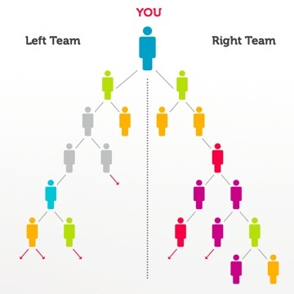

Slide 23
Two Team weekly Pay: Earn 10%-20% on your lesser team based on your sales volume rank (example 15%) volume from all sales- 1st orders /all rep purchases including monthly auto ships/customers left = 2500 right = 3000
15% of 2500= $375 wk
$500 excess volume on right carries over max payout $20,000 per week …………………………………………………..

Slide 26
Next Step
Need more info- 100% epic (facebook) try products/follow up call tue/thur 8pm EST zoom id 719 402 5698 bobby tue/thur 9pm EST zoom id 895 2623 7385 company
Join us - As long as you have the desire—Let’s get started and begin earning pick your starting products then follow the getting stated plan we lay out for you will work with you every step of the way

