Slide 1
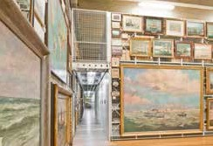
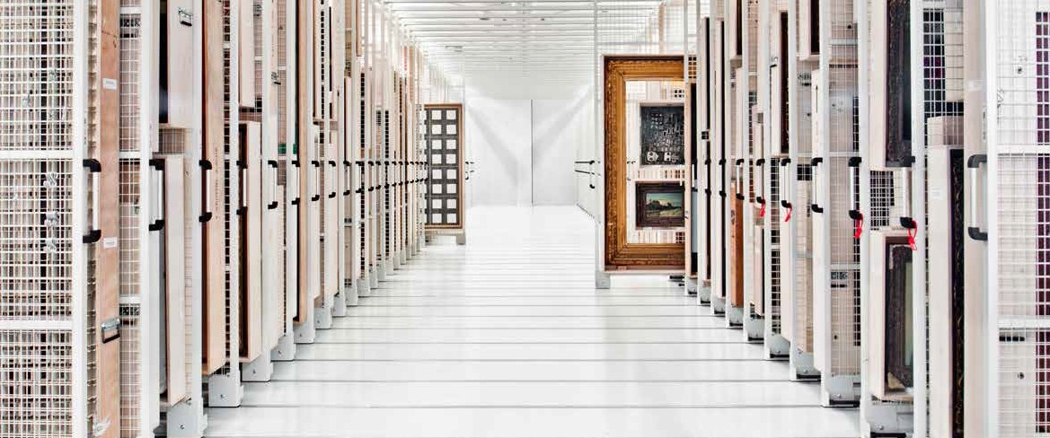
Museum Preserving our history
Museums

Slide 2
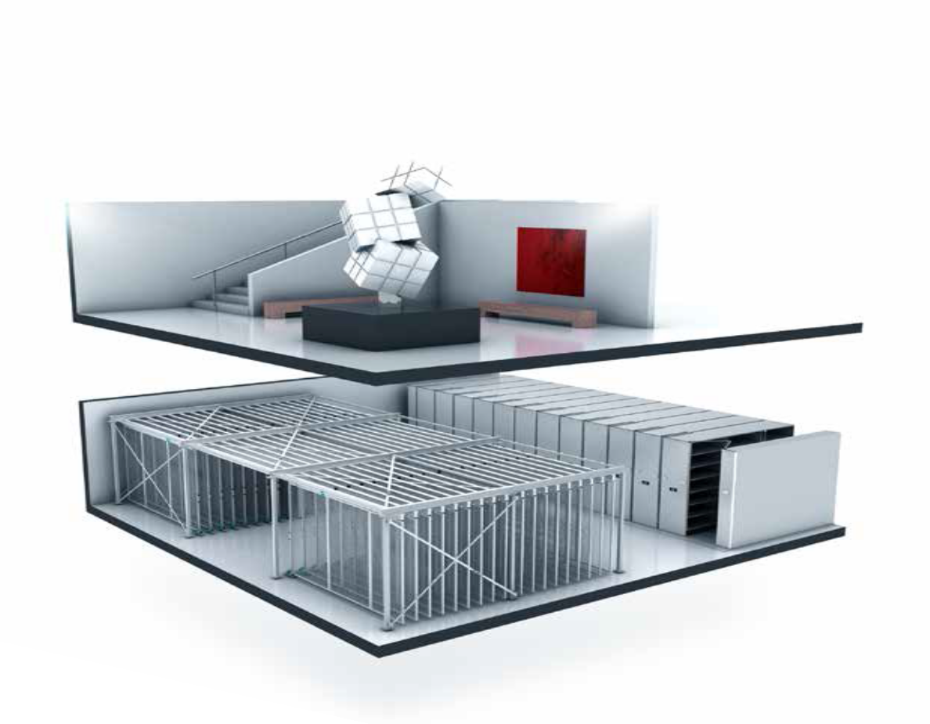

Optimizing space
At some point, all museums run out of floor space for storage in their building or off-site repositories. The need for more and better research facilities, combined with ever-increasing collections that require safe storage, means that rethinking a museum’s floor area becomes imperative. We can help you with the one remaining option if a large building project is to be avoided: optimizing your museum’s existing space.

Slide 3
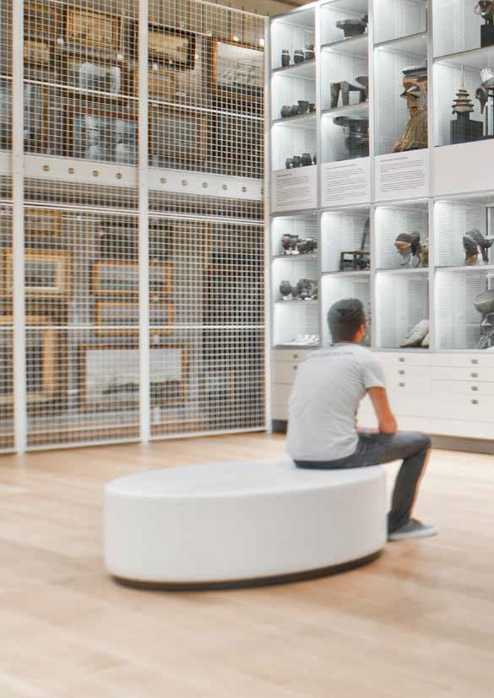
Visible storage
For all to enjoy
With many museums holding up to 95% of their collection in storage at any one time, opening up a facility with
a mobile system is a creative way to engage the public and increase access to artifacts that would otherwise be hidden from public view.
Visible storage is one method of maximizing public access to museum and art collections held in repositories and storerooms. This technique was used in an installation for Museum Aan de Stroom in Belgium, pictured right, where it was integrated into a Double Decker storage system.

Slide 4
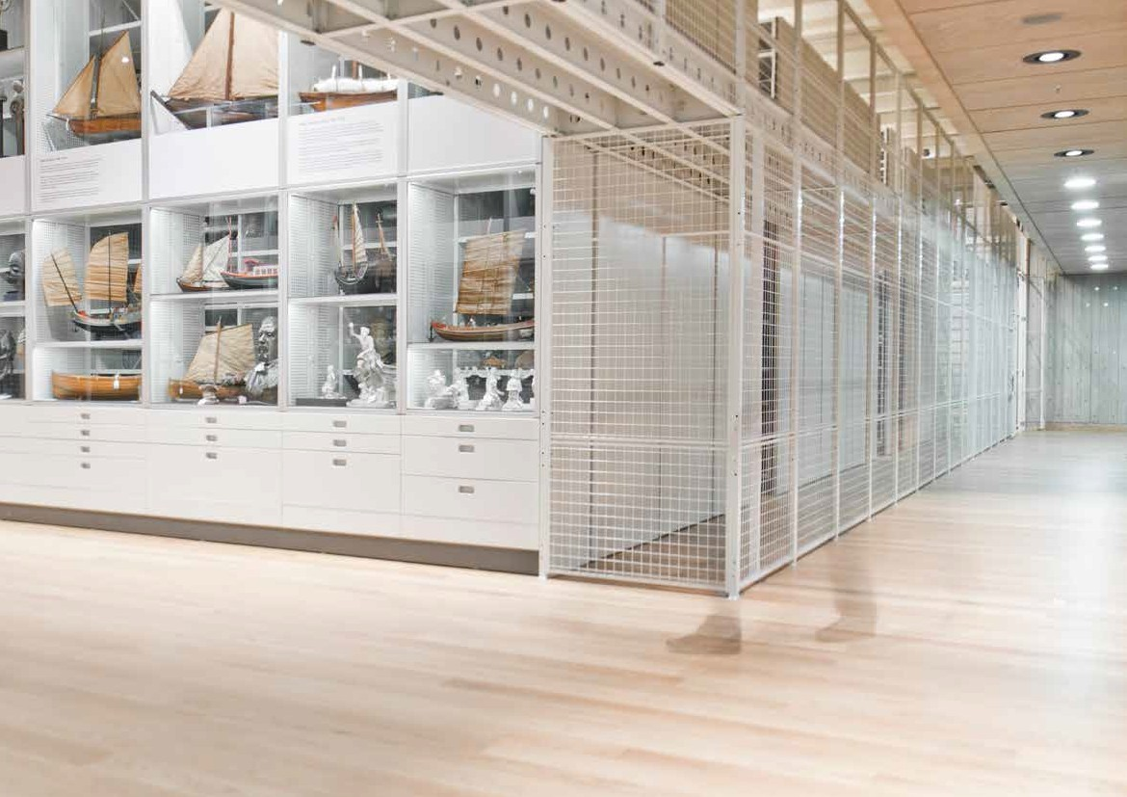
“Our biggest challenge was to store a large part of our collection in a compact way in our depot, at the same time being accessible to the public.
Bram Janssens, Repository manager MAS Visible Storage Depot

Slide 5
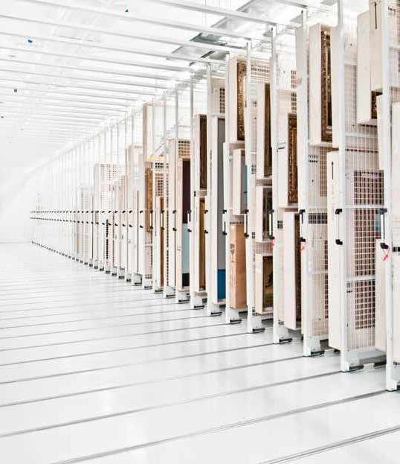
Pull-out picture racking
Designed for easy access
Pull-out picture racks make efficient use of space while allowing paintings to be easily accessible. If you need to view a certain object, only the art work in the relevant frame is moved.
With our pull-out painting frames, you will discover that preservation and accessibility go hand in hand. The frames are available in three versions to suit a range of preservation requirements and budgets: fully suspended; running on fixed rails; or running on wheels. Find out which solution would fit your environment.

Slide 6
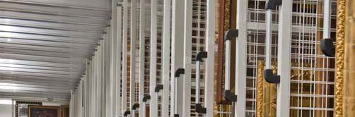
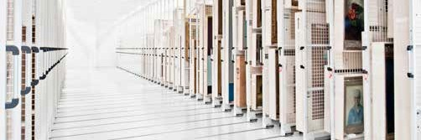
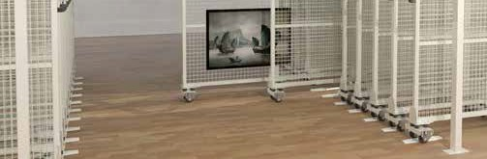
Uninterupted transport routes
ArteStore Penda frames are the best system for valuable, delicate artworks. Its near-zero vibration movement ensures paintings are kept in prime condition. An additional advantage of this system is the floor is uninterrupted by rails, an important feature if the floor area also serves as a transport route.
Rarely requires the construction of a load-baring steel frame ArteStore Terra frames also have virtually vibration free movement and are extremely stable. As the frames are not suspended, this option rarely requires the construction of a load-baring steel frame, helping to keep costs down. With this system, the dimensions of the wire-mesh frames are also matched to the size of the paintings and the available space. Alternatively, the rails can be set flush into a concrete floor.
Cost-effective storage
If customization is not required, ArtStore Rota offers a cost-effective solution in standard sizes. The degree of vibration in the movement is dependent on the quality and consistency of the floor surface.

Slide 7
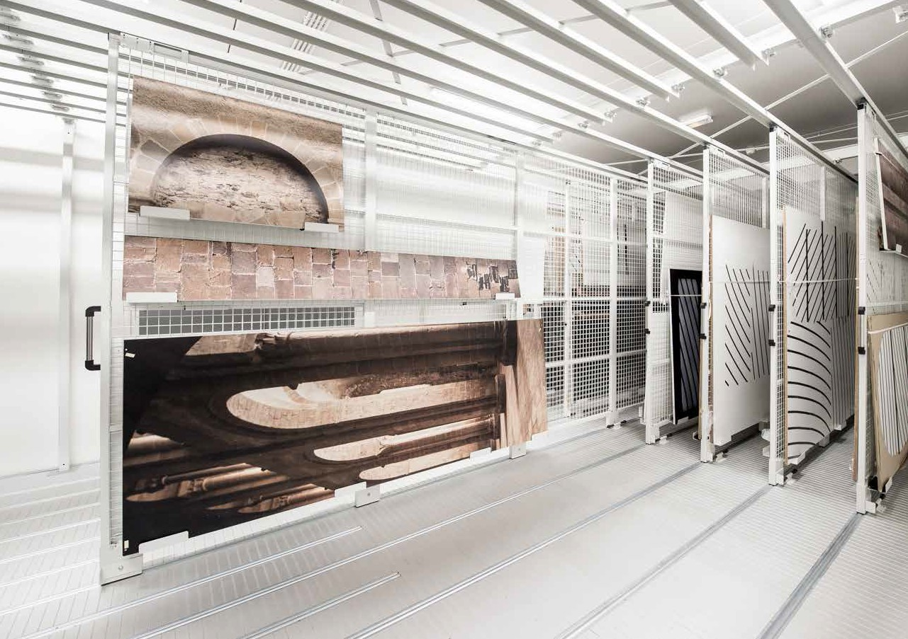
“I am astonished by the quality and the technical nature of the works. As an example, I was not expecting such a high quality of the museum repository. A museum without a good repository is not a good museum.”
Pierre Soulages, Artist, about the Soulages Museum

Slide 8
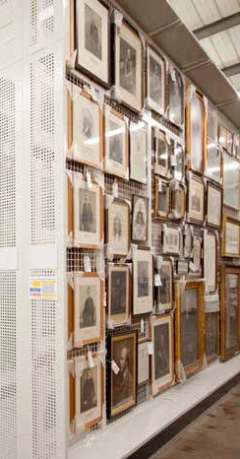
Static picture racking
Static picture racks are available in different sizes, so they will neatly fit into the available repository space. They offer a cost-effective storage solution, suitable for the demands of
a high-density storage system.
Static
picture racking
Built to your specification
Mobile picture racking
Mounting picture racks on Compactus® mobile bases makes optimal use of the available space by using only a single aisle. The mobile frames can be moved individually or several at the same time, creating an aisle wherever necessary.
Looking for an efficient storage solution for your artworks? Or a storage solution that can be used for temporary storage situations that have quick turnaround, such as transit and quarantine storage
for art libraries? Static picture racks will fit your need.
In addition to maximizing storage capacity, electronic operation minimizes vibration and provides optimal protection against dust and light when the system is closed.
Pushed for space? The picture racking can be mounted on our mobile base equipped with an electronic Compactus® Dynamic drive system,
thereby doubling your storage capacity.

Slide 9
Compactus® mobile shelving
Double your capacity
In the spring of 1947, Swiss engineer Hans Ingold applied for a patent for his invention: a hand-wheel operated mobile storage system.
The Compactus® storage system was born.
With the Compactus® system, only one ‘floating’ aisle is required,
enabling up to twice as many cabinets to be fitted in the same floor space. The system can be adapted to any construction and fitted around specific building constraints, such as pillars and ventilation shafts. The drive system ensures effortless movement of the system, regardless of the content or the number of cabinets.

Slide 10
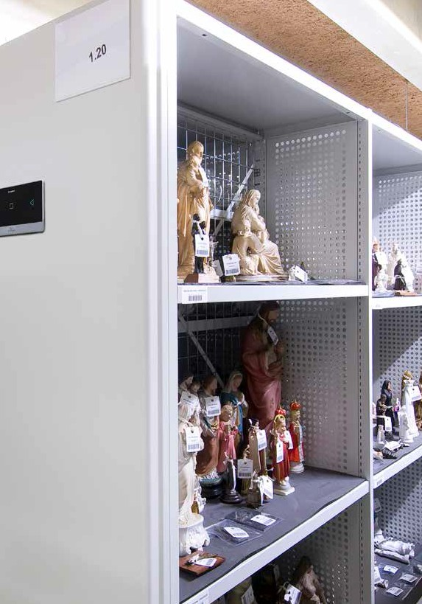
11
Compactus® Double Decker: the next generation
The unique Compactus® Double Decker offers the best possible space optimization available on the market. This system provides four times the capacity of ordinary static storage space; the ultimate space optimization for buildings with high ceilings.
The convenient Compactus® Double Decker enables you to work and store materials on two levels within the same integrated system.
The Double Decker solution is proving extremely popular for museum storage, in part because of the space and cost savings achieved.
However, innovative features such as ‘Auto Air Circulation’ make this system even more attractive; the units can be programmed to separate after a pre-set interval of inactivity, to create spaces between each mobile in a bank, thereby enabling air to circulate and prevent stale air pockets from forming. The system can be linked to Fire Alarms and units will open or close (this will depend on the Fire Control system in the room) when the alarm is activated.

Slide 11
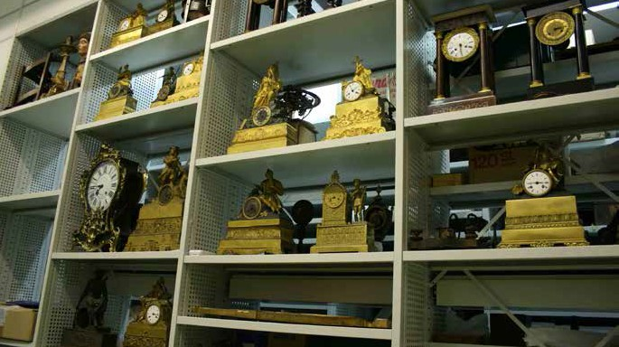
Sysco® shelving
Immediate access to your collection
Whatever your requirements, our modular systems can be tailored to your needs.
The distance between the shelves is easy to adjust, to accommodate objects of various sizes.
Available through Inpro, LLC.; Bruynzeel manufactures two types of versatile modular shelving. Our Sysco® Open racks have open ends without solid dividers, for ultimate flexibility. Sysco® racks are fitted with closed uprights to restrict objects migrating between sections.

Slide 12
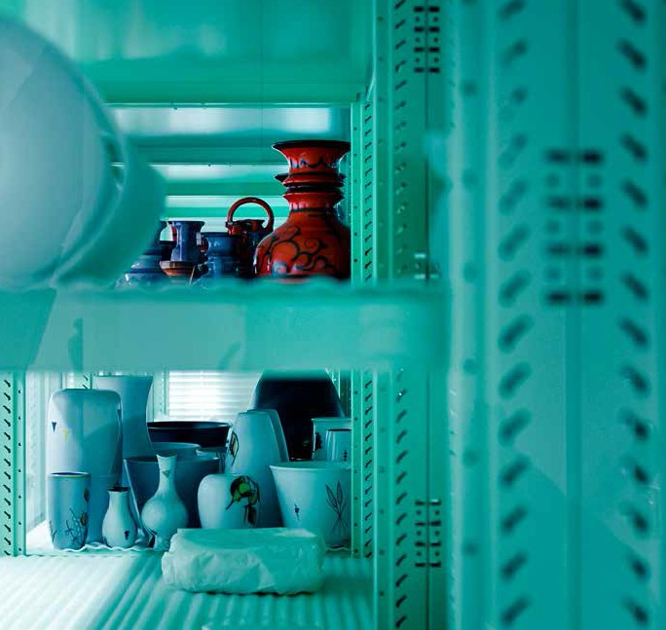
To create optimum safe storage, we have been refining rack systems over many years, with the addition of key modifications based on practical trials and customer feedback.
For example, our shelf clips are concealed within the shelves to prevent damage to the stored objects. To create easy access, the racks can be configured as single or double-sided runs.
Do you need storage that requires extra protection against organisms such as bacteria, fungi and algae? Our anti-microbial coating minimises the risk of cross-contamination from surface contact.
Should you require extra storage space, these systems can also be transformed into mobile units.

Slide 13
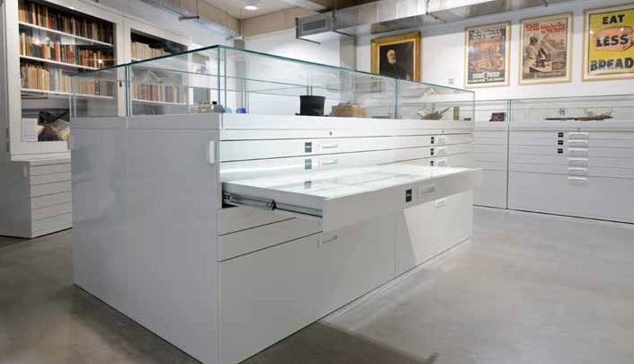
Drawers
Flexible storage in one system
Is your collection best stored lying flat?
Should it be protected against dust and light?
If this is the case, our drawer cabinets offer a protective and user-friendly solution to your storage needs.
Drawers are available in a huge range of dimensions and specifications.
Drawers may be pulled out completely, allowing safe access to the contents, without the risk of accidental damage.

Slide 14
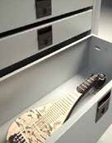
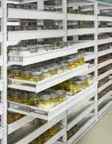
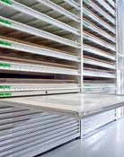
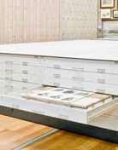
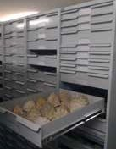
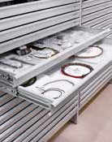
Organize and protect your collection
Standard drawers | Spill-proof drawers | Oversized flat drawers | Drawers for prints | Deep drawers | Multipurpose drawers
Optimize your multi- | With spill-proof, | Fragile textiles or | Drawer cabinets are | For irregularly shaped | In addition to our
functional shelving | reinforced drawers | drawings can be stored | ideal for the storage | objects, it is possible | standard drawer range,
unit by using shelves | you can safely store | in a space efficient and | of drawings and prints. | to create customised | we offer specialized
and drawers in the | heavy specimens in | safe way in oversized | The cabinets can also | deep drawers with | multipurpose drawers.
same bay. | liquid preservatives. | drawers with a large, flat surface area. To avoid damage it is possible to remove the complete drawer from the cabinet. | be placed on mobile carriages to create optimal use of space. | dimensions up to several feet wide. | These can be fully customized and dividers added to create multiple compartments within individual drawers.

Slide 15
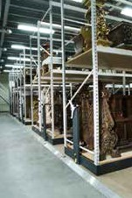
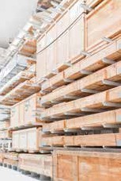
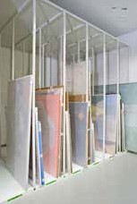
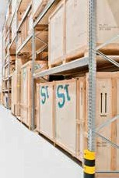
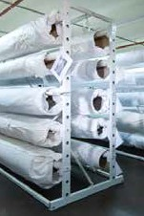
Racks
Tailored to your collection
Regardless of the shape and weight of the objects to be archived, we can offer the best possible storage solution for your collection, thanks to a wide range of racking options.
If the objects are even heavier, pallet racks are ideal. These stable and versatile systems will guarantee safe and compact storage of the heaviest objects. For long and flat objects, panel racks provide a space-saving and safe solution. Carpet racks are an efficient method for storing all kinds
of rolled materials. If required, they will provide a functional solution for oversized canvases.
Long span shelving is perfect for the storage of large objects.
The shelves are easily accessible, adjustable in 50 mm / 1.96 inch increments and have a load-bearing capacity up to several hundred pounds.
long span
Cantilever
Panel racks
Pallet racks
Carpet racks

Slide 16





Choosing quality
with a sustainable touch
Your storage solution is made in our factory in the Netherlands, according to ISO 9001 and ISO 14001.
World-class manufacturing tools and methods implemented in our facilities allow us to produce your order with great precision
in thousands of different configurations. We use mainly oil-free steel to minimize our impact on the environment by eliminating the need for detergents and cleaners. Our powder coating process guarantees a 100% coating with epoxy powder, so no corrosion can occur.
We would be delighted to assist you in achieving your sustainability goals by offering you durable products and space-saving concepts.
Choosing Bruynzeel through Inpro LLC. means quality is guaranteed.
To make sure you get the best possible storage system our products comply with recognized international quality standards, awarded by independent experts in the field. The RAL certificates awarded for our products are your guarantee for performance and reliability.

