Slide 1
Earth & Envrionmental Semester Programmes 2020
September 2020

Slide 2
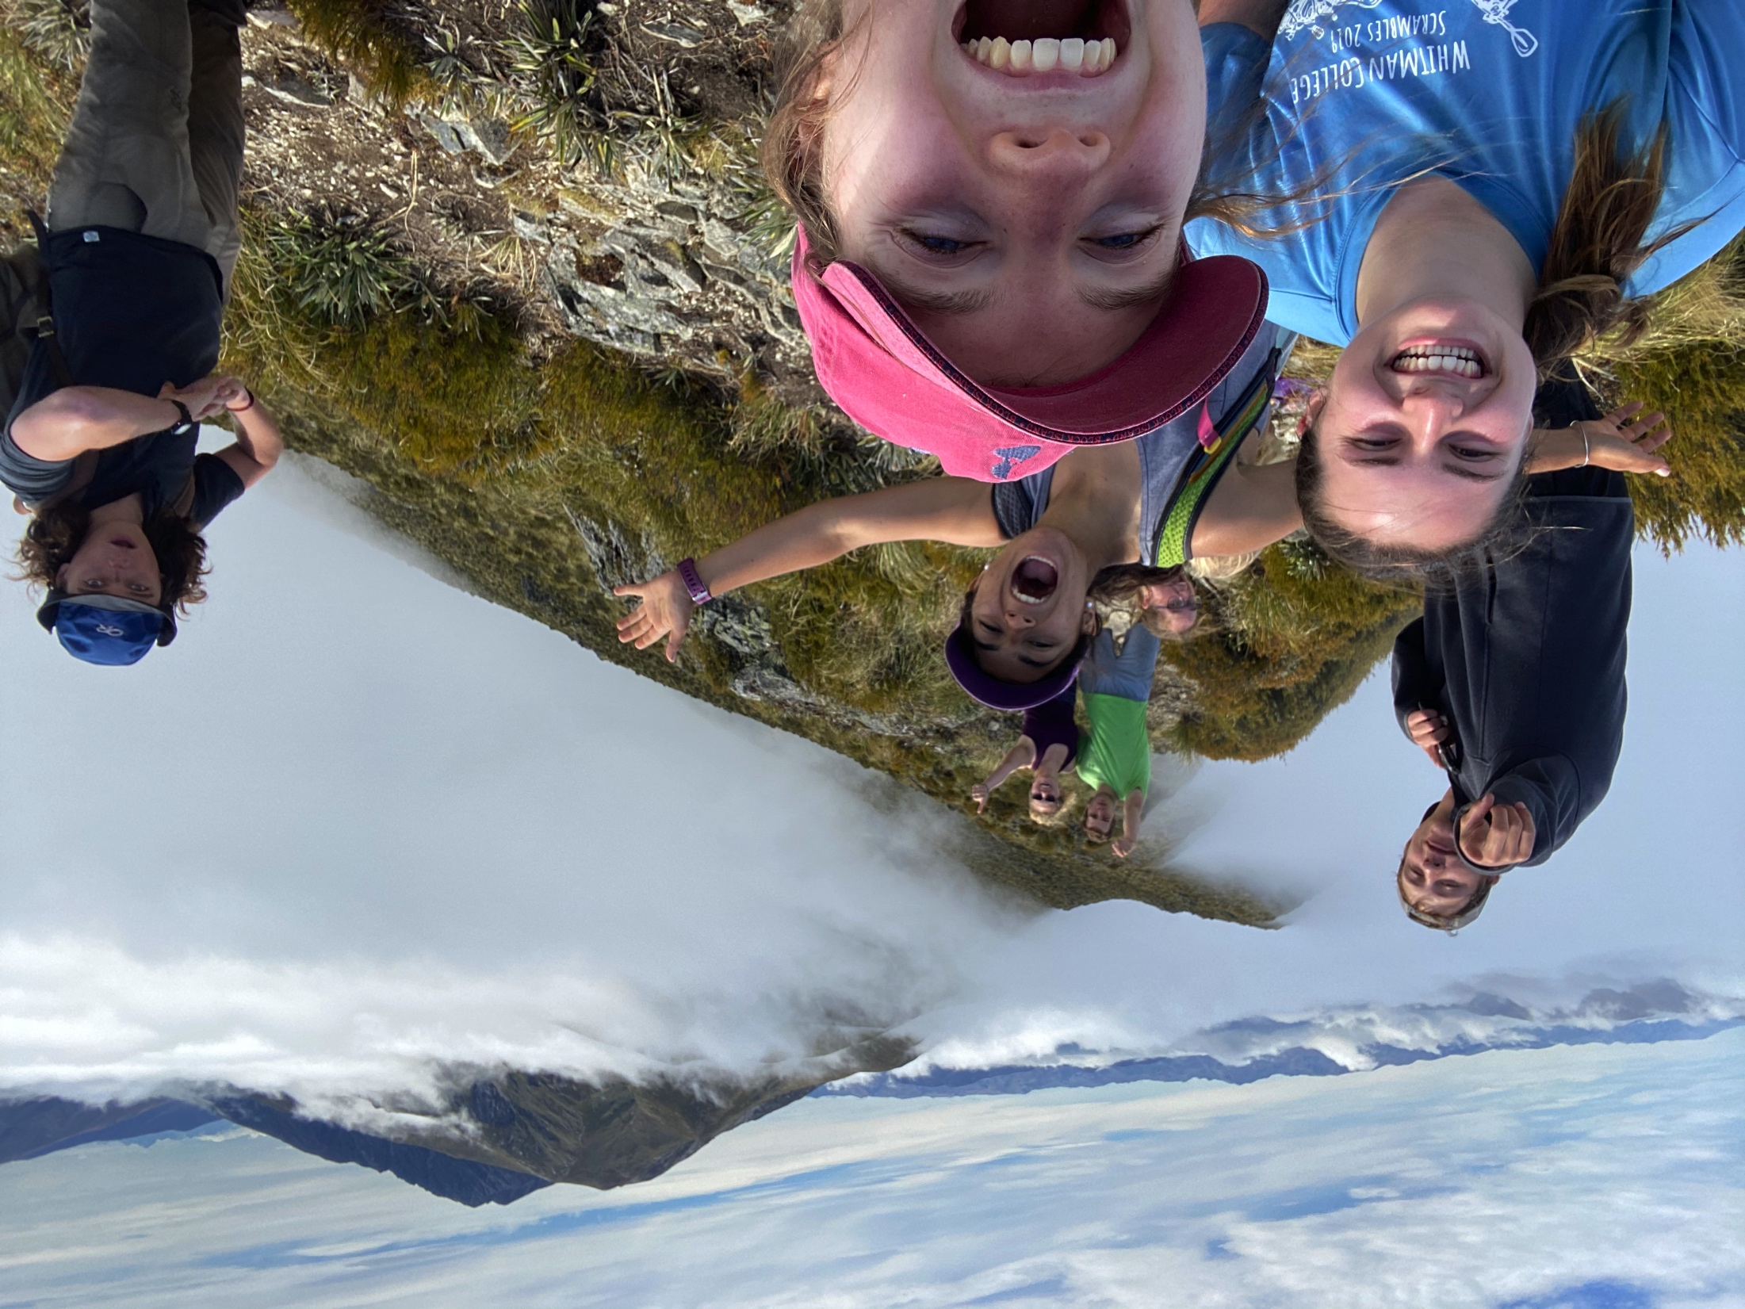
What is frontiers abroad?
“It’s like a dream, New Zealand is unreal. It’s very cool.”
Our aim is for you to have a life-changing experience in Aotearoa (New Zealand) and return home with a road map for your future!
“It’s very epic, there is so much variety. It’s hard to believe.”
Notes:
New Zealand based study abroad programme
Field training experiences in the diverse culture and environment of the New Zealand landscape
Our “immersion learning experiences” take you to places of active research
We combine field-based education, inquiry-based learning, and research projects to provide an incredible study abroad experience
Delivering pioneering study abroad experiences since 2008

Slide 3
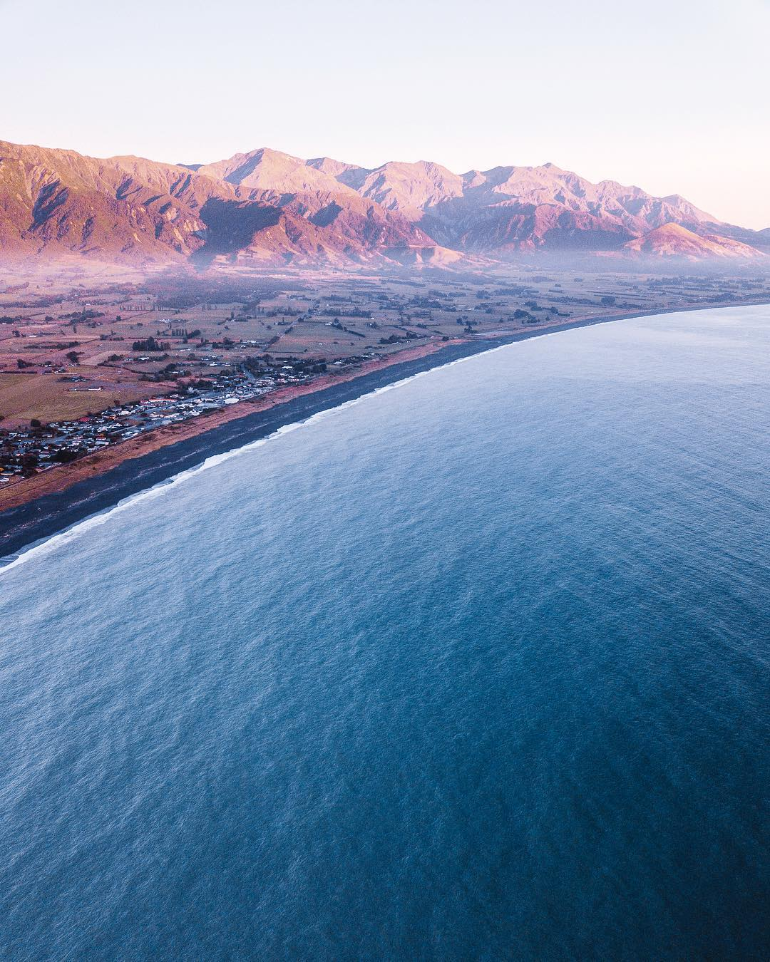
Not your Typical Study Abroad
Kaikoura Township in the foreground with the
Seaward Kaikoura Ranges in the background,
South Island
Learning Earth and Environmental Science in the New Zealand outdoors with local experts
An emphasis on student Wellbeing through adventure, challenge, community engagement, reflection, and personal growth
Performing authentic research with an academic mentor
Discovering different ways of knowing including Mātauranga Māori
Connecting, sharing, engaging with local communities through academic pursuits
Frontiers Abroad has a family-like atmosphere
“Frontiers Abroad can take you as someone with not too much experience, as a background, and supply you with the tools that you need in order to succeed.”
Notes:
Our field camps are delivered in a series of modules led by Frontiers Abroad staff and associated academics.
Each module has themes and defined learning outcomes, which scaffold and build your expertise in the varying fields of science.
For field camp we stay in a variety of accommodations. Our main accommodation is in field stations, buildings situated directly in the environments that we explore.
Unlike other field camps you are catered for. We provide breakfast, provisions to make your own packed lunch and snacks, dinner and desert.

Slide 4
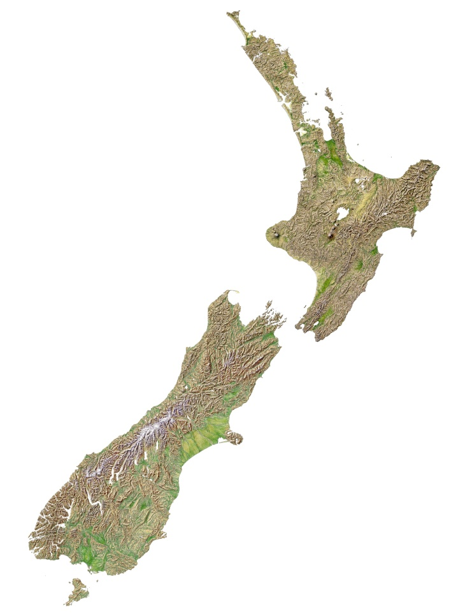

Our programmes
Coupled Field Camp and Campus Semester Programmes
  University of Canterbury, Christchurch, South Island
  University of Auckland, Auckland, North Island
Two Programmes to choose from:
Geology / Earth Science
Earth Systems / Environmental Science

Slide 5
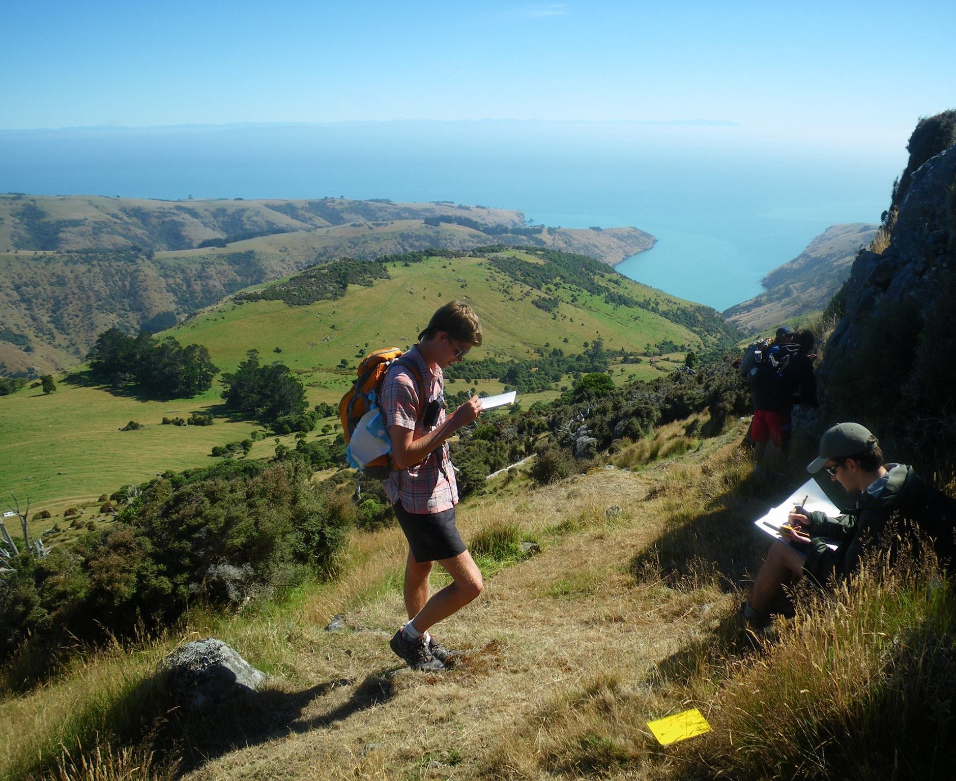
Programme Starts with Field Camp
Objectives
Build breadth through different disciplinary field modules
Build and develop your field skills
Observe, record, interpret, reflect
Work in teams
Challenge yourself
Learn how to perform field research
Grow as a person
“I’ve had friends say that they eat, live, and breathe geology, but I don’t know if they can do it quite as much as they can here.”
Getting perspective of the geologic units,
West Coast, South Island
Field research on Banks Peninsula, South Island

Slide 6
Geology Field Camp (5 weeks)
VOLCANOES
Lava flow fields
Super volcanoes
Geothermal
Geohazards
Quantitative Data
FUNDAMENTALS
Field notes
Descriptions
Observations
Measurements
Field mapping
MAPPING
Tectonics - Structure
Stratigraphy
Geomorphology
Professional -Geologic map
GEOMORPHOLOGY
Geomorphic mapping
Deformation
Processes
Timing
Landscapes
RESEARCH
Projects
Mentors
Self-directed
Data collection

Slide 7
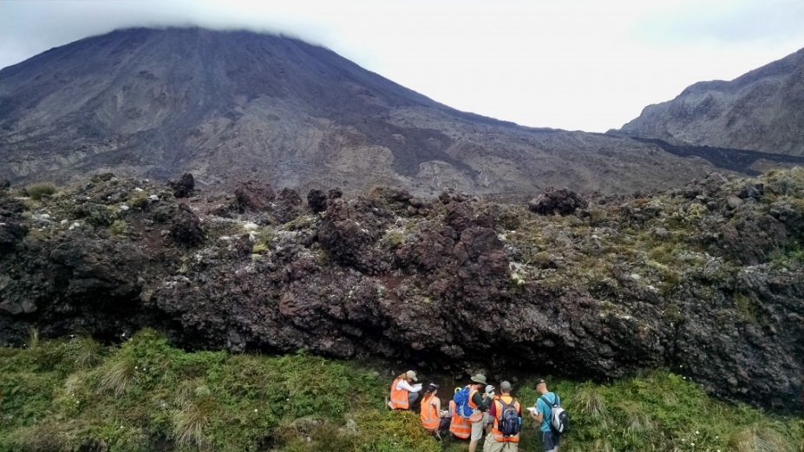
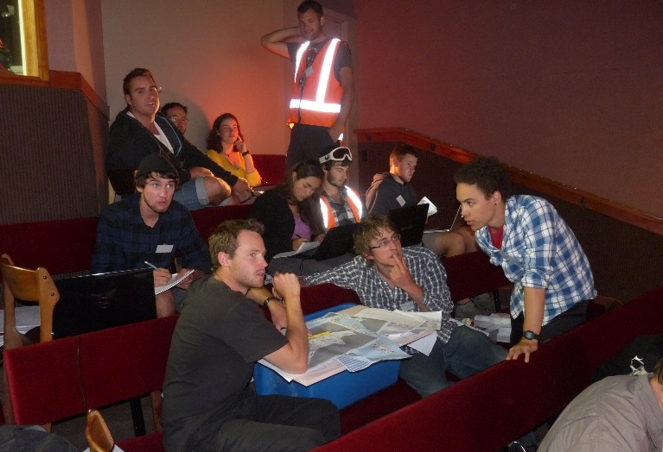
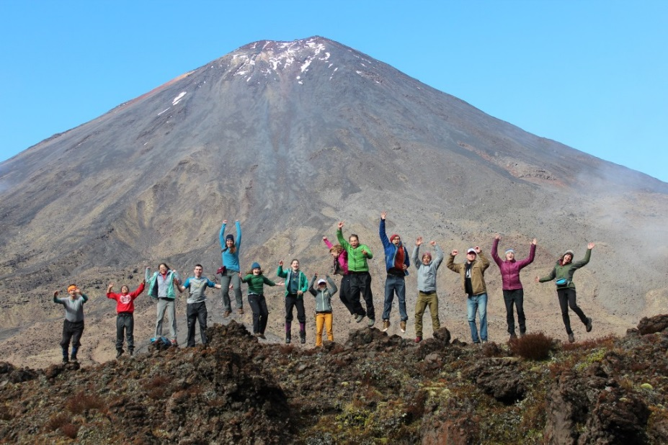
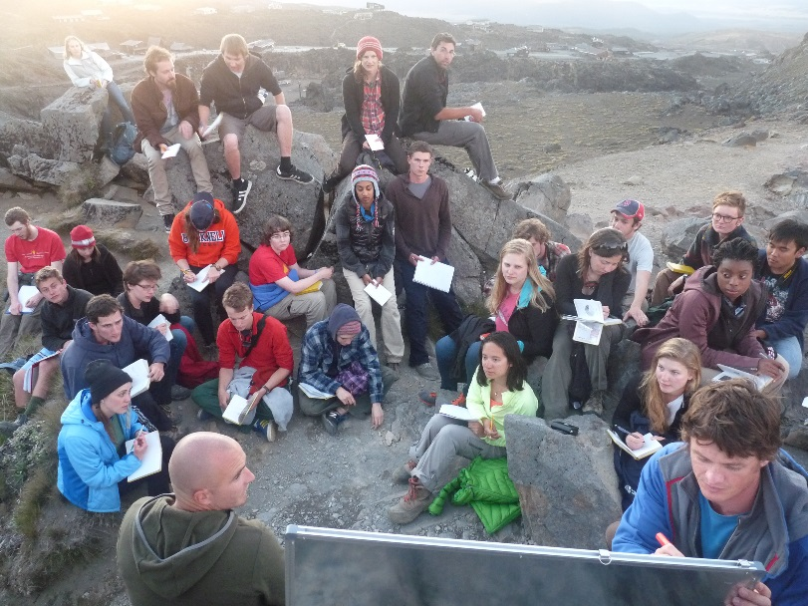
Volcanoes Module- Tongariro (Mt. Doom)
Getting perspective of the geologic units,
West Coast, South Island
Lava flow field mapping
Field observations to interpretation
Eruption processes
Volcanic hazards and eruption simulation exercise
Integrated with students from New Zealand
Eruption Simulation
Tongariro Crossing – Mt Doom
Natural classroom

Slide 8
EARTH SYSTEMS Field Camp
(4 weeks)
FIELD SKILLS
Environmental -restoration
Natural hazards
Resource management
KAITIAKITANGA
Maori - World view
Observations
Field notes
Communities
Ecology
COMMUNITY
Engagement
Reflection
Culture
Research
HYDROSPHERE
Hydrology
Chemistry
Data analysis
NZ issues
Source to Sink
ANTHROSPHERE
Glaciers
Climate
Tourism
Sustainability
Challenges
Notes:
2020 Field Modules (Modules Subject to Change)
Module 1: Introduction to Earth Systems Field Skills and Observations in the Bay of Plenty and Mt. Ruapehu
Module 2: Kaitiakitanga, Maori perspectives on natural hazards, resource management, and environmental restoration, Bay of Plenty.
Module 3: New Zealand Hydrosphere -The Southern Alps
Module 4: Climate Change and Conservation in the Southern Alps
Module 5: Research Projects

Slide 9
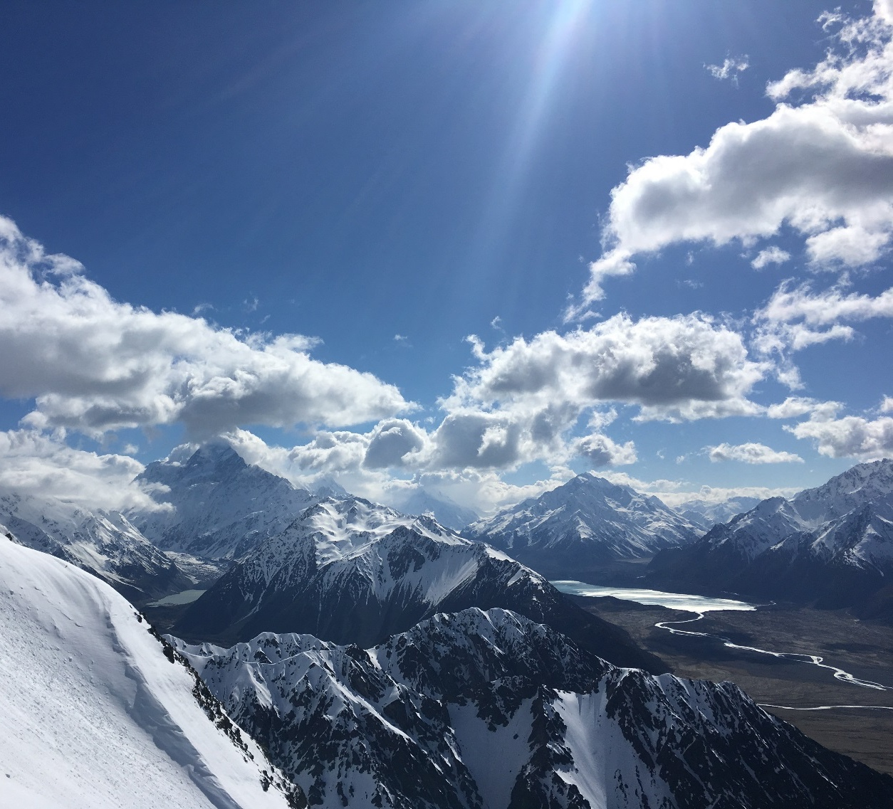
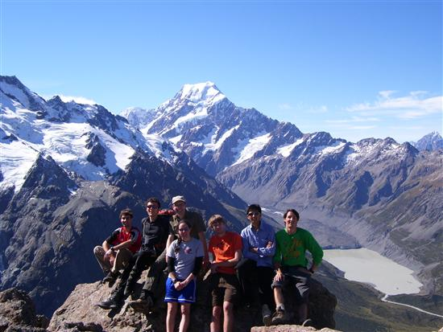
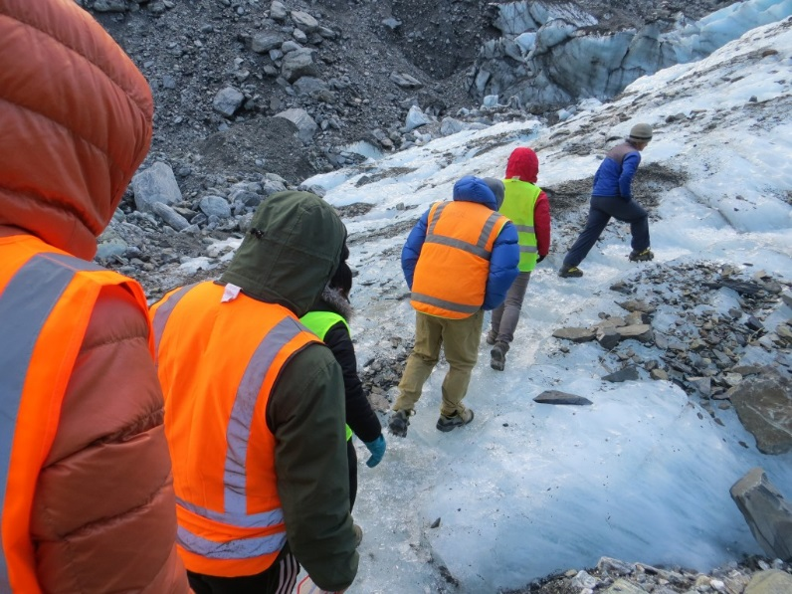
Anthrosphere module– Climate change and conservation at Aoraki / Mt Cook
Southern Alps and glaciers
Aoraki in the background
Intersecting spheres of the Earth system
Anthropogenic climate change
Sustainable tourism
Cultural significance
Conservation strategies
Glacier traverse

Slide 10
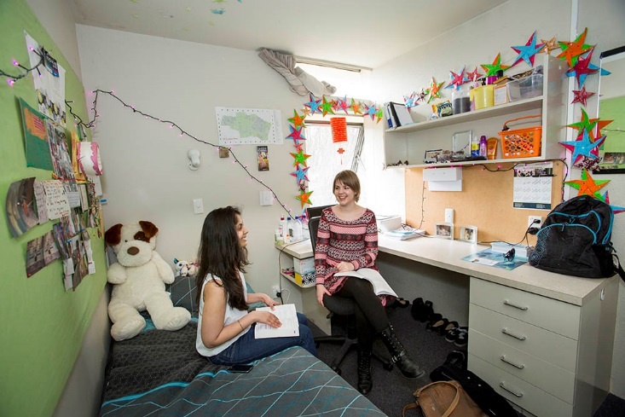
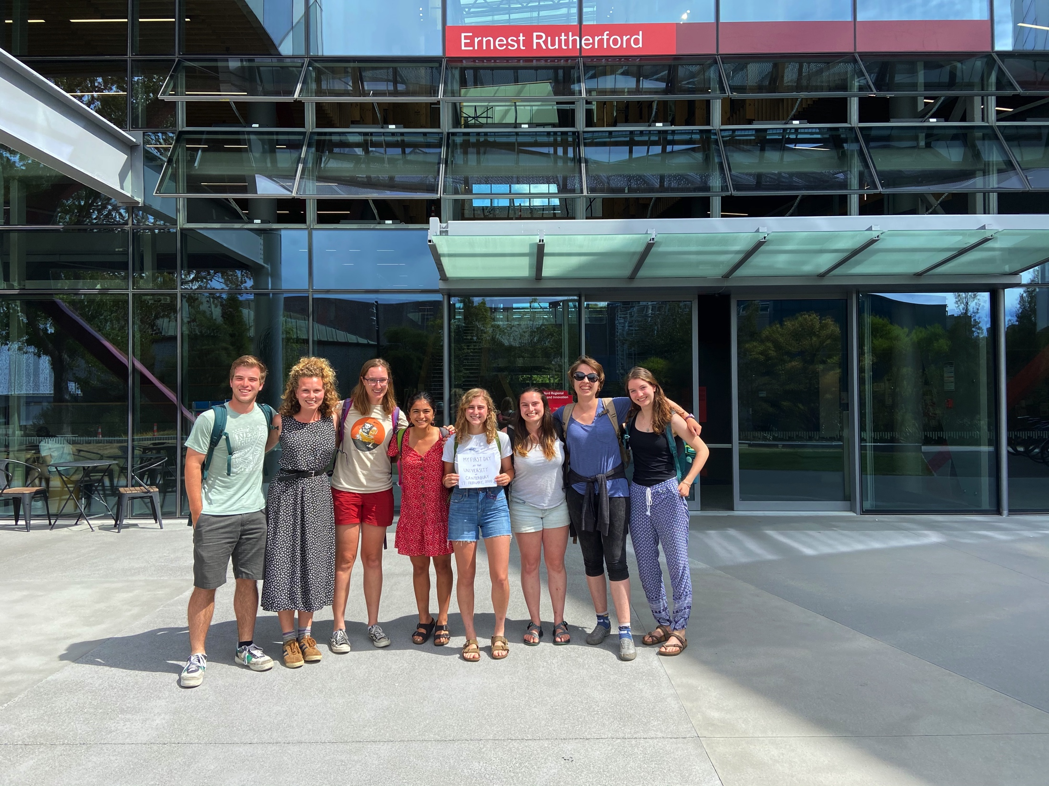
Campus Life
Live on / near campus at University housing
Choose courses from a complete University course catalogue
Take our Frontiers Abroad crafted research course
Join University social & recreation clubs
Make Kiwi mates
Pastoral care and support
Individual room at Ilam Apartments, Christchurch
First Day of Class on Campus 2020

Slide 11
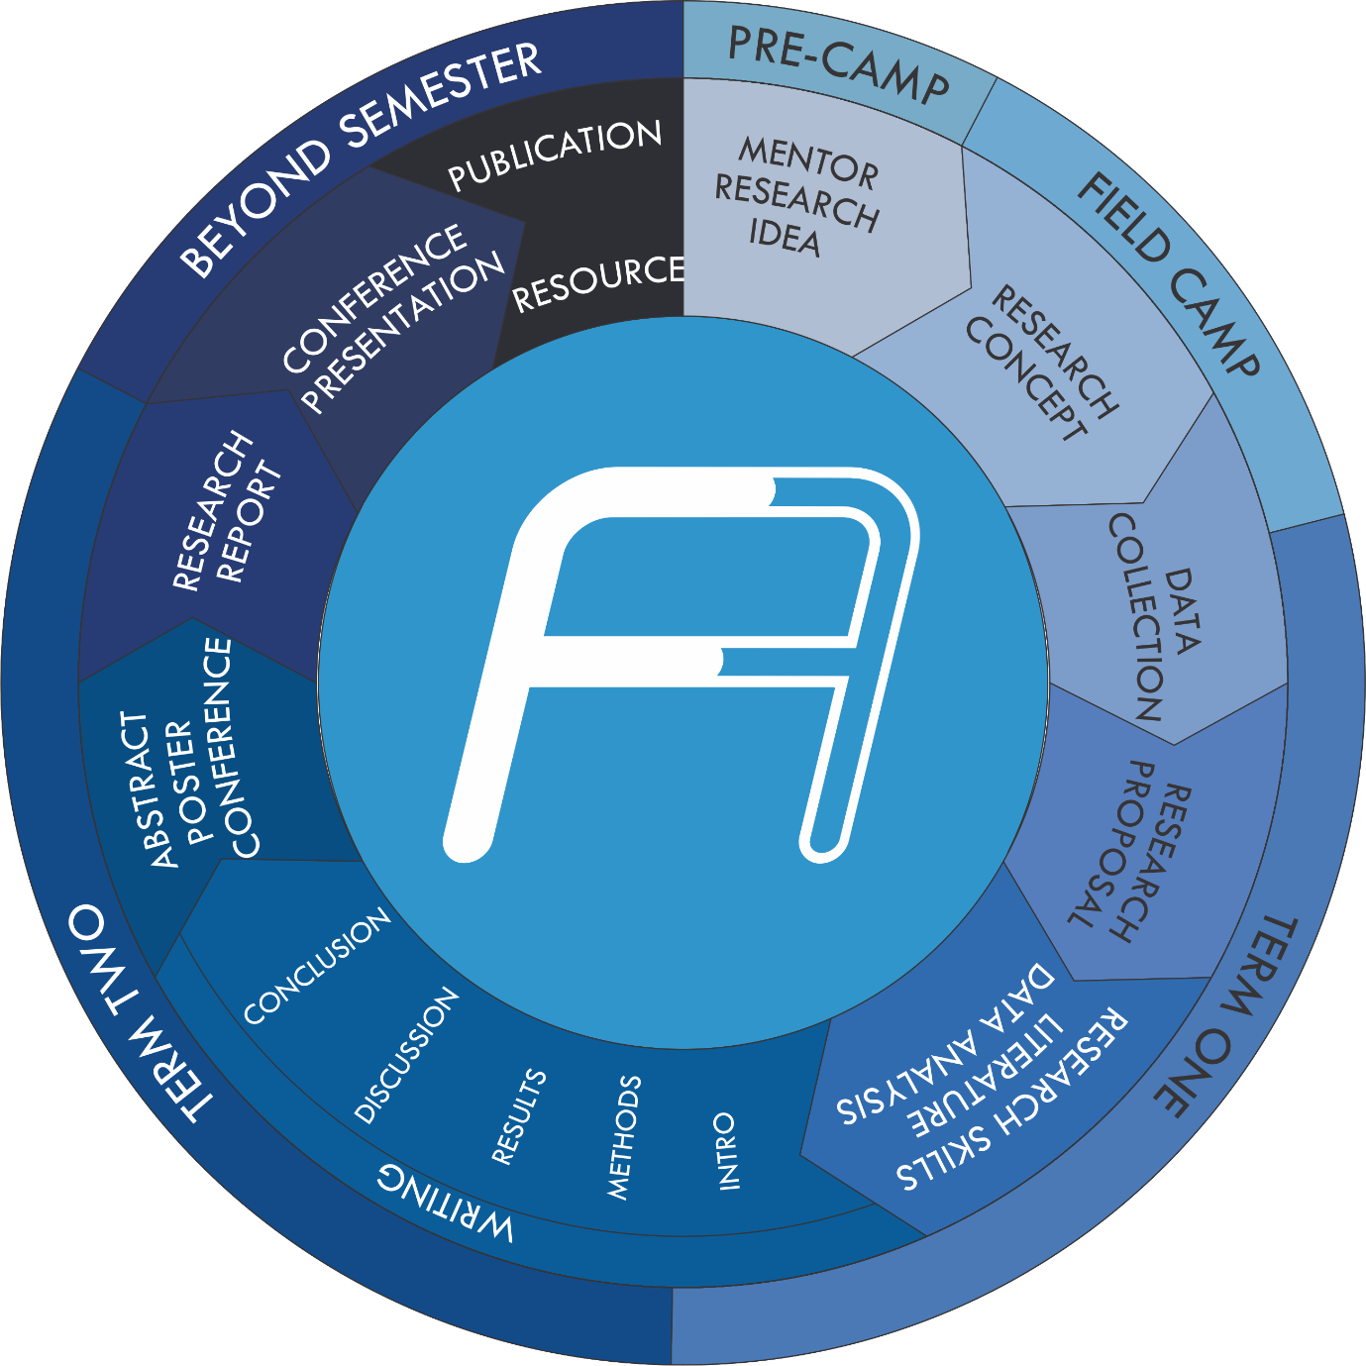
Semester – Research Course
Our Research Learning Model:
‘Longitudinal learning’ (from the field to the classroom/laboratory)
Inquiry-driven/scientific method
Being part of a research team
Communicationg Science (presentation skills)
Manuscript/Report production
Kick start your career (academic, industry, NGO, government)
Notes:
Actively contributing to ongoing research programs, enabling collaboration and networking, and exposed to specific skill sets and analytical techniques
Defines and initiates your research question under the guidance of an academic mentor
Projects - undertaken within an academic semester (~12 weeks).
Individually may be of significance, or
Cumulatively begin to answer and contribute to our scientific knowledge and objectives
Outputs - journal-article style manuscript or scientific report, and a professional research poster presentation
Partnership with the University of Canterbury, and University of Auckland
Designed to link field research, data collection, lab analysis, with instruction in scientific research
Guide you through research journey, introducing fundamental skills, processes, graphic design, scientific writing, presentation, and reporting

Slide 12
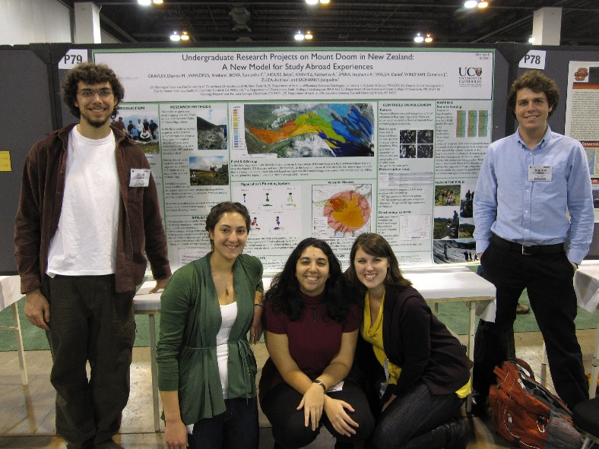
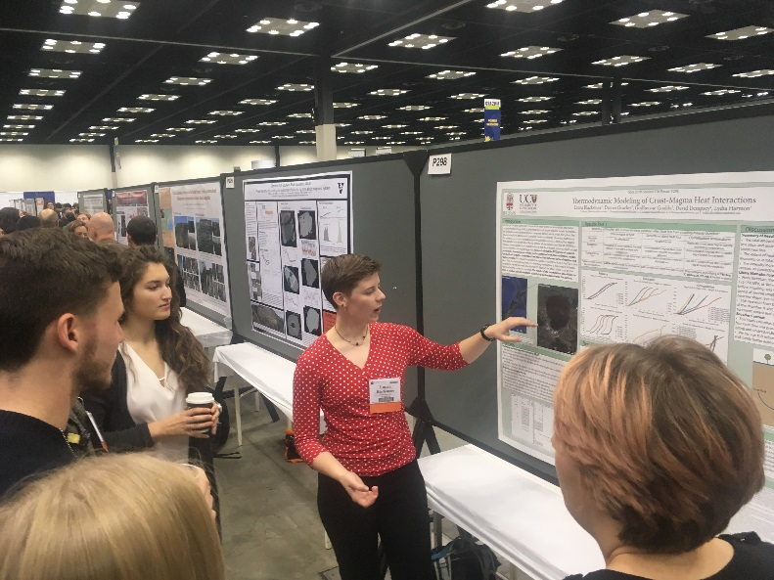
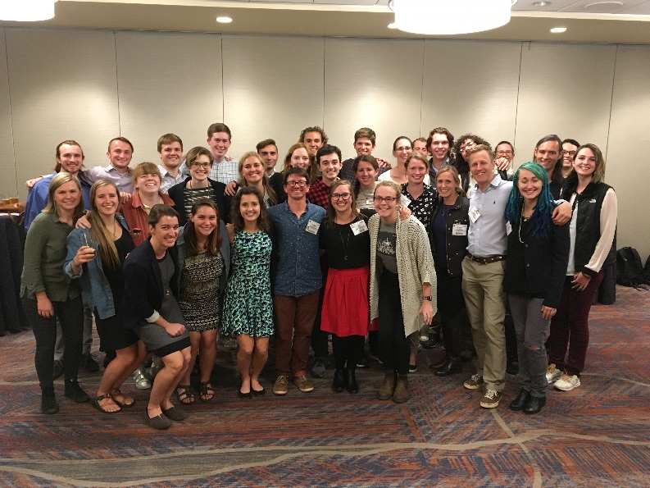
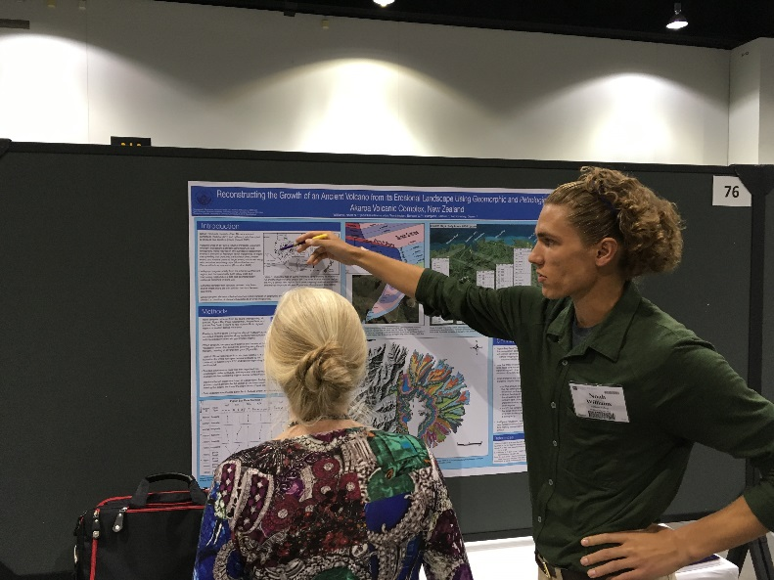
Conferences – GSA
“I think that having come to New Zealand and studied with Frontiers Abroad it definitely gave me a leg up when I went to apply for jobs. Because most students coming from undergraduate careers don’t really have this field research and this field experience that I got here.”
GSA poster presentations
Oral presentation
Poster presentation
Networking
Career
Alum events
Over a hundred student presentations
  2019 – 17 students
  2018 – 14 students
  2017 – 16 students
GSA 2010
GSA poster presentations
FA Alum at GSA

Slide 13
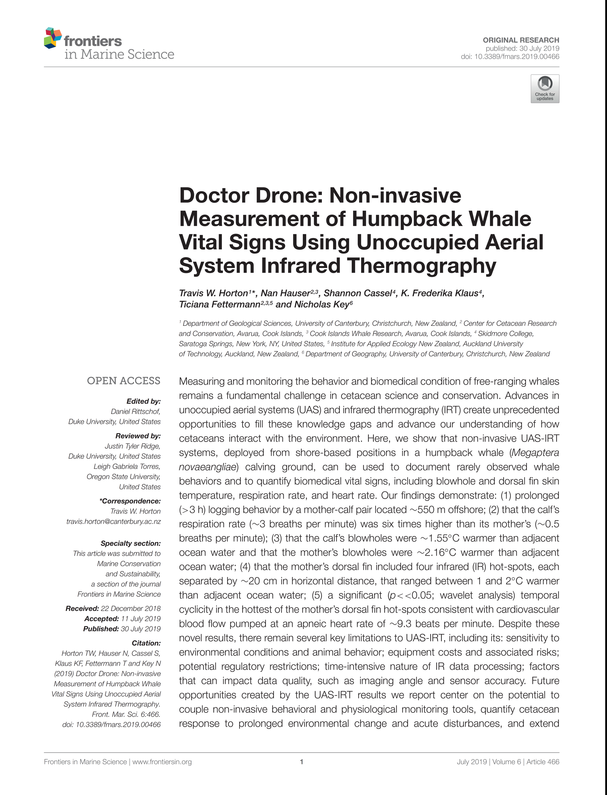
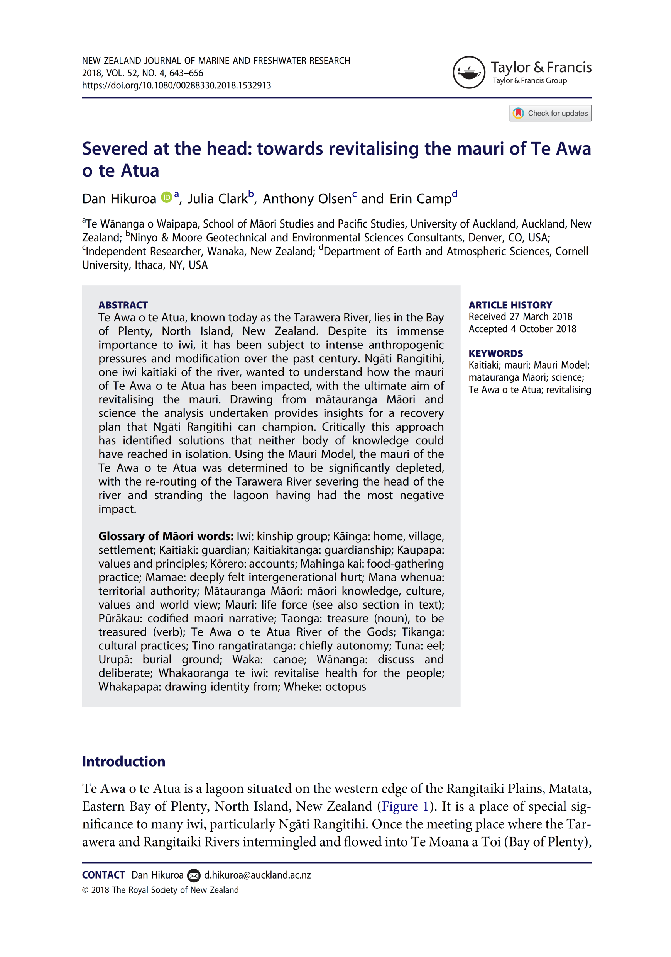
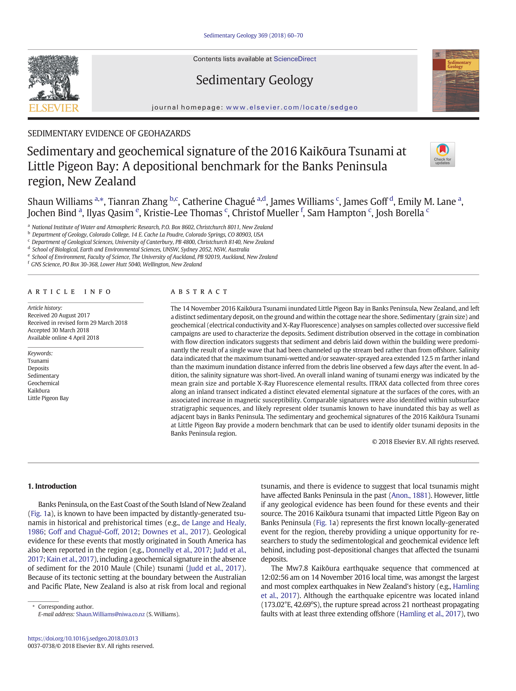
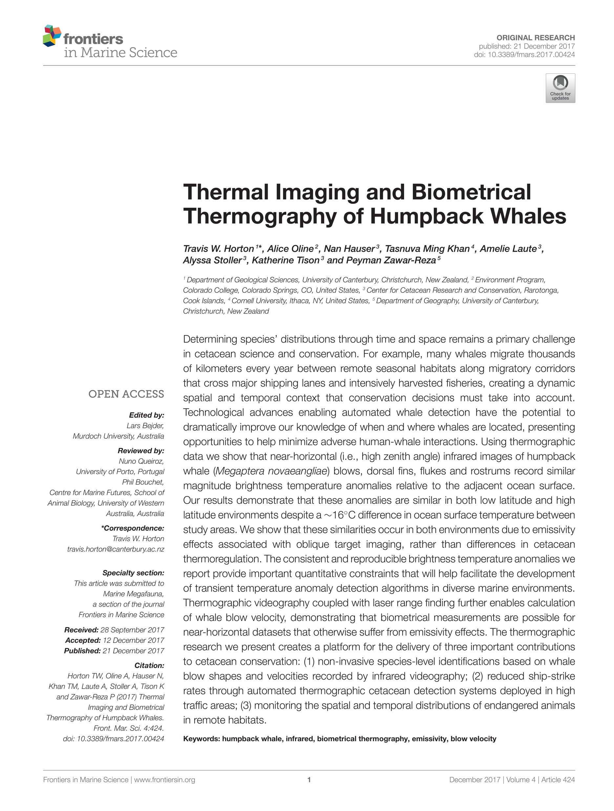
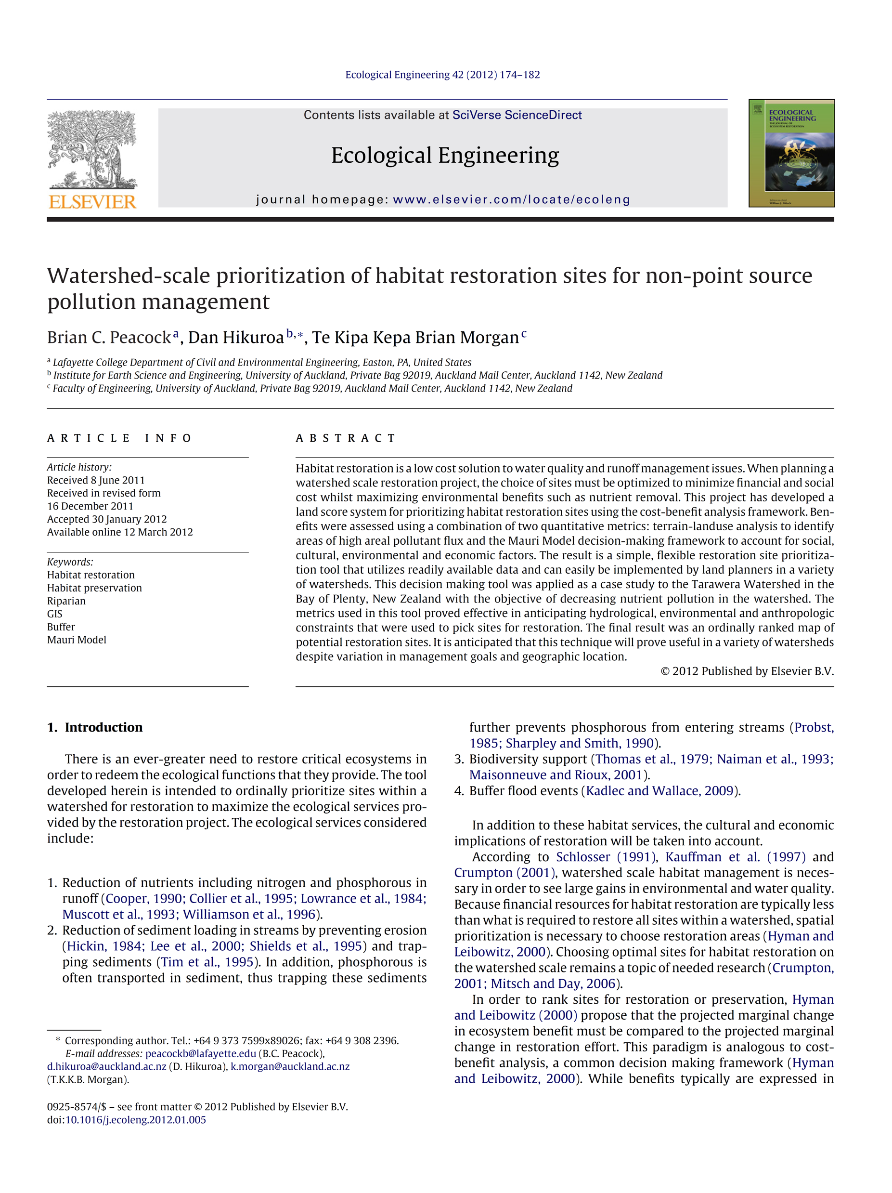
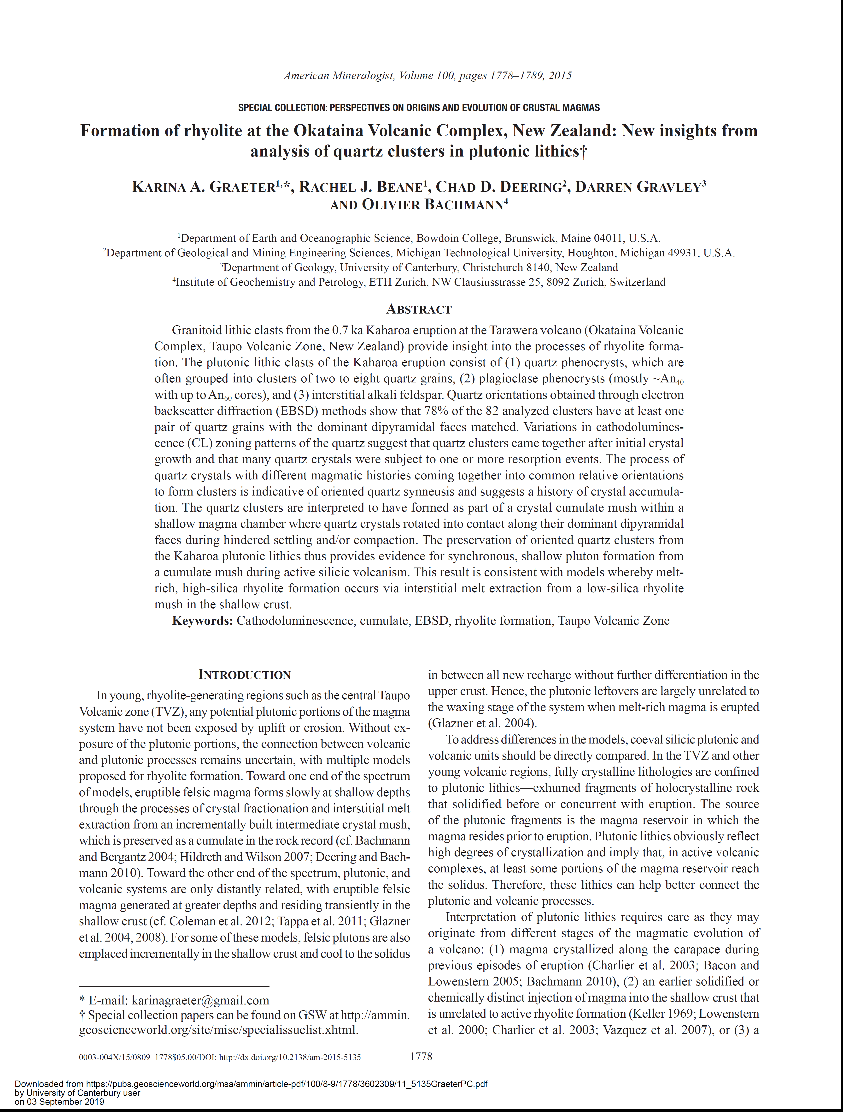
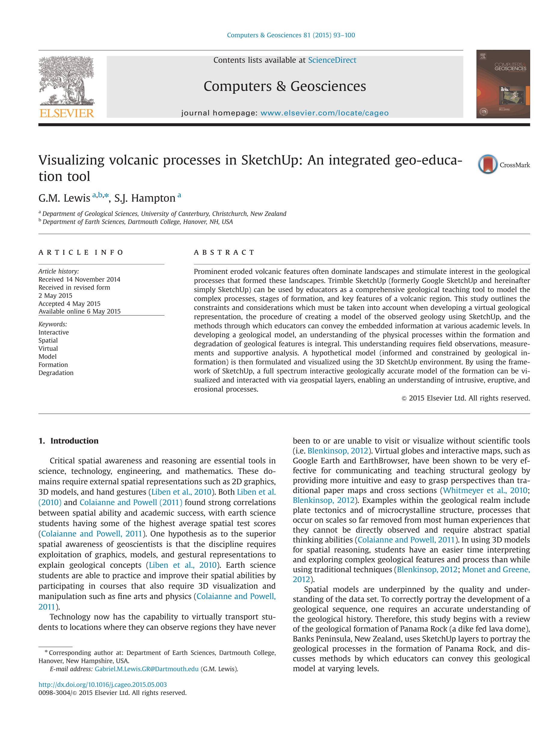
FA Students Publish!!

Slide 14
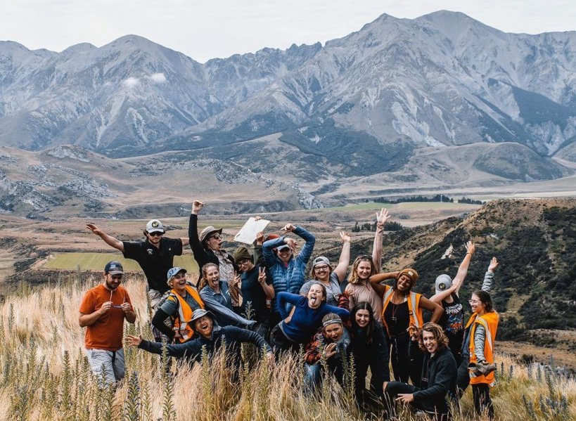
Personal Wellbeing- Having Fun while learning
Academic rigour but in a relaxed ‘kiwi’ style learning environment
Reflective learning approaches
Make life-long friends
Family environment
“It’s been an unbelievable learning experience, not only about geology, but about myself as well. And just being out in New Zealand, you know pretty much as far as way from home as possible, really makes you reflect on the things that you never really would have thought of before.”
Notes:
NZ Laboratory – discover, work and learn in the dynamic environment of New Zealand
Expert field instructors – our expert instructors are academics based at New Zealand Universities
Experiential learning – work, live, play, and experience in New Zealand
Be part of a dynamic team – work with your fellow students and academics in field and research teams
Not your typical field camp – sleep in beds, fully catered, amazing people

Slide 15
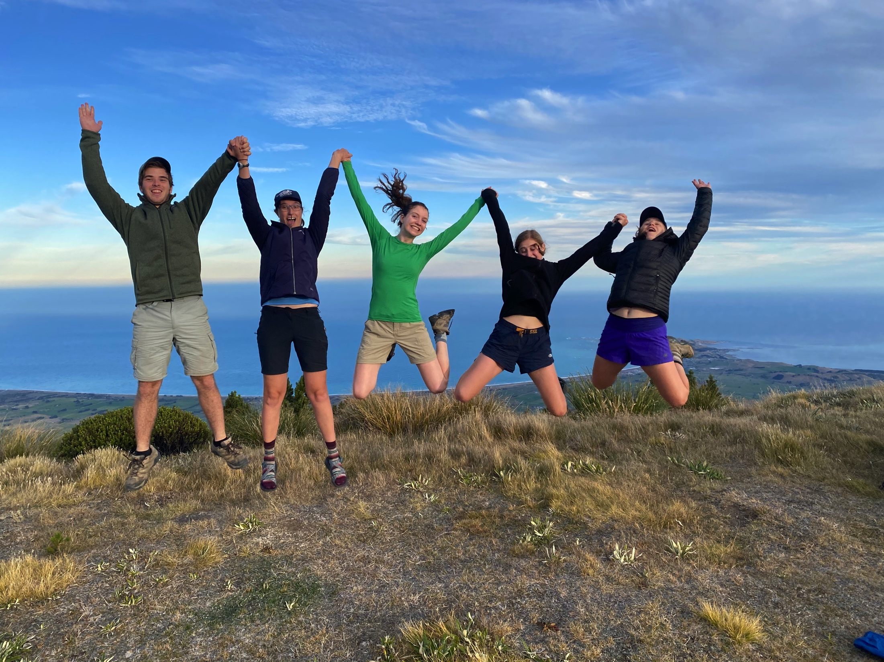
Personal Wellbeing- Stay Active (Body & Mind)
Local hiking
Local climbing and bouldering gyms
Frontiers Abroad Yoga, Pilates and Mindfulness sessions
Weekly social rugby sessions and go to Professional Rugby match
Getting out on the weekends!!
Notes:
Be part of a research team – work alongside academics on their research
We want you to be successful – research projects are designed to be successfully supported and undertaken
Continuity – our research projects build on each other, tying into ongoing academic research
Projects in the New Zealand laboratory – we look to the NZ environment for our research projects
Set you up for academic success – our courses are structured to enable you to undertake, present and write up research
Present your research – the majority of our geology research students present their research at GSA

Slide 16
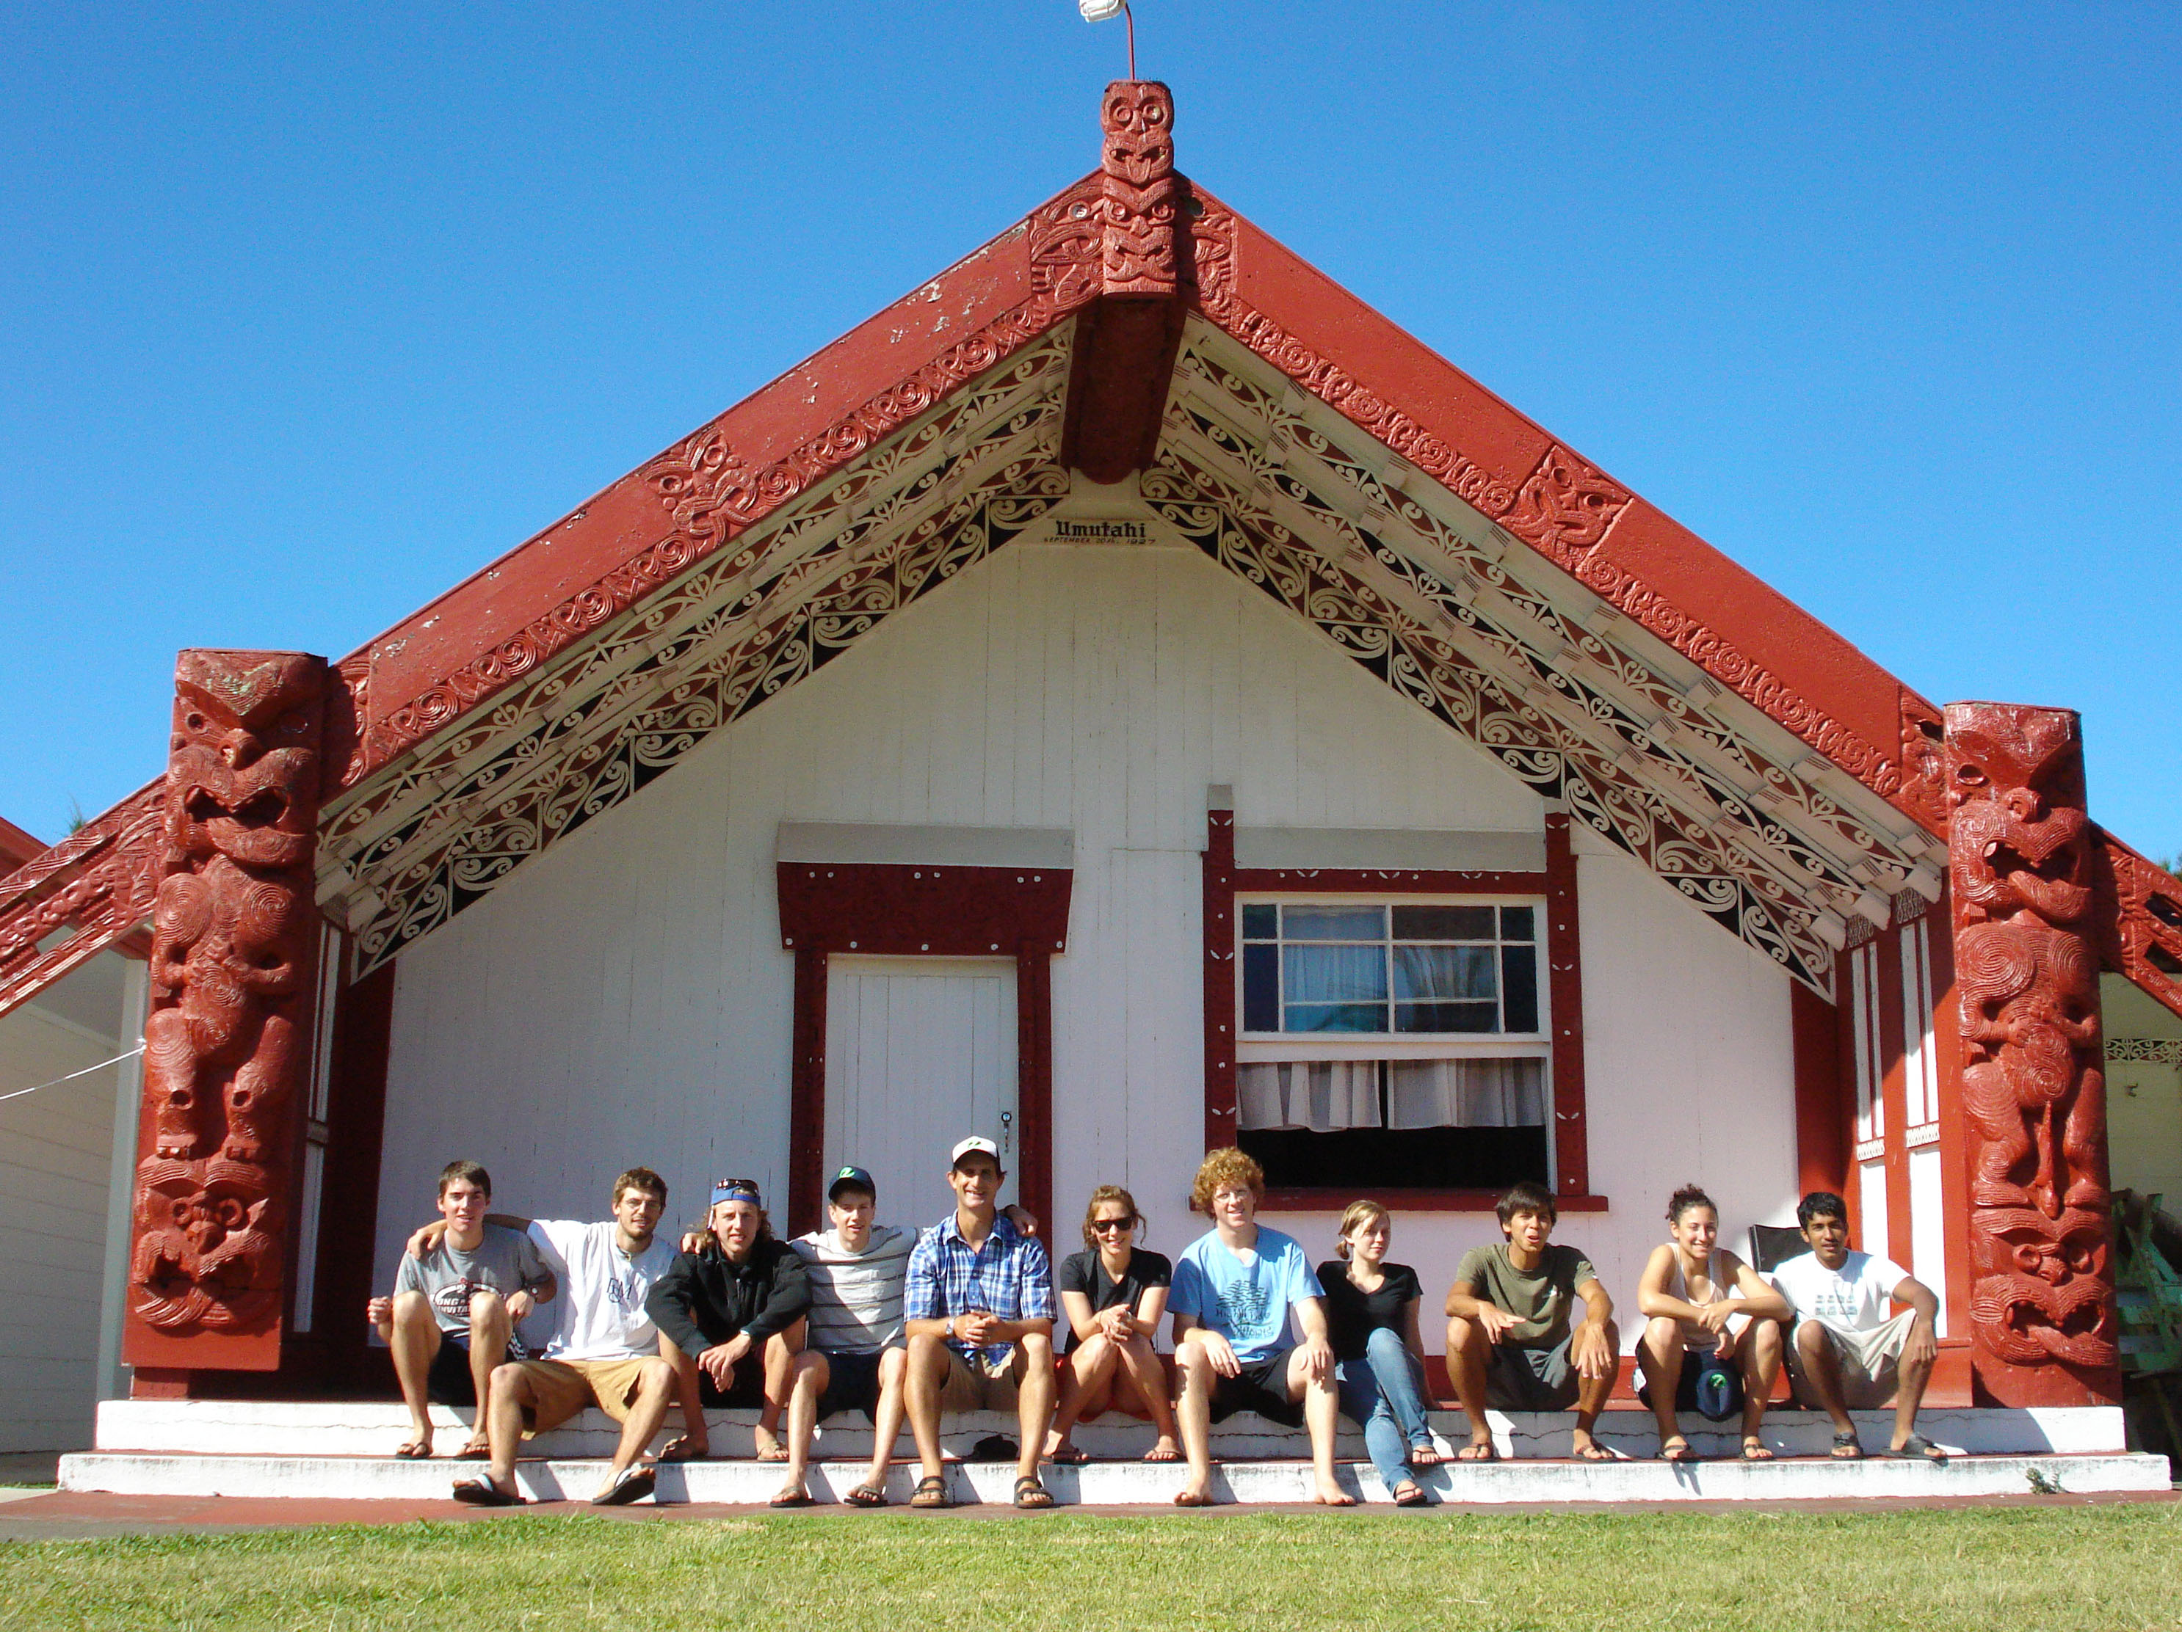
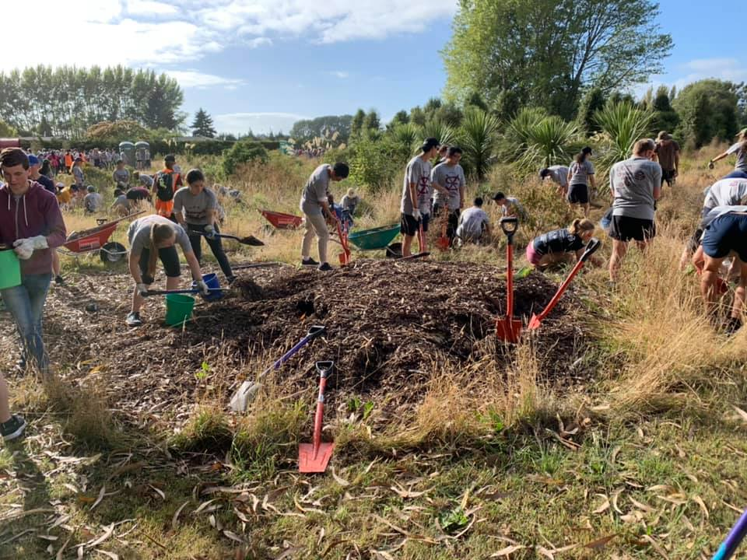
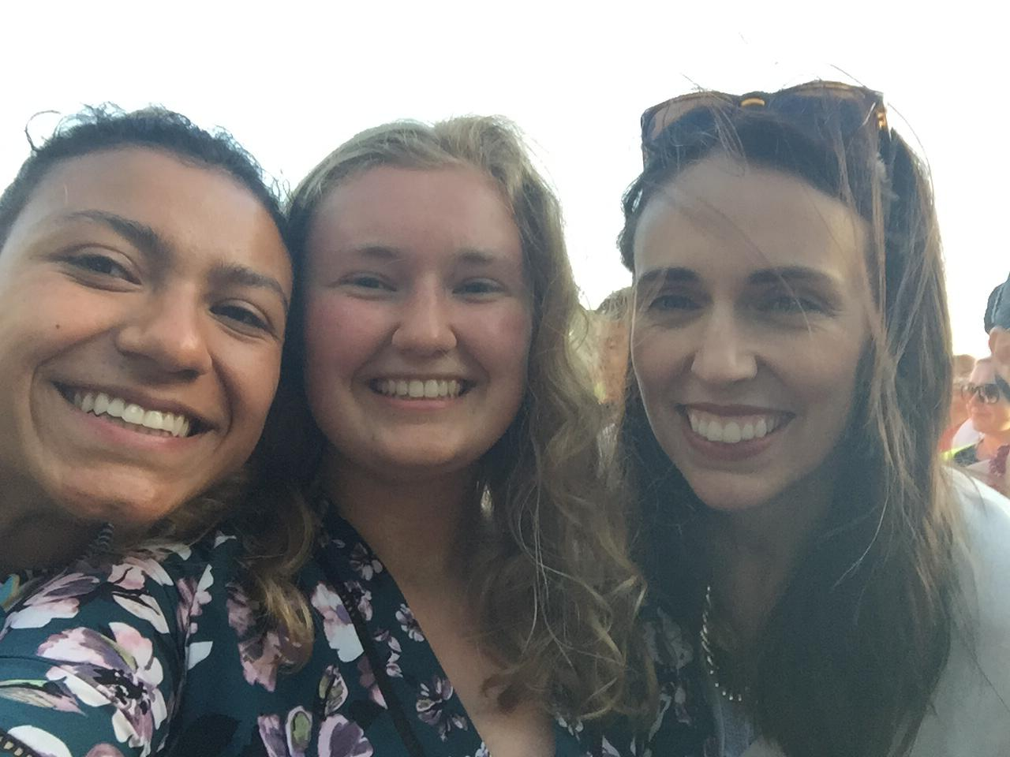
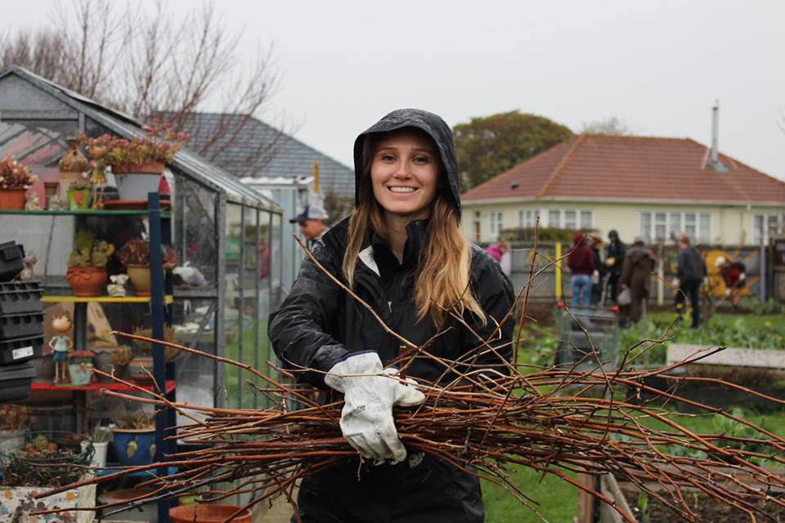
Community & Cultural Integration
Community & Cultural events (volunteering, engagement)
Making a difference in the environment and climate (native tree planting events)
Getting out and enjoying festivals and meeting Kiwis!!
FA students at festival with
Prime Minister Jacinda Ardern
Notes:
Be part of a research team – work alongside academics on their research
We want you to be successful – research projects are designed to be successfully supported and undertaken
Continuity – our research projects build on each other, tying into ongoing academic research
Projects in the New Zealand laboratory – we look to the NZ environment for our research projects
Set you up for academic success – our courses are structured to enable you to undertake, present and write up research
Present your research – the majority of our geology research students present their research at GSA

Slide 17
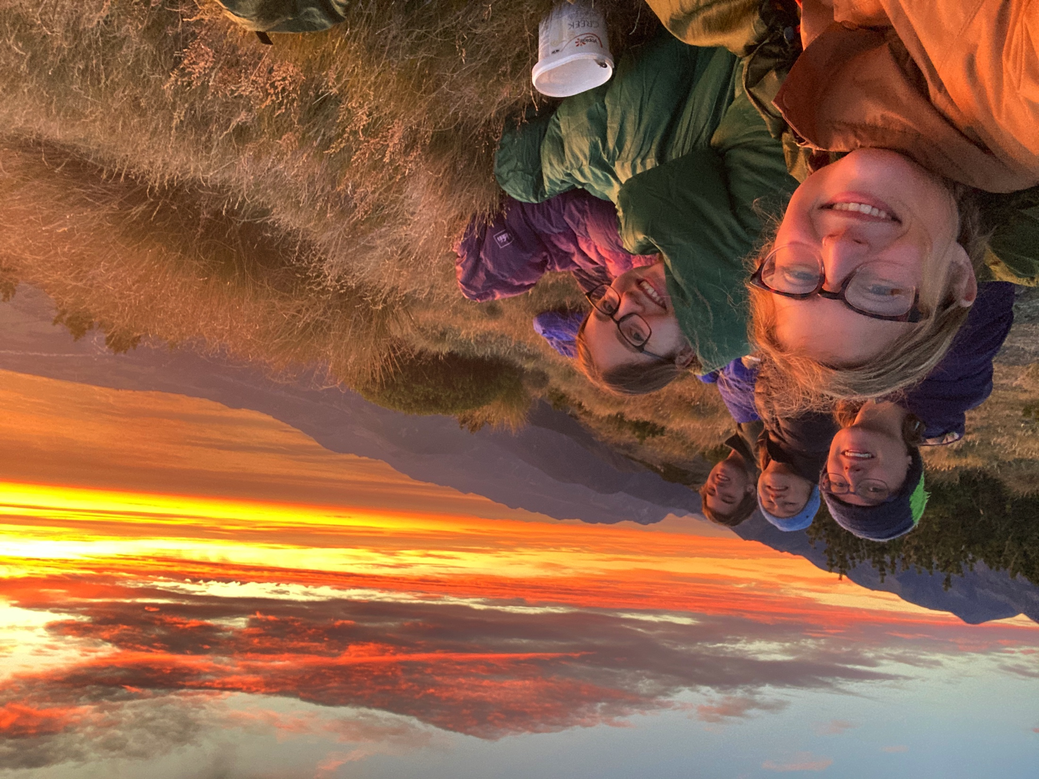
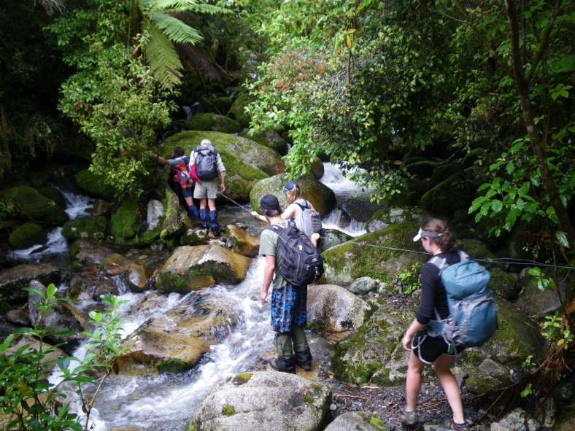
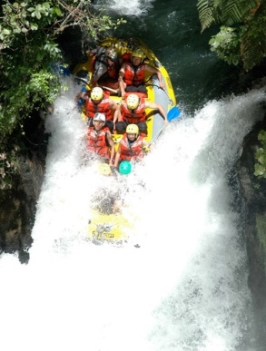
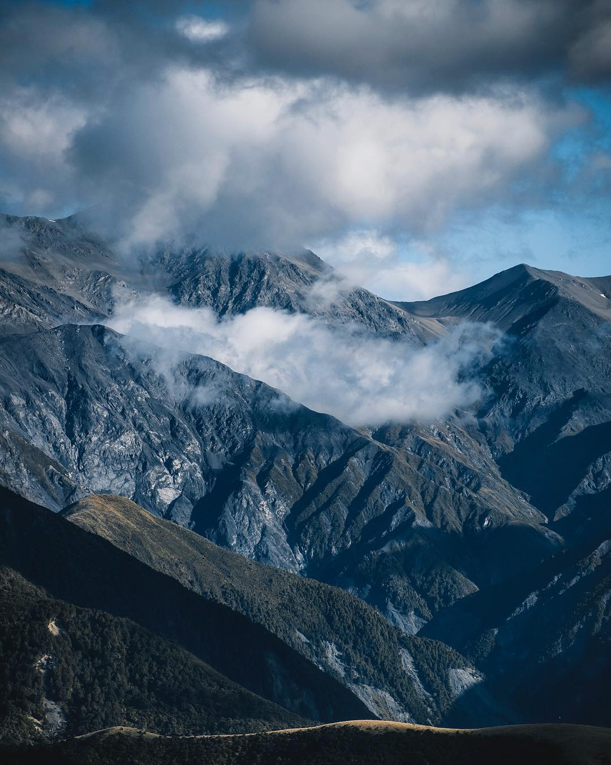
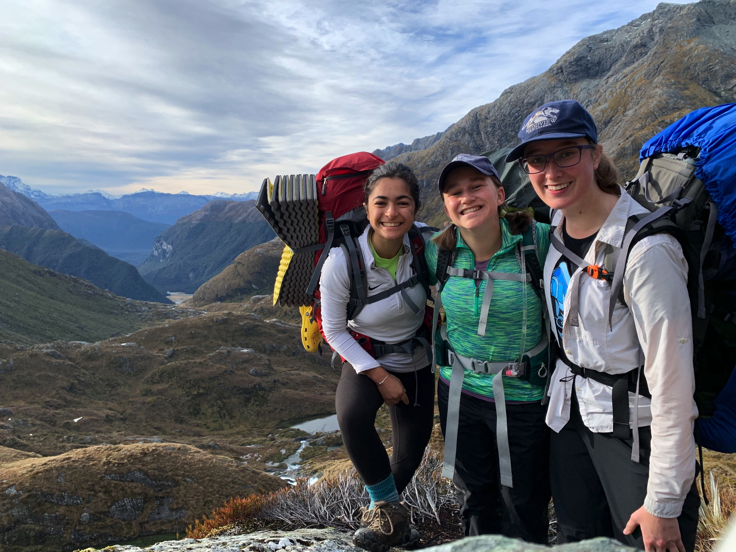
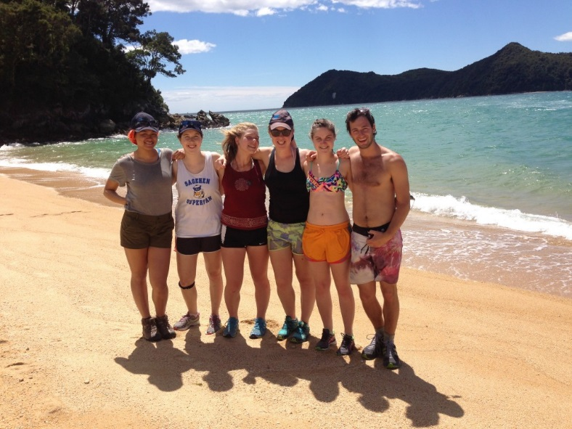
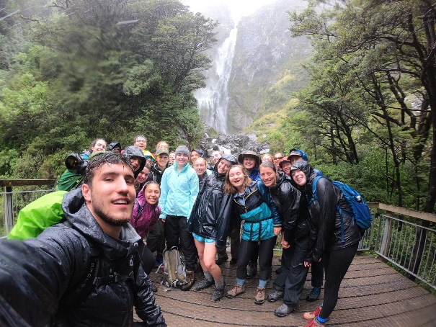
Challenge yourself- Explore - Grow
“I was able to go kayaking, skiing, surfing, rock climbing, bungy jumping, nearly every single weekend.”
Notes:
Whether in New Zealand during field camp or staying for a semester you have plenty of opportunities to see and experience New Zealand.
Our field trips traverse the North and South Islands of Aotearoa / New Zealand and provide you with “guided tours” while you learn.
While here in New Zealand many of our students make the most of their weekends and their mid semester breaks. If you stay in Christchurch or Auckland the outdoors is only a short drive away.

Slide 18
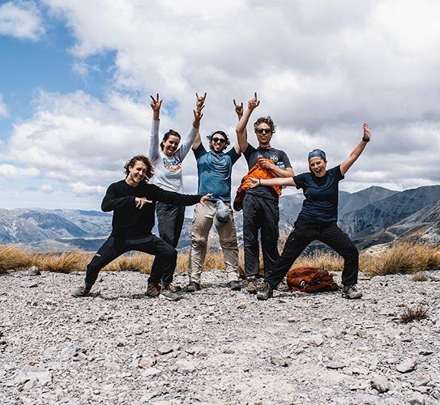
How to Apply to Frontiers Abroad
Online at frontiersabroad.com
Head to our Apply Now page
Complete our online form
Contact us:
max@frontiersabroad.com
darren@frontiersabroad.com
Avalanche Peak, Arthurs Pass, South Island

