Slide 1
BPD Conference - Beyond 2020 - “Educating Students for Ethical International Social Work Practice ”
March 20, 2020
1:45 to 3: PM
Birmingham, AL
Dawn Hobdy, LICSW, Director, Office of Ethics and Professional Review, NASW [DHobdy@naswdc.org]
Allan Barsky, PhD, JD, Sandler School of Social Work, Florida Atlantic University [Barsky@Barsky.org]

Slide 2
Agenda
IFSW Statement of Principles
Case-Based Discussion
Approaches for Pre-Empting or Managing Ethical Issues
Questions, Comments, and Ideas
Further resources

Slide 3
IFSW Statement of Principles
Recognition of the Inherent Dignity of Humanity
Promoting Human Rights
Promoting Social Justice
Promoting the Right to Self-Determination
Promoting the Right to Participation
Respect for Confidentiality and Privacy
Treating People as Whole Persons
Ethical Use of Technology and Social Media
Professional Integrity
An array of values and ethical principles inform us as social workers; this reality was recognized in 2014 by the International Federation of Social Workers and The International Association of Schools of Social Work in the global definition of social work, which is layered and encourages regional and national amplifications.

Slide 4
Trends in International Social Work - “Beyond 2020”
Technology – SW at a distance
NGOs, Community Development Groups, International Justice
Effects of globalization on trade, jobs, poverty, culture, climate change, migration, social dislocation, and social wellbeing
International Disaster Preparedness/Response
International advocacy
International partnerships
International education

Slide 5
Case 1 – Cultural Humility and Responsiveness
Sasha completed her social work education in USA, including social work with families coursework (including family systems concepts re boundaries, roles, rules, triangles, differentiation, and enmeshment).
Sasha obtains work in Vietnam, helping families with elderly grandparents who are developing dementia

Slide 6
Case 2 – Cultural and Ethical Differences
Sunil, a social work professor, is familiar with the laws and codes of ethics governing social work practice in his home state of Colorado.
Sunil is supervising American students with international field placements in Haiti.
During supervision, one of Sunil’s students, Val, says the grandparents of a 13-year-old client have been using corporal punishment (with a belt) for discipline

Slide 7
Case 3 – Legal Differences
Solel, an American BSW student, has a field practicum with an addictions program in the Czech Republic (Barsky, 2019).
One of her clients discloses having been verbally abusive to his young son.
Does Solel have a duty to report the abuse? To Czech authorities, to American authorities ,or both?
Is Solel operating under American or Czech laws and codes of ethics?

Slide 8
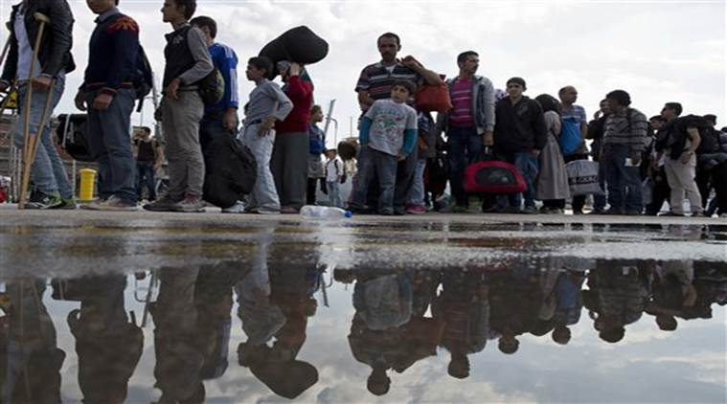
Case 4: Short-Term Work vs. Long-Term Implications
As part of a program in Greece to help refugees from Syria, the XYZ Aid Group provides refugees with cell phones so that they can receive telephone–based counseling from Arabic-speaking social workers who specialize in trauma.
After 2 years of operation, XYZ runs out of funding and can no longer provide social work services.
Photo Source: https://indianexpress.com

Slide 9
Case 5: Oppressive Policies and Social Experiments
Sergei, an American social work, moves to Russia to help develop a government-funded center for at-risk youth.
Sergei discovers that his client records are reviewed by state authorities to identify gay and transgender youth.
The authorities use this information to send the gay and transgender youth to “conversion therapy” camps.
Photo Source: https://www.youtube.com/watch?v=kAWPvI-1790

Slide 10
Case 6: Emergencies
Quincy provides counseling via teleconferencing to clients in Estonia.
One of Quincy’s clients, Kaspar, discloses plans to bomb an abortion clinic (without saying which one).
Kaspar terminates videoconference without notice and does not return Quincy’s calls or messages.
Photo Source: https://www.polkcountyiowa.gov/emergency-management/emergency-preparedness/be-informed/bomb-threats/

Slide 11
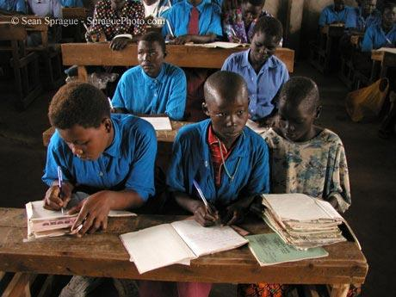
Case 7: Overseas Advocacy
Verna, an American SW working with a humanitarian aid group in South Sudan, has concerns about girls having access to education
Notes girls are more likely to die in pregnancy than to graduate primary school
Verna proposes nonviolent social action to promote education access
Some colleagues accuse Verna of cultural colonialism and chauvinism
Some community members believe education for girls goes against traditional values and religious beliefs
Photo Source: www.SpraguePhoto.com

Slide 12
Approaches to Consider
Cultural humility and responsiveness
Partner, not decide for
Attend to local laws, ethics, values, customs
Negotiate differences
Narrative ethics
Cultural consultants

Slide 13
Conclusion
Image Source: www.clipartpanda.com

Slide 14
References
Barsky, A. E. (2019). Ethics and values in social work: An integrated approach for a comprehensive curriculum (2nd ed.). New York: Oxford University Press.
Barsky, A. E. (2019). Narrative ethics in social work practice. In S. Marson and McKinney, R. (Eds.). The Routledge handbook of social work ethics and values (Chapter 8). New York: Routledge.
Cox, D., & Pawar, M. (2013). International social work: Issues, strategies, and programs (2nd ed.). Thousand Oaks, CA: SAGE.
International Federation of Social Workers (IFSW). (2018). Global social work statement of ethical principles. Retrieved from https://www.ifsw.org/global-social-work-statement-of-ethical-principles
Levin Institute (n.d.). Globalism 101: Issues in depth. Retrieved from http://www.globalization101.org/issues-in-depth

Slide 15
References (continued)
Nadan, Y. (2017). Rethinking cultural competence in international social work. International Social Work, 60(1), 74-83.
National Association of Social Workers. (2018). Code of ethics. Washington, DC: Author. Retrieved from https://www.socialworkers.org/About/Ethics/Code-of-Ethics/Code-of-Ethics-English
National Association of Social Workers (NASW), Council on Social Work Education, Association of Social Work Boards, & Clinical Social Work Association. (2017). Practice standards on social work and technology. Washington, DC: Author. Retrieved from https://www.socialworkers.org/Practice/Practice-Standards-Guidelines
Wilks, T. (2005). Social work and narrative ethics. British Journal of Social Work, 35(8), 1249–1264.

Slide 16
To access this PowerPoint presentation online, please use your cellphone camera to capture this QR Code.

