Slide 1
Narrative Ethics:
A storied approach to managing challenging ethical concerns
Allan Barsky, PhD, JD
Sandler School of Social Work
Florida Atlantic University abarsky@fau.edu
www.barsky.org
BPD Preconference
Workshop
March 18, 2020
10 AM to 4 PM
Birmingham, Alabama

Slide 2
Agenda
10:00-10:30 Introduction to Narrative Ethics (overview,
rational, relation to social work practice
10:30-11:00 Framework for Employing Narrative Ethics
in Practice
11:00-12:00 Applications of Narrative Ethics
(Examples, Demonstration)
Noon Lunch (On own)
1:00-3:30 Experiential Exercises and Role Plays:
Constructing, deconstructing, and
reconstructing stories with embedded
ethical issues
3:30-4:00 Conclusion/Discussion: Opportunities and
Challenges in Applying Narrative Ethics,
Suggestions for SW Educators and key points

Slide 3
“It's like everyone tells a story about themselves inside their own head. Always. All the time. That story makes you what you are. We build ourselves out of that story.”
- Patrick Rothfuss (author)

Slide 4
Introduction: Narrative Ethics
An approach to dealing with ethical concerns by listening, interpreting, and responding to the stories told by clients, co-workers, or other people affected by the situation
Morals and ethics are embedded in stories (helps us understand local context, history, culture)
Encourages us to attend to the unique experiences, stories, emotions, and identities of the people affected by the ethical issues
Deconstruction – exploring assumptions, meanings, and implications of stories
Co-constructing stories – moving forward

Slide 5
History of Narrative Therapy
Michael White (Oz) & David Epston (NZ)
“People Live their Lives by their Stories.”
Principles
Stories capture living experience of individuals and families
Stories rich, complex, explanatory
Stories have power to enrich lives and are inclusive rather than exclusive.
Stories encourage meaning making.
Underlying Theories
social constructionism, feminist theory, literary theory, & critical theory

Slide 6
Contrast with other Approaches to ethics
Legalism
Deontology
Teleology
Virtue Ethics
Narrative Ethics
Relational Responsiveness

Slide 7
ELEMENTS OF STORIES
Voice
Perspective
Audiences
Plot
Character
Conflict
Resolution

Slide 8
Rationale & FIT WITH SW
Starting with the Client
Person-In-Environment
Relationships
(not rules)
Holistic
(avoid reductionism)
Storytelling in practice
Social Histories
Group Work
Incident Reports
Bearing Witness
Supervision
Conflict Res’n

Slide 9
Framework for Employing Narrative Ethics in Practice
Engage others in storytelling – listen actively, validate, clarify
Jointly deconstruct – consider voice, perspectives, characters, plots, key points (moral lessons), assumptions
Identify questions – “How should the story move forward?” “What should we do now concerning…” “What’s the rest of the story?”
Co-construct the future

Slide 10

Applications of Narrative Ethics
Example: Chantal
French Canadian, studied SW in FL
Field placement in Vietnam
Client: Huy, 16,
Late onset Pompe disease – 3 months to live
Learns Dr. Ngo has not told Huy or parents about diagnosis
How would Chantal and Dr. Ngo approach conversation from various ethics approaches: legalism, deontology, teleology, & narrative ethics?

Slide 11
Ethical Issues
Boundary Issues
Interprofessional Conflicts
Professional vs. Personal Values
Gun Rights/Safety
Pro-Life/Pro-Choice
Confidentiality vs. Safety
End-of-Life Decisions
Organizational, Family, Community, Policy conflicts

Slide 12
Barsky Family Story
Generations of boys
Mom’s first pregnancy
Carried to term
Funeral but not allowed to go
No mourning, no SW or counseling
Never to discuss
Stephen - first born
Adelle – “You had a sister”

Slide 13
Narrative Ethics:
Generation to Generation
Think of a story that members of your family have passed down from generation to generation
From whose perspective is the story told?
What can we learn about the characters from the story?
What can we learn about their values, morals, or messages that they would like the next generation to embrace?

Slide 14
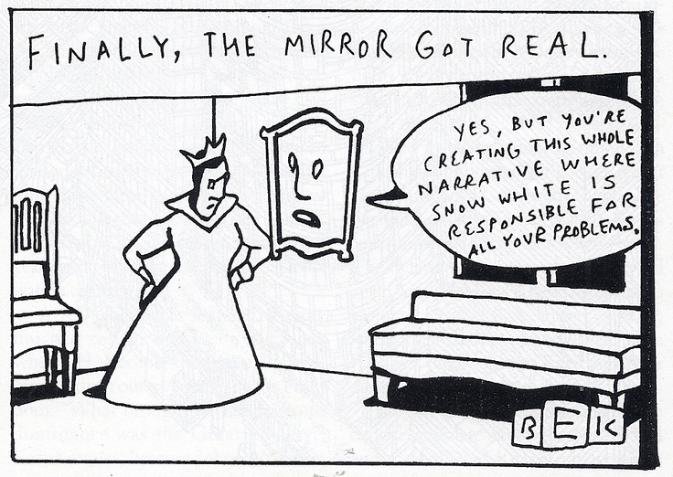
Stories with Moral
What is your favorite…
family story
fairytale
movie
fable
with a moral question or lesson
Perspective: Dorothy / Elphaba

Slide 15

Think of a story that your parents/grandparents often told you when you were growing up
Write 5 key points – the plot
Who were the characters?
What was the story’s lesson?
What assumptions are within the story?
How does culture and location affect the story, its moral questions, and lessons?

Slide 16

Example: MaE
SW works at an agency that provides outreach and support to families with transgender individuals
Mae (22) – Assigned male at birth, identifies as female
Mae’s mother, Elida – believes her “son” is male and should always be male
Mae’s brother, Rodolfo, is getting married and wants both Mae and Elida to attend his wedding
Elida says she will not attend the wedding unless Mae dresses and presents as a man; Mae refuses
SW wants to use narrative ethics to engage the family

Slide 17
Video example
Trauma not Transformed is Trauma Transferred | Tabitha Mpamira-Kaguri | TEDxOakland
https://www.youtube.com/watch?fbclid=IwAR36jJMj_0CJsfT5UdqPenoWoUoabihlbFchct_hIOghjiuChnJTpLU2sPo&feature=youtu.be&v=b4loBphYCXI&app=desktop

Slide 18
Experiential Example
What is the appropriate role of government in society?
Select facilitator – establish ground rules for courageous narrative conversation
Engage in storytelling rather than answering the question directly
How do you identify politically, culturally, and ethnically?
Describe an experience or story that helped to inform your beliefs about the appropriate role of government?
How do your past experiences affect your views about democracy, socialism, capitalism, conservatism, and liberalism?
How does your identity as a social worker affect your political belief system and moral values?

Slide 19
Journaling Exercise
Describe a situation in which you made use of help from another person (e.g., a social worker, clergy, physician, nurse, teacher, mentor).
Describe the boundaries that you and the other person established, including examples that you felt were appropriate or inappropriate.
What made the boundaries appropriate or inappropriate?
How might your perception about the appropriateness of boundaries change depending on the professional role, culture, age, and religion of you and the other person?

Slide 20
COnclusion
Key points
Questions
Additional Resources

Slide 21
Bibliography
Barsky, A. E. (2019). Ethics and values in social work. New York: Oxford University Press.
Barsky, A. E. (2019). Narrative ethics in social work practice. In S. Marson and McKinney, R. (Eds.). The Routledge handbook of social work ethics and values (Chapter 8). New York: Routledge.
Brody, H., & Clark, M. (2014). Narrative ethics: A narrative. Hastings Center Report, 44(1): S7–11.
Halpern, F. (2018). Closeness through unreliability: Sympathy, empathy, and ethics in narrative communication. Narrative, 26(2), 125-145.
Miller, M. (2017). Narrative research: Discoveries in listening to clinical-scholars’ experiences of working across trauma and loss. In A. Burack-Weiss, L. S. Lawrence, & L. B. Mijanos. (Eds.). Narrative in social work practice: The power and possibility of story (pp. 213-233). New York: Columbia University Press.

Slide 22
Phelan, J. (2014). Narrative ethics. The living handbook of narratology. Retrieved from http://www.lhn.uni-hamburg.de/article/narrative-ethics
Porz, R., Landeweer, E., & Widdershoven, G. (2011). Theory and practice of clinical ethics support services: Narrative and hermeneutical perspectives. Bioethics, 25(7): 354–360.
Reamer, F. G. (2018). Social work values and ethics (5th ed.). New York: Columbia University Press.
Slote, M. (2007). The ethics of care and empathy. New York: Routledge.
Stevenson, S. (2016). Toward a narrative ethics: Indigenous community-based research, the ethics of narrative, and the limits of conventional bioethics. Qualitative Inquiry, 22(5), 365-376.
Wilks, T. (2005). Social work and narrative ethics. British Journal of Social Work, 35, 1249–1264.

