Slide 1
Technological Justice: Ethical Issues and Responses
Allan Barsky, JD, MSW, PhD Florida Atlantic University Sandler School of Social Work abarsky@fau.edu CSWE APM, Nov. 7, 2021 @ 10 AM

Slide 2
Learning Objectives:
Explain
Explain the concept of technological justice, including examples of technological injustices that may affect individuals, families, groups, organizations, and communities.
Assess
Assess ethical issues that may arise when clients, families, groups, organizations, and communities do not have equitable and reasonable access to technology.
Develop
Develop options to promote technological justice, including ways to address specific problems in access to technology.

Slide 3
Agenda
Definition of Technological Justice
Tech to Promote Justice
Tech Injustices
Access
Exclusion
Unintended Effects
Social Work Ethics & Responses
Questions and Key Points

Slide 4
Definition: Technological Justice
Fairness or equity regarding
access to, and
impacts of
technology as used by individuals, families, groups, communities, organizations, and society
Consider: benefits, risks, costs
(Ortega et al., 2018).

Slide 5
SW Value of “Social Justice” vs. “Technological Justice”
Relationships with People
Relationships with Technology

Slide 6
Tech to Promote Social Justice (COE Part 6)
What types of tech can we used to:
Build coalitions
Educate
Mobilize
Advocate for social justice in distribution of resources

Slide 7
Tech Injustices
1. Lack of access to tech
affects ability to acquire:
Good education
Jobs
Housing
Food information
Other needs
(Hermann, 2019)

Slide 8
Tech Injustices
Exclusion from tech dehumanizes by:
inhibiting relationships with family, friends, and other social systems (Alonso, 2016)

Slide 9
Tech Injustices
Negative / Unintended Impacts of Tech:
Pollution
Misinformation
Hate speech
Business monopolies
(vulnerable populations tend to suffer most)

Slide 10
What are the pros and cons of “Telemental Health”? Who benefits? Who doesn’t?

Slide 11
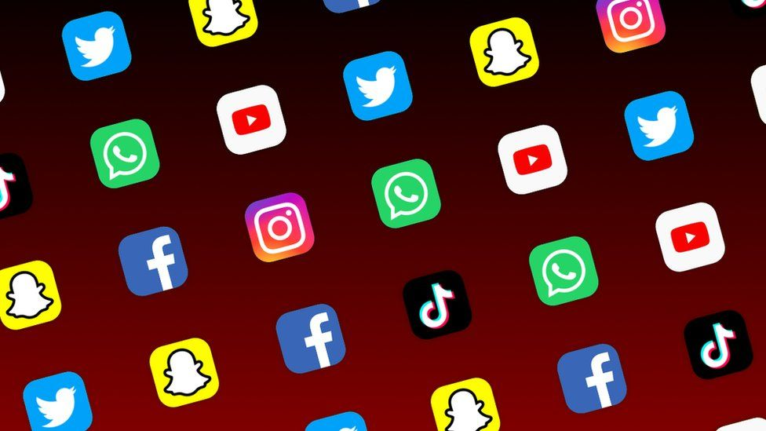
Who benefits and who suffers from social media?

Slide 12
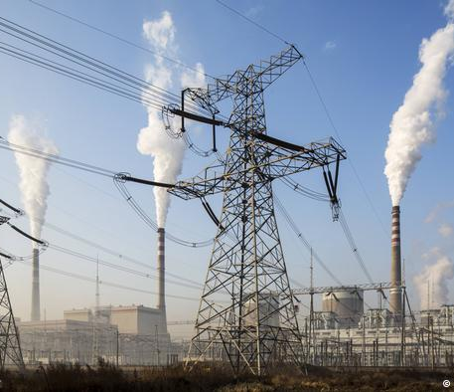
How are different groups affected differently by specific types of power plants: nuclear, hydroelectric, coal… ?

Slide 13
How might today’s tech affect future generations?
Global climate change
Employment
Quality of life
Health disparities
(Indigenous peoples: 7 generations)

Slide 14
SW Response to Tech Injustices
Psychosocial assessments should address access to and the impacts of technology on individuals, families, groups, or communities (BPD Technology Committee, 2018).

Slide 15
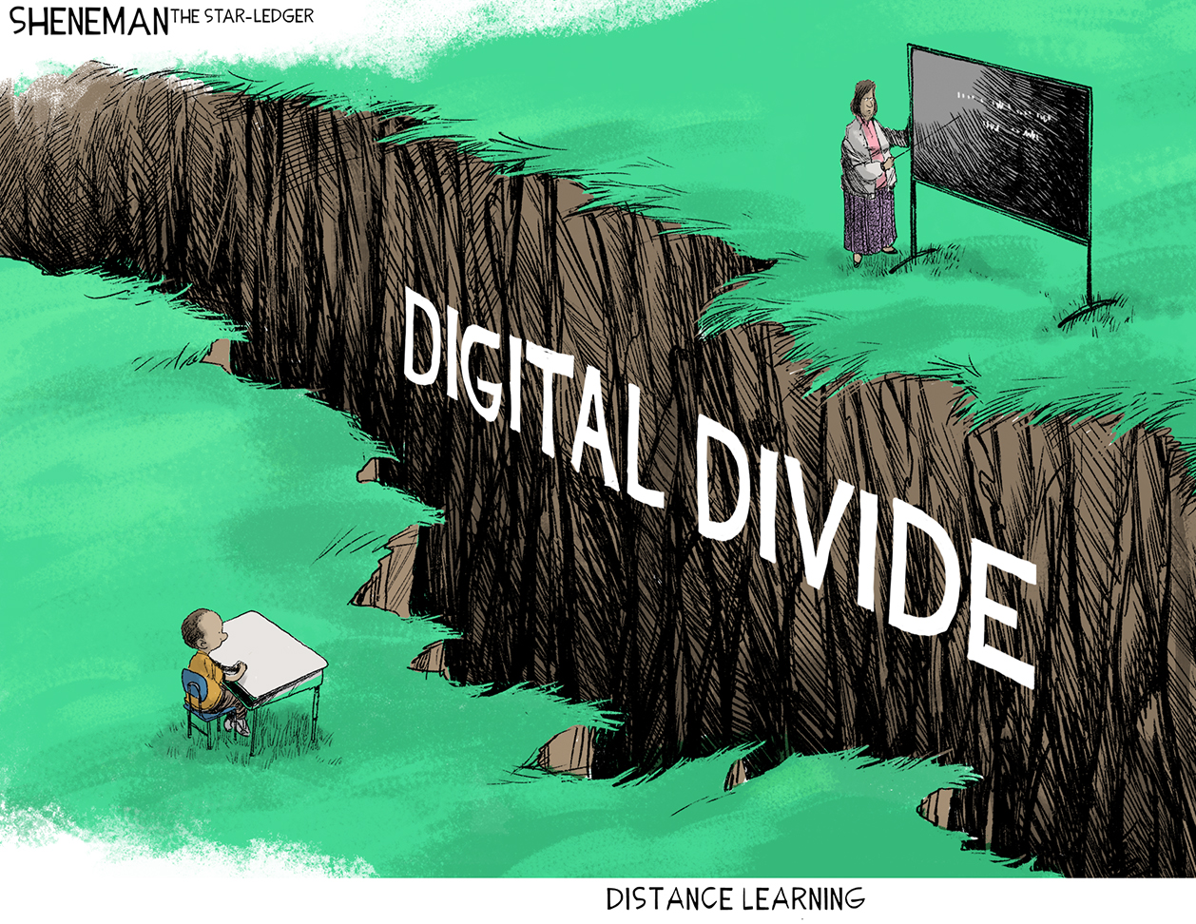
How can we address digital divides related to:
Socioeconomic status
Age
Race and ethnicity
Rural / urban location
Disability

Slide 16
SW Value: Access How can we ensure true access to health, mental health and SW services that require tech?

Slide 17
How to we ensure AI and Algorithms do not have discrimination embedded…
Child abuse risk assessments
Facial recognition
Problem-solving programs
CBT apps

Slide 18
How do we address “transitional” injustices with new tech?
Social innovation – disruptive
Affects employment, social support, ways people interact
Wealthy and educated benefit first
Vulnerable populations may “resist” access
Consider: voice, fair opportunity, transitional support

Slide 19
Questions & Key Points

Slide 20
References:
Alonso, D. (2016). Social work and technology: Acceptance and use among professionals in training. Doctoral dissertation (translated from Spanish). Universidad Complutense de Madrid.
BPD Technology Committee. (2018). Technology assessment checklist for social work practice. https://figshare.com/articles/BPD_Technology_Committee_s_Technology_Assessment_Checklist_For_Social_Work_Practice_Version_2_/7267598
British Association of Social Workers (BASW). (2020). Digital capabilities: Ethical considerations. https://www.basw.co.uk/digital-capabilities-ethical-considerations
García, S. A. (2020). Analysis of digital technologies to benefit the professional practice of family mediators in Chile. Revista deRecho Privado (Private Law Magazine), 39, 33-60.
Glen, L. (2020). Artificial intelligence: How social work input shapes social impact. Social Work Advocates. https://www.socialworkers.org/News/Social-Work-Advocates/2020-June-July/Artificial-Intelligence
Goldkind, L., Wolf, L., & Freddolino, P. (2018). Digital social work: Tools for practice with individuals, organizations, and communities. Oxford University Press.
Hermann, J. (2019). Technological justice. Justice everywhere. http://justice-everywhere.org/international/technological-justice/

Slide 21
References (continued):
International Federation of Social Workers (IFSW). (2018). Global social work statement of ethical principles. https://www.ifsw.org/global-social-work-statement-of-ethical-principles
Leonhard, G. (2016). Technology vs. human: The coming clash between man and machine. Fast Future Publishing.
National Association of Social Workers (NASW) (2021). Code of ethics. https://www.socialworkers.org/About/Ethics/Code-of-Ethics/Code-of-Ethics-English
National Association of Social Workers (NASW), Council on Social Work Education, Association of Social Work Boards, and Clinical Social Work Association. (2017). Standards for technology and social work practice. https://www.socialworkers.org/Practice/Practice-Standards-Guidelines
Ortega, A., Pérez, F., & Turianskyi, Y. (2018). Technological justice: A G20 agenda. Kiel Institute for the World Economy. http://www.economics-ejournal.org/economics/discussionpapers/2018-58
Steiner, O. (2020). Social work in the digital era: Theoretical, ethical, and practical considerations. British Journal of Social Work, 51, 1-19. https://doi.org/10.1093/bjsw/bcaa160
Yanardağ, U. (2020). Teknoloji ve sosyal çalışma mesleği (Technology and social work profession). Mehmet Akif Ersoy University, Turkey (Conference Paper). https://www.researchgate.net/publication/342549483

