Slide 1
Professional Boundaries and Dual Relationships in Rural Social Work: Challenges and Opportunities
Allan Barsky, PhD, JD
Florida Atlantic University
allanbarsky@gmail.com
Michael Daley, PhD
Texas A & M University - Central Texas
mdaley@tamuct.edu
BPD Conference in New Orleans
February 28, 2026 at 12:30 to 1:45 PM in Oak Alley Room
Notes:
Allan
Welcome, Objectives, and Framing the Session
Brief overview of goals
Why rural boundary issues matter for social work education
Abstract: This presentation examines the ethical challenges regarding maintenance of appropriate professional boundaries and navigating dual relationships when working in rural communities. In these settings—where multiple connections are commonplace and where authenticity and informality are highly valued—balancing professional obligations and community norms requires critical self-awareness and proactive strategies.
Proposal text (500-word maximum)
This interactive workshop utilizes a case-based approach to explore ethical challenges that social workers may encounter in rural practice, particularly when striving to maintain appropriate boundaries and manage dual relationships. While recognizing the special challenges of rural practice, this session also highlights the strengths and positive opportunities of practicing in this context. Rather than focusing solely on how to mitigate risks in rural practice, we will use practice-based situations to explore strategies that maximize potential in rural communities.
The nature of what is ethical or appropriate in social work practice depends on the context (Strom, 2023). Rural settings differ from urban environments in their cultural norms. In rural communities, people tend to value informality and authenticity in professional relationships (Bosch & Boisen, 2011; Author, 2021). Being more authentic may mean sharing more personal information with clients. However, maintaining appropriate professional boundaries could also mean being more judicious about self-disclosure, balancing cultural expectations with the profession’s ethical standards.
To help social work students appreciate the nature of appropriate boundaries in a rural context, it is important to help them focus on social work’s core values, including access to services, human relationships, integrity, and respect for the dignity and worth of all people (National Association of Social Workers [NASW], 2021a). Although the NASW Code of Ethics suggests avoiding dual relationships, social workers in rural practice need to understand how dual relationships are often unavoidable in their context of practice. Accordingly, this presentation will highlight ways of managing dual relationships rather than simply assuming that dual relationships can be avoided altogether.
This presentation highlights the importance of a collaborative approach to managing ethical issues with rural clients (Author, 2023). Rather than simply “deciding what is ethical for clients,” this approach emphasizes having good conversations with clients to determine jointly how to manage concerns related to the risks of dual relationships, maintaining confidentiality, and ensuring access to appropriate, effective services.
In terms of linkages to the APM conference theme, “It’s Time to Act: Championing Disability Justice and Disability Joy in Social Work,” the proposed workshop will address people with disabilities in relation to intersectional identities and concerns related to access to services in small, remote, or rural communities. The case studies will include situations involving people who with various types of disabilities, including blindness, learning disabilities, and mobility-related disabilities (Slayter et al., 2023).
This presentation celebrates the unique aspects of rural social work practice, challenging assumptions that it is inherently riskier or less ethical than urban practice (Author, 2025). Instead, it highlights how social workers can respect and embrace rural culture while upholding professional values and ethical principles.
Upon completion of this session, participants will be able to:
1. Describe ways in which social work in rural settings is different from practice in urban settings.
2. Identify ethical challenges in relation to navigating dual relationships and maintaining appropriate boundaries when practicing in rural contexts.
3. Educate students about ways of effectively navigating social worker-client boundaries in small, close-knit communities where avoiding dual relationships may be unavoidable.
Professional boundaries and dual relationships in rural social work: Challenges and opportunities
Format: Workshop
Date: Saturday, 2/28
Time: 12:30p-1:45p
Location: Gallier AB

Slide 2
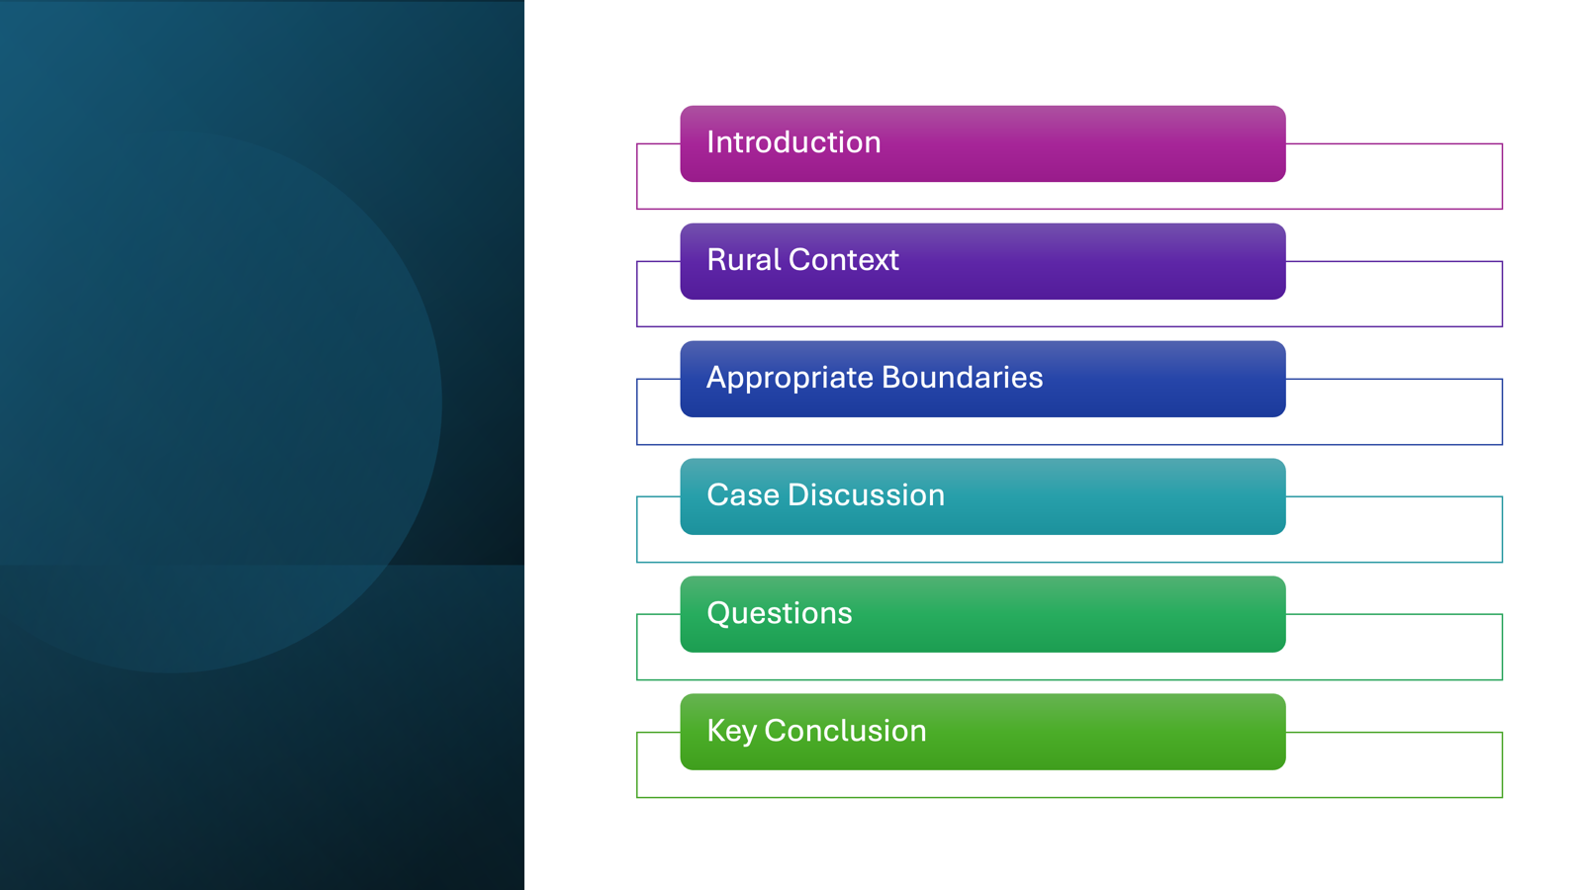
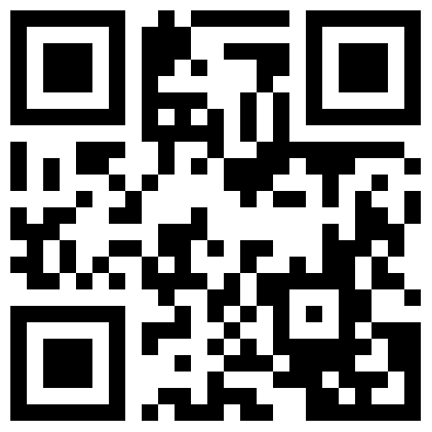
Agenda
Barsky & Daley, 2026 - 14-Feb-26
Notes:
Relate topic to conference theme: “Keep Moving - The Best is Yet to Come” Agenda - Introduction (Rationale, Key Concepts), The Rural Context, “Appropriate Boundaries,” Case Discussion, Questions, Conclusion
Introduction of speakers

Slide 3
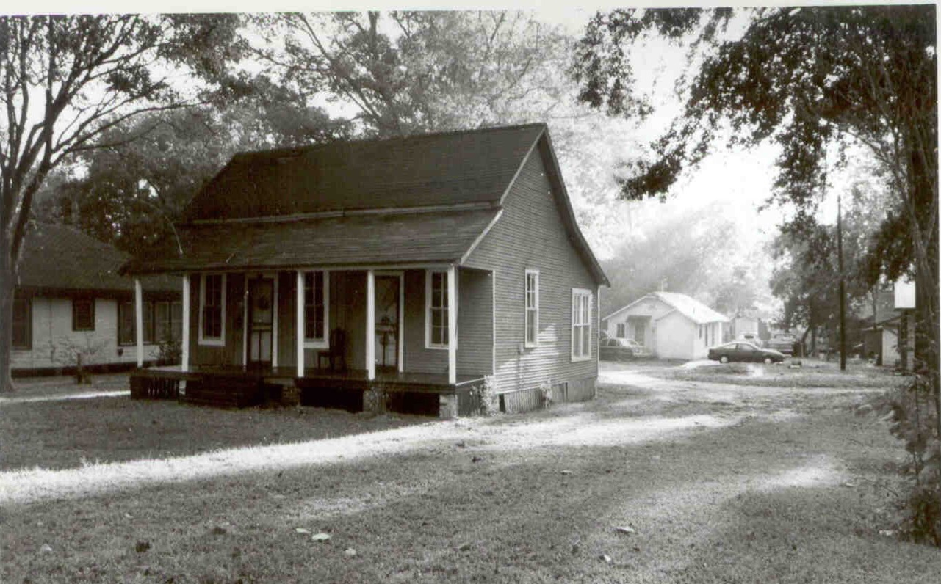
The Rural Context(s)
Notes:
Mike - discuss different types of rural contexts (geography, cultures, migration, socioeconomic factors… )
Relevance of SOWK ethics to rural social work
Obviously, we teach SOWK ethics as part of Competency 1
Rural people (and potential clients) are an underrepresented minority (18-19%) or 50-60 million people
Rural communities have lower incomes, more substandard housing, are older, and have worse access to health and behavioral health
But social work is & has been an urban profession
The ethics we teach tend to be for urban practice
So why are we discussing this topic here at BPD?
From the 1960s through the 1980s BSW education & rural social work practice developed an association
They both felt neglected by mainstream social work and the two groups often worked together for things like generalist practice

Slide 4
Ethics of Professional Boundaries - COI’s
NASW COE 1.06(a) Conflicts of Interest
Social workers should be alert to and avoid conflicts of interest that interfere with the exercise of professional discretion and impartial judgment. Social workers should inform clients when a real or potential conflict of interest arises and take reasonable steps to resolve the issue in a manner that makes the clients’ interests primary and protects clients’ interests to the greatest extent possible. In some cases, protecting clients’ interests may require termination of the professional relationship with proper referral of the client.
Barsky & Daley, 2026 - 14-Feb-26
Notes:
Allan
4. Ethical Foundations for Rural Practice
Core social work values in the NASW Code of Ethics
Contextual ethics (Strom, 2023)
Balancing integrity, dignity, access to services, and community realities

Slide 5
Ethics of Professional Boundaries - Dual Relationships
1.06 (c) Social workers should not engage in dual or multiple relationships with clients or former clients in which there is a risk of exploitation or potential harm to the client. In instances when dual or multiple relationships are unavoidable, social workers should take steps to protect clients and are responsible for setting clear, appropriate, and culturally sensitive boundaries.
Barsky & Daley, 2026 - 14-Feb-26
Notes:
Allan

Slide 6
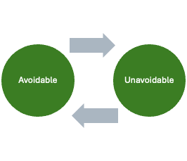
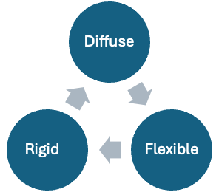
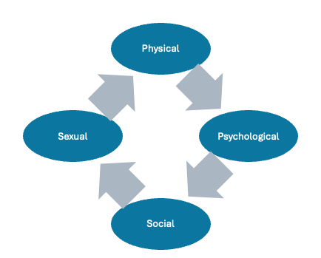
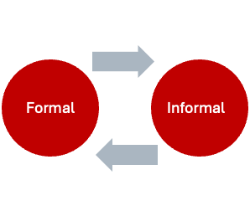
Types of Boundaries
Barsky & Daley, 2026 - 14-Feb-26
Notes:
Allan - Types of boundaries - physical, psychological, social (dual relationships), and sexual Diffuse, flexible, rigid Avoidable vs. Unavoidable conflicts Formal, Informal

Slide 7
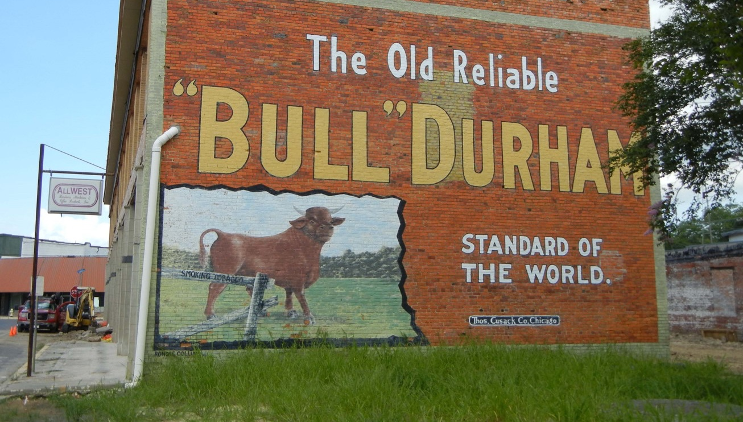
Rural Social Work: Myths and Realities
Small, close-knit communities (inter-connectedness)
Rural norms
Everybody knows everybody
Authenticity
Informality
Lack of alternative professionals
Avoidable and unavoidable dual relationships
Is rural practice inherently riskier than urban practice?
Barsky & Daley, 2026 - 14-Feb-26
Notes:
Mike - The Rural Context
2. Understanding the Rural Context
Cultural norms: informality, authenticity, interconnectedness
Community expectations vs. professional expectations
Strengths of rural living and rural practice
The boundaries we talk about in ethics have to do with the types of relationships in the helping process.
In a social work relationship maintaining boundaries is important
The issue for rural social work is that the expectations for relationships is different than in larger cities
This makes managing ethical boundaries and practice very important

Slide 8
Reframing Boundaries in Rural Practice
Rural communities view personal relationships as important
But SWs need to maintain professional boundaries
But those boundaries may not be as formal as in urban areas
Rural areas may see stiff & formal relationships as rude
Especially with someone they don’t know, formality breeds distrust
So, we may need to create boundaries in culturally appropriate ways
A key element in these relationships is: protect clients from exploitation and harm
While still offering culturally appropriate, effective services
Barsky & Daley, 2026 - 14-Feb-26
Notes:
Mike
3. Reframing Boundaries and Dual Relationships
What “appropriate boundaries” mean in rural vs. urban settings
Why dual relationships are often unavoidable
Myths about “boundary violations” in rural practice

Slide 9
Framework for Managing Ethical Issues
Identify ethical issue
Access help
Use critical thinking
Manage conflict
Plan and implement decision
Evaluate and follow up
(Barsky, 2023)
Barsky & Daley, 2026 - 14-Feb-26
Notes:
Barsky

Slide 10
Collaborative Ethical Decision-Making With Clients
Many ethical issues can be resolved by informed consent
Engage clients in collaborative conflict resolution
Identify needs interests (safety, respect, effective services, reducing risks, maintaining privacy…)
Brainstorm options
Jointly select options that satisfy most important needs and interests
Barsky & Daley, 2026 - 14-Feb-26
Notes:
Allan
6. Collaborative Ethical Decision-Making With Clients
Moving from “deciding for” to “deciding with”
Transparency, informed consent, and shared risk assessment
Culturally responsive conversations with clients about boundaries

Slide 11
Relevant Social Work Values
Access to services
Human relationships
Integrity
Respect for the dignity and worth of all people
Value Conflicts
SW
Client
Agency - Coworkers, Supervisees, Educators/Students
Community
Barsky & Daley, 2026 - 14-Feb-26
Notes:
Mike

Slide 12
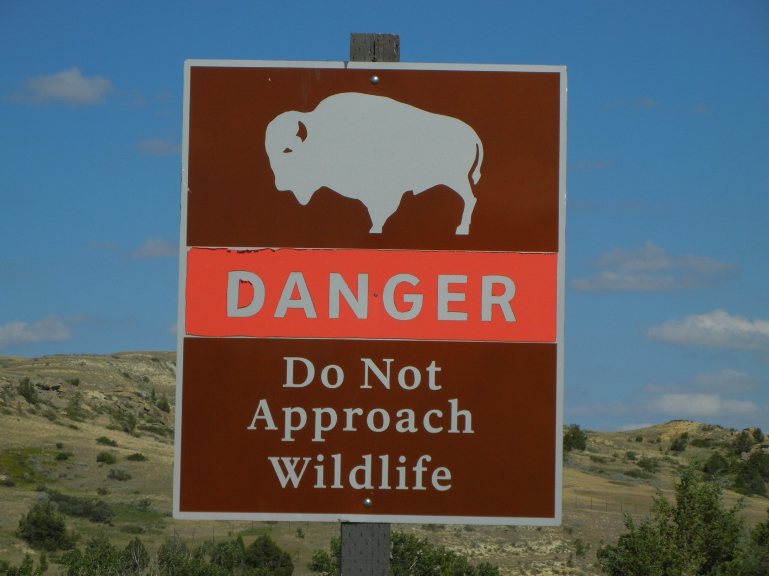
Ethical Challenge: Social Worker - Client Boundaries
Sandy (SW) in a small community works as a child welfare worker
Sandy is assigned to investigate potential neglect by her neighbors, Jeanette and Clarence
Sandy is the only child welfare worker in the county.
What ethical issues does this situation raise?
Barsky & Daley, 2026 - 14-Feb-26
Notes:
Mike
5. Case-Based Exploration of Boundary Dilemmas
Everyday dilemmas involving overlapping roles
Managing personal visibility and self-disclosure
Confidentiality challenges in close-knit communities
Cases involving practitioners/clients, supervisors/supervisees, prof/student, coworkers, group members

Slide 13
Ethical Challenge - Supervisor-Supervisee Boundaries
Hugo (supervisor) is working with a practicum student, Shelley.
During high school Hugo and Shelley dated (8 years ago).
Hugo still has feelings for Shelley, but they are not currently dating.
Few alternatives for practicum placements (or alternative supervisors) in the community.
Types of boundary concerns?
Suggestions for managing boundary or dual relationship issues?
Barsky & Daley, 2026 - 14-Feb-26
Notes:
Allan
Possibility of online supervision; unavoidable dual relationship?

Slide 14
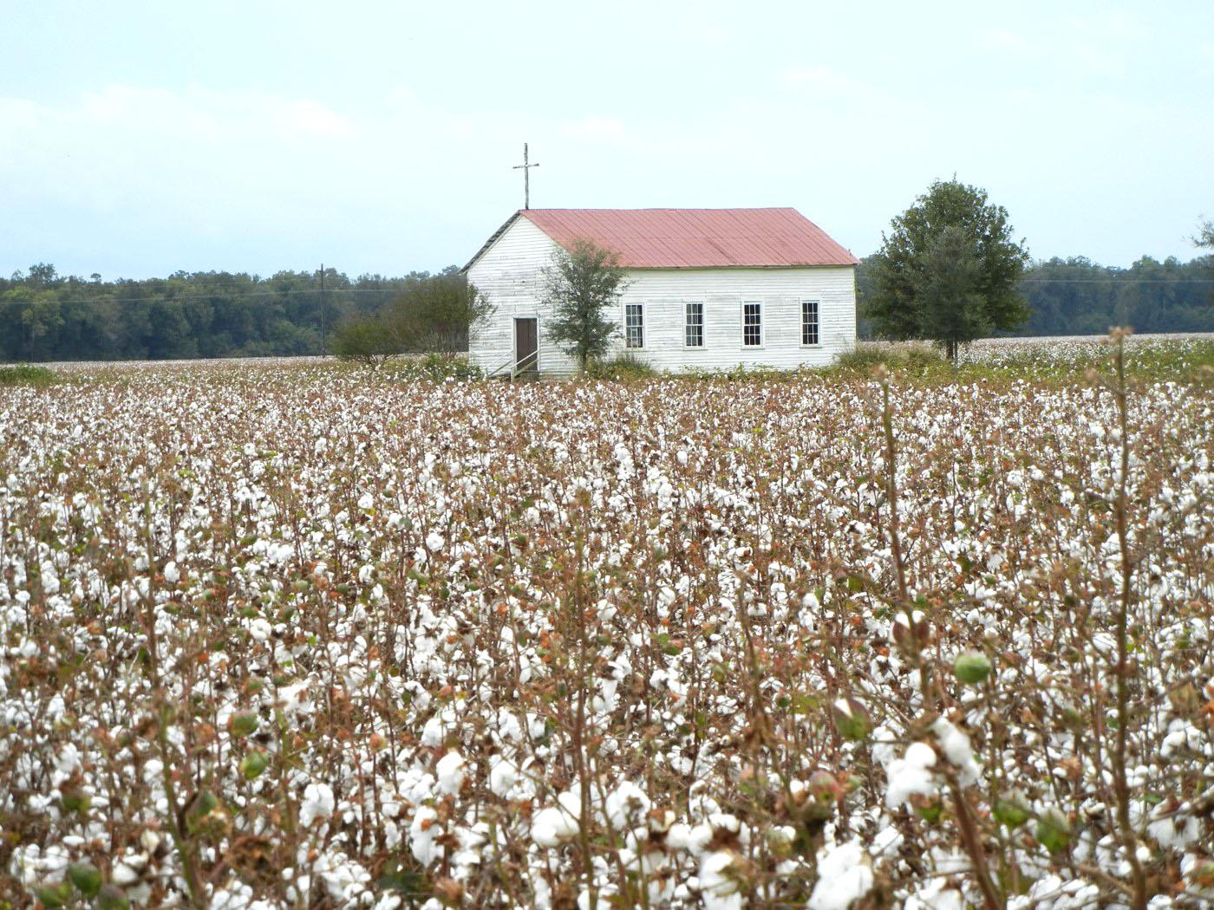
Ethical Challenge: SW Prof-Student Boundaries
A professor in private practice is approached by a student
The student (retired military) discloses having a mental health issue (PTSD)
The student asks the professor for assistance from the prof.
The community is small and doesn’t have many clinicians that deal with PTSD issues.
How should the professor respond?
What roles are appropriate/inappropriate?
Barsky & Daley, 2026 - 14-Feb-26
Notes:
Mike -

Slide 15
Ethical Challenge - Coworker Boundaries
Gabby and Estrella are coworkers in SW department of the hospital.
The hospital does not have a policy about dating among employees.
Gabby and Estrella have started dating but do not want to tell anyone about this relationship.
Any ethical issues re boundaries or dual relationships?
Does it matter that the couple is lesbian and the community may not “approve”?
Barsky & Daley, 2026 - 14-Feb-26
Notes:
Allan
Don’t find your honey where you make your money.

Slide 16
Ethical Challenge - Boundaries between Group Members
SUDs group designed for clients referred by Problem-Solving Courts (Drug Court)
Two group members, Hal and Adina, know each other as neighbors in a small town - children go to school together; members of same church
Is it ethical for them to be in the same group? Why/why not?
Who decides? How?
What are the risks if they are in the same group?
Barsky & Daley, 2026 - 14-Feb-26
Notes:
Mike Each know each other’s drug issues - rural people “do talk”

Slide 17
Mitigating Risks re Dual Relationships and Informal Boundaries
Identify boundary and dual relationship risks early
Discuss concerns openly with clients
Brainstorm options to maximize benefits and minimize risks
Work toward collaborative solutions
Document: concerns, options, consultations, agreements, monitoring
When in doubt, refer out
Barsky & Daley, 2026 - 14-Feb-26
Notes:
Allan
7. Managing the Practical Realities
Strategies for navigating unavoidable dual relationships
Setting expectations early
Documentation and consultation
The role of supervision (including remote supervision models)

Slide 18
Preparing Students for Rural Practice & Boundary Concerns
Teach students about mindfulness and cultural humility (understanding self and community context)
Provide students with strategies for ethical practice: cultural guide / mentor, know alternate resources, how to build trust in community
Use case studies to teach contextual ethics
Encourage students to focus on strengths and best practices in rural SW (not just risks or problems)
Barsky & Daley, 2026 - 14-Feb-26
Notes:
Mike
9. Preparing Students for Ethical Rural Practice
Pedagogical strategies for BSW/MSW classrooms
Using case studies to teach contextual ethics
Helping students reduce fear and build confidence in rural settings
Strength-based perspectives
Relationship-building as a community asset
Challenging urban-centered assumptions about “best practice”
Quick ethical reasoning exercise based on a mini-case

Slide 19
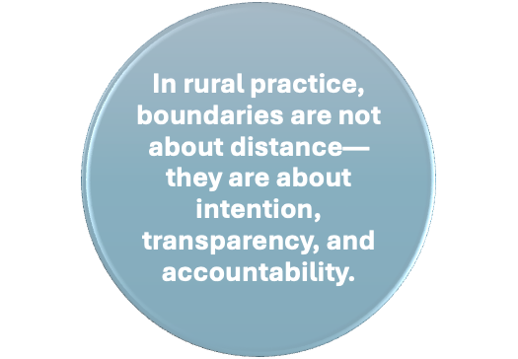
Conclusion
Barsky & Daley, 2026 - 14-Feb-26
Notes:
Allan
12. Key Takeaways and Closing
Practical strategies
Final reflections
Resources for faculty and students (reference list)
When in doubt:
• Pause
• Consult
• Document
• Return to client well-being
“Ethical practice is not about avoiding risk, but about managing risk with integrity.”
— Frederic Reamer (adapted)

Slide 20
References
Barsky, A. E. (2025). Professional boundaries and dual relationships in rural social work: Challenges and opportunities. In M. Daley & P. Pitman-Munke (Ed.), Back home: Opportunities and challenges of social work with rural communities (pp.53-80). Oxford University Press.
Barsky, A. E. (2023). Essential ethics for social work practice. Oxford University Press.
Beauchamp, T. L., & Childress, J. F. (2019). Principles of biomedical ethics (8th ed.). Oxford University Press.
Bosch, L., & Boisen, L. (2011). Dual relationships in rural areas. In L. Ginsberg, L. (Ed.), Social work in rural communities (5th ed., pp. 111-123). CSWE Press.
Daley, M.R. (2021). Rural Social Work in the 21st Century: Serving Individuals, Families & Communities in the Countryside. Oxford.
DeCino, D., Waalkes, P., & Iverson, V. (2023). Rural school counselors’ experiences with dual relationships. Journal of Child and Adolescent Counseling. https://doi.org/10.1080/23727810.2023.2195229
Dewane, C. J. (2010). Respecting boundaries – The don’ts of dual relationships. Social Work Today, 10(1), 18. https://www.socialworktoday.com/archive/012610p18.shtml
Dorton, K. (2011). Global access and rural inclusion in information and communication technology. In L. Ginsberg, L. (Ed.), Social work in rural communities (5th ed., pp. 67-85). CSWE Press.
Halverson, G., & Brownlee, K. (2010). Managing ethical considerations around dual relationships in small rural and remote Canadian communities. International Social Work, 53(2), 247–260. https://doi.org/10.1177/0020872809355386
Hepworth, D. H., Der Vang, P., Blakey, J. M., Schwalbe, C., Evans, C., Rooney, R., Dewberry Rooney, G., & Strom, K. (2023). Direct social work practice: Theory and skills (11th ed.). Cengage.
Barsky & Daley, 2026 - 14-Feb-26

Slide 21
References (continued)
Jeffery, B., & Novik, N. (Eds.) (2022). Rural and northern social work practice: Canadian perspectives. University of Regina. https://opentextbooks.uregina.ca/ruralandnorthernsocialworkpractice
Landsman, M. J., & Rathman, D. (2023). Rural challenges in social work regulation. Research on Social Work Practice, 33(1), 121–131. https://doi.org/10.1177/10497315221118360
National Association of Social Workers [NASW]. (2021a). Code of ethics. https://www.socialworkers.org/About/Ethics/Code-of-Ethics/Code-of-Ethics-English
National Association of Social Workers [NASW]. (2021b). Rural social work. Social Work Speaks (12th ed., pp. 287-292). NASW Press.
Newcomb, M. (2022). Supportive social work supervision as an act of care: A conceptual model. British Journal of Social Work, 52(2), 1070-1088. https://doi.org/10.1093/bjsw/bcab074
Pugh, R. (2008). Dual relationships: Personal and professional boundaries in rural social work. British Journal of Social Work, 37(8), 1405-1423. https://doi.org/10.1093/bjsw/bcl088
Reamer, F. G. (2012). Eye on ethics: Managing boundaries in small communities. Social Work Today. https://www.socialworktoday.com/news/eoe_012712.shtml
Reamer, F. G. (2023). Risk management in the behavioral health professions: A practical guide to preventing malpractice and licensing board complaints. Columbia University Press.
Barsky & Daley, 2026 - 14-Feb-26

Slide 22
References (continued)
Riebschleger, J. (2007). Social workers’ suggestions for effective rural practice. Families in Society, 88(2), 203–213. https://doi.org/10.1606/1044-3894.3618
Saskatchewan Association of Social Workers. (2020). Standards of practice for registered social workers in Saskatchewan. https://www.sasw.ca/document/5075/Approved%20Standards%20Document%20eff%20March%201%202020.pdf
Scales, T. L., Streeter, C., & Cooper, H. S. (Eds.) (2014). Rural social work: Building and sustaining community capacity (2nd ed.). Wiley.
Slayter, E., Kattari, S., Yakas, L., Singh, R., Goulden, A., Taylor, S., Wernick, L., Simmons, L., Prince, D. (2023). Beyond ramps, curb cuts, and captions: A call for disability justice in social work. Social Work, 68(1), 89–92. https://doi.org/10.1093/sw/swac045
Strom, K. (2023). Straight talk about professional ethics. Oxford University Press.
Varela, S., Hays, C., Knight, S., & Hays, R. (2021). Models of remote professional supervision for psychologists in rural and remote locations: A systematic review. Australian Journal of Rural Health, 29, 211-225. https://doi.org/10.1111/ajr.12740
Yurach, W. W., Lavallie, C., & Ramsden, V. R. (2022). Practice competencies to effectively support wellness for social workers and clients in northern Saskatchewan communities. In Jeffery, B., & Novik, N. (Eds.). Rural and northern social work practice: Canadian perspectives (pp.58-74). University of Regina. https://opentextbooks.uregina.ca/ruralandnorthernsocialworkpractice
Barsky & Daley, 2026 - 14-Feb-26

