Slide 1


Slide 2
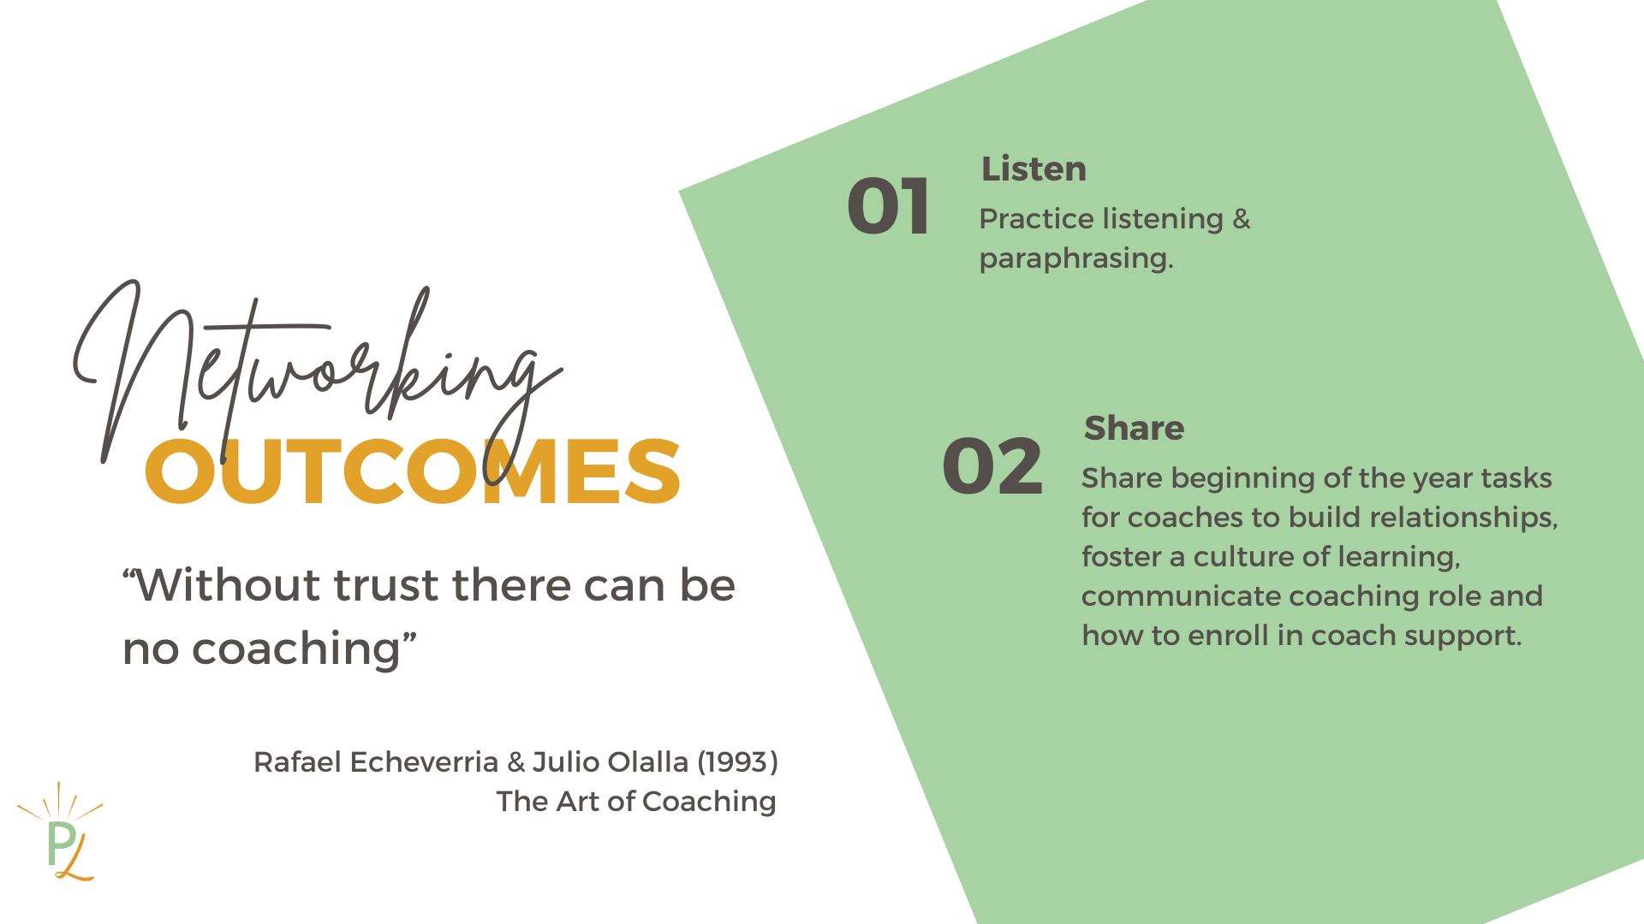

Slide 3
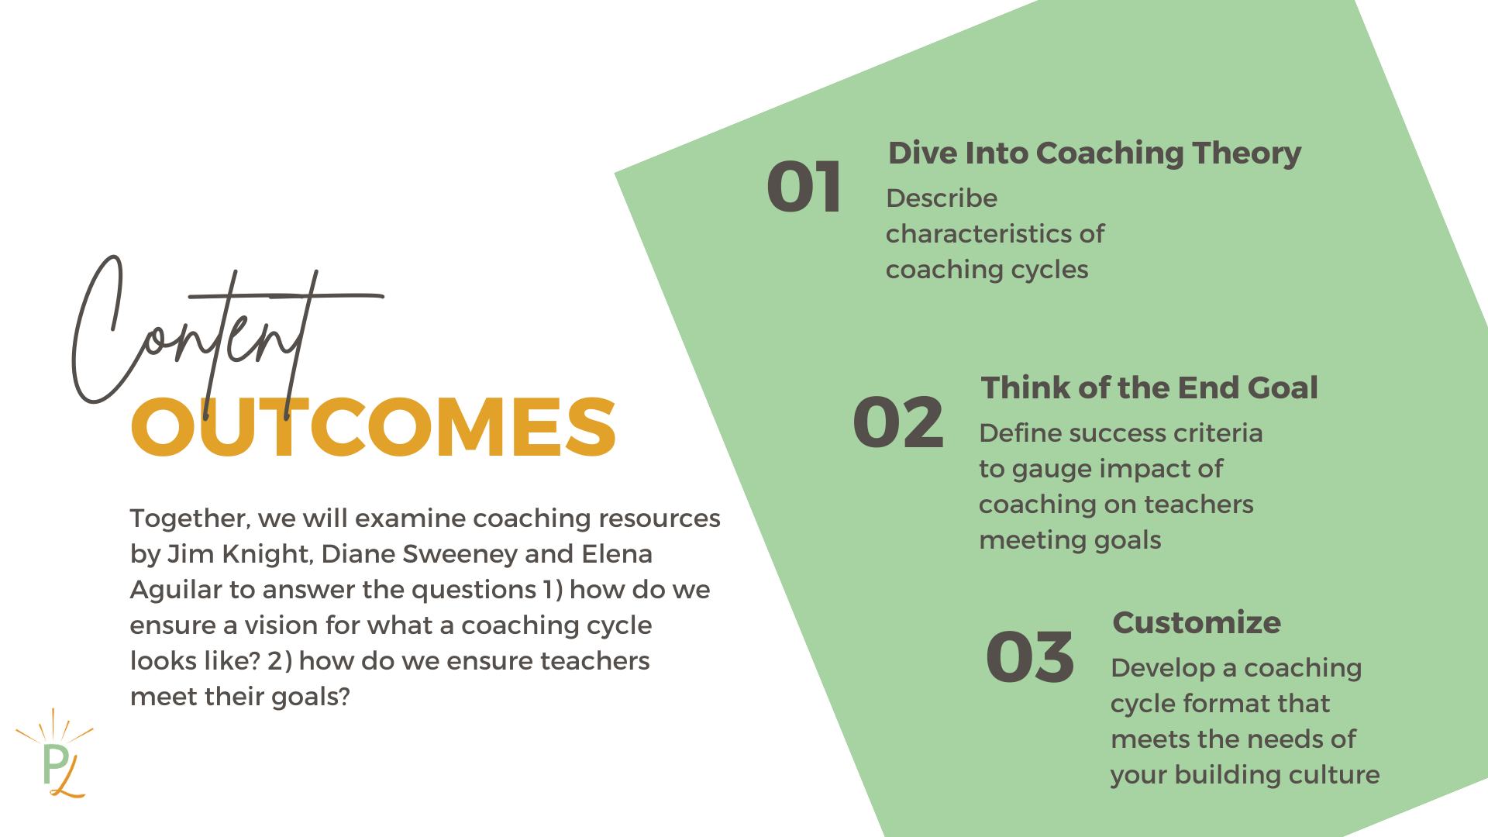

Slide 4
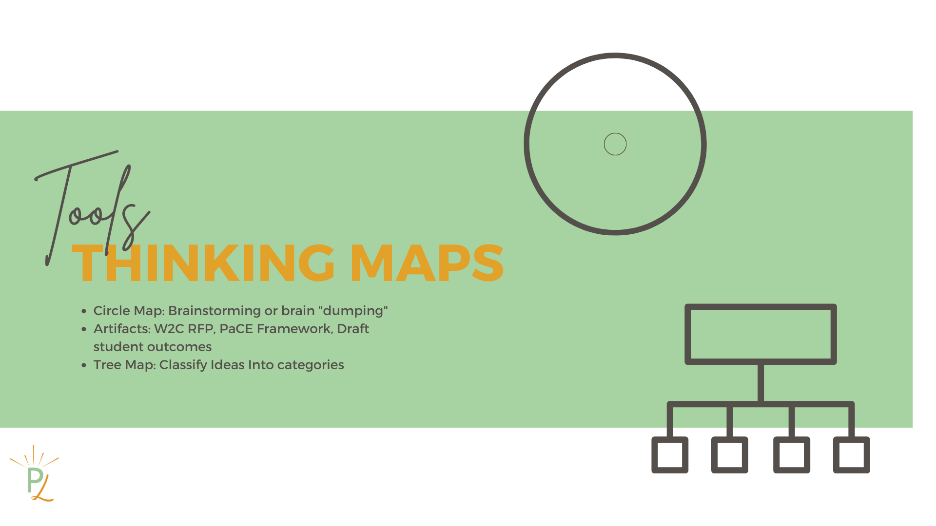
Circle Map: “brain dump” all of your thoughts before goal setting
Tree Map: classify characteristics of coaching using Aguilar, Knight & Sweeney resources

Slide 5

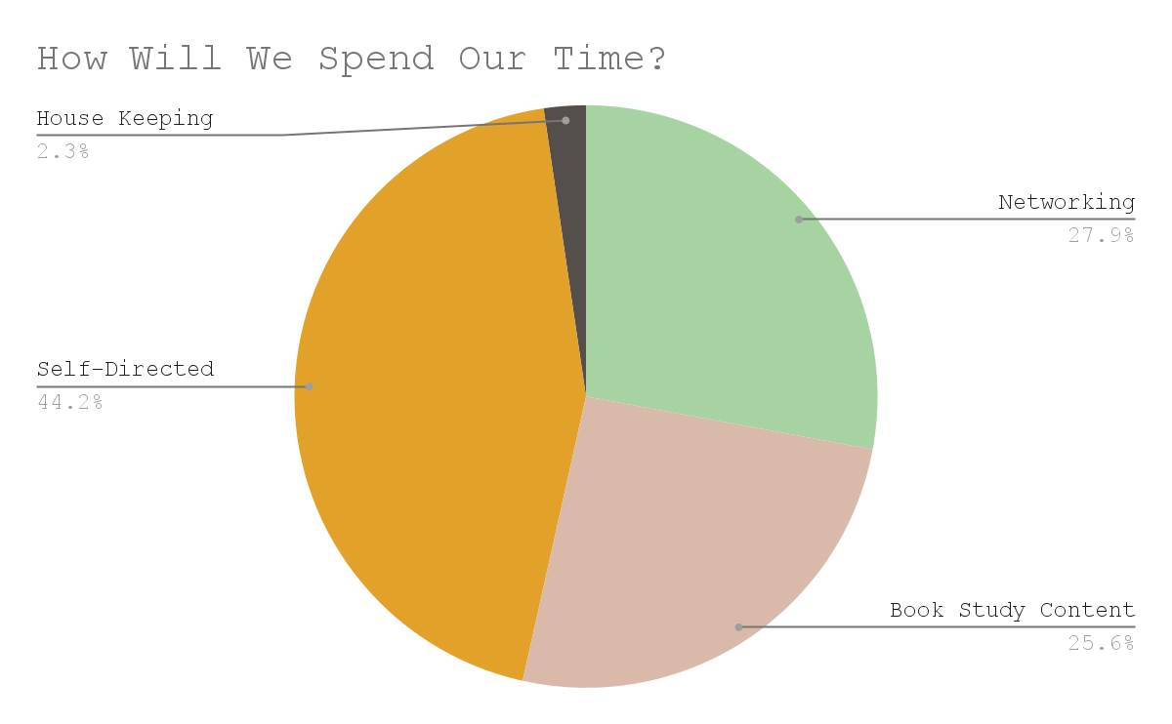
Notes:
Note about bathrooms, snacks, personal breaks, sign-in sheets

Slide 6
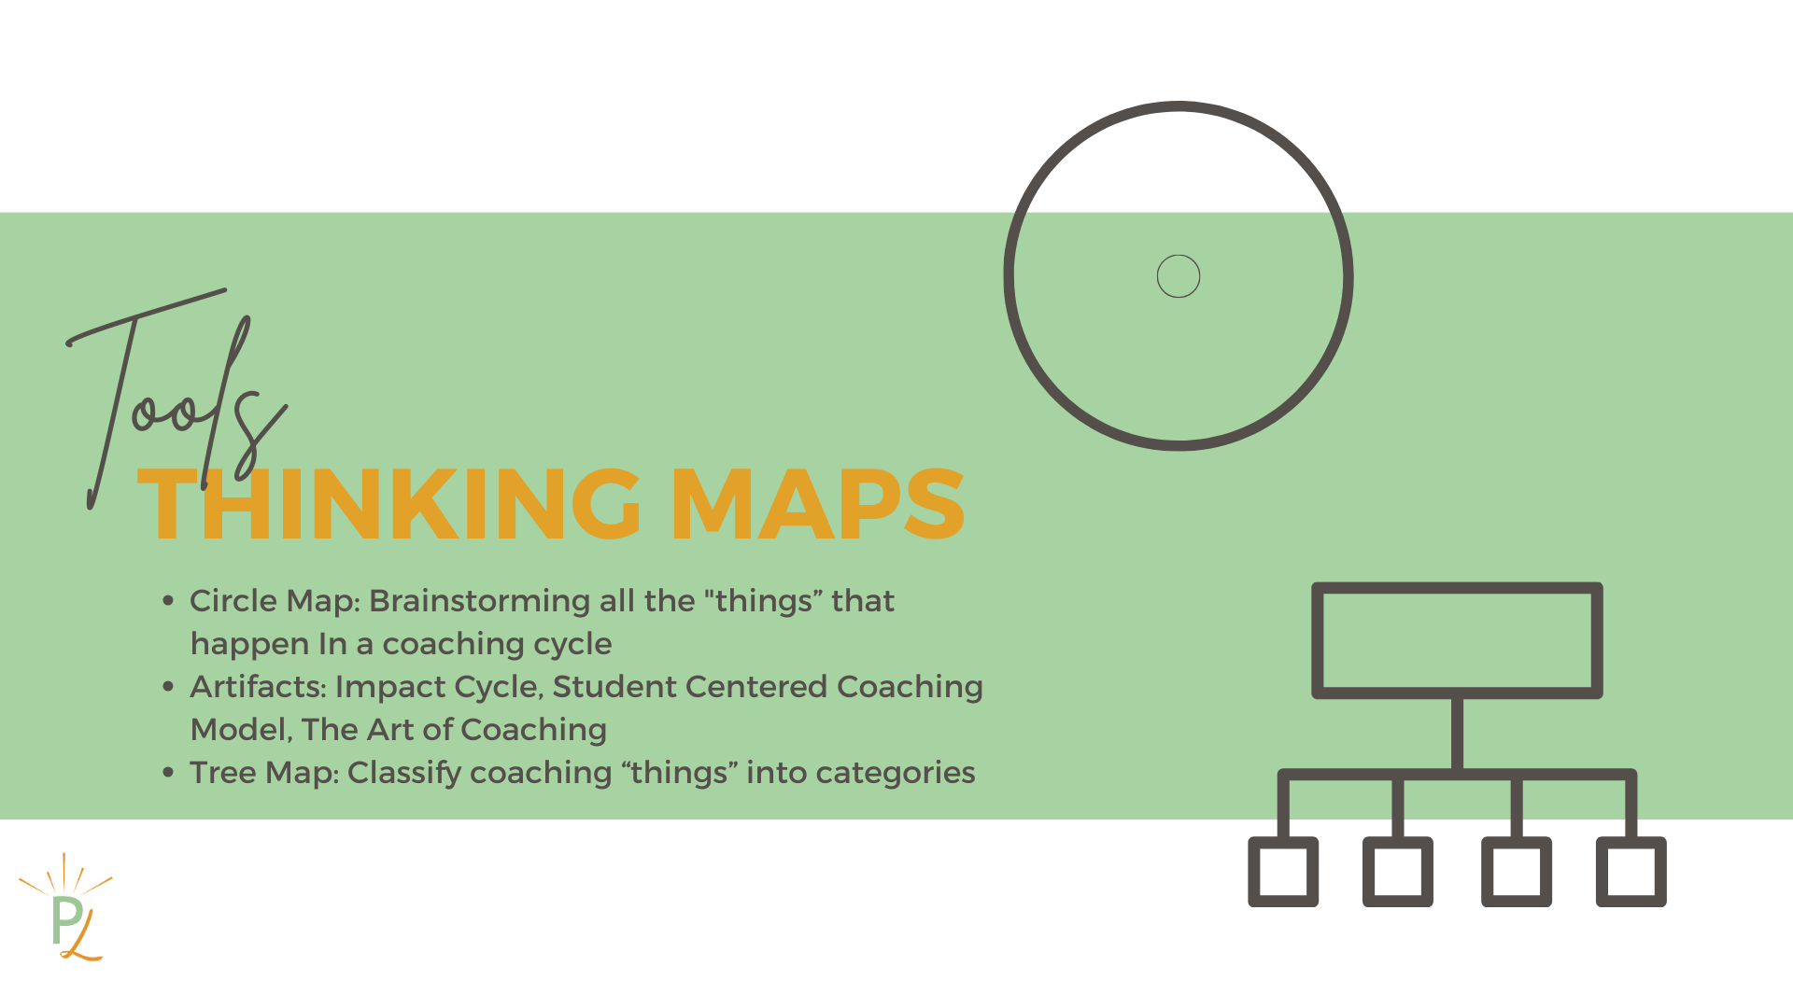


Slide 7
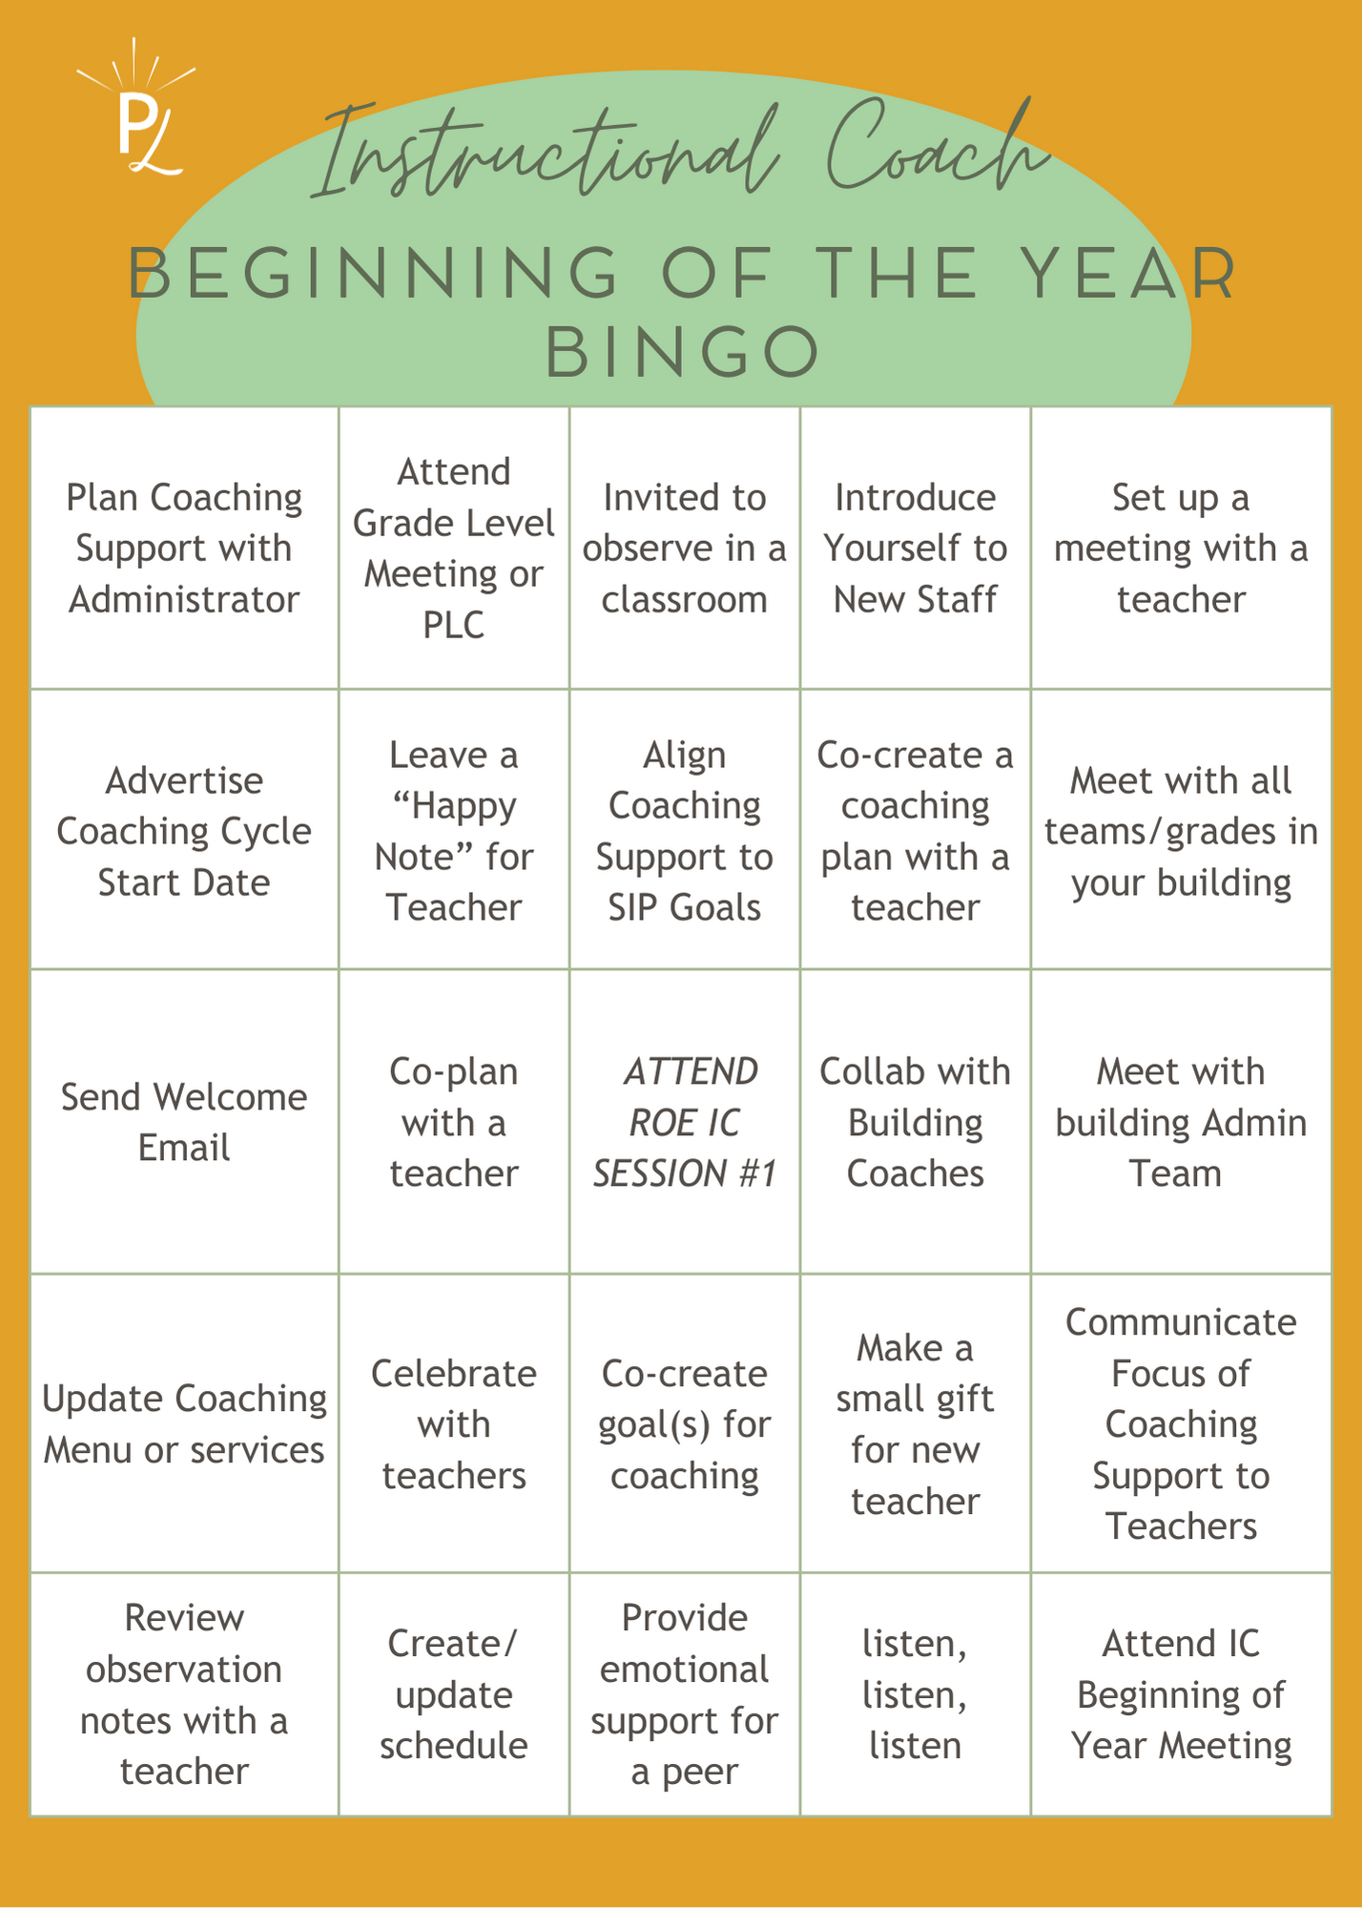
Instructional Coach “Beginning of the Year Bingo”
Review the beginning of the year tasks on the BINGO card
Travel around the room to find others IC’s who completed a task on the BINGO card
Cross off (5) in a row/diagonally to win a prize
Notes:
Keep this bingo card, you will use the back!

Slide 8


Slide 9

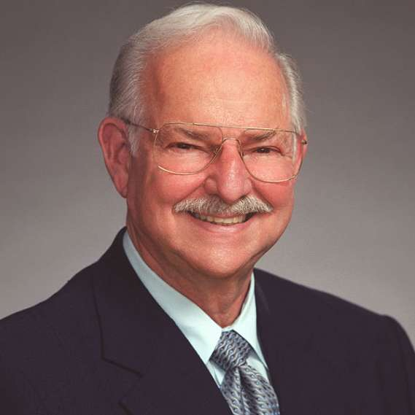
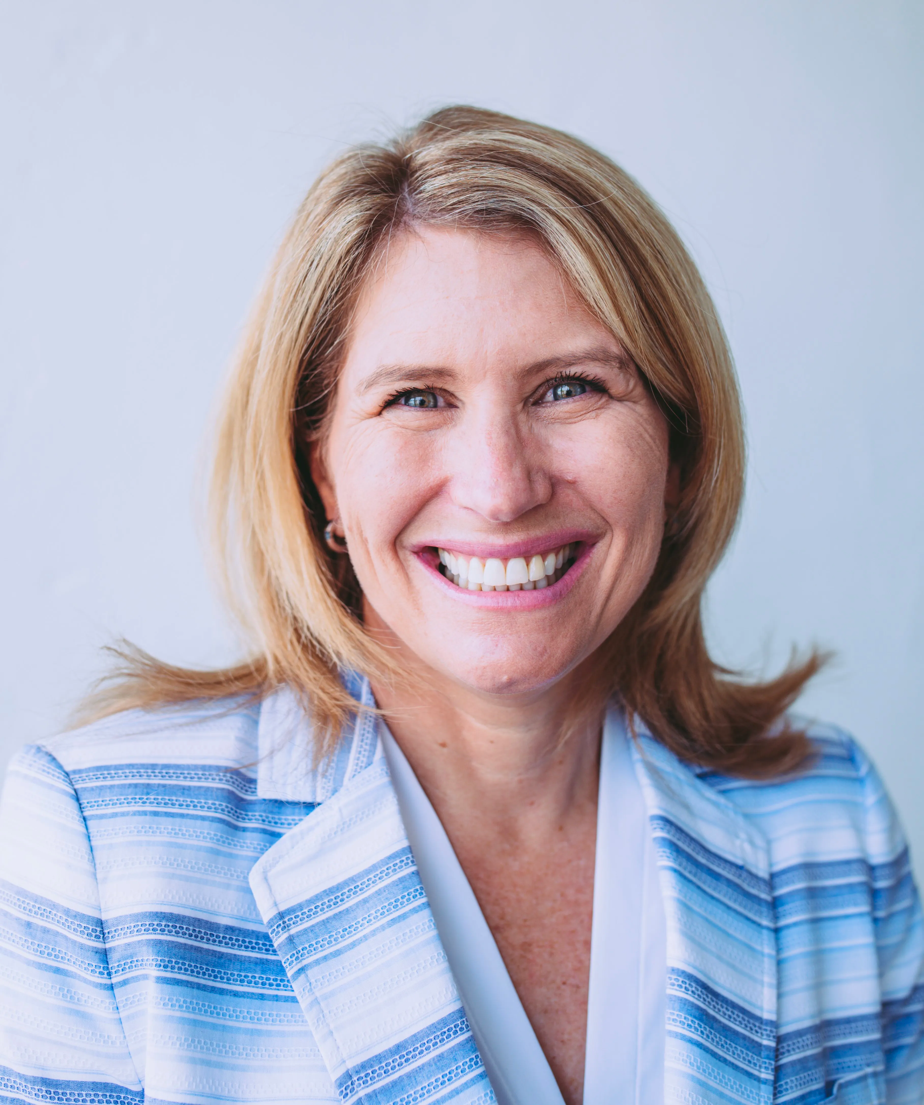



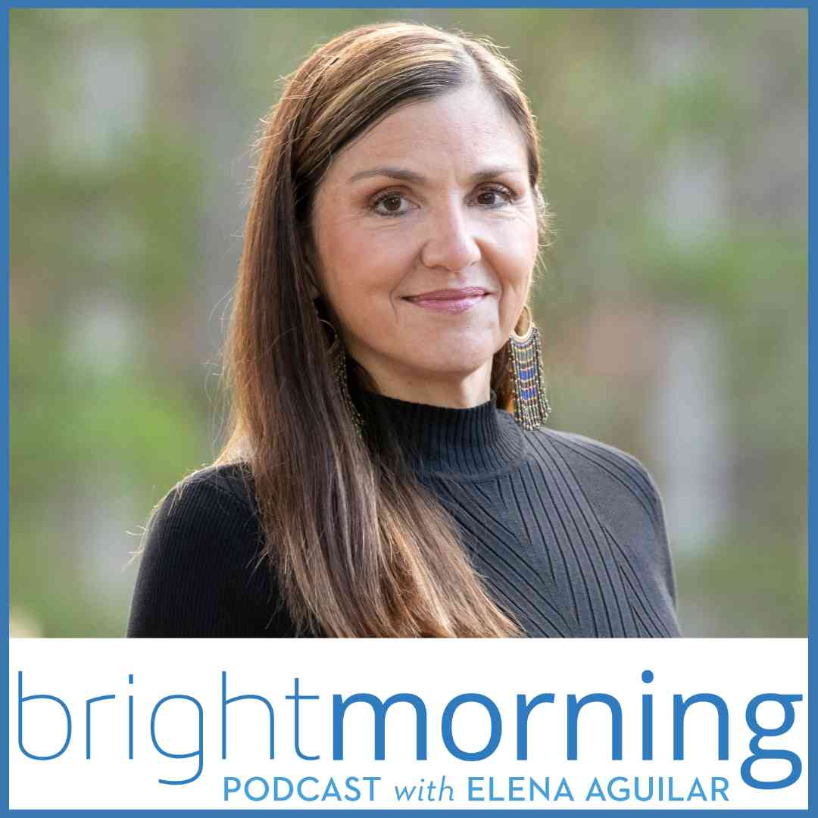

Google Classroom Code
klnuhsy
Alone: Choose resources to explore from Aguilar, Knight & Sweeney
With a Partner: Create a Tree Map that classifies the characteristics of a Coaching Cycle
District Team: Debrief & share your thinking. What does the success criteria look like for coaching in your district?

Slide 10



Slide 11
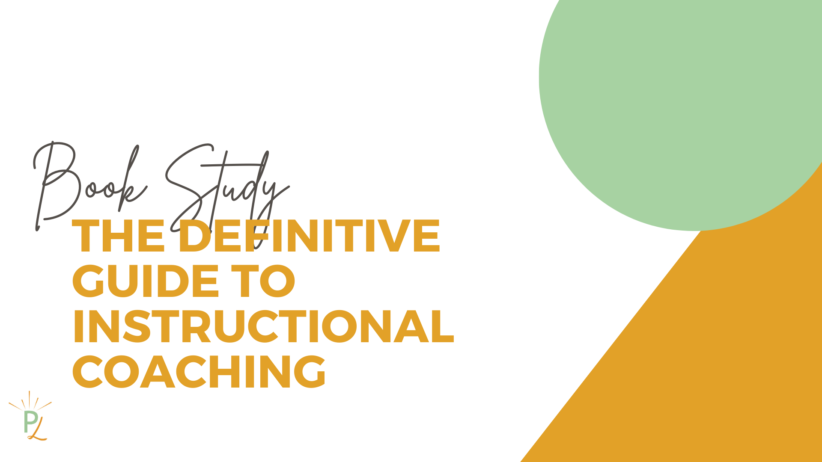

Slide 12
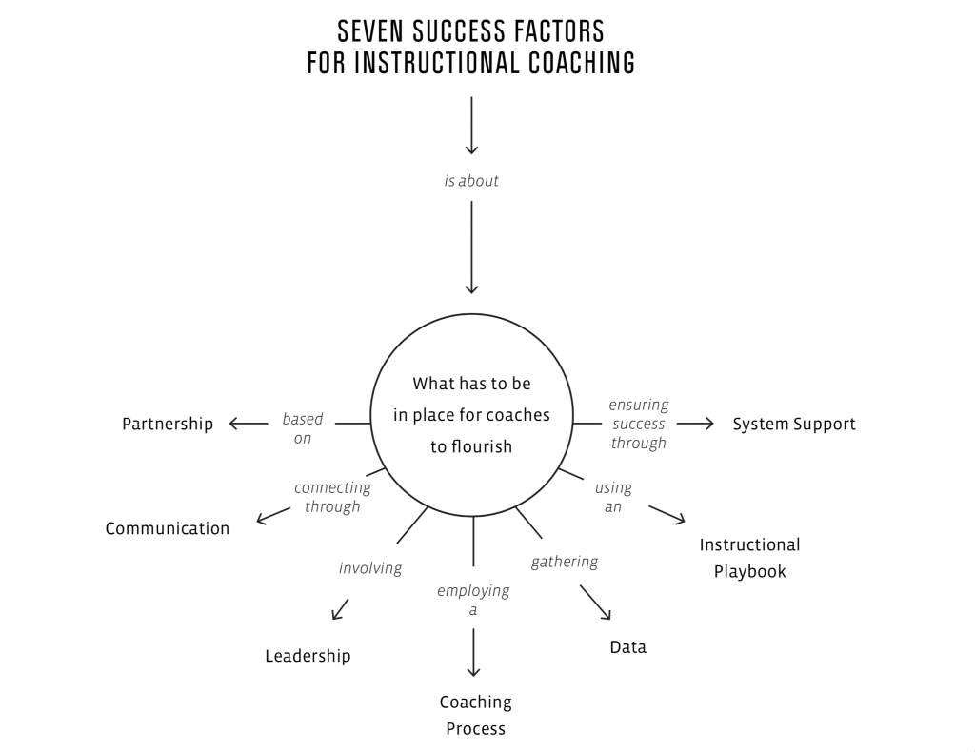
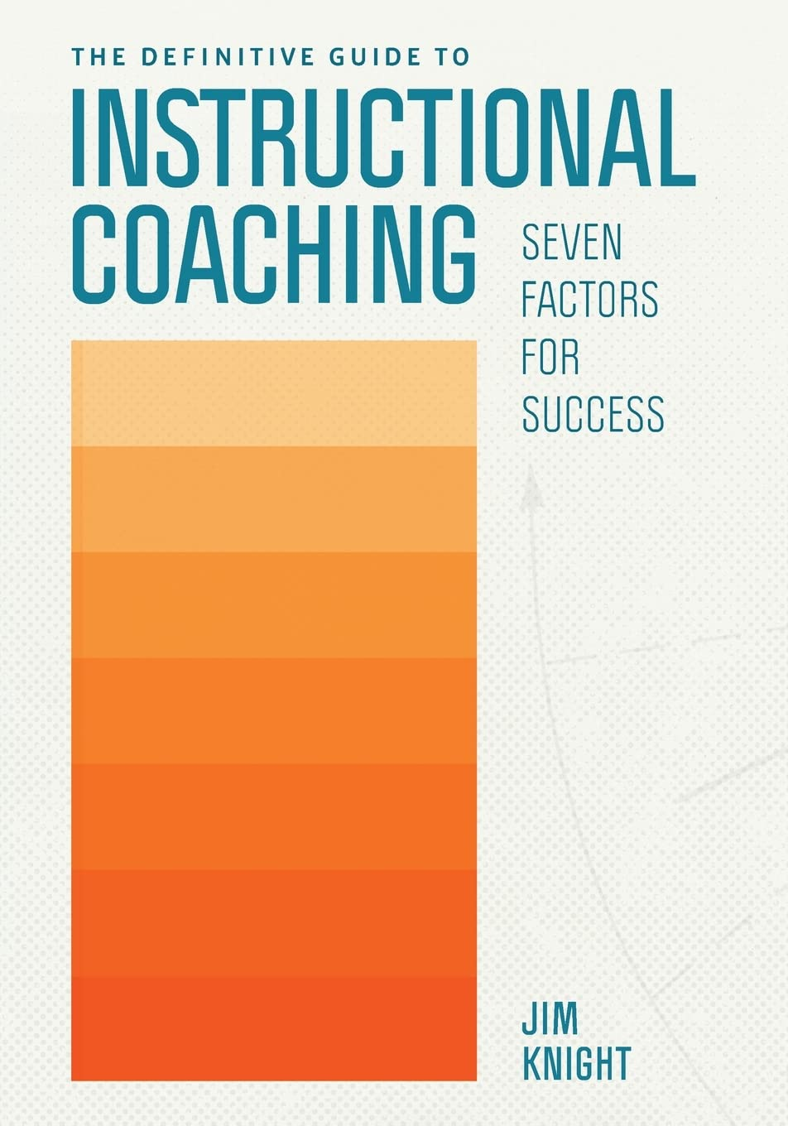

Slide 13
Who You Are
What You Do
Where You Work
The Partnership Principles
Communication skills
Coaches as leaders
System Support
The Impact Cycle
Data
The instructional playbook

Slide 14
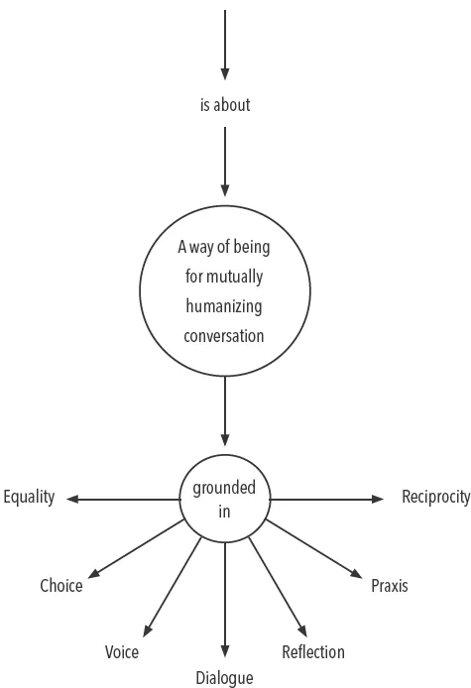
Who You Are: 1. Partnership Principles
The following slides will have main points for each of the Partnership Principles along with reflective questions from the “Sum It Up” section of the chapter.

Slide 15
“I don’t believe any person or group is more valuable than any other, and I recognize and honor the dignity of every individual.
Equality is when collaborating teachers feel seen, valued, and respected as professionals.
Equality and resistance: directive + confrontational counsel leads to resistance while reflective + supportive counsel leads to change talk
Equality and moralistic judgement: contradicts equality by placing others below us
Reflection Questions
What can you do to be fully present in conversations?
How easy is it for you to avoid moralistic judgement? What can you do to be less judgemental?
What are some subtle ways that you might be communicating that you don’t see your collaborating teachers as equals? Do you think you engage in any of these behaviors?
Notes:
Number off 1-7 OR view the principle at your table in your group–browse the accompanying text using your book

Slide 16
I communicate in a way that acknowledges the professional discretion of others by positioning them as decision makers.
Teachers make most, if not all, of the decisions about changes to their classrooms.
Social determination theory: people feel motivated when they 1) are competent 2) have large measures of control over their lives 3) are engaged in and experience positive relationships
Choice = ownership of goals, learning path, and outcomes
Reflection Questions
To what extent do teachers make the decisions about what happens in their classrooms when you coach?
How do you go about explaining strategies while also honoring teacher choice?

Slide 17
I want to hear what others have to say, and I communicate that clearly.
Voice is a natural outcome of a commitment to equality and choice. Teachers words, thoughts, ideas and emotions genuinely shape conversations and actions that occur during coaching.
Specific actions are taken to promote voice.
When teachers have voice, their students have voice.
Reflection Questions
Who does most of the talking when you are coaching? Do you need to change anything?
What do you do to ensure that you deeply understand the emotions and needs of your conversation partners?
What do you do to ensure that your collaborating teachers know that they have been heard?

Slide 18
I believe conversations should consist of a back-and-forth exchange, with all parties hearing and responding to one another’s opinions.
Reflection Questions
Do you think dialogue is necessary in coaching?
Do you think it is important to demonstrate love, humility, and faith to collaborating teachers during coaching? If so, how do you demonstrate those qualities?
In your experience, what are the characteristics of a life-giving conversation?
In your organization, are teachers irresponsibly or responsibly accountable? What do you see in teachers’ behavior that supports your answer?
Dialogue…fluid, energizing, thrilling, reflective, creative and life-giving!
Grounded in mutual respect to explore ideas together instead of forcing your truth on someone else.
Letting go of the need to be right so that we can do what is right.
Love, Faith, Hope, Trust, Critical thinking

Slide 19
I engage in conversations that look back, look at, and look ahead.
Reflection empowers teachers to think of what happened in the past, what is happening now, and what could happen in the future.
Having tools and protocol to support looking back, look at and looking ahead.
Coaches who ensure teachers do a lot of the thinking are grounded in the principle of reflection.
Reflection Questions
How easy is it for you to let your teachers make the decisions about what happens in their classrooms?
When are you most reflective? How much time do you set aside to look back, look at, and look ahead?
What difference would it make if you spent more time reflecting on your personal and professional life?

Slide 20
I structure learning so that it is grounded in real life.
Praxis is learning in action—grounded in and shaped by the realities of the collaborating teacher’s classroom and life outside of the school building.
Thinking + Doing + Acting
Your authentic self, your true and real learning.
Reflection Questions
What can you do to ensure that the professional development you provide genuinely addresses teachers’ real-life concerns?
What does it look like when teachers enthusiastically implement the ideas you discover and create together? What can you do to ensure that happens more often?
What can you do to ensure that professional development is guided by teachers’ concerns?

Slide 21
I enter each conversation open and expecting to learn.
Reciprocity is when teachers and coaches are learning together.
Coaches seek out and value the ideas teachers share, and teachers learn from coaches.
Reciprocity is revealed in the way coaches talk, listen and act.
Reciprocity means you get as much as you give.
Reflection Questions
Do you believe you can learn from every single teacher with whom you partner?
Are your collaborating teachers energized by your coaching conversations? Are you?

Slide 22



Who You Are: 2. Communication Skills

Slide 23
Communication Skills: Questioning
Questions: customize question sets to the person or people you are collaborating with
Open questions invite thinking, exploring, reflecting…letting the other person find their own way.
Paraphrasing, nonverbal gestures and clarifying keep the communication going.
Reflection Questions
On a scale of 1 to 10, how effectively do you listen to your conversation partners?
What resources do you use to develop question sets?
What are one or two things you could do today to improve as a listener?
When you explain strategies, what can you do to move away from giving advice toward a mutual exploration of ideas?

Slide 24
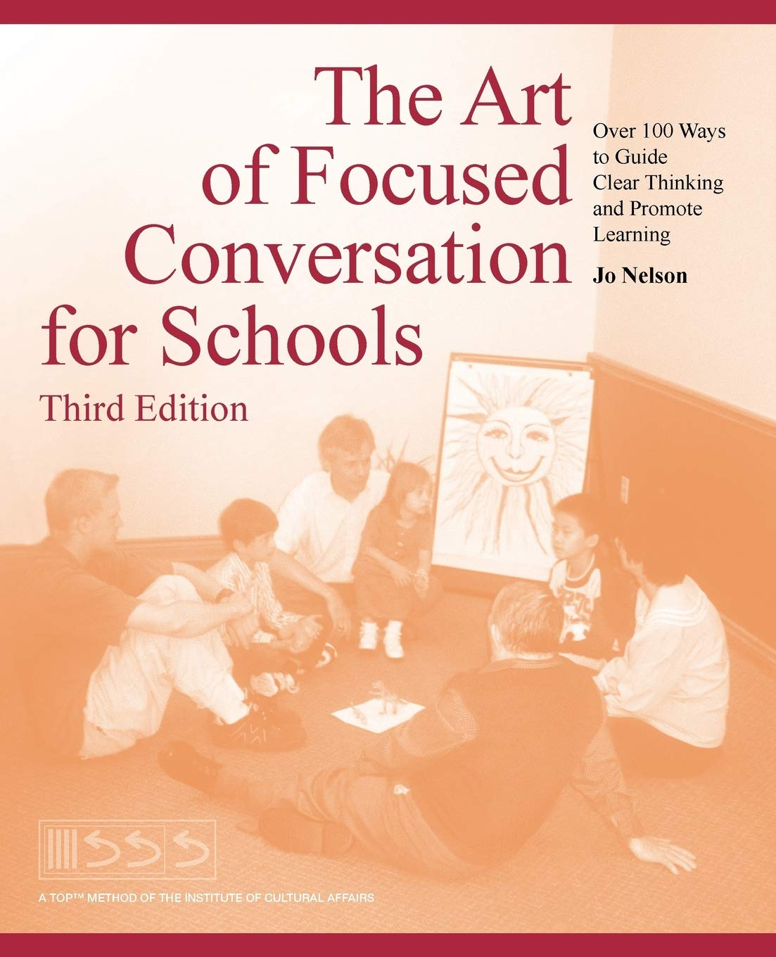
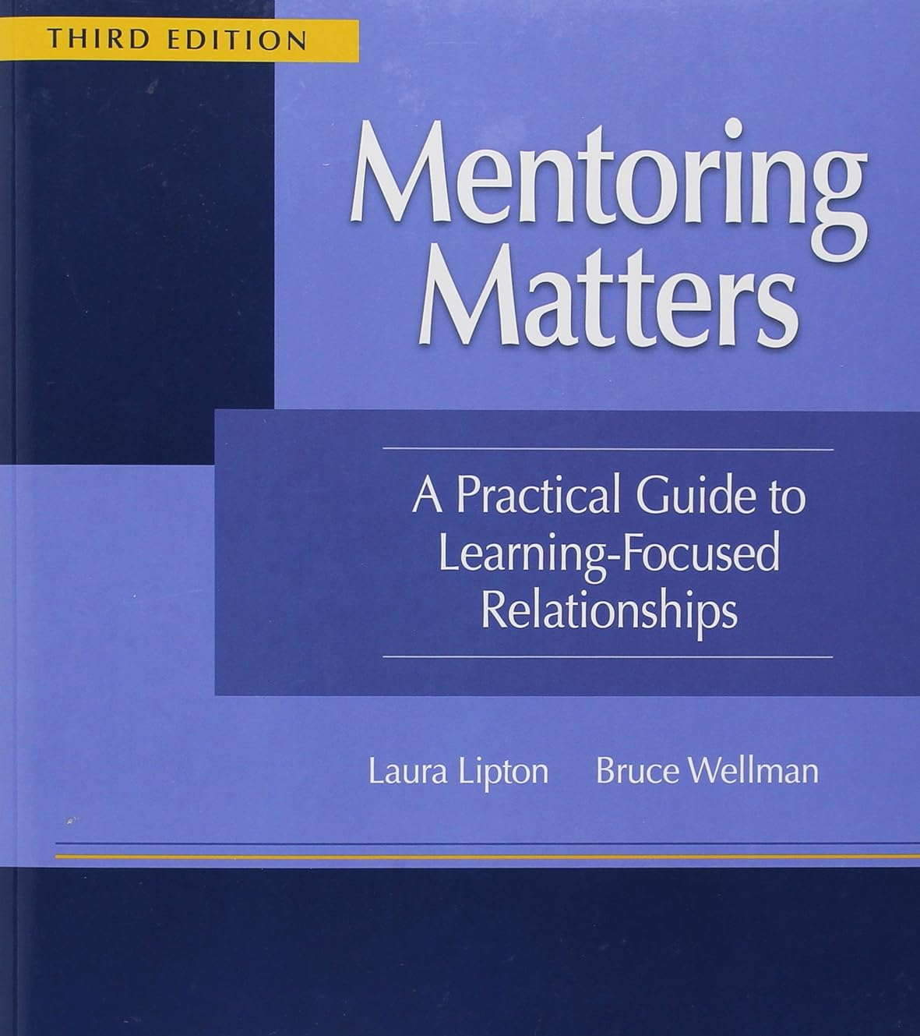
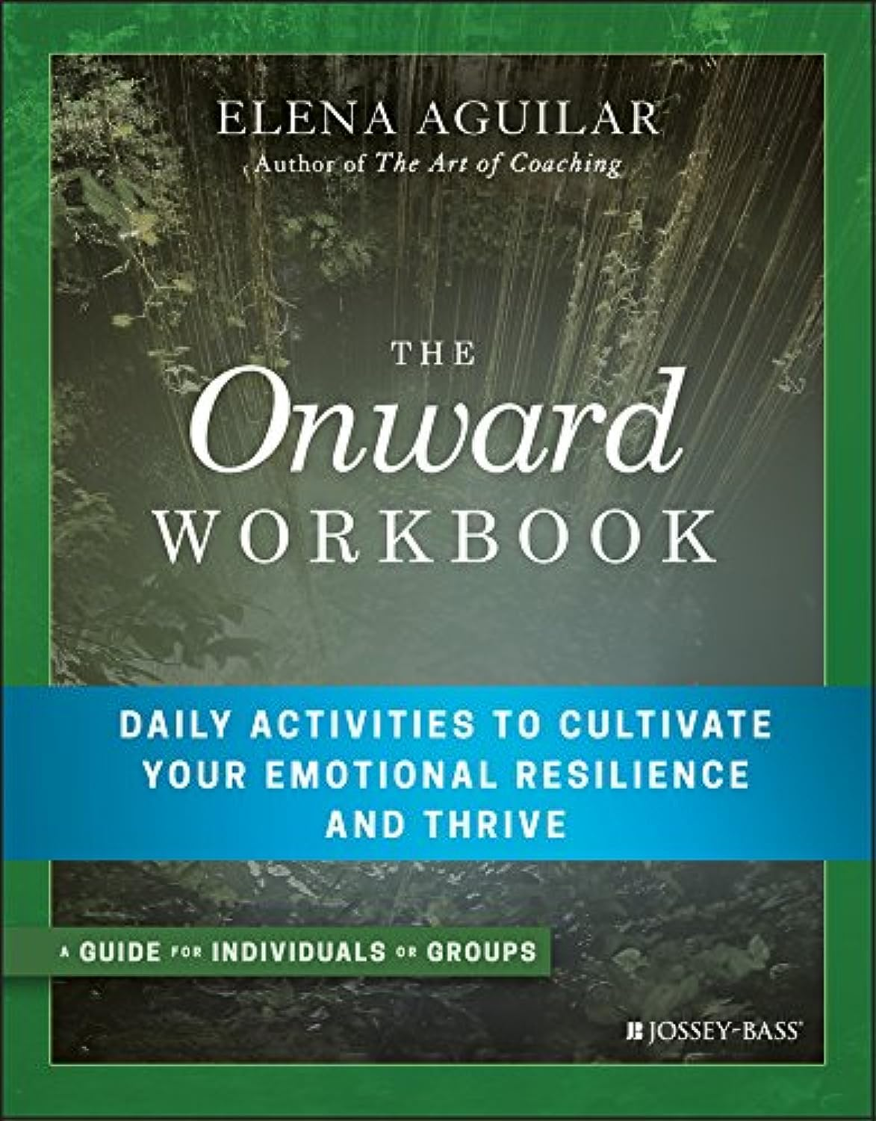
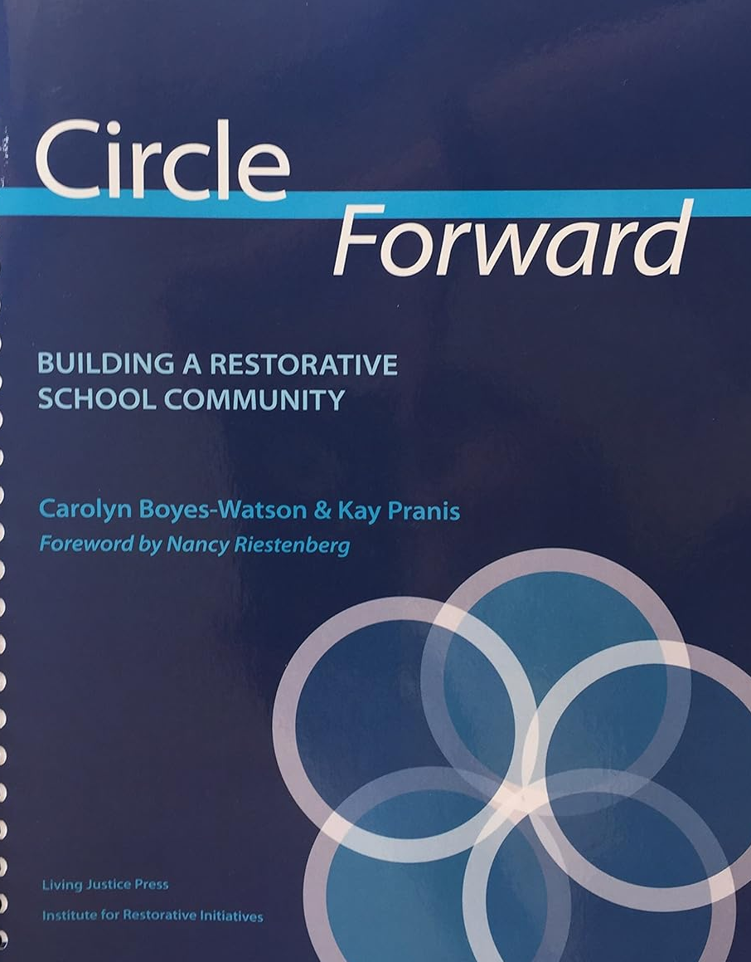

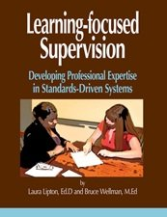

Questioning & Listening Resources

Slide 25
Communication Skills: Listening
Internal Dimension: ways we control our thinking to better hear the conversation partner
Focus
Notice
No Assumptions
Awareness of mental model
Letting go of control
Demonstrating Empathy
External Dimension: words and actions we say and do that our partners observe during a conversation
Awareness of body/face/stance
Note taking habits
Interrupting, unless necessary

Slide 26
Independent Reflection
Use this time to dump all those thoughts out! This step will help you in the next breakout session!
ALL OF MY THOUGHTS

Slide 27


Slide 28
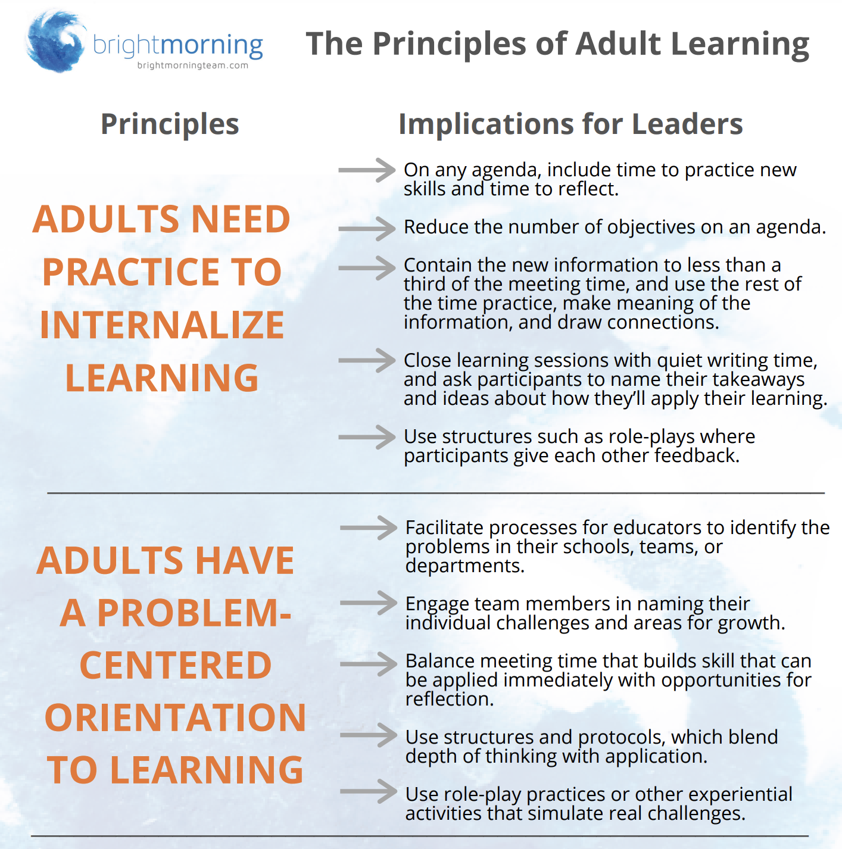
Practice Active Listening: October/November Coaching Goals

Slide 29
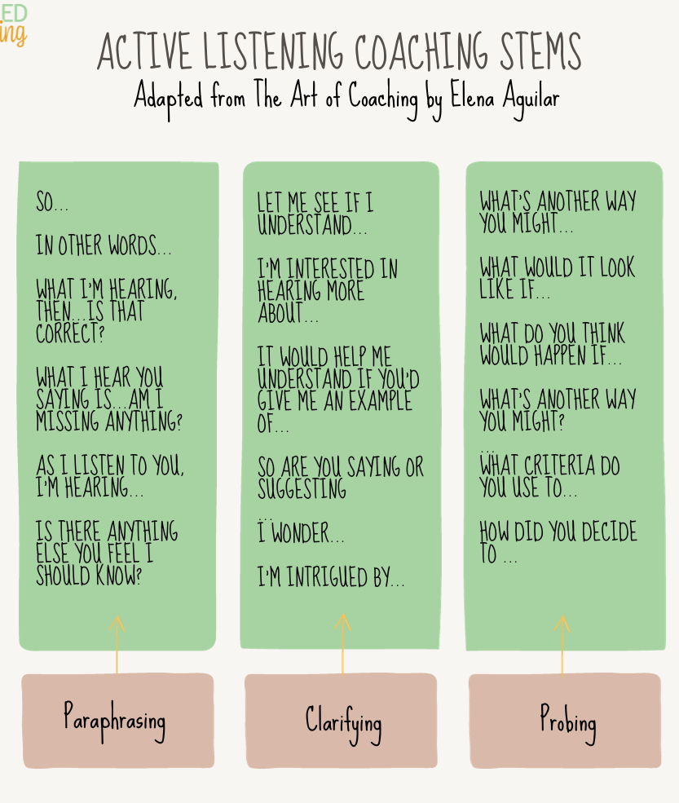
Find a partner from outside of your school district or team

Slide 30
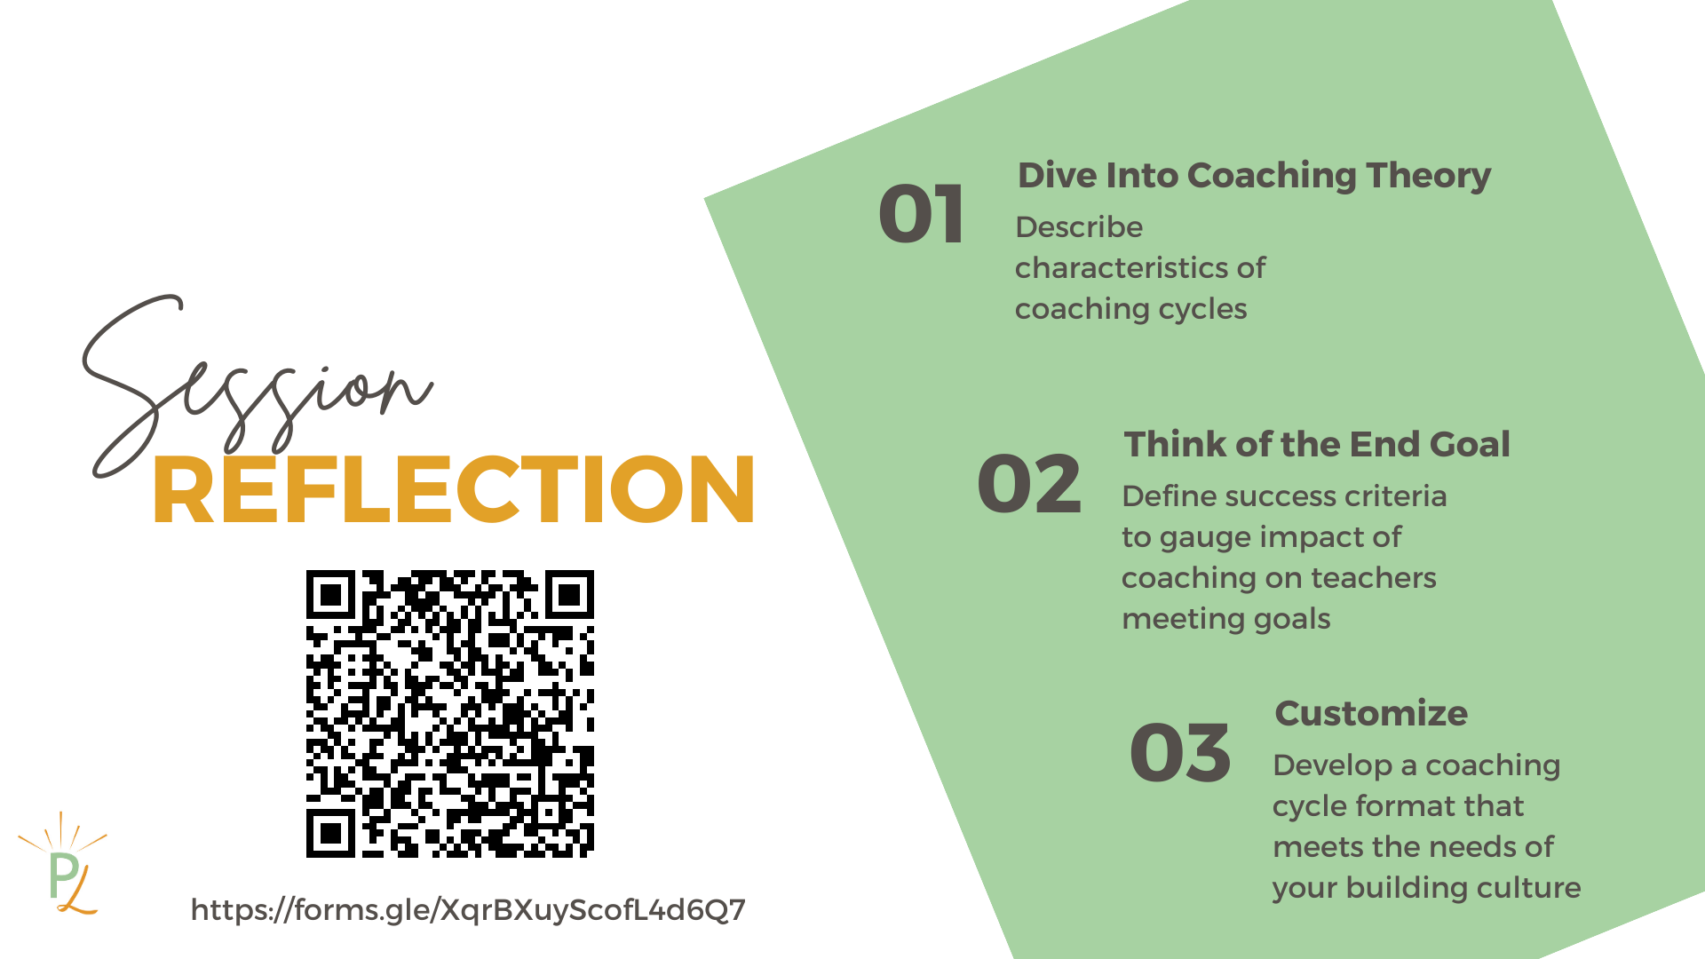
https://forms.gle/dv4Q2UaS3RwmAiCJ6

Slide 31

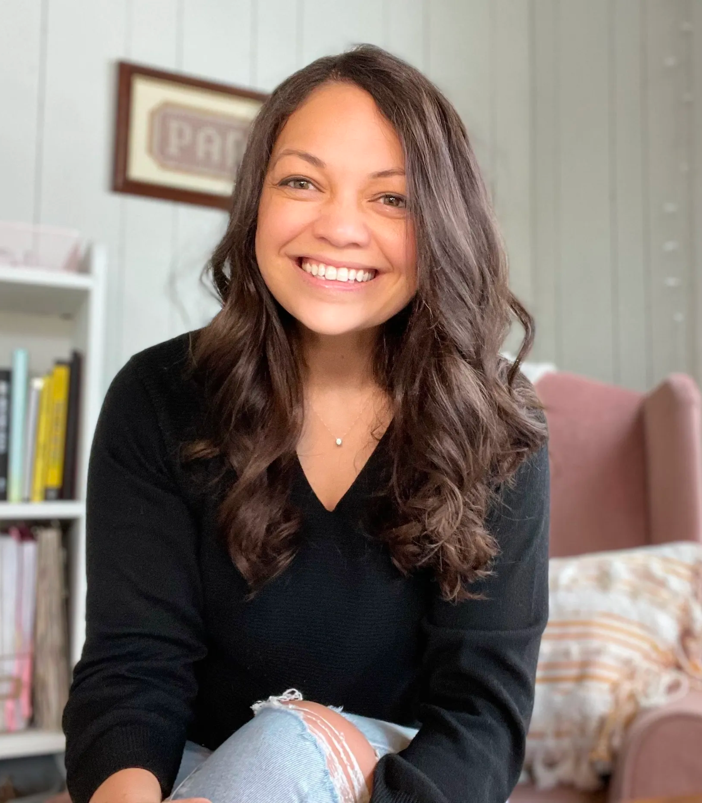



autumn@pairedlearning.org
Pairedlearning.org

