Slide 1



Greenbelt Cultural Center
October 22nd 2024
12:20pm-2:20pm

Slide 2
Table Groups: Mission Statement Check-in
Enhance Tier 1 instruction by partnering with educators to analyze data, address student needs, and engage in reflective practices through student-centered, data-driven coaching cycles. | Supporting all teachers in the planning, implementation, and evaluation of Tier 1 curriculum to ensure that at least 60% of students achieve mastery 80% of the time. | Through a targeted coaching model, we aim to foster a cycle of continuous teaching, learning, and reflection, ultimately creating sustainable growth in educators and driving impactful student outcomes.
How have you “lived” the mission since our last session?

Slide 3
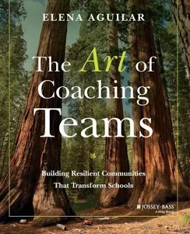
Reflect & Connect Across the Room
Chapter 2 Knowing Ourselves as Leaders
Self-awareness
Self-management
Social awareness
Relationships Management
“Once you start noticing how the role that emotions play in our work–whether in building teams or teaching children–you may feel like you can’t stop seeing them everywhere.” pg 17
Pg 28 “Reflect on Your Role” and “Reflect on Power Dynamics”

Slide 4
Active Learning: Book Study Groups
“Professional learning results in equitable and excellent outcomes for all students when educators engage in continuous improvement, build collaboration skills and capacity, and share responsibility for improving learning for all students.”
Standards for Professional Learning: Culture of Collaborative Inquiry
Add link to book groups
Add layout of tables and book group location

Slide 5


Active Learning: Book Study Groups Ch 3
Chapter 3: Creating a Culture of Trust
Read last paragraph on pg 42, 43 & 44
Meet with assigned book group

Slide 6
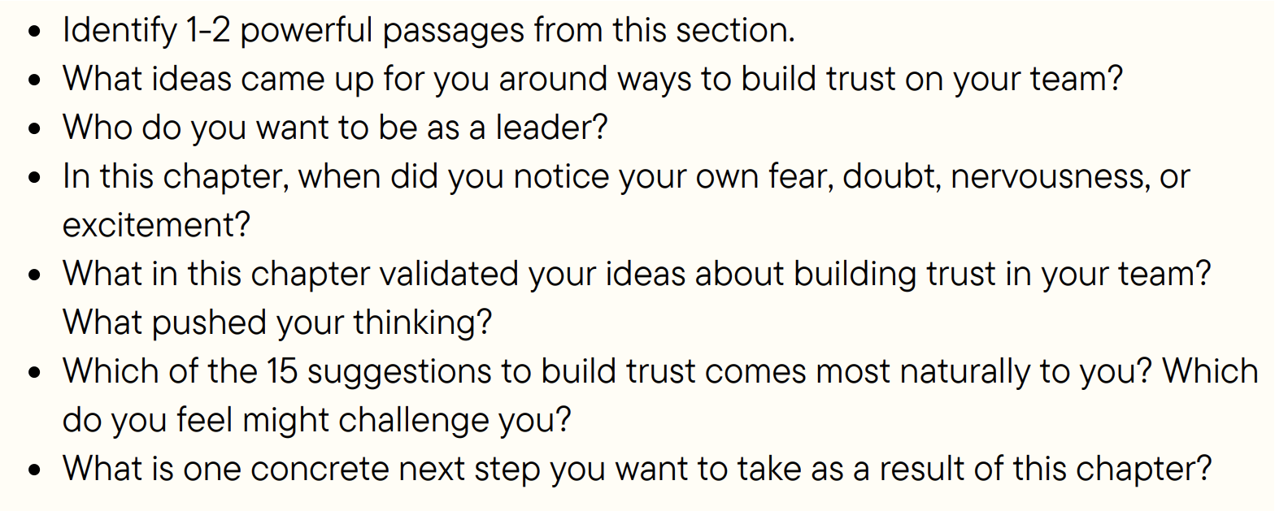
Active Learning: Book Study Groups Ch 3
Chapter 3: Creating a Culture of Trust

Slide 7
Active Learning: Book Study Groups Ch 5
Chapter 5: Foundation of Trust (Norms)
Read pg 100-108
Using Exhibit 5.2 as a model, set Norms for
your Book Group

Slide 8
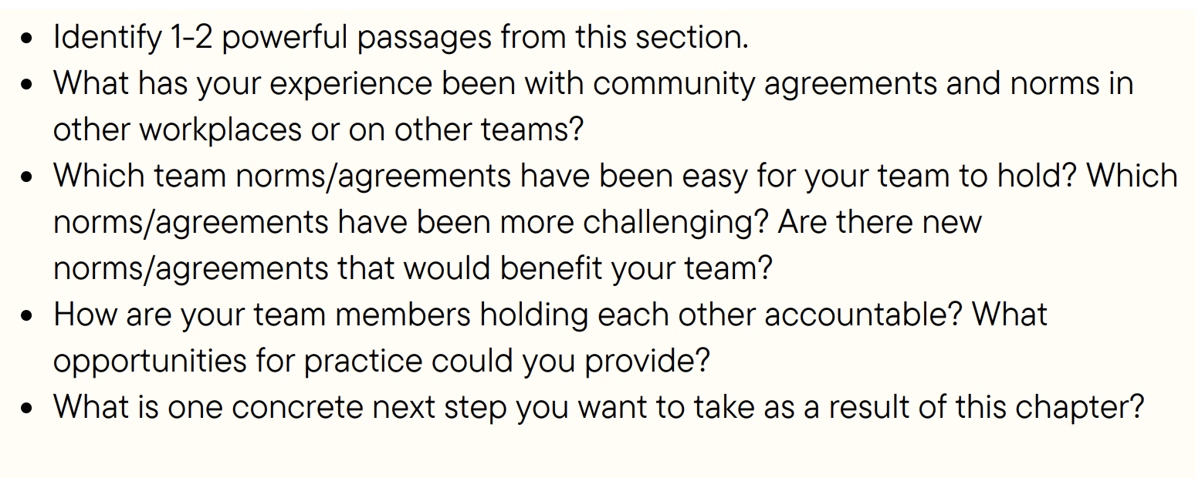
Active Learning: Book Study Groups Ch 5
Chapter 5: Foundation of Trust

Slide 9
Application: Choose Your Own Adventure
Aim: Provide adult learners with choice and options to differentiate their learning, honoring background knowledge and experience
Outcome: Waukegan Coaches works in their ZPD, maximizing time away from buildings
Using what you’ve learned over Sept/Oct, plan your next steps of meeting with teams in your buildings to revisit norms (5.2)
Sign-up for a 10 minute coaching session with Autumn, Stacey or a member of WPS60 leadership
Join an impromptu coach-led roundtable on a topic of your choice (Board, Marker to write topic, 20 minute sessions)
Synthesize what you’ve learned today with Diane Sweeney’s The Moves

Slide 10

Greenbelt Cultural Center
November 12th 2024
12:20pm-2:20pm

Slide 11
Table Groups: Mission Statement Check-in
Enhance Tier 1 instruction by partnering with educators to analyze data, address student needs, and engage in reflective practices through student-centered, data-driven coaching cycles. | Supporting all teachers in the planning, implementation, and evaluation of Tier 1 curriculum to ensure that at least 60% of students achieve mastery 80% of the time. | Through a targeted coaching model, we aim to foster a cycle of continuous teaching, learning, and reflection, ultimately creating sustainable growth in educators and driving impactful student outcomes.
How have you “lived” the mission since our last session?

Slide 12
Reflect & Connect Across the Room
Chapter 4 Defining Purpose, Process, Product
“I aspire to hold meetings that are focused, meaningful, and productive and that feed the heart, mind, and spirit. I want to make sure we get things done, and I want people to leave feeling energized and rejuvenated.” pg 64
Refer to pg 66 Table 4.1
Choose a lens to reflect from:
  Your role on a team
  A teacher in your school
  Your role in your Book Club Group

Slide 13
Active Learning: Book Study Groups
“Professional learning results in equitable and excellent outcomes for all students when educators engage in continuous improvement, build collaboration skills and capacity, and share responsibility for improving learning for all students.”
Standards for Professional Learning: Culture of Collaborative Inquiry
1
2
1
2
3
4
5
6
3
4
2
3
4
5
6
7
5
1
1
2
3
4
5

Slide 14
Active Learning: Book Study Groups Ch 4
Chapter 4: Defining Purpose, Process and Product
Read bullets 3-7 from pgs 70-71
Meet with assigned book group

Slide 15

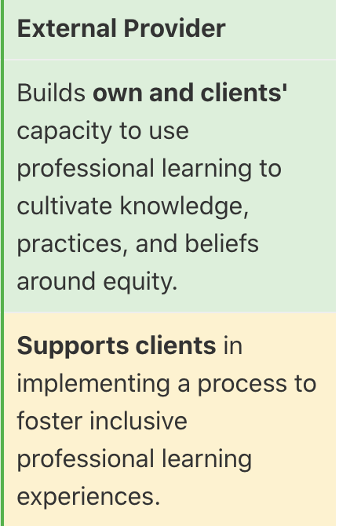
Active Learning: Book Study Groups Ch 4
As a Book Group practice using the tools…
Mission & Vision (group level)
Core Values
Communication Agreements
Roles

Slide 16
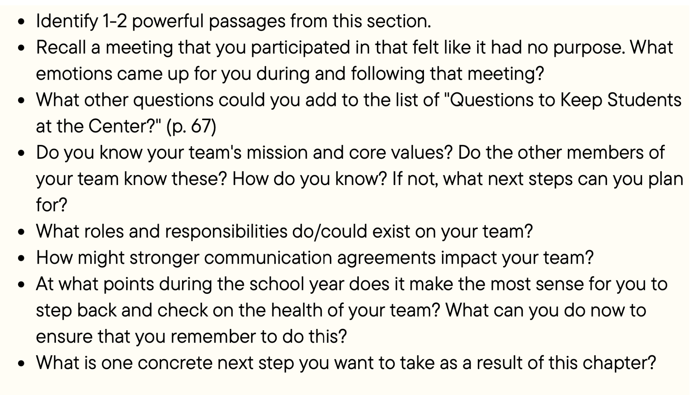
Active Learning: Book Study Groups Ch 4
Chapter 4: Defining Purpose, Process, and Product

Slide 17

Let’s
Meet
Diane Sweeney

Slide 18
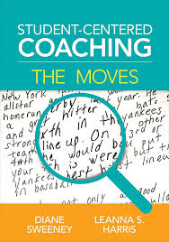
Active Learning: The Moves
Chapter 1:
Read pg 9-10; 16
Where are we at as individual coaches with
support student-centered goals?

Slide 19
Active Learning: Book Study Groups Introduction
7 Core Practices for Student Centered Coaching
Organizing Coaching through Cycles
Setting Goals for Coaching Cycles
Using Standards-Based Learning Targets
Using Student Evidence to Co-Plan Instruction
Co-Teaching with a Focus on Effective Instructional Practices
Measuring the Impact of Coaching on Student and Teacher Learning
Partnering with the School Leader

Slide 20
Application: Choose Your Own Adventure
Aim: Provide adult learners with choice and options to differentiate their learning, honoring background knowledge and experience
Outcome: Waukegan Coaches work in their ZPD, maximizing time away from buildings
Using what you’ve learned today, plan your next steps of meeting with teams in your buildings to revisit missing, vision, core values (4.1)
Sign-up for a 10 minute coaching session with Autumn, Stacey or a member of WPS60 leadership
Join an impromptu coach-led roundtable on a topic of your choice (Board, Marker to write topic, 20 minute sessions)
Synthesize what you’ve learned today with Diane Sweeney’s The Moves

Slide 21

Greenbelt Cultural Center
December 17th 2024
12:20pm-2:20pm

Slide 22

SNOWBALL TIME
Scramble to make groups around a snowball!
Person with the snowball shares what they have done to live the mission & vision in the last month
Toss or hand the snowball to a peer who can ADD ON with a connection
See how many connections you can make in your small group

Slide 23
ChatGPT Says…
1. Start Small, Build Momentum
Just like a snowball starts small but gains speed and size as it rolls down the hill, instructional coaching efforts often begin with modest actions but can grow into significant impacts. Early on, focus on small, manageable steps—whether it’s building trust with teachers or introducing a single strategy. Over time, these efforts will accumulate, gaining momentum as teachers see results and begin to adopt more strategies

Slide 24
ChatGPT Says…
2. Consistency Leads to Growth
A snowball grows larger because it continues to roll, picking up more snow along the way. In coaching, consistency in feedback, support, and professional development is key. By regularly engaging with teachers, offering timely feedback, and maintaining a steady presence, you help create a culture of continuous improvement. Over time, this consistency will lead to greater buy-in and lasting change in instructional practices.

Slide 25
ChatGPT Says…
3. Embrace Adaptability to Overcome Obstacles
As a snowball rolls down the hill, it may encounter rocks or obstacles that temporarily slow it down or cause it to shift direction. Similarly, challenges will arise in coaching—whether it’s teacher resistance, resource constraints, or other setbacks. Embrace these obstacles as opportunities to adjust your approach, find creative solutions, and keep moving forward. Just like the snowball, the key to success is not in avoiding obstacles, but in learning to navigate them and keep the momentum going.
In December, reflect on how far you've come and plan for how to keep the "snowball" of progress rolling through the rest of the year.

Slide 26
Table Groups: Mission Statement Check-in
Enhance Tier 1 instruction by partnering with educators to analyze data, address student needs, and engage in reflective practices through student-centered, data-driven coaching cycles. | Supporting all teachers in the planning, implementation, and evaluation of Tier 1 curriculum to ensure that at least 60% of students achieve mastery 80% of the time. | Through a targeted coaching model, we aim to foster a cycle of continuous teaching, learning, and reflection, ultimately creating sustainable growth in educators and driving impactful student outcomes.
How have you “lived” the mission since our last session?

Slide 27
Reflect & Connect Across the Room
Chapter 6 Developing the Emotional Intelligence of a Team
“Emotionally intelligent teams have ways of managing the moods of one member and of the team as a whole. This management doesn’t necessarily come from the leader–in face, an indicator of an emotionally intelligent team is that any member accepts authority to address moods, communication dynamics, and interactions between members.” pg 123
Choose a team you are on or facilitate
Use the Indicators handout to assess the EI

Slide 28
Active Learning: Book Study Groups
“Professional learning results in equitable and excellent outcomes for all students when educators engage in continuous improvement, build collaboration skills and capacity, and share responsibility for improving learning for all students.”
Standards for Professional Learning: Culture of Collaborative Inquiry
Today, how will your book study group…
Internalize new learning
Practice with new coaching moves
Support one-another
Coach each other up!

Slide 29
Active Learning: Book Study Groups Ch 6
Chapter 6: Developing the Emotional Intelligence of a Team
Reread building behaviors vs. uprooting
behaviors on pg 126-127
Meet with assigned book group to process

Slide 30

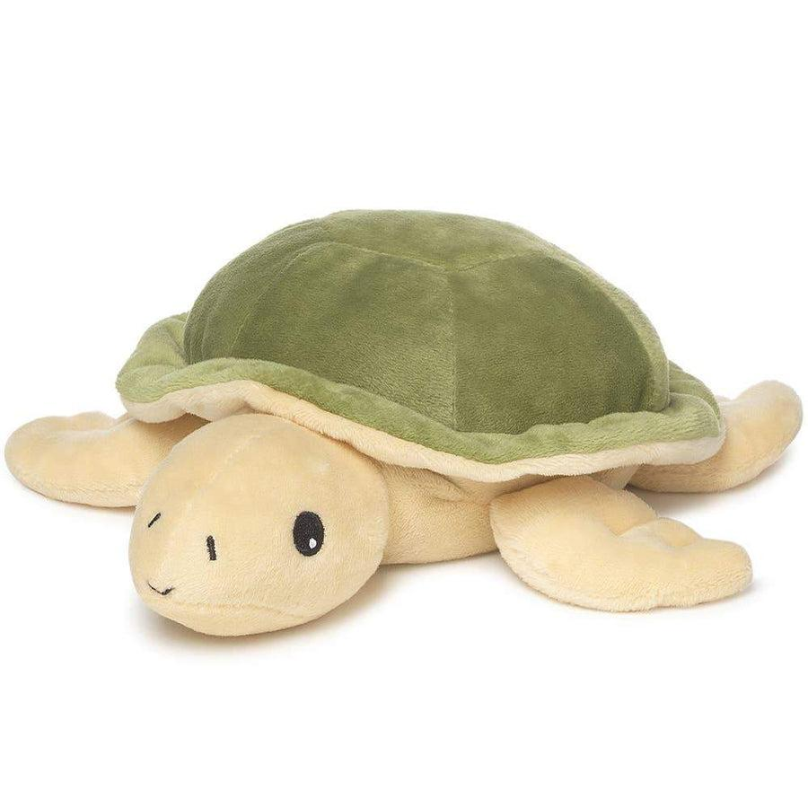
Active Learning: Book Study Groups Ch 6
Want to take this further with your book group?
Work together to write out a “coaching move” to use when a norm is broken; practice it!
Identify a behavior that needs to be uprooted. Work together to write out a “coaching move” for how to do it.

Slide 31
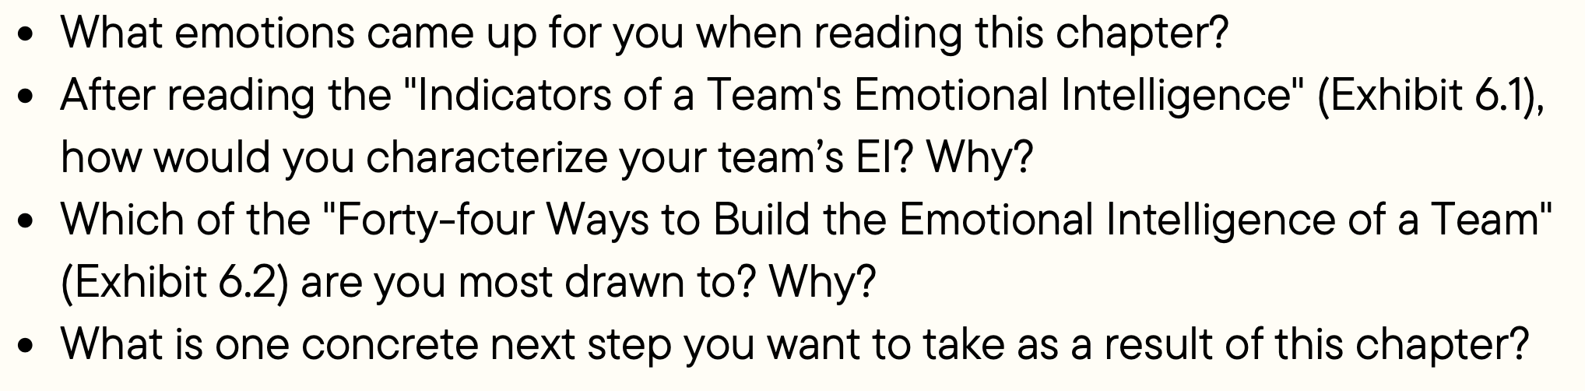
Active Learning: Book Study Groups Ch 6
Chapter 6: Developing the Emotional Intelligence of a Team

Slide 32

Active Learning: Book Study Groups Ch 7
Chapter 7: Cultivating Healthy Communication
“In a good conversation, I feel heard. My listeners validate my thoughts, they don’t interrupt me, and they don’t leap to respond when I finish. I don’t need others to agree with me or share their own story about a similar experiences. I just need to know that they hear what I was saying. …In good conversation, I also hear receptivity, and flexibility. I hear openness to understanding, I hear interest in varied perspectives, and I hear emotions acknowledged. I hear ideas shifting and morphing—I hear a willingness to be influenced by questions and contributions from others.” pg 141
Who is the last person who you had a good conversation?
What did they do to make you feel this way?

Slide 33
Active Learning: Book Study Groups Ch 7
Want to take this further with your book group?
Look at Exhibit 7.1 in your handout. Make a plan for using these questions BEFORE winter break with a team/group that needs it.
Look at Exhibit 7.2 Patterns of Participation. Make a plan to observe another IC’s meeting for practice.

Slide 34
Application: Choose Your Own Adventure
Aim: Provide adult learners with choice and options to differentiate their learning, honoring background knowledge and experience
Outcome: Waukegan Coaches work in their ZPD, maximizing time away from buildings
Join a coach-led roundtable based on a problem of practice: HS Coach as facilitator
Sign-up for a 10 minute coaching session with Autumn, Stacey or a Pam
Synthesize what you’ve learned today by mapping out January priorities, mindfully integrating content from Diane Sweeney’s The Moves or Aguilar’s Forty Ways to Build the Emotional Intelligence of a Team

Slide 35
Greenbelt Cultural Center
January 14th 2025
12:20pm-2:20pm

Slide 36
Table Groups: WELLNESS Check-in
How did I prioritize rest during winter break to recharge my energy and focus for the upcoming semester?
What activities or practices helped me create a sense of balance and peace during the break, and how can I integrate these into my daily routine moving forward?
In what ways did stepping back from work allow me to gain perspective on my coaching goals and the support I offer to teachers?

Slide 37
Check back on the Ch 7 Challenge
Want to take this further with your book group?
Look at Exhibit 7.1 in your handout. Make a plan for using these questions BEFORE winter break with a team/group that needs it.
Look at Exhibit 7.2 Patterns of Participation. Make a plan to observe another IC’s meeting for practice.

Slide 38
Reflect & Connect Across the Room
Chapter 6 Developing the Emotional Intelligence of a Team
“Emotionally intelligent teams have ways of managing the moods of one member and of the team as a whole. This management doesn’t necessarily come from the leader–in face, an indicator of an emotionally intelligent team is that any member accepts authority to address moods, communication dynamics, and interactions between members.” pg 123
Choose a team you are on or facilitate
Use the Indicators handout to assess the EI

Slide 39
Active Learning: Book Study Groups
“Professional learning results in equitable and excellent outcomes for all students when educators engage in continuous improvement, build collaboration skills and capacity, and share responsibility for improving learning for all students.”
Standards for Professional Learning: Culture of Collaborative Inquiry
Today, how will your book study group…
Internalize new learning
Practice with new coaching moves
Support one-another
Coach each other up!

Slide 40
Active Learning: Book Study Groups Ch 6
Chapter 6: Developing the Emotional Intelligence of a Team
Reread building behaviors vs. uprooting
behaviors on pg 126-127
Meet with assigned book group to process

Slide 41
Active Learning: Book Study Groups Ch 6
Want to take this further with your book group?
Work together to write out a “coaching move” to use when a norm is broken; practice it!
Identify a behavior that needs to be uprooted. Work together to write out a “coaching move” for how to do it.

Slide 42
Active Learning: Book Study Groups Ch 6
Chapter 6: Developing the Emotional Intelligence of a Team

Slide 43
Active Learning: Book Study Groups Ch 7
Chapter 7: Cultivating Healthy Communication
“In a good conversation, I feel heard. My listeners validate my thoughts, they don’t interrupt me, and they don’t leap to respond when I finish. I don’t need others to agree with me or share their own story about a similar experiences. I just need to know that they hear what I was saying. …In good conversation, I also hear receptivity, and flexibility. I hear openness to understanding, I hear interest in varied perspectives, and I hear emotions acknowledged. I hear ideas shifting and morphing—I hear a willingness to be influenced by questions and contributions from others.” pg 141
Who is the last person who you had a good conversation?
What did they do to make you feel this way?

Slide 44
Active Learning: Book Study Groups Ch 7
Want to take this further with your book group?
Look at Exhibit 7.1 in your handout. Make a plan for using these questions BEFORE winter break with a team/group that needs it.
Look at Exhibit 7.2 Patterns of Participation. Make a plan to observe another IC’s meeting for practice.

Slide 45
Application: Choose Your Own Adventure
Aim: Provide adult learners with choice and options to differentiate their learning, honoring background knowledge and experience
Outcome: Waukegan Coaches work in their ZPD, maximizing time away from buildings
Join a coach-led roundtable based on a problem of practice: HS Coach as facilitator
Sign-up for a 10 minute coaching session with Autumn, Stacey or a Pam
Synthesize what you’ve learned today by mapping out January priorities, mindfully integrating content from Diane Sweeney’s The Moves or Aguilar’s Forty Ways to Build the Emotional Intelligence of a Team

