Slide 1



Slide 2


Slide 3

Meet your team….
Stacey Hodits - Regional Office of Education
Autumn Parrish - Regional Office of Education Consultant
Gina Kupfer - Lake Villa
Tonya Mitchell - Antioch
Lisa Wilm - Wauconda
Alexa Young - Beach Park
Melissa Watters - Grasslake

Slide 4

Who we are…
Your name
Your district/school
Your role
Your favorite football team!
Something about you that you would like us to know.

Slide 5

Let’s get to know each other!
Form four lines.
Two lines face each other.
When given the question, each person has 2 minutes to talk.
After 4 minutes, we will all move one person to the right.

Slide 6


Slide 7


Slide 8
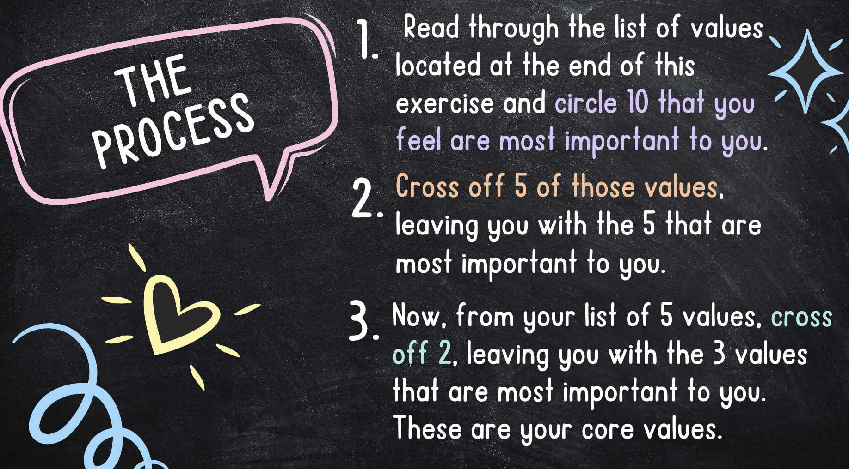

Slide 9


Slide 10
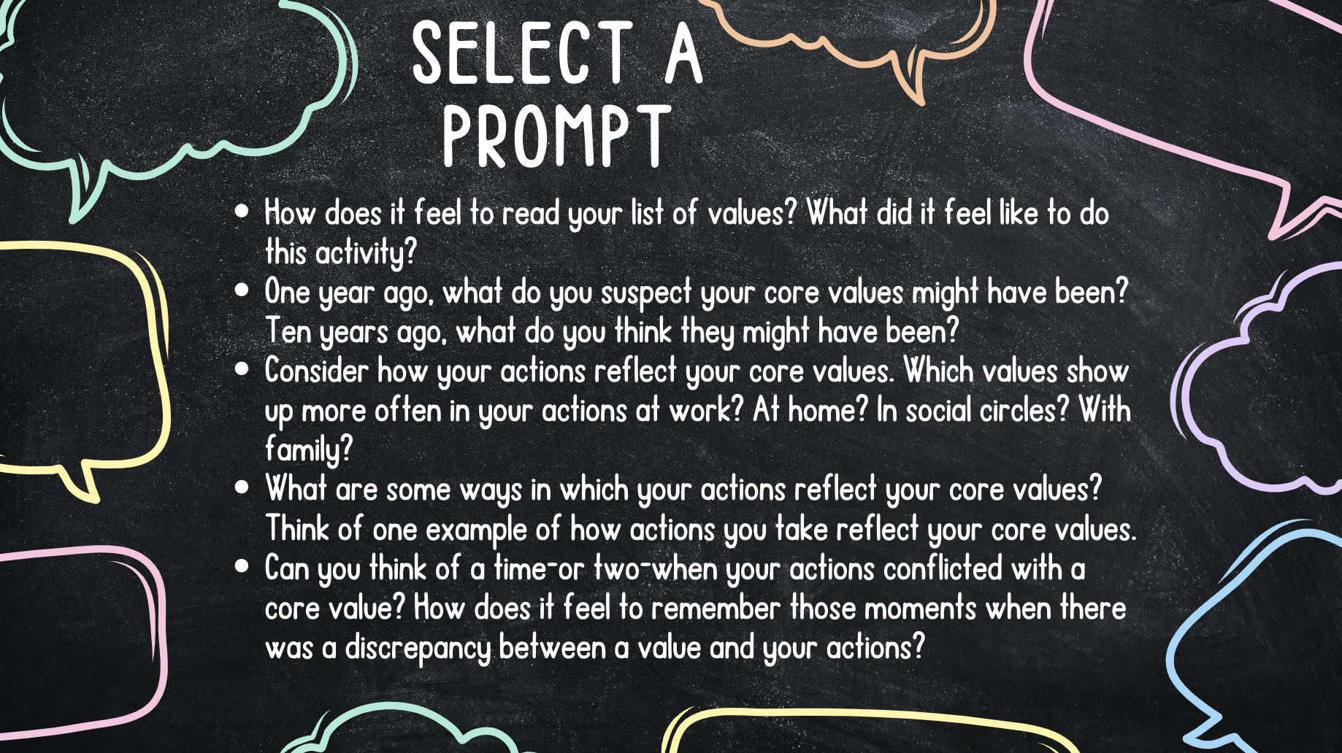

Slide 11


Slide 12
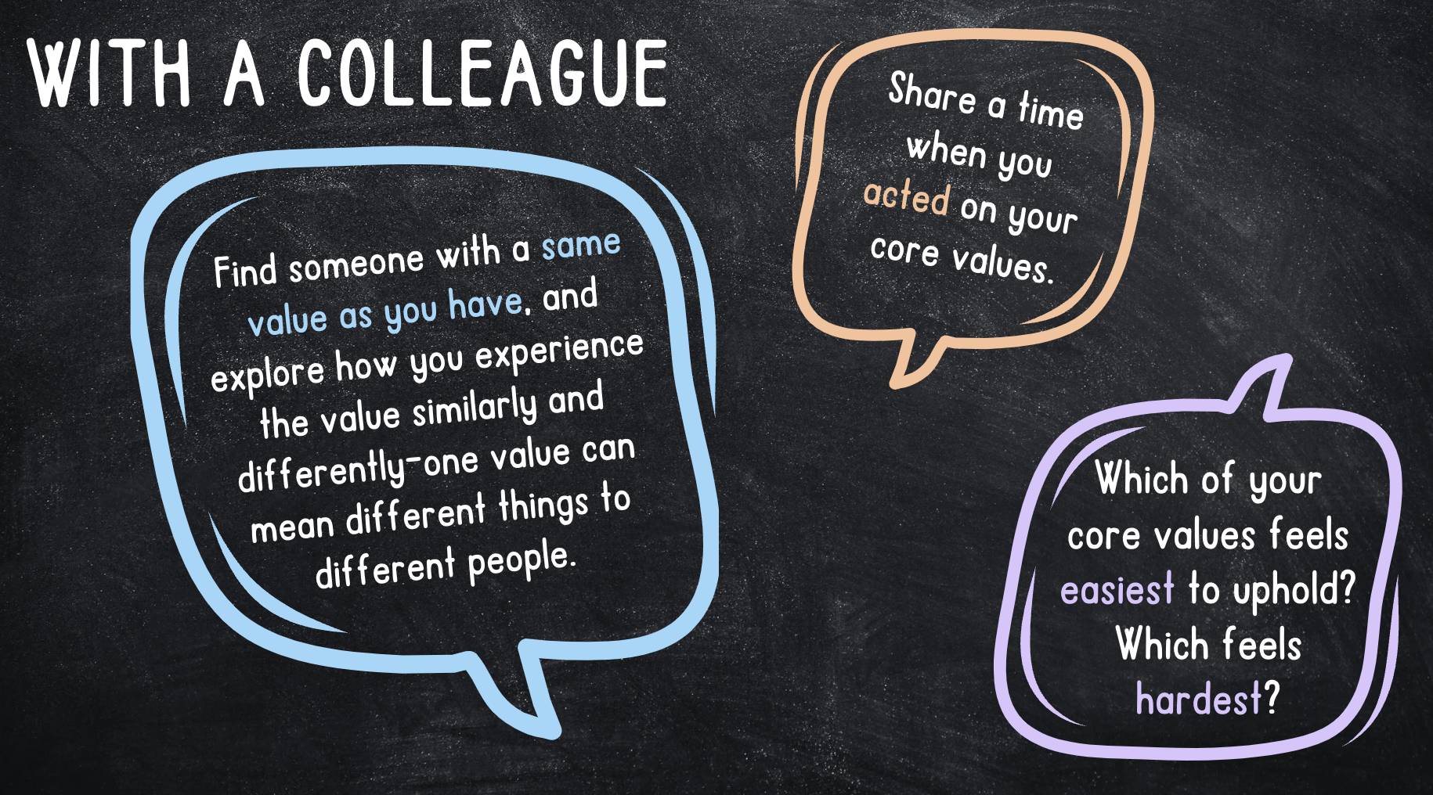

Slide 13

10 minutes

Slide 14
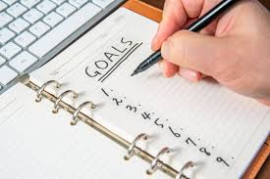
Setting Instructional Coaching Goals
Presentation

Slide 15
Ethics in Coaching
Presentation

Slide 16

11:30 - 12:30

Slide 17


Slide 18
Action Plan
Next Steps

Slide 19

Next steps
Next meeting November 19, 2024
Monthly newsletter begins October 2024
Planning survey goes out October 7, 2024
  Small group topics
  Discussion requests
  Tech requests

Slide 20

We are a team…
Reach out for anything you need!

