Slide 1

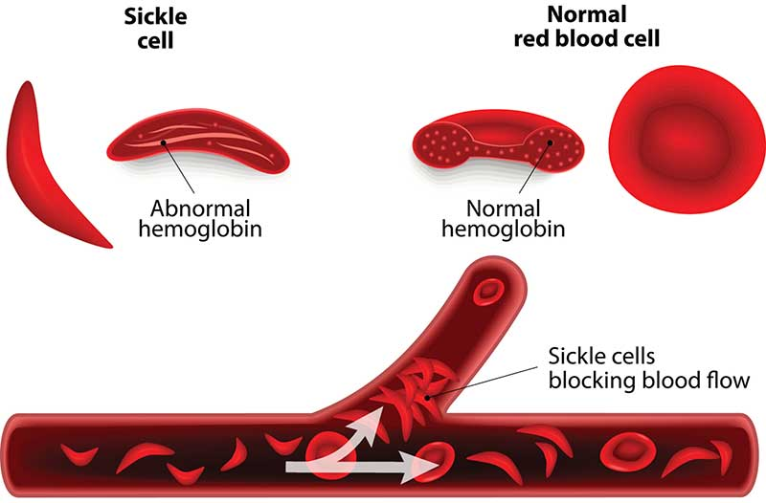
Sickle Cell
Sickle Cell Definition
Sickle cell disease (SCD) is a genetic blood disorder where red blood cells become misshapen (like a sickle) and can block blood flow. This causes pain, anemia, and other complications. It's inherited and most common in people of African, Mediterranean, Middle Eastern, and Indian ancestry.

Slide 2
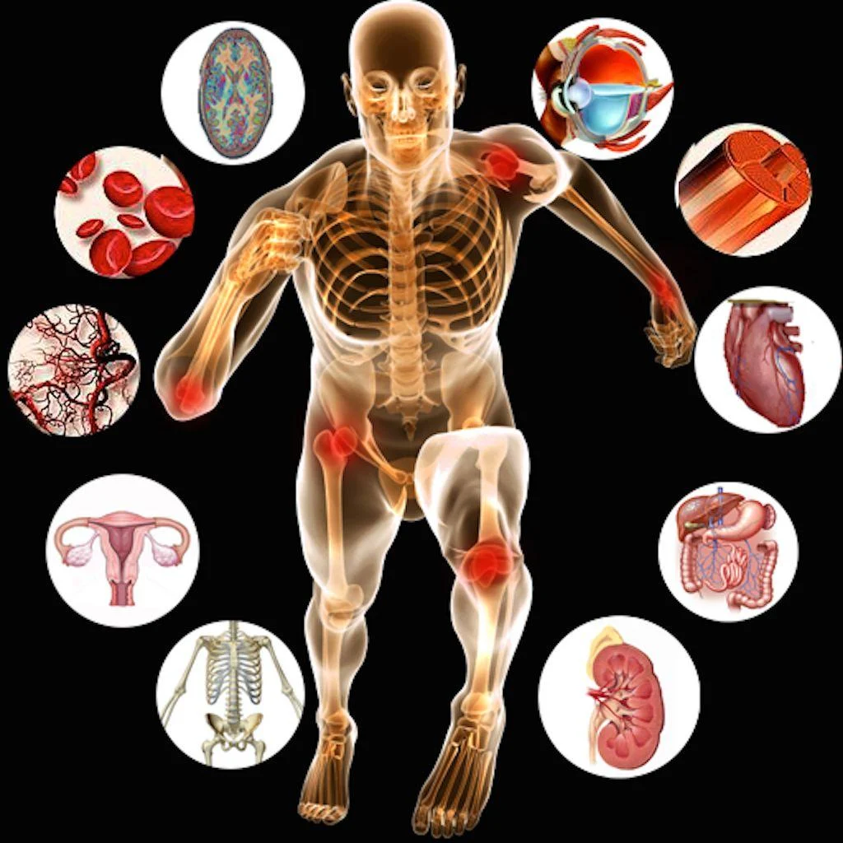
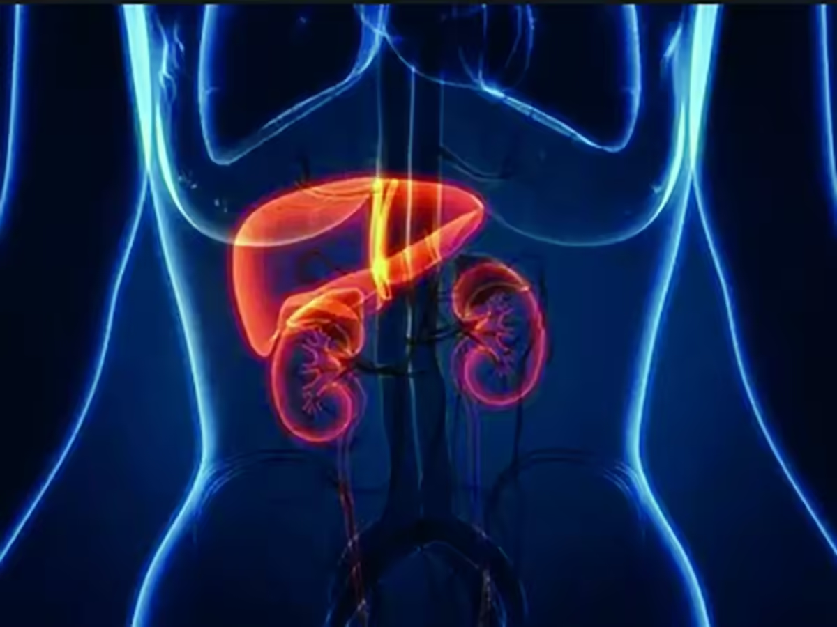
What is it?
Crisis
Sickle Cell Crisis is when the blockages, hypoxia, and organ damage cause unbearable pain that lasts between a few days and weeks.
Those with Sickle Cell are often managed by specialist teams and have universal care plans.
Pathophysiology
Sickle Cell Disease is a hereditary condition affecting haemoglobin within red blood cells, causing them to form an abnormal sickle shape.
This shape restricts the ability to carry oxygen and leads to increased risk of blockage of small blood vessels (Vaso-occlusion) and increased red blood cell breakdown, resulting in anaemia (haemolytic). Causing tissue hypoxia, pain, and organ damage.
These abnormal blood cells are more likely to form in hypoxic environments, extreme temperatures, dehydration, infection, pregnancy, surgery or stress.
Inheritance
As associated with recessive genes, both parents must have the trait for Sickle Cell to be inherited. If only one parent has the trait, then the person can be a carrier of Sickle Cell
Most common in, but not specific to, African and Caribbean ethnicities

Slide 3
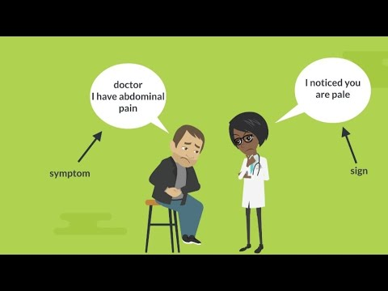
Sign and Symptoms
Signs
Symptoms
Fever/high temperature
Reduced oxygen (O₂) saturation
Cough
Pallor or jaundice
Change in level of consciousness
Dehydration
Severe pain (in long bones, joints, back, chest, abdomen)
Tiredness/weakness
Headache
Chest pain
Difficulty in breathing
Priapism (prolonged erection)
Inability to move a limb

Slide 4
Management
Ask the patient about any routine management plan, often documented in Universal or London Care Record. Note that the patient will often understand which pain relief works best for them during a crisis.
Investigate for possible causes such as infection, thrombus, and anaemia.
Plan known?
Oxygen
Oxygen to maintain 94-98% SP02. (monitoring hypoxaemia)
Oxygen in cases where there is significant signs of anaemia, or respiratory distress. (reflective of hypoxia)
Immediate pain management
Paracetamol and Ibuprofen can be given (provided no contraindications),
Entonox if available (not advised for long-term use),
Methoxyflurane (provided SOP followed which includes Kidney or renal problems being a contraindication)
HCP
Opiates such as Morphine/ Ketamine are often used for Sickle Cell Crisis. Often stated as Oral, Subcutaneous, or Intramuscular in Universal Care Plans.
Fluids may be indicated during a prolonged crisis.
Convenance?
Conveyance destination on a Universal Care Plan will often be a specialist hospital such as UCLH or St. George’s in London. If no plan is available, then conveyance to the local ED under normal road conditions, unless signs of being time critical.
Ensure adequate hydration, as dehydration can be a trigger. Begin following the predesignated management plan if known.

Slide 5

Complications of SCD?
Thrombus
Patients with sickle cell disease are at a high risk of thrombosis. Pulmonary embolus is an important differential diagnosis when patients complain of shortness of breath or chest pain.
Acute Chest Syndrome
Stokes
Acute chest syndrome is the leading cause of death amongst sickle cell patients. This is a common and potentially life-threatening complication of painful crises and is often precipitated by a chest infection. Patients present with shortness of breath, hypoxia and tachypnoea and tachycardia. Chest pain is often present, and the hypoxia responds poorly to inhaled oxygen. Crackles are often present in the lung bases and will ascend rapidly to involve the whole lung fields in severe cases. Patients with acute chest syndrome should be managed on intensive care and require exchange transfusion. It can be caused by Bone Marrow Necrosis, Fat embolism, and infections, among others...
A stroke should be suspected in patients with any change in consciousness, a seizure, severe headache, loss of movement in a limb or loss of speech, and treated accordingly. Stroke in children is usually due to a thrombotic event and may not present as a medical emergency.

Slide 6

Further reading
https://www.nhs.uk/conditions/sickle-cell-disease/
https://www.sparksicklecellchange.com/treatment/professional-support
https://www.crisis-control.co.uk/
https://www.uclh.nhs.uk/theredcellnetwork/patients/living-sickle-cell-disorder-guide-patients
https://www.paramedicpractice.com/content/features/pre-hospital-management-of-pain-associated-with-an-acute-sickle-cell-crisis
https://icpgweb.co.uk/guidelines/G0340 (JRCALC)
https://my.clevelandclinic.org/health/diseases/23290-acute-chest-syndrome
https://cks.nice.org.uk/topics/sickle-cell-disease/#!references/1381889

