Slide 1
WELCOME to the NEWPORT MOORING ASSOCIATION FALL MEETING

Slide 2
Introduction
- Roll Call – Current Board Introductions - Recap of 2017 – 2018 - Keynote Speaker – Carol Jacobs, Assistant City Manager - Hot Topics of the Harbor - Questions and Answers - Wrap Up – 2100 Hrs

Slide 3
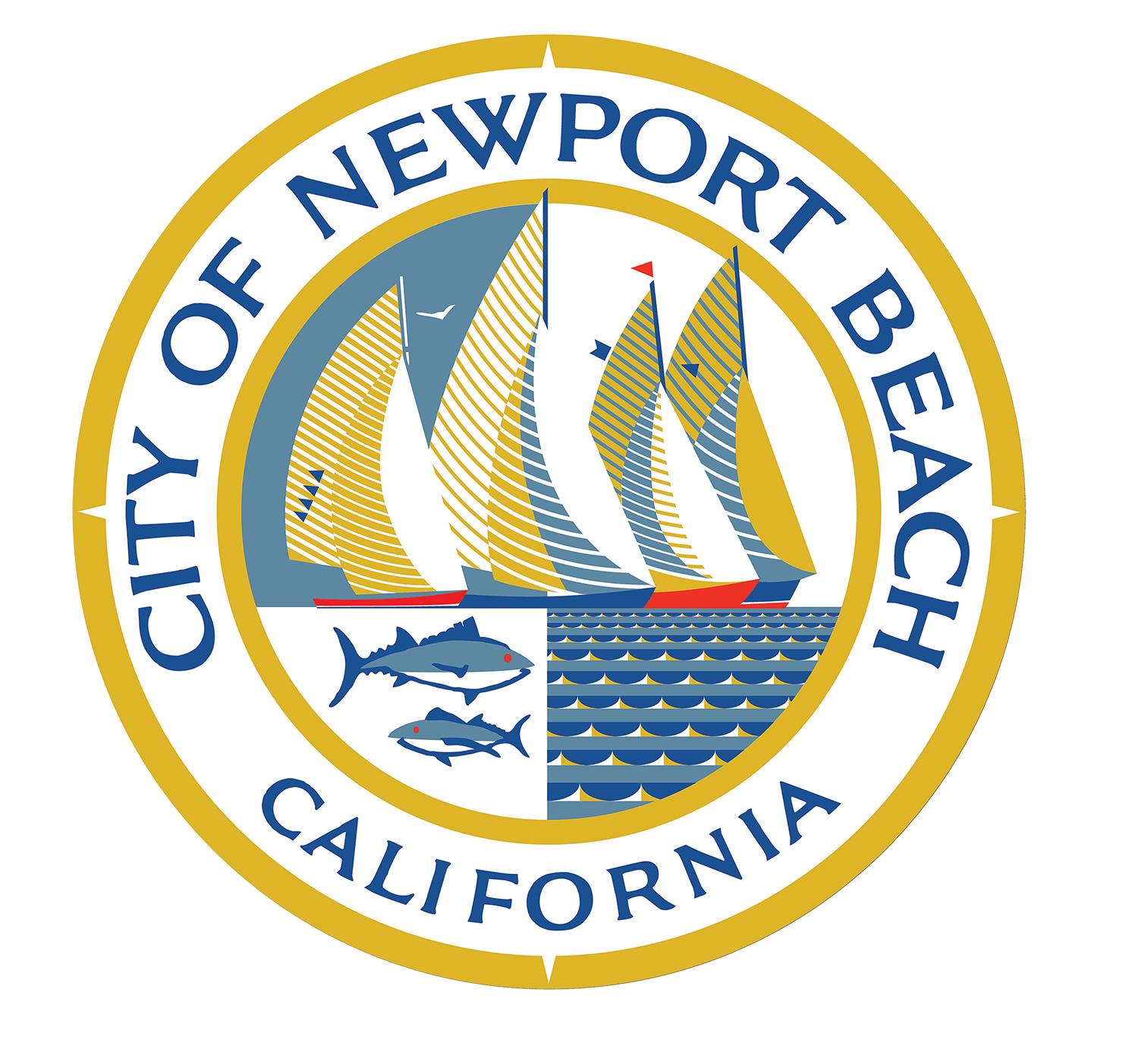
City of Newport Beach Harbor Department
Newport Mooring Association October 24, 2018

Slide 4
Harbor Department – Staff
1 Full-time Harbormaster
1 Part-time Department Assistant
1 Full-time Code Enforcement Supervisor (on loan)
Part-time Lead Service Workers
15 Part-time Harbor Service Workers

Slide 5
Notable Projects – The First Year
New Administration, policies, procedures, record keeping, mooring audits and reconciliation, staffing
New custom in-house management software, new mooring maps (locations, sizes, public docks and pump out stations)
FCC Base Station License for Marina Park
Outfitted three Harbor Master vessels to provide enhanced customer service on the water
Implementation of an Administrative Code Enforcement Program
Enhanced Harbor Map with boater safety information made in conjunction with local Coast Guard Auxiliary
Met with local rowing programs on best practices for shared harbor use
Updated Municipal Code to allow for wind and human powered events over 5mph

Slide 6
General Statistics
07/01/2017-06/30/2018
General Assists | 2,144
Speeding/Wake Advisement | 962
Mooring Check | 662
Pollution/Fuel/Discharge | 48
Hazard | 412
Noise | 21
Pier/Dock/Bridge Issue | 253
Duffy | 98
Emergency | ___19
Total | 4,619
General Assist-public contact
Speeding – Wake Advisement – slow down
Mooring Check – Special Moorings Checks for Issues (not daily check for vacancy)
Pollution/Fuel/Discharge – Report of pollutant in the water
Hazard – Trash or Large Debris Pick Up
Noise – Noise Complaints
Pier/Dock/Bridge Issues – Includes Bridge Jumpers, Fishing, Time Limit, Gangway issues
Duffy/Dinghy- Assisting of vessels under 20’
Emergency- Sent to PD/OCSD

Slide 7
Code Enforcement Cases
07/1/17-06/30-2018
Short term lodging | 17
Title 17 cases of all types | 221
Revocation | 2
Impounds | 71
Vessel Turn In | 7
Total Cases Opened | 318
Total Cases Closed | 177
07/1/18-10/23/2018 | Opened | Closed
Misc. Cases | 27 | 8
Mooring Fees | 4
Live Aboard Cases | 23
Marine Activities | 10
Property Maintenance | 68 | 12
Registration Only | 7 | 1
Sea Lions | 53 | 5
Short Term Lodging | 6 | 1
Sub Permittees | 3 | 1
Total | 220 | 28

Slide 8
Code Enforcement Cases
07/1/17-06/30-2018
Short term lodging | 17
Title 17 cases of all types | 221
Revocation | 2
Impounds | 71
Vessel Turn In | 7
Total Cases Opened | 318
Total Cases Closed | 177
07/1/18-09/04/2018 | Opened | Closed
Misc. Cases | 17 | 8
Mooring Fees | 3
Live Aboard Cases | 5
Marine Activities | 1
Property Maintenance | 43 | 12
Registration Only | 1 | 1
Sea Lions | 20 | 5
Short Term Lodging | 1 | 1
Sub Permittees | 2 | 1
Total | 90 | 28

Slide 9
Mooring Permits
OFFSHORE MOORINGS
A | 127 (+4 BYC)
B | 50 (+10 BYC)
BYC | 15 (+64 BYC)
C | 51
D | 56
F | 21
H | 91
J | 127
K | 22
MP | 10
NHYC | ~78
Total | ~726
ONSHORE MOORINGS
E (Little Island) | 33
L (Lido) | (+46 LICA)
LN (Lido) | 15
LS (Lido) | 7
N (Balboa) | 136
P (Peninsula) | 51
S (Balboa) | 155
W (Coves) | 38
Total | 481
Total Moorings: 1,207
Total Rentable Moorings: 1,005
Onshore: 435 OffShore:570

Slide 10
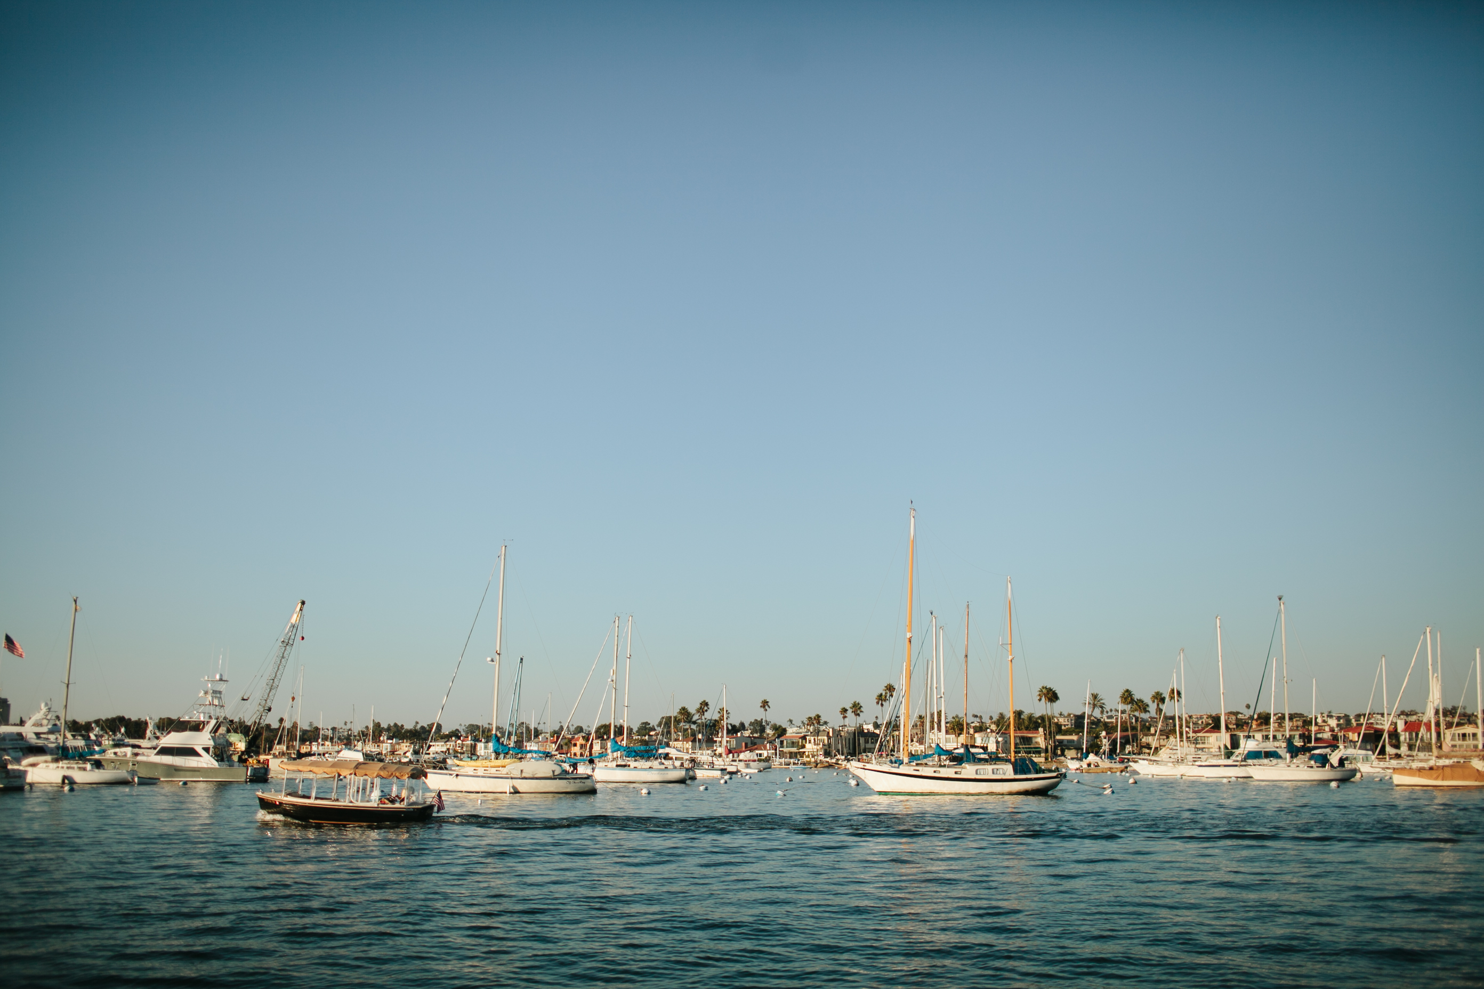
Mooring Permittee Non-Compliance
Invalid Insurance | 483
Invalid Reservations | 296
No Primary Vessels | 112
Invalid Overhaul | 276

Slide 11
Rentals/Anchorage/Live Aboard/Transfers
Mooring Sub-Permits | 1,550 | ~17.61 per night
Marina Park Moorings | 442 | ~5.02 per night
Slip Rentals 06/08/18-09/04/18 | 1,087 | ~12.37 per night
Anchorage | 1,033
Live Aboard Permits | 38 | (4 new since 07/01/2018)
Mooring Transfers (New Permittee, 2nd permittee, Family Transfer) | 111
Raft Ups | 23

Slide 12
Dredging & Copper Paint

Slide 13
Harbor Department Goals
Improve code compliance in the harbor (mooring fields, liveaboards, dock time limits)
Educate the public on safety in the harbor
Update Newport Beach Municipal Code Title 17 – Harbor Code
Develop monitoring system for charter boat industry
Continue evaluation of mooring fields (requests for extensions and enhancements)
Dredging program and copper paint solutions
Evaluate Marine Activities Permit process
Sea Lion mitigation – separate meeting

Slide 14
Sea Lion Mitigation – Marine Mammal Protection Act
Section 101(a)(4) of the MMPA allows for the non-lethal deterrence of nuisance animals under certain circumstances:
· The owner of other private property, or an agent, bailee, or employee of such owner, may deter a marine mammal from damaging private property (e.g. developed waterfront, decks, docks, floats, piers, bait receivers, vessels at anchor, etc.)
· Any person may deter a marine mammal from endangering personal safety.
· A government employee may deter a marine mammal from damaging public property.
Non-lethal deterrence measures may be used in any of these circumstances so long as such measures do not result in the death or serious injury of a marine mammal. NOAA Fisheries has defined serious injury as “any injury that is more likely than not to result in mortality.”

Slide 15
Harbor Commission – 2018 Objectives
Harbor Dredging
Harbor Operations and Management
Harbor Amenities and Capital Improvements (Mooring Fields, Shore Facilities, Docks)
Harbor Policies, Codes and Regulations (Title 17 Revisions)
Commercial, Recreational and Educational Activities
Long Term Vision for the Harbor

Slide 16
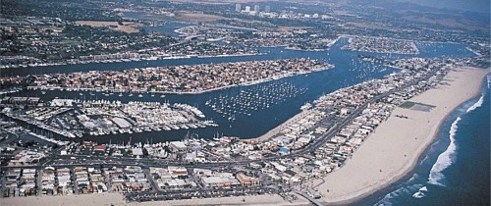
Objective 6.0 Long Term Vision of the Harbor
Objective 6.1 - Draft a Harbor Plan that can be used independently or in conjunction with an update to the General Plan and/or Harbor Area Management Plan (HAMP). Specific attention should be paid to state requirements including conservation for harbors, MLPA/MPAs and fisheries and work previously done by the Harbor Commission related to preservation of marine related activities and businesses in Newport Harbor and the Harbor Financial Master Plan.

Slide 17
Approach
Facilitated Work Sessions
Facilitated work session techniques have been used successfully by organizations for large consensus-based decision making.
The technique gives all participants an equal voice in the decision process by displaying visually the collective thoughts and concerns contributed.
The process ensures equal weights of votes and comments contributed across all participants.

Slide 18
Functional Areas Identified
ADMINISTRATION AND OPERATIONS
BEACH REPLENISHMENT
CHANNEL AND PIERHEAD LINES
CHARTER FLEET
CODE/LAW ENFORCEMENT
DREDGING
ECONOMIC VALUE/FUNDING
ECOSYSTEM
EELGRASS CAPACITY/MANAGEMENT
FLOOD CONTROL MANAGEMENT
HABITAT RESTORATION/PRESERVATION
LIVE ABOARD PERMITS
MARINE RELATED ACTIVITIES
MARINE RELATED BUSINESSES
MOORINGS/MOORING FIELDS
REGULATORY REQUIREMENTS
PUBLIC ACCESS
PUMPOUT FACILITIES
SAFETY
SEA LEVEL RISE
SEDIMENT MANAGEMENT/CONTROL
SUSTAINABILITY
TIDELAND/WATER USES
UPLAND USES
VISUAL CHARACTER
WATER QUALITY
ZONING AND DEVELOPMENT

Slide 19
Sample Exercise
DREDGING
MOORINGS/MOORING FIELDS
More is better
Inexpensive
“One and done” with the Feds
Good progress recently
Electricity and water
Marina Park Work dock
Not enough amenities
Affordable
Funding/
Cost
No simple process
No work dock
BY Basin Work dock
Permitting is expensive
No place to work on boat
Eelgrass Mgmt. Plan
Not enough dinghy storage
Access and Views
Scarcity of equipment
Privacy
RGP54 is complicated
City owned equipment
Dedicated parking
Dedicated dinghy docks
Consolidate applications
No auto parking
Plenty of eelgrass
Footprint too large
Better spoils management
Multiple vessel mooring system
Eelgrass
Discharge
Regulations too strict
Continuous suction dredging
Dye tabs for everyone

Slide 20
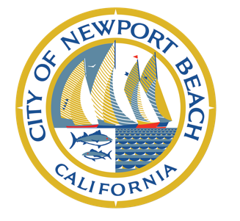
NEWPORT BEACH HARBOR COMMISSION 2018 Special Meeting and Harbor Tour November 17, 2018 8:30 am Marina Park

Slide 21
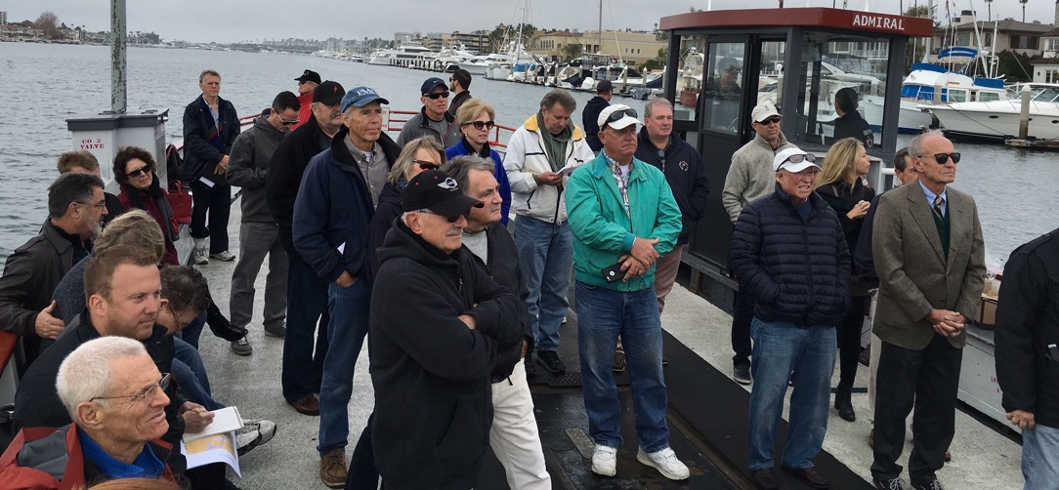
Objective

Slide 22
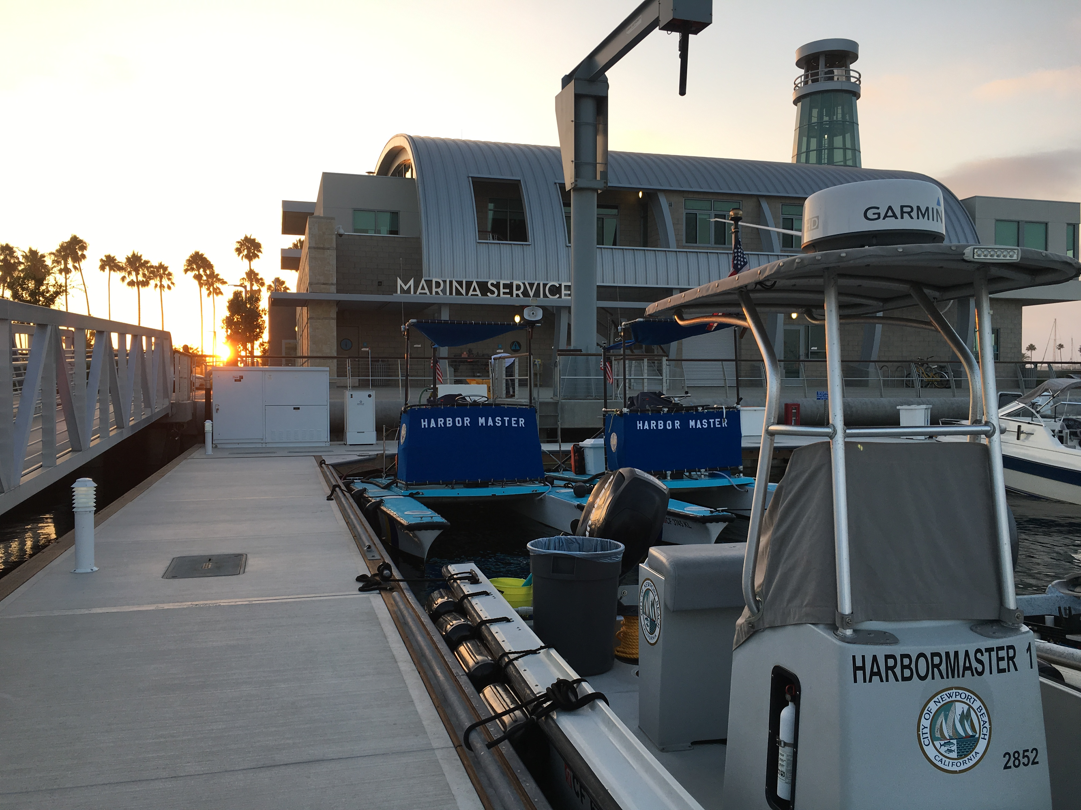
Questions?

