Slide 1
California’s Granted Lands and the Public Trust Doctrine
Newport Beach Harbor Commission Meeting| March 9, 2022
CALIFORNIA STATE LANDS COMMISSION

Slide 2
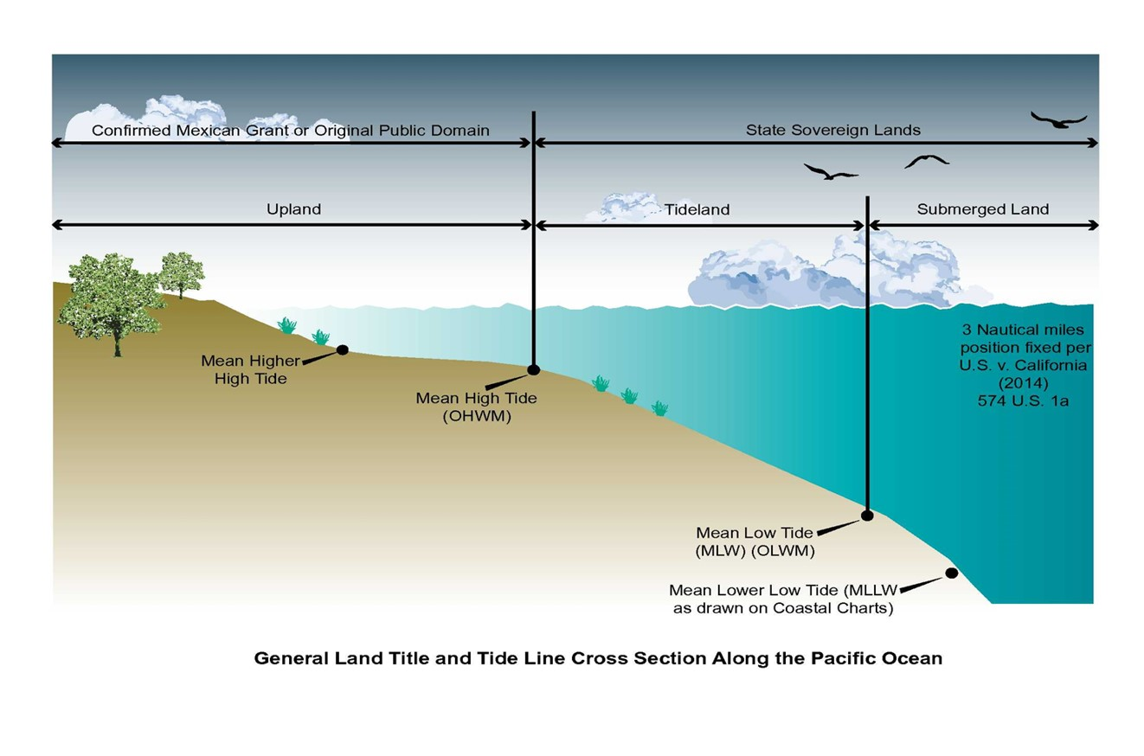
Boundary
General Land Title and Tide Line Cross Section along the Pacific Ocean

Slide 3
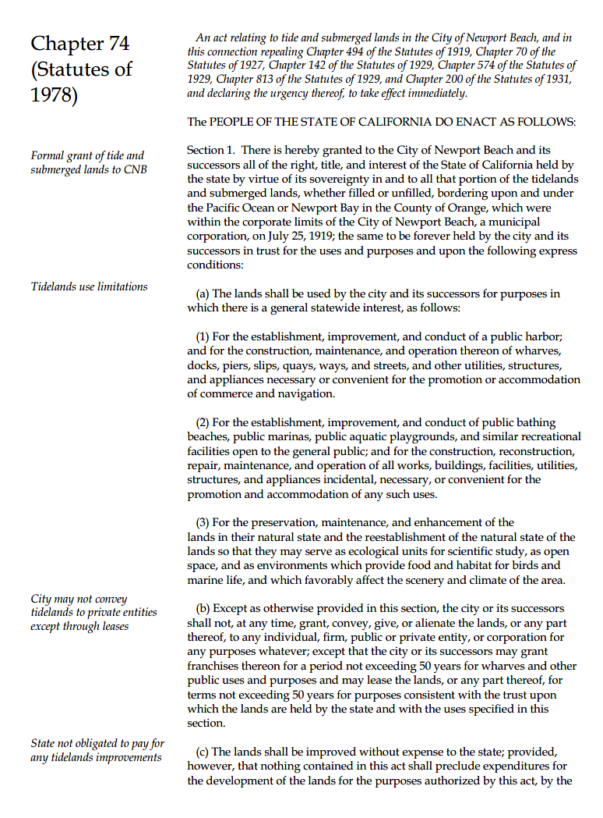
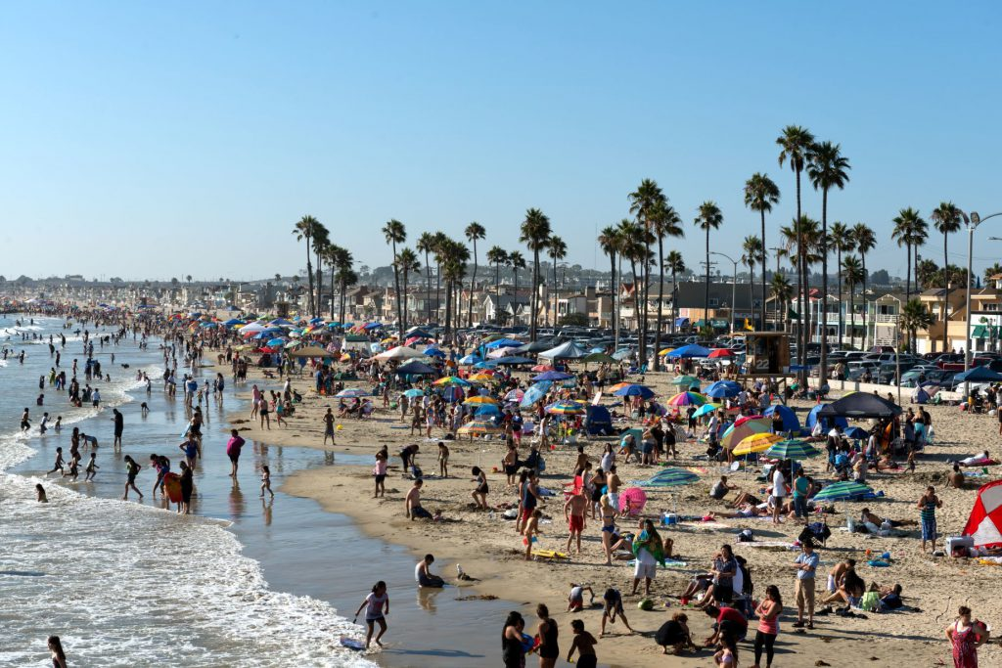
Granted Lands Overview
Newport Beach

Slide 4
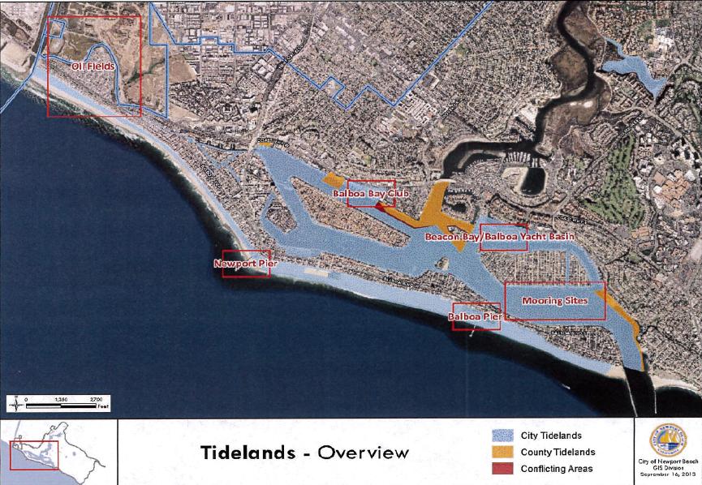
Tideland Grant
City of Newport Beach
(Created by City)

Slide 5
Public Trust Revenues
  Trustee is required to charge fair rental rates for the commercial or private use of trust lands. The California Constitution prohibits the gift of trust lands to private persons
  Trustee is required to maintain accurate records of all revenues received from the trust lands and assets, and all expenditures of those revenues
  Revenues generated by from use or operation of its granted lands are public trust assets of the State and must be reinvested back into the trust
  Revenues must be kept separate from the general funds of a local government
  May not be used for any municipal purpose, or any purpose unconnected with the trust
  Expenditures must be consistent with the common law Public Trust Doctrine and the statutory trust grant

Slide 6
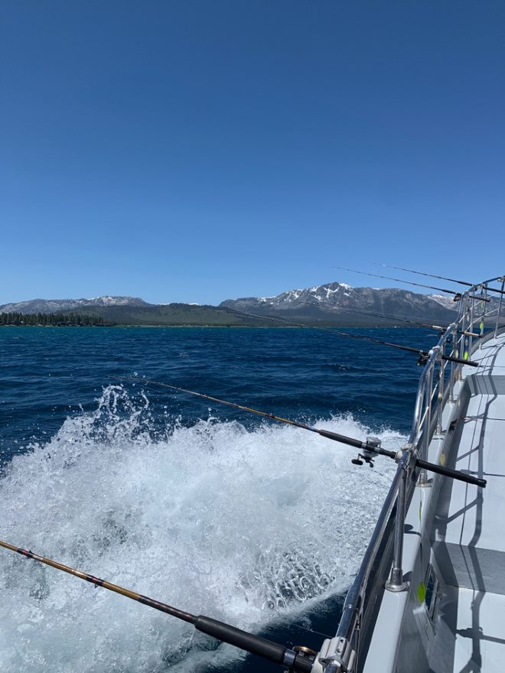
Public Trust Doctrine: Uses of the lands
Traditionally Public Trust uses were limited to:
  Water-related Commerce
  Navigation
  Fishing

Slide 7
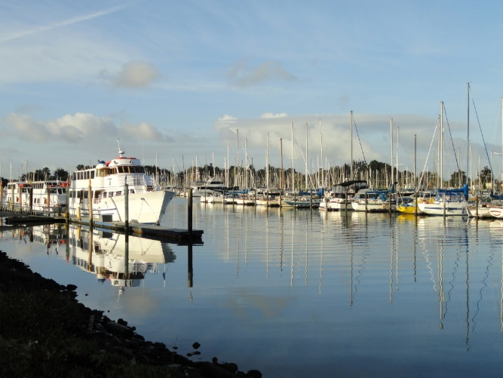
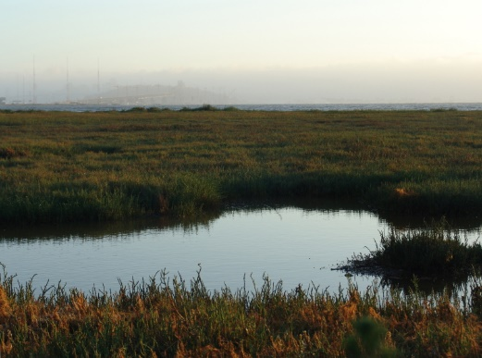
Public Trust Doctrine: Uses of the lands cont.
As a common law doctrine, which is continuously evolving, the courts have found that other water-oriented uses that benefit the public are also consistent with the trust:
  Open Space
  Ecological Preserve
  Scientific Study
  Water-dependent or water-oriented recreation
  Marks v Whitney (1971) 6 Cal. 3d 251
Emeryville mudflats distant San Francisco by Seaklaus~commonswiki is licensed under CC BY-SA 3.0.

Slide 8
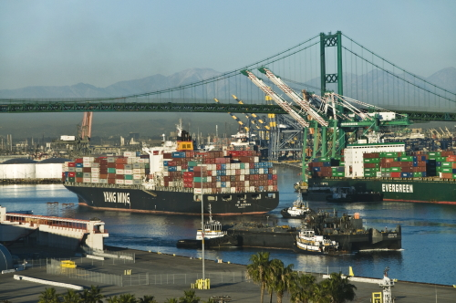
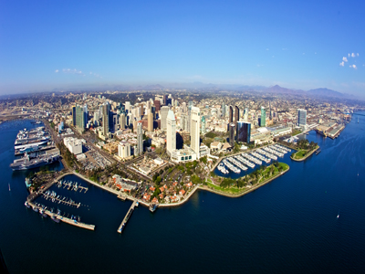
Public Trust Doctrine: Uses of the lands cont.
Commercial facilities:
  Warehouses
  Oakland v. Williams (1929) 206 Cal. 315
  Container cargo storage
  Convention and trade facilities
  Haggerty v. Oakland (1958) 161 Cal.App.2d 407
Facilities to serve waterfront visitors:
  Hotels
  Restaurants
  Parking Lots

Slide 9
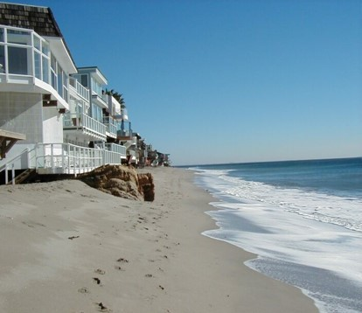
Public Trust Doctrine: Uses of the lands cont.
Uses that are generally not permitted on Public Trust lands are those that:
  Are not water-dependent or water-related
  Do not serve a statewide public purpose
  Examples:
    Residential
    General Commercial
    Non-visitor Serving Retail
    Public Schools, Hospitals, etc.
    Mallon v. City of Long Beach (1955) 44 Cal.2d 199

Slide 10
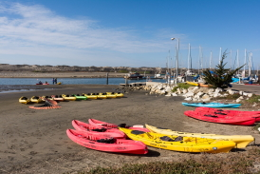
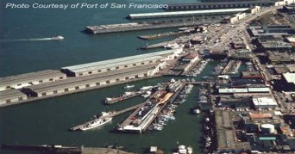
Public Trust: General Guidelines
Water-dependent or water-related.
Promote or support uses authorized by the common law Public Trust Doctrine.
Accommodate or enhance the statewide public’s enjoyment or benefit from the trust lands and not merely provide a local or municipal public benefit.
Kayaks at Moss Landing, California by Dan DeBold is licensed under CC BY 2.0.

Slide 11
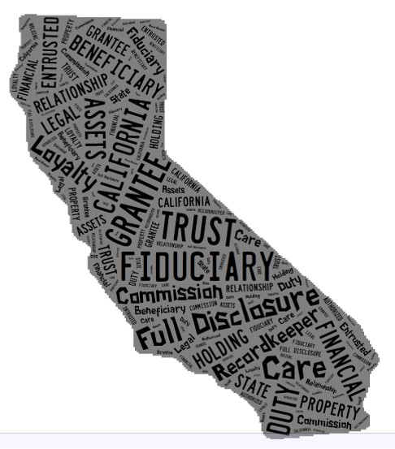
Trustee Obligations – Fiduciary Duties
Public Resources Code 6009.1
Duty of loyalty
Duty of care
Duty of full disclosure
Duty to keep clear and adequate records and accounts
Duty to administer the trust solely in the interest of the beneficiaries
Duty to act impartially in managing the trust
Duty to keep control of and preserve the trust property
Duty to make trust property productive
Duty to keep trust property separate from other property
Duty not to delegate trust responsibilities
Duty to not use trust property for trustee’s own profit

Slide 12
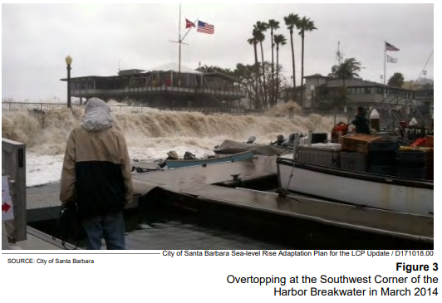
Sea-Level Rise Preparedness
Assembly Bill 691
(Muratsuchi, Chapter 592, Statutes of 2013)
Assessment of sea-level rise vulnerability to Public Trust lands and assets
Maps of sea-level rise for 2030, 2050, and 2100​
Financial costs of sea-level rise​
Description of proposed adaptation strategies

Slide 13
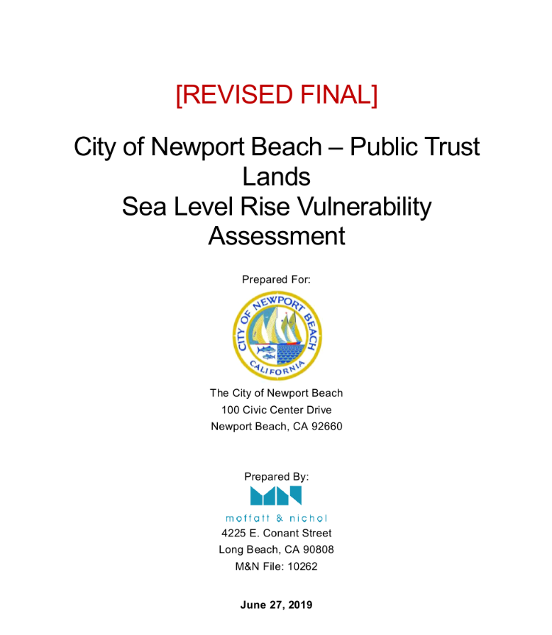
Sea-Level Rise Preparedness
Assembly Bill 691
(Muratsuchi, Chapter 592, Statutes of 2013)
Synthesis report under development now
Most trustees need more assistance assessing financial risks
Public Trust lands, resources, assets, and values are at the front lines of sea-level rise
Their protection and adaptation are critical to the state’s blue economy and environmental quality

Slide 14

www.slc.ca.gov
THANK YOU & QUESTIONS
Reid Boggiano
External Affairs
Reid.Boggiano@slc.ca.gov
916.574.0450
@CAStateLands

