Slide 1
Bank Owned Life Insurance
Primer
Illinois Bankers CEO Forum
November 14th, 2019
Brian E. Watterson, Senior Managing Director

Slide 2
What is BOLI?
A form of Life Insurance purchased by Banks in which the Bank is the owner AND Beneficiary of the policy.
BOLI is typically only available to profitable financial institutions.
BOLI is a highly specialized form of a single premium insurance product with strong investment attributes that is specifically tailored to banks.
It is a high-yield, low risk investment and is approved by the regulators.
In accordance with FIL 127-2004, BOLI provides tax-free income to assist the bank in offsetting the rapidly rising cost of providing employee benefits for the entire bank. No new benefits need to be added in order to put BOLI on the balance sheet.
IBA CEO FORUM

Slide 3
How BOLI Works
When a Bank enters a purchase of Bank Owned Life Insurance:
The policies cover a select group of Employees/Officers*, which can include Directors.
Single premium life insurance contract.
The Bank is the premium payer, owner and beneficiary.
BOLI products are institutionally priced investment products and not designed like “typical” insurance.
No loads- 100% of premium booked as an Other Asset on Day 1.
Full cash value growth booked as Other Non-Interest Income.
Cash value grows tax-free.
No charges if policy surrendered.
Pension Protection Act of 2006 / COLI BOLI Best Practices states in order to be insured the individual must meet the definition of a “highly compensated employee”
IBA CEO FORUM

Slide 4
BOLI Issues/Risks
Liquidity
  Only a small percentage of the Bank’s assets are involved.
Transaction
  Specific carriers specialize in BOLI. There is over $160 billion of BOLI on bank balance sheets.
Tax and insurable interest implications
  Management should understand the tax implications of the BOLI asset. The bank has significant insurable interest in the lives of the officers.
Reputation risk
  The Bank obtains written consent from all participants
  The Bank will only purchase insurance on officers and directors of the bank.
IBA CEO FORUM

Slide 5
BOLI Issues/Risks
Credit
  Only the highest rated carriers provide BOLI products. As a life insurance policy owner, the Bank is in the first position as a creditor.
  The Bank has the ability to implement a IRC §1035 Exchange from one carrier to another (in the event of a credit downgrade or carrier non-performance) without creating a taxable event.
Interest Rate
  Carriers reset the interest rate quarterly or annually depending on the product structure, based upon its portfolio investment return and current interest rate environment.
Compliance
  The BOLI transaction complies with FIL 127-2004, and Illinois Insurable Interest laws.
Price
  Accepted by carriers, the Bank’s investment in BOLI is always held at book value.
IBA CEO FORUM

Slide 6
Regulatory Relationships
We collaborate closely with and advise National Bank regulators:
Advised the interagency supervisory task force in drafting the Interagency Statement on Purchase and Risk Management of Life Insurance, OCC 2004 – 56.
Involved in predecessor regulations, including OCC 96-51 and OCC 200-23.
Instrumental in developing the call report classifications of BOLI, i.e. General, Separate Account, and Hybrid Account.
Meet regularly with the agencies in Washington DC to discuss current issues related to BOLI and executive benefits.
Invited to lead three BOLI training sessions as part of the 2015 FFIEC Community Bank Emerging Issues Conference where over 300 examiners from the OCC, FDIC, and Federal Reserve were in attendance.
IBA CEO FORUM

Slide 7
BOLI Participation by Asset Size
IBA CEO FORUM

Slide 8
Sizing a New BOLI Transaction
An FDIC regulated Bank’s overall BOLI holdings should not exceed 25% of Tier One Capital.
  OCC-FED regulated banks may add ALLL to T1 Capital before applying the 25% Factor
In accordance with FIL 127-2004, a bank, when considering a BOLI transaction, should look at their legal lending limits and concentrations of credit.
As of 9/31/19, Bank “X” $4,332,000 of Tier One Capital. In accordance with FIL 127-2004, the Bank could purchase $1,083,000 million of BOLI.
IBA CEO FORUM

Slide 9
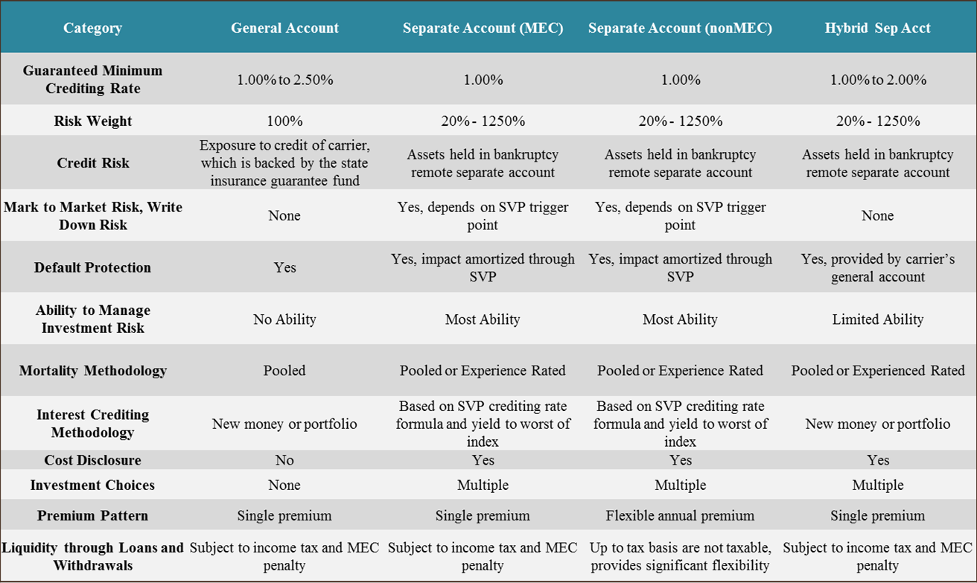
BOLI Product Comparison
IBA CEO FORUM

Slide 10
Death Benefit Sharing With Participants
At the Bank’s discretion a portion of the death benefit can be shared with each participant’s beneficiaries.
Typical plan design elements:
  Benefit can be a function of the BOLI policy death benefit, or a fixed dollar amount, or a multiple of salary. Because this is not an ERISA plan, the bank can discriminate and provide different amounts to different participants.
    A typical benefit is one to two times salary is provided to all participants, at the Bank’s discretion.
  The two main designs are Split Dollar or Death Benefit Only (DBO ) plans:
    Split Dollar
      Benefit is paid directly by the insurance carrier, and is received tax free by the named beneficiary.
      Participant is taxed annually on the imputed income.
      Benefit is not a deductible expense for the Bank.
    DBO
      Benefit is paid directly by the Bank, and is received fully taxable by the named beneficiary.
      No tax impact to the participant.
      Benefit is a deductible expense for the Bank.
IBA CEO FORUM

Slide 11
Death Benefit Sharing With Participants
Design elements continued
  The main difference between Split Dollar and DBO is that under Split Dollar the IRS treats the payout at a life insurance proceeds, and under DBO as compensation paid by the bank.
  Term of plan can be either while employed only, or can survive into retirement. Under GAAP the bank must only accrue for post retirement benefits. However if the benefit is only while employed no accounting accrual is required.
The most common type of plan is:
  DBO, because it does not generate imputed income for participants.
  Benefit a function of salary, for example 1 x salary, because it’s generally considered a reasonable amount of benefit to provide.
  Benefit is paid while employed only, because it does not require the bank to setup an accounting accrual.
IBA CEO FORUM

Slide 12
BOLI Provides
Immediate substantial tax-free income to the Bank
Historical yields in excess of 2.50% (net after-tax and after Cost of Funds)
Lower effective tax rate
Predictable future earnings
Tax deferred growth (booked as Other Non-Interest Income)
Non-taxable death benefits (booked as Other Non-Interest Income)
Offsets increasing cost of all employee benefit expenses
Increased net income
IBA CEO FORUM

Slide 13
BOLI Carrier Guide
 | Mass Mutual | Midland National | Minnesota Life | New York Life | North American
Financial Ratings
AM Best | A++ | A+ | A+ | A++ | A+
S&P | AA+ | A+ | AA- | AA+ | A+
Moody’s | Aa2 |  | Aa3 | Aaa
Fitch | AA+ | A+ | AA | AAA | A+
Comdex | 98 | 88 | 93 | 100 | 88
Group Affiliation/Parent Co. | MassMutual Financial Group | Sammons Financial Group | Securian Financial Group | New York Life Group | Sammons Financial Group
Year Established | 1851 | 1906 | 1880 | 1841 | 1886
Company Type | Mutual | Stock | Stock | Mutual | Stock
Domiciled | MA | IA | MN | NY | IA
Approximate Admitted Assets | $223B | $51B | $40B | $170B | $22B
BOLI Product Types Available | General Account | General Account & Hybrid Account | General Account | General Account & Hybrid Account | General Account
IBA CEO FORUM

Slide 14
BOLI Implementation Process
Plan Design
Carrier Product Selection
Sizing the Transaction
Regulatory and Insurable Interest Compliance
Board Approval
Implementation
Employee Enrollment, Consent & Underwriting
Plan Closing
Plan Funding
Policy Issue
Service
Compliance Manual
Administrative Manual
Ongoing Reporting
Annual Review
IBA CEO FORUM

Slide 16

MEYER-CHATFIELD GROUP
    Brian Watterson
    Senior Managing Director
    Meyer-Chatfield Group
    717 Brentwood Court
    Glen Ellyn, IL 60138
    C: (630) 721-1079
    Brian.watterson@meyerchatfield.com
    www.meyerchatfield.com
Notes:
Confirm that the correct producers are on here

Slide 17
This material constitutes our confidential information, and by reviewing it you agree to maintain it in strict confidence. If you do not agree to maintain this material in strict confidence, then you are not authorized to review it and are instructed to return it to us immediately. This material is for informational purposes only and does not constitute an offer to sell, a solicitation of an offer to buy, or a recommendation for any securities or other financial instruments. You should not construe any portion of this material as legal, tax, investment, financial or other advice. The statements contained herein are based upon information that we believe to be reliable as of today’s date, but we cannot represent that such statements are complete or accurate.
Past performance is no guarantee of future results. There is no guarantee that any investment strategy referenced herein will work under all market conditions. Prior to making any investment decision, you should evaluate your ability to invest for the long-term, especially during periods of downturns in the market. You alone assume the responsibility of evaluating the merits and risks associated with any potential investment or investment strategy referenced herein. To the extent that this material contains reference to any past specific investment recommendations or strategies which were or would have been profitable to any person, it should not be assumed that recommendations made in the future will be profitable or will equal the performance of such past investment recommendations or strategies.
IRS Circular 230 Disclosure Notice: Meyer-Chatfield and its affiliates do not provide tax advice. Accordingly, any discussion of tax matters contained herein (including any attachments) is not intended to or written to be used, and cannot be used, in connection with the promotion, marketing, or recommendation by anyone unaffiliated with Meyer-Chatfield of any of the matters addressed herein or for the purpose of avoiding tax related penalties.
Republic Bank of Chicago

