Slide 1
Lonseal Flooring

Slide 2
Highlights
Lonseal specializes in Resilient Sheet, that’s all we manufacturer – so it’s our specialty
  Over 45 years in U.S. market with an excellent reputation
  Manufacturered in Japan to the highest quality standards
  Fully stocked in Southern California
  Beautiful and Unique products using only the highest quality films
  Each product has it’s custom colored weld thread that does not need glazing
  Topseal is our factory applied finish – twice the thickness of most other resilient sheet finishes. UV cured at the factory
  Floor Score Certified-all products
  Mindful Materials compliant
  Conforms to California 01350 Low Emitting Materials
  Member IIDA, AAHID & ASID
  IICRC Certified for ISSI and FCT
  Member of ASTM Committee F06 on Resilient Floor Coverings

Slide 3
Latest News
Lonseal has been a trend setter for 45+ years and was recently awarded the Product Innovations 2019 Merit Price for Lonstrand Topseal! Being “green” is no longer enough, which is why we have devoted our designs to Biophilia. Studies have proven positive results in people when applied science is used to unite humans with nature. Rather than addressing the latest trend in design and color, we develop product lines that are part of a solution. Not just for the health and wellbeing of the people inhabiting the spaces, but also for the positive influence on our clients’ business profit margin. Our LONSTRAND TOPSEAL that was showcased at NeoCon was an example of restorative design. Attached is the LONSTRAND STORY

Slide 4
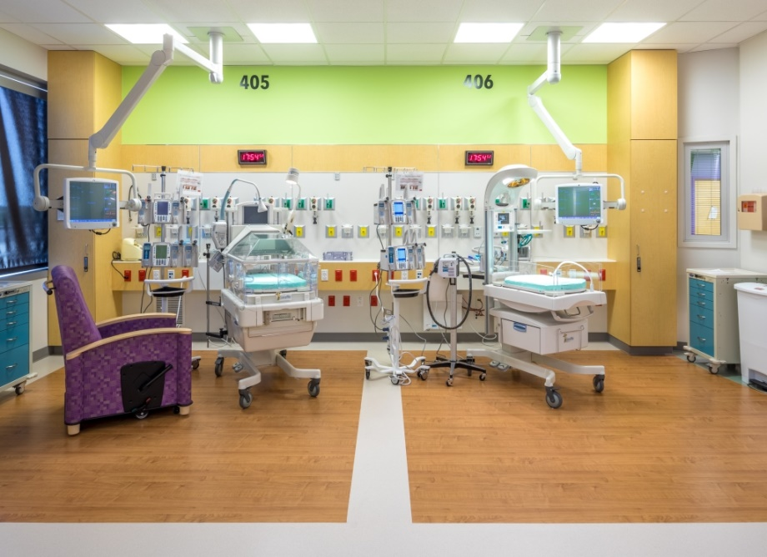
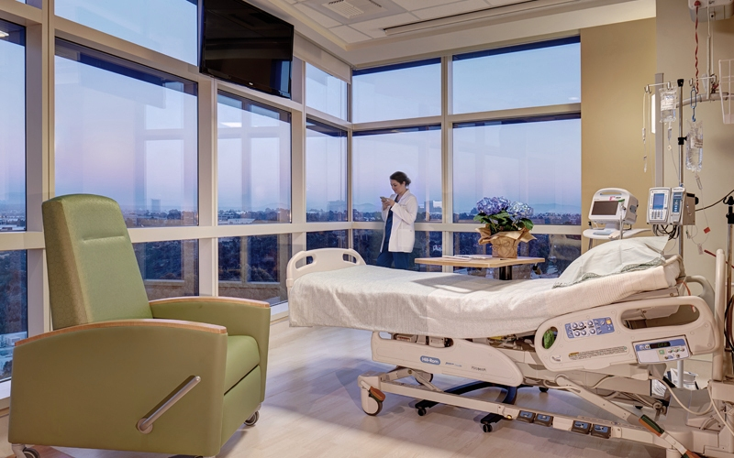
Patient Rooms

Slide 5
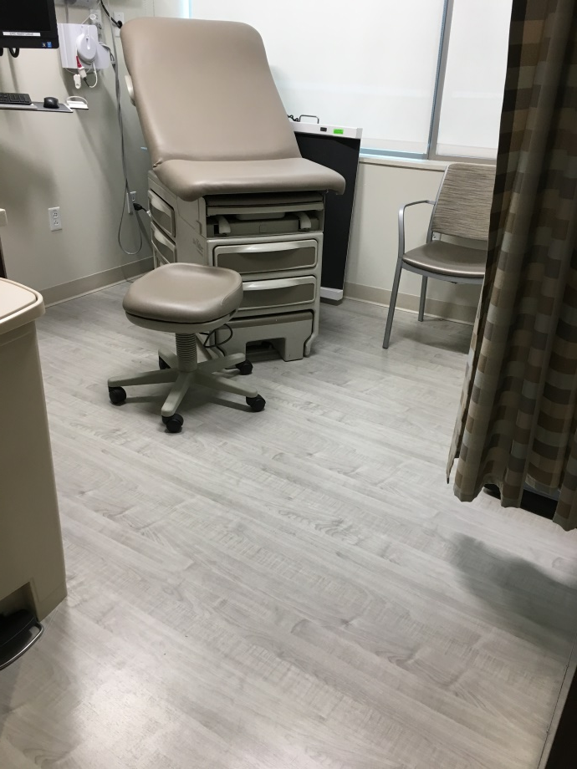
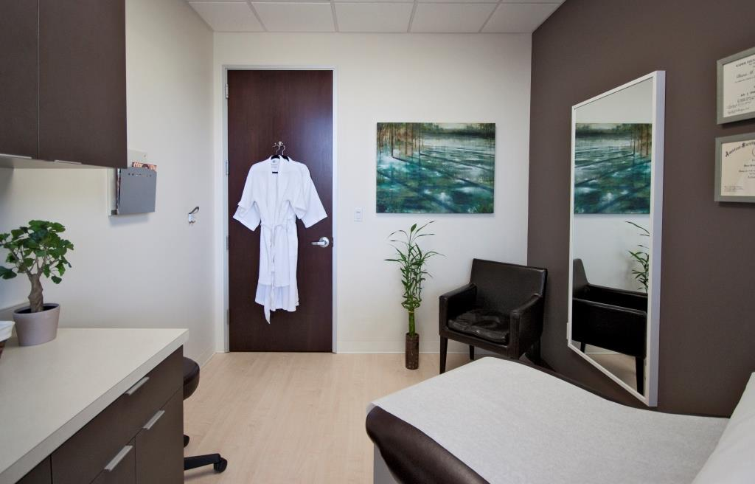
Exam Rooms

Slide 6
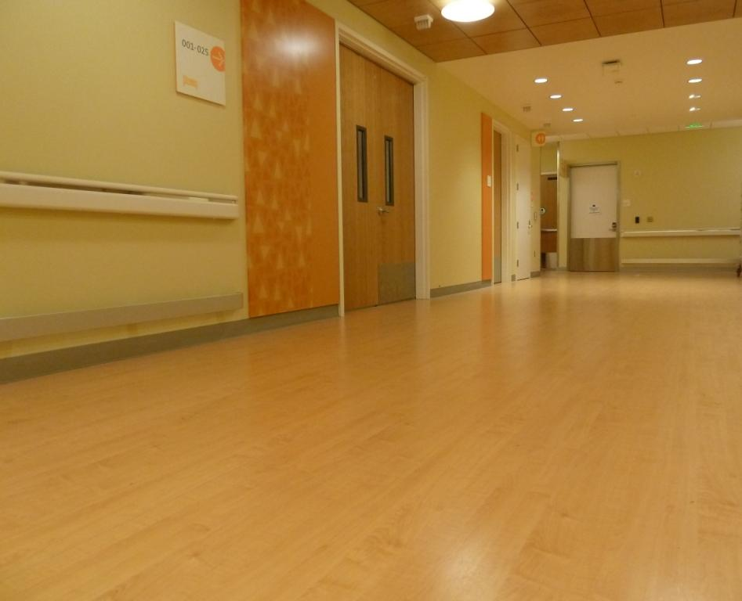
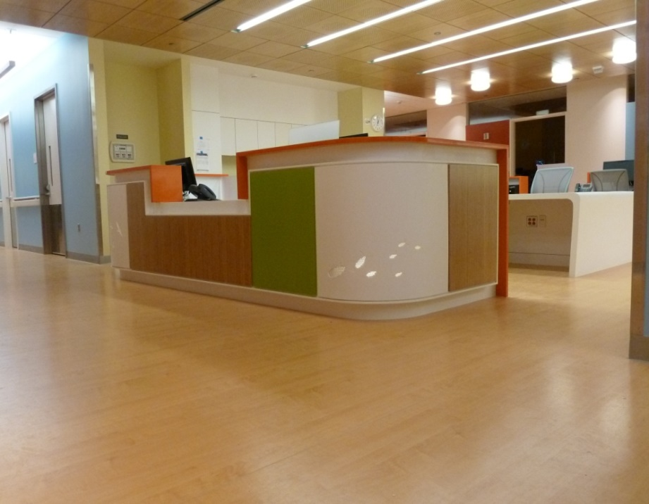
Hospital Corridors

Slide 7
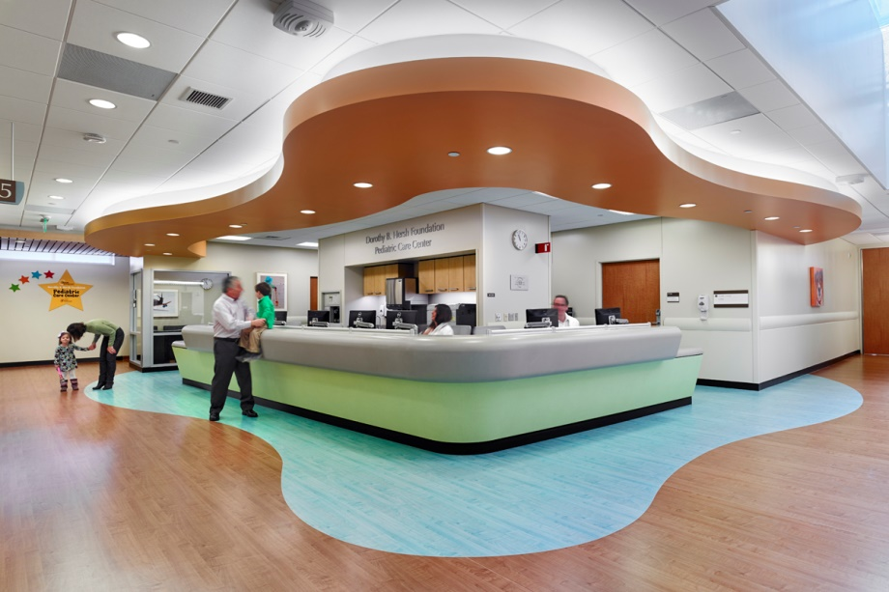
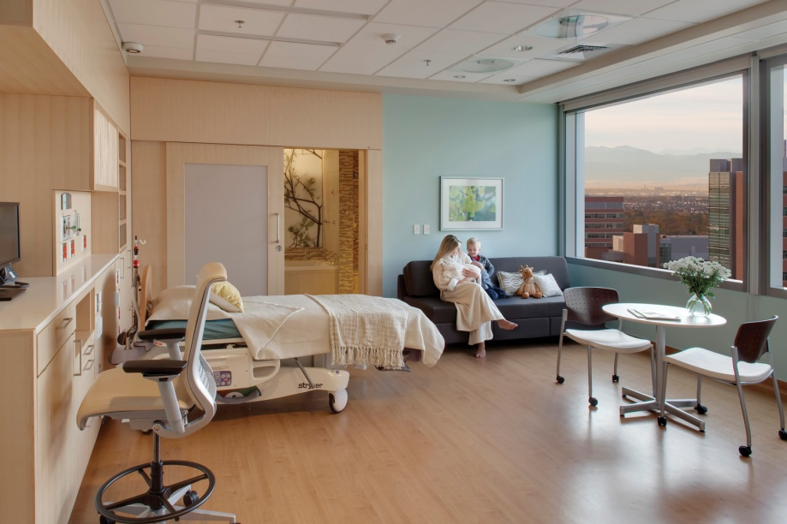
Children’s Hospitals

Slide 8
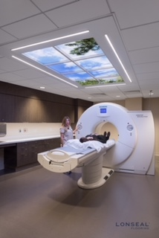
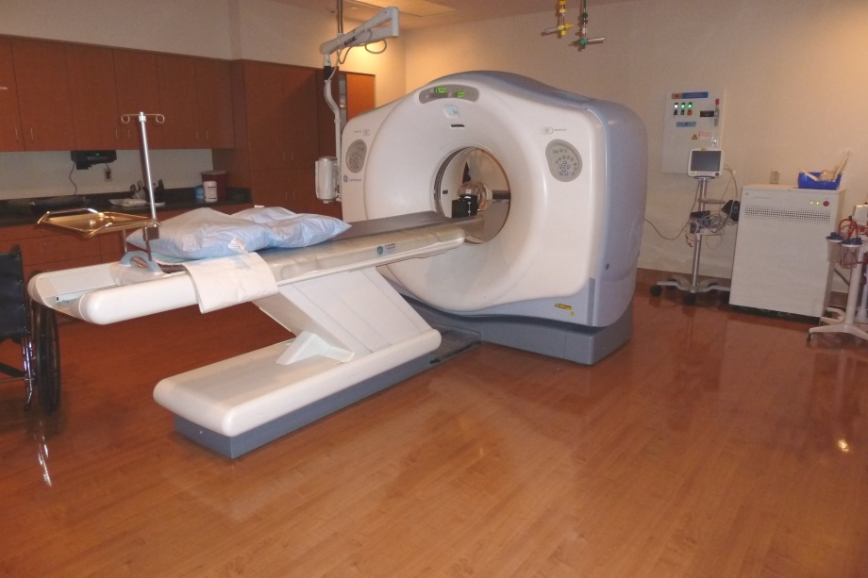
MRI

Slide 9
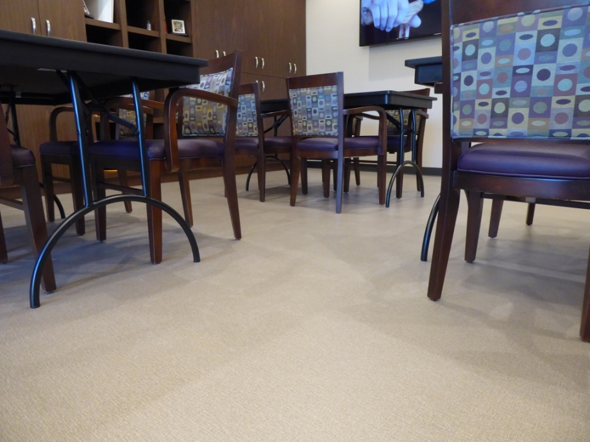
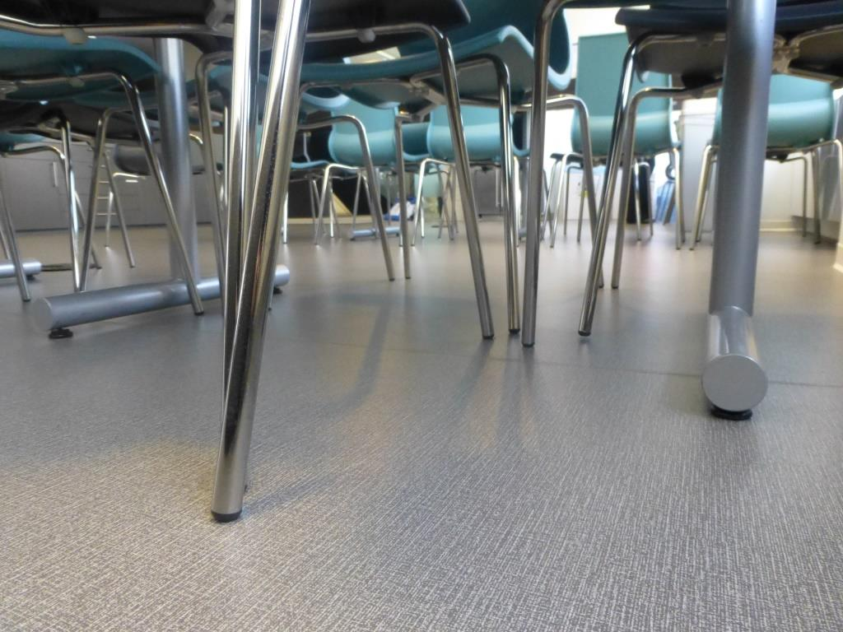
Assisted Living

Slide 10
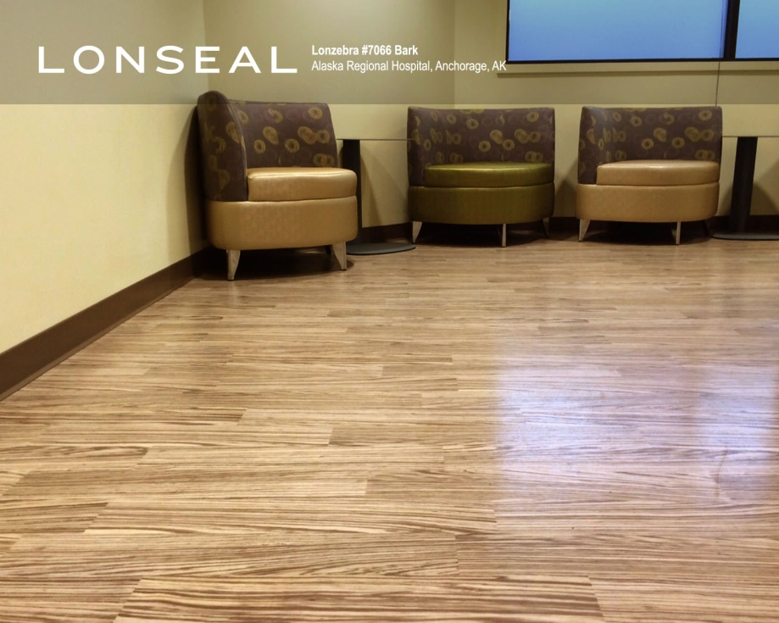
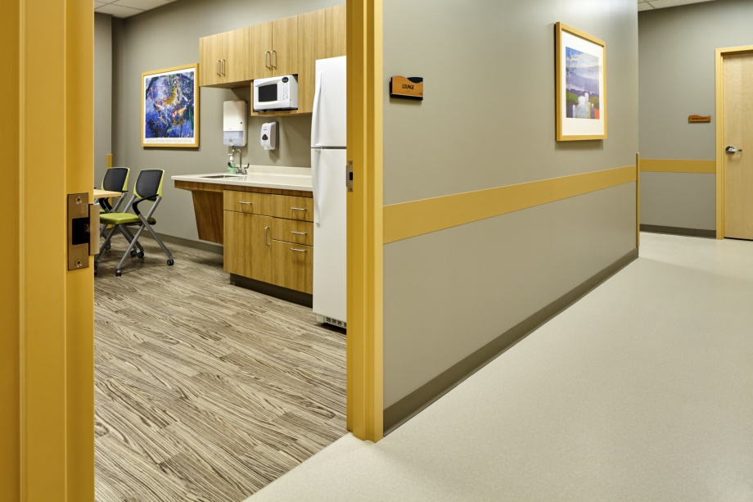
Unique Patterns for MOB

Slide 11
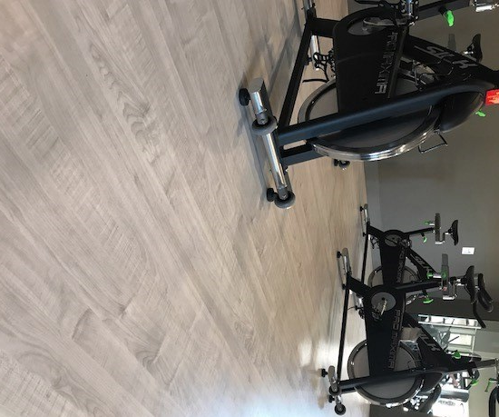
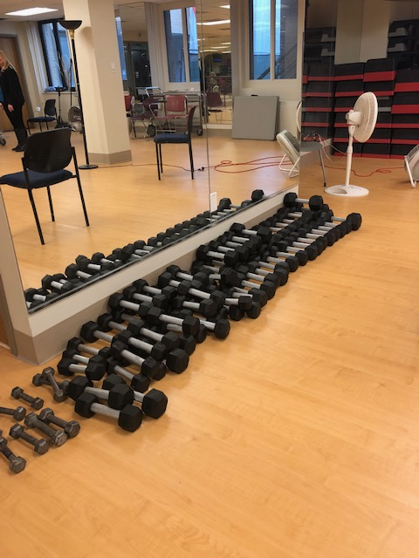
Physical Therapy

Slide 12
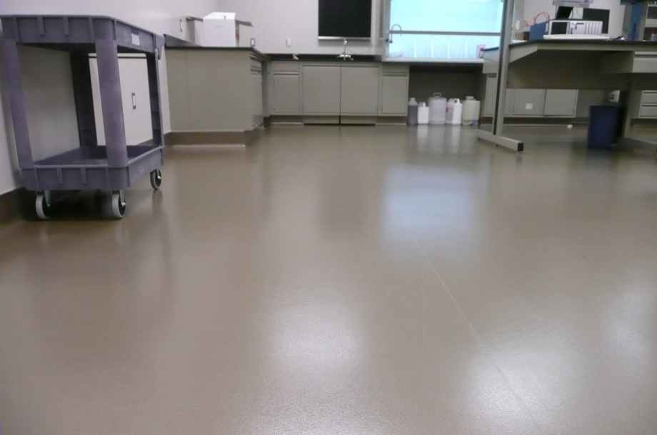
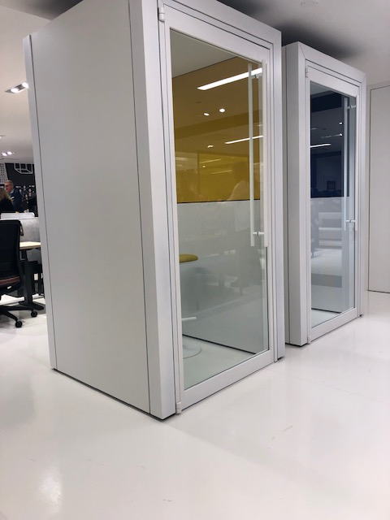
Labs

Slide 13
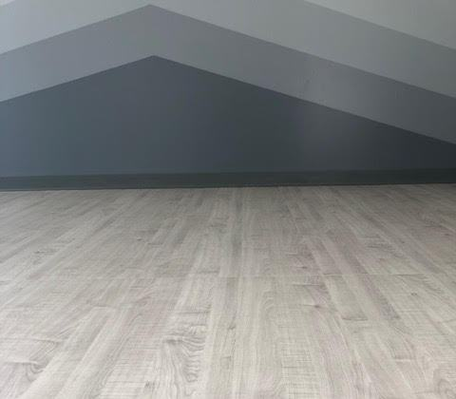
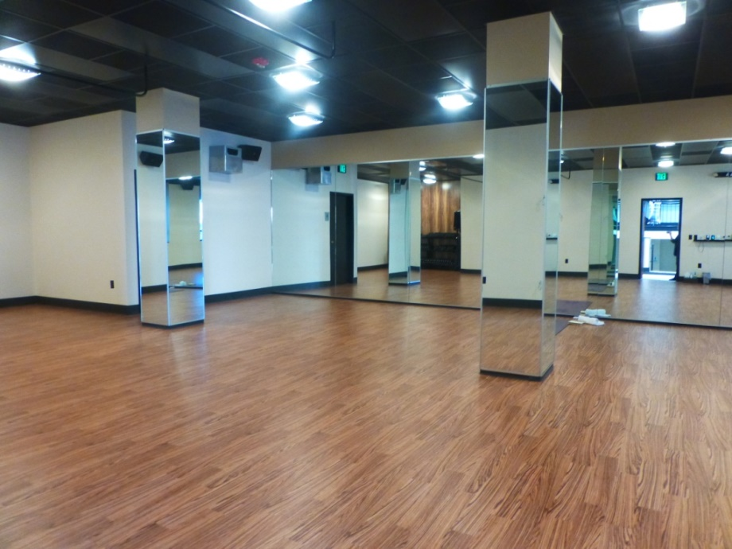
Hot Yoga

Slide 14
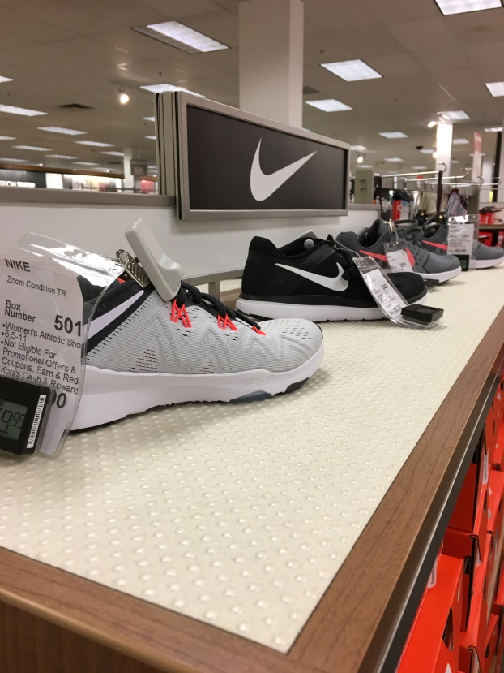
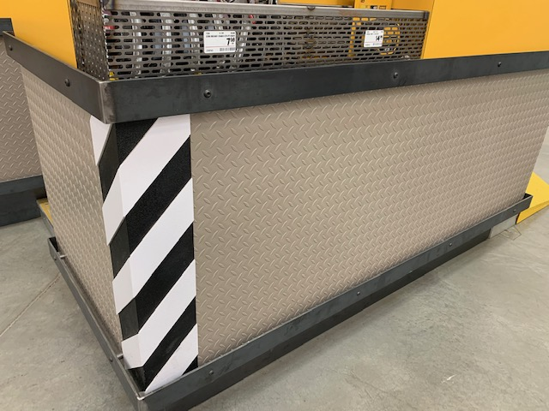
Fixtures

Slide 15
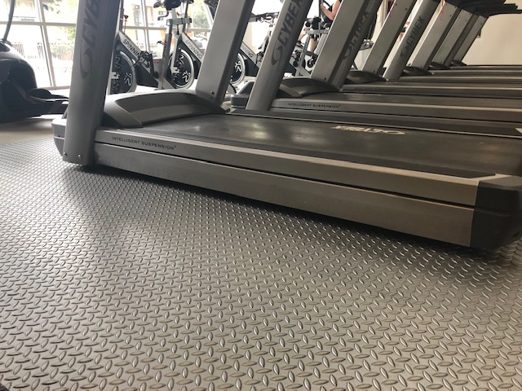
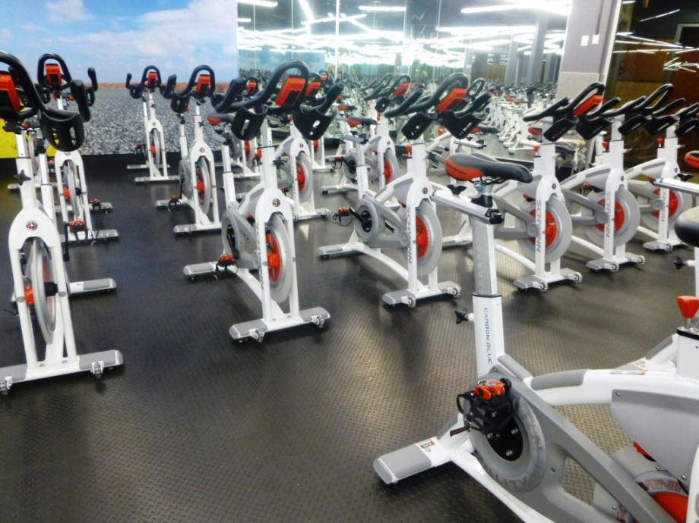
Fitness

Slide 16
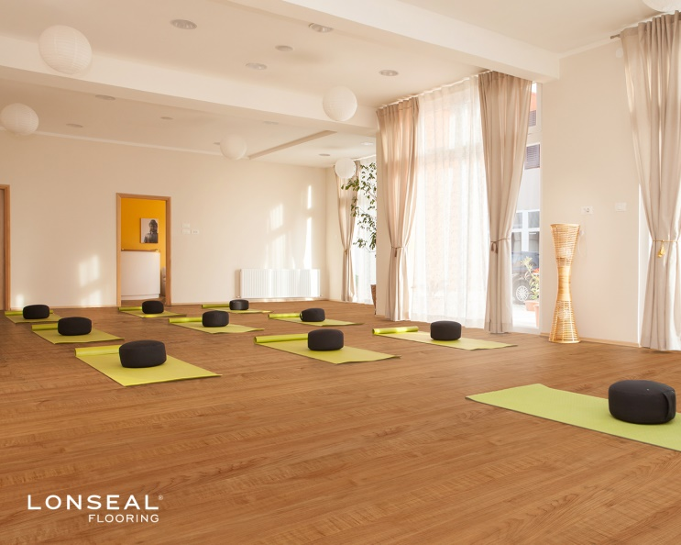

New Lonwood Performa colors

Slide 17
Current Green Features
GreenAir™
  Lonseal’s proprietary low VOC formulation-Lowest VOC resilient in the industry
  Meets JIS A 1901 per 3rd Party testing
GreenMedic™
  Lonseal’s proprietary antimicrobial technology
  Meets JIS Z 2801 per 3rd Party testing
FloorScore®
  Certified by SCS Global Services
Recycled Content
  Majority of Lonseal’s flooring contains a minimum of 20% pre-consumer recycled content
Green Label Plus
  #650 and #813 adhesives
  Certified by CRI
Group Environmental Product Declaration (EPD)
  Industry-wide EPD with most major vinyl flooring manufacturers

Slide 18
Product Performance
Indentation Resistance
ASTM F970 – Static Load Limit
  An indentation machine is used to indent a 1.125 in. (28.6 mm) diameter surface into the flooring under a specified load for 24 hours. Residual indentation is measured 24 hours after load removal. To classify as Commercial quality per ASTM F1303, the load must be 175 lbs. and residual indentation cannot exceed 0.005 in. Lonseal also tests under a load of 250 lbs., the maximum allowed under this standard.
  Tests that use a load in excess of 250 lbs. exceed the Precision and Bias of F970. Accuracy and consistency of these results will vary, and may not be indicative of the flooring’s actual performance.

Slide 19
Product Performance
Slip Resistance
ASTM D2047 – Dry SCOF
  A James Machine is used to measure the dry static coefficient of friction (SCOF) of the flooring surface. Testing is performed in a laboratory setting. Higher results indicate better traction.
  Surfaces with results ≥0.60 are generally considered acceptable for horizontal surfaces, while results ≥0.80 are recommended for ramps.

