Slide 1
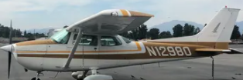
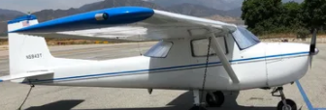
MISSION FLIGHT ACADEMY SAFETY MEETING
APRIL 2021

Slide 2
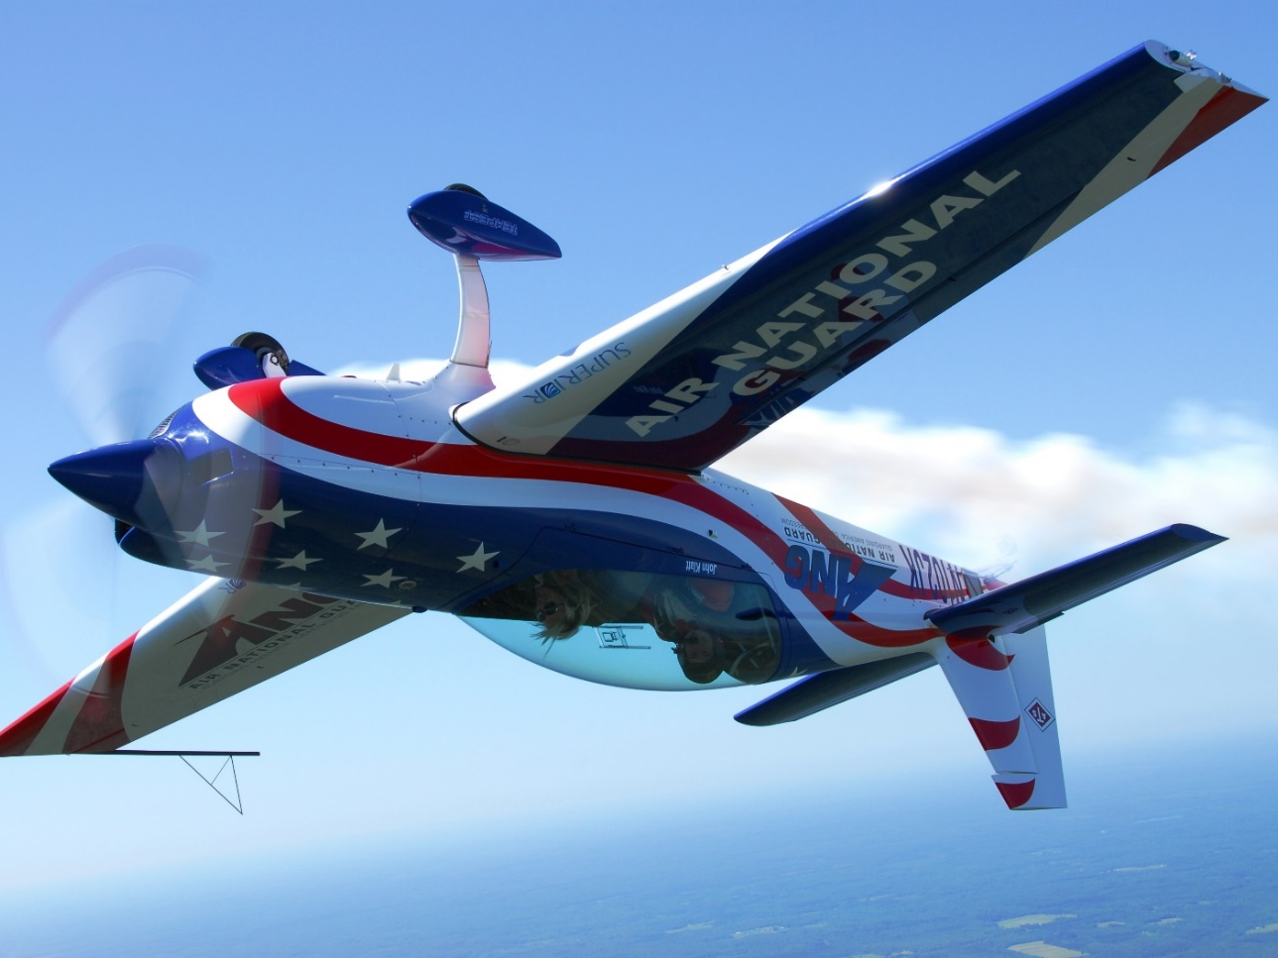
JASON REARICK
What he would like to do with his 172
r CC BY-SA

Slide 3
WINGS
Besides the obvious “WINGS” is not what you may thing it is!

Slide 4
WINGS Pilot Proficiency Program
IT IS A PILOT PROFICIENCY PROGRAM WHERE PILOTS IN GENERAL AVIATION CAN CONTINUE TO TRAIN JUST LIKE THE AIRLINES OR MILITARY PILOTS DO.

Slide 5
WINGS
Studies have shown that pilots who participate in regular proficiency training are much less likely to experience accidents. The FAA’s WINGS Pilot Proficiency Program is one way for GA pilots to ensure they are competent, confident, and safe in their flight operations.

Slide 6
WINGS PROGRAM COMES FROM:

Slide 7
The objective of the WINGS program is to prevent the primary causes of GA accidents. WINGS is not an “award” program; it is a proficiency program designed to help improve pilot skills and knowledge. Pilots who maintain their currency and proficiency will enjoy a safer flight experience.

Slide 8
The WINGS program consists of learning activities and flight tasks selected to address the documented causal factors of aircraft accidents. You can participate by selecting the category and class of aircraft in which you wish to receive training. Requirements for each aircraft category and class include specific subjects and flight maneuvers.

Slide 9
All pilots holding a U.S. pilot certificate may participate in the WINGS program.
To participate in the Basic level of WINGS:
1. Create an account on FAASafety.gov and fill out your “WINGS Profile” under “Account Preferences” and click “Save.”

Slide 10
2. Earn 3 Basic Knowledge activity credits through online courses, in-person seminars, and/or webinars.
= 1 credit from Basic Knowledge Topic 1
= 1 credit from Basic Knowledge Topic 2
= 1 credit from Basic Knowledge Topic 3

Slide 11
3. Complete 3 approved Basic Flight activities with your favorite flight instructor. = 1 credit from Basic Flight Topic 1
= 1 credit from Basic Flight Topic 2
= 1 credit from Basic Flight Topic 3

Slide 12
4. Go to “My WINGS” under the “Pilots” tab on FAASafety.gov to track your status.

Slide 13
5. If all credits to earn a phase of WINGS have been earned within a 12-month period, click “Claim Reward” on the “My WINGS” page.

Slide 15
The WINGS Topic of the Quarter makes it even easier to earn your next phase of WINGS. The program has pre-selected courses and flight activities that will earn a phase of WINGS. Go to bit.ly/GetYourWINGS to see all the program material. Download the “checklist” for the pre-selected courses and flight activities.

Slide 16
Satisfy Flight Review Requirement
In addition to helping you sharpen your flying skills, completing a phase of WINGS also satisfies your flight review requirement. You may also continue to select your own flight activities and knowledge topics for WINGS according to your own personal preference.

Slide 17
WINGS also provides you with opportunities to complete online courses, attend seminars, and participate in webinars from third-party activities, including those offered by the Aircraft Owners and Pilots Association (AOPA), National Association of Flight Instructors (NAFI), Aviation Supplies and Academics, Inc. (ASA), Sporty’s Pilot Shop, and many others.

Slide 18
No longer you have to do the biannual review.
As you participate in the WINGS program, your flight review date will be updated each time you earn enough credits to complete the Basic phase.

Slide 19
Even the Pro’s have to do this!
In order to keep playing your “A” game, get good coaching, and then stick with it. Fly regularly with a flight instructor who will challenge you to review what you know, explore new horizons, and to always do your best. Of course, you’ll have to dedicate time and money to your proficiency program, but it’s well worth it for the peace of mind that comes with confidence.

Slide 20
Find a Pro
If you need more info or help with WINGS, you can contact a WINGSPro! Go to the FAASTeam directory on FAASafety.gov under the “Resources” tab. Next, type “wingspro” in the keywords field and enter your state abbreviation in the state field. Press “Search,” and then scroll down to find WINGSPros in your state. You can also contact your local FAASTeam Program Manager or Rep; they love to make new pilot friends and help with WINGS.

Slide 21
Resource Guide
The WINGS Pilot Proficiency Program helps pilots build an educational curriculum suitable for their unique flight requirements. It is based on the premise that pilots who maintain currency and proficiency in the basics of flight will enjoy a safer and more stress-free flying experience.
Download the WINGS Pilot Proficiency User’s Guide at bit.ly/WINGSguide for more information about WINGS.

Slide 22
Questions

Slide 23
NEXT MEETING MAY 12, 2021

