Slide 1
Text & Graphic Features
Created by: Tabatha Gravell

Slide 2
Textbooks and informational text have important elements that stand out from the other parts of the text. These are called text and Graphic features!

Slide 3
Caption
A caption is small text found near an illustration or picture that gives the reader important information about the picture.
Saturn is the sixth planet from the sun. Saturn has many rings of rock and ice that orbit the planet.

Slide 4
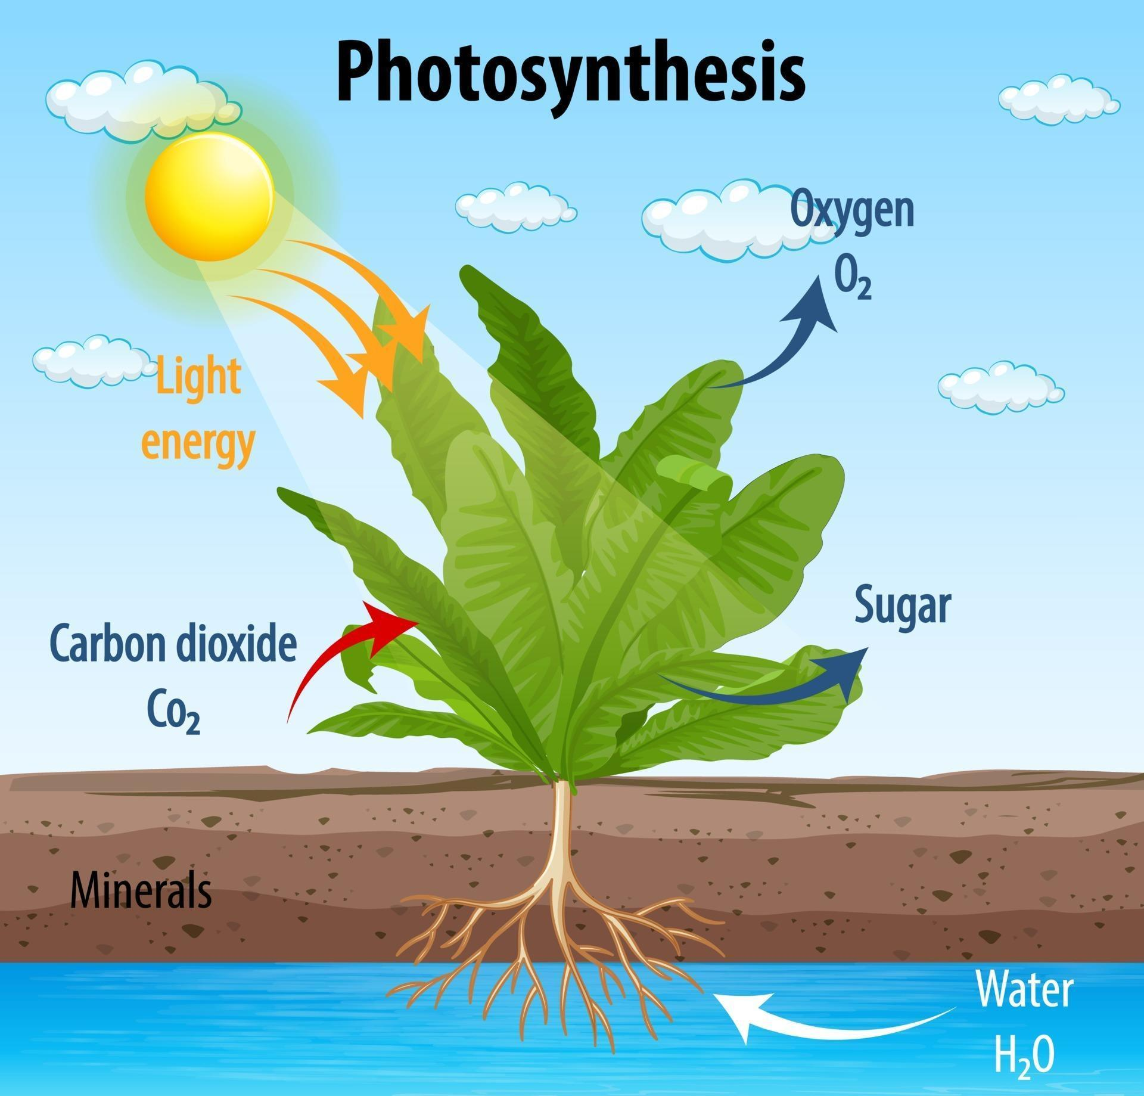
Diagram
A Diagram is a labeled picture that shows the parts of something.

Slide 5
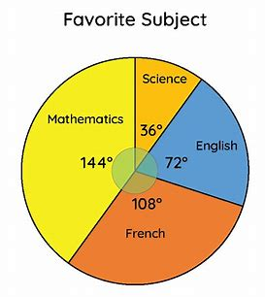
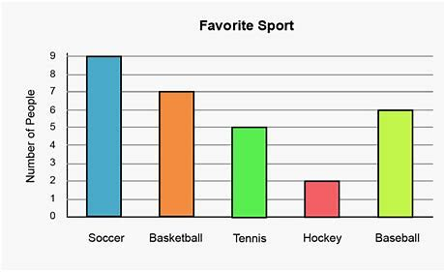
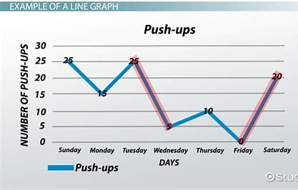
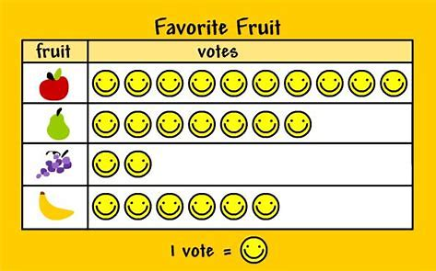
Graph
A graph shows information in a visual way so that is more easily understood by readers.

Slide 6
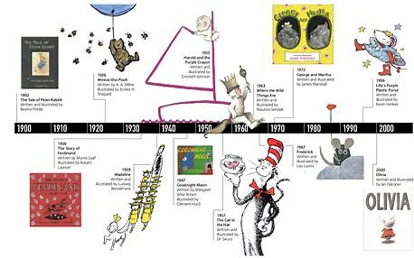
Timeline
A time lone shows a list of events in chronological order.

Slide 7
Image
A photo or picture.

Slide 8
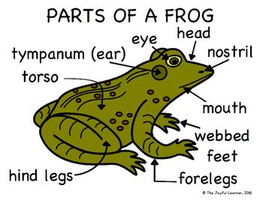
Label
Labels help readers identify the parts of a picture or photograph.

Slide 9
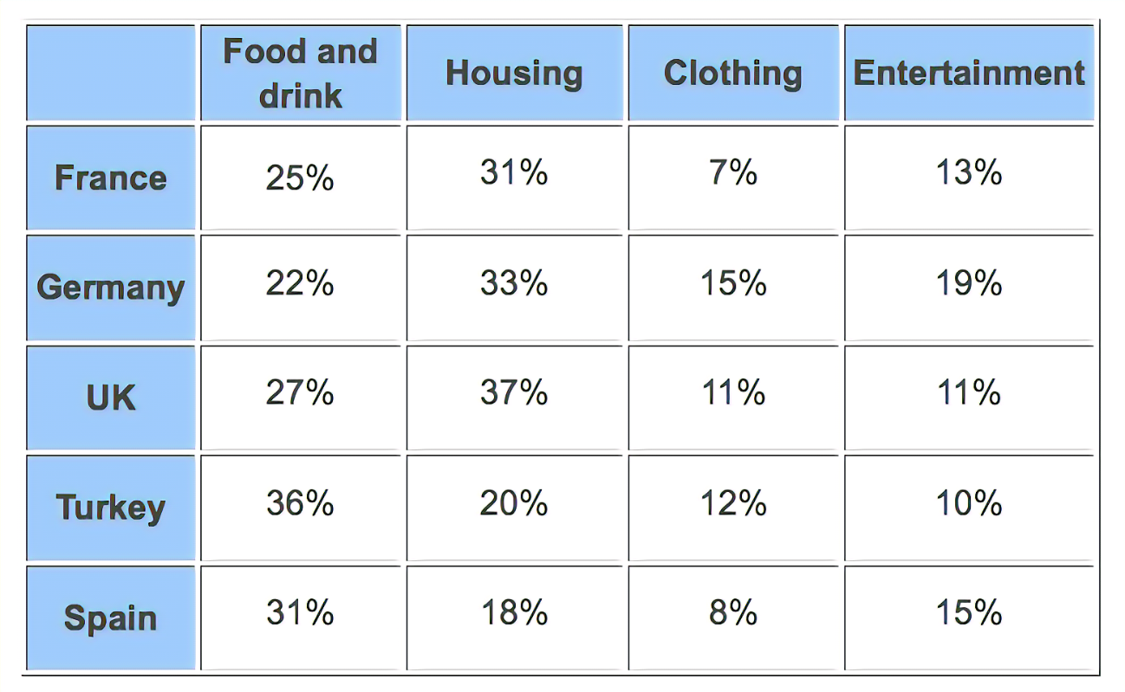
Table
A table is a chart of information presented in a visual way. It is often used to compare things.

Slide 10
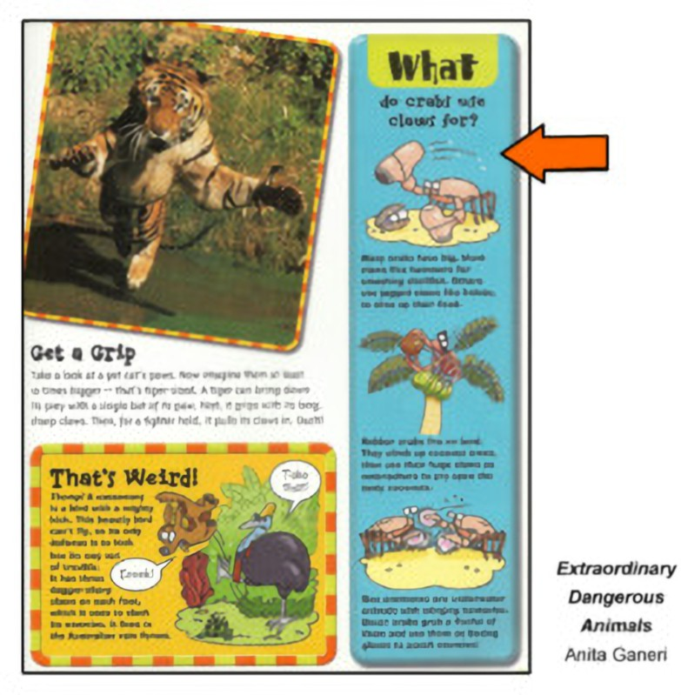
Sidebar
A sidebar gives additional information related to a topic or picture. It is usually located at the side of the page.

Slide 11
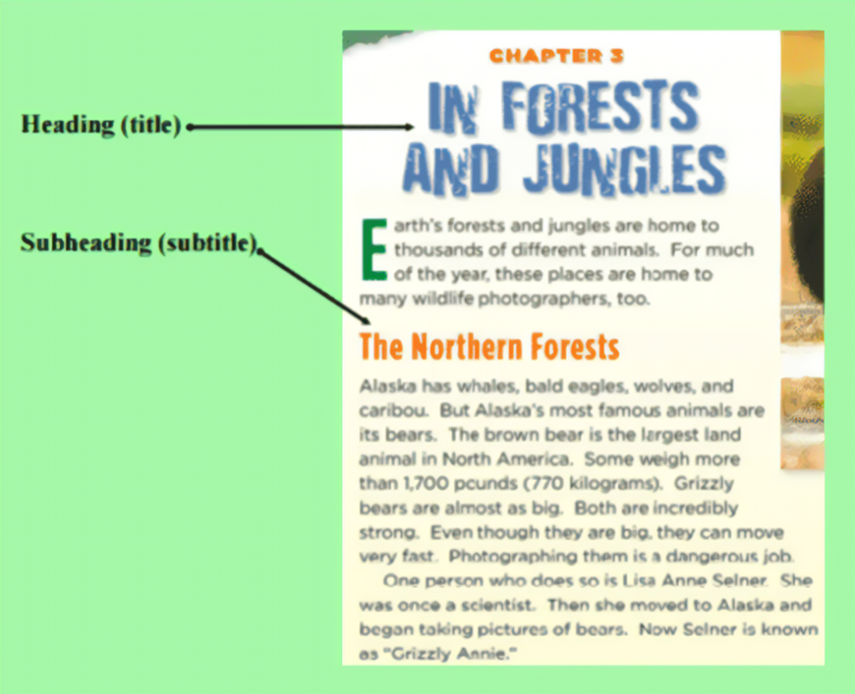
Heading
Headings are words or phrases that tell the reader what the paragraph below is about.

Slide 12
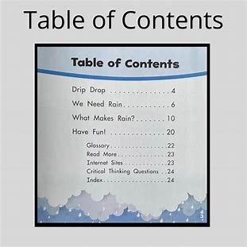
Table of Contents
The table of contents is found at the front of a book. It tells us the main topics or chapters in a book and tells us what page to find them on.

Slide 14
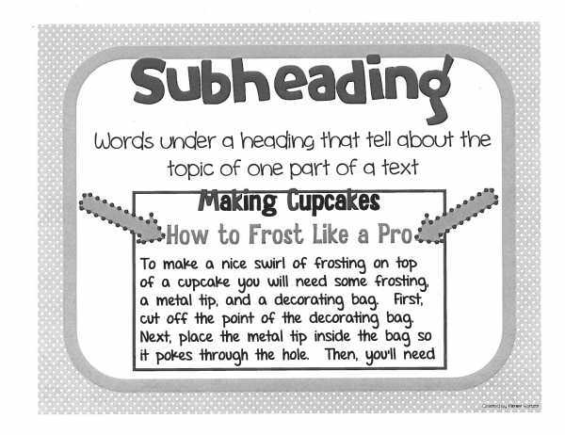

Slide 15
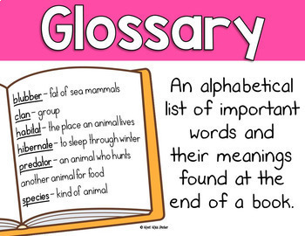

Slide 16
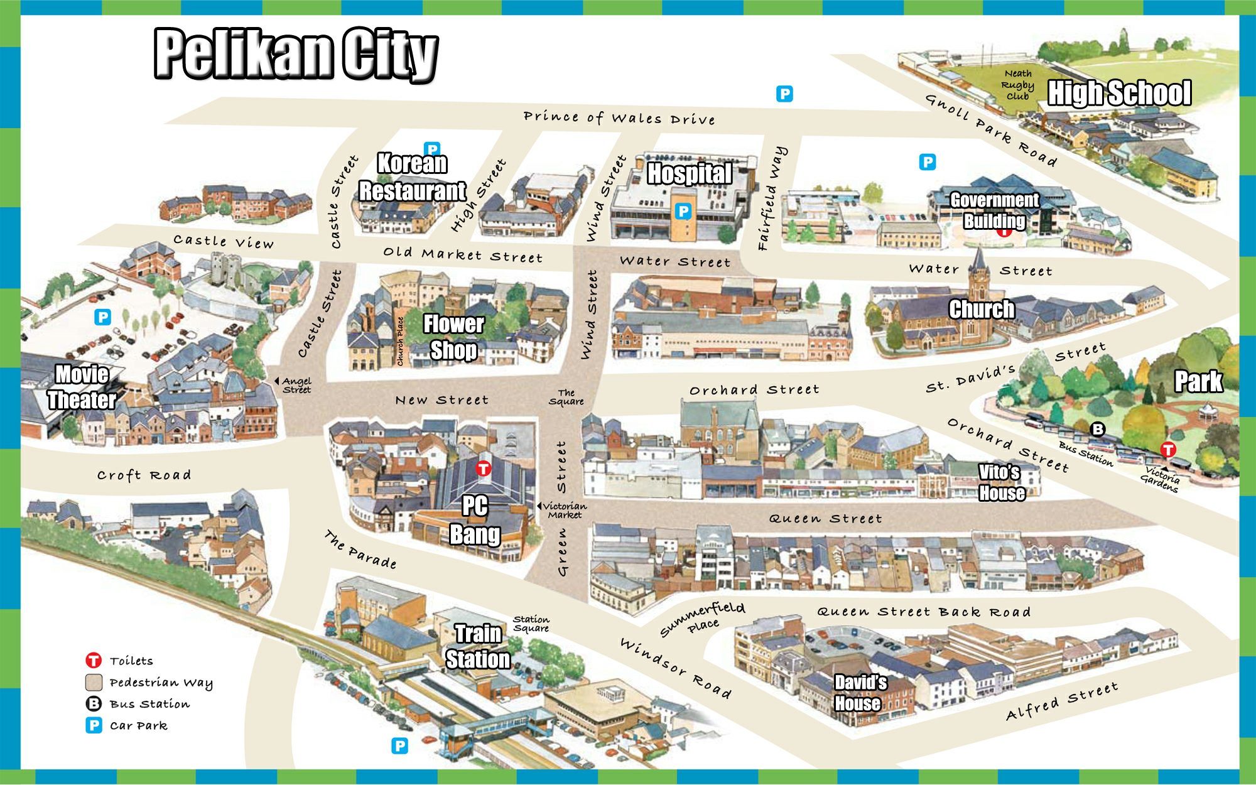
Map
Maps are pictures that show the locations of things or places.

