Slide 1
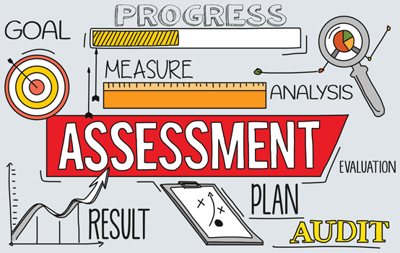
Aligning Assessments with State Standards: A Strategic Approach

Slide 2
Objectives
Introduction to Standards Alignment
Understanding State Assessment Outcomes
Benchmark Development Process
Assessment Blueprint Creation
Alignment Strategies
Quality Control Measures
Implementation Guidelines
Best Practices
Action Planning
Notes:
Welcome to today's session on aligning assessments with state standards. We'll cover essential components of effective alignment and practical implementation strategies.

Slide 3
Understanding the Arizona State Standards Framework
Structure of AZ Academic Standards
Grade-level Performance Indicators
Content Area Specifications
Depth of Knowledge (DOK) Levels
Performance Level Descriptors
AZED English Language Arts Standards
Arizona Mathematics Standards
Notes:
Arizona's academic standards provide clear expectations for student learning across grade levels and subject areas. Understanding these standards is crucial for effective assessment alignment.

Slide 4
Assessment Blueprint Components
Standard Reference Number
Content Strand
Number of Items
Point Values
DOK Distribution
Item Type Specifications
Time Allocations
Notes:
An assessment blueprint serves as your roadmap for test construction, ensuring proper coverage of standards and appropriate distribution of item types.

Slide 5
Alignment Process Steps
Standards Analysis
Content Mapping
Cognitive Complexity Matching
Item Development Guidelines
Review and Validation
Documentation
Notes:
Following a systematic alignment process ensures that assessments accurately measure student mastery of state standards.

Slide 6
Creating Aligned Benchmarks
Identify
Identify Priority Standards
Determine
Determine Assessment Frequency
Set
Set Performance Targets
Design
Design Assessment Items
Establish
Establish Scoring Criteria
Notes:
Benchmarks should serve as meaningful checkpoints that reflect progress toward mastery of state standards.

Slide 7
Quality Control Measures
Peer Review Process
Content Validation
Statistical Analysis
Bias and Sensitivity Review
Technical Advisory Committee
Field Testing Procedures
Notes:
Regular quality control ensures assessments remain valid, reliable, and aligned with standards over time.

Slide 8
Implementation Strategy
Professional Development Needs
Assessment Calendar
Data Collection Methods
Reporting Procedures
Feedback Mechanisms
Resource Allocation
Notes:
Successful implementation requires careful planning and systematic rollout of aligned assessments.

Slide 9
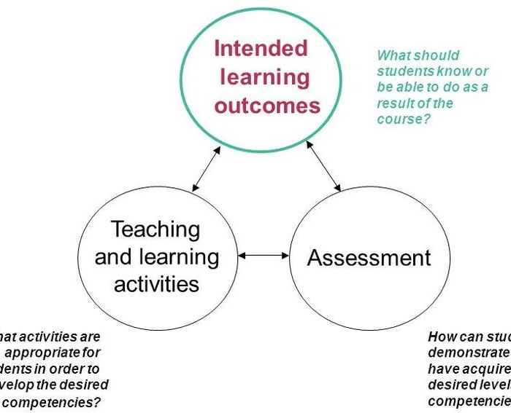
Action Planning Template
Current Status Assessment
Gap Analysis
Timeline Development
Resource Identification
Professional Development Plan
Monitoring System
Notes:
Use this template to develop your own action plan for implementing aligned assessments in your educational setting.

Slide 10
Next Steps and Resources
Arizona Department of Education Resources
1
Assessment Literacy Training
2
Professional Learning Communities
3
Online Tools and Templates
4
Technical Assistance Contacts
5
Notes:
These resources will support your ongoing work in assessment alignment. Remember to regularly review and update your alignment processes as standards evolve.

