Slide 1
History of the Death Penalty in Alabama
Presented by Attorney Paul Young

Slide 2
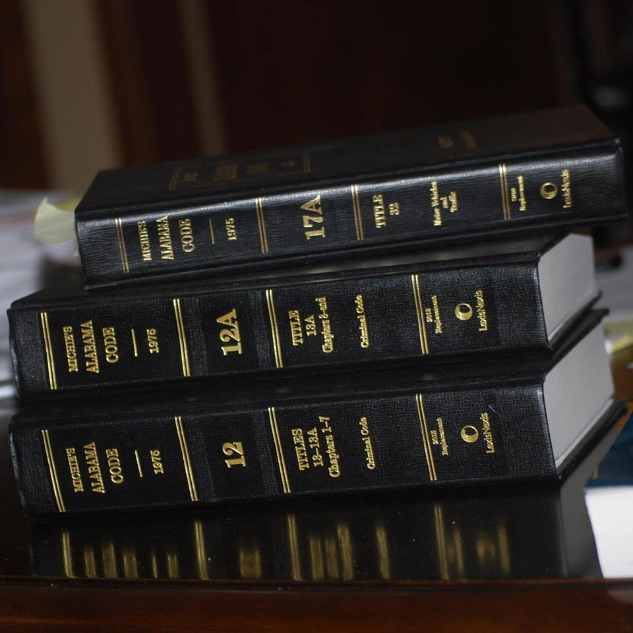
The death penalty in Alabama
has always existed in Alabama
as a means of punishing those
who commit the most serious crimes.
What constituted the most serious crimes was necessarily dependent upon
societal interests and values existing
at the time various death penalty statutes were adopted.

Slide 3
1807
Willful Murder
On September 1, 1842, Nabors took a young male slave valued at $300 from Henry M. Herrin. He was convicted of slave stealing. The relevant statute read "without the consent of the slave." On appeal, Nabors claimed that the slave had been stolen with his consent. Judge Goldthwaite ruled that Nabors still could be prosecuted for grand larceny. Nabors v State, 6 Alabama 200 (1844).
The Legislative Council and House of Representatives of the Mississippi Territory enacted the first "criminal code" to be in force in the territory (a portion of which would later become the State of Alabama). This criminal code authorized death by hanging as a mode of punishment and specified ten capital crimes. These original capital crimes were:
Arson
Rape
Robbery
Burglary
Accessory Before the Fact to any Murder, Arson, Rape, Robbery, or Burglary
Selling a free person as a slave
Slave Stealing
Treason
Counterfeiting Coins

Slide 4
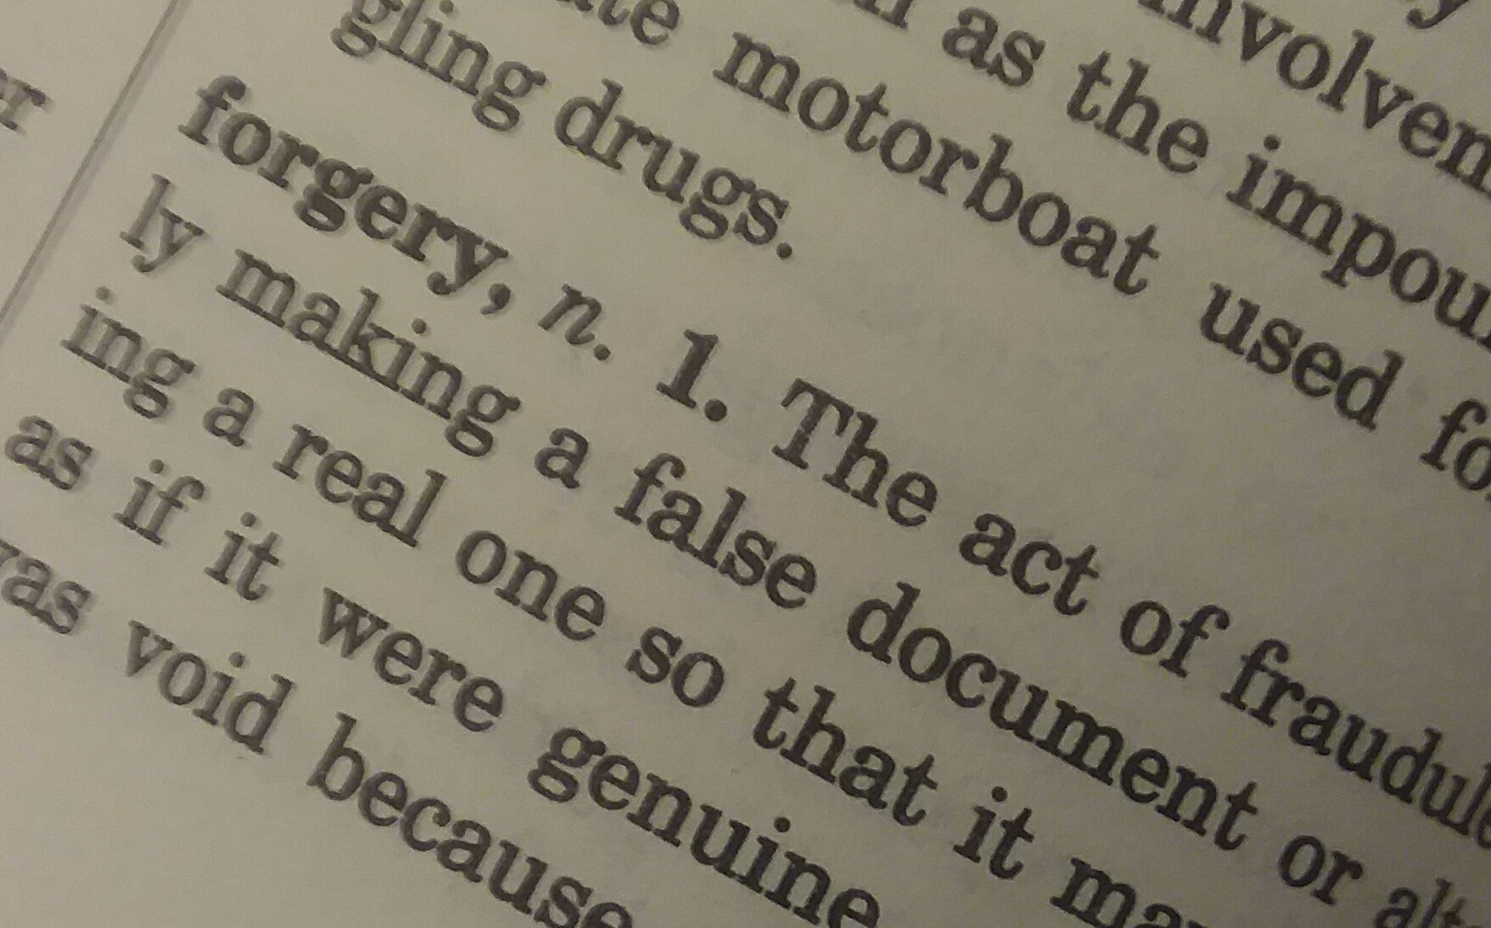
1812
An amendment to the 1807 Code added three additional capital crimes:
Aiding an insurrection by slaves
Conspiracy by any slave to commit murder or rebel
Forgery
Sidebar:
Primâ facie proof

Slide 5
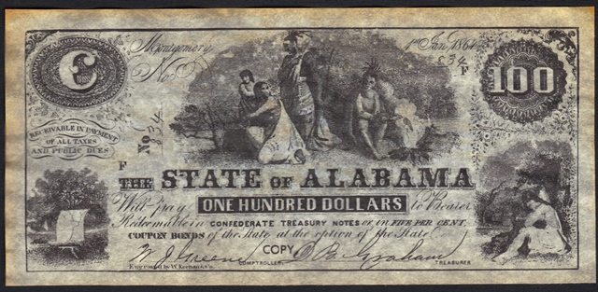
Each of these capital statutes was mandatory in nature, providing that any person who committed the specified crimes "shall suffer death." Excluding those statutes which were founded upon societal values extant during the period when slavery was legal in Alabama, only the following crimes were deemed serious enough to warrant the death penalty:
Murder
Arson
Rape
Robbery
Burglary
Treason
Forgery
Counterfeiting
Counterfeiting Gang
Tom Davis was hanged on October 11, 1822
John Reed, died the Wednesday before his hanging date.
One year later, Solomon Brigman, of St. Clair County, went to the gallows in old Shelbyville, the county seat of Shelby County.
Randall Smith was pardoned.

Slide 6
Dec. 19, 1812 hanging of Eli Norman
for the crime of murder.
All but one of the executions between
1812 and 1927 were hangings.
Feb. 6, 1814,
John Woods was executed by gunshot
for an unknown crime.

Slide 7
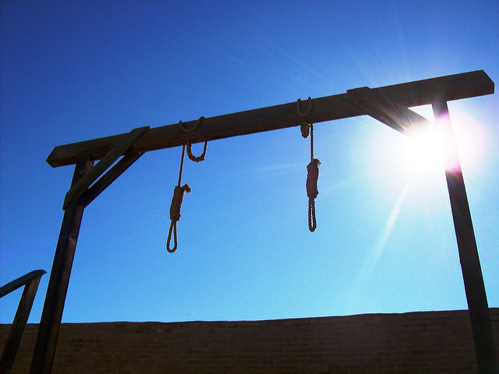
Alabama's first execution was carried out in 1812
By 1812,
there were 13 capital crimes
for which the death penalty
was mandatory
and the primary form
of death
was by hanging.

Slide 8
1833
A new capital crime was added to the criminal code:
Circulating seditious papers for the purpose of inciting insurrection among the slaves
A new subsection was added to the criminal code entitled Crimes and Misdemeanors by Persons of Color. This subsection recognized the new capitally punishable crimes:
Any second conviction of any Negro or Mulatto whatsoever
Accessory of any sort to a capital crime or maiming of any white people on by a slave
Any attempt to commit a rape on any free white female by any person of color
Mandatory death penalty

Slide 9
1836
White citizens could no longer be capitally punished for the crimes of arson, robbery or burglary.
Blacks convicted
of those crimes could be sentenced to death.
Punishment for the crimes of Forgery and Counterfeiting was reduced to terms of imprisonment.
The death penalty was mandatory for Murder, Rape, and Treason.

Slide 10
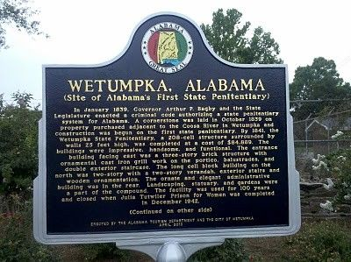
1841
Alabama's first official penal code was enacted.
A statewide penitentiary system was established.
The mandatory language of prior statutes was removed and jury discretion was authorized regarding the usage and imposition of the death penalty.
The statutes enacted at this time represent the forerunners of the death penalty statutes eradicated in the wake of Furman v. Georgia, 408 U. S. 238 (1972).
The Wetumpka State Penitentiary (WSP), originally known as the Alabama State Penitentiary, was the first state prison established in Alabama. Built on the east bank of the Coosa River in Wetumpka, Alabama, it was nicknamed the "Walls of Alabama" or "Walls". (photo credit: WillyT)

Slide 11
Under this 1841 Code, the death penalty (or life imprisonment at the discretion of the jury), could be imposed for the following offenses:
Treason
Murder in the first degree
Aiding any insurrection by slaves
Circulating seditious papers for the purpose of inciting insurrection
Killing any slave in a barbarous manner
Rape
Punishments for other previously capital crimes were similarly reduced to terms of imprisonment
(e.g., selling any free person as a slave -reduced to ten years). Robbery was made punishable by
imprisonment for not less than ten years, Burglary by imprisonment for not less than three nor
more than fifty years, and First Degree Arson by imprisonment for not less than fourteen years.

Slide 12
Conspiracy by any slave to Murder or Rebel
Murder of any white person or Assault with intent to murder any white person by any slave
Rape or attempt to commit rape of any white female by any slave or free Negro
Burglary
Robbery or maiming of any white person by a slave
Arson by any slave
The final chapter of the Penal Code of 1841
pertained to crimes by slaves and free Negroes.
Imposition of the death penalty for the following crimes:
These statutes were mandatory in nature.

Slide 13
Under the first official Code of Alabama, enacted in 1852, death by hanging was expressly authorized as one of several modes of punishment; however, even though it was clearly specified, its use was authorized in very limited instances. Outside of the various slave statutes enacted in 1841, and re-codified under the 1852 Code, death could only be imposed in two limited situations:
where the defendant was convicted of Murder in the First Degree
where the defendant was convicted of Treason
In these limited cases, death could be imposed at the discretion of the jury.

Slide 14
Other changes to criminal code in 1852
Life imprisonment:
Rape
Carnal knowledge of a female above ten years of age by administering to her any substance which prevents an effectual resistance
Carnal knowledge of a female under ten years of age
Terms of imprisonment:
Robbery-less than ten years
Burglary-three to fifty years
First Degree Arson-less than fourteen years

Slide 15
“But when the cohabitation is, in fact, consentive, although that consent was procured by fraudulent personation of the female's husband, there is neither actual nor constructive force, and such act does not amount to the crime of rape.” [Hon. Robert Dougherty]
Shortly after the Court made the above remark in Lewis v. State, 30 Ala. 54 (1857-58),
the Alabama Legislature revised its rape laws to make impersonation of a husband for the purpose of having carnal relations a felony punishable by death.

Slide 16
1867
Treason
Murder in the First Degree
Rape
Carnal knowledge of any female above ten years of age by administering to her any substance which prevents an effectual resistance
Carnal knowledge of any female under ten years of age
Carnal knowledge of any married woman by falsely impersonating her husband
Robbery
First Degree Arson
The revised Code of Alabama of 1867 (post-Civil War) reveals that the so-called Reconstruction Legislature expanded significantly the crimes for which the death penalty could be imposed. Death by hanging was one of several forms of punishment for:
The imposition of the death penalty in such cases was, as before, to be governed entirely by the discretion of the jury. In short, the Reconstruction Legislature reinstituted the death penalty for certain crimes but abrogated the slavery statutes which previously characterized the Code of 1852.

Slide 17
1867 (continued)
Murder
Assault with intent to commit murder
Effectuated an escape
Attempted to escape
First statutes concerning the capital punishment of crimes committed by convicts serving life sentences. Mandatory death sentence for any convict sentenced to imprisonment for life, who committed:
Mandatory death sentence for convicts already sentenced to life for previous crimes.

Slide 18
Treason
Murder in the First Degree
Rape
Carnal knowledge of any female over ten years of age by administering any substance which prevents an effectual resistance
Carnal knowledge of any female under ten years of age
Carnal knowledge of any married woman by impersonating her husband
Robbery
Arson
1876
The Code of Alabama of 1876 made no changes in Alabama's death penalty law. Jury discretion continued to govern its imposition for the following crimes:
Likewise, the convict statutes remained the same except that escapes or attempted escapes by life inmates were no longer punishable by death.

Slide 19
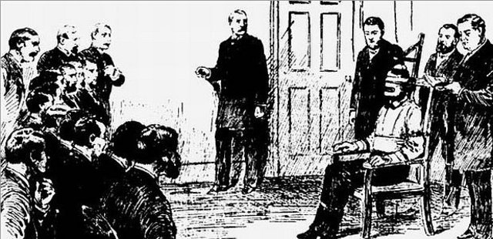
1887
The Code of Alabama of 1887 contained no changes. Prior Alabama was merely re-codified with the death penalty remaining as a viable criminal punishment. Jury discretion remained the standard for imposing a sentence of death.
Sidebar:
Electric chairs were first used in the United States in 1890.

Slide 20
1897
The Code of Alabama of 1897, like its predecessor, contained no major substantive changes.
The statutes raised the age designation from ten to fourteen years, and
added train robbery as a new capital offense

Slide 21
1907
The 1907 Code added yet another capital offense:
kidnapping for ransom
The death penalty remained a viable means of punishing individuals who committed certain aggravated offenses.
1923
The most striking contribution which the Code of 1923 would make to the history of the death penalty in Alabama was its modification of the manner in which the death penalty would be imposed. Death by electrocution would thenceforth be the method.

Slide 22
1927
Yellow Mama was built in 1927
The chair was built in 1927 at Kilby Prison, then home to Alabama’s death row, by prisoner Ed Mason.
The chair was named for its distinctive paint. It was painted its distinctive bright yellow because the paint was readily available at the Alabama Highway Department, which began contracting with the Department of Corrections for inmate labor in 1927. The paint was reportedly used for road striping.

Slide 23
1928
The 1928 recompilation of the Code of 1923 made no changes in Alabama's death penalty law, save the addition and definition of yet another capital offense:
exploding or setting off any dynamite in or under any steamboat, or vessel, or railroad car, in which there is at the time any human being, or any prison or jail, or any other house or building, which is occupied by a person, or any inhabited dwelling
As in all other capital cases, the imposition of the death penalty was to be fixed at the discretion of the jury.

Slide 24
1940
The 1940 Alabama Code added three new capital offenses:
Attempted kidnapping
Second Degree Arson
Burglary in the First Degree

Slide 25
1943
In 1943, the legislature adopted what the Supreme court of the United States, in Coleman v. Alabama, 377 U. S. 129 (1964), called an “enlightened procedure" of an automatic appeal which now formulates a very important favor in achieving a uniform imposition of the death penalty.
Prior to Furman (ignoring all the procedural developments in the administration of the death penalty, the following offenses were punishable by death by electrocution or life imprisonment at the discretion of the jury:
Treason
Murder in the first degree
Rape
Carnal knowledge of any female over fourteen years of age by administering any substance which prevents an effectual resistance
Carnal knowledge of any female under twelve years of age
Carnal knowledge of a married woman by falsely impersonating her husband
Robbery
Kidnapping for ransom
Attempted kidnapping
First Degree Arson
Second Degree Arson
First Degree Burglary
Any exploding dynamite near an occupied dwelling
sidebar:
Certiorari

Slide 26
Because of
the verdict in
Furman
v.
Georgia,
the death penalty was ruled
illegal within the
United States
in 1976.
Sidebar:
De facto moratorium

Slide 27
Code of Alabama, 1975
Alabama Code Title 15. Criminal Procedure § 15-18-82
(a) Where the sentence of death is pronounced against a convict, the sentence shall be executed at any hour on the day set for the execution, not less than 30 nor more than 100 days from the date of sentence, as the court may adjudge, by lethal injection unless the convict elects execution by electrocution as provided by law. If electrocution is held unconstitutional, the method of execution shall be lethal injection.
(b) Executions shall take place at the William C. Holman unit of the prison system at Atmore in a room arranged for that purpose. It shall be the duty of the Department of Corrections of this state to provide the necessary room and appliances to carry out the execution.
(c) The warden of the William C. Holman unit of the prison system at Atmore or, in case of his or her death, disability, or absence, his or her deputy, shall be the executioner. In the case of execution by lethal injection, the warden, or in the case of his or her death, disability, or absence, his or her deputy, may designate an employee of the unit to administer the lethal injection. In the event of the death or disability or absence of both the warden and deputy, the executioner shall be that person appointed by the Commissioner of the Department of Corrections.

Slide 28
Code of Alabama, 1975 (cont.)
Alabama Code Title 15. Criminal Procedure § 15-18-82.1 (a)
(a) A death sentence shall be executed by lethal injection, unless the person sentenced to death affirmatively elects to be executed by electrocution. The sentence shall be executed pursuant to Section 15-18-82 .

Slide 29
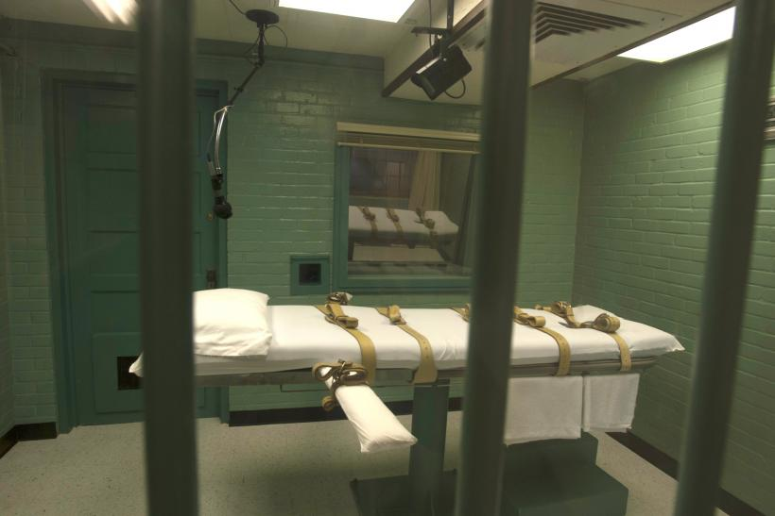
Today, the primary method is lethal injection,
although inmates convicted prior to 2002 can choose to be executed by electrocution
or lethal injection.

Slide 30
Famous Cases
Scottsboro Boys
In 1931, nine black boys were charged with raping two white girls. They were tried in Scottsboro, Alabama, and became known as the Scottsboro Boys. All-white juries sentenced eight of the boys to death. The cases were heard by the U.S. Supreme Court in Powell v. Alabama (1932), the landmark case which guarantees the right to counsel in a capital trial. After numerous retrials, only one of the boys was sentenced to death, but his sentence was later commuted to life in prison.

Slide 31
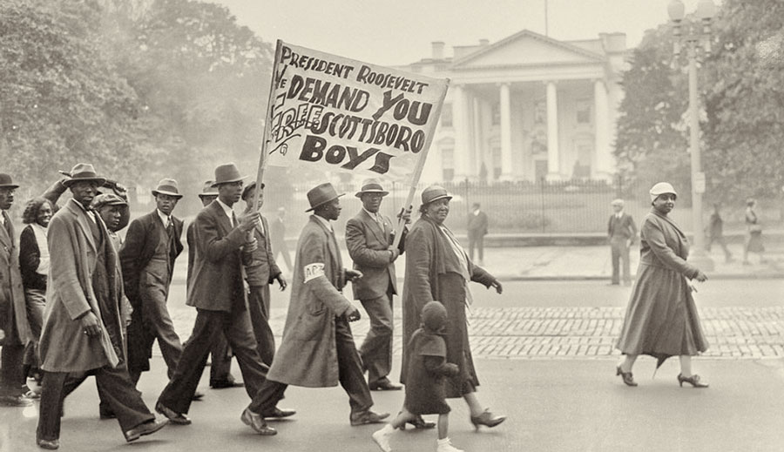
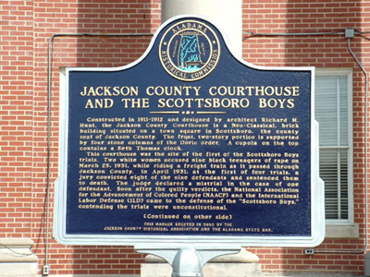
March 26, 1931 - "Scottsboro Boys" Falsely Accused of Rape, Arrested
https://www.youtube.com/watch?v=k_q4GG3iHGY
sidebar:
Voir Dire

Slide 32
Famous Cases (cont’d.)
Cornelius Singleton, an inmate with an IQ of 55, was executed November 20, 1992.
Darrell B. Grayson, an African-American man, was convicted by an all-white jury for the murder of a white woman. The Innocence Project sought DNA testing in Grayson's case, saying that testing not available at the time of his trial might prove him innocent. Requests for new testing were denied, and Grayson was executed on July 26, 2007.
Holly Wood was executed September 9, 2010 despite evidence that he was intellectually disabled, and therefore exempt from execution. His lawyer did not present evidence of Wood's low IQ during Wood's original trial. A federal District Court overturned Wood's sentence, but the U.S. Supreme Court agreed with the ruling from the U.S. Court of Appeals for the Eleventh Circuit that Wood failed to show that the lawyers were constitutionally ineffective.

Slide 33
The history of the death penalty in Alabama shows without question that throughout the state's history, the legislature has authorized the death penalty for the intentional killing of another.

Slide 34
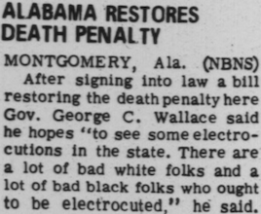
Death Penalty: Yes
Date of Reinstatement (following Furman v. Georgia): May 3, 1976
Location of Death Row: Holman Prison, Atmore (main), William E. Donaldson Prison near Birmingham (secondary), Tutwiler Prison (women)
Location of Executions: Holman Prison, Atmore

Slide 35
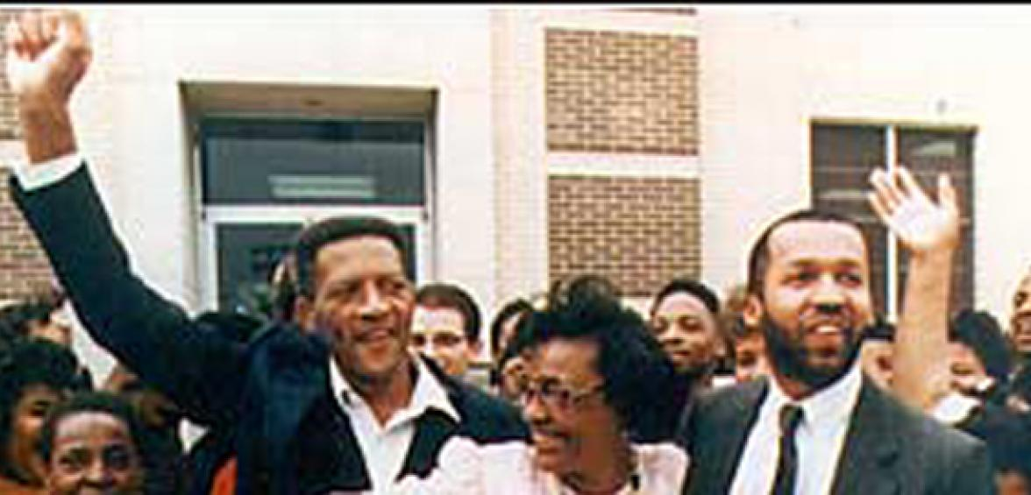
Notable Exonerations
Walter McMillian was sentenced to death in 1988 despite the jury's recommendation for a life sentence. An investigation by 60 Minutes uncovered prosecutorial misconduct and perjury by witnesses. McMillan was released from prison in 1993.

Slide 36
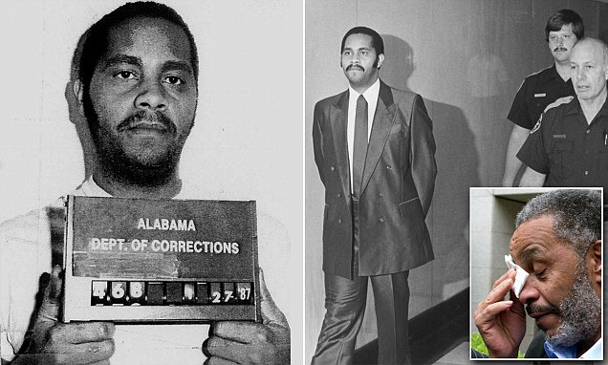
Notable Exonerations
Anthony Ray Hinton spent thirty years on death row in Alabama for crimes he did not commit. He was released in 2015.

Slide 37
Alabama Inmates Currently on Death Row
Last Updated: 06/11/2019
Total Number of Inmates on Death Row: 175
Average Age of Inmates on Death Row: 25
Black males: 86 Black females: 1
White males: 82 White females: 4
Other males: 2 Other females: 0

Slide 38
Other Interesting Facts
Until 2017 when Governor Kay Ivey signed into effect the judicial override bill, Alabama was one of only three states that allowed judges to override jury sentencing recommendations, and the only state that allowed a judge without restriction to override when the jury votes for a life sentence.
Alabama is the only state whose anti-death penalty organization (Project Hope to Abolish the Death Penalty) was founded by death row inmates in 1989. The Chairman and Board are at Holman on death row.

Slide 39
Courtney Lockhart, a 24- year-old African American man and Iraq War veteran, was sentenced to death in 2011 by Lee County Circuit Judge Jacob Walker for the killing of a white female Auburn University student despite the jury’s unanimous verdict for life.
Thomas Ferguson was convicted of capital murder at age 24. The jury heard evidence that he was a person with borderline mental retardation and a highly dysfunctional family background who had been co-opted into a criminal scheme by his father-in-law. The jury returned a life verdict, but the trial judge overrode and imposed the death penalty.
Given the key role of the jury in American justice, it is difficult to justify giving officials who will be held to account for their stance on the death penalty every four years the power to substitute their own individual opinions for those of the 12- member jury. - The Anniston Star, July 6, 2008
Anthony Johnson was convicted of a 1984 murder. The State of Alabama conceded that Mr. Johnson did not kill the victim, who was shot by a co-defendant. The jury determined that the appropriate punishment was life in prison without parole, but the trial judge overrode the jury’s verdict and condemned Mr. Johnson to death. In dissent from the United States Supreme Court’s decision upholding Mr. Johnson’s death sentence in 1988, Justice Thurgood Marshall wrote: “[I]t approaches the most literal sense of the word ‘arbitrary’ to put one to death in the face of a contrary jury determination where it is accepted that the jury had indeed responsibly carried out its task.”
Anthony Johnson was executed by lethal injection on December 12, 2002.
Such life-or-death power shouldn’t be vested in a single judge, particularly an elected judge subject to political pressures.
- The Birmingham News, July 31, 2002

Slide 40
24 Hours on Death Row description of Alabama Electric Chair
https://www.youtube.com/watch?v=_oC_fQpn6cM&t=2s

Slide 41
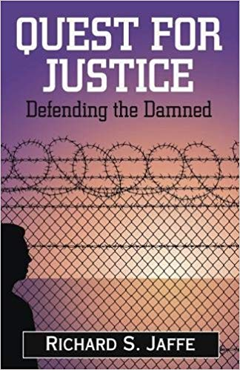
Good Reads
Quest for Justice
Defending the Damned
Just Mercy
The Sun Does Shine
by Bryan Stevenson, founder of Equal Justice Initiative
by Anthony Ray Hinton, a death row exoneree
by Richard Jaffe, Criminal Defense Attorney

Slide 42
Good Movies

Slide 43
CONTENT CREDIT
H. Toulmin, A Digest of the Laws of the State of Alabama, Tit. 17 (1823)
J. Aikin, A Digest of the Law of the State of Alabama (1833)
A. Meek, A Supplement to Aikin’s Digest on the Laws of the State of Alabama (1841)
Yellowhammer News
szcourseworkslxe.aci-Ukraine.com
Black’s Law Dictionary
Marty Bucella
www.oprah.com
South Baldwin Community Theater
www.doc.state.al.us/DeathRow
www.deathpenaltyinfo.org/alabama
1980.AL.1496 <http://www.versuslaw.com>, 396 So. 2d 645
Rape & Race in the nineteenth century (by Diane Miller Sommerville)
The Birmingham News
The Anniston Star
LandmarkHunter.com
WillyT
A Treatise on Criminal Law by Francis Wharton LL.D.
www.shestokas.com
www.ottthemark.com
www.workers.org
Los Angeles Sentinel
Equal Justice Initiative
Smithsonian Magazine
www.antiquemoney.com
www.Wikipedia.com
www.timetoast.com
www.youtube.com
www.phadp.org
www.al.com

