Slide 1
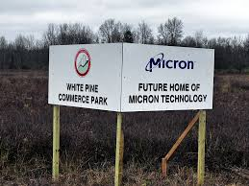
MICRON CNY
GOOD JOBS &
ENVIRONMENTAL REVIEW PROCESS
Khadeejah Ahmad
Syracuse Organizing Manager
Jobs to Move America
kahmad@jobstomoveamerica.org

Slide 2

JOBS TO MOVE AMERICA
URBAN JOBS TASK FORCE
IUE- CWA
GREATER SYRACUSE LABOR COUNCIL
CNY SOLIDARITY
CITIZEN ACTION
CNY GOOD JOBS & EQUITABLE ACCESS
WORKING GROUP

Slide 3
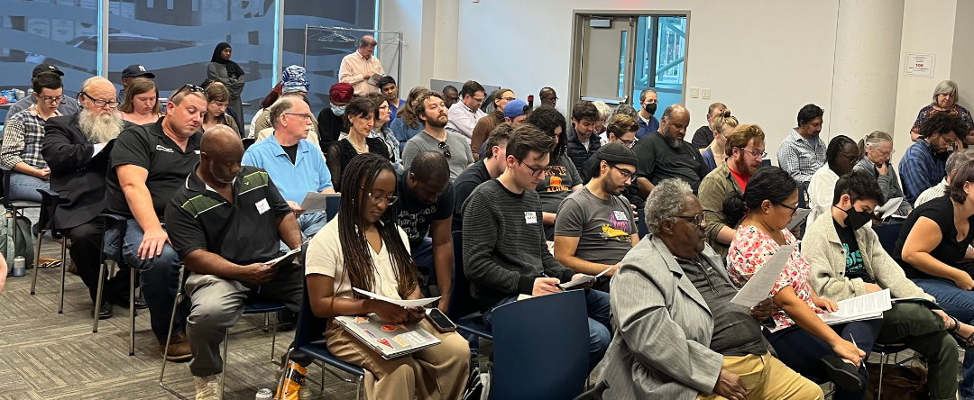
ALIGN
Alliance for a Green Economy
Alliance of Communities Transforming Syracuse
Central New York Area Labor Federation, AFL-CIO
Citizen Action of New York
CNY Solidarity Coalition
Coalition of Black Trade Unionists, CN Y Chapter
Communications Workers of America - District 1
Cooperative Federal
Cross Cultural Strategies
Empire State Indivisible
Energy 21
Families for Lead Freedom Now
Food Access Healthy Neighborhoods Now (FAHNN)
Good Jobs First
Greater Syracuse Labor Council, AFL-CIO
Greening USA
IUE-CWA
JHP Industrial Supply Co
Jobs to Move America
Legal Services of Central New York
Make the Road New York
ORGANIZATIONAL SUPPORT
COMMUNITY, LABOR, AND ENVIRONMENT
Moving People Transportation Coalition
New Americans Forum
New York Communities for Change
New York State AFL-CIO
New York State Council of Churches
Northside Futures
Satter Ruhlen Law Firm, PLLC
SEIU 200 United
Sierra Club
Sierra Club Atlantic Chapter
Strong Economy For All Coalition
Syracuse Chapter National Action Network
Syracuse Cultural Workers
Syracuse Peace Council
Syracuse Urbanism Collective
Syracuse-Onondaga Food Systems Alliance
Teamsters Union 1149
UNITE HERE Local 150, AFL-CIO
Uplift Syracuse
Urban Jobs Task Force of Syracuse
VOCAL-NY
Workers Center of Central New York

Slide 4
MICRON OVERVIEW
Micron Technology Inc. is a semiconductor company that is headquartered in Boise Idaho. Micron is a large producer of memory chips.
Micron’s products include: dynamic random access memory (DRAM) semiconductor devices and non-volatile re-writable semiconductor memory devices that provide fast read speeds (NAND). These products are used as products for the cloud server, enterprise, client, graphics, networking, industrial, and automotive markets, as well as for smartphone and other mobile-device markets.
43,000 employees worldwide - 96 facilities worldwide
No unionized facilities - mixed history with labor
Two Principal U.S. facilities are in Boise, Idaho & Manassas, Virginia
  Boise (R&D) - 6,000 workers
  Manassas (Manufacturing) - 1,300 workers
U.S. based workforce is 20% women and 80% male
Growth Plan includes constructing a new leading edge DRAM manufacturing facility in Clay, New York

Slide 5
MICRON CNY
$20 BILLION “megafab” in Clay, NY - just outside of Syracuse.
Micron intends to invest over $100 billion in the megafab over the next 20 years and projects that 9,000 jobs will be created by 2045 & 40,000 jobs in the community.
NY State is providing an estimated $5.5 billion in economic incentives.
Micron claims this will be “the largest private investment in New York state history.”

Slide 6

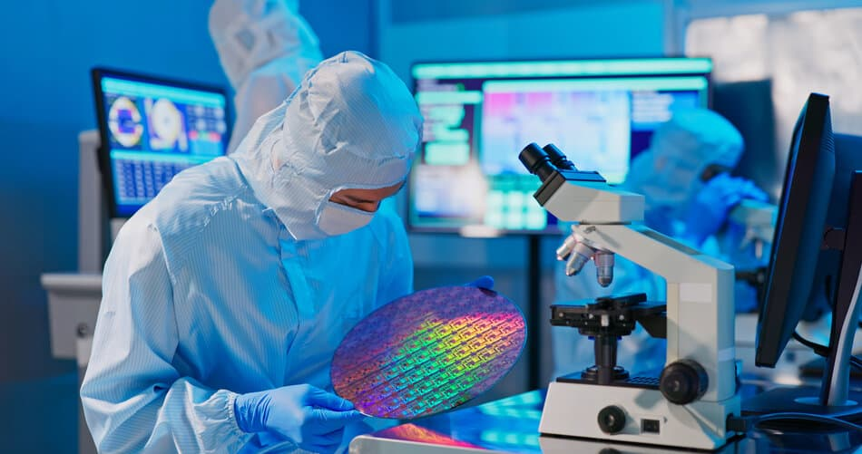
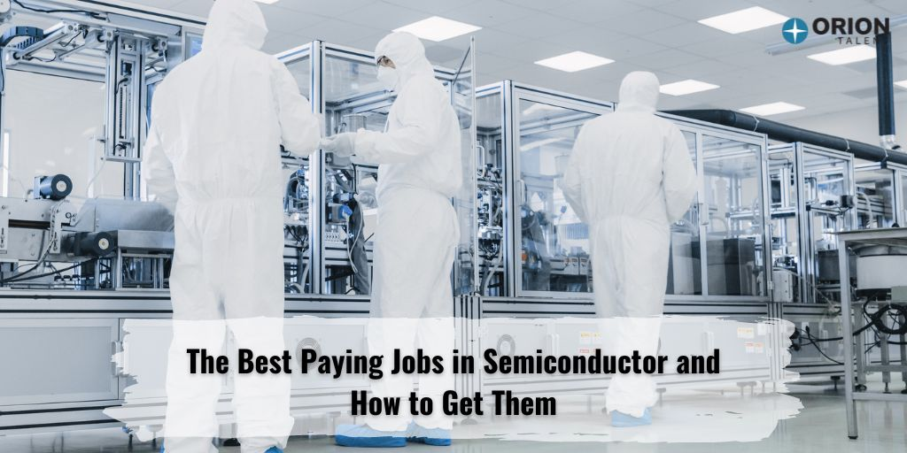
INDUSTRY BRANDING
“GOOD JOBS”
“CLEAN”
“GREEN”

Slide 7
PRIORITIES & RECORD MISMATCH?
Biden Administration’s Stated Priorities:
Reshore & Build Domestic Supply Chain
Invest in American Manufacturing
National Security
Create Good Paying (Union) Jobs
Invest in Diverse Workforce (Women!)
Strong Workforce Development Pipeline & Community Investment
Semiconductor Industry Record:
Massive offshoring
Low wages for manufacturing workers
Brutal working conditions
Lack of racial and gender diversity
Aggressive and coordinated anti-union activity
Dangerous toxic chemical exposure

Slide 8
UNION BUSTING
“Remaining non-union is an essential for survival for most of our companies… This is a very high priority for management here. " - Bob Noyce, co-founder of Intel
“The American high-tech sector decided then that it would not allow unions…good companies should be able to request that workers not form unions.” - Morris Chang, TSMC Chairman
Historically, Semiconductor Firms and Industry Associations Have…
Surveilled and intimidated workers
Illegally fired workers for organizing
Coordinated on union-avoidance training
Exchanged intelligence between firms
Funneled financial resources to smaller firms where workers were organizing
Union Density Rate in Computer Manufacturing/Electronics Manufacturing = <1%

Slide 9
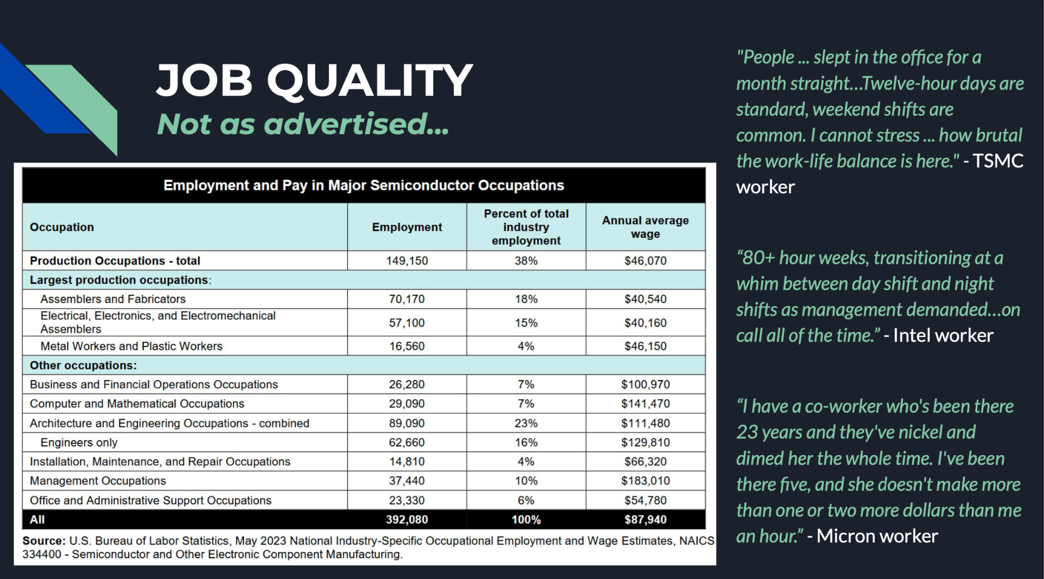
JOB QUALITY
Not as advertised…

Slide 10
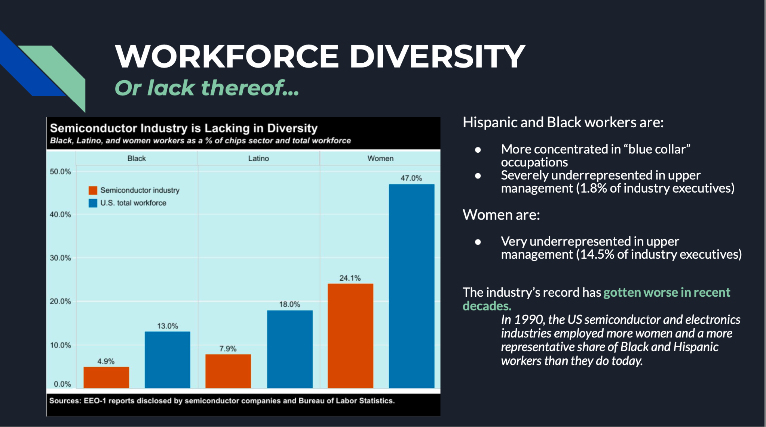

Slide 11
ENVIRONMENTAL & HEALTH HAZARDS
“It isn’t green …”
Despite industry efforts to brand itself as “green,” semiconductor manufacturing is a water, energy, and toxic chemical glutton.
An individual fab can use tens of millions of gallons of water per day (equivalent to the household water consumption of a city of 122k) and most chemical processes require Ultrapure Water (~1.4k to 1.6k gallons of municipal water required for 1k gallons of UPW).
The industry has responded by adopting new technologies to recycle +return wastewater to drinking water standards which is incredibly energy intensive and considered not clean enough for their use.
Re: Forever Chemicals, industry reports, “Most PFAS are not regulated pollutants and therefore unless company specific provisions are in place, the wastewater from processes… that contain PFAS would likely be discharged to the publicly owned treatment works without substantive removal of the PFAS.”
The industry’s electricity consumption is expected to more than double by 2030 with emission projections larger than several countries.
Producing advanced 2nm microchips requires more than 2x as much water and 3x as much electricity as 28nm chips. Carbon emissions have also more than doubled for making the most advanced chips.
Notes:
Ted

Slide 12
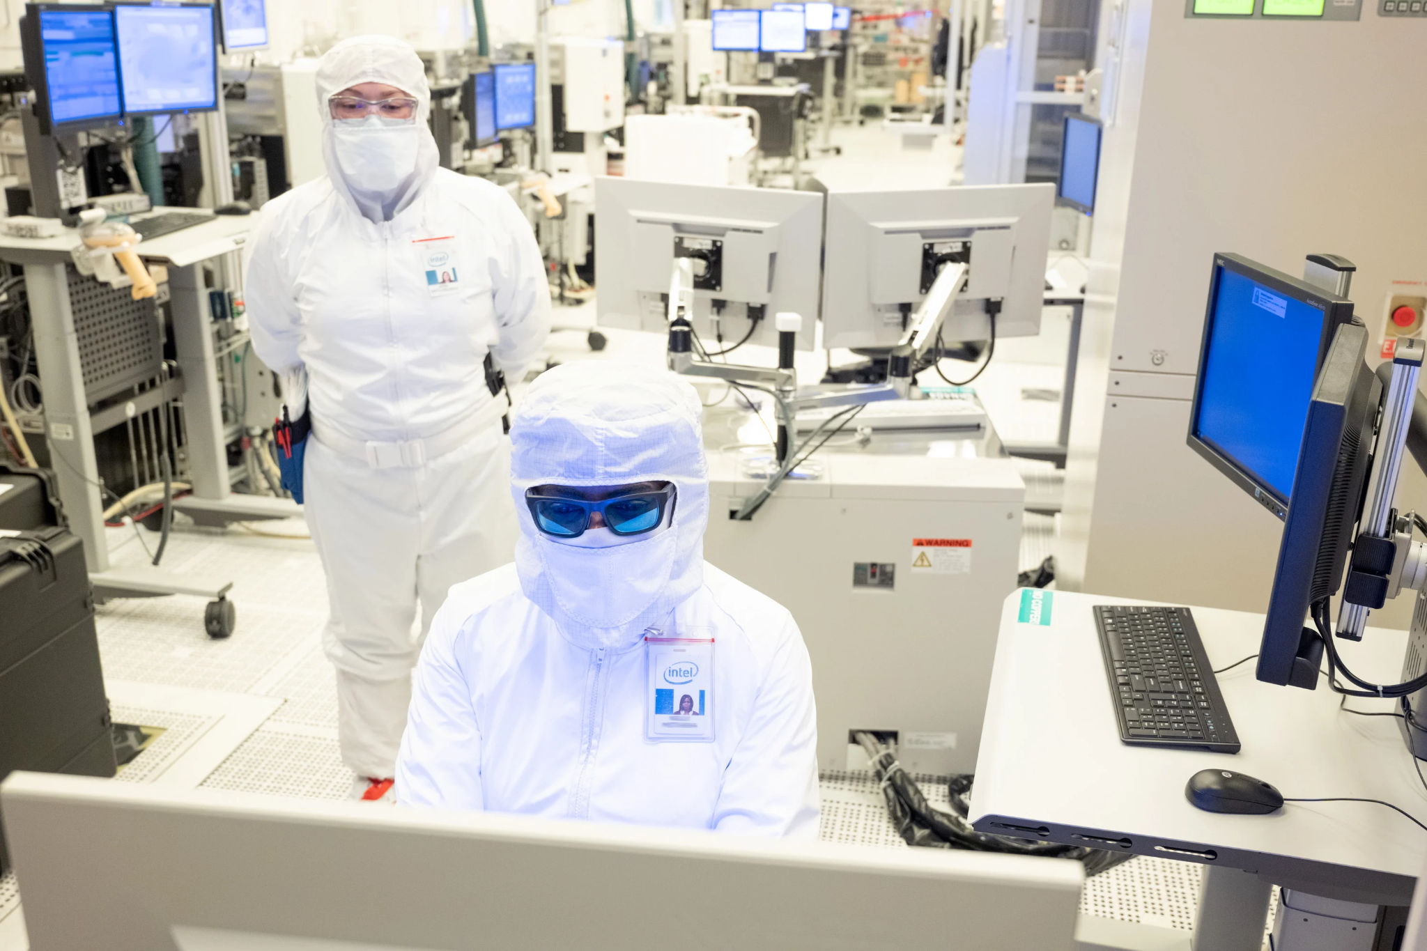
ENVIRONMENTAL & HEALTH HAZARDS
“...and it isn’t clean…”
The semiconductor industry is highly dependent on the use of thousands of hazardous chemicals with little regulatory oversight in the U.S. and even less so globally.
Silicon Valley has more Superfund sites than any other county in the US - most are polluted by the electronics industry.
An analysis of 81 of the most commonly used chemicals in electronics manufacturing found:
  30 are recognized as carcinogens (cause cancer)
  40 are recognized as mutagens (causes mutations)
  45 are recognized as reproductive toxins (birth defects)
  Most have never been evaluated for health effects and companies regularly introduce chemicals without first testing for environmental & human impact.
The exact chemicals companies use are often treated as a trade secret, leaving workers in the dark about what toxics they are being exposed to and the long-term health effects of their exposures.
Clean room protocols are designed to protect the product from workers NOT protect workers from the product…
Notes:
Ted

Slide 13
ENVIRONMENTAL & HEALTH HAZARDS
“...and it isn’t clean…”
Legal ≠ Safe
Commerce is focused on compliance with existing law but OSHA publicly acknowledges that “many of its permissible exposure limits (PELs) for toxic chemicals in the workplace are outdated and inadequate for ensuring protection of worker health.”
  Former OSHA agency head David Michaels estimates 90% of OSHA’s PELs date to industry standards of the 1960s and are not safe and penalties for breaching these inadequate standards are minimal.
The disparity between what regulatory bodies consider “permissible” and what the biomedical literature says regarding safe exposure limits is vast and causes serious preventable harm.
  Ex. OSHA allows 100 parts per million for exposure to Ethylbenzene, but biomedical literature detected serious adverse health effects at 0.06 parts per million, more than 1,660 times lower than the legally allowable exposure.
Workers deserve but do not get as much protection from toxics as the community does. The discrepancy is enormous and the most vulnerable suffer the most: workers of child-bearing age, workers with pre-existing conditions, and the offspring of exposed workers.
As of now, there are NO known efforts for federal agency coordination on safe and effective health protective exposure standards, occupational protections, and standards for monitoring and removing toxics in the CHIPS program.
Notes:
Mandy

Slide 14
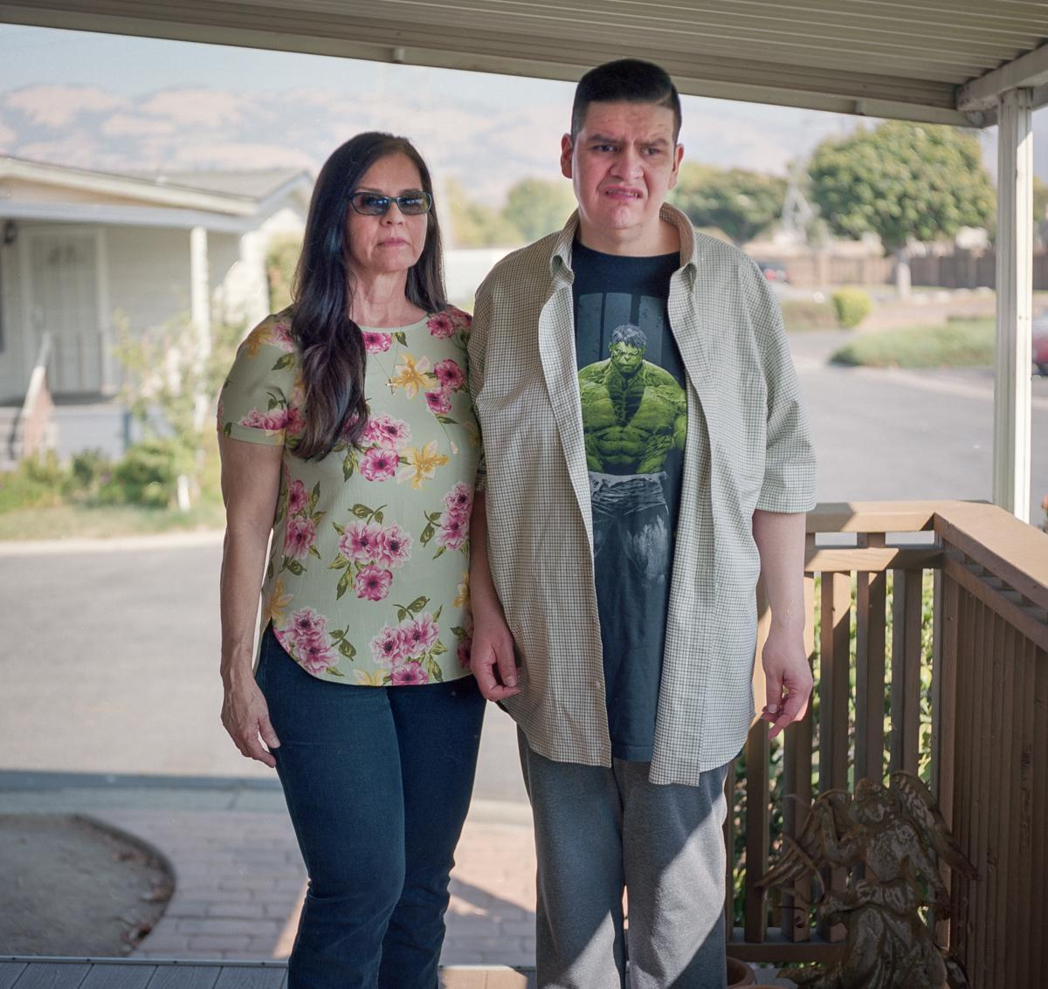
ENVIRONMENTAL & HEALTH HAZARDS
“...and it isn’t clean…” (cancer, miscarriages, and fetal brain damage are among some side effects to exposure to these industry chemicals)
Mark Flores was born with severe birth defects, likely due to his mother’s exposure to toxic chemicals while working at a factory in Silicon Valley. Yvette Flores worked with lead and other harmful substances during her pregnancy, which contributed to Mark's disabilities. Mark experienced developmental delays, crossed eyes, and dislocated hips. Despite efforts for compensation, the Flores family faced significant legal challenges.
The ongoing impacts of industry’s H&S failures is enormous and ongoing.
Notes:
Mandy —> Ted

Slide 15
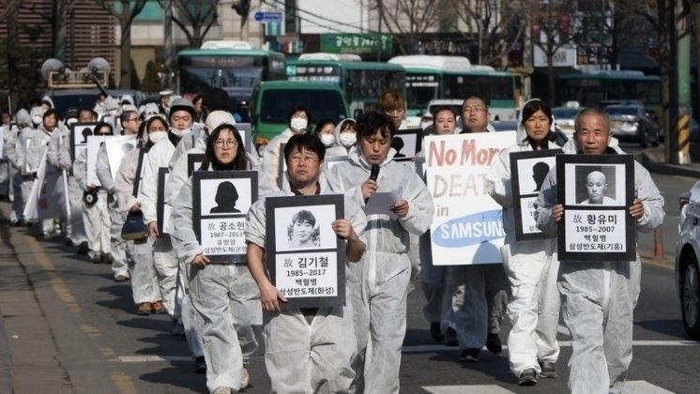
ENVIRONMENTAL & HEALTH HAZARDS
“...and it isn’t clean…” (cancer, miscarriages, and fetal brain damage are among some side effects to exposure to these industry chemicals)
U.S. semiconductor manufacturers, grappling with toxic chemicals that caused miscarriages and birth defects, outsourced production to Asian companies to avoid regulations. Despite pledging to eliminate harmful chemicals, American firms failed to ensure their suppliers abroad followed similar safety measures, resulting in health risks for workers, particularly women. This highlights the issue of ethical and legal concerns regarding the environmental and health impacts of offshoring manufacturing to regions with lax labor laws and weaker regulations.
The Stop Samsung campaign takes place primarily in South Korea, where workers, particularly in semiconductor factories, were exposed to harmful chemicals and have complained about health issues, including blood disorders and cancer, resulting from unsafe working conditions. Many workers suffered from severe illnesses and death due to prolonged exposure. Families and activists are participating in the campaign, demanding justice, corporate accountability, and better working conditions and worker protections, and also compensation for affected workers.
The US industry has outsourced most of its production and also outsourced its hazards to Asia, Latin America, and around the world.
Notes:
Mandy —> Ted

Slide 16
THE CNY GOOD JOBS AND EQUITABLE ACCESS PLATFORM
CNY DESERVES STRONG WORKER & COMMUNITY STANDARDS…
Diverse, Equitable and Inclusive Workforce with Accessible Pathways to Employment
Family Sustaining Wages & Comprehensive Benefits
Strong Metrics Language in Contracts w/Transparency
  Specific plans around wages and benefits broken down by job classification with minimums not averages
  Expected staffing requirements including projected hires and total jobs by job title (level) including worker classification by year of operation
  Quarterly reporting w/public access
Required Worker-Led Health & Safety Committees
Prioritizing Union Partnerships
Labor Peace Agreements & Community Benefits Agreements
Safe Working Conditions - Moving Beyond OSHA Compliance – Federal Coordination on Toxics & Safety
R&D Investment – Need Technology for a Truly “Green and Clean” Fab
Transportation Access & Childcare

Slide 17
MICRON’S ENVIRONMENTAL IMPACT ASSESSMENT REPORT
TOPICS THAT WILL BE COVERED:
SOCIO-ECONOMIC CONDITIONS
Environmental Justice communities
Housing
Healthcare
NATURAL RESOURCES
Water consumption
Endangered species
Wetlands
Forests
VISUAL IMPACTS AND COMMUNITY CHARACTER
WATER POLLUTION
Release of chemicals into waterways
AIR POLLUTION
Release of chemicals into the air
SOLID WASTE & HAZARDOUS MATERIALS
Storage of chemicals
Worker safety
Transport & Disposal of hazardous waste
Transport & Disposal of other waste (solid, liquid)
CLIMATE CHANGE
Use of natural gas
Use of electricity from fossil fuels
Release of GHGs, especially fluorinated gases
TRANSPORTATION
Public transit to Micron
I-81 interchange
Other traffic issues
UTILITIES & INFRASTRUCTURE
Electric substation
Natural gas pipeline
Wastewater pipes
Water line from Oswego
USE AND CONSUMPTION OF ELECTRICITY
On-site renewables
Off-site renewables
Nuclear power

Slide 18
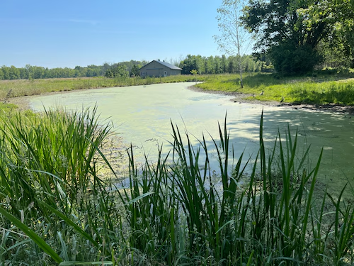
DESTRUCTION OF WETLANDS
Micron Project to destroy 200 acres of wetlands
Subject to the Clean Water Act
Micron’s working with The Wetland Trust to develop an offsite mitigation plan
Home to endangered species: Indiana Bat, Northern Long-Eared Bat, Sedge Wren

Slide 19
UTILITIES AND WATER USE
Energy Use
Micron will use to use 7.15 million MWhrs per year of electricity
Will need 24/7 power
Unclear how Micron will meet their 100% renewable energy needs
Will this have an impact on ratepayers
Water Use
Micron is expected to pull 48 million gallons of water per day from Lake Ontario – More than the City of Syracuse uses per day
Micron’s liquid waste generation per day is expected to be 8-20 million gallons
Will need to treat wastewater before returning it to Lake Ontario

Slide 20
POLLUTION & HEALTH AND SAFETY
Pollution Concerns
Certain extremely hazardous substances. are essential to semiconductor production including PFAS forever chemicals
Concerns around toxic gas emissions, wastewater treatment, and groundwater contamination
Greenhouse Gas Emissions associated with facility
Impact on Health and Safety
Need strong health safety procedures and training to protect workers from exposure to dangerous chemicals
Burning of chemicals & PFAS or wastewater leakages can have an impact on community health
Need to review Micron’s chemical storage, transportation of chemicals, worker safety, emergency response, and disposal of solid chemicals and PFAS

Slide 21
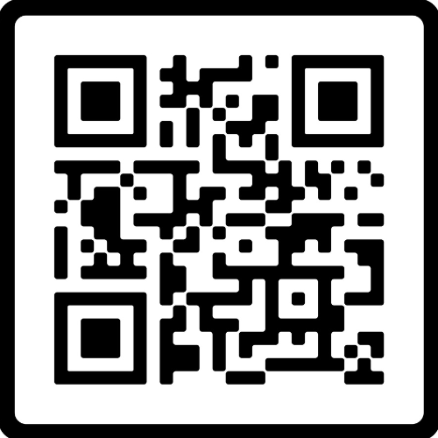
CNY CALL TO ACTION! #1
THE GOOD JOBS AND EQUITABLE ACCESS PLATFORM
PLEASE SCAN QR CODE
AND SIGN PLATFORM :
REMEMBER TO CHECK THE BOX :
“YES, I WANT TO HELP WITH ENVIRO REVIEW COMMENTS”
(WE WILL CONTACT YOU WITH INFORMATION AND INSTRUCTIONS ON WHERE TO SUBMIT AND BY WHEN)

Slide 22
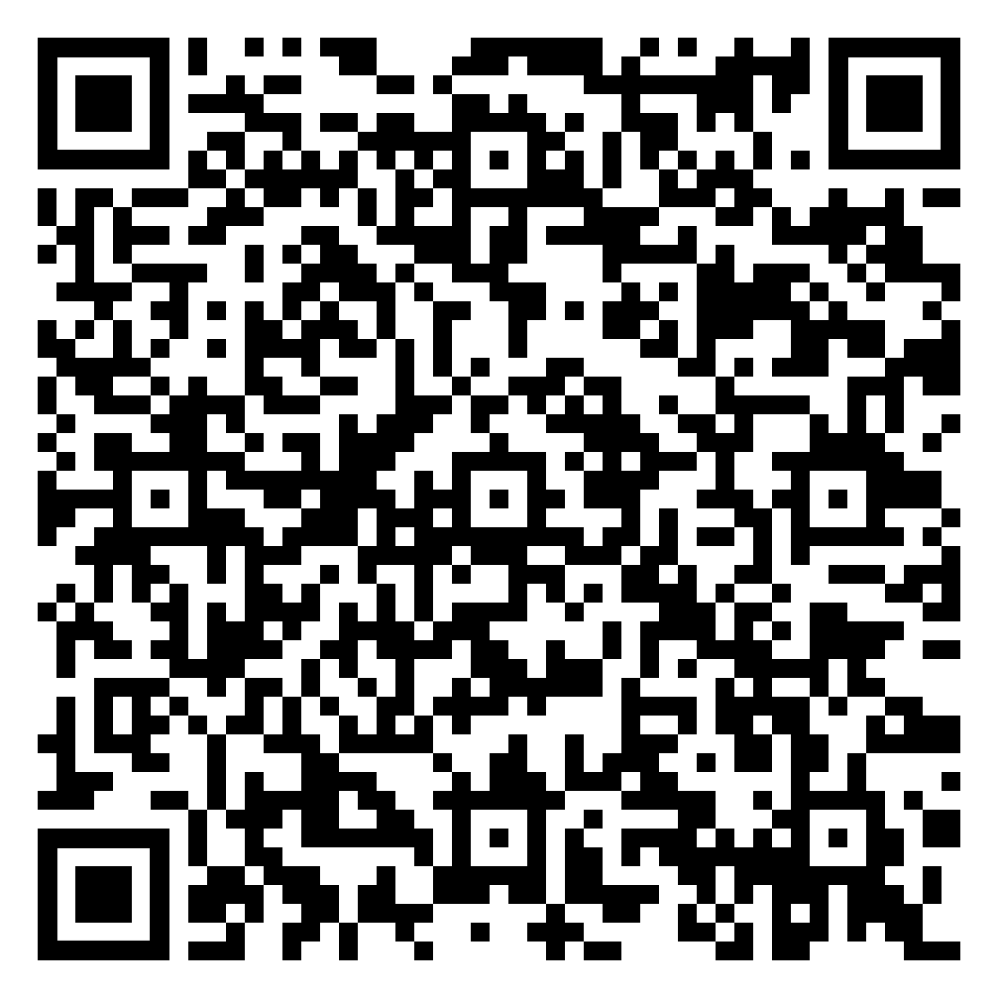
CNY CALL TO ACTION #2
EXTENSION OF COMMENT PERIOD
Micron’s draft environmental impact statement (DEIS) pursuant to the National Environmental Policy Act (NEPA) for the construction and operation of Micron’s Clay, NY chip fabs is expected to be released JUNE 4TH, along with the NY State Environmental Quality Review (SEQR).
The law provides for a public comment period of 45 days from the day the DEIS is released.
We are requesting an extension of the comment period to 120 days & a minimum of
5 public hearings
PLEASE SCAN QR CODE
& SIGN THE PETITION

