Slide 1
Case Study
CREATING A UNIFIED GLOBAL POWER BRAND
Results
The company
Contributed to the doubling of IG’s revenue to £1B p.a
Contributed to the 44% increase in share price
5% year-on-year increase in brand awareness and consideration in key markets.
Campaign achieved:
74% in saliency
78% in understanding
65% in consideration
IG is a FTSE 250 fintech leader providing derivatives trading and investment solutions to retail and commercial clients globally, with a turnover exceeding £1 billion annually. Operating across 17 international markets, IG has built a strong reputation for innovation and market leadership.
The Challenge
IG faced significant brand fragmentation across its global footprint, diluting its strength and hindering differentiation. More than just unifying its brand, IG needed a distinctive, bold positioning and strategy that would resonate deeply with diverse global audiences and clearly set it apart in the competitive fintech landscape.
Insight & Solution
By embracing a bold positioning and establishing a unified global brand, IG strengthened its market leadership, delivering exceptional commercial growth and brand impact.
A comprehensive global brand audit revealed that, beyond fragmentation, IG lacked a differentiated and compelling positioning. IG embarked on a strategic transformation:
Distinct Global Positioning. Developed a bold, differentiated positioning built on the insight that “where others see events, traders see opportunities”.
Unified Global Strategy. Consolidated fragmented identities across 17 markets into a cohesive brand system, supported by clear, consistent messaging and a progressive visual identity capable of global resonance and local relevance.
Bold Global Campaign. Launched "See it, IG it," a multilingual global campaign spanning 17 markets in 22 languages. The campaign underscored IG’s distinctive positioning, emphasizing the immediacy and ease with which clients could seize trading opportunities.

Slide 2
Case Study
Brand commercial
https://www.youtube.com/watch?v=jbmdORyBrYg

Slide 3
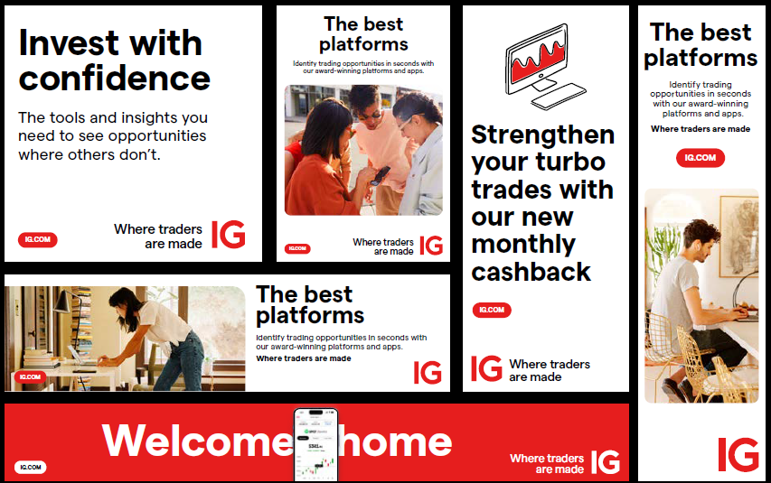
Case Study
Examples of display ads

Slide 4
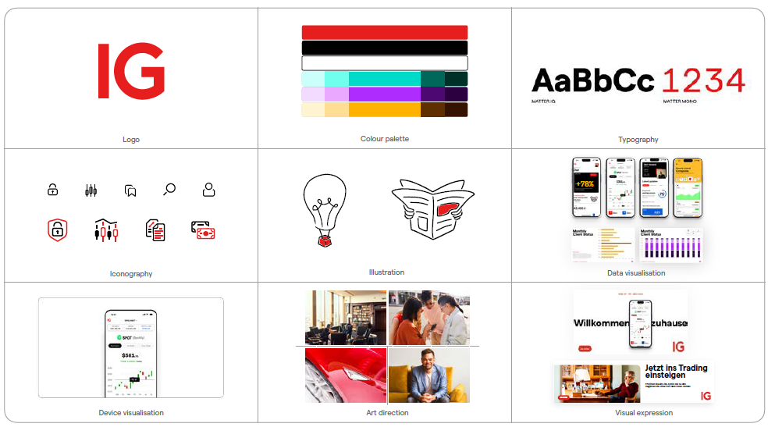
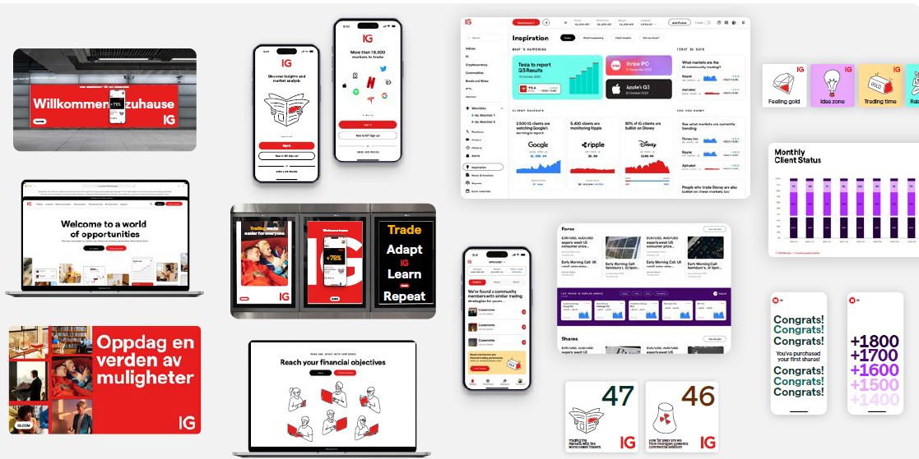
Case Study
VI development

