Slide 1

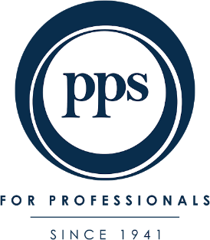
Case Study
TURNING MUTUALITY INTO A MARKET ADVANTAGE
Results
The company
122% increase in leads—huge brand momentum from a small budget.
9.1% revenue growth (outpacing the industry’s 6%).
266% increase in new risk policies, driven by both new members and increased coverage.
Brand awareness tripled—knowledge of PPS’ unique model rose from 7% to 21% among non-members.
PPS is a mutual insurance company catering exclusively to graduate professionals, where members own the company and share in its profits—a unique model in the insurance landscape.
The Challenge
PPS was an unknown brand in a highly competitive industry dominated by mass-market insurers. Its unique mutuality model was not well understood, and consumer skepticism around insurance was high—especially in a tough economic climate where people were cutting back on policies. With a tiny budget (0.43% SOV), PPS needed to stand out in a category of sameness.
Insight & Solution
Success isn’t just about what you earn—it’s about what you share.
The campaign, "The Secret to Success Lies in Sharing It," highlighted the power of mutuality through:
A striking TV ad featuring rival bakers—one struggling, the other thriving because everyone in his bakery "owned" the business. A metaphor for PPS’ unique model.
Distinctive print and digital ads featuring iconic partnerships (The Beatles, Harley-Davidson), reinforcing the idea that shared success creates greater value.
Expanding beyond niche professional journals to include TV, mainstream business press, and online media, reaching a broader professional audience.
By challenging category norms, PPS didn’t just sell insurance—it redefined what success looks like.

Slide 2

Case Study
TURNING MUTUALITY INTO A MARKET ADVANTAGE
Brand commercial

