Slide 1
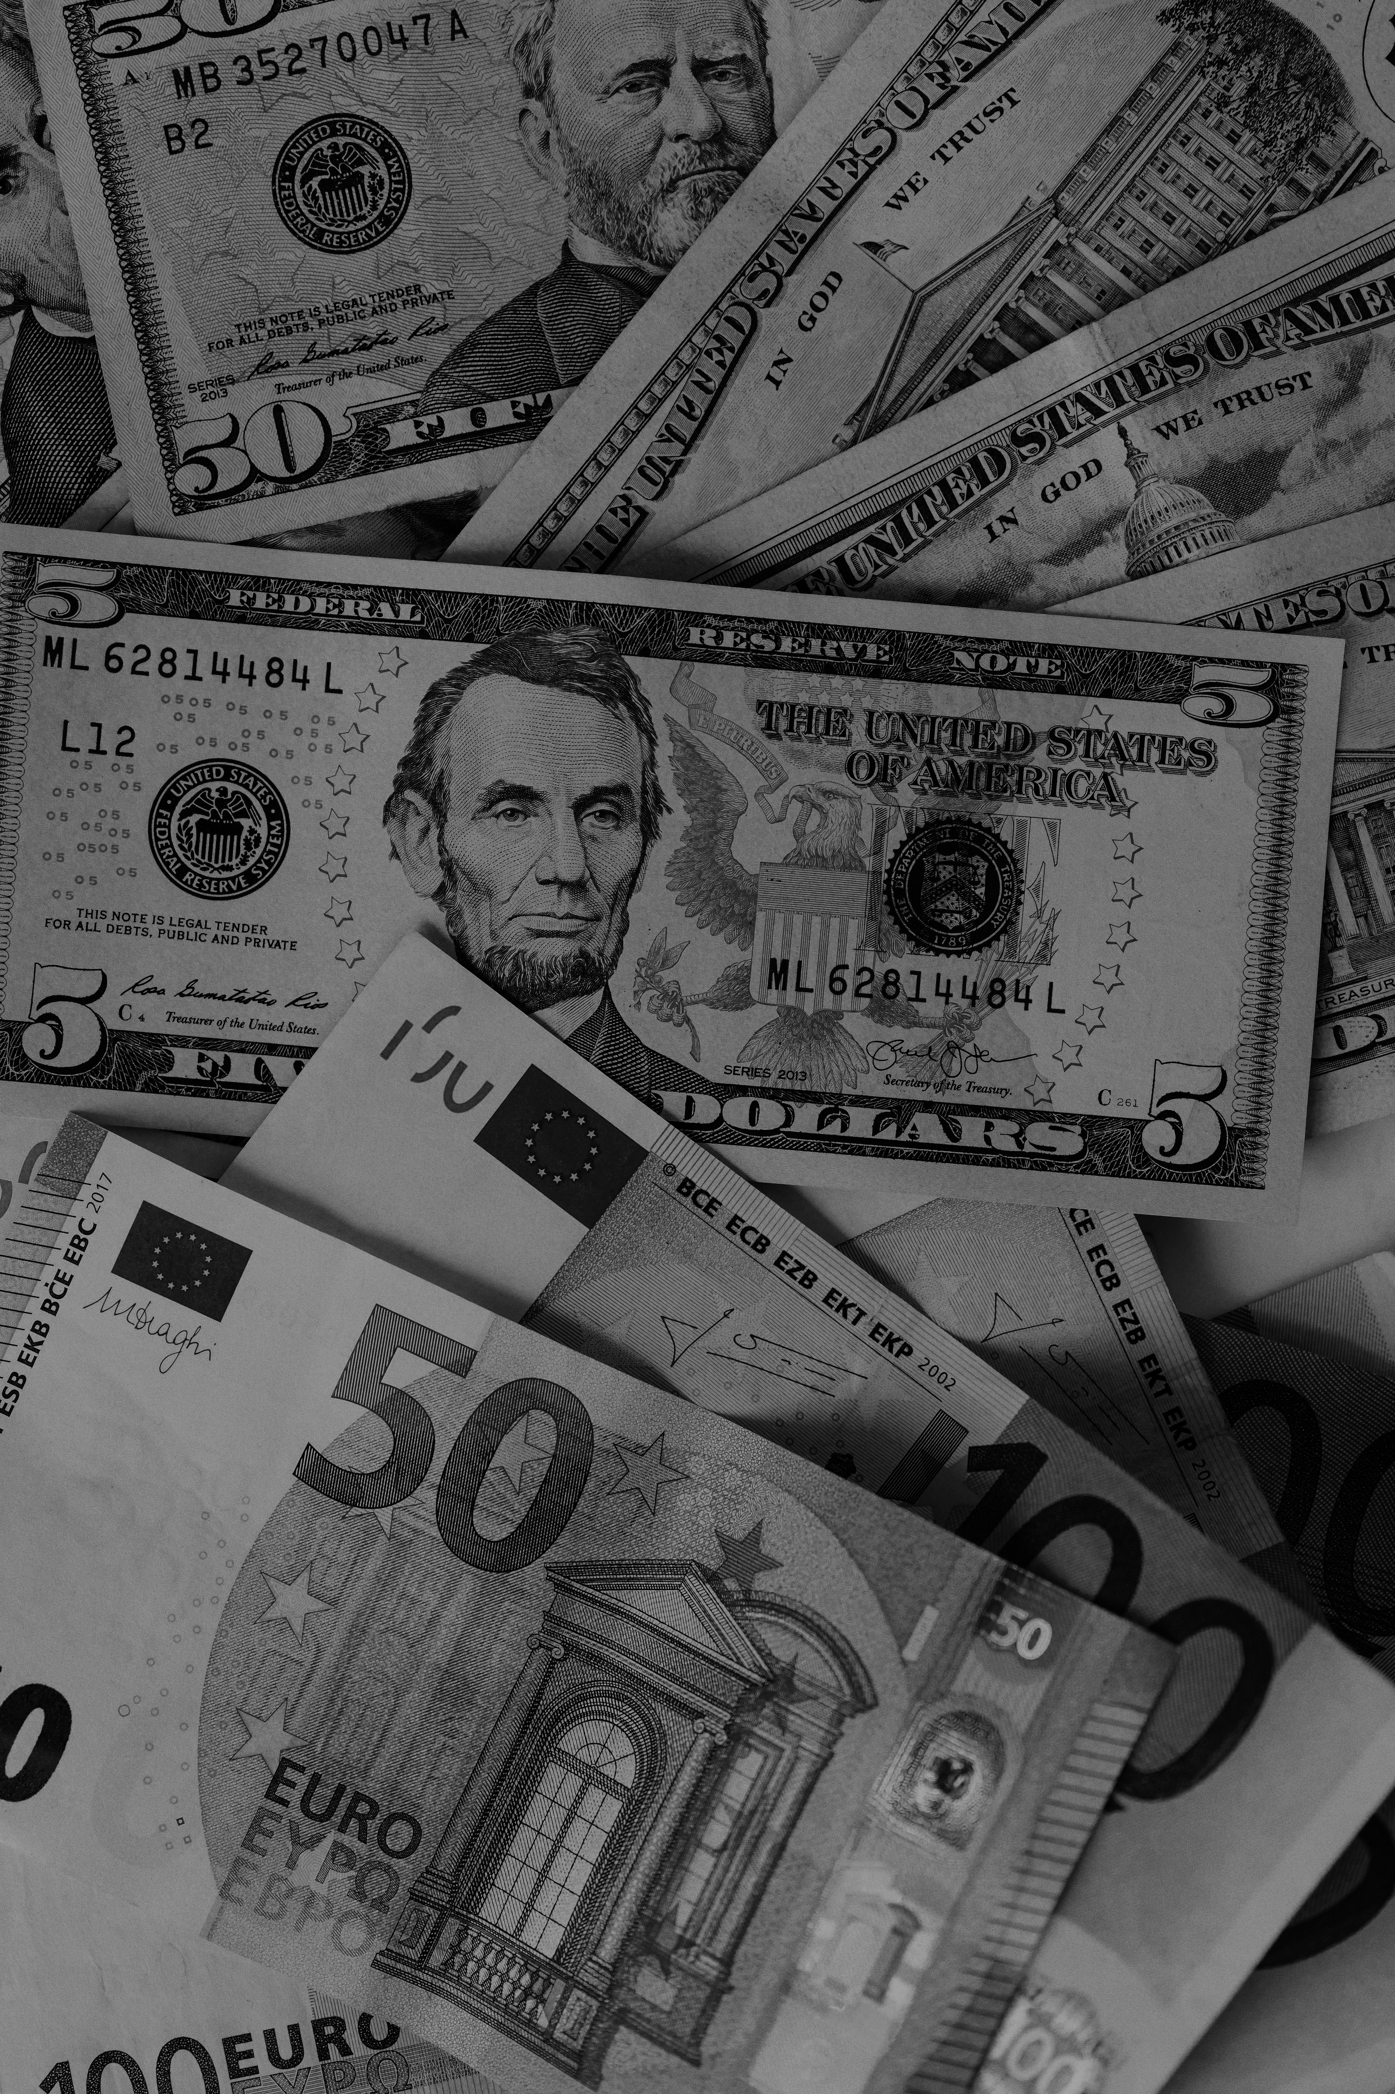
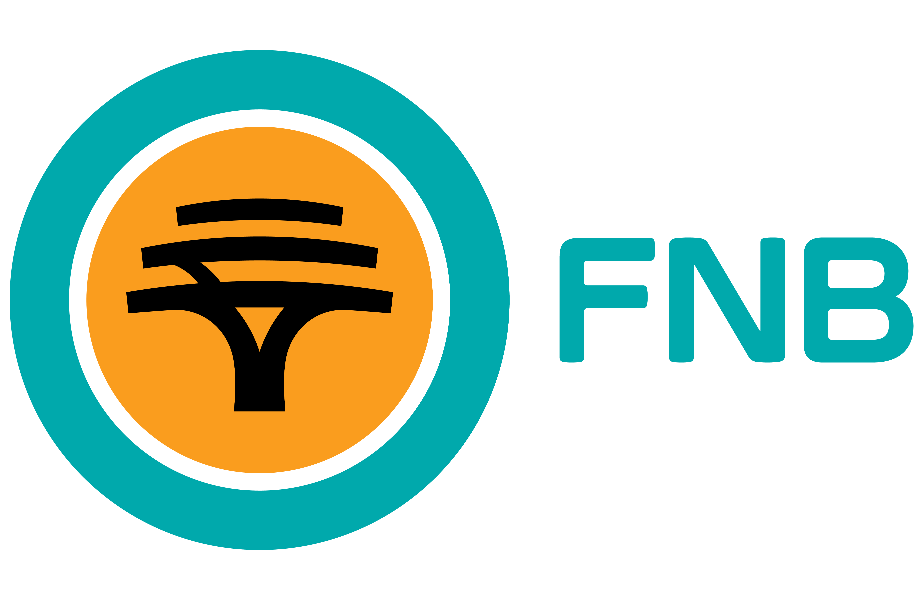
Case Study
THE CAMPAIGN THAT BROKE BANKING INERTIA
Results
The company
1.74 million new accounts in the first year
5% market share growth
41% revenue growth over three years (from 0.03%)
Cross-sell ratio increased from 1.97 to 2.13 products per customer
Became the most talked-about bank in SA, with Steve turning into a pop culture icon
FNB is one of South Africa’s leading banks, built on a reputation for innovation and customer-centric solutions under the "How Can We Help You?" brand positioning.
The Challenge
South Africans rarely switch banks—over 80% had never done so, seeing all banks as essentially the same. The perceived hassle of switching reinforced customer inertia. Despite being named the bank with the lowest fees, FNB struggled to translate this into significant new account growth. It needed a game-changing approach to convince customers that banking with FNB was worth the switch.
Insight & Solution
Price alone doesn’t drive banking decisions—but perceived value does. People don't leave a bank for marginally lower fees, but they will switch for more benefits.
Enter Steve from [Beep] Bank—a humorous, satirical radio campaign featuring a hapless call center agent struggling to convince customers to stay with their outdated, uninspiring bank. Every ad highlighted FNB’s superior benefits, ending with the powerful question: "Does your bank do all that?"
The campaign used high-frequency radio and outdoor media to keep FNB top of mind and continually reinforce its superior value.
By challenging banking inertia and forcing customers to compare, FNB didn’t just increase sign-ups—it changed the way people think about switching banks.

Slide 2
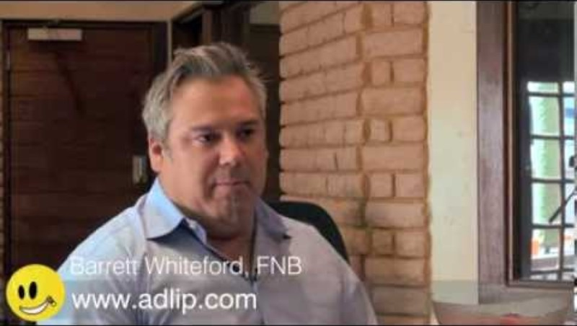
Case Study
THE CAMPAIGN THAT BROKE BANKING INERTIA
Interview with Barret Whiteford (FNB) about the campaign and it’s success

