Slide 1
Evangelism & Discipleship
An intro into becoming a disciple series

Slide 2
Parable of the seed growing
Mark 4:²⁶ And he said, “The kingdom of God is as if a man should scatter seed on the ground. ²⁷ He sleeps and rises night and day, and the seed sprouts and grows; he knows not how. ²⁸ The earth produces by itself, first the blade, then the ear, then the full grain in the ear. ²⁹ But when the grain is ripe, at once he puts in the sickle, because the harvest has come.”

Slide 3
God gives the growth
1 Corinthians 3:⁶ I planted, Apollos watered, but God gave the growth. ⁷ So neither he who plants nor he who waters is anything, but only God who gives the growth. ⁸ He who plants and he who waters are one, and each will receive his wages according to his labor. ⁹ For we are God’s fellow workers. You are God’s field, God’s building.

Slide 4
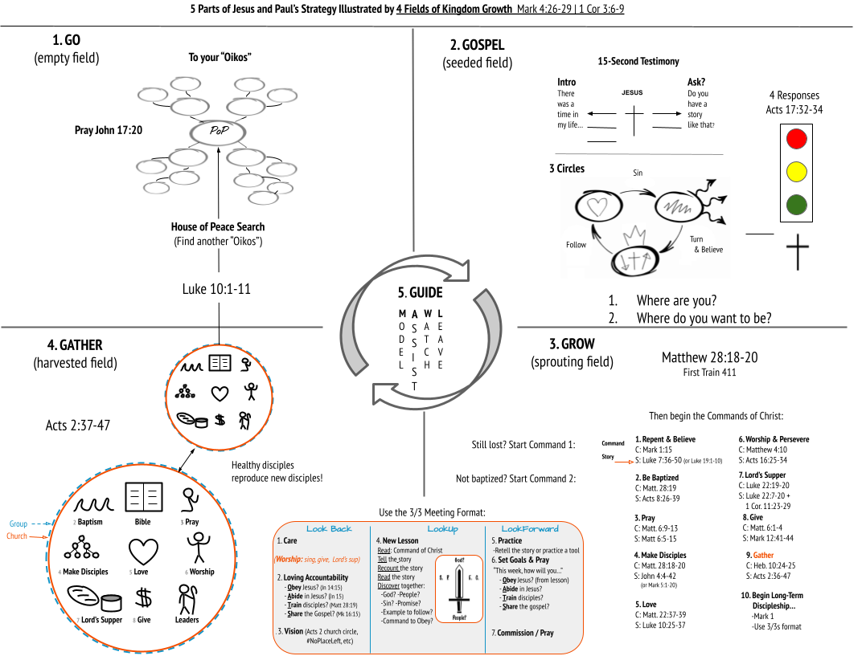

Slide 5
1. Go; New community and new Person-of-peace
John 17:²⁰ “I do not ask for these only, but also for those who will believe in me through their word,
Luke 10:² And he said to them, “The harvest is plentiful, but the laborers are few. Therefore pray earnestly to the Lord of the harvest to send out laborers into his harvest. ³ Go your way; behold, I am sending you out as lambs in the midst of wolves. ⁴ Carry no moneybag, no knapsack, no sandals, and greet no one on the road. ⁵ Whatever house you enter, first say, ‘Peace be to this house!’ ⁶ And if a son of peace is there, your peace will rest upon him. But if not, it will return to you. ⁷ And remain in the same house, eating and drinking what they provide, for the laborer deserves his wages. Do not go from house to house.

Slide 6
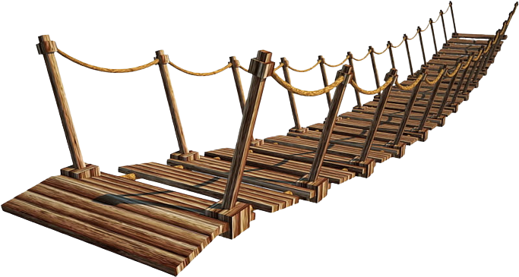
1. Go; Bridge building
The Relational Bridge illustrates the building of relationships as you seek to Pray, Care, and Share the Gospel with those you meet.
Each “Touch” meaningful conversation is a Plank in the Relational Bridge.
Each common interest or prayerful concern/follow up is a Suspension Support in the Relational Bridge.

Slide 7
1. Go
Be involved; in the lives of those you know, in the affairs of your community, in the activities of your kids, etc.
Be inviting; are you an approachable person, are you gentle and kind
Be hospitable; the challenge is to engage in those you know and do life with and share a meal with them in your home.
Be looking; search as you go for that Person-of-Peace that is willingly to engage in Bible Study.
Be the Person-of-Peace; continue to be the hospitable witness in your community

Slide 9
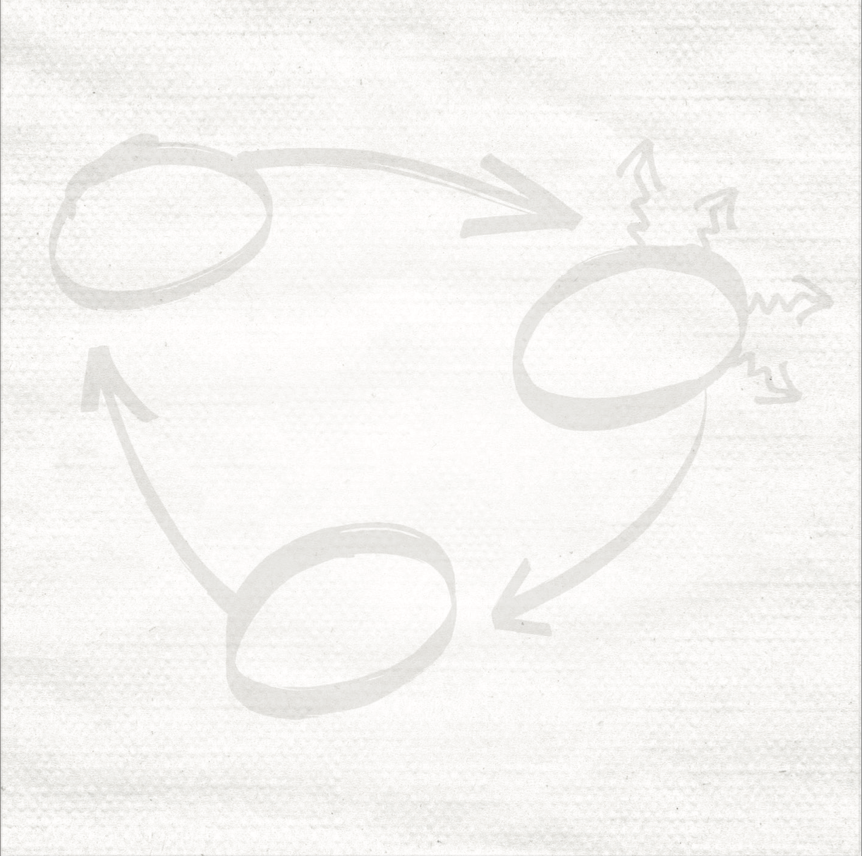
2. Gospel

Slide 10
3 circles

Slide 11

3 circles

Slide 12

3 circles

Slide 13
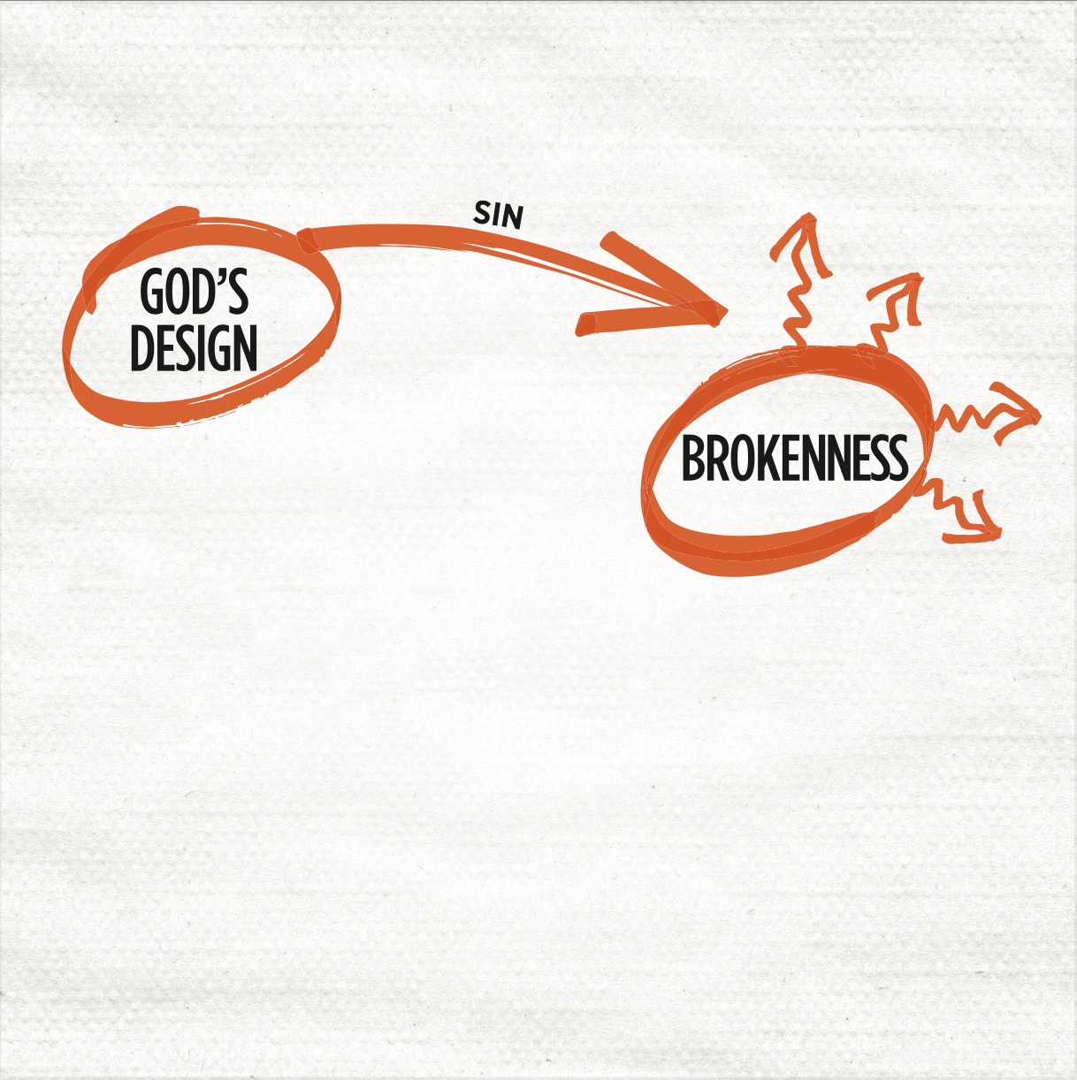
3 circles

Slide 14
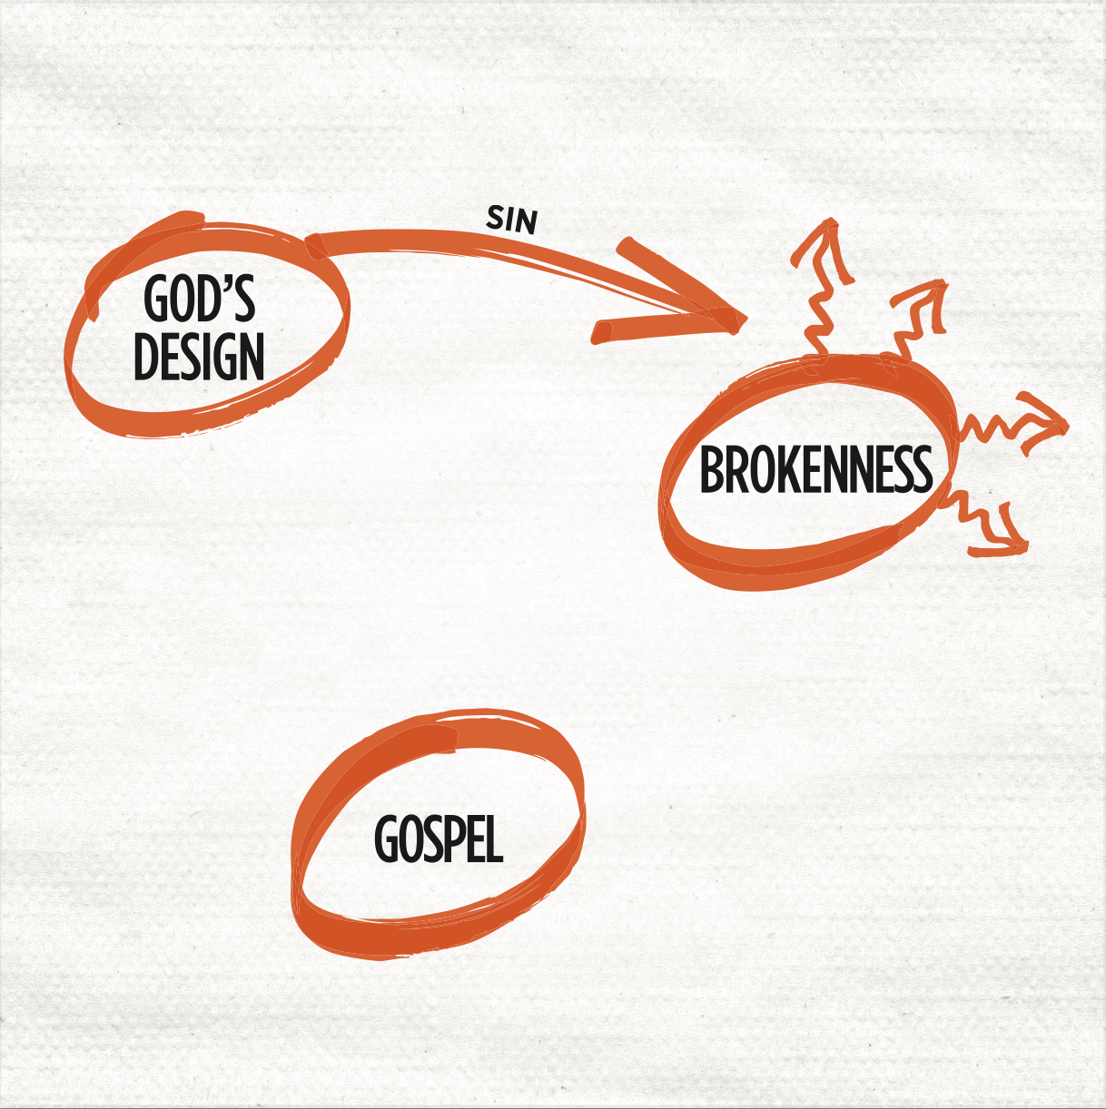
3 circles

Slide 15
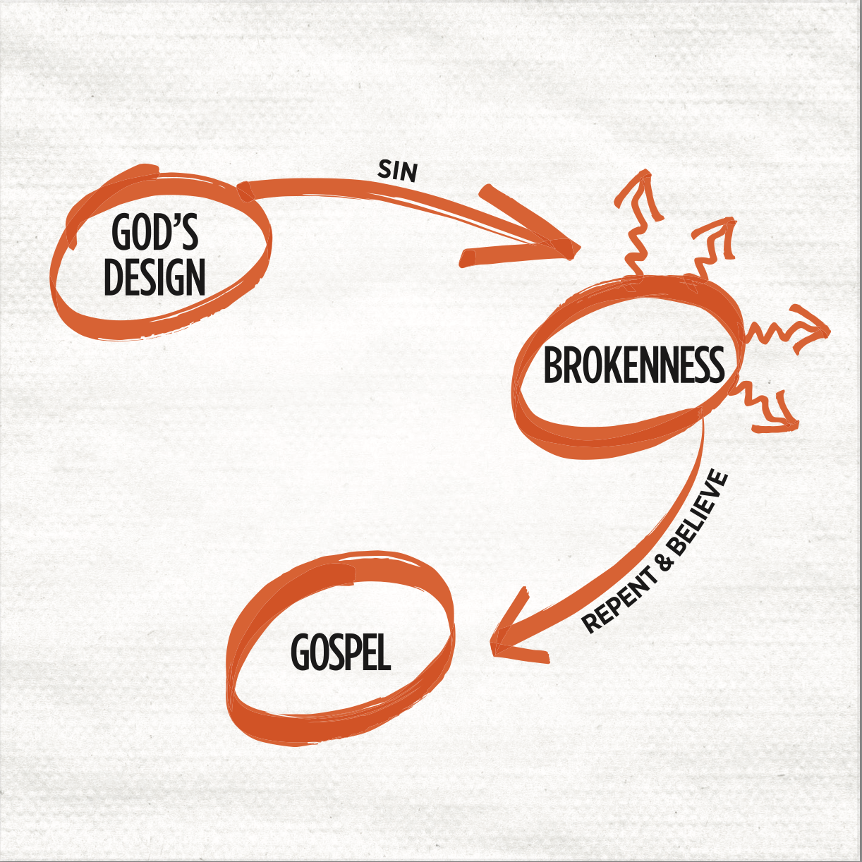
3 circles

Slide 16
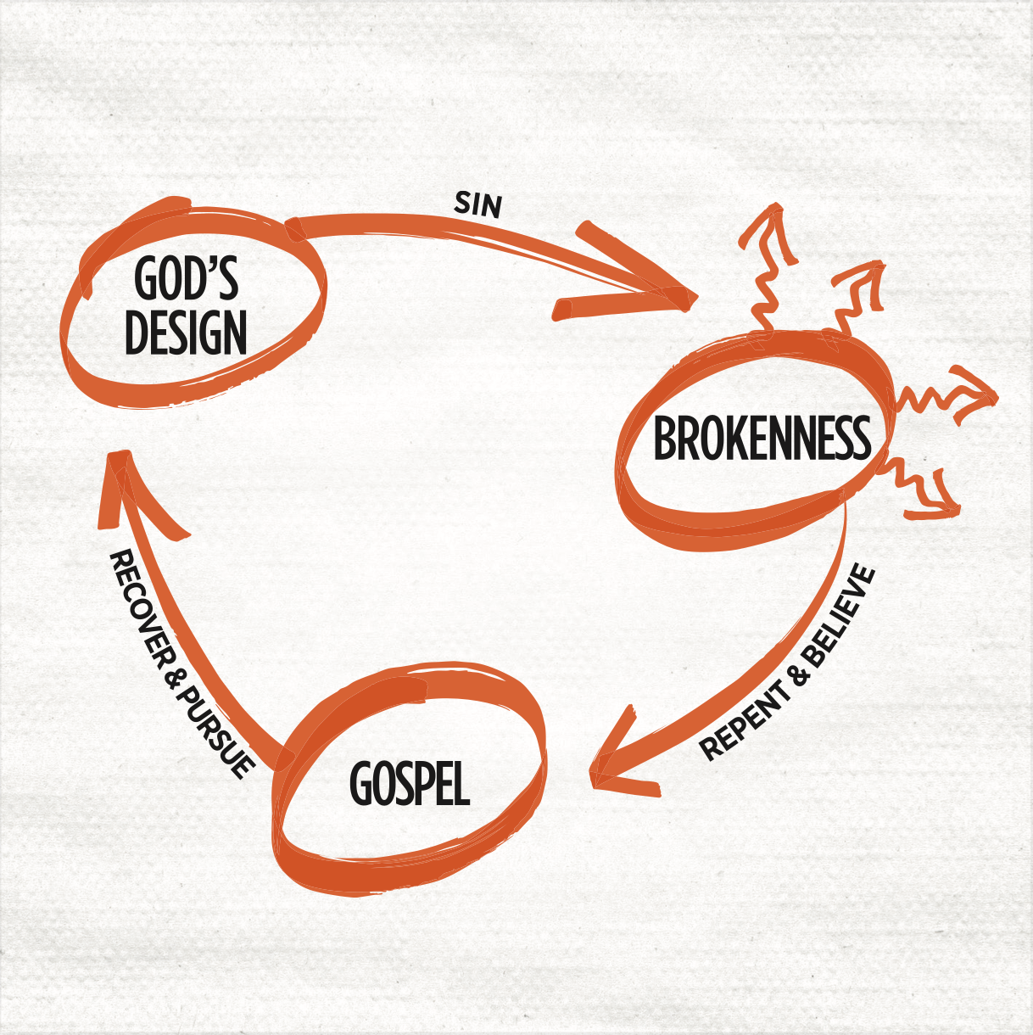
3 circles

Slide 17
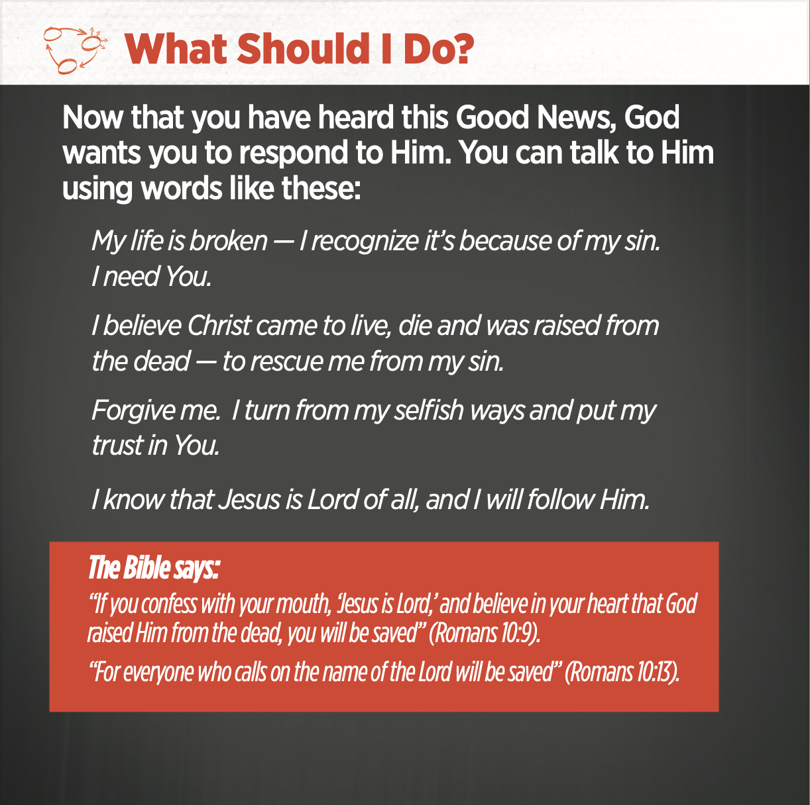
3 circles

Slide 18
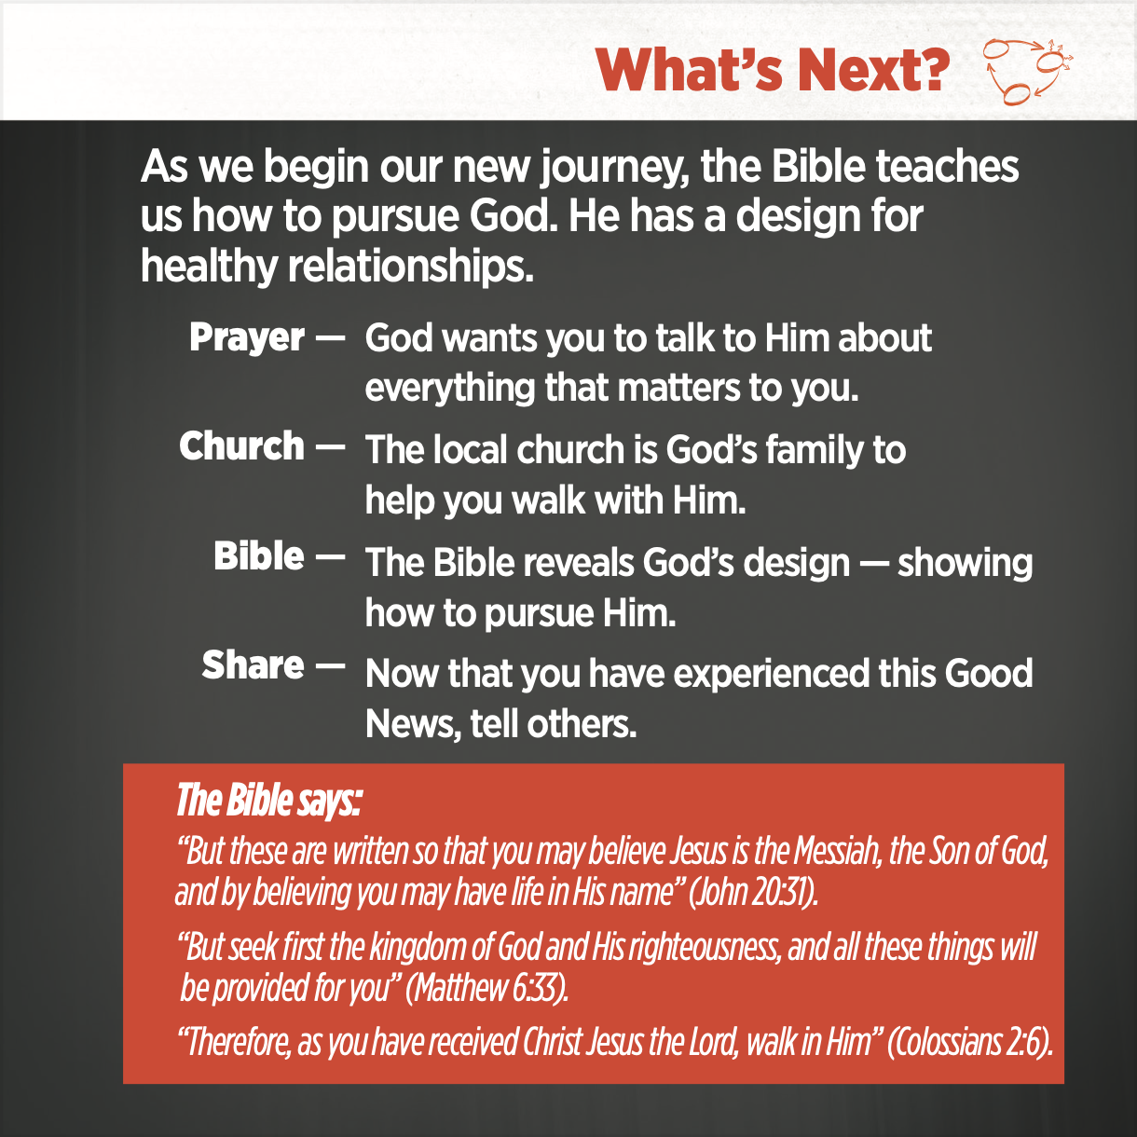
3 circles

Slide 19
4 Responses to the gospel
Acts 17:³² Now when they heard of the resurrection of the dead, some mocked. But others said, “We will hear you again about this.” ³³ So Paul went out from their midst. ³⁴ But some men joined him and believed, among whom also were Dionysius the Areopagite and a woman named Damaris and others with them.

Slide 21
The great commission
Matthew 28:¹⁷ And when they saw him they worshiped him, but some doubted. ¹⁸ And Jesus came and said to them, “All authority in heaven and on earth has been given to me. ¹⁹ Go therefore and make disciples of all nations, baptizing them in the name of the Father and of the Son and of the Holy Spirit, ²⁰ teaching them to observe all that I have commanded you. And behold, I am with you always, to the end of the age.”

Slide 22
3. Grow
Core Equipping; 411 Training, 3-Circles, Commands of Christ, Gospel of Mark
Functional Discipleship can be thought of as three types times you spend with your disciple.
These times are not rigid and completely separate from one another, unable to blend into each other.
3 Types of Time;
  Windshield Time
  Table Time
  Street Time

Slide 23
3 Types of Time; Windshield time
This is time spent on the road with those you are discipling.
This includes long trips and short trips.
Forward progress behind a windshield provides focused time of concern, friendship, and story-telling with one another.
These times, with the right attitude, bring about some of the more deeper conversations about God, the Church, life, etc.

Slide 24
3 Types of Time; Table time
This time has multiple facets centered around nourishing fellowship around the table;
  1. Formal, 2. Informal, 3. Familial, 4. Worshipful
Formal; This is structured time of engaging in Scriptures, Sanctification, and Challenge. Known as DNA Group (Discipleship, Nurture, Accountability). Framed by 3/3rds Principle.
Informal; These are times or meals with no agenda meant to strengthen relationships.
Familial; These are meals within your home in which you invite your disciples into your family and home.
Worshipful; This is the time in which we come together as a Church and feast at the Table of the Lord on the Bread of Life and the Word of God.

Slide 25
3 Types of Time; Street time
This a time of missional and intentional engage of those within your community for the sake of the Gospel.
During these times you will MAWL the ones God has blessed you to disciple.
  Modal
  Assist
  Watch
  Launch, Leave, Love

Slide 26
3 Types of Time; Street time
These times are ones that move in-and-out the other 2 Types of Time.
Some examples are;
  Door-to-Door
  Conversations with Wait Staff at restaurants
  Conversations with Cashiers
  Conversations with those along the sidewalks, ballparks, trails, bingo nights, etc
  Randoms along your travels during Windshield Time
In each of these moments we are MAWL(ing) our Church’s Core Values (Renew, Restore, Revive, Reproduce) and seeking opportunity for Prayer, Care, and Share.

Slide 28
9 Church disciplines of the first church
Acts 2:³⁷ Now when they heard this they were cut to the heart, and said to Peter and the rest of the apostles, “Brothers, what shall we do?” ³⁸ And Peter said to them, “Repent and be baptized every one of you in the name of Jesus Christ for the forgiveness of your sins, and you will receive the gift of the Holy Spirit. ³⁹ For the promise is for you and for your children and for all who are far off, everyone whom the Lord our God calls to himself.” ⁴⁰ And with many other words he bore witness and continued to exhort them, saying, “Save yourselves from this crooked generation.” ⁴¹ So those who received his word were baptized, and there were added that day about three thousand souls.

Slide 29
9 Church disciplines of the first church
Acts 2:⁴² And they devoted themselves to the apostles’ teaching and the fellowship, to the breaking of bread and the prayers. ⁴³ And awe came upon every soul, and many wonders and signs were being done through the apostles. ⁴⁴ And all who believed were together and had all things in common. ⁴⁵ And they were selling their possessions and belongings and distributing the proceeds to all, as any had need. ⁴⁶ And day by day, attending the temple together and breaking bread in their homes, they received their food with glad and generous hearts, ⁴⁷ praising God and having favor with all the people. And the Lord added to their number day by day those who were being saved.

Slide 30
4. Gather
Here the disciples are gathered for their ultimate purpose, the worship of God and the advancement of His Kingdom!
Gather exist in two context; The Church, and the Life Group.
The Church practices these 9 Church Disciplines consistently;
  Baptism
  Prayer
  Scripture Exposition
  Worship
  The Lord’s Supper
  Financial Contribution
  Love One Anothers
  Making Disciple-Making Disciples
  Shepherding

Slide 31
4. Gather
Here the reproduction of disciples continue into the development of a new church.
Reproduction of the Church ensures that the Gospel continues to reach the Unreached and Lost in our county, state, nation, and the world.
The reproduction of Life Groups ensures the continuation of the spread of the Gospel within our communities and various “People Groups” within our communities.
Life Groups are those that practice many of the 9 Church Disciplines in the context of a Worship Community.

Slide 32

Repeat!

Slide 33
1. Go; New community and new Person-of-peace
John 17:²⁰ “I do not ask for these only, but also for those who will believe in me through their word,
Luke 10:² And he said to them, “The harvest is plentiful, but the laborers are few. Therefore pray earnestly to the Lord of the harvest to send out laborers into his harvest. ³ Go your way; behold, I am sending you out as lambs in the midst of wolves. ⁴ Carry no moneybag, no knapsack, no sandals, and greet no one on the road. ⁵ Whatever house you enter, first say, ‘Peace be to this house!’ ⁶ And if a son of peace is there, your peace will rest upon him. But if not, it will return to you. ⁷ And remain in the same house, eating and drinking what they provide, for the laborer deserves his wages. Do not go from house to house.

Slide 34
1. Go; Bridge building
The Relational Bridge illustrates the building of relationships as you seek to Pray, Care, and Share the Gospel with those you meet.
Each “Touch” meaningful conversation is a Plank in the Relational Bridge.
Each common interest or prayerful concern/follow up is a Suspension Support in the Relational Bridge.

