Slide 1

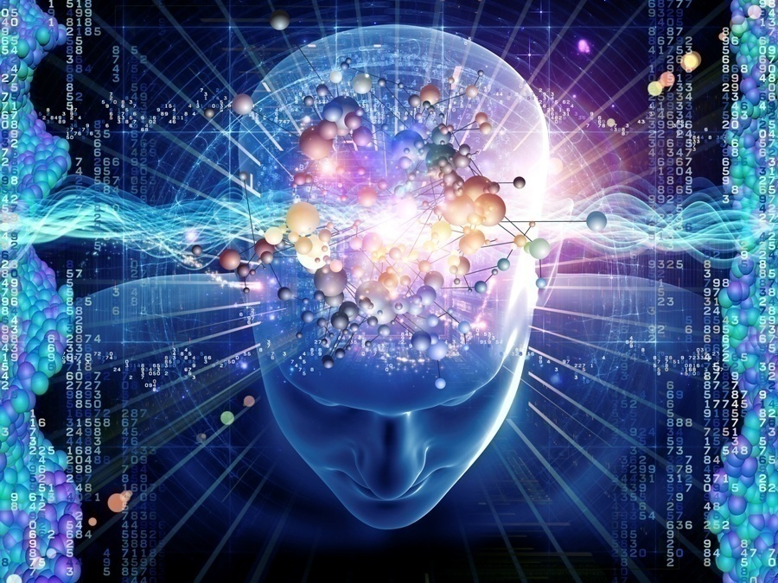
Enhance Brain Power
Improve Mental Wellness
Brain Power + Mental Wellness
Presentation
•

Slide 2
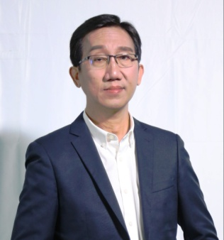
Founder & Inventor of Neuro Soundwave Technology
Tang Juel Hoi
National University of Singapore - B.Eng (EE)(Hons), MSc. (EE)
University of Florida, USA - Hon. PhD in Education
Chairman & CEO, Neuro Code Research Pte Ltd
Chairman & CEO, Beijing Neuro Code Technology Co., Ltd.
Possesses more than 25 years of R&D experience, 15 years in Artificial
Intelligence and Neural Network technologies, and 10 years in Neuro Soundwave technology.
Filed 8 Patents in Neuro Soundwave technology and 2 Original Music Copyright ownership in China.
Lecturer, Researcher and Senior Management of Temasek Polytechnic, National University of Singapore and Agency of Science, Technology and Research (A*Star) Research Institute. CEO of A*Star spin-off company.
Represented United Nation’s specialized agency, World Intellectual Property Organization as an International Expert Speaker in Intellectual Property Rights. Published Paper was used by several countries including the United States International Trade Commission in 2009, the Network of African Medical Librarians (Medlibafrica) in 2010 and The Republic of China (Taiwan) Parliament in 2013.
Inventor of World’s First Virtual Factory, realization of concept design to 3D prototyping manufacturing from different parts of the world through Internet.
CEO and GM of companies in SGX Main Board Listed Corporation.

Slide 3
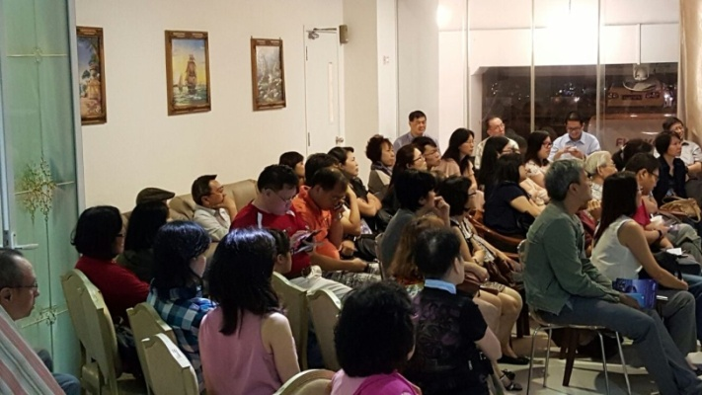
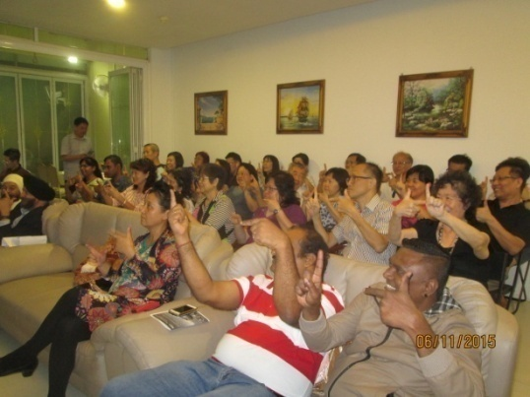
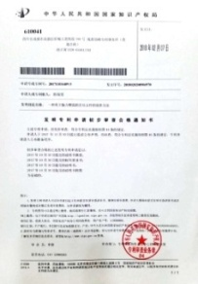
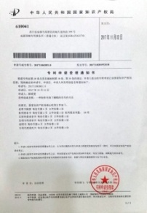
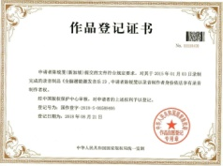
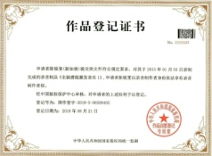
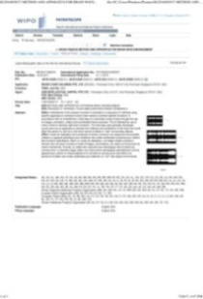
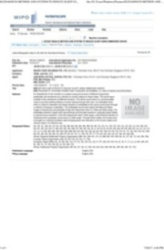
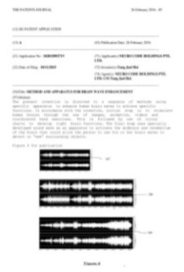
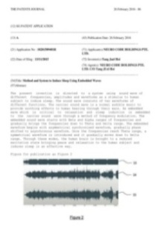
Incorporated in Jan 2015 with >10 years of research
Nero Code Research Pte Ltd, Singapore
Beijing Neuro Code Technology Co., Ltd
Shenzhen Neuro Code Research Co., Ltd
Neuro Code (M) Sdn Bhd, Malaysia
Neuro Code (Thailand) Co., Ltd
Neuro Code India Pvt Ltd
Neuro Code Taiwan Co., Ltd
Neuro Code Group of Companies
Filed 8 Patents and 2 Original Music Copyright in China

Slide 4
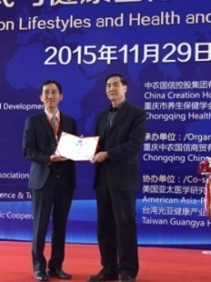
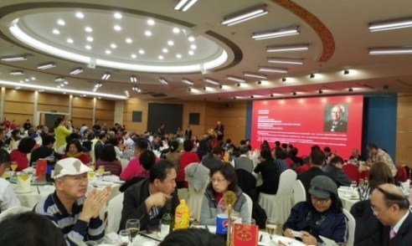
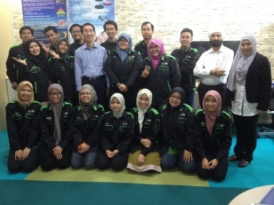
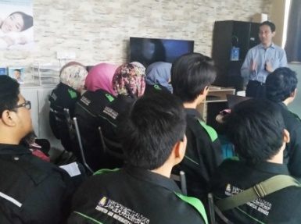
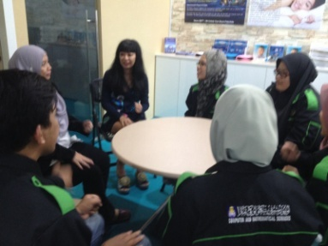
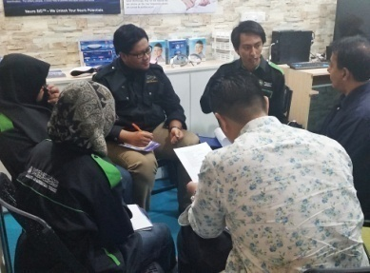
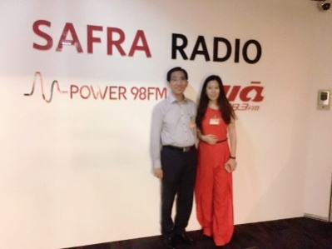
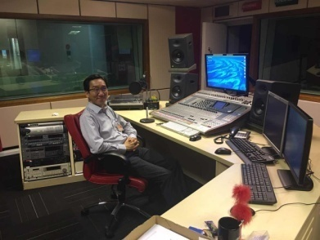
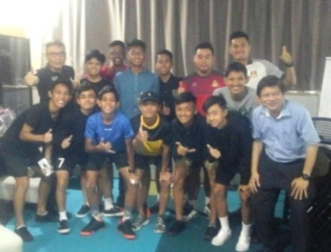
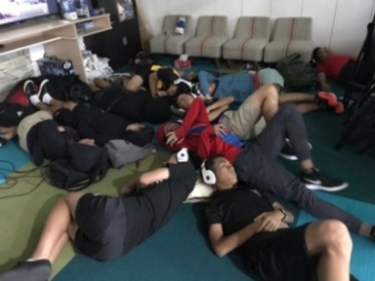
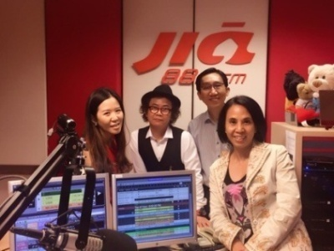
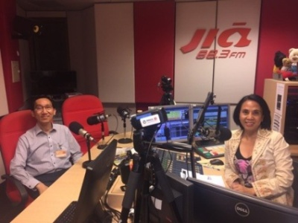
Key Milestones
Nov 2015 – Invited to present @ 6th World Healthy Lifestyle Forum - Chongqing, China
Apr 2016 – Training for Malaysia University Professor and students in AI and Neural Network
Jun 2017 – SID training for Hougang United
Soccer Team – Enhanced Sensory Perception
Aug 2016 – Interviewed by 883FM Radio Station

Slide 5
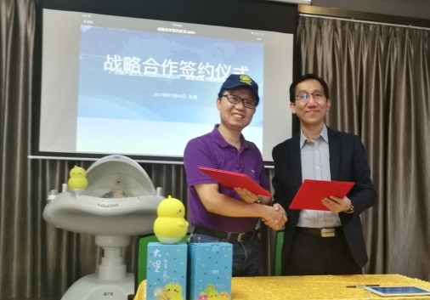
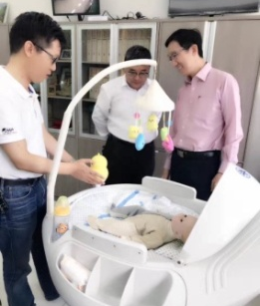
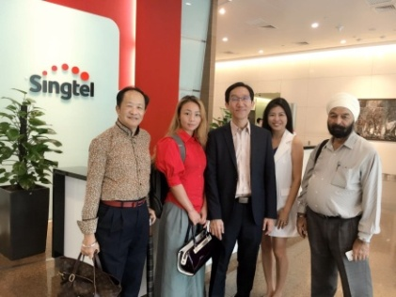
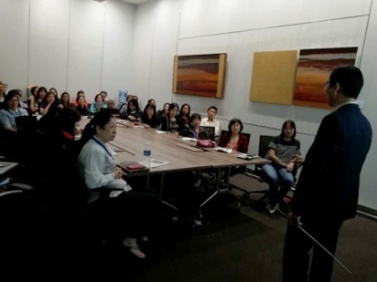
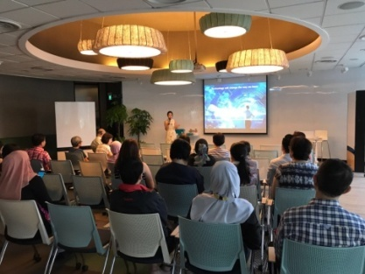
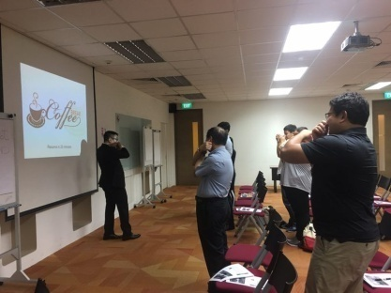
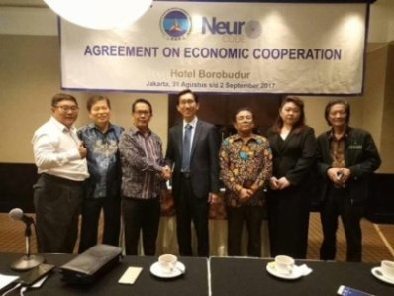
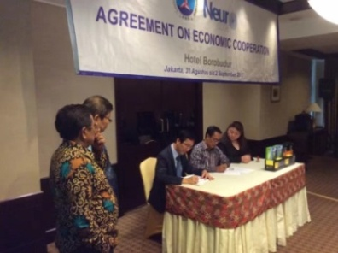
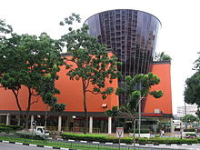
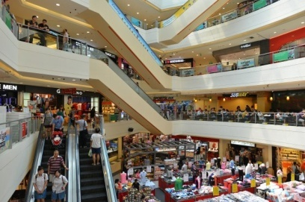
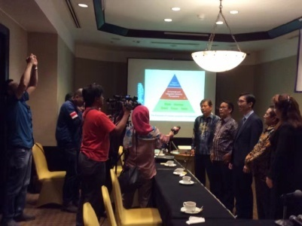
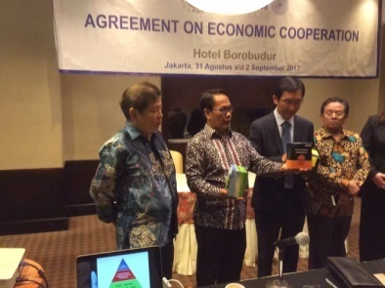
Key Milestones
Jul 2017 – Licensing of Soundwave to Hulubao, a China listed company
Aug 2017 – Invite by Singapore Telecoms to present at SingTel Learning Fiesta
Oct 2017 – Hougang Mall conducted Clinical Trial of Neuro Code Soundwave with Relaxation waves for retail outlets, shoppers, staff and public in general
Sep 2017 – Signing of Economic Cooperation Agreement with BMD Indonesia

Slide 6
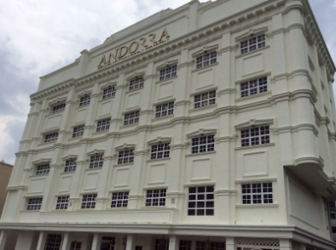
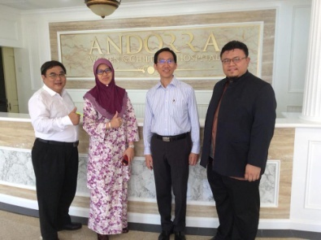
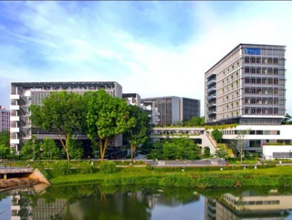
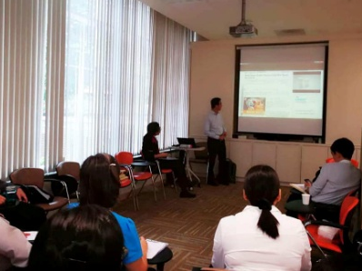
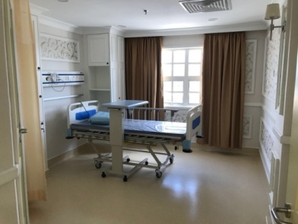
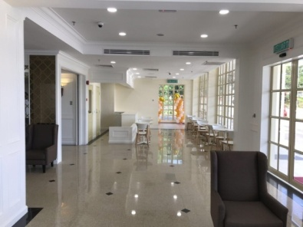
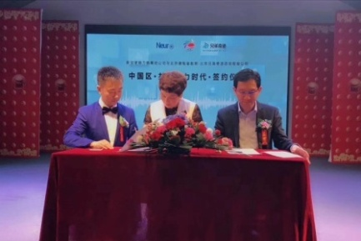
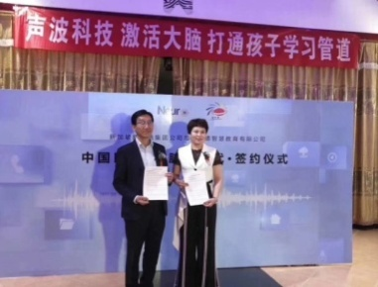
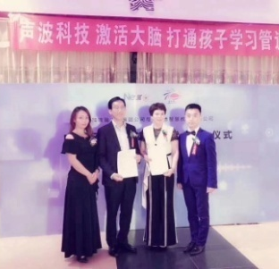
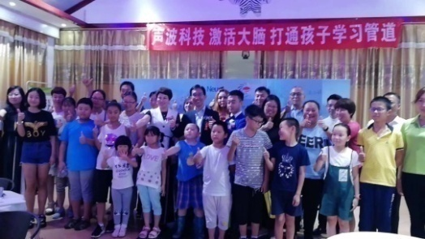
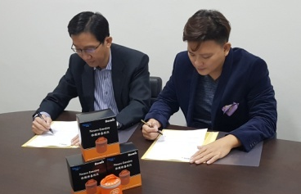

Key Milestones
July2018 – Technical Exchange with Doctors & Researchers at Khoo Teck Puat Hospital
Oct 2017 – Andorra Women and Children Hospital Implemented Neuro Code Soundwave for Delivery Wards, Reception Areas and Hospital Rooms
May 2018 – Neuro Code Research forged Strategic Partnership with EnableAsia, a social enterprise company to build a world without Dementia.
Aug 2018 – Signing Ceremony with Beijing Dezhihua Education Group as Master Distributor of Brain Stimulator in China

Slide 7
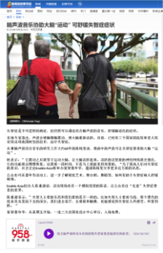
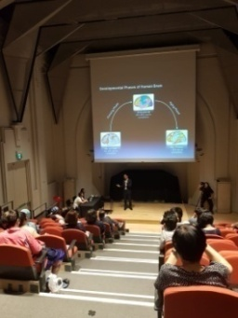
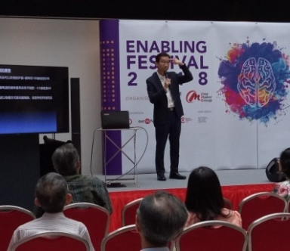









Key Milestones
Sep 2018 – Invitation by Consumer Association of Malaysia to share benefits of Neuro Soundwave on Brain Enhancement and Mental Wellness
Jan 2019 – Signing of Technology Licensing
Agreement with Shenzhen Lan Baobei Co. Ltd
Nov 2018 – Official Opening of Neuro Code
Super Intelligence Centre in Shenzhen

Slide 8


Mission:
To develop effective technologies to enhance brain power and improve mental wellness;
to help special
needs people with hyperactivity, autism, depression and dementia, so as to improve the quality of their life.

Slide 9





Development of Neural Network in Human Brain
Neurons need to be activated and connected to produce effective functions.
New Born Baby
One Year Old
10 Years Old
30 Years Old
40 Years Old
60 Years Old
An adult’s brain has about 100 billion neurons, each connected to its neighbours by thousands of synapses to form a large neural network.
Source: Johns Hopkins University

Slide 10



Human Brain Development Phases
Growing Phase
Aging Phase
30-40years old
80%-90% neuron connections
Brain Stimulation
Soundwave
Mental Wellness
Soundwave
Dementia
New born baby
with 20% neuron connections
After 60 years,
< 50% neuron connections

Slide 11



Background Theory of Neuro Soundwave
Original Music
Neuro Soundwave
Music embedded with Neuro Soundwave

Slide 12









What is Neuro Soundwave?
Brainwave Entrainment
Binaural Beats
Music Therapy
Brainwave Entrainment
Binaural Beats
Wave Therapy
Extract useful harmonics to form Neuro Soundwave
Education
Stress Reduction
Sports
Mental Health
Sleep Therapy

Slide 13


Effect of Neuro Soundwave on Human Brains
Unstimulated Neural Network in Brain
After 2 months of
Soundwave Stimulation

Slide 14

How Our technology will change the way we learn
Reinventing learning:
Quicker knowledge absorption ● Longer memory retention
Focus & concentration ● Enhanced sensory perception
Neuro Soundwave Technology
- Exercise your brain cells
- Physical method, non invasive
- No side effect

Slide 15











Neuro Code Products

Slide 16

Infant & Toddler Sleep Aid
Helping children (0 to 6yrs) to enter high-quality sleep
Promote the connection of neurons to strengthen brain development and executive functions.
Guides the brain to relax, and enters high quality sleep through low frequency neuron oscillations.
Infant & Toddler Sleep Aid
Retail Price :$880
Wholesale:$490

Slide 17


Neuro Laxo – A device that helps you to relax
Help people to relax their mind. It is used to enhance workplace wellness.
Put users into imagination state of mind; producing relaxation effects similar to the state of meditation.
Develop Right Brain
(Improve Creativity)
Meditation State of Mind
(Subconscious Development)
Use Alpha waves to enhance right brain, improves creativity and innovative thinking.
Neuro Laxo
(For Individual & Small Group Usage)
Neuro Laxo Plus
(For Bigger Group Usage)
Retail Price :$680
Retail Price :$1,200
Wholesale:$390
Wholesale:$750

Slide 18

Neuro Emojoy
Stimulates brain cells and enhances activities among them.
Cultivates positive emotion and make human brains more alert and active.
Help people with
Depression
Anxiety
Early symptom of dementia.
Neuro Emojoy
Retail Price :$680
Wholesale Price :$390

Slide 19



Brain Stimulator
Retail Price $1200
Distributor
$650
Unstimulated Neural Network in Brain
After 2 months of
Soundwave Stimulation
Use Alpha waves to enhance right brain, improves creativity and innovative thinking.
2. Synchronise right and left brain waves. Reduce pressure on right brain, enhances the function of Corpus Callosum.
3. Activates Midbrain to enhance motor skill coordination ability.
Activates Cerebellum to enhance fear regulation and environment sensing ability.
Enhances Amygdala to improve emotion control and long term memory.

Slide 20




Neuro Dormio –Help Sleep
Helping Adult (6yrs – 90yrs) to enter high-quality sleep
Promote the connection of neurons to strengthen brain development and executive functions.
When the Adult sleeps, the device will guides the brain to relax, and enters high quality sleep through low frequency neuron oscillations.
Neuro Dormio Plus
(Hall Size for more than 5 pax)
Neuro Dormio
(Bedroom Size for 5 pax)

Slide 21
Courses

Slide 22






Super Intelligence Development (SID) Programs
Aim: Optimise Brain Function, Develop Brain Potential
SID for Children
(Basic Program)
SID for Children
(Advance Program)
Destress Program for Students
SID for Adults
(Basic Program)
SID for Adults
(Advance Program)
Destress Program for Adults

Slide 23



Super Intelligence Development Program for Children
Super Intelligence Development (SID) is a brain development program for children (3-18 yrs) to enhance their brain power and unlock inherent potentials of human brains. The full program is conducted over 8 sessions of 3 hrs each. It also has a Basic and an Advance level course of 2 full days each, 6 hours per day.
The program is conducted using Neuro Code’s proprietary pedagogy Neuro SDESA. Combining Psychology, Picture, Video, Finger Exercise, Chroma Chart and Activatio Soundwave; participants could see improvements in:
Focus and Concentration Ability
Enhanced Memory Power
Enhanced Creativity
Enhance Sensory Perception
Upon completion of the program, an Unified NeuroPad Soundwave, a Gold Key and a set of training cards will be given to all participants.
Unified NeuroPad
Gold Key
Training Cards

Slide 24



Super Intelligence Development Program for Adults
A brain development for adults to enhance their brain power and unlock inherent potentials of human brains. The program has a Basic and an Advance course.
SID is an effective brain development program conducted over 2 days of 6 hours each.
Every participant is given a set of training material including: an “Unified NeuroPad” (training tablet), a Gold Key and a set of Training Cards which allows him/her to continue with brain development practice after completion of the program.

Slide 25


Neuro Destress Program for Children and Adults
Neuro Destress Program (NDP) is a brain relaxation program for children and adults to relax and enhance mental wellness through Neuro Soundwaves and relaxation techniques.
In this 6 hours workshop , participants will also get to experience Neuro Code’s Relaxation, Sleep, Positive Emotion and Brain Activation Soundwaves.
All participants attending this program will get a Neuro Laxo. It is a device embedded with Neuro Relaxation Soundwaves.

Slide 26

客户证言

Slide 27


Student Testimonials

Slide 28



Neuro Code Student – Thind Paulvinder Singh
Won Hwa Chong International School Model United Nations Conference - “Best Delegate” award for consecutive 2 years.
The only secondary 1 student in whole school to be awarded “Exceeding Expectation” in all categories of assessment.

Slide 29



Testimonial from China customers:
Case 1: A 2 year old boy, cannot speak. Consulted doctor and diagnosed as mild retarded. After using Neuro Stimulator for a month, he can read and sing songs.
Case 2: A 4 year old boy, hyper active, can only speak few words. Consulted many doctors and tried alpha wave equipment, but no improvement. After using Neuro Stimulator for 2 months, parent report significant improvements. Enrolled child to Neuro Code’s Brain Development program.

Slide 30

Customer Testimonial

Slide 31

Customer
Testimonials
it is normal for me to stay awake long enough to get up bake a cake or cookies in the middle of the night.
my sleep pattern improved and I baked less at night. Ever since then, my ability to focus has also become sharper and memory recall is quicker.

Slide 32

Student Testimonial
Student – Su Manning， Female, 14 yo
Tianjin Yangcun Secondary School
March 2017 attended Neuro Intelligence Program
Before attending program, average result 47%. After program, average result 69.3%, improvement of 22.3%.
Student
Instructor
Mother
 | 数学 | 语文 | 英语 | 物理 | 平均
上次月考 | 30.0 | 68.0 | 42.0 | 48.0 | 47.0
期中 | 56.0 | 81.5 | 71.5 | 68.0 | 69.3
进步 | 26.0 | 13.5 | 29.5 | 20.0 | 22.3

Slide 33


Slide 34



Customer Testimonials
Charles & Sean Morrier – ATC Owners
Eddie Teo – IT Trainer
Rachel Yeh – Healthcare Provider

Slide 35


Student Testimonial
Student – Zhang Shijie， 7yo
Oct 2016 attended Neuro Intelligence Program
Before attending program, school results 80%-85%.
2016 year-end result：
Math - 100%
Language - 97%
2017 mid-year result：
Math - 97%
Language - 98.5%
“ My son has done extremely well for school exams after attending the Neuro Intelligence Program. His concentration level and memory has also improved substantially”. April, 2017 – Zhang Xia (mother), Fuzhou, China.

Slide 36


成功案例

Slide 37


成功案例

Slide 38


成功案例

Slide 39


成功案例

Slide 40


成功案例

Slide 41

Neuro Code Research Pte Ltd
www.neurocodesg.com
Thank You
•
Enhance Brain Power Improve Mental Wellness

Slide 42

新加坡总商会 Singapore Chamber of Commerce & Industry
www.scci.org.sg
Making Good Entrepreneur Better

Slide 43





新加坡总商会 Singapore Chamber of Commerce & Industry
www.scci.org.sg
Making Good Entrepreneur Better

Slide 44



新加坡总商会 Singapore Chamber of Commerce & Industry
www.scci.org.sg

Slide 45

Neuro Code Program
Distributor

Slide 46
Authorise Distributor 市场代理
SGD $15,000 (Distributor Value 代理价)
(Refund of Balance after 12 month)
Founding Distributor (创始人)代理
SGD $510 (Distributor Value 代理价)
(Refund of Balance after 6 month)
Referral 介绍奖励 : 10% (1 Tier) / 10% (2nd Tier)
Limit to
10
Founding
Distributors

Slide 47
Current Plan – Events For Marketing
Weekend Free Tuition Class (Weekend) Help the Children Class
  9.30am to 11.30pm : Pri 1 to 6
Weekly Product Preview Class
  Mandarin Seminar - (Wednesday 3pm to 5pm)
  English Seminar – (Wednesday 7pm to 9pm)
Ad Hoc Sales Presentation Support (2hrs in Advance)
  Subject to availability
Future Plan
Event Roadshows
Seminars
Future Bursary
Study sponsor scheme for children

Slide 48
Authorise Distributor 市场代理
SGD $15,000 (Distributor Value 代理价)
(Refund of Balance after 12 month)
Founding Distributor (创始人)代理
SGD $510 (Distributor Value 代理价)
(Refund of Balance after 6 month)
Referral 介绍奖励 : 10% (1 Tier) / 10% (2nd Tier)
Limit to
10
Slot
Founding
Distributors

