Slide 1
DRAFT Mission Community Plan Building the Kingdom of God
One Disciple at a Time

Slide 2


Slide 3


Slide 4

Nothing new under the sun
(Jesus already did it)

Slide 5
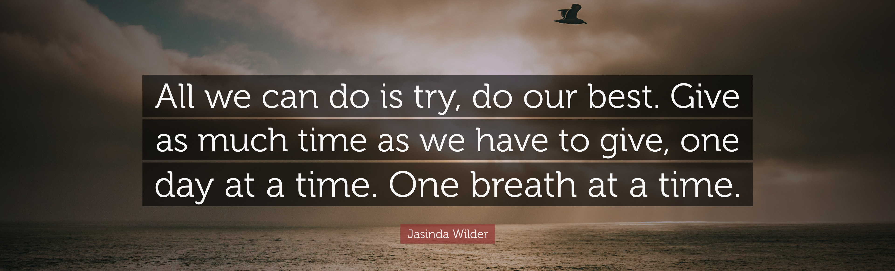
We have tried this before!

Slide 6

Why Bother, what’s different?
Accountability
Measurable Outcomes
Shared Ownership
"If you fail to plan,
you are planning to fail." —Benjamin Franklin

Slide 7
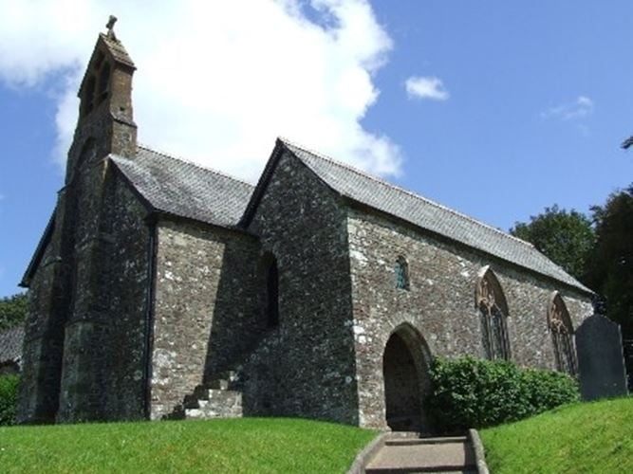
St Michael’s Bulkworthy

Slide 8
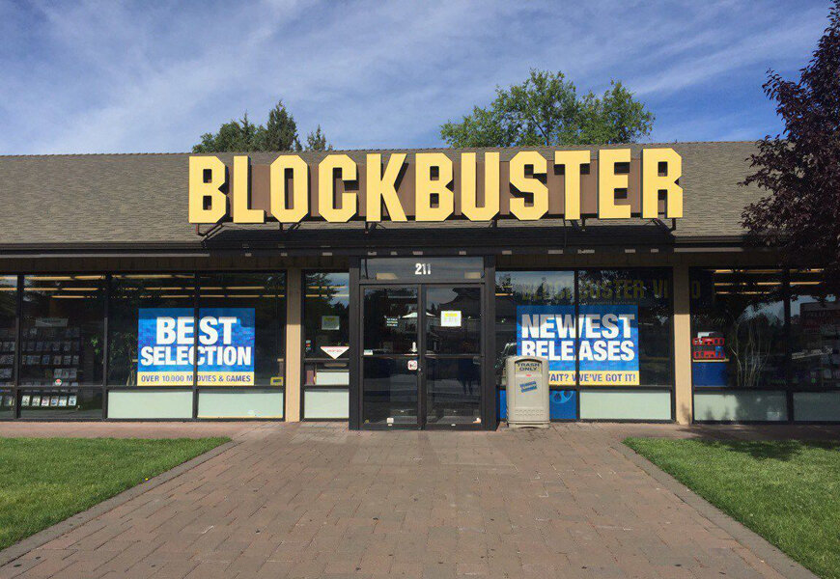

Slide 9

It’s the same message
Never Expect To Follow – Live In Xhrist

Slide 10
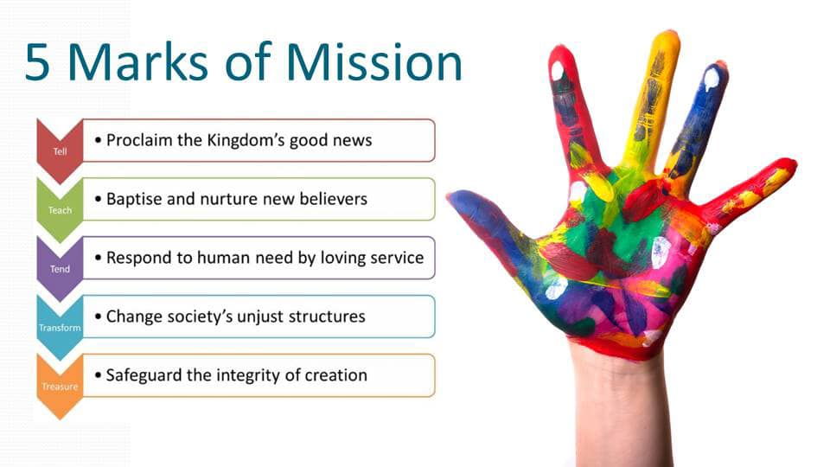

Slide 11
The Highlights
“It’s all about”
Christ Centred Prayer
P
Building Disciples / Church, One person at a time
The Invitation
Shared ownership – ‘Ecclesia’
Discipleship
Joyful, reactive & daring Worship
People Focused Prayer

Slide 12

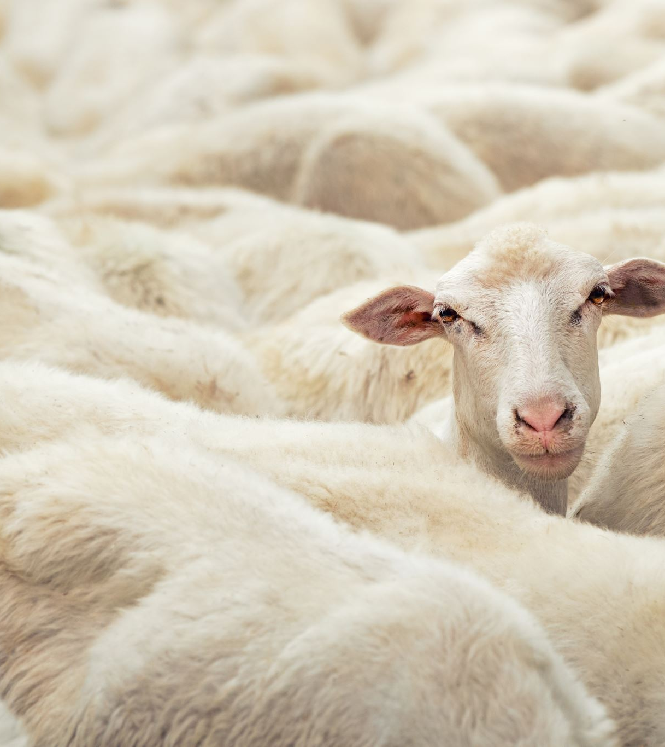
Building the Church One Person at a Time
Matthew 9:36 — "When he saw the crowds,
he had compassion on them,
because they were harassed and helpless,
like sheep without a shepherd."

Slide 13

The Power of Invitation
"Ask yourselves: Who is God prompting you to invite?"

Slide 14
Ecclesia – Shared Ownership of the Mission
Ephesians 4:4 "We were all called to travel on the same road, and we share the same direction."

Slide 15


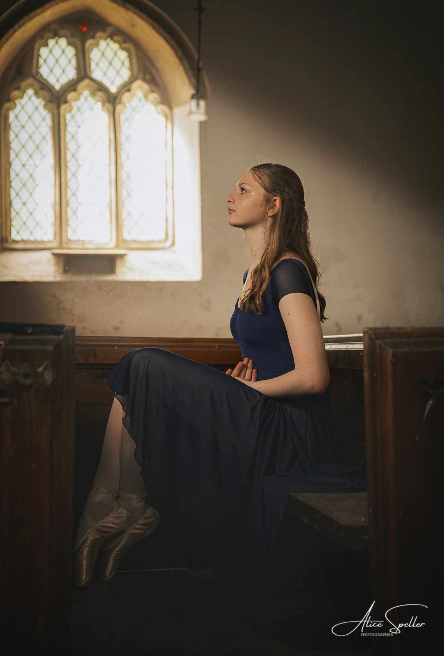
Discipleship and Growth
Matthew 28:19-20 "Go and make disciples of all nations… teaching them to obey everything I have commanded."

Slide 16

Worshiping with Joy
Creative worship and liturgy
Welcoming spaces
Churchyards as spaces of peace and community

Slide 17
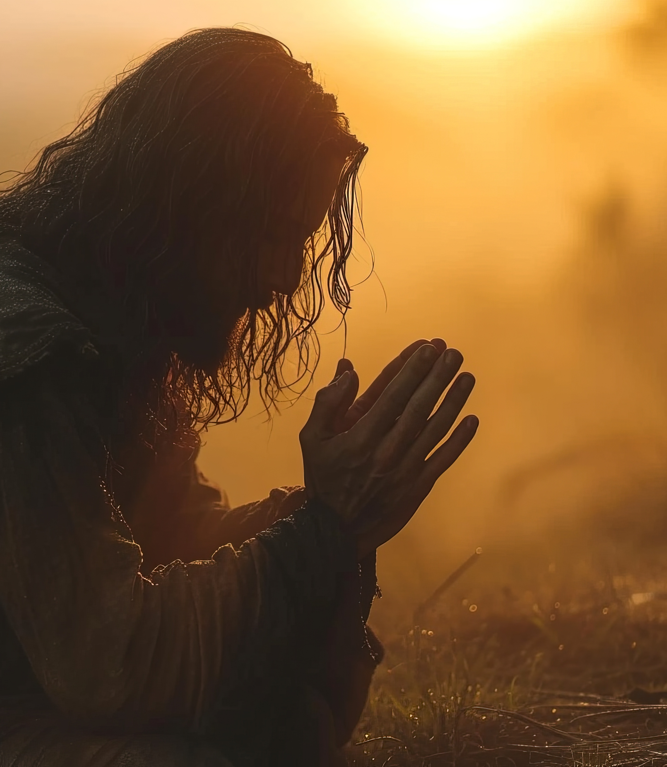
Wrapping it All in Prayer
Matthew 9:38
"Ask the Lord of the harvest… to send out workers into his harvest field."

Slide 18
Bespoke and with real ambition and achievability!
Paul Fitzpatrick, Rural Dean 2024

Slide 19
Download the 1st draft
www.bradworthybenefice.org

