Slide 1
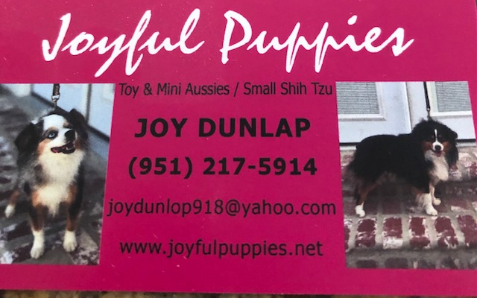
Joyfulpuppies.net
Puppy Application:
If there is a puppy you are interested in, please let us know which one and we can reserve him/her for you!

Slide 2
Application:
First Name:__________________________
Last Name:__________________________
Email:______________________________
City, State:___________________________
Preferred Sex:__________
Color Preference:________
Eye Color:____________
Puppy’s Purpose:_____________

Slide 3
Application:
Type of Home, please circle all that apply:
Active:
Quiet/Calm
Young Children
Fenced Backyard
Experienced Owner
Please email completed application form to joydunlap918@yahoo.com

