Slide 1
HEALTH 2.0 CONFERENCE · APRIL 2026
Building the Invisible
Infrastructure of
Modern Healthcare
Precision Healthcare Technologies
Doug Sparks · Founder & CEO
Notes:
⏱ TARGET: 30 seconds Thank you. I want to start with a question — not a rhetorical one. How many of you have had a patient, a family member, or honestly yourself, fall through the cracks of the healthcare system? Not because care didn't exist. Not because a provider didn't care. But because the system itself couldn't connect the dots. That's what we built Precision Healthcare Technologies to fix. Over the next 20 minutes I'm going to show you exactly how we're doing it. [ADVANCE]

Slide 2
THE PROBLEM
Healthcare is failing on three fronts simultaneously.
140M+
$1T+
6+
Americans uninsured
or underinsured
In compliance-linked
revenue at risk annually
Disconnected systems
the average patient navigates
These are not isolated failures. They share a single structural root cause.
PRECISION HEALTHCARE TECHNOLOGIES
Notes:
⏱ TARGET: 90 seconds These three numbers represent three separate crises — but they are symptoms of the same disease. One hundred forty million Americans don't have meaningful health coverage. Not because they don't want it — because the system priced them out or made it impossible to use. Over a trillion dollars in healthcare revenue sits in a compliance grey zone every year. Penalties providers don't see coming. Revenue they should have captured but didn't. And the average patient navigates six or more disconnected systems just to manage their own care — a portal here, a pharmacy app there, a provider system that doesn't talk to any of them. These aren't technology problems. They're infrastructure problems. And nobody has solved all three together. Until now. [ADVANCE]

Slide 3
ROOT CAUSE
Three critical markets. None of them connected.
⚖
⚙
🔐
CMS & Payer
Compliance Intelligence
Workflow &
Care Navigation
Consumer Health
Record Control
Regulation lives outside clinical systems. Providers never see their compliance exposure — until the penalty arrives.
AI tools are being layered onto broken workflows. They add complexity instead of removing it. The friction multiplies.
Patients are locked out of their own data. Portals exist but don't connect. Records don't travel with the patient.
PRECISION HEALTHCARE TECHNOLOGIES
Notes:
⏱ TARGET: 90 seconds For decades, healthcare has tried to solve these three problems independently. And that is precisely why they have never been solved. The compliance intelligence market — understanding what CMS and payers actually require and penalize — lives completely outside clinical systems. Providers are flying blind. The workflow and care navigation market has attracted billions in AI investment. But most of those tools get bolted onto existing workflows and create more complexity than they remove. And consumer health record control? We have had portals for twenty years. Patients still cannot move their own data between providers without faxing something. Each market has vendors. Each has investment. None of them talk to each other. That is not a vendor problem — that is a structural problem. Structural problems require infrastructure solutions. [ADVANCE]

Slide 4
THE EVIDENCE
What the numbers
actually show.
One physician. One year. Real data.
Notes:
⏱ TARGET: 20 seconds I am not going to ask you to take my word for any of this. Let me show you what we actually found — in a real practice, with a real physician, in a real year. [ADVANCE]

Slide 5
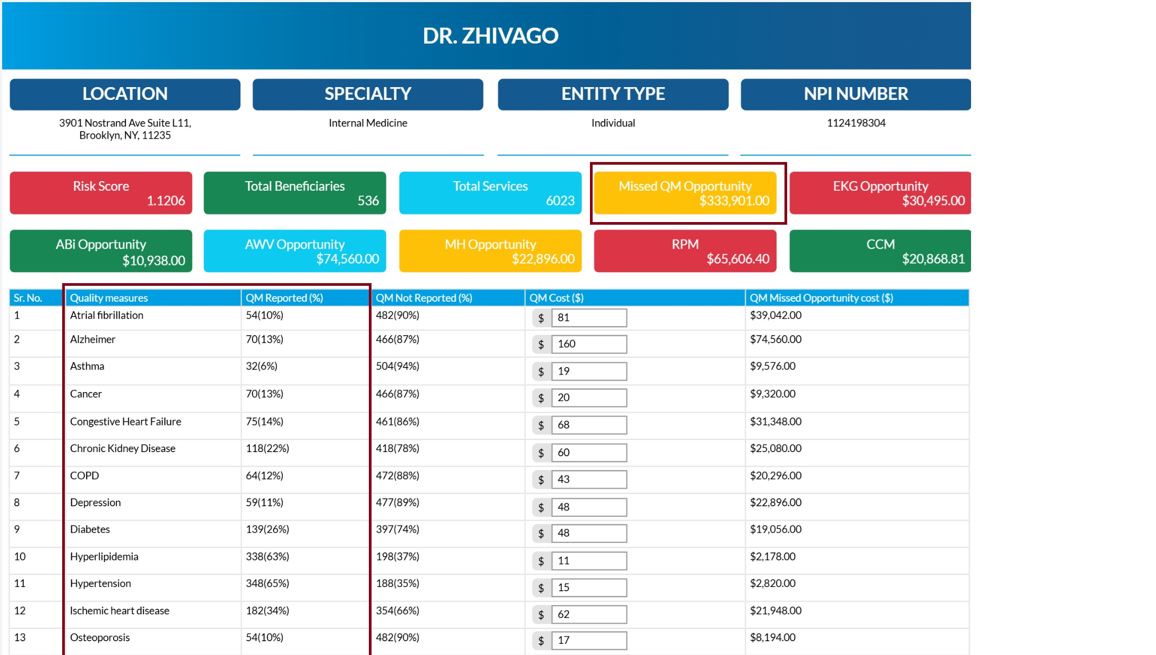
CMS / PAYER REPORT CARD · REAL PROVIDER DATA
$333,901
in missed compliance-mandated care
One physician · One year
$352
$179
~50%
Compliant provider
reimbursement rate
Non-compliant provider
reimbursement rate
Revenue lost to
non-compliance
You never see this number. We do — because we built the system that generates it.
PRECISION HEALTHCARE TECHNOLOGIES
Notes:
⏱ TARGET: 2 minutes 30 seconds This is a real report card from a real internal medicine physician in Brooklyn, New York. Look at that highlighted number — three hundred thirty-three thousand, nine hundred and one dollars. That is what this physician missed in compliance-mandated care. In one year. From one NPI number. Now look at the reimbursement rates. A compliant provider gets reimbursed at three hundred fifty-two dollars. A non-compliant provider gets one hundred seventy-nine. That is nearly a fifty percent haircut — and the provider never knew why. Atrial fibrillation — ninety percent of quality measures not reported. Alzheimer's — eighty-seven percent not reported. Congestive heart failure — eighty-six percent. These are not edge cases. This is the norm. This physician is not unusual. We have found two-point-one million dollars tied to a single provider in a single year. The system knows these numbers. CMS knows. The payers know. The providers don't — because nobody built the infrastructure to make this visible at the point of care. We built it. [ADVANCE]

Slide 6
WHY EXISTING SOLUTIONS FAILED
The market tried. None of the solutions connected.
Big Tech
AI Point Tools
Consumer Apps
Built record platforms disconnected from care decisions
No integration with clinical or compliance logic
Billions spent — adoption never scaled to impact
Layered onto broken workflows without fixing the structure
Improved one metric while disrupting three others
Generated insight without generating action
Disconnected from provider incentives and payment systems
Siloed from the compliance logic that governs care
Records stayed fragmented — patients carry the burden
PRECISION HEALTHCARE TECHNOLOGIES
Notes:
⏱ TARGET: 90 seconds Before I tell you what Precision does, let me be direct about what did not work — because understanding the failure pattern matters. Big Tech came in with HealthVault, Google Health, and a dozen others. They built beautiful record platforms. Patients did not use them, because the records were not connected to care decisions. The platforms did not change what happened in the exam room. The AI wave has brought point solutions for prior auth, coding, and documentation. Most make one thing marginally better while adding friction somewhere else. They are solving for a feature, not the infrastructure. Consumer health apps have the same fundamental problem — they are standalone. They do not connect to the compliance logic that governs reimbursement. They do not connect to the workflows that direct care. They are islands. Every one of these failures shares a common characteristic: they were built as products sitting on top of a broken system. We took a different approach. We built a layer underneath. [ADVANCE]

Slide 7
THE SOLUTION
We built the layer
that connects all three.
Invisible. Embedded. Systemic.
Compliance Intelligence
Workflow Navigation
Consumer Access
Notes:
⏱ TARGET: 20 seconds Precision Healthcare Technologies is not a portal. Not a point solution. Not a marketplace. We built the operating layer that compliance intelligence, clinical workflow, and consumer access all run through — simultaneously, invisibly, without disrupting what providers already have. Let me show you how each layer works. [ADVANCE]

Slide 8
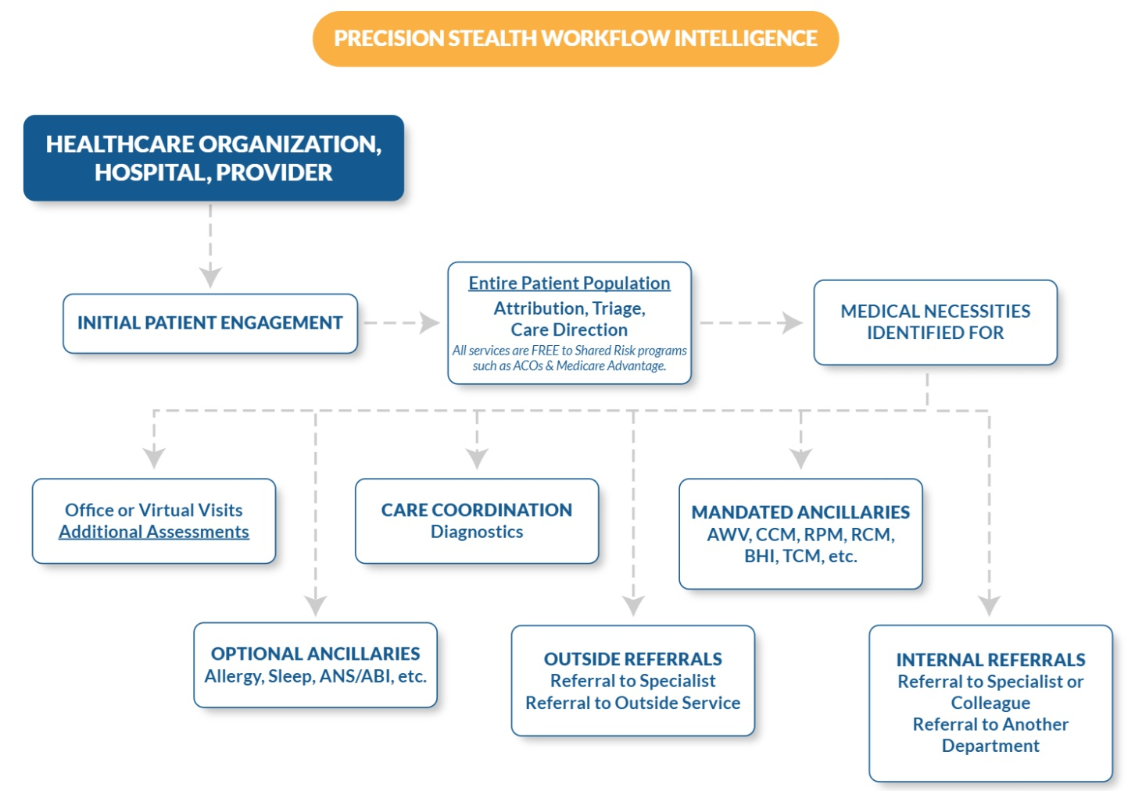
LAYER ONE · COMPLIANCE & WORKFLOW INTELLIGENCE
Precision Stealth Workflow Intelligence
⚡
Translates payer ruleset logic into live care decisions at the point of service
🔍
Operates across CMS and commercial payer standards — Medicare Advantage, ACOs, and more
🔄
No EHR replacement required — embeds in existing workflows without disruption
📊
Aligns clinical, financial, and compliance logic simultaneously in real time
PRECISION HEALTHCARE TECHNOLOGIES
Notes:
⏱ TARGET: 2 minutes This is PSWI — Precision Stealth Workflow Intelligence. The name tells you everything. It works in the background. It does not replace what a provider already has. It embeds. What you are looking at is the provider-facing logic layer. A patient comes in. The system performs attribution, triage, and care direction for the entire patient population simultaneously — not just the patients who show up that day. It identifies medical necessities. It routes to the right ancillaries. It tracks quality measures against the standards that govern reimbursement. And this is free for shared-risk programs like ACOs and Medicare Advantage. Here is what makes this different from every other compliance tool on the market: we built the system using the same logic CMS and payers use to evaluate performance. We are not guessing at what they want. We are measuring against the actual standards that determine payment. That report card you just saw? That is what PSWI generates. And it generates it in real time, before the claim goes out — not six months later when the audit letter arrives. [ADVANCE]

Slide 9
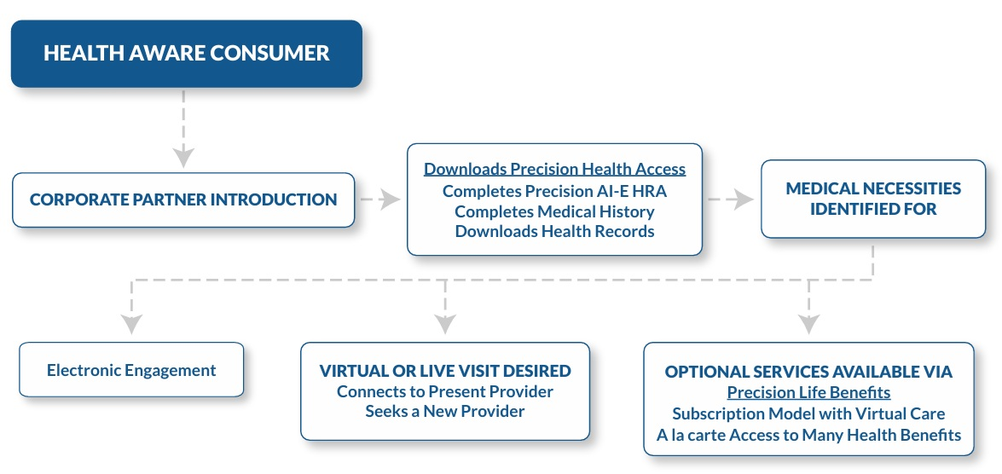
LAYER TWO · CONSUMER HEALTH CONTROL
The consumer pathway — from awareness to coordinated care.
Record Control
Patients download, manage, and share their complete health record — connected to care decisions in real time.
Care Navigation
System identifies medical necessities and routes to the right provider, visit type, and payment pathway.
Payment Flexibility
Cash, subscription, insurance, or mixed — patient chooses. Provider receives correct reimbursement regardless.
PRECISION HEALTHCARE TECHNOLOGIES
Notes:
⏱ TARGET: 2 minutes Layer two is where the consumer enters the system. And this is where Precision does something nobody else has done — we connect the patient's experience directly to the compliance and clinical intelligence underneath. A health-aware consumer enters through a corporate partner — an employer, a pharmacy, a health plan. They download Precision Health Access. They complete a health risk assessment, build their medical history, and download their health records. That is the entry point. From there, the system identifies their medical necessities and routes them appropriately. Virtual or live visit. Existing provider or new one. Three payment paths, available simultaneously — cash, subscription, insurance, or a combination. That is not a feature. That is what makes access actually accessible. And the consumer flow feeds back into the provider layer. When a patient arrives with their record already populated, quality measures already flagged, medical necessities already identified — the provider's compliance posture improves automatically. The patient benefits. The provider benefits. The payer gets what they need. This is what connected infrastructure looks like in practice. [ADVANCE]

Slide 10
LAYER THREE · AFFORDABLE ACCESS
Solving the 140 million person access gap.
Cash Pay
140M+
Transparent pricing, physician-led, no surprise billing
Subscription
Americans uninsured
or underinsured —
not because healthcare
doesn't exist, but because
access is structurally broken.
Family & household shared-visit model — a fraction of insurance cost
Insurance
Full compatibility with existing plans — no system replacement
PRECISION HEALTHCARE TECHNOLOGIES
Notes:
⏱ TARGET: 90 seconds One hundred forty million Americans. That number does not move because we keep trying to fix healthcare around the edges. The real problem is not that care does not exist. It is that the access architecture is broken. Deductibles people cannot meet. Networks that do not include their doctor. Billing they cannot predict. Layer three addresses this directly. We created a family and household shared-visit subscription model that delivers physician-led primary care at a fraction of traditional insurance cost. Providers see new revenue from patients they were not capturing. Patients get access they could not afford before. And critically — we do not force a choice. Cash, subscription, insurance, or a mix of all three. The patient chooses based on their situation. The system handles the routing. This is not a charity model. It is a structural one. When access is built into the infrastructure layer, it scales with the system instead of fighting against it. [ADVANCE]

Slide 11
THE CONNECTED ECOSYSTEM
20 healthcare sectors.
One unified data layer.
Primary Care
Specialty Care
Mental Health
Pharmacy
Unified flow without centralization.
Interoperability without disruption.
Independent of any EHR vendor.
Home Health
Urgent Care
Telehealth
ACOs
PRECISION LAYER
Medicare
Advantage
Health Systems
Value-Based
Orgs
Consumers
PRECISION HEALTHCARE TECHNOLOGIES
Notes:
⏱ TARGET: 90 seconds What you are looking at is the scope of what Precision connects. Twenty distinct healthcare and consumer health sectors. Primary care, specialty care, mental health, pharmacy, home health, ACOs, Medicare Advantage, health systems, value-based organizations, and direct consumers. Every one of these sectors currently operates in its own data environment. They exchange information through fax machines, HL7 feeds that drop data, and portal integrations that require a team to maintain. Precision does not replace any of that. We sit underneath it. We create unified data flow without centralization — meaning no single entity owns or stores everything. And we do it independently of whichever EHR vendor a practice is running. That last point matters enormously. We work across any EHR. Providers do not have to choose between upgrading their system and participating in this infrastructure. [ADVANCE]

Slide 12
THE CONSUMER PLATFORM
My Health Youniverse
The consumer face of the Precision infrastructure layer.
📁
My Health Records
🩺
Virtual Care Access
Secure, shareable, always accessible. Complete history in one place — controlled entirely by the patient.
Board-certified physicians 24/7. No waiting rooms. No referral friction. Physician-led care on demand.
💊
Pharmacy Connected
🛡
HIPAA by Design
Medication history, refills, and care coordination linked to your trusted pharmacy network — already integrated.
Data is never sold. Never shared without explicit authorization. Privacy is architecture, not a checkbox.
PRECISION HEALTHCARE TECHNOLOGIES
Notes:
⏱ TARGET: 90 seconds My Health Youniverse is the consumer-facing platform powered by this infrastructure. It is what patients interact with directly. Four core elements. Health Records — your complete medical history, stored securely, shareable with any provider in one click. No more fax requests. No more release of information forms. Virtual Care — board-certified physicians available twenty-four hours a day, seven days a week. Physician-led. No urgent care markup. No waiting three weeks for an appointment. Pharmacy connected — a patient's medication history, refills, and care coordination all live in the same place as their records and their care access. And HIPAA by design. Our answer to data privacy is architectural, not policy-based. The data is never sold. The patient controls every share. Privacy is not a feature we turned on — it is how the system was built. My Health Youniverse is how the infrastructure becomes real for consumers. [ADVANCE]

Slide 13
REAL-TIME IMPACT
Three outcomes. Delivered at the same time.
📈
🛡
💰
Improved Outcomes
Reduced Compliance Risk
Maximized Revenue Capture
Quality measures reported accurately and on time
Medical necessities identified and acted on
Patient care continuity across all providers
Penalty exposure surfaced before claims go out
Payer grading standards applied in real time
Revenue durability built in — not audited after the fact
Missed care opportunities recovered before close
Correct reimbursement rates maintained
New revenue streams via consumer access layer
PRECISION HEALTHCARE TECHNOLOGIES
Notes:
⏱ TARGET: 60 seconds Here is what the infrastructure actually produces — and notice that all three happen simultaneously. That is not incidental. That is the point. Outcomes improve because medical necessities are identified and acted on before care is delivered, not documented after. Compliance risk drops because payer grading logic is applied in real time, at the point of care. The revenue a provider earns is durable — it survives scrutiny because it was built on defensible clinical signals from the start. And revenue capture increases because the missed opportunities on that report card get surfaced before the claim goes out — not recovered in an audit six months later. These three outcomes reinforce each other. That is what infrastructure does. It makes every layer perform better simultaneously. [ADVANCE]

Slide 14
THE POSITIONING
Not a point solution.
Not a marketplace.
A new operating layer.
✕ Point solutions fix one metric
and break three others
✓ Precision improves all three layers
simultaneously
→
✕ Marketplaces create new intermediaries
without fixing the underlying logic
✓ Precision eliminates friction at
the infrastructure level
→
✕ Technology layers add burden
to existing workflows
✓ Precision embeds invisibly —
providers don't change how they work
→
PRECISION HEALTHCARE TECHNOLOGIES
Notes:
⏱ TARGET: 60 seconds This is the most important frame I can give you for understanding what Precision is. We are not a point solution. We do not fix one problem and call it done. We are not a marketplace. We do not create a new layer of intermediaries on top of the ones that already exist. We are infrastructure. That means we operate underneath everything else. We make the entire system perform better without requiring the system to change. The providers we work with do not replace their EHR. They do not change their workflows. Their patients do not notice a new technology in the exam room. But their compliance posture improves. Their revenue capture improves. And their patients get a connected experience they have never had before. That is what it means to build invisible infrastructure. [ADVANCE]

Slide 15
THE FUTURE OF HEALTHCARE
Invisible intelligence.
Aligned incentives.
Affordable, compliant care.
Compliance becomes automatic
Care becomes navigable
Control returns to consumers
pvbmtech.com · myhealthyouniverse.com
Questions
Notes:
⏱ TARGET: 80 seconds — then open Q&A (10 minutes) Let me close with this. Healthcare has been fragmented by design for thirty years. Not maliciously — but structurally. Compliance lived in one place. Clinical workflows lived in another. Consumer access lived somewhere else entirely. And the patient sat in the middle, carrying the burden of a system that was never built to serve them. What Precision has built is the infrastructure that connects those three layers. Not with a new product on top. With a new operating layer underneath. Compliance becomes automatic — because the standards that govern payment are applied at the point of care, not reviewed after the fact. Care becomes navigable — because medical necessity is identified before the patient arrives, and the right path is already clear. And control returns to consumers — because their records travel with them, their options are transparent, and their care is coordinated instead of fragmented. That is the future we are building. And it is not theoretical. It is running today. Thank you. I am happy to take your questions. [OPEN Q&A] --- ANTICIPATED QUESTIONS --- Q: How do you handle EHR integration? A: We embed — no replacement required. Works across any major EHR. No API dependency required for core functionality. Q: What is the business model? A: Provider-side is performance-based. Consumer-side is subscription. Both feed the infrastructure layer. Q: How is this different from Epic or Cerner building similar tools? A: They build on top of their own platforms. We operate independently of any platform — which is why we connect across 20+ sectors simultaneously. Q: Data privacy and HIPAA? A: Architecture-level HIPAA compliance. Patient owns and controls all sharing. We do not monetize data — not the business model, not even an option we have considered.

