Slide 1
Nijmegen Four Day March
July 17 – 20 2018
All photographs used in this presentation were taken during 2016 and 2017 Nijmegen 4Daagse.

Slide 2
Nijmegen Four Day March
July 17 – 20 2018
✓
History
Participation Data
Goals

Slide 3
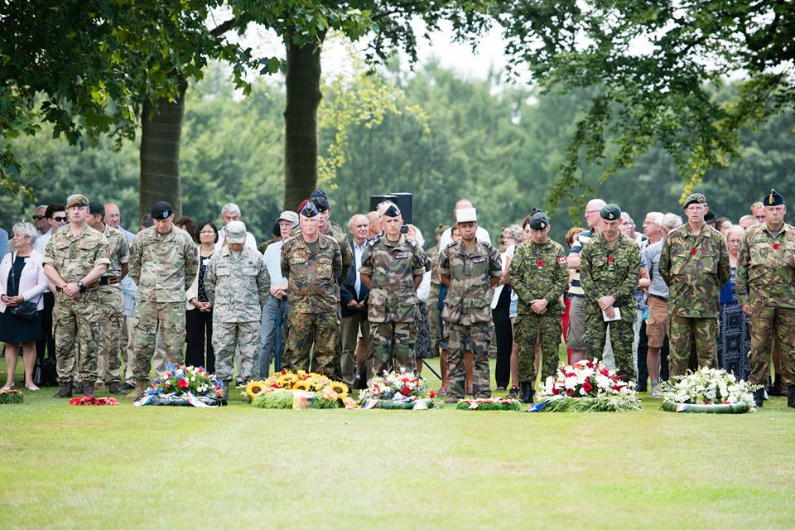

Nijmegen Four Day March
Military History Lest we forget
      2,331 Canadian Graves in Groesbeek
        Joint Military ceremony held on third day of march
      110 Monuments / Museums commemorate Americas role in Liberating Netherlands
        82nd Airborne Division Memorial, Beek-Ubbergen
      Marsgratan - American Cemetery and Memorial
        Only American military cemetery in Netherlands
        8,301 American Soldiers laid to rest
        1,723 missing American soldiers commemorated
      Americans Bombed Nijmegen, February 22, 1944
        763 Civilian deaths
        Mistook Nijmegen for Kleve, Germany 20km further east in cloudy weather

Slide 4
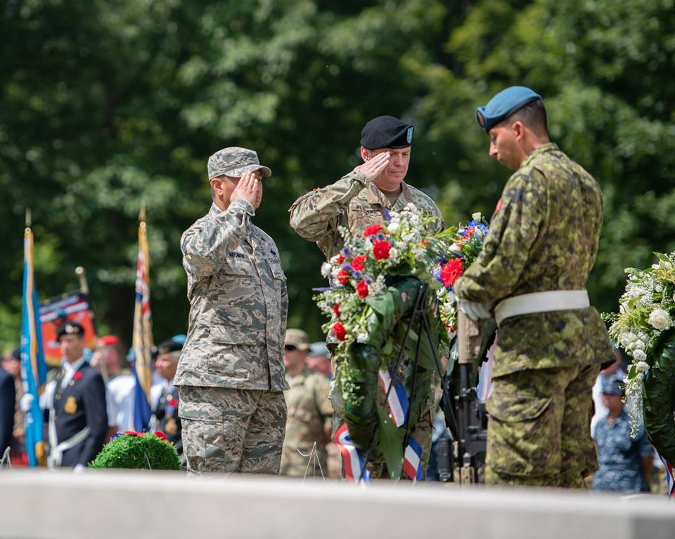
Nijmegen Four Day March
Respecting Military History
    Military March
      4 Day March Established in 1909
      306 male participants, 10 civilians in 1909
      2019 will be 103^{d} edition
    Present Military Operations
      Approximately 5,000 military participants
      All Military participants from all Nations MUST possess Military Identification Cards
      Military marchers follows independent route different from Civilians
      Approximately 30 Nations Join together on Kamp Heumensoord – 21 in 2017
      US Military participation varies from 50 to 400 participants per year
      Highest US rank in 2018, 102nd Edition O-6
      US Team Management provided by ID’d military

Slide 5
Nijmegen Four Day March
March Content
    U.S. Forces participation
      US Military participation generally varies from 50 to 400 participants per year
        Participants sign up with US Contingency - 347 and Small Contingency - 39
        US contingency marchers paid €378 / USD$420.00
      2018 US Military 386 Total Starts / 60 Drops / 326 Completions / 84.46% Completion rate
      US Contingency group (excluding Small Contingency US participants)
        347 Paid Registrants
        No-Shows: 22
        Drops/Withdrawals: 11, Day 1 / 23, Day 2 / 16, Day 3 / 6, Day 4 / 56 Total
        Percent of Paid Registrants Started : 93.66% 6.34% no-show
        Percent of Paid Registrants Completed: 77.52% 22.48% paid didn’t finish
        Percent of US Contingency starts completing event: 82.77% 17.23% dropped out

Slide 6
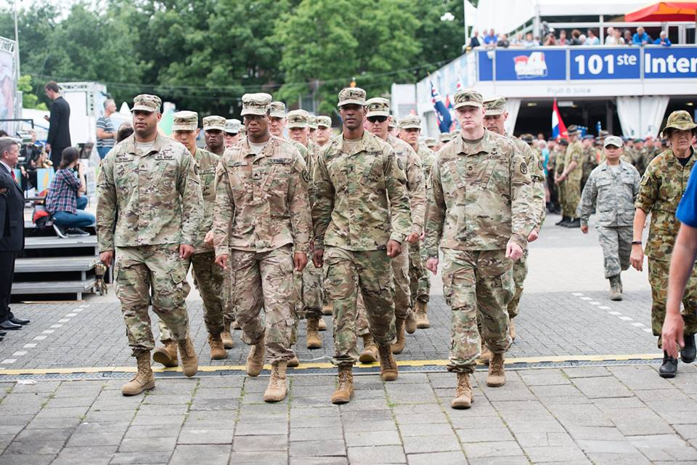
Nijmegen Four Day March
Military Added Value
    Military Value
      Simulates distance operations on foot with ruck and weight
      Enhances military physical conditioning
      Activates military medical support
      Activates operational support with field operations to support troops
      Brings together US military members from Army, Air Force, Navy and Marines
        With “unified” goal
        Regardless of rank, MOS/AFSC or age, success and teamwork is the ultimate goal
      Units marching together learn how to support each other through effort
        Teamwork is a valuable tool not easily learned in many functions
    Esprit de Corps
      Part of 5,000 military participants from up to 30 countries
      Joint operations and communications improves multi nationals military relations
        Joint operations allows nationals to learn culture and national perspectives
      Marching more than one hundred miles in four days is not accomplished without pain and effort

Slide 7
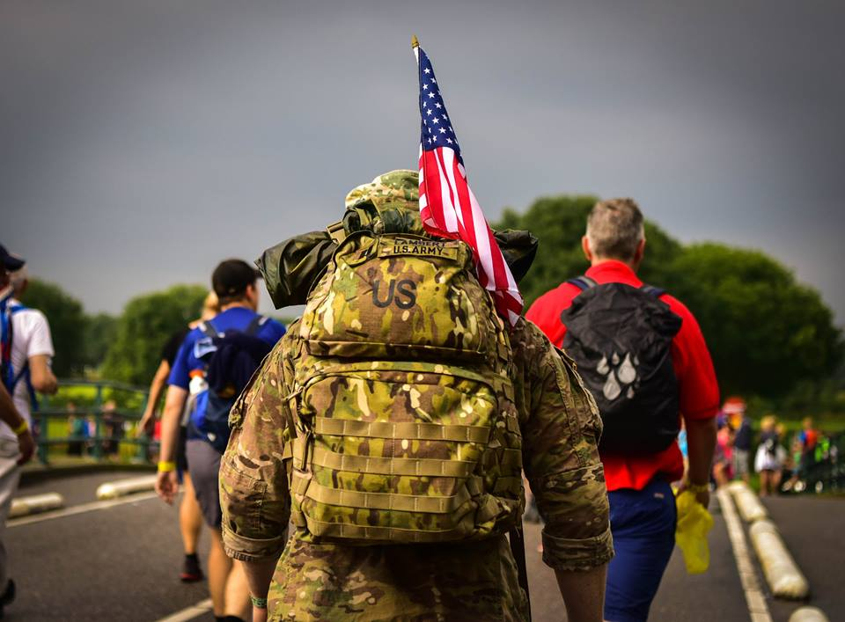
Nijmegen Four Day March
March Structure and Tradition
    The March
      Commences on third Tuesday in July and ends after four days
      Military March “Green” route different from Civilians:
        40Km (25 miles) per day
        Military start and finish from Camp, not city center
        Approximately 60% of military march routes overlap with civilians
      Military males under age 50 must carry 10 kg weight excluding food and water (23lb)
      Females no weight requirement, most wear ruck for uniformity
      Highest US rank in 2018, 102nd Edition O-6
      Uniformed military participants march either as:
          Individuals
          Detachments in military formation, with minimum 11 participants
    Public Support
      Over 1.5 million people cheer on the marchers over the 100 mile march
      The military marchers are shown the greatest respect resulting from the WWII liberation of Holland
      Americans and Canadians receive great applause in thanks and respect for war efforts supporting region

Slide 8
Nijmegen Four Day March
July 18 – 21 2017
History
Participation Data
Goals
✓

Slide 9
Nijmegen Four Day March
Note: 2006 March Cancelled due to Extreme Heat
1990 Data Unavailable
Prior to 2010 Military and Civilian data Combined
Source: 4Daagse Data Records and Media Releases

Slide 10
Nijmegen Four Day March
Note: 2006 March Cancelled due to Extreme Heat
1990 Data Unavailable
Source: 4Daagse Data Records and Media Releases

Slide 11
Nijmegen Four Day March
USA 4.41% of Military Representation 2017
USA 7.54% of Military Representation 2018

Slide 12
Nijmegen Four Day March
15.54% U.S.A. Drop Rate
8.34% Total Military Drop Rate
7.81% All Drops (Civ & Mil)

Slide 13
Nijmegen Four Day March
USA 4.41% of Military Representation

Slide 14
Nijmegen Four Day March
11.98% U.S.A. Drop Rate
7.52% Total Military Drop Rate
9.77% All Drops (Civ & Mil)

Slide 15
Nijmegen Four Day March
USA 1.40% of Military Representation

Slide 16
Nijmegen Four Day March
7.69% U.S.A. Drop Rate
5.61% Total Military Drop Rate
6.07% All Drops (Civ & Mil)

Slide 17
Nijmegen Four Day March
USA 4.65% of Military Representation

Slide 18
Nijmegen Four Day March
14.42% U.S.A. Drop Rate
5.55% Total Military Drop Rate
7.21% All Drops (Civ & Mil)

Slide 19
Nijmegen Four Day March
July 18 – 21 2017
History
Participation Data
Goals
Command Support Requested
✓

Slide 20
Nijmegen Four Day March
“Ruck Ya!”
Target: 400 Military Participants
Target: 92% completion rate
Target: US Military to Exceed
average participant completion rate

Slide 21
Nijmegen Four Day March
Support Considerations
    Website
      Should be built and maintained for US Military Participants to register and gather / post information
    Patches, Ribbons, Awards
      USA Forces Nijmegen Patch should be available for purchase to all U.S. march and support personnel
      March Ribbon should be available for purchase on Kamp Heumensoord
      All support and medical staff should receive Commendation letter from command / Embassy staff
      A letter of completion/certificate with marcher full name should be issued authorizing marchers the right to wear the ribbon (Internal document signed by U.S. Embassy Army Attaché)
    Tee Shirts
      “USA 2019 Nijmegen 4daagse” branded tee-shirt should be available for purchase at U.S. admin shack.
      Military from other nations should also be able to purchase on a availability basis.

Slide 22
Nijmegen Four Day March
July 18 – 21 2017
History
Participation Data
Goals
Command Support Requested
✓

Slide 23
Nijmegen Four Day March
Building Stronger Forces
    Military Benefits from March and Kamp Heumensoord participation
      Improved physical fitness / Long distance mobility fitness knowledge
      Strong Esprit de Corps (all marchers are voluntary)
      Intra branch relations Army / Navy / Air Force / Marines
      Strong teamwork building exercise with units participating
      Multi National military relations, ability to establish strong cross-national military contacts
      Multi-national field medical forces training in diverse environment

Slide 24
Nijmegen Four Day March
Command / Unit Support
    Marcher Preparation for Success
      Authorization of “Permissive TDY” for marchers and detachment staff
      Marcher training time approved and supported at Command / Unit levels
Minimum first time participant training needed to complete march successfully (16 days)
        12 single day training sessions starting 16 weeks out
          10km, 10km, 15km ,15km, 20km, 20km, 30km, 30km, 35km, 35km, 40km, 40km
        2 two day “back to back” training sessions 8 and 4 weeks out
          First back to back 2 X 20km
          Second back to back 2 X 30km
        No training sessions in July within two weeks of march.

Slide 25
Nijmegen Four Day March
Command Support Needed for Success
    Support Personnel (TDY)
      Saluting Officer for protocol
      Junior Officer
      6 admin at Kamp Heumensoord to support US Forces marchers
      Field Support – 3 staff for military Rest Areas (one each rest area)
      Field Support - 3 Logistic Specialists / Drivers (Will be involved in moving equipment each day)
      Total: 14 Support Staff
    Medical Personnel / Force Protection (TDY)
      10 Field Medics 3-Rest Area 1 / 4-Rest Area 2 / 3 Rest Area 3
      15 On camp Medics to work at Kamp Heumensoord clinic. (Will work with Dutch, Scandic and British staff)
      Total: 25 Medics
    Equipment for US Military Rest Area
      Transport and Support Vehicles for Military Rest Areas
      3 US Flags with Stands / 6 - 150 sq.ft. Field Medical Tents / three area cordoning system / 12 cots / 9 ground mats for sitting on / three large table for medical supplies
      6 large tables for water / beverages / food distribution

Slide 26
Nijmegen Four Day March
Fitness, Preparation, Esprit de Corps
July 16 – 19 2019

