Slide 1
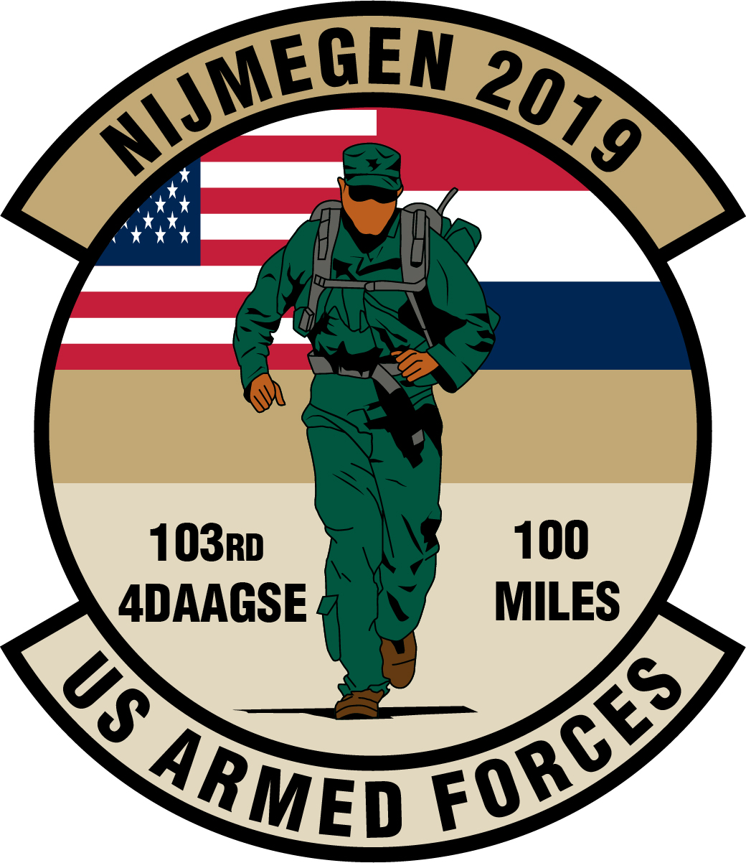
Nijmegen Four Day March

Slide 2
Nijmegen Four Day March
July 17 – 20 2018
Fitness, Preparation, Esprit de Corps
July 16 – 19 2019
Registrations: WWW.USDODMIL-4daagse.com
All photographs used in this presentation were taken during 2016 and 2017 Nijmegen 4Daagse.

Slide 3

Nijmegen Four Day March
2018 US Survey Quotes
WWW.USDODMIL-4daagse.com
    This was by far the greatest organized event that I have participated in. From basic support provided to local support it was simply amazing.
    I enjoyed the “field” type of environment and the feeling of pushing myself.
    This was the first time I got to experience other countries militaries. I enjoyed that.
    The march was unlike anything I have done before. It was incredibly challenging, but it was such a unique and rewarding experience.
    The esprit de corps surrounding the entire event was amazing. Bonding with our teammates and other nations was an unforgettable experience.
    The march is just amazing, the people you meet, the bonds you form with people from other states, countries, etc. ……. It’s a must do at least once.
    After the first day of the march, I was saying out loud that this was the first and last time. However in retrospect, I would certainly do it again. I look forward to the next experience.
    One of the coolest multi national events I will ever take part in/witness in my life. The people of Nijmegen, Netherlands are amazing!

Slide 4
Nijmegen Four Day March
July 16 – 19 2019
WWW.USDODMIL-4daagse.com
✓
Where
When
What
Who
Why

Slide 5
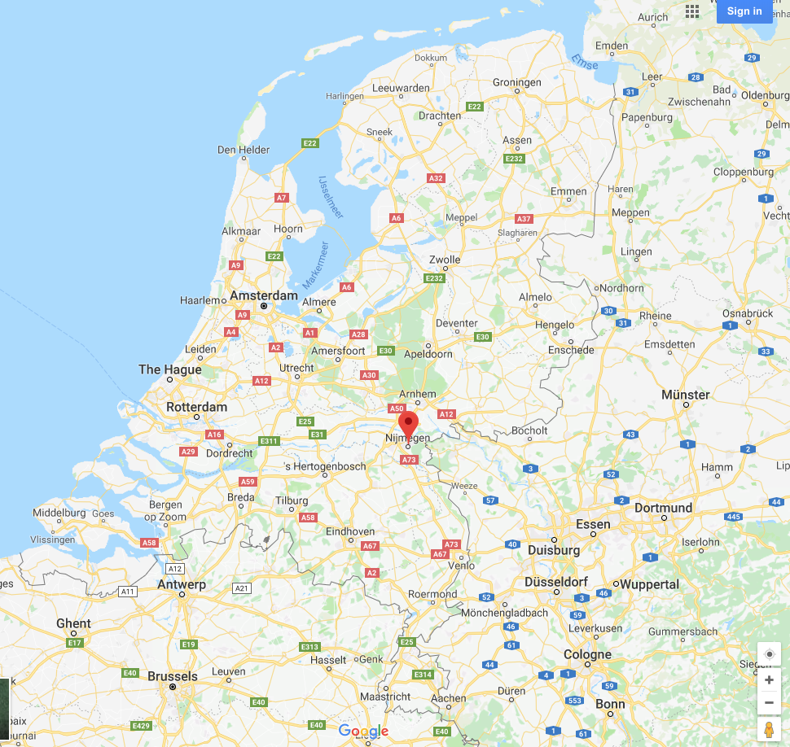
Nijmegen Four Day March
Nijmegen, the Netherlands
WWW.USDODMIL-4daagse.com
    Eastern Holland, just over border.
      Oldest city in Netherlands
      On the Maas and Waal (Rijn tributary)
      Walking distance to Germany
      Some roads are in both countries
    To Baumholder, 350Km
    To Ramstein/LRMC 371Km
    To Wiesbaden, 321Km
    To Stuttgard, only 500Km

Slide 6
Nijmegen Four Day March
July 16 – 19 2019
WWW.USDODMIL-4daagse.com
Where
When
What
Who
Why
✓

Slide 7
Nijmegen Four Day March
WHEN?
WWW.USDODMIL-4daagse.com
    Kamp Heumensoord opens July 13 – Noon.
    March registration and credential(s) pickup by 1500 Monday July 15
    March days Tuesday July 16 – Friday July 19
    Kamp Heumensoord closes July 20 – Noon.
      Three meals available during all days while residing on Camp.
    Camp is military controlled by Dutch.
      No mil ID - no entrance
      Everyone registered will get a RFID card for camp entry
      Military exercise “Phoenix Blister” ongoing with armed perimeter surveillance
      No Civilians except contractors on Camp (No dependents)
      Some special guests may get guided tour from Dutch

Slide 8
Nijmegen Four Day March
July 16 – 19 2019
WWW.USDODMIL-4daagse.com
Where
When
What
Who
Why
✓

Slide 9
Nijmegen Four Day March
The March
WWW.USDODMIL-4daagse.com
    4 Days, starting third Tuesday in July every year
      March Established in 1909
      306 male participants, 10 civilians in 1909
      2019 will be 103^{d} edition
    4 different routings
      30Km (Tan registration) over 60 years old / from city center
      40Km (Yellow registration) over 50, females, from city center
      50Km (Red registration) under 50 males / from city center
      40Km Military (Green registration) all age groups, must be military registered. From Kamp Heumensoord
        Males under 50 years old must carry 10Kg weight.
    US Forces include
      All Branches
      Active Duty
      Reserves
      ROTC / Military Schools
      Retirees / Veterans

Slide 10
Nijmegen Four Day March
The March
WWW.USDODMIL-4daagse.com
    Worlds largest march
      6,000 Military
        UK 800 / CDN 170 / DK 460 / NO 400 / SWE 350 / GE 350 / CH 190 / US 385 / FR 320 / FIN 200 / NL 1950 / Small Contingents 425 / Total 6,000 Military
      39,000 civilians
    Centrale Admin expected 2.4 million visitors supporting 2018 event. (180K residents)
      You march 25 miles each day – You get thousands of well wishers out from 5am cheering you on
      You get occasional free hugs
      You get lots of high and low fives
      You will give away patches, flags and trinkets to the children promoting your unit and country
      You will be offered free candy, water, vegetables, cucumbers, fruit and the odd beer
      You will see supporters wearing the craziest things, hear the weirdest music
      You will wear your head gear and salute the reviewing stand in each town you pass through
      The crowds get larger and more supportive with each day.

Slide 11
Nijmegen Four Day March
The Catch
WWW.USDODMIL-4daagse.com
    Of course there’s an effort side to this event!
    You have to march around 25 miles each day
      Takes about 8 hours each day
    Some will fail, historically 15% of Americans
    Rules
      You will be in uniform
      You will sleep on a military camp
      You will attend multiple military ceremonies
      You rise around 3am on march days, depending on departure time
      You will hang out with military from approximately 30 other nations
      Your feet will hurt, no pain, no gain, no reward
      You will be with some people who will whine about everything and I mean everything!
    And some will simply quit?
      Some people quit after the first day asking, “And this is fun?”

Slide 12
Nijmegen Four Day March
July 16 – 19 2019
WWW.USDODMIL-4daagse.com
Where
When
What
Who
Why
✓

Slide 13
Nijmegen Four Day March
US Forces
WWW.USDODMIL-4daagse.com
    Any military member who can complete the march and wants the joy of being appreciated
      The MIL are loved by the spectators
      The MIL represent a huge history in this area of the world
    Basically anyone who can march / trek for 8 hours
    Marchers can participate as -
      Individual Marcher
      Detachment Marcher
        Those under 25 should march with a detachment
        First timers should consider marching with a detachment, if possible

Slide 14
Nijmegen Four Day March
July 16 – 19 2019
WWW.USDODMIL-4daagse.com
Where
When
What
Who
Why
✓

Slide 15
Nijmegen Four Day March
Value from the March
WWW.USDODMIL-4daagse.com
    To prove your physical conditioning
    To show pride in our nations forces, past and present
    To build teamwork skills
    To strengthen management and decision making skills
    To gain military friends from other nations all with the same goal
    To experience an event where 2 million supporters cheer us on
    To built cross cultural friendships
    To get the medal
    To get the Army authorized Ribbon
    To trade paraphernalia with other countries

Slide 16
Nijmegen Four Day March
General Information
WWW.USDODMIL-4daagse.com
    Participation Costs
      March Ticket €90
      Camp Cost €290
    Optional Items to Purchase
      Certificate €10
      US Forces March Patches €4 ea
      Tee Shirt €12 ea
      Authorized US Army Ribbon €3 ea
    Payments will be processed February through March on EventBrite by invitation email
    420 Approved Start Positions
    Detachments must have 12
    Individuals, team of 1
    Practice
      Plan on website timeline
      Know your body
      Correct boot size

Slide 17
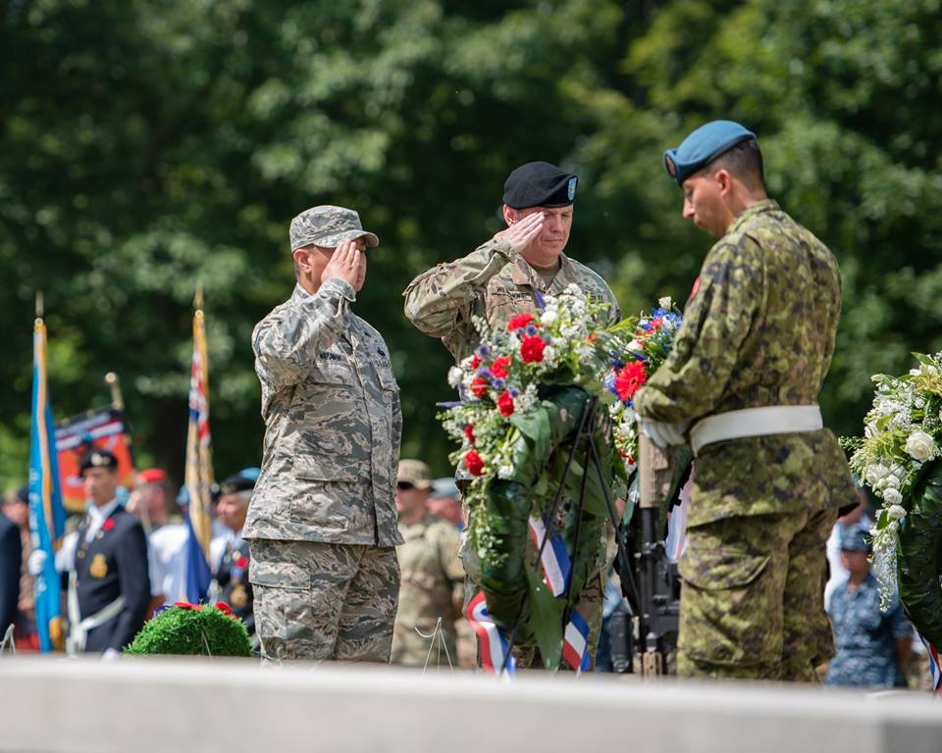
Nijmegen Four Day March
Digging Deeper
    Military March
      4 Day March Established in 1909
      306 male participants, 10 civilians in 1909
      2019 will be 103^{d} edition
    Present Military Operations
      Military participants from all Nations MUST possess Military Identification Cards
      Military marchers follows independent route different from Civilians with 60% overlap
      Approximately 30 Nations Join together on Camp Heumensoord – 21 in 2018

Slide 18
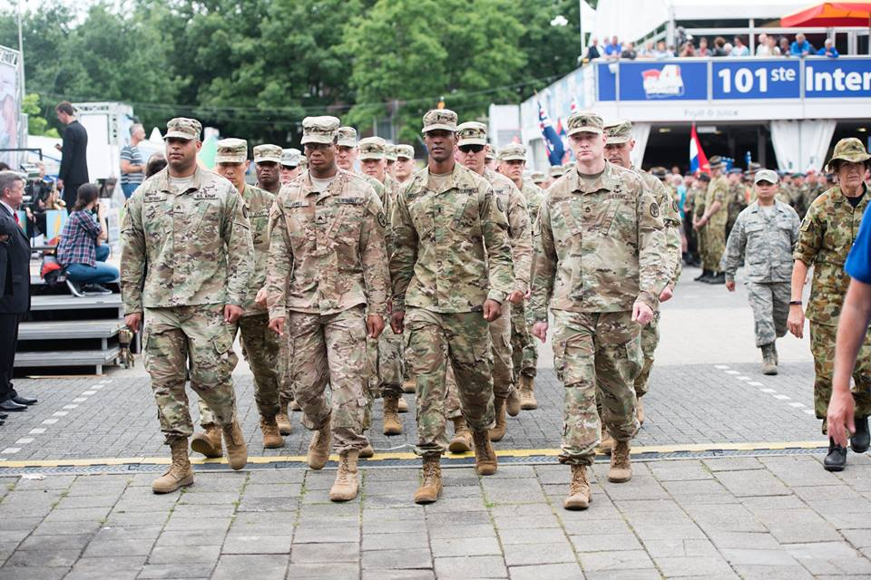
Nijmegen Four Day March
Military Added Value
    Military Value
      Simulates distance operations on foot with ruck and weight
      Enhances military physical conditioning
      Activates military medical support
      Activates operational support with field operations to support troops
      Brings together US military members from Army, Air Force, Navy and Marines
        With “unified” goal
        Regardless of rank, MOS/AFSC or age, success and teamwork is the ultimate goal
      Units marching together learn how to support each other through effort
        Teamwork/teambuilding is a valuable management tool
    Esprit de Corps
      Part of 6,000 military participants from up to 30 countries
      Joint operations and communications improves multi nationals military relations
        Joint operations allows nationals to learn culture and national perspectives
      Marching more than one hundred miles in four days is not accomplished without pain and effort

Slide 19
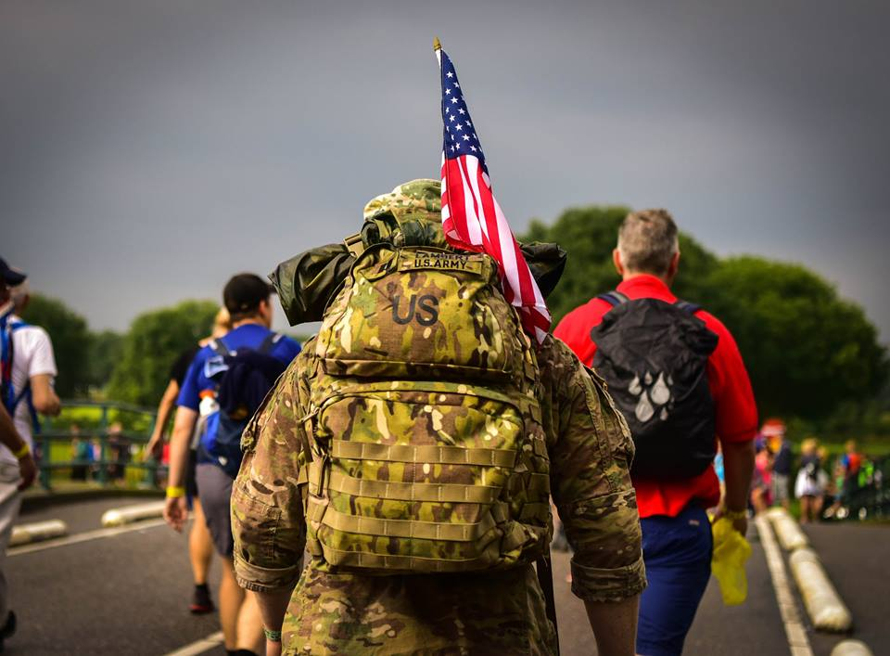
Nijmegen Four Day March
March Structure and Tradition
    The March
      Commences on third Tuesday in July and ends after four days
      Military March “Green” route different from Civilians:
        40Km (25 miles) per day
        Military start and finish from Camp, not city center
        Approximately 60% of military march routes overlap with civilians
      Military males under age 50 must carry 10 kg weight excluding food and water (23lb)
      Females no weight requirement, most wear ruck for uniformity
      Highest US rank in 2018, 102nd Edition O-6
      Uniformed military participants march either as:
          Individuals
          Detachments in military formation, with minimum 11 participants
    Public Support
      Over 2.0 million people cheer on the marchers over the 100 mile march
      The military marchers are shown the greatest respect resulting from the WWII liberation of Holland
      Americans and Canadians receive great applause in thanks and respect for war efforts supporting region

Slide 20
Nijmegen Four Day March
July 16 – 19 2019
✓
History
Participation Data
Goals
Unit Support

Slide 21
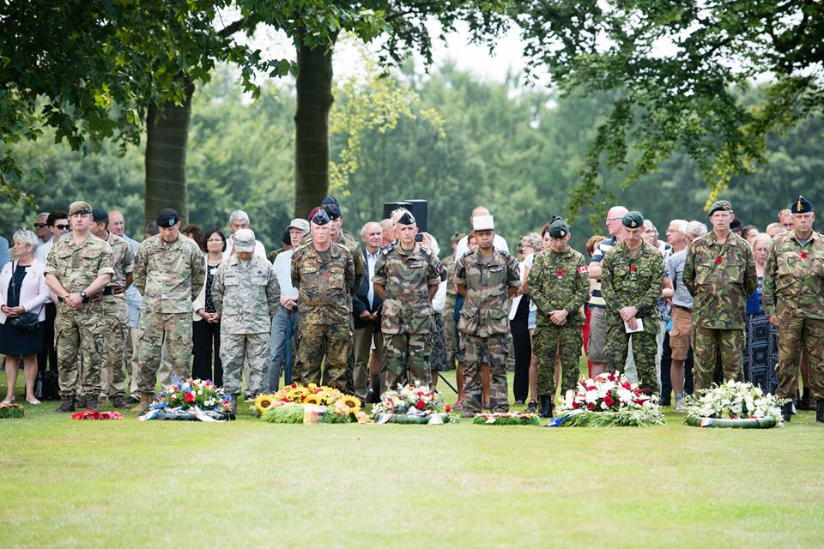
Nijmegen Four Day March
Military History Lest we forget
      110 Monuments / Museums commemorate Americas role in Liberating Netherlands
        82nd Airborne Division Memorial, Beek-Ubbergen
      Marsgratan - American Cemetery and Memorial
        Only American military cemetery in Netherlands
        8,301 American Soldiers laid to rest
        1,723 missing American soldiers commemorated
      Americans Bombed Nijmegen, February 22, 1944
        763 Civilian deaths
        Mistook Nijmegen for Kleve, Germany 20km further east in cloudy weather
      2,331 Canadian Graves in Groesbeek
        Joint Military ceremony held on Monday before march

Slide 22
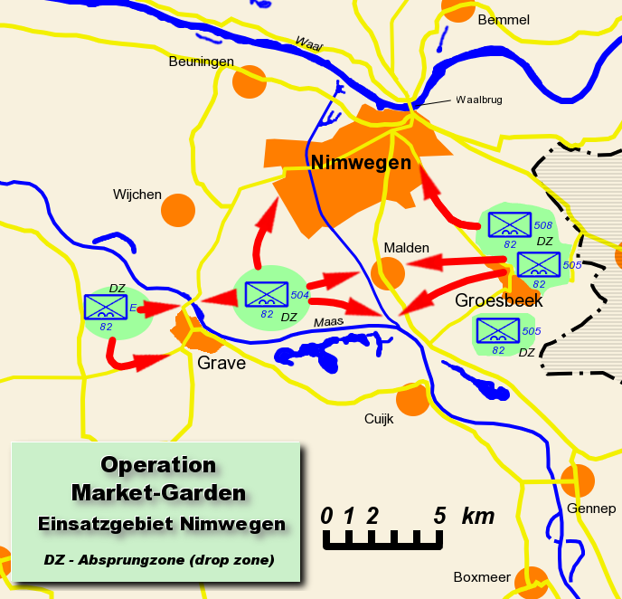

Nijmegen Four Day March
Market Garden
75th Anniversary
3,974 Dead and Missing
American Soldiers

Slide 23
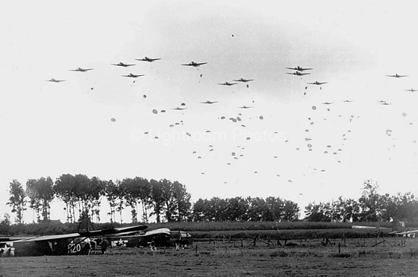
Nijmegen Four Day March
Grave
4th Day
Of March

Slide 24
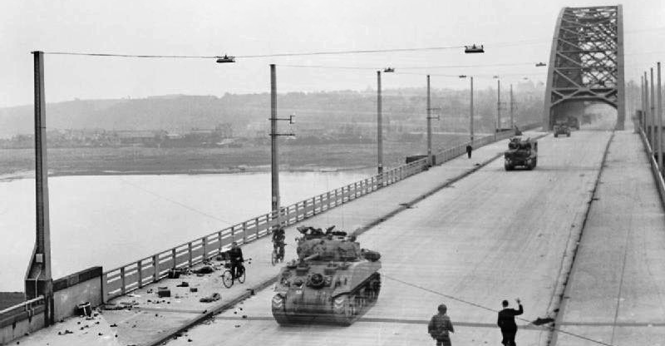
Nijmegen Four Day March

Slide 25
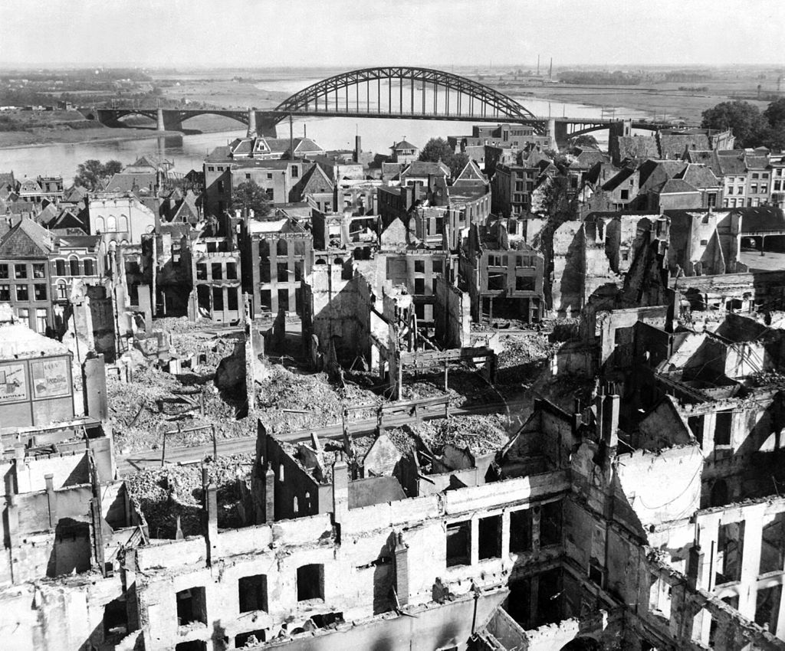
Nijmegen Four Day March
Nijmegen
75 Years ago
US Forces
march these streets
Day one (Lent)
Day two (Wijchen)

Slide 26
Nijmegen Four Day March
July 16 – 19 2019
History
Participation Data
Goals
Unit Support
✓

Slide 27
Nijmegen Four Day March
US Participation 2018
    U.S. Forces participation
      US Military participation generally varies from 50 to 700 participants per year
        Participants sign up with US Contingency - 347 and Small Contingency - 39
        US Forces pay their own way
      2018 US Forces / 386 Total Starts / 60 Drops / 326 Completions / 84.46% Completion rate
      US Contingency (excluding Small Contingency – multi national)
        347 Paid Registrants
        No-Shows: 22 paid
        Drops/Withdrawals: 11, Day 1 / 23, Day 2 / 16, Day 3 / 6, Day 4 / 56 Total
        Percent of Paid Registrants Started : 93.66% 6.34% no-show
        Percent of Paid Registrants Completed: 77.52% 22.48% didn’t finish
        Percent of US Forces starts completing event: 82.77% 17.23% dropped out

Slide 28
Nijmegen Four Day March
Note: 2006 March Cancelled due to Extreme Heat
1990 Data Unavailable
Prior to 2010 Military and Civilian data Combined
Source: 4Daagse Data Records and Media Releases

Slide 29
Nijmegen Four Day March
Note: 2006 March Cancelled due to Extreme Heat
1990 Data Unavailable
Source: 4Daagse Data Records and Media Releases

Slide 30
Nijmegen Four Day March
USA 4.41% of Military Representation 2017
USA 7.54% of Military Representation 2018

Slide 31
Nijmegen Four Day March
15.54% U.S.A. Drop Rate
8.34% Total Military Drop Rate
7.81% All Drops (Civ & Mil)

Slide 32
Nijmegen Four Day March
July 16 – 19 2019
History
Participation Data
Goals
Unit Support
✓

Slide 33
Nijmegen Four Day March
“Ruck Ya!”
Target: 420 Military Participants
Target: 92% completion rate
Target: US Military to Exceed
average participant completion rate

Slide 34
Nijmegen Four Day March
Support Goals
    Website
      Has been built and maintained for US Military Participants to register and gather / post information
      www.USDODMIL-4daagse.com
    Patches, Ribbons, Awards
      USA Forces Nijmegen Patch should be available for purchase to all U.S. march and support personnel
      March Ribbon should be available for purchase on Kamp Heumensoord
      All support and medical staff should receive Commendation letter from command
      A letter of completion/certificate with marcher full name should be issued authorizing marchers the right to wear the ribbon
    Tee Shirts
      “USA 2019 Nijmegen 4daagse” branded tee-shirt should be available for purchase at U.S. admin shack.
      Military from other nations should also be able to purchase on a availability basis.

Slide 35
Nijmegen Four Day March
July 16 – 19 2019
History
Participation Data
Goals
Unit Support
✓

Slide 36
Nijmegen Four Day March
Command / Unit Support
    Marcher Preparation for Success
      Authorization of “Permissive TDY” for marchers from Units
        Option: Consider PTDY for those completing march
          Leave status for those not completing
      Marcher training time supported by Unit
Minimum first time participant training needed to complete march successfully (16 days)
        12 single day training sessions starting 16 weeks out
          10km, 10km, 15km ,15km, 20km, 20km, 30km, 30km, 35km, 35km, 40km, 40km
        2 two day “back to back” training sessions 8 and 4 weeks out
          First back to back 2 X 20km
          Second back to back 2 X 30km
        No training sessions in July within two weeks of march.

Slide 37
Nijmegen Four Day March
Command / Unit Support
    Orderly Detachment Support
      Orderlies ensure improved force protection and success rate
        Maintain cell communication with Detachment Leader
        Provide assistance as needed
        Provides limited medical support as needed
        Prepares military break areas for assigned detachment
        Move around by Bicycle
      Two Orderlies permitted per Detachment per official march rules
      Required to wear RED jacket/shirt, Military uniform not permitted
        US Contingency will provide two (2) Red Cotton Polo Shirts for each orderly
      Recommend TDY or PTDY Unit authorization for Orderly(s) assigned to unit detachment(s)

Slide 38
Nijmegen Four Day March
Fitness, Preparation, Esprit de Corps
July 16 – 19 2019
Thank You !

