Slide 1
LOGISTICS RULE THE LAND & SEA by Karen Cook, Esq., Dean, School of Business and Law 410.777.7370 / kcook@aacc.edu for 2019 National Maritime Education Conference Norfolk, VA June 10-11, 2019

Slide 2
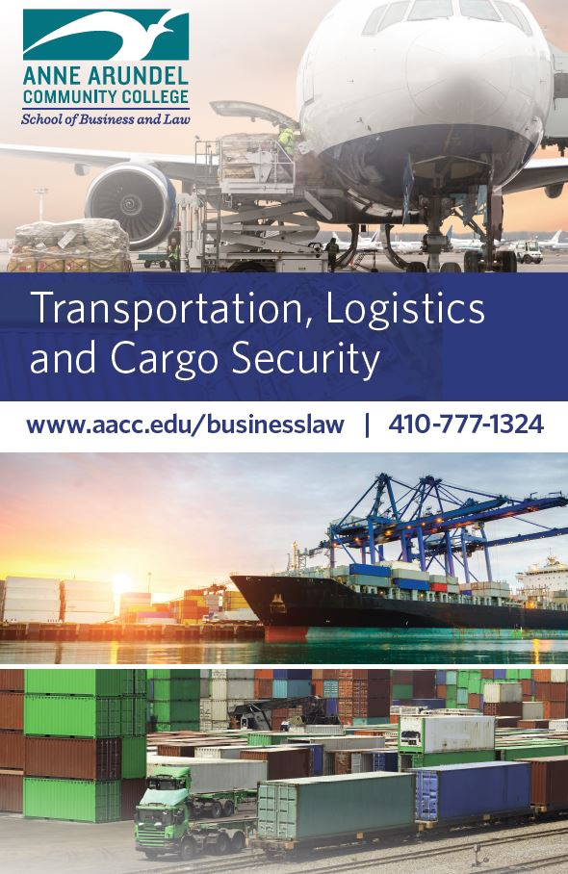
Transportation, Logistics & Cargo Security (TLCS) Program @ AACC
AACC is located minutes from the U.S. Naval Academy and in close proximity to Baltimore Washington Thurgood Marshall International Airport, the Port of Baltimore, the Maritime Institute of Technology and Graduate Studies (MITAGS), Fort George G. Meade, the National Security Agency, U.S. Cyber Command, and many other government agencies and private industries.
This location makes AACC ideally situated to provide programming that gives students the broad knowledge, skills, and training required to work in jobs related to cargo handling, warehouse and distribution, supply chain logistics, airport and seaport operations, related technologies, and security operations.
We strive to close the skills gap that exists at ports,
marinas, and airports in the Central Maryland region and to identify the next generation of such workers.

Slide 3
AACC Transportation & Logistics Curriculum
Credentials
Transportation, Logistics and Cargo Security
18-credit Certificate
Supply Chain Management
18-credit Certificate that stacks into the AAS in
Business Management degree
Courses
Introduction to Transportation and Logistics
Airport and Seaport Operations – separating these into tracks
Supply Chain Management
Domestic and International Freight Operations
Transportation and Border Security
Internship
Procurement and Materials Management
Logistics Technologies
Safety & Risk Management in TLCS
Courses are taught face-to-face, online, hybrid, and can be customized for workforce contract clients.

Slide 4
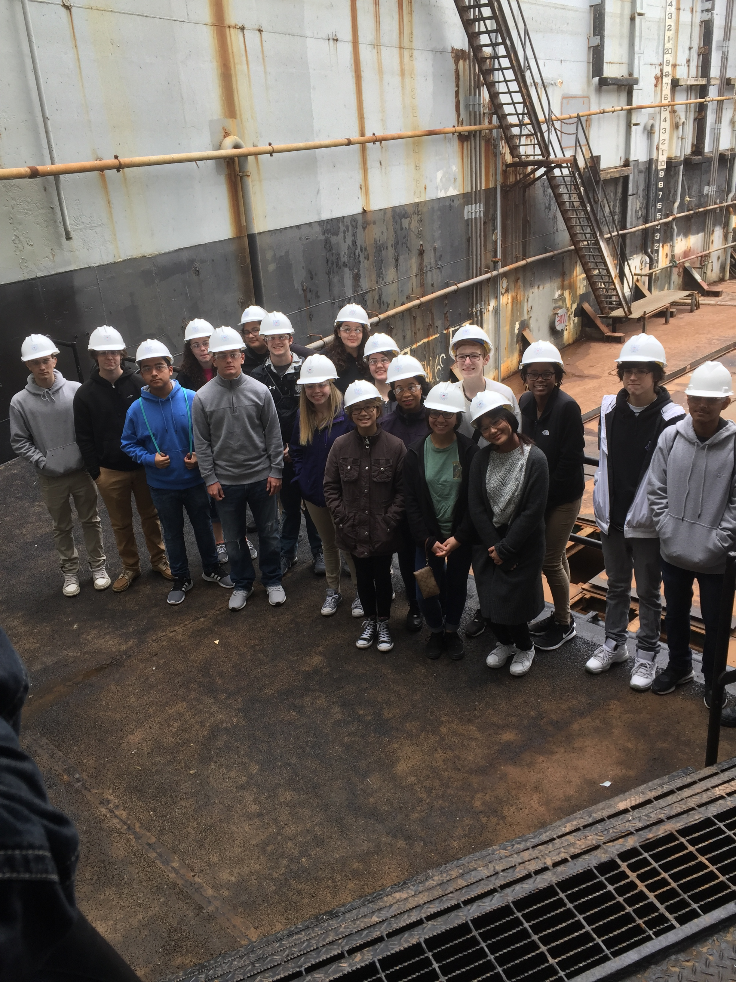
AACC Transportation & Logistics Program Target Areas
Dual enrollment – high school dual enrolled students
Job-ready training – adults needing a job-ready credential
Incumbent worker training – currently employed workforce needing training/credential to advance
Skilled Trades training – training in plumbing, welding, electric, HVAC, forklift and eventually specific marine skilled trades
Drone/Robotic training – training in marine drone technology

Slide 5
Work Closely with:
Logistics industry and businesses in the Baltimore metro region
Federal intelligence agencies (NSA, CIA) requiring logistics education/training
Port of Baltimore
Baltimore Washington International Airport
Transportation & Logistics Advisory Board at AACC
Logistics Roundtable – County Workforce Development Board

Slide 6
Biggest Workforce/Education Challenges Identified by our Logistics Partners
Changing perception of logistics jobs
Finding and retaining good talent
Finding employees with basic knowledge and skills
Training employees in soft skills

Slide 7
Other Challenges identified by our Logistics Partners
Use of technology, including drones
Shipments to areas outside the continental US, including Guam, Hawaii, Alaska, and Puerto Rico
Weather
Modes of shipment
International shipping and Customs

