Slide 1
Oak Ridge,TN
October 1-3, 2018
OSHA Be Standard - Materion's web-based Guide to Compliance.
Marc Kolanz, VP EH&S

Slide 2
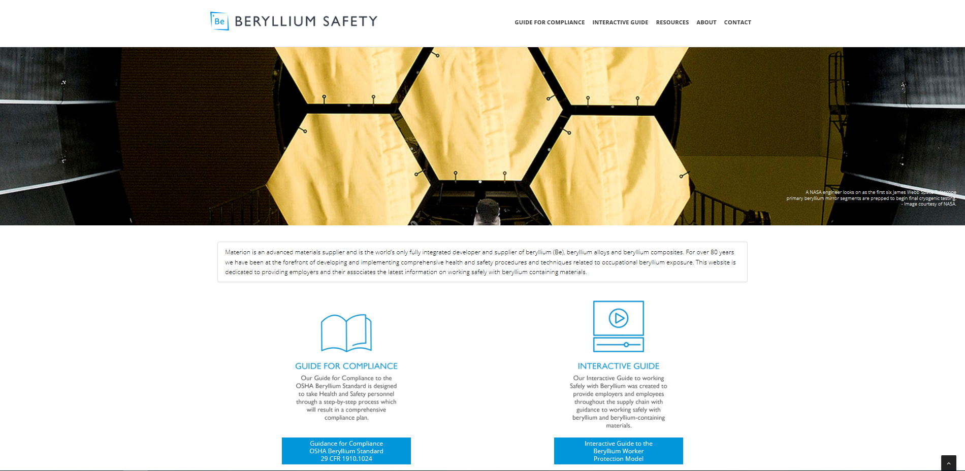
Guide for Compliance Website
GOAL - Develop a “user friendly” web based, interactive guide to determine compliance obligations and provide example procedures, tools, and templates to assist with OSHA 1910.1024 compliance.
Notes:
Talk about the major items of concern and likely legal action – Dermal Contact, Recycling Scrap, Adverse Health Effect of BeS, Cancer Risk at low exposures. Also talk about FAQ that was issued on OSHA webpage which provides some clarification of requirements and definitions in the standard.

Slide 3
Guide for Compliance Website
Interactive Q&A that walks users through the OSHA Beryllium Standard, as proposed by the Settlement Agreement:
  Scope
  Permissible Exposure Limits
  Exposure Monitoring
  Beryllium Work and Regulated Areas
  Methods of Compliance
    Written Exposure Control Plan
    Engineering and Work Practice Controls
  Respiratory Protection
  Protective Clothing and Equipment
  Hygiene Areas and Practices
  Housekeeping
  Medical Surveillance
  Medical Removal
  Communication of Hazards
  Recordkeeping

Slide 4
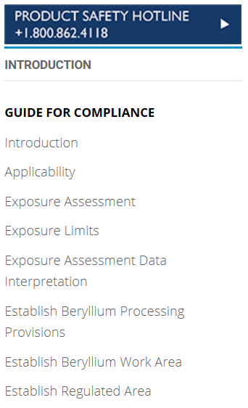
Guide for Compliance Website
8 Navigation Sections
Must do this first…
…to determine your compliance track.

Slide 5
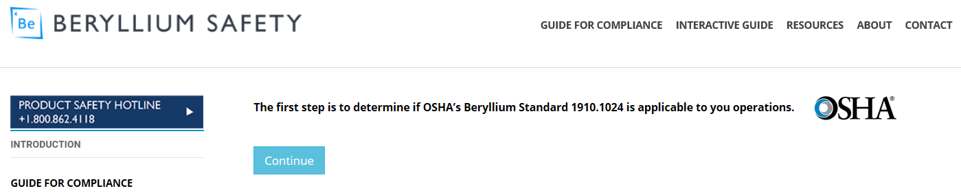
Scope & Applicability
  Outside Scope, or
  Within Scope – 1 of 3 compliance tracks:
    Beryllium Processing Provisions
    Beryllium Work Area
    Regulated Area
The “EASY” part:

Slide 6
Scope & Applicability
  The 3 compliance tracks:
    Beryllium Processing Provisions - processes not listed in Appendix A - Table A.1 and exposures are at or below the Action Level
    Beryllium Work Area - processes listed in Table A.1 or exposures are greater than the Action Level
    Regulated Area - exposures are greater than the PEL or STEL

Slide 7
www.berylliumsafety.com Website
LET’S TAKE A WALK
www.berylliumsafety.com

Slide 8
Questions?

