Slide 1

BRING YOUR ‘A’ GAME
6 Steps to Manage Anxiety

Slide 2

Dr. Ellen Contente is the Founder and Chief Positivity Officer of Heart-Centered Programs, a training and consulting business 'Empowering People to live and work with more Passion, Purpose and Play’™.
Heart- Centered Programs provides Wellness Programs on:
  Stress Management
  Creating Healthy Lifestyle
  Everyday Mindfulness
  HeartMath Resonance
  Many other topics on Well-Being, Leadership, and Compliance

Slide 3

Is this You?
Racing Thoughts
Sleep Disturbance
Withdrawn
Sad
Fearful
Physical Ailments
Outburts

Slide 4
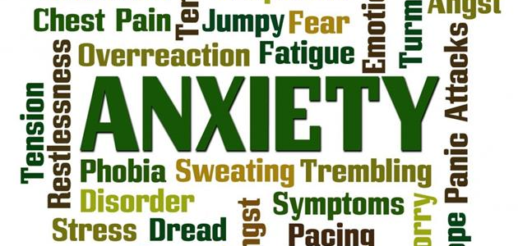

Slide 5
CAUSES OF ANXIETY
Anxious personality. Some people are genetically prone to anxiety.
Childhood experiences. Bullying, hostile parents or other frightening experiences during childhood.
Long-term health problems like chronic pain are linked to anxiety.
Everyday habits such as working long hours, financial or housing problems and stress can cause anxiety.
Outside Conditions such as COVID-19, weather, political unrest, environmental factors

Slide 6

Overcome ‘Infodemic’ Anxiety
&
Find
Some
Peace
“Inner peace begins the moment you choose not to allow another person or event to control your emotions.”
Pema Chodron

Slide 7
Bring your ‘A’ Game
6 Steps:
Awareness
Acknowledge
Assess
Attention
Action
Appreciation

Slide 8
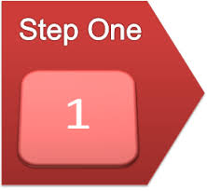
Awareness
What am I Feeling
Physically
Emotionally
Behaviorally

Slide 9

Acknowledge
What Is …
Admit it to Yourself
Own your Experience
Express your Fears

Slide 10

Assess
What Needs Attention
Health
Finances
Relationships
Career

Slide 11

Attention
Put your focus in the Present
3 Pillars of Health
  Diet
  Exercise
  Nutrition
3 ‘M’s of the Moment
  Mindfulness
  Meditation
  Mind/Body Connection

Slide 12

'Try to remember that anxiety is a blend of fear and hope and see if you can keep the hope part in mind too.’
Catherine Belling, Ph.D.

Slide 13

Action
Choose Positive Steps
Self-Care Practices
Reframe Anxious Thoughts
Practice Stress Inoculation
Maintain healthy routines

Slide 14

Appreciation
Find the Silver Linings
Strengthen Resilience
Find Gratitude in Challenges
Overcoming shortfalls

Slide 15

“I cannot always control what goes on outside. But I can always control what goes on inside.”
Wayne Dyer
Personal Action Plan

Slide 16
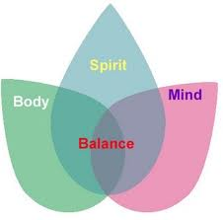
verywellmind.com psychcentral.com betterhealth.com psychologytoday.com virusanxiety.com nami.org nimh.nih.gov
Resources

Slide 17
To work with us directly:
Heart-Centered Programs ellen@heartcenteredprograms.com
6 Steps to Manage Anxiety

