Slide 1
Refurbished Xumo Devices
June 24th, 2024

Slide 2
Field Ops Use of Refurbished Xumo Devices
Current situation:
Field Techs only have New Xumo devices in their Totes (No refurbished devices)
We are running through our inventory of new devices and building up inventory of returned devices and therefore want to start refurbishing and redistributing Xumo devices.
Project Aim:
To ensure that returned devices are refurbished and redistributed to Lease Xumo customers only
  Currently there is approx. 450K devices on hand
  Xumo Purchase Customers should continue to receive new devices only
Refurbished Xumo devices will be distributed by: Home ship & Field (Stores will not distribute Refurbished Xumo devices)
Launch needs to be in approximately a one-month time frame. Therefore, we will need to identify the MVP solution as well as the full-scale launch
Key dates:
Logic to deploy on June 18th
X1 Xumo to deploy August 8th

Slide 3
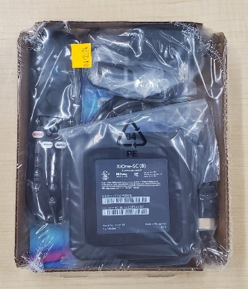


Refurbished Xumo Devices – Equipment Labeling
Leased Device Packaging:
LEASED
6/7/24
LEASED on Yellow Born-On Sticker.
For Xumo Lease Customers ONLY
For Technicians & Contractors
Purchased Device Packaging:
PURCHASE
6/7/24
PURCHASE on Green Born-On Sticker.
For Xumo Purchase and Lease Customers
(Purchase Only for the upcoming months due to new device shortages)
For Technicians & Contractors

Slide 4
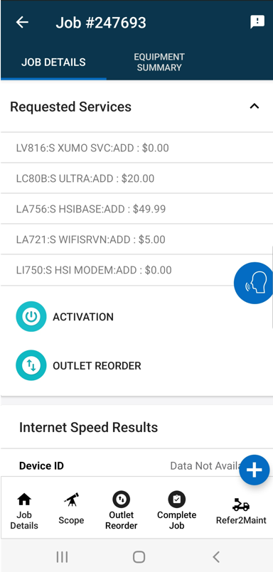
Xumo Initiative – Field Ops to Install Refurbished Xumo Devices (on Leased Devices Only)
 | Current State | MVP Solution | Full Scale Solution
Installation policy/ Process | During professional installs Field techs only install new Xumo devices for all installations (Purchased and Leased). | During professional installs Field techs will install: New devices only for purchases New or refurbished devices for leases
Totes | Techs have only new Xumo devices in their Totes. | All Field Techs will have a totes containing New and Refurbished Xumo devices which are clearly labeled/ differentiated
Systems | TechMobile does not identify new and refurbished Xumo devices. There is no warning to notify the field tech that there a Purchase installation is required(Filed Tech must refer to job details) Guardrails to prevent refurbished devices from being installed for Xumo purchases do not exist. | Use of job details to determine whether New or Refurbished equipment can be installed | TechMobile and Device Qualification build will allow TechMobile to: prevent the installation of refurbished equipment for purchases to notify the Field Tech when only new equipment can be installed at the beginning of the Job Inform the Tech of Tote levels of purchased and Leased devices

Slide 5
Next Steps
Agree on MVP solution, approximate launch date, and to accept risk that a refurbished device may be installed for a Xumo Purchase
Inform Contractors
Add Refurbished Devices to Tech Totes
Create New Processes based on current TechMobile Build
Provide Training on New Processes
Publish FON articles regarding the change
Prioritize and work towards the full-scale solution

Slide 6
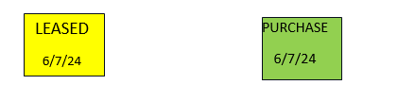
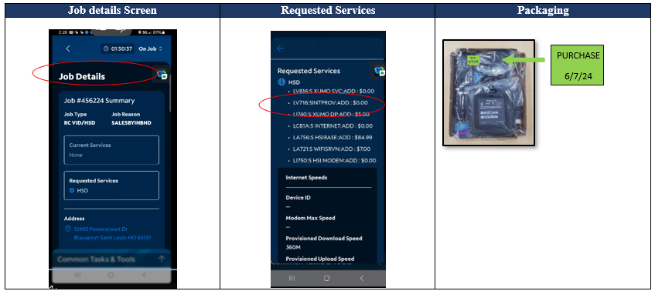
Process for Identifying when to use a Purchased Device
Starting July 12th all Field Techs will start receiving Xumo kits that will be labeled with one of the following stickers.
Field Techs that have Kits with the Leased Sticker in their tote should take the following steps before any Xumo installation:
      Go to Job Detail Screen => Select Requested Services:
          If LV816 - S XUMO SVC is listed => Do not install a device with a Leased Sticker
Install a device with: No sticker (from devices currently in your tote) or with a green purchase sticker
        In all other cases => Install a Device with a Leased Sticker
              If one is not available install a device with a Purchased Sticker.

Slide 7
Appendix

Slide 8
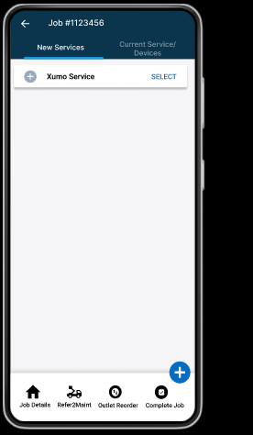
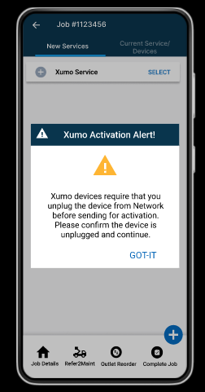
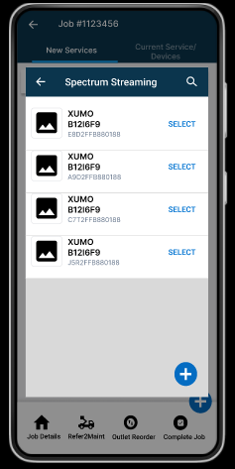
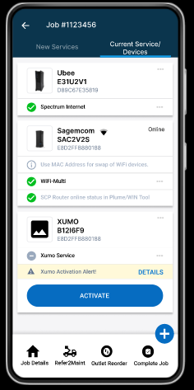
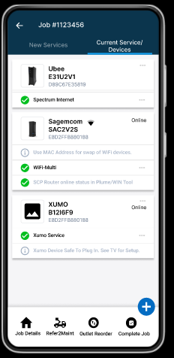
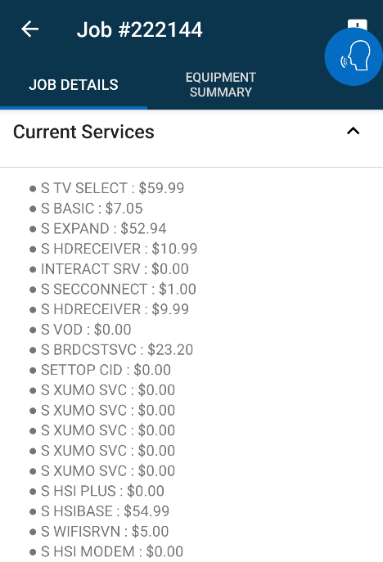
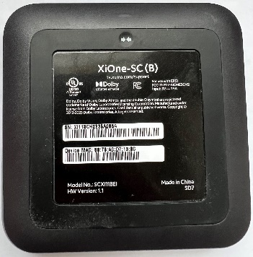
TechMobile – Display screens Leased Device

