Slide 1

Sam Rayburn Texans
2025-2026 PARENT MEETING

Slide 2

WHO ARE THE COACHES?
HEAD COACH
  Duke Barrier – dbarrier@pasadenaisd.org
ASSISTANT COACHES
  Joseph Kennedy - jkennedy@pasadenaisd.org
  Winston Pullin – wpullin@pasadenaisd.org
  Jordan Guy
  Marcus Ruiz

Slide 3
What are the expectations of the players?
  BE ON TIME
  BE OF GOOD CHARACTER ON THE COURT, IN THE CLASSROOM AND THROUGHOUT THE COMMUNITY
  GIVE MAXIMUM EFFORT
THREE SIMPLE RULES TO ABIDE BY TO BE IN OUR BASKETBALL PROGRAM.

Slide 4

WHERE CAN I FIND THE PRACTICE AND GAME SCHEDULES
ALL PRACTICE AND GAME SCHEDULES WILL BE POSTED ON OUR SPORTSYOU PARENT PAGE.
SCHEDULES CAN ALSO BE FOUND AT OUR TEAM WEBSITE: www.srtexanbasketball.godaddysites.com/
You can follow the Texans on twitter;
@RunninTexans
GAMES WILL BE STREAMED AT SAMYRAYBURNBASKETBALL.COM; OR HUDL
SPORTSYOU LINK:

Slide 5
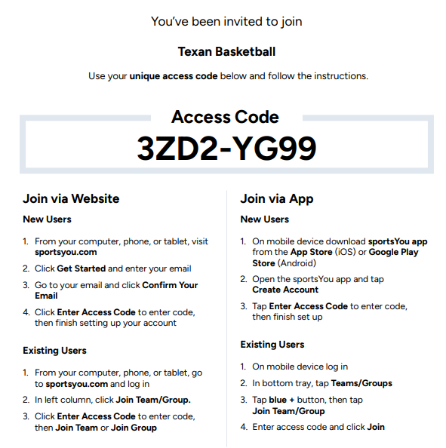
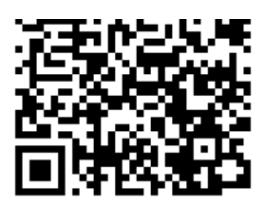
JOIN OUR SPORTSYOU

Slide 6
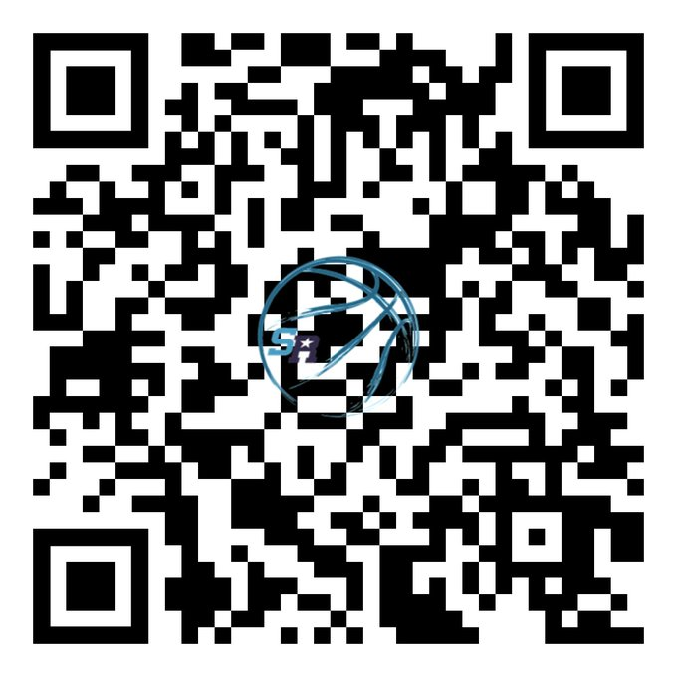
VISIT OUR WEBSITE

Slide 7

PROCEDURES AFTER GAMES
ALL PLAYERS WILL BE REQUIRED TO RIDE THE BUS HOME FROM AWAY GAMES.
IN THE CASE OF AN EMERGENCY PLAYERS WILL BE ALLOWED TO RIDE HOME WITH THEIR PARENT/GUARDIAN IF THEY HAVE FOLLOWED THE PROPER PROCEDURES.
PLAYERS WILL ONLY BE RELEASED IF THEY HAVE FILLED OUT A TRAVEL RELEASE FORM AND TURNED IT IN TO THEIR COACH DURING THE ATHLETIC PERIOD THE DAY BEFORE THE GAME.
NO PLAYERS WILL BE RELEASED TO ANYONE ELSE’S PARENT/GUARDIAN.
SUB-VARSITY PLAYERS WILL BE ALLOWED TO LEAVE AFTER THEIR HOME GAMES BUT ARE HIGHLY ENCOURAGED TO STAY.

Slide 8
WHAT SHOULD PLAYERS DO IF THEY ARE GOING TO MISS?
ANY STUDENT ATHLETE THAT WILL NOT BE AT PRACTICE WILL BE REQUIRED TO CONTACT ONE OF THEIR COACHES DIRECTLY BEFORE PRACTICE.
YOU WILL NOT BE ALLOWED TO SEND WORD WITH A TEAMMATE. COACHES CONTACTS CAN BE FOUND ON THE PREVIOUS SLIDES AND ON OUR WEBSITE
FAILURE TO ATTEND PRACTICE COULD AFFECT THEIR PLAYING TIME IN THE NEXT GAME.
REPEATED UNEXCUSED ABSENCES WILL RESULT IN REMOVAL FROM THE PROGRAM.

Slide 9
WHAT SHOULD PLAYERS DO IF THEY GET HURT?
NOTIFY THE COACHING STAFF FIRST.
VISIT OUR TRAINING STAFF BEFORE GOING TO THE DOCTOR.
  ALL PLAYERS THAT GET HURT MUST VISIT THE TRAINING ROOM BEFORE SCHOOL FOR TREATMENT. IF YOU DON’T MAKE IT BEFORE SCHOOL THEN WE WILL ASSUME THAT YOU AREN’T HURT.
VISIT YOUR DOCTOR AFTER SPEAKING WITH OUR ATHLETIC TRAINING STAFF.
  ALL PLAYERS THAT GET HELD OUT BY A DOCTOR MUST PROVIDE A DOCTOR’S NOTE TO GET CLEARED TO BEGIN PRACTICING AGAIN.
TRAINING STAFF CONTACT INFORMATION
  HANNAH SAENZ – HGODWIN@PASADENAISD.ORG

Slide 10
WHAT TYPE OF COMMUNICATION SHOULD I EXPECT FROM THE COACH?
COACH’S PHILOSOPHY
THE EXPECTATION HE HAS FOR YOUR SON AND ALL THE OTHER PLAYERS ON THE TEAM.
LOCATION AND TIMES OF ALL PRACTICES AND GAMES.
TEAM REQUIREMENTS (FEES, SPECIAL EQUIPMENT NEEDED, IMPORTANT DATES)
PROCEDURES TO FOLLOW WHEN YOUR CHILD IS INJURED DURING PARTICIPATION.

Slide 11
WHAT TYPE OF COMMUNICATION DOES THE COACH EXPECT FROM ME?
CONCERNS ABOUT YOUR STUDENT ATHLETE EXPRESSED DIRECTLY TO THE COACH AT THE APPROPRIATE TIME AND PLACE.
NOTIFICATION OF ANY SCHEDULE CONFLICTS WELL IN ADVANCE.

Slide 12
WHAT CAN WE DISCUSS AT A MEETING?
ISSUES NOT APPROPRIATE TO DISCUSS WITH A COACH.
  HOW MUCH PLAYING TIME ATHLETES ARE GETTING.
  TEAM STRATEGY.
  ISSUES OR CONCERNS ABOUT OTHER PLAYERS.
ISSUES THAT ARE APPROPRIATE TO DISCUSS WITH A COACH
  THE MENTAL AND PHYSICAL TREATMENT OF YOUR CHILD.
  WHAT YOUR CHILD NEEDS TO IMPROVE.
  CONCERNS ABOUT YOUR CHILD’S BEHAVIOR.

Slide 13
HOW DO I HANDLE A CONCERN?
ALL PARENTS NEED TO FOLLOW THE PROPER PROCEDURE WHEN HANDLING CONCERNS.
  HAVE YOUR SON TRY TO RESOLVE THE ISSUE WITH THEIR COACH AT THE APPROPRIATE TIME AND PLACE FIRST.
  IF THAT DOES NOT RESOLVE THE ISSUE THEN YOU SHOULD CALL THE COACH TO SET UP A MEETING.
  THINK ABOUT WHAT YOU WANT TO ACCOMPLISH DURING THE MEETING.
  MAKE SURE THAT WE STAY ON TOPIC DURING OUR MEETING.
IF WE CANNOT COME TO A HEALTHY SOLUTION TO YOUR ISSUES OR CONCERNS THEN YOU CAN CONTACT OUR CAMPUS AD.
  SERGIO GONZALEZ-CAMPUS ATHLETIC DIRECTOR
    SGONZALEZ@PASADENAISD.ORG

Slide 14
WHAT CAN I DO TO HELP THE PROGRAM?
VOLUNTEER TO HELP WITH SENIOR NIGHT/TOY DRIVE
FUNDRAISERS AND CONCESSIONS HELP US RAISE MONEY TO OBTAIN THE THINGS WE NEED TO KEEP OUR PROGRAM RUNNING AT A HIGH LEVEL.
VOLUNTEER YOUR TIME TO HELP ON SPECIAL GAME NIGHTS.
SUPPORT ALL PLAYERS, TEAMS AND COACHES. REFRAIN FROM NEGATIVE TALK ABOUT TEAM OR COACHES IN FRONT OF YOUR KIDS. SET A POSITIVE EXAMPLE!

Slide 15
PROGRAM FEES
KIDS WILL NEED MONEY TO EAT DINNER AT HOME AND AWAY GAMES IF THEY DON’T BRING FOOD WITH THEM
CONCESSION HELP:
FRESHMAN - 1 BOX OF CANDY AND CASE OF WATER
SOPHOMORES - 2 12 PACKS OF SODA (DR. PEPPER, COKE, DIET COKE, SPRITE, FANTA) AND CASE OF WATER
JUNIORS - 1 BOX OF VARIETY CHIPS (28 OR MORE) AND CASE OF WATER
SENIORS- 12 20 OZ. GATORADE AND CASE OF WATER
PLAYERS MAY CHOOSE TO SIMPLY PAY $25 IN LIEU OF PURCHASING ITEMS

Slide 16
WHAT WILL MY SON LEARN AS A TEXAN BASKETBALL PLAYER?
HE WILL LEARN THE IMPORTANCE OF AN EDUCATION.
HE WILL LEARN HOW TO COMMUNICATE EFFECTIVELY.
HE WILL LEARN HOW TO BE RESPONSIBLE FOR HIS OWN ACTIONS.
HE WILL LEARN HOW TO TREAT THE PEOPLE AROUND HIM.
HE WILL LEARN HOW TO DEVELOP A STRONG WORK ETHIC.
HE WILL DEVELOP INTO A YOUNG MAN THAT IS READY TO COMPETE AT A HIGH LEVEL IN OUR SOCIETY.

Slide 17
WHAT IF MY SON WANTS TO PLAY ANOTHER SPORT?
DO IT!!
ALL ATHLETES ARE ENCOURAGED TO PARTICIPATE IN ANY SPORT THEY ARE ABLE TO MAKE AT SAM RAYBURN HIGH SCHOOL.
ANYONE PARTICIPATING IN BASKETBALL WILL BE GIVEN AN OPPORTUNITY TO TRY OUT FOR ANY SPORT AFTER THE COMPLETION OF OUR SEASON.

Slide 18
FAN BEHAVIOR
Straight from UIL:
Sportsmanship: Be proactive when it pertains to sportsmanship. Ensure athletes (and parents) at all levels in your program understand expectations and provide specific instruction to athletes in regards to sportsmanship. Have a sideline plan in the event of a game altercation, and ensure all coaches are aware of the plan. As the head coach, set and exemplify the standard.
NO WARNINGS THIS YEAR
Player Ejection: Any player ejected from a contest is subject to an automatic penalty. Ejected player misses the rest of the game in which they were ejected plus all of the following game. Player ejections cannot be overturned by a game official. Any questions regarding the ejection need to be addressed at the UIL office.
IF A TEAM ISN’T LISTED THEN THEY DO NOT NEED TO BE HERE. HOWEVER THE GYM WILL BE
AVAILABLE FOR THEM TO PUT UP SHOTS IF THEY WOULD LIKE TO.

Slide 19
LETTERING POLICY
PLAYERS MUST FINISH THE SEASON IN GOOD STANDING WITH THE PROGRAM AND HAVE PLAYED ON THE VARSITY TEAM FOR 25% OR MORE OF THE SEASON.
DOMINATE THE DAY

Slide 20
HOLIDAY SCHEDULES
MISSING PRACTICE OVER THE BREAK IS
GROUNDS FOR REMOVAL FROM TEAM
NOVEMBER - THANKSGIVING
MONDAY, 11/24 - GAME VS WEST FORK - 9A/B/JV/VARSITY - 10:00 AM
TUESDAY, 11/25 - GAME @ PASADENA - 19A/B/JV/VARSITY - 10:00 AM
SATURDAY, 11/29 - PRACTICE - ALL TEAMS - 10:00 AM

Slide 21
HOLIDAY SCHEDULES
DECEMBER – CHRISTMAS
FRIDAY, 12/19 - GAME @ ALVIN - 4:00 PM
SATURDAY, 12/20 - PRACTICE - VARSITY ONLY - 10:00 AM
12/21-12/26 - NO BASKETBALL - MERRY CHRISTMAS
SATURDAY, 12/27 - PRACTICE - VARSITY ONLY - 10:00 AM
MONDAY, 12/29 - VARSITY @ LEE COLLEGE
TUESDAY, 12/30 - VARSITY @ LEE COLLEGE
WEDNESDAY, 12/31 - PRACTICE - ALL TEAMS - 8:00/10:00 AM
IF A TEAM ISN’T LISTED THEN THEY DO NOT NEED TO BE HERE. HOWEVER THE GYM WILL BE
AVAILABLE FOR THEM TO PUT UP SHOTS IF THEY WOULD LIKE TO.

Slide 22
HOLIDAY SCHEDULES
JANUARY – NEW YEARS
THURSDAY, 1/1 - PRACTICE - ALL TEAMS - 8:00/10:00
FRIDAY, 1/2 - PRACTICE - ALL TEAMS - 8:00/10:00
SATURDAY, 1/3 - GAME @ MANVEL - 10/11:30/1
MONDAY, 1/5 - PRACTICE - ALL TEAMS - 2:00/ 4:00
TUESDAY, 1/6 - PRACTICE - ALL TEAMS - 2:00/ 4:00
IF A TEAM ISN’T LISTED THEN THEY DO NOT NEED TO BE HERE. HOWEVER THE GYM WILL BE
AVAILABLE FOR THEM TO PUT UP SHOTS IF THEY WOULD LIKE TO.

Slide 23
THANK YOU FOR COMING!
PLEASE VISIT ALL OF OUR TABLES BEFORE YOU LEAVE.
IF YOU HAVE ANY SPECIFIC QUESTIONS PLEASE WRITE THEM ON YOUR INDEX CARD AND LEAVE THEM WITH COACH STRICKLAND. BE SURE TO LEAVE YOUR EMAIL ADDRESS OR PHONE NUMBER ON THERE AS WELL.
DOMINATE THE DAY

Slide 24

Parent Acknowledgement
I, _____________________, acknowledge that I understand and agree to the policies and procedures for the Sam Rayburn Boys Basketball Program.
Player’s Name:__________________________
Parent Signature: ________________________

