Slide 1

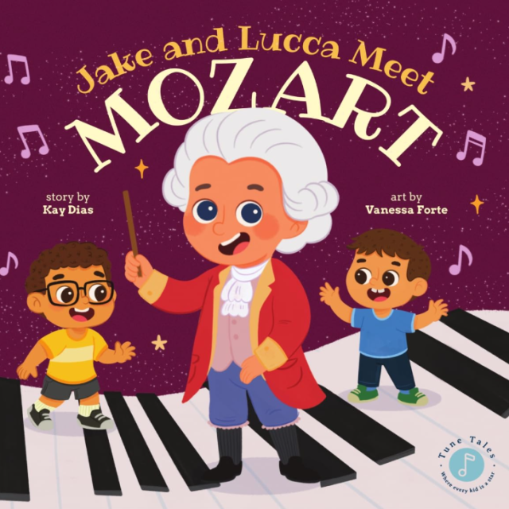
Jake and Lucca
Meet Mozart
A musical adventure into the magical world of Mozart!

Slide 2

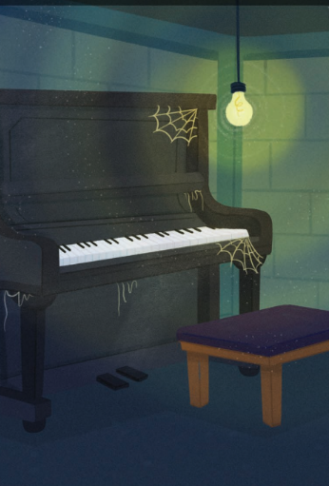
A Magic Piano
in the Basement
What happens when you touch a
dusty old piano?

Slide 3
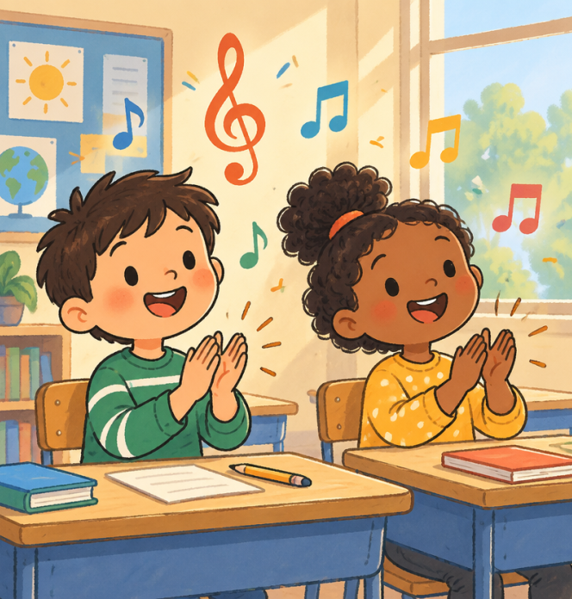
Our Learning Goals
Today in our lesson, we will:
Discover who Mozart was and what he did as a child.
Learn what a composer does with musical notes.

Slide 4
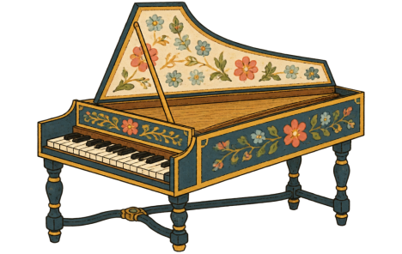
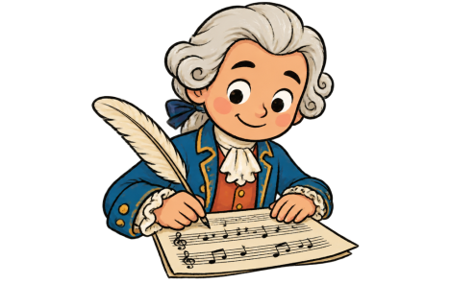

Words to Know
Harpsichord - An early keyboard with plucked strings.
Composer - A creative person who writes new songs.
Music - Sounds and rhythms we hear and sing.

Slide 5
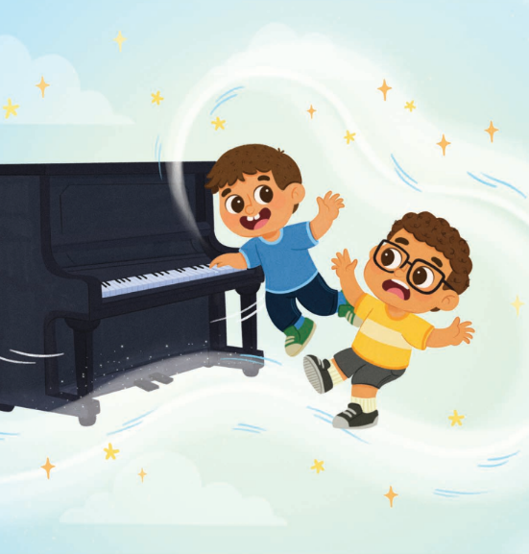
Traveling Back in Time
Lucca pressed a key on the mysterious piano, and swoosh! Magic swirls carried Jake and Lucca across time to Vienna, Austria.
They landed in a grand concert hall, where they met a boy named Mozart wearing a fancy white wig!

Slide 6
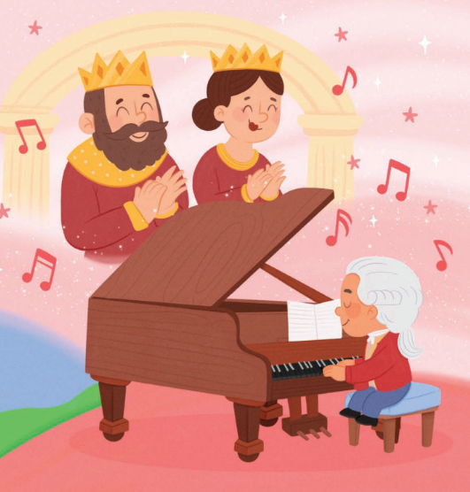
The Boy Wonder
Mozart was lively and bright! By age five, he was already composing his own pieces of music.
🤯
Fun fact
Young Mozart traveled across Europe to play the harpsichord for kings and queens in royal palaces!

Slide 7
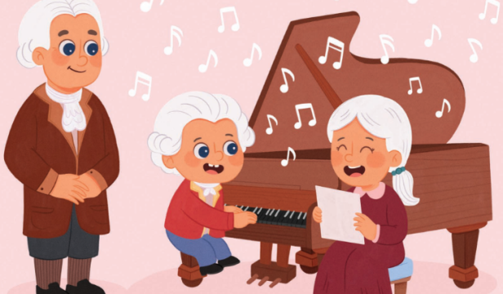
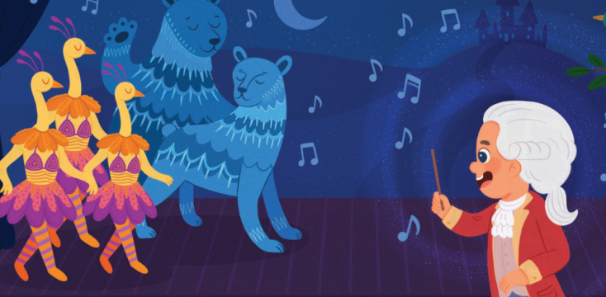
Family and Famous Stories
Musical Family
Mozart's father taught him, and he loved playing duets with his sister.
The Magic Flute
Mozart wrote operas, including a magical tale with enchanted instruments and animals!

Slide 8
Mozart's Young Age
How old was Mozart when he began composing his own music in the story?
1.
20 years old
2.
12 years old
3.
5 years old
4.
1 year old

Slide 9
Mozart's Young Age
✅
How old was Mozart when he began composing his own music in the story?
1.
20 years old
2.
12 years old
✓
3.
5 years old
4.
1 year old

Slide 10
Jake and Lucca's Journey
Put the story events in order from first to last:
Lucca presses a key and bright magic swirls lift them up.
Jake and Lucca find a dusty piano in their basement.
The boys arrive in a grand concert hall in Vienna.
Mozart plays the harpsichord and shares his story.

Slide 11
Jake and Lucca's Journey
✅
Put the story events in order from first to last:
1
Jake and Lucca find a dusty piano in their basement.
2
Lucca presses a key and bright magic swirls lift them up.
3
The boys arrive in a grand concert hall in Vienna.
4
Mozart plays the harpsichord and shares his story.

Slide 12
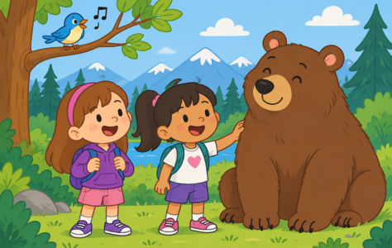
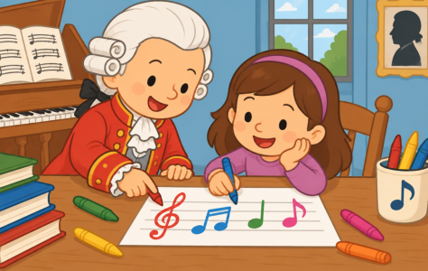
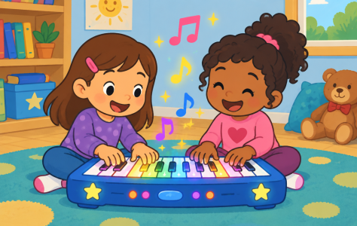
Making Magic Music Like Mozart
Compose a tune with Jake and Lucca!
Step 1: Pick Notes - Choose high bird or low bear sounds.
Step 2: Write Notes - Draw notes like Mozart did!
Step 3: Play Song - Tap keys or sing your melody!

Slide 13
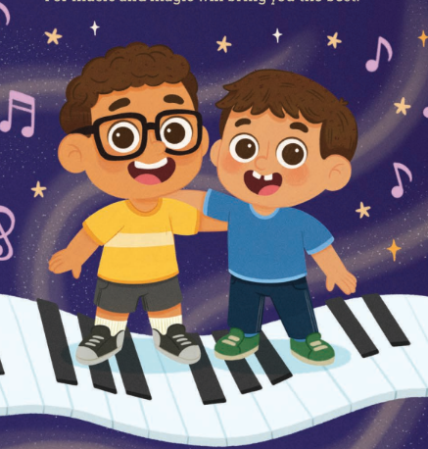
Listening to Mozart's Notes!
Mozart used musical notes to write down how high or low a sound should be. High notes sound light like a tiny bird, and low notes sound deep like a big bear!
🔍
Example
Try it with Jake and Lucca! Tap a high key on a keyboard or make a high beep sound. Now try making a low rumble sound!

