Slide 1

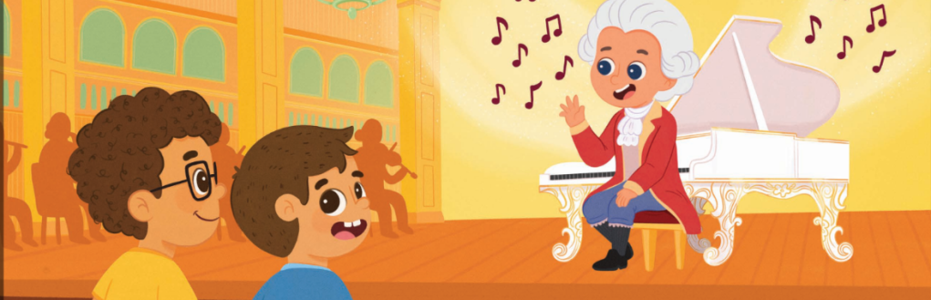
TEMPO WITH MOZART
Explore music speed with Jake and Lucca!

Slide 2
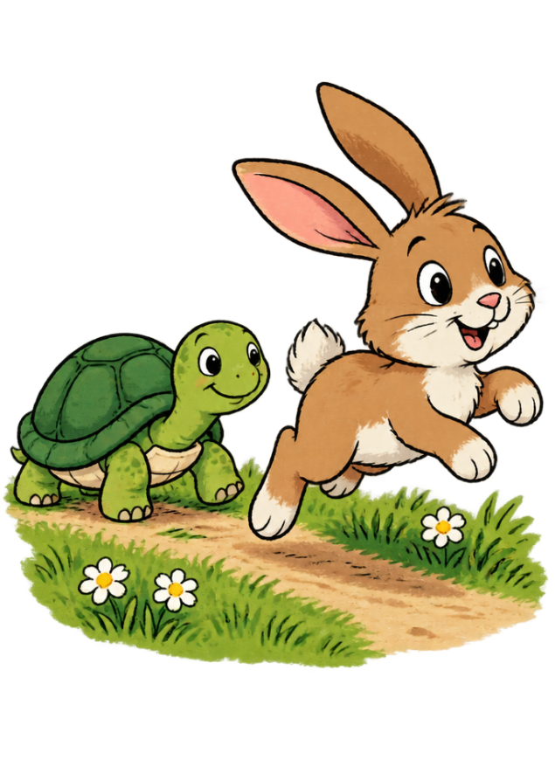
FAST OR SLOW?
Imagine a tiny turtle crawling across a garden, and then a quick rabbit hopping away!
When Mozart plays the piano, his songs can move slow like a turtle or fast like a bunny. In music, this speed is called tempo.

Slide 3
OUR GOALS TODAY
Identify four Italian tempo words: largo, moderato, allegro, and presto.
1
Match musical tempos to everyday animal movements and clapping speeds.
2

Slide 4
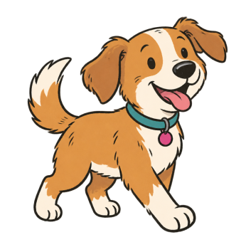
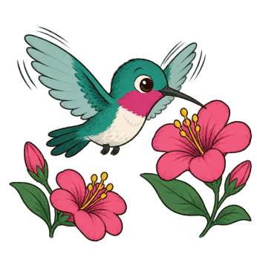
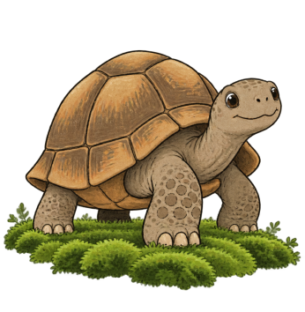
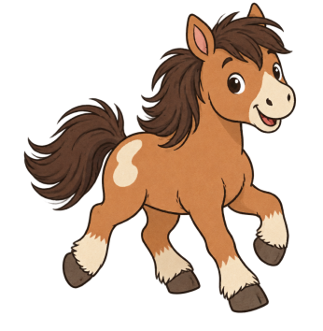
FOUR TEMPO WORDS
Moderato
Medium, easy walking speed.
Presto
Very fast like buzzing wings!
Largo
Very slow and stately pace.
Allegro
Fast, lively, and joyful speed.

Slide 5
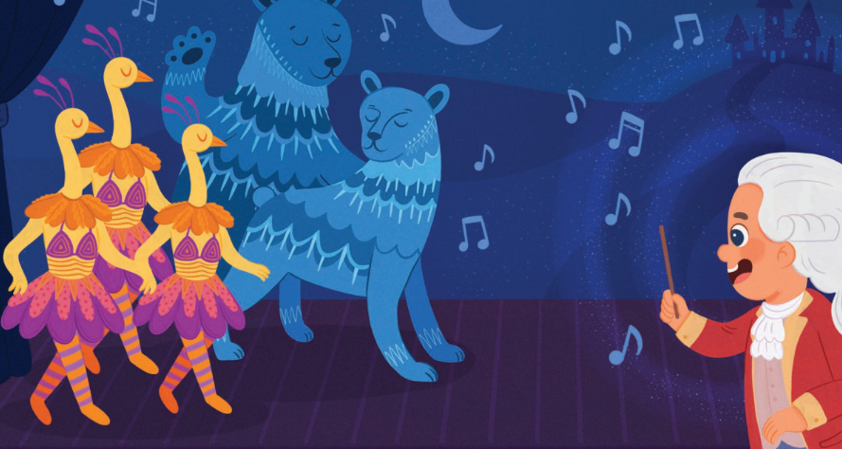
LARGO MEANS
VERY SLOW
In Vienna, Mozart showed Jake and Lucca giant dancing bears
moving under the moonlight.
When bears take huge, heavy steps, the music slows way down.
Largo gives every note plenty of room to ring out.

Slide 6
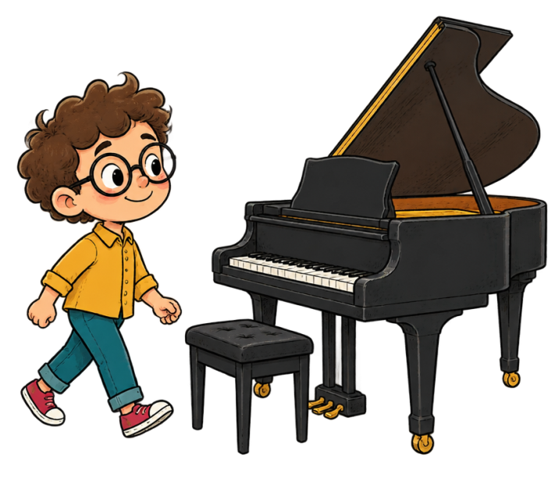
WALKING AT MODERATO
When Jake walks over to the shiny piano, he takes steady, regular steps. Not rushing, and not crawling.
This middle speed is moderato. You can clap along easily with your hands like counting 1, 2, 3, 4!

Slide 7
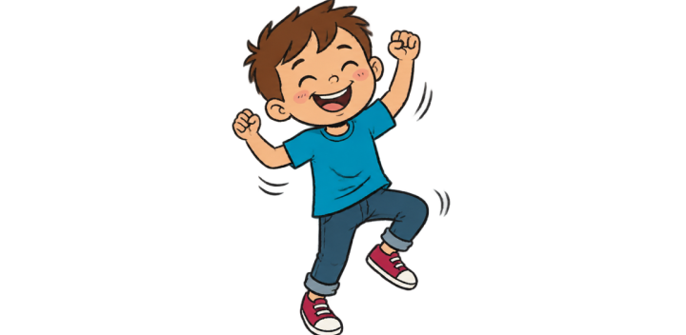
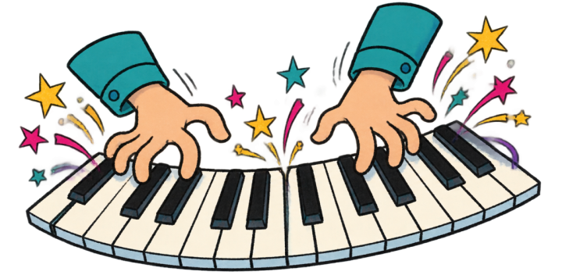
ALLEGRO: LIVELY & FAST
Lucca laughs and dances from head to toe! Allegro feels bright, bouncy, and happy.
PRESTO: SUPER FAST!
Mozart’s nimble fingers fly across the keys like a racing gust of wind! Presto zooms with energy.

Slide 8

LISTEN TO MOZART'S TEMPO
Listen to the audio and answer the questions
Jake and Mozart Talk Speed
▶ Play audio
1
What animal walks slow like largo?
2
Which tempo matches Lucca's cheerful dance?
3
What does presto mean in music?
4
Who plays the fast notes on the piano?

Slide 9
LISTEN TO MOZART'S TEMPO
✅
Check your answers below
Jake and Mozart Talk Speed
▶ Play audio
1
Elephants
2
Allegro
3
The fastest tempo
4
Mozart

Slide 10




1. LARGO
Very slow and steady like a crawl.
2. MODERATO
A calm, medium walking tempo.
3. ALLEGRO
Fast, joyful, and full of bounce.
4. PRESTO
Super fast like a lightning flash!

Slide 11
TEMPO CHALLENGE
Which Italian word means music played super fast?
1.
Presto
2.
Largo
3.
Moderato
4.
Piano

Slide 12
TEMPO CHALLENGE
✅
Which Italian word means music played super fast?
✓
1.
Presto
2.
Largo
3.
Moderato
4.
Piano

Slide 13
TEMPO CHALLENGE
Which Italian word means music played slow?
1.
Largo
2.
Moderato
3.
Allegro
4.
Piano

Slide 14
TEMPO CHALLENGE
✅
Which Italian word means music played slow?
✓
1.
Largo
2.
Moderato
3.
Allegro
4.
Piano

Slide 15
REMEMBER YOUR TEMPO AND HAVE FUN!
When you sing or play music, you can move slow like a turtle or fast like a bunny.
Try different tempos and listen to how the music changes.
Great musicians can play at many different speeds!

