Slide 1


Slide 2
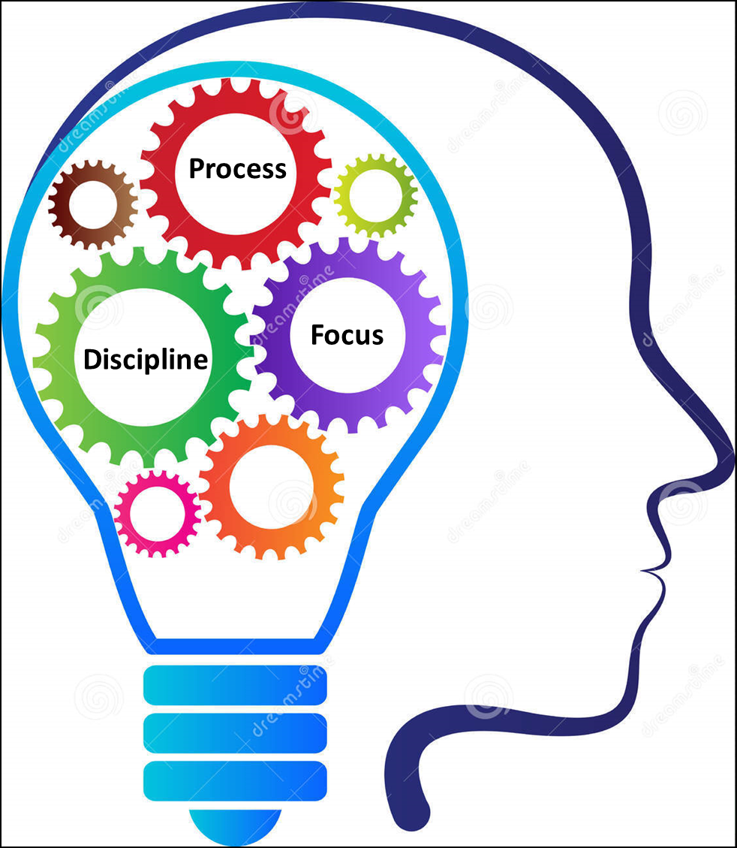


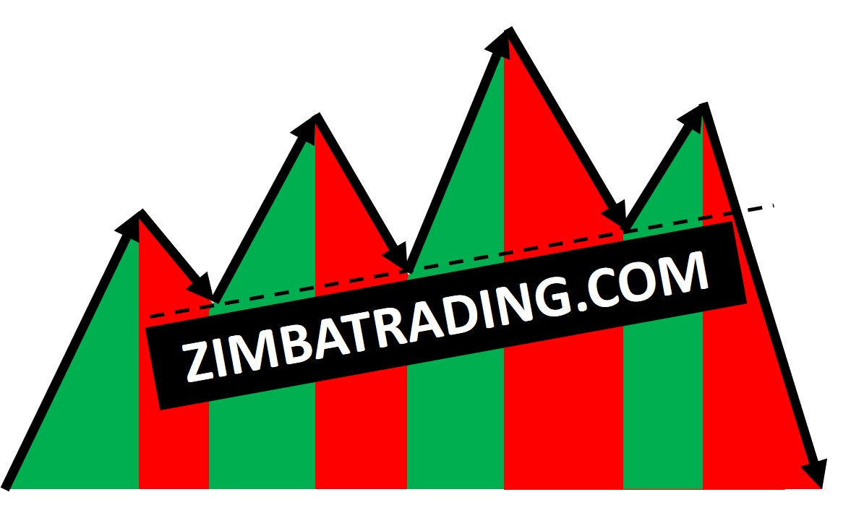

Slide 3
Three types of trend
Uptrend
Downtrend
Sideways
Two phases of trend
Impulse
Correction
What has to happened to change a trend from up to down or vice versa?
It has to reverse.
What’s an impulse?
Simply an up trend or down trend on a lower time frame
What’s a correction?
Simply an up trend or down trend on a lower time frame.
Where does an impulse begin or end? When does a correction end or begin?
At a reversal of the lower time frame trend
Where does a trend reversal take place?
At the higher time frame supply and demand zones.
5 Deliberate Things to Do to Improve Your Trading
Get Help – Coach
Avoid Other's Opinions on Trades
Practice
Mental Clarity, Everyday
Record Every Trade You Make - Journal

Slide 4
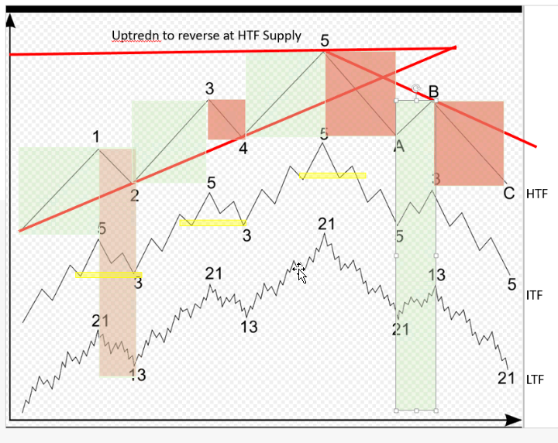
Uptrend to Reverse at HTF Supply

Slide 5
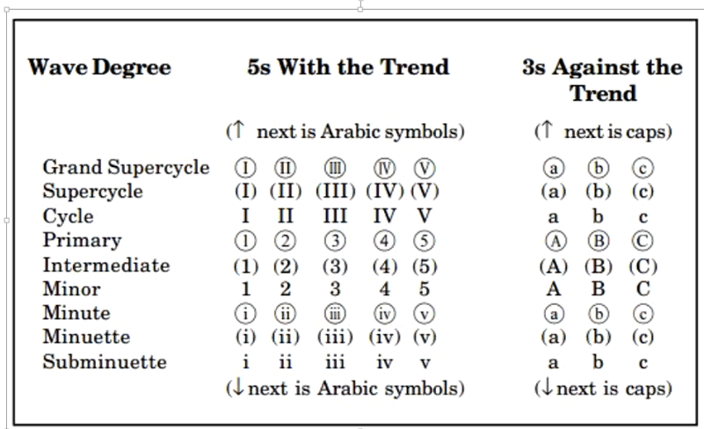
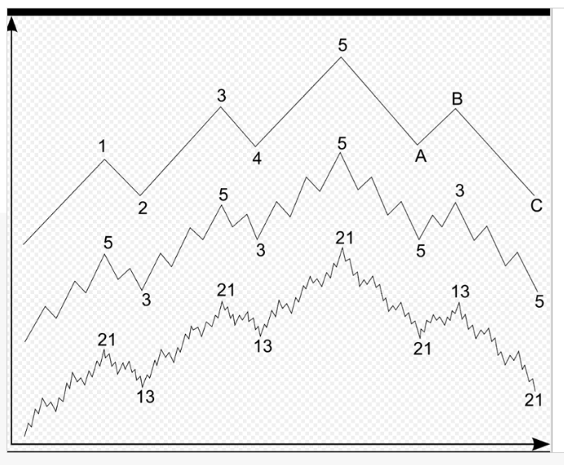

Slide 6
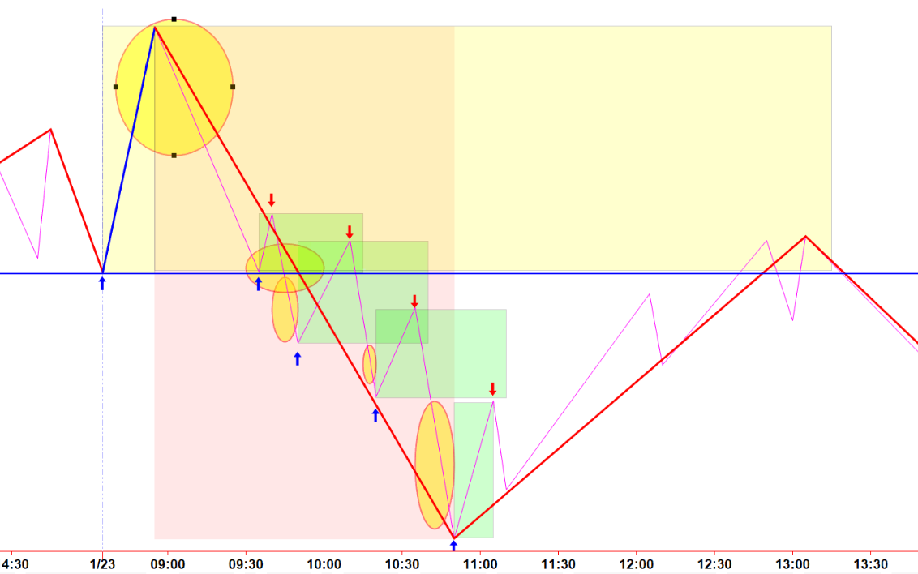

Slide 7
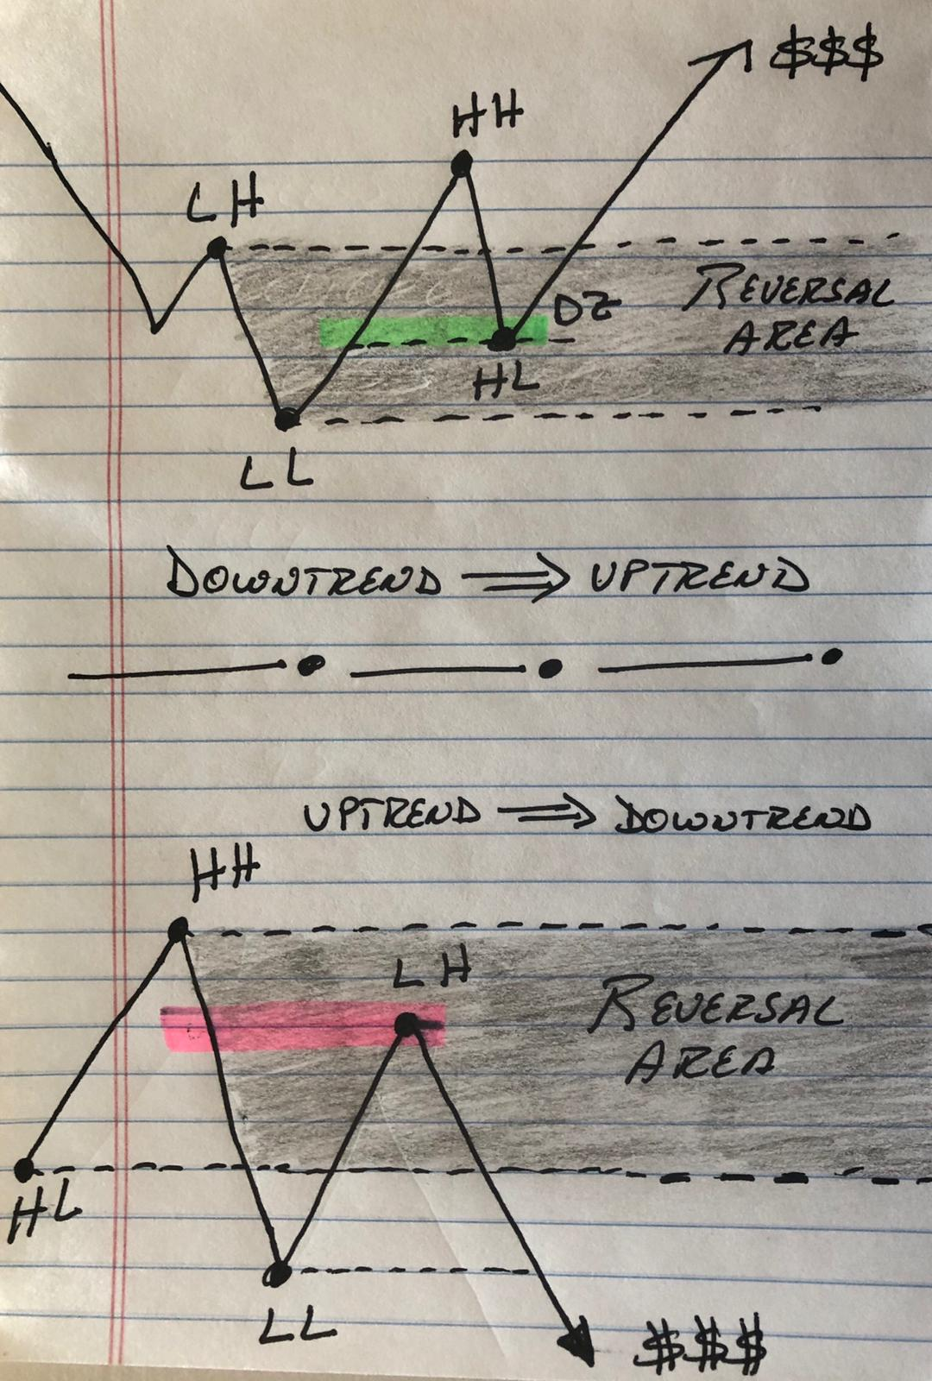

Slide 8
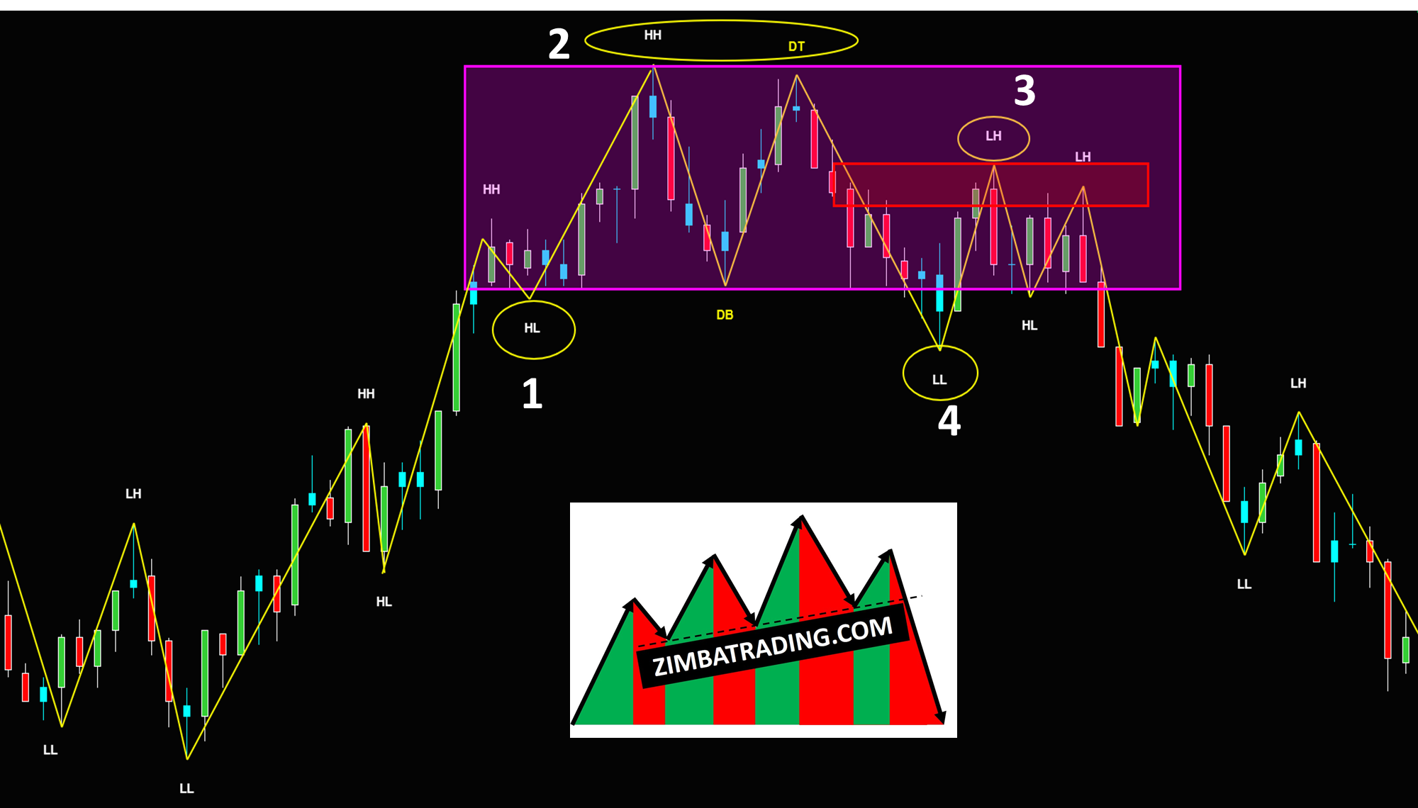

Slide 9
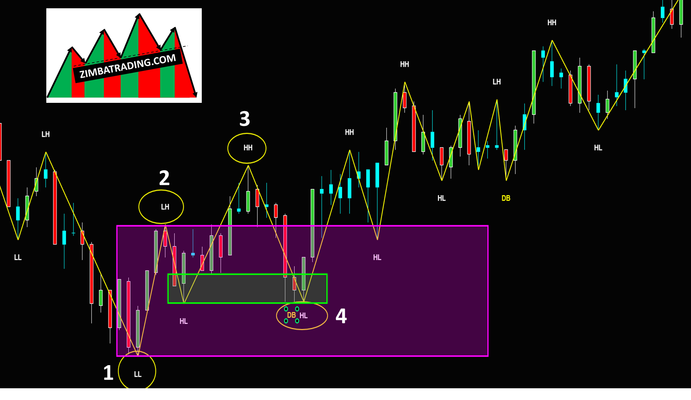

Slide 10
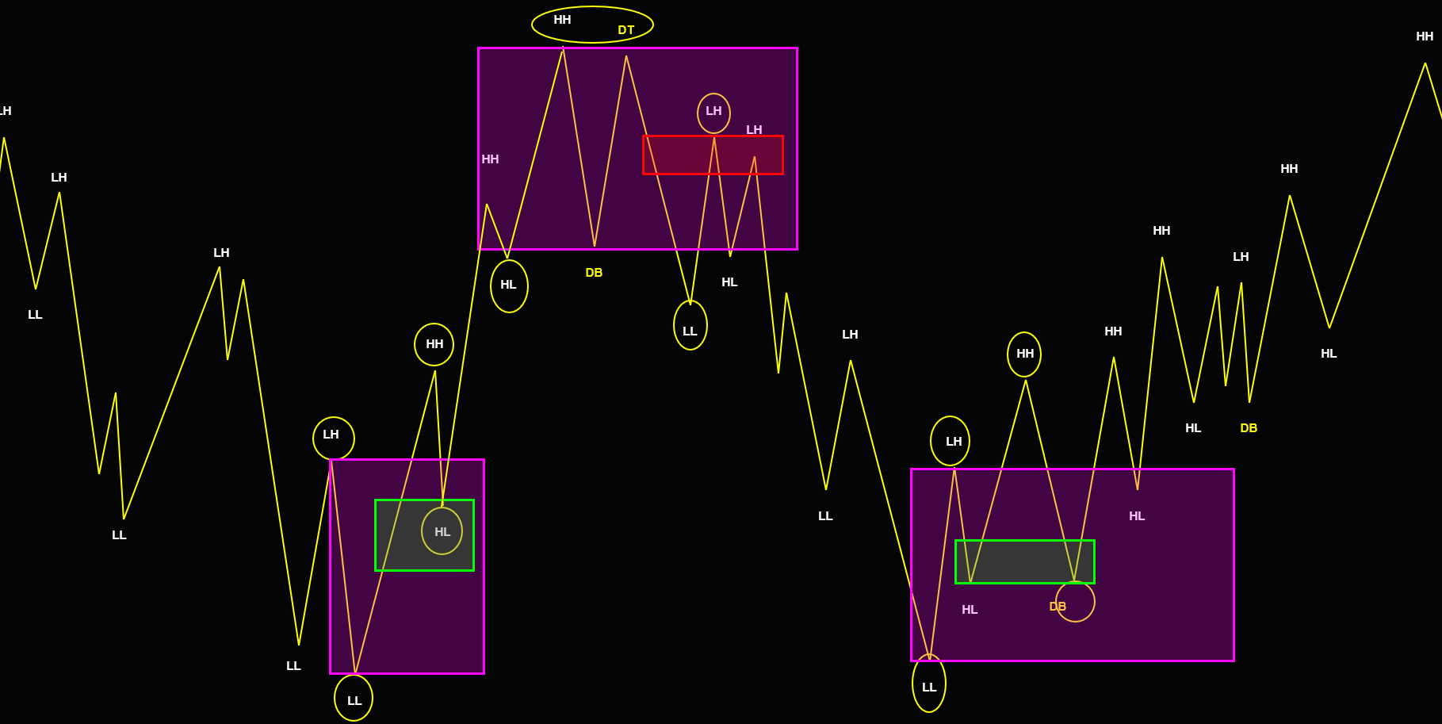

Slide 11
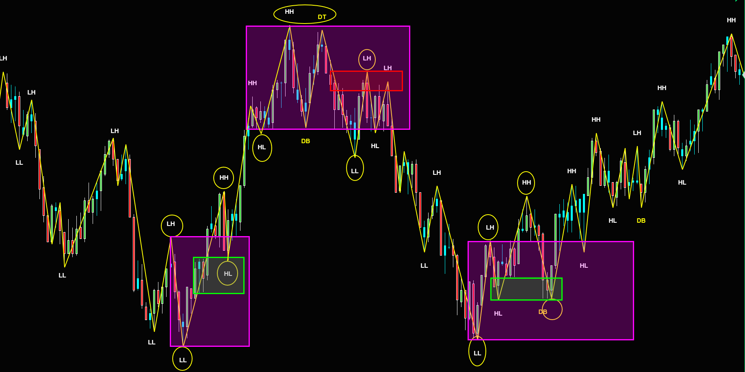

Slide 12
ES
REVERSAL AREA

Slide 13
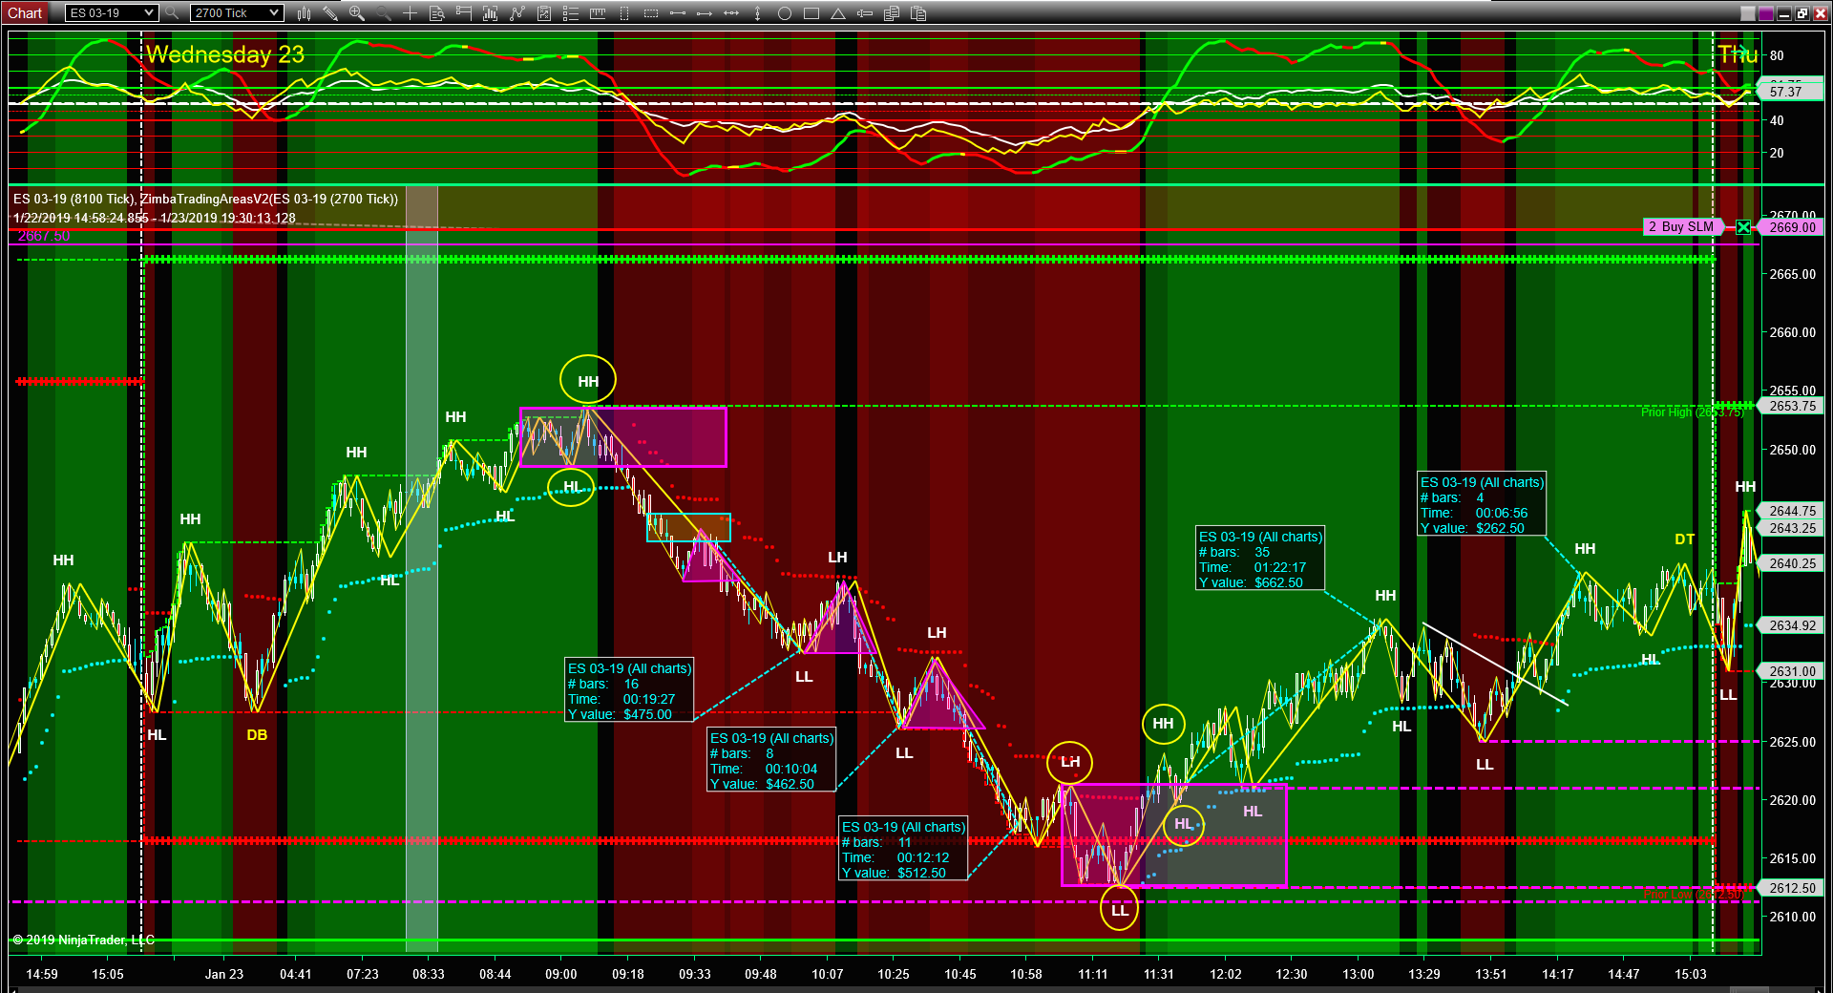

Slide 14
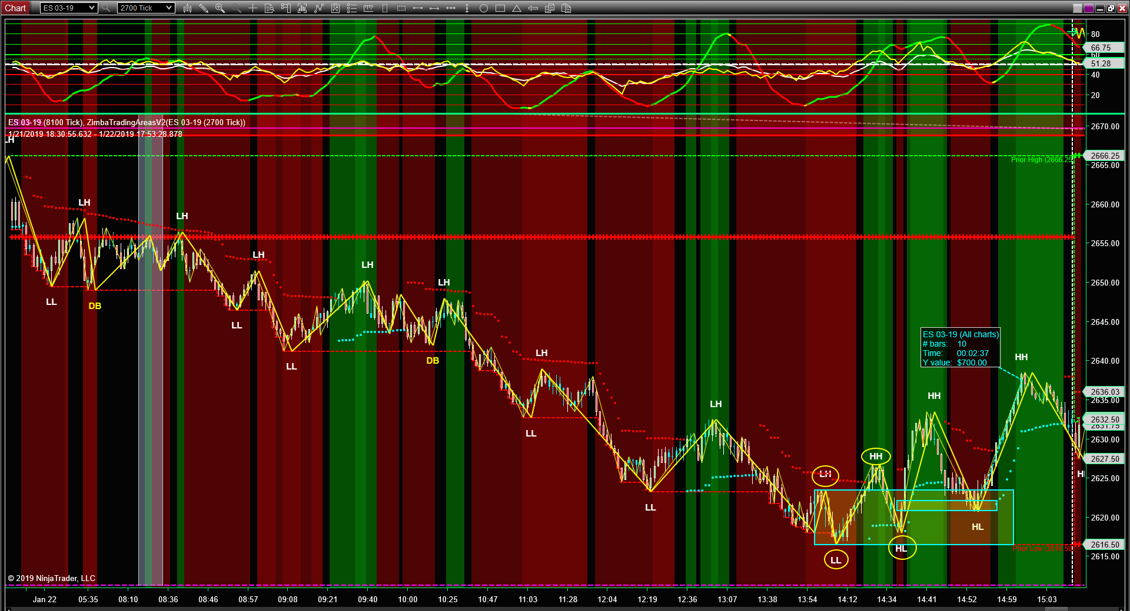

Slide 15
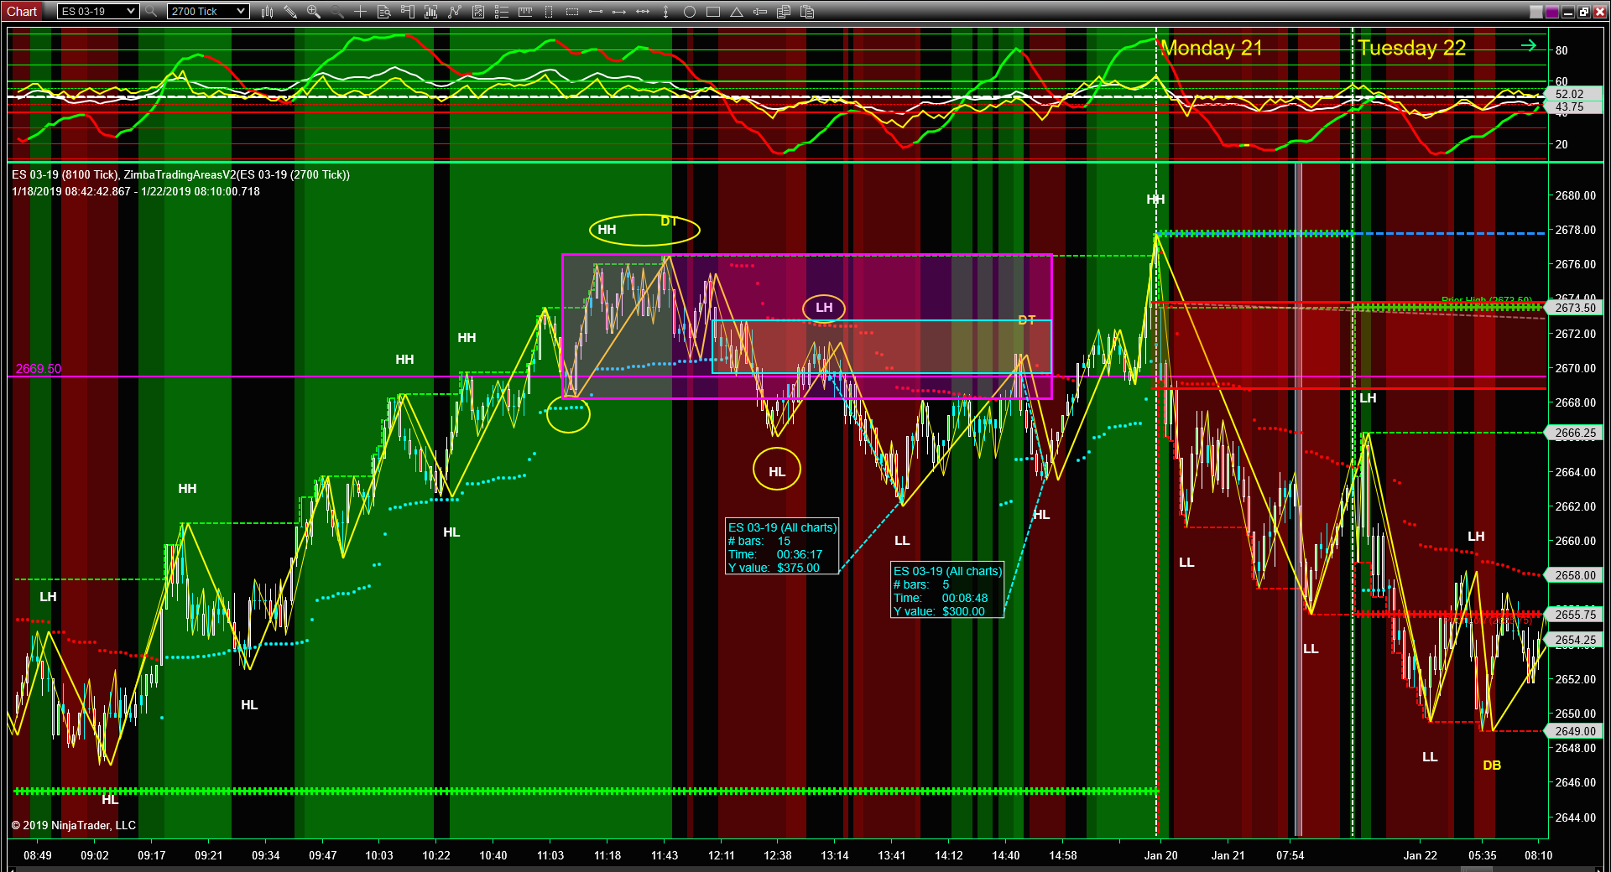

Slide 16
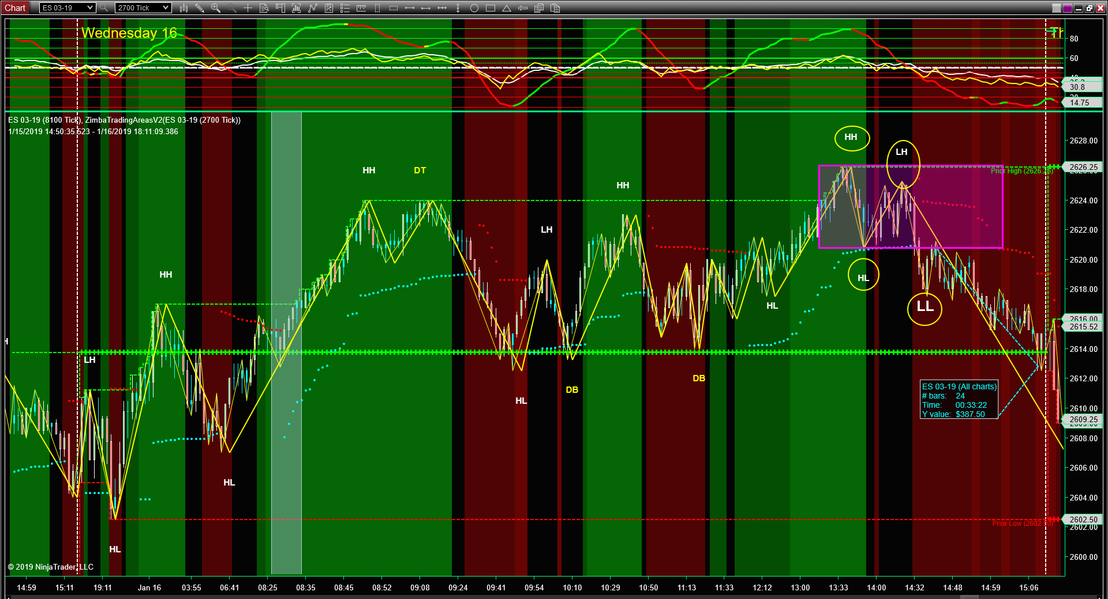

Slide 17
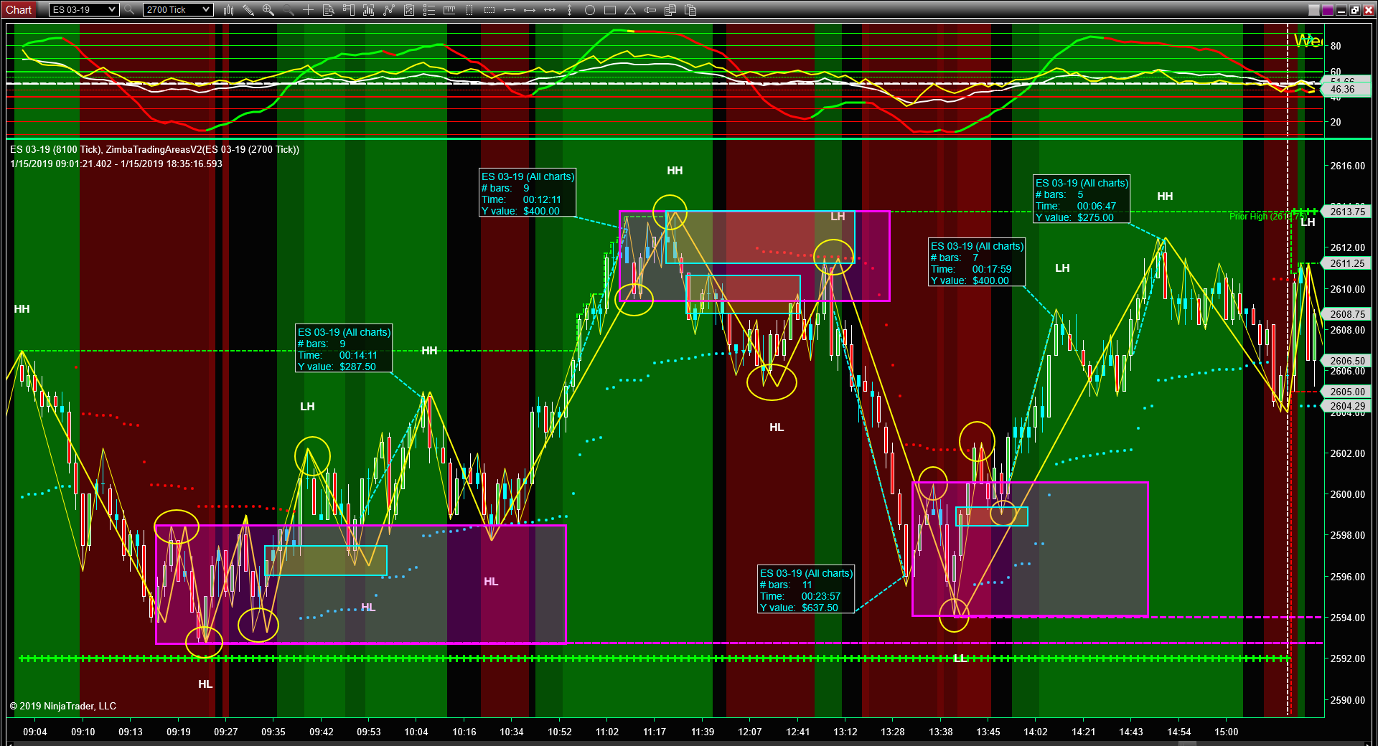

Slide 18
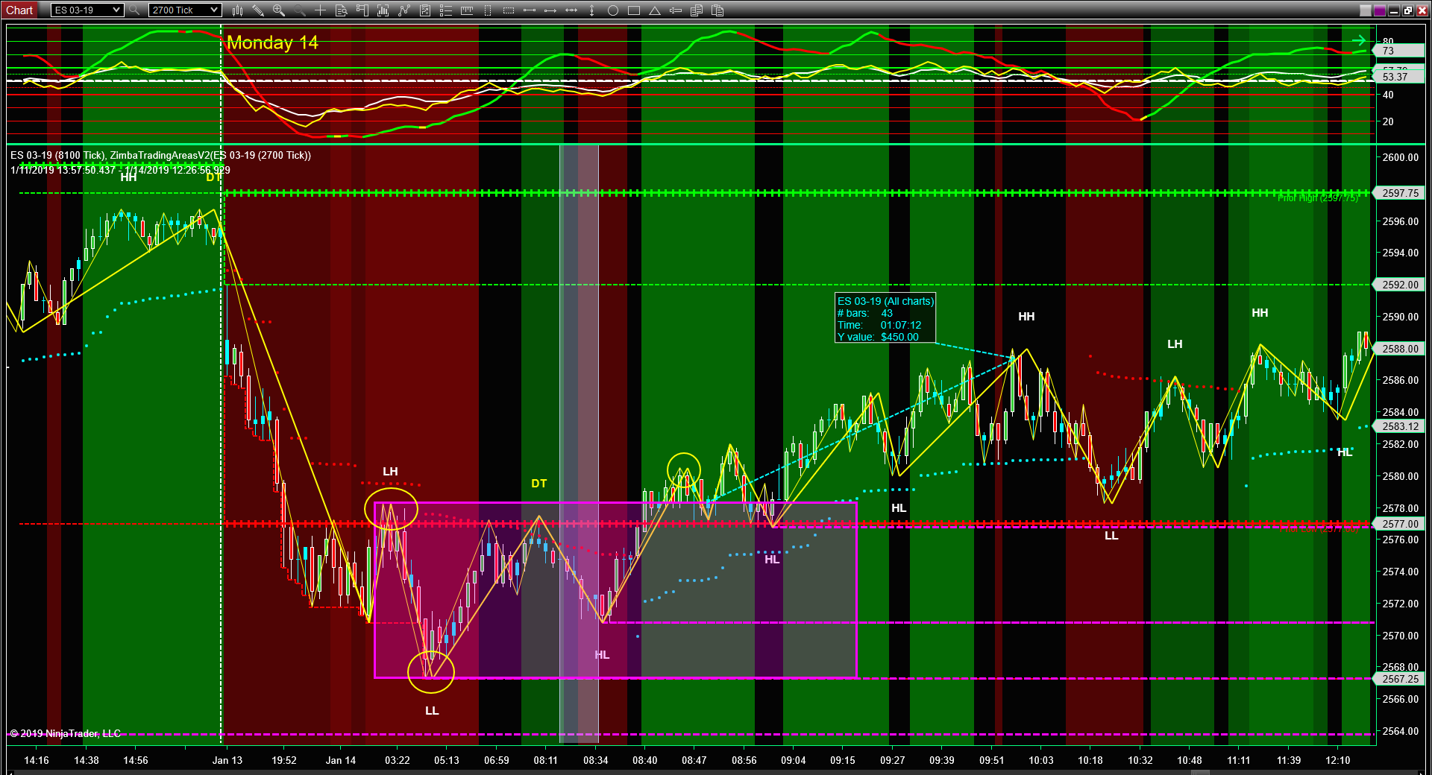

Slide 19
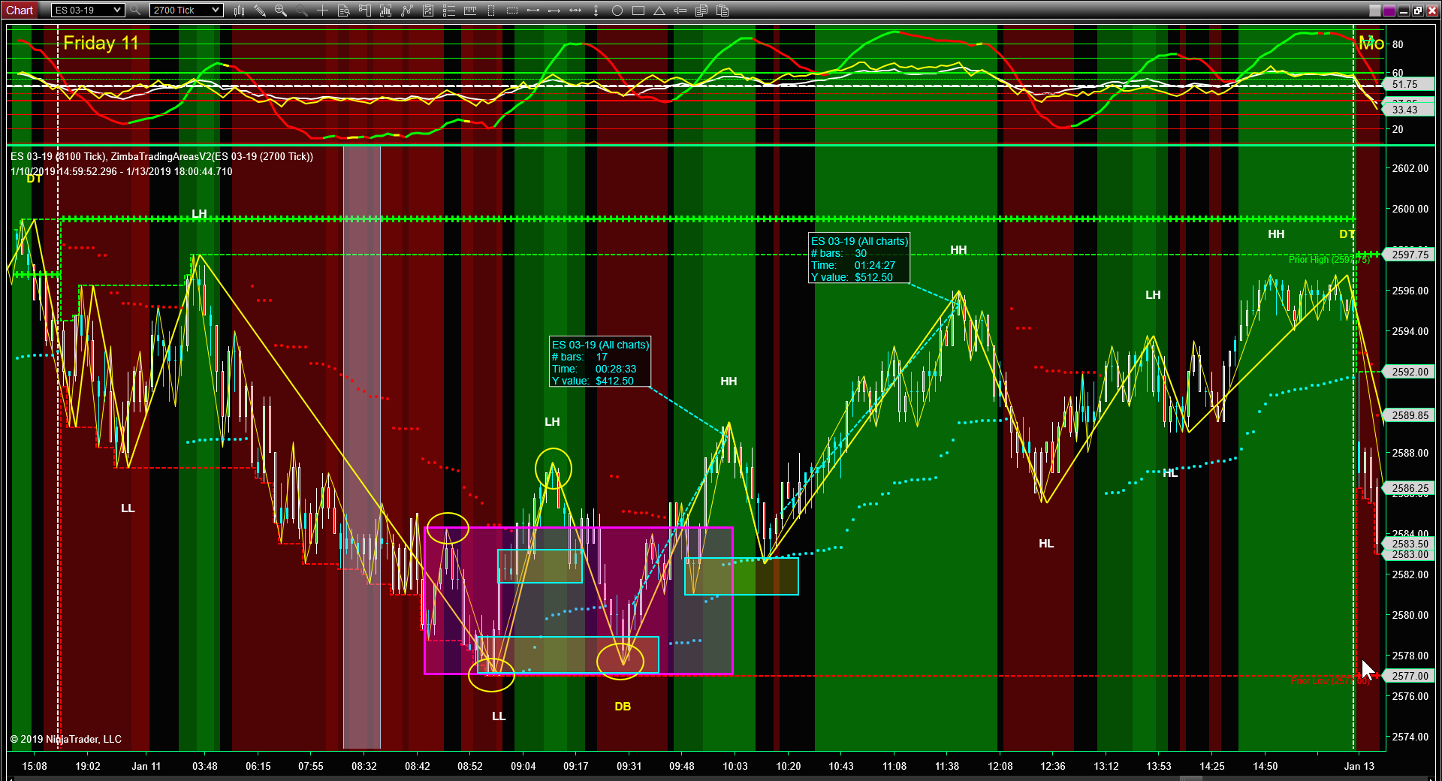

Slide 20
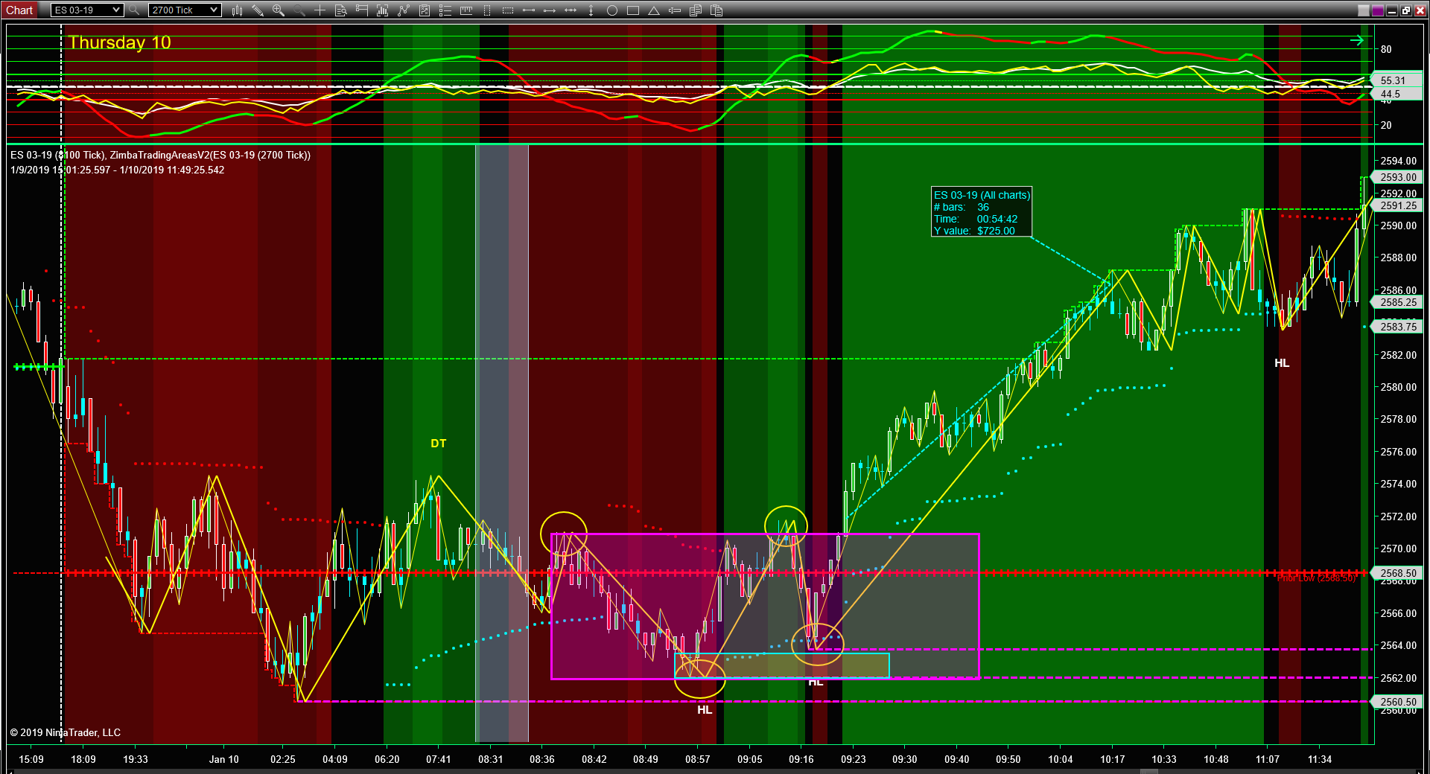

Slide 21
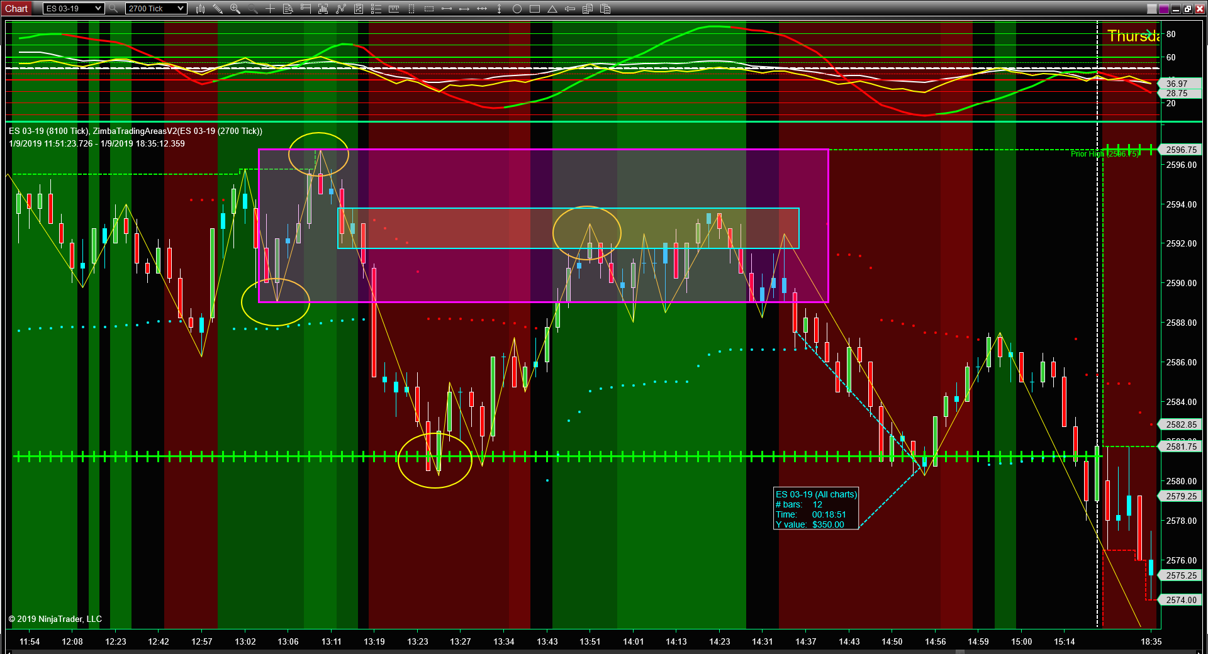

Slide 22
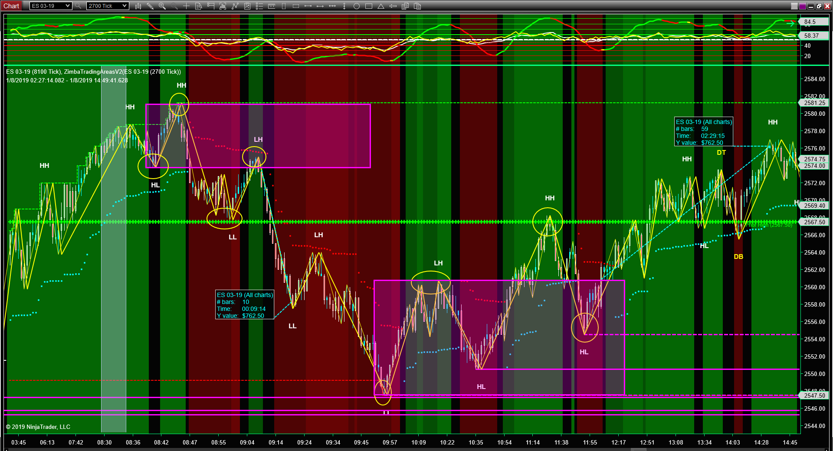

Slide 23
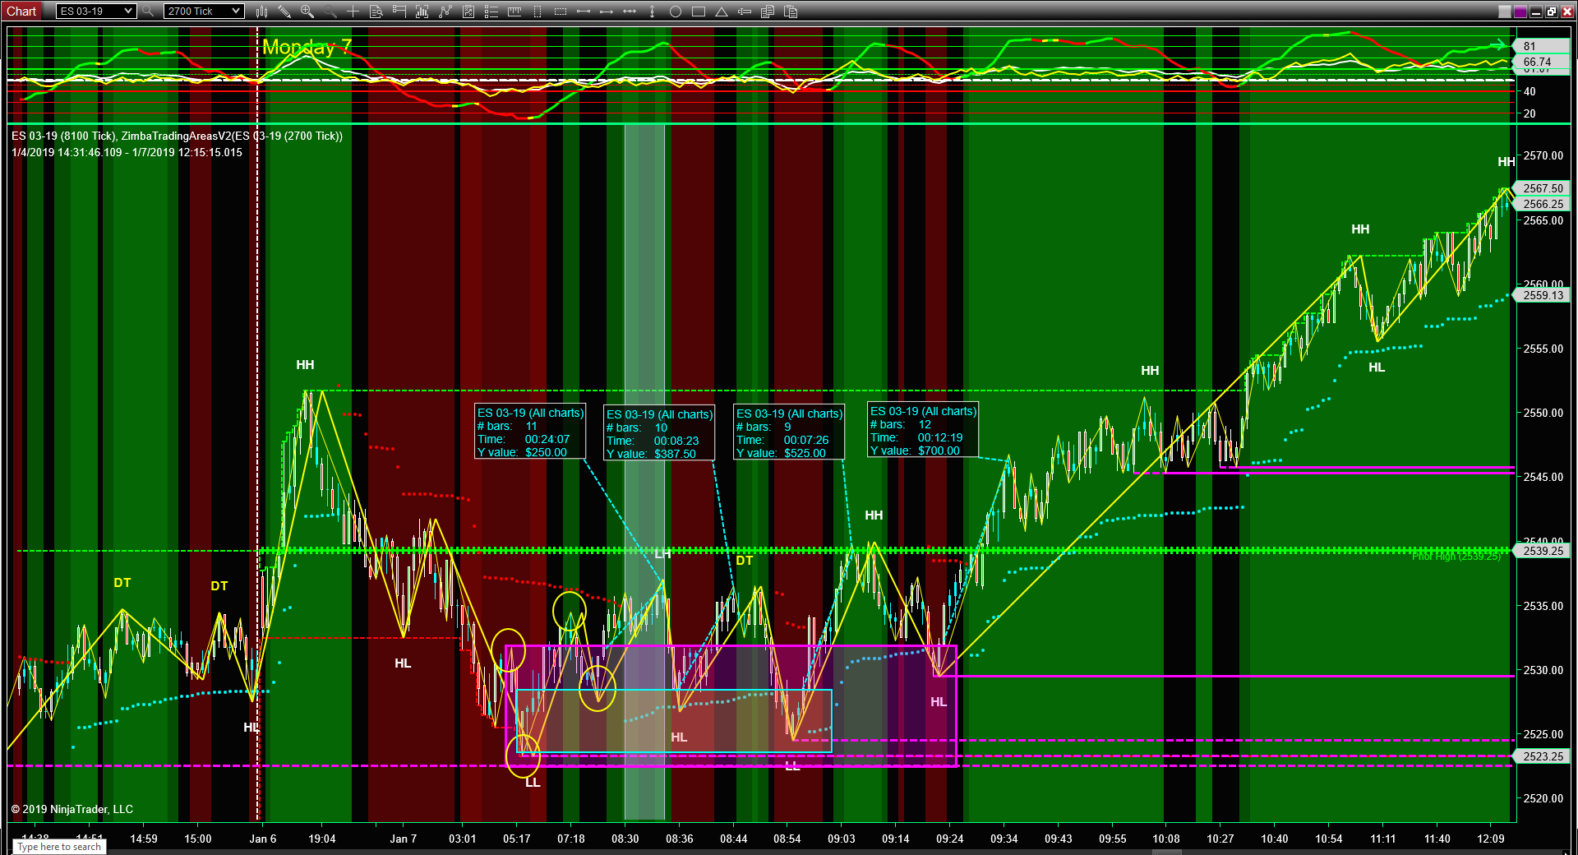

Slide 24
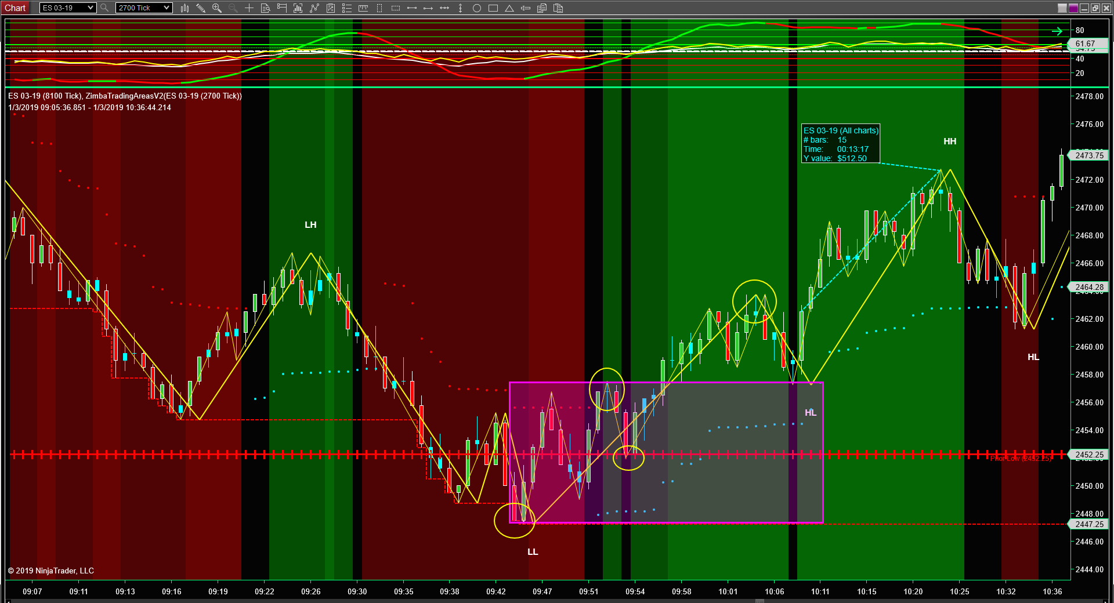

Slide 25
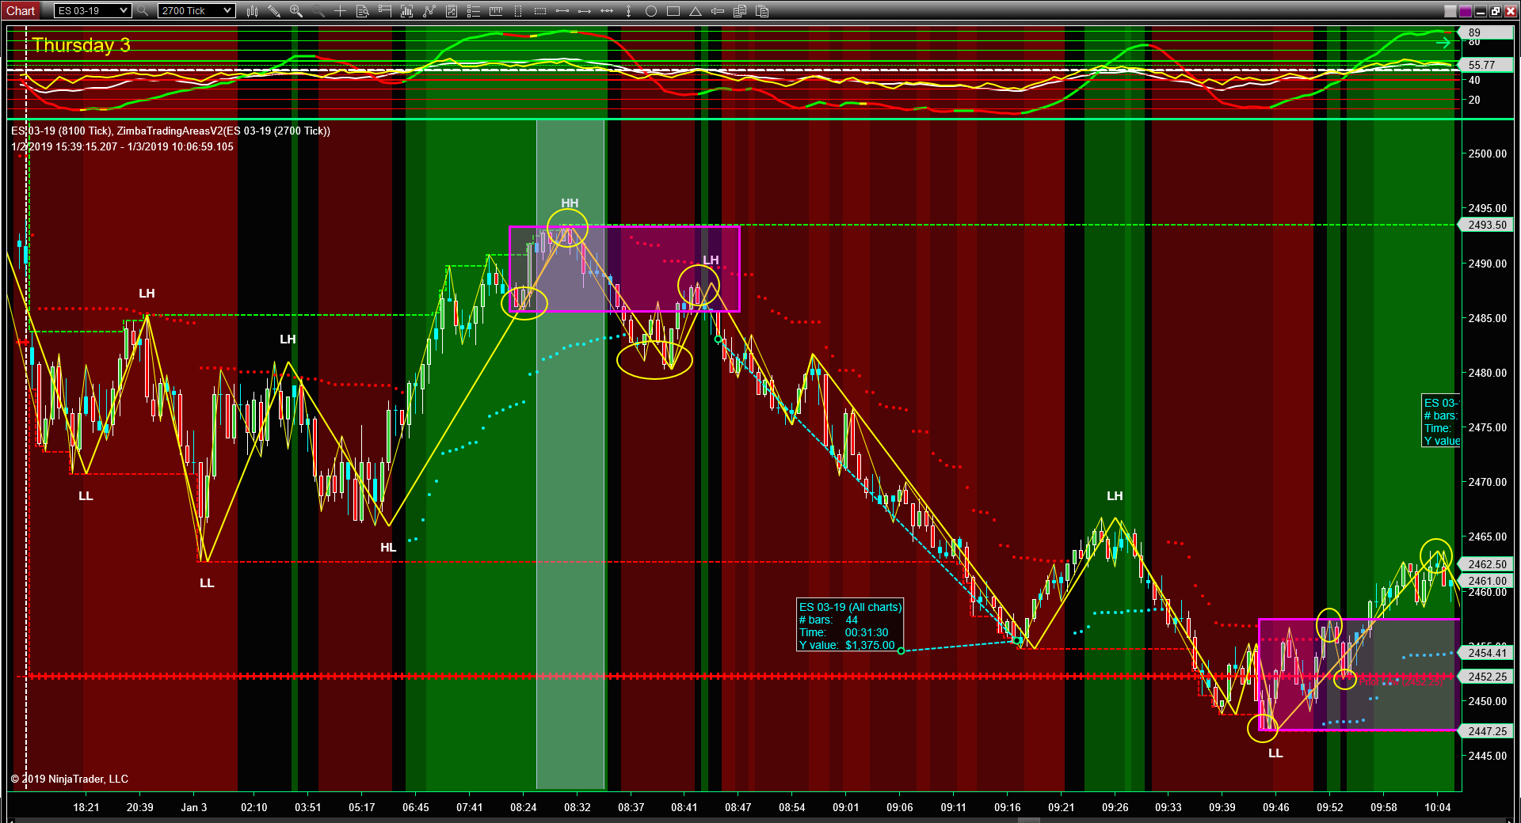

Slide 26
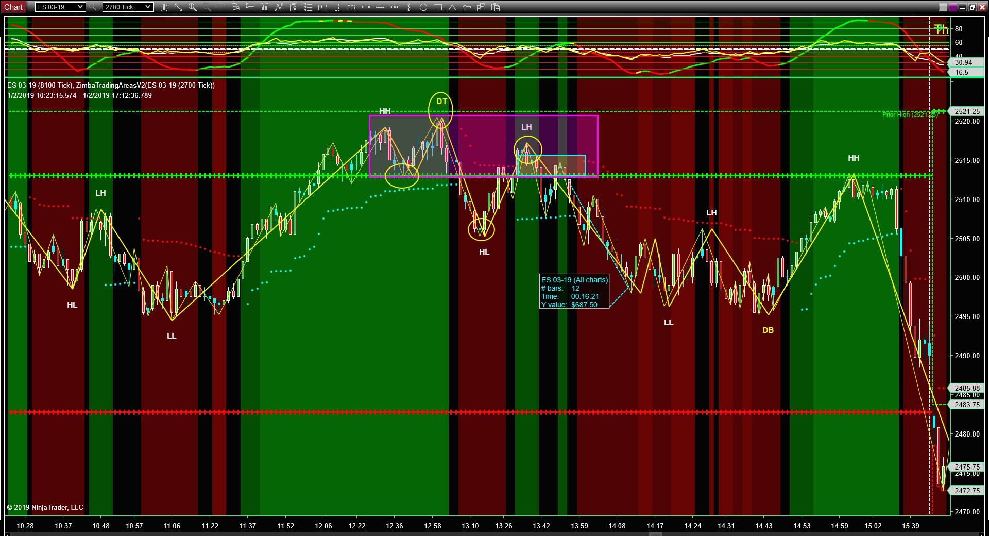

Slide 27
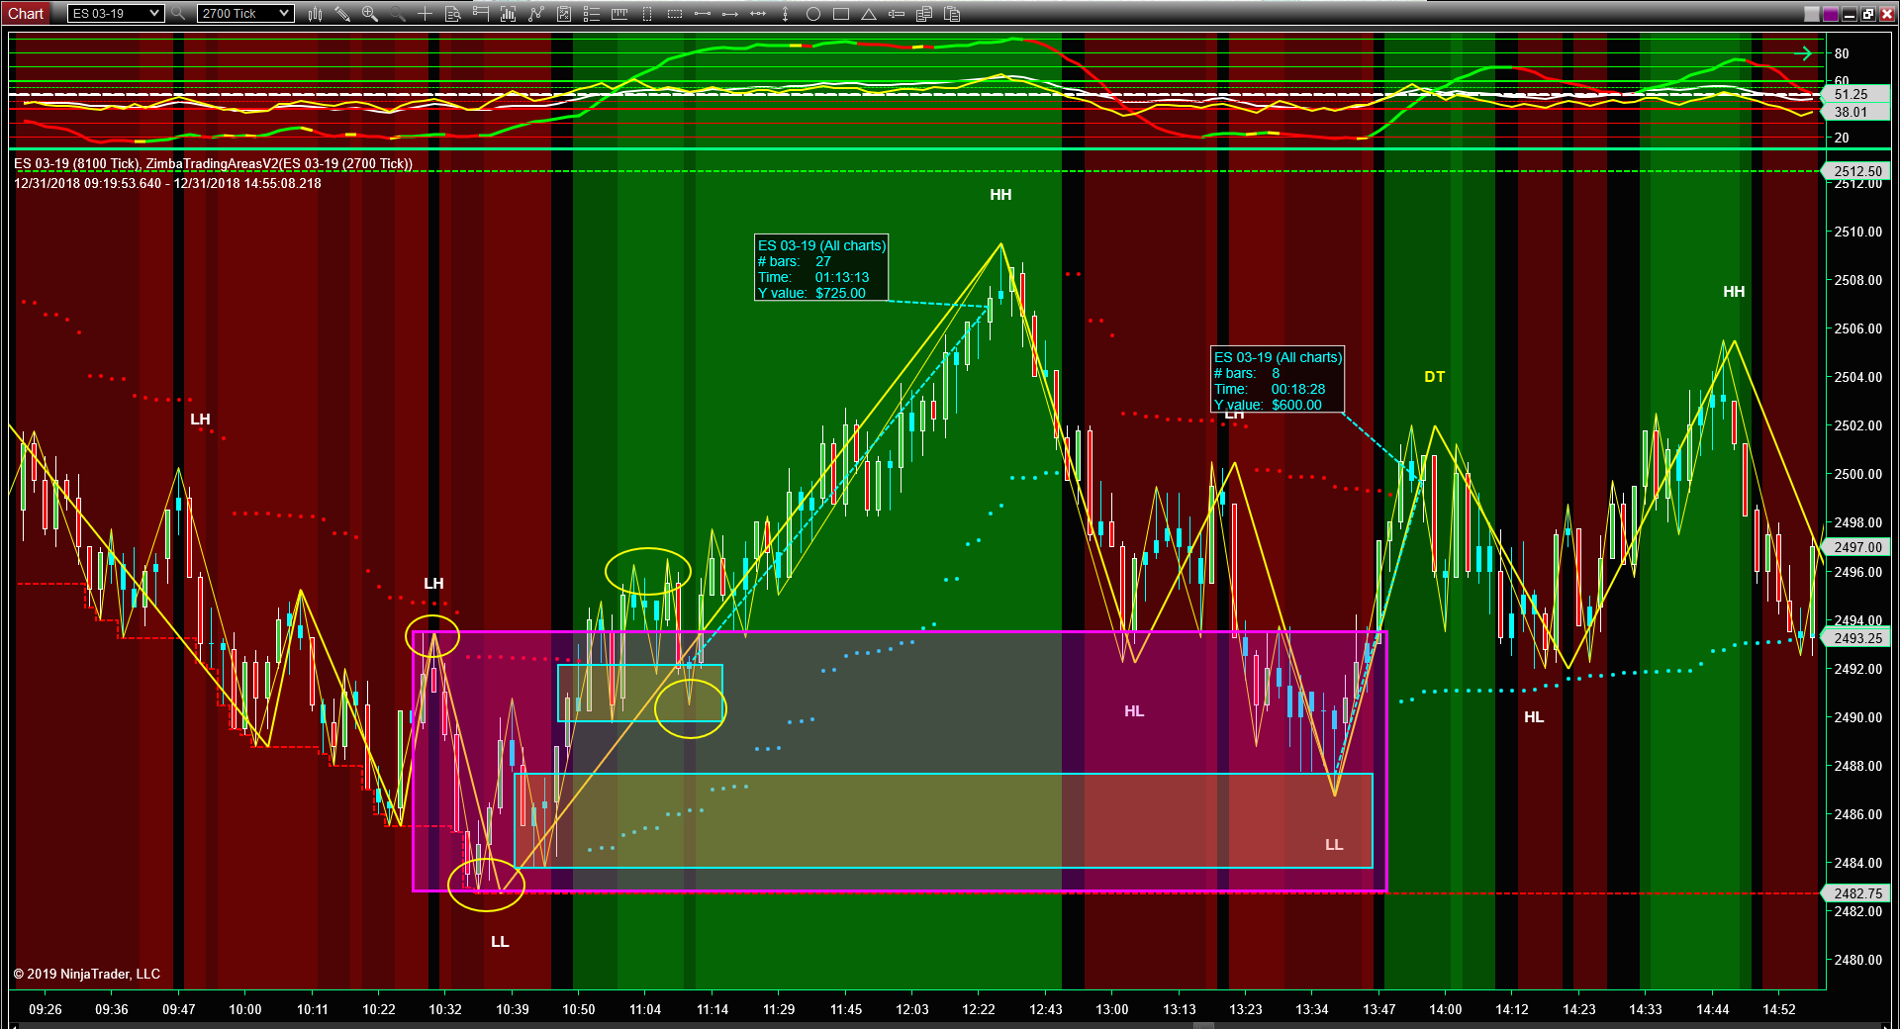

Slide 28
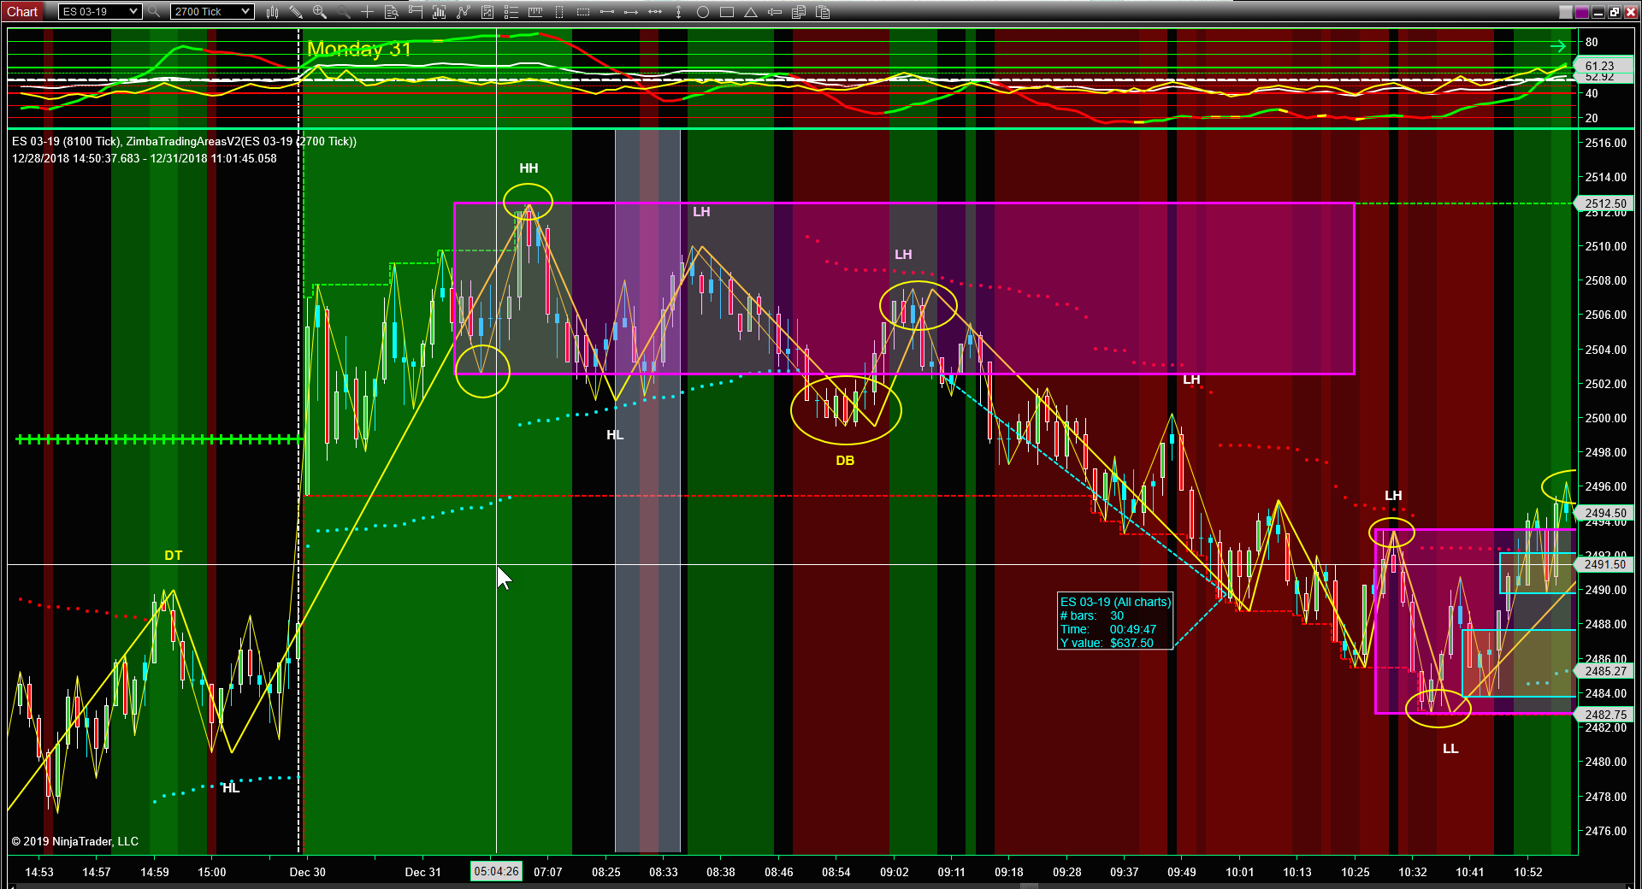

Slide 29
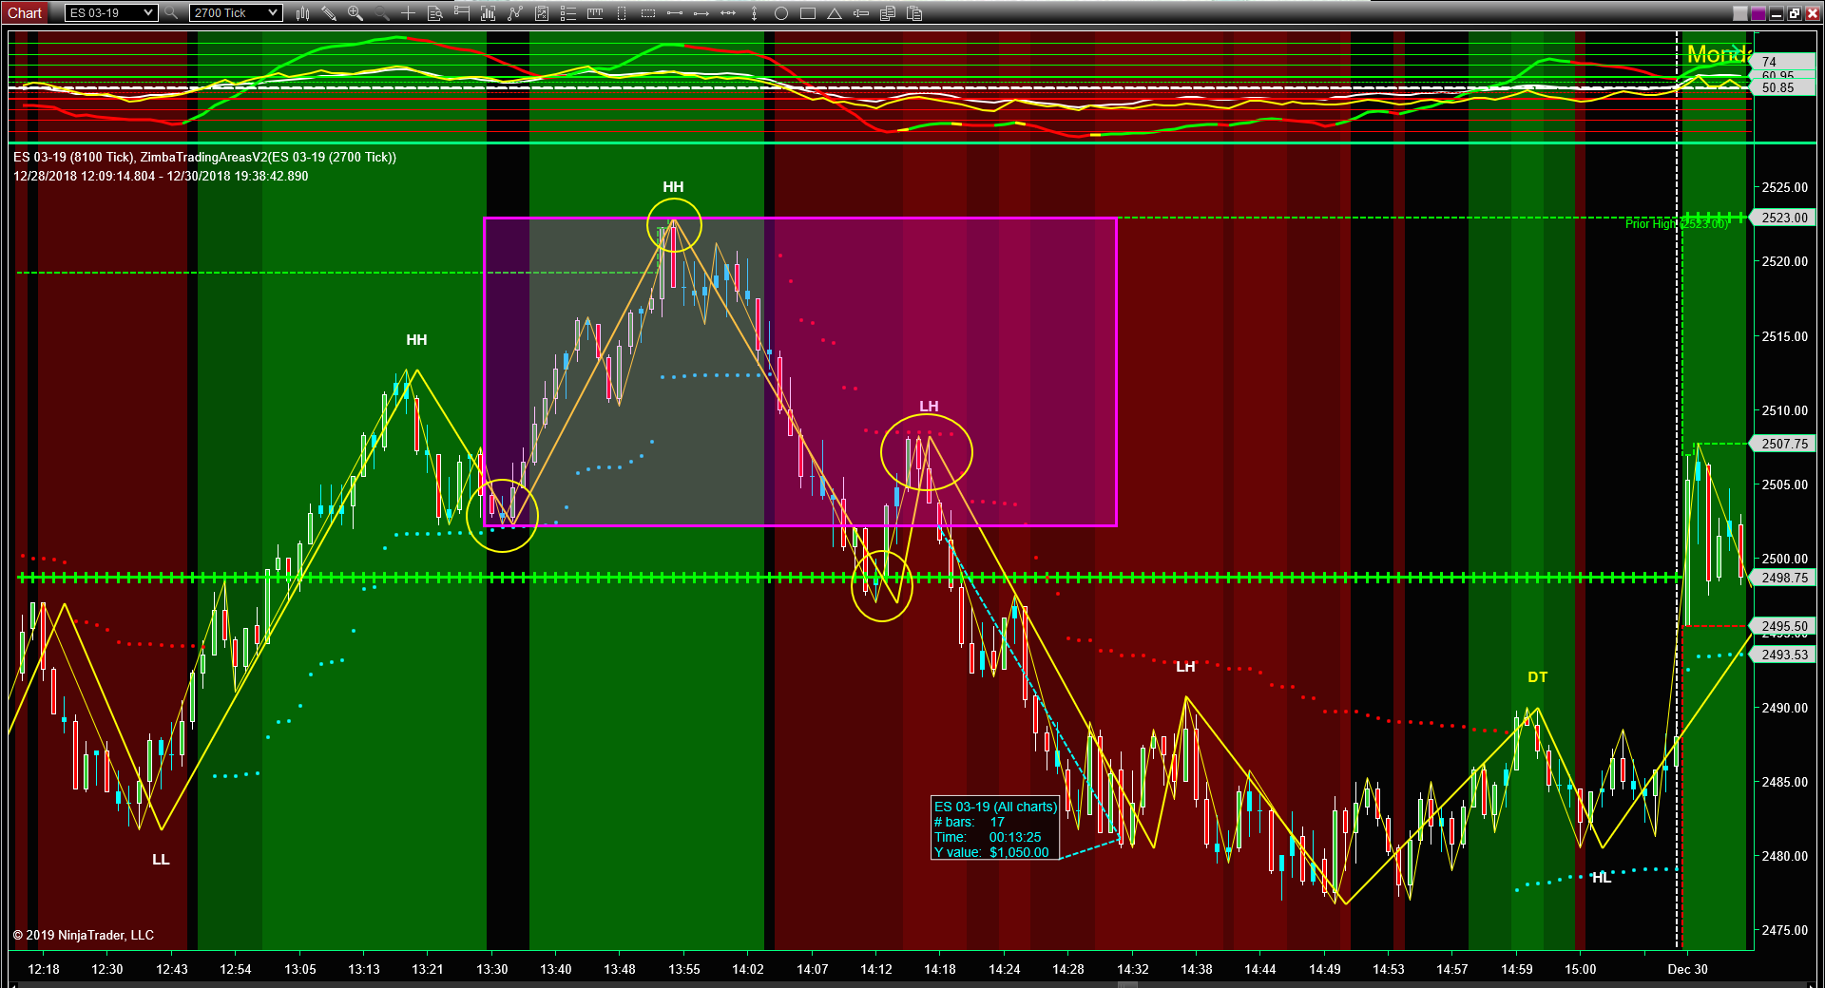

Slide 30
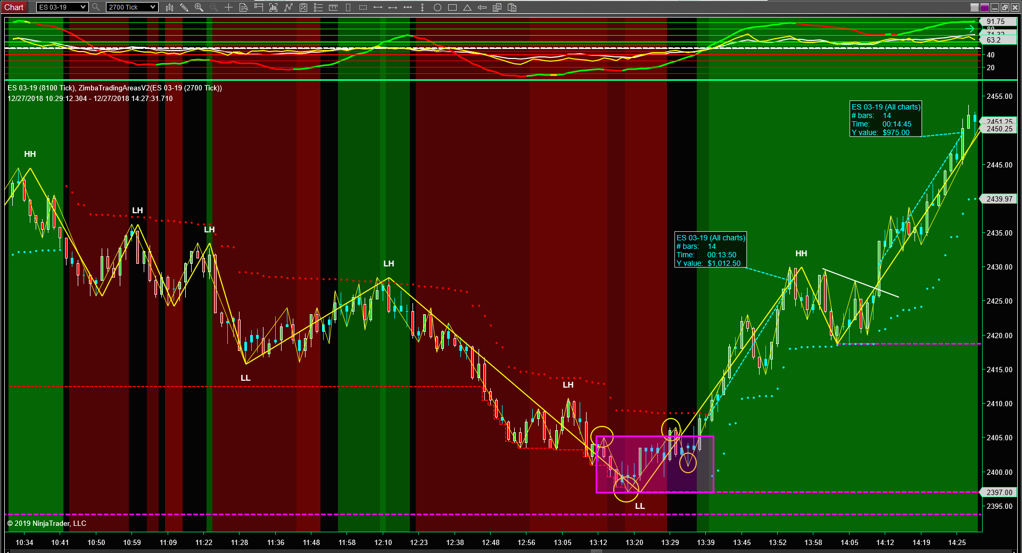

Slide 31
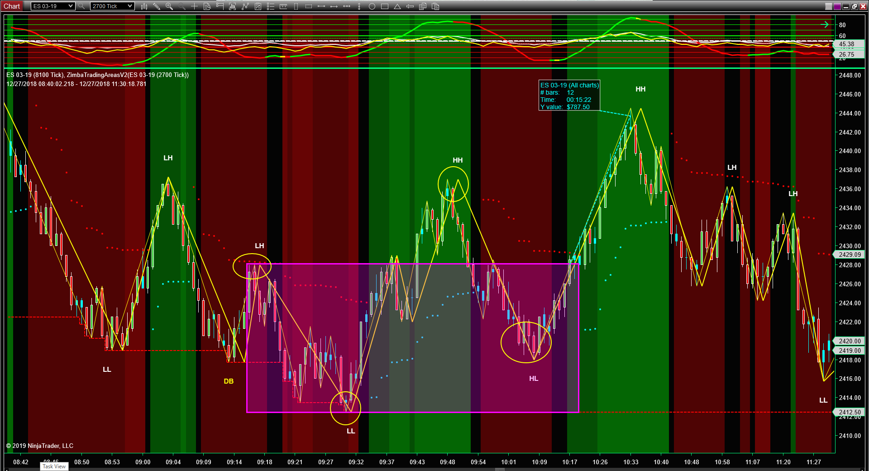

Slide 32
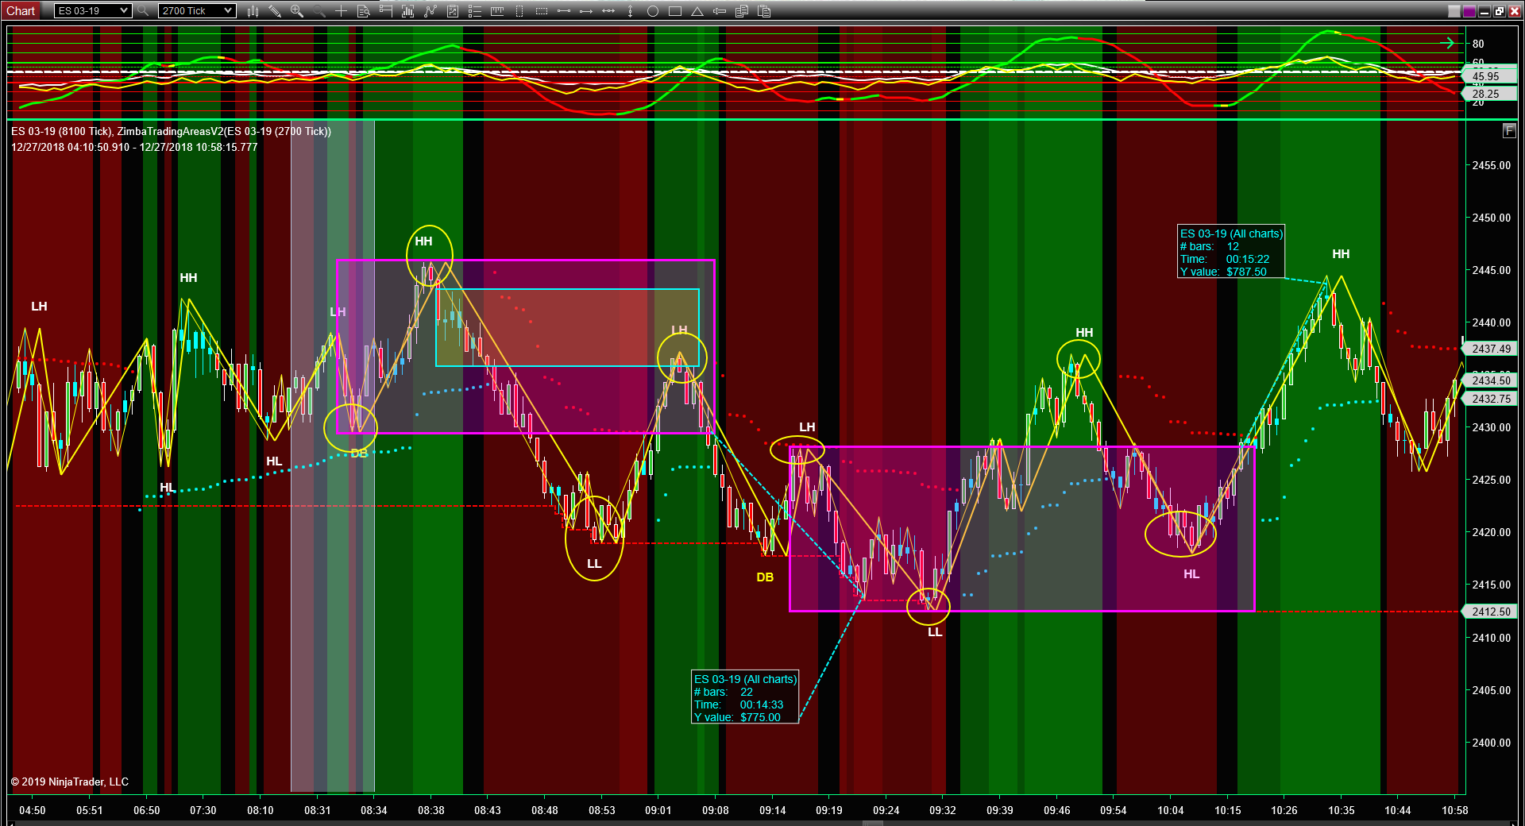

Slide 33
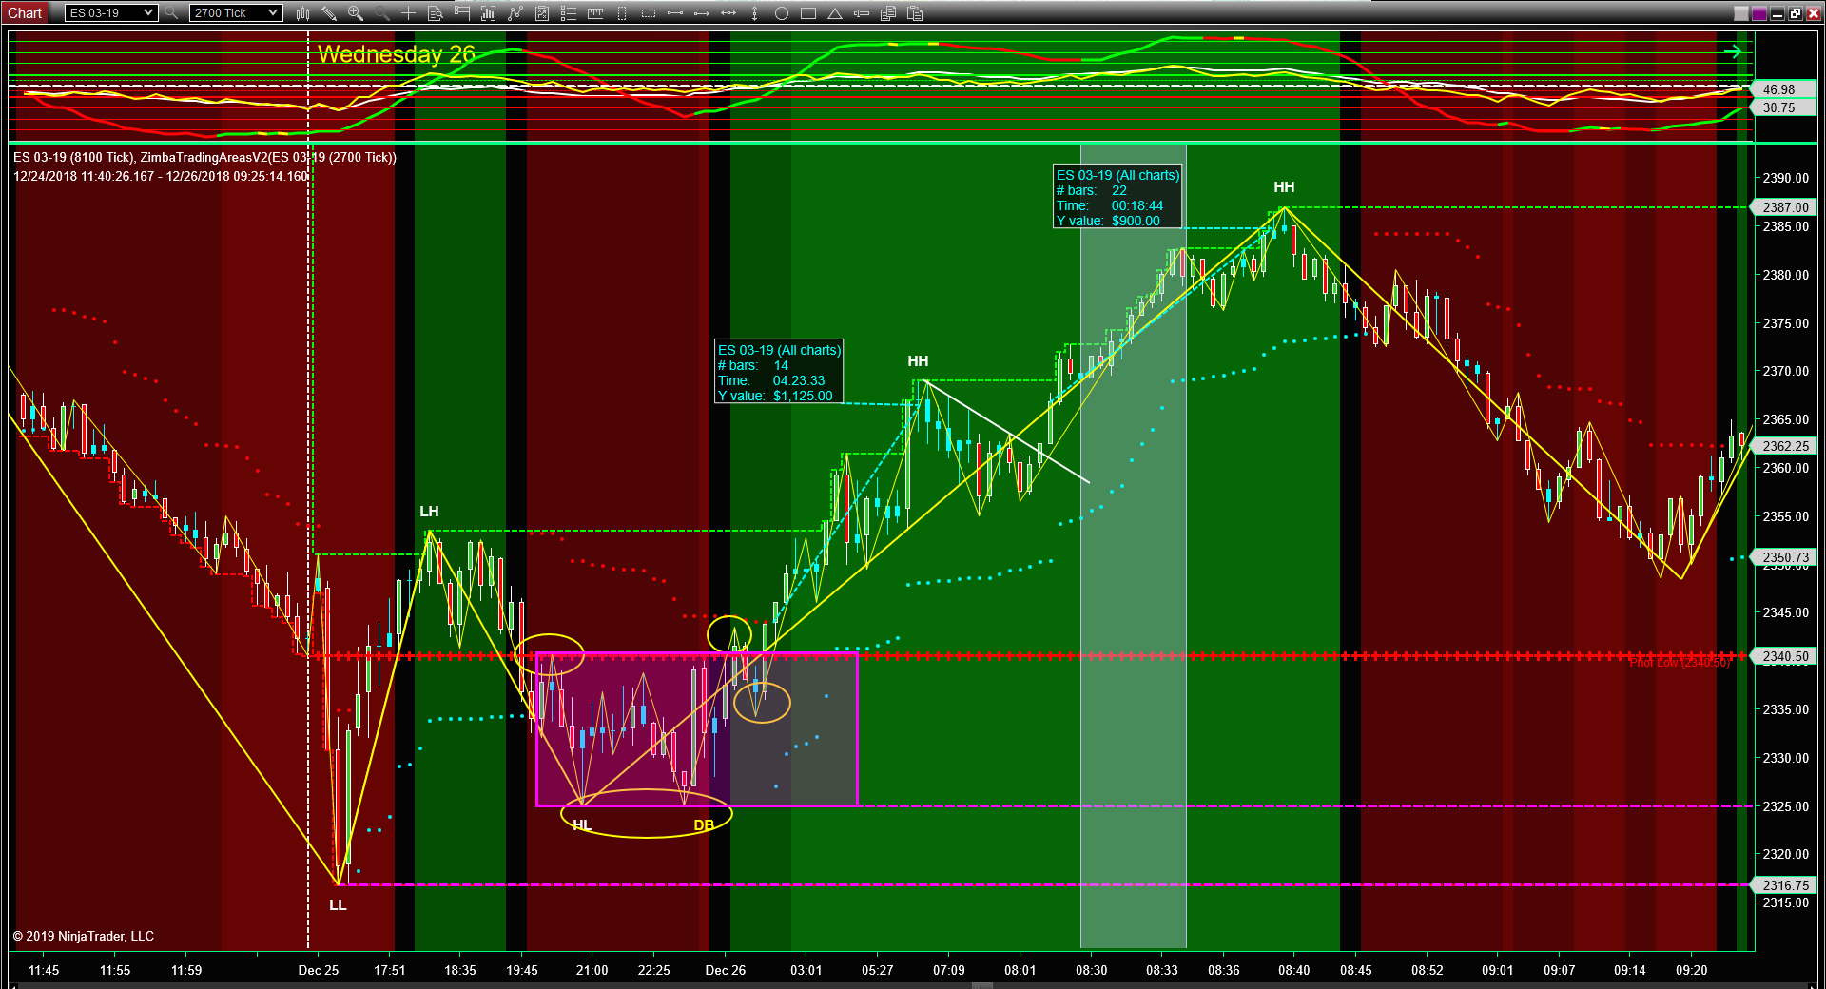

Slide 34
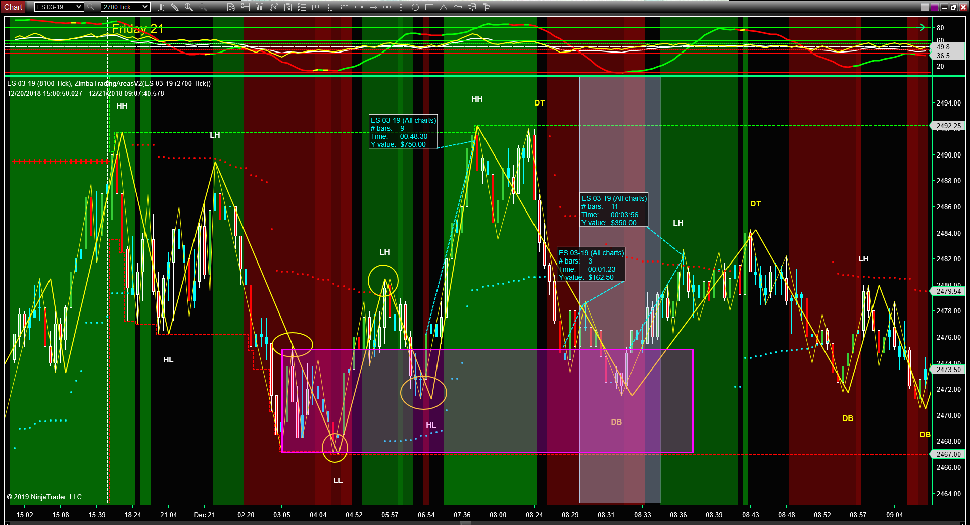

Slide 35
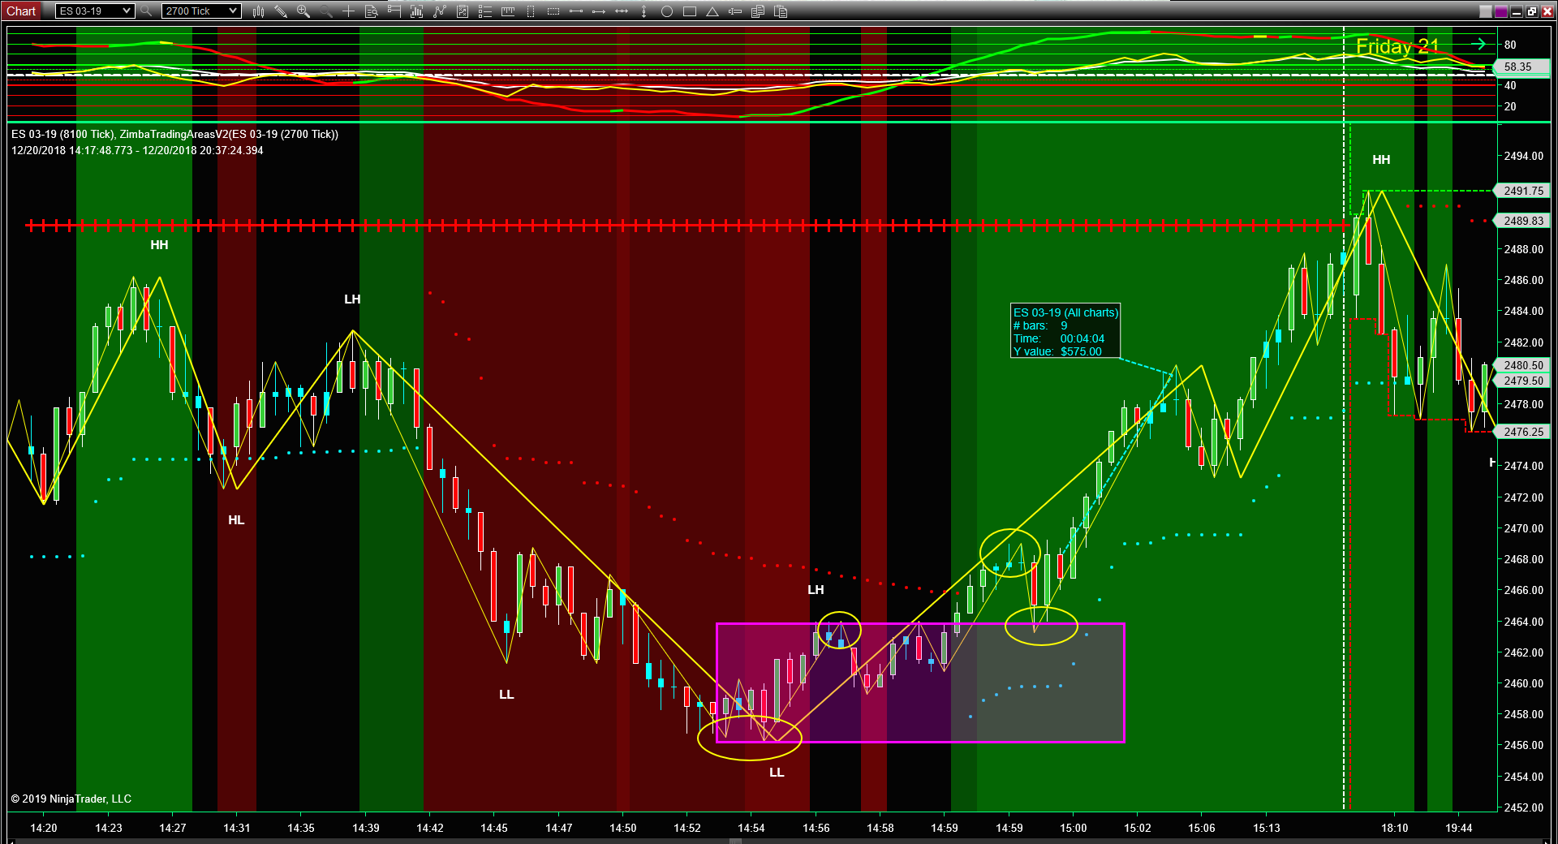

Slide 36
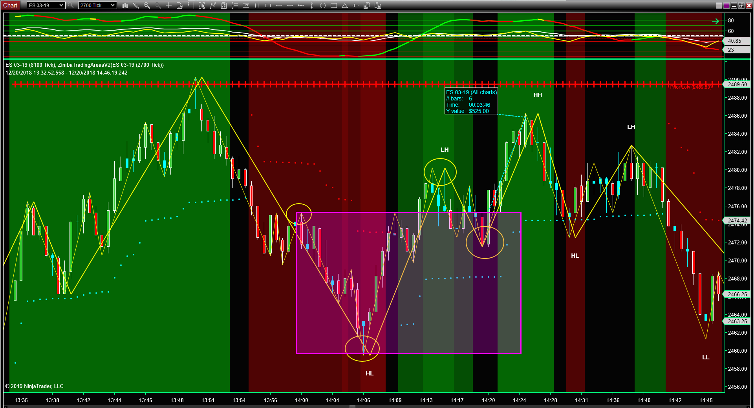

Slide 37
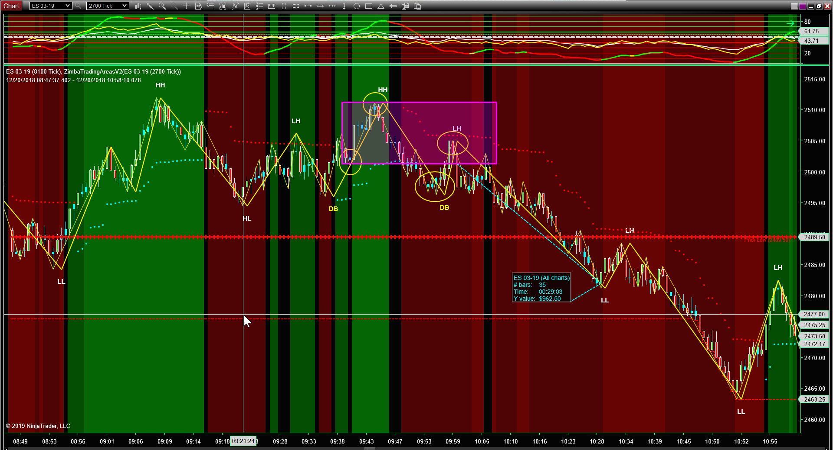

Slide 38
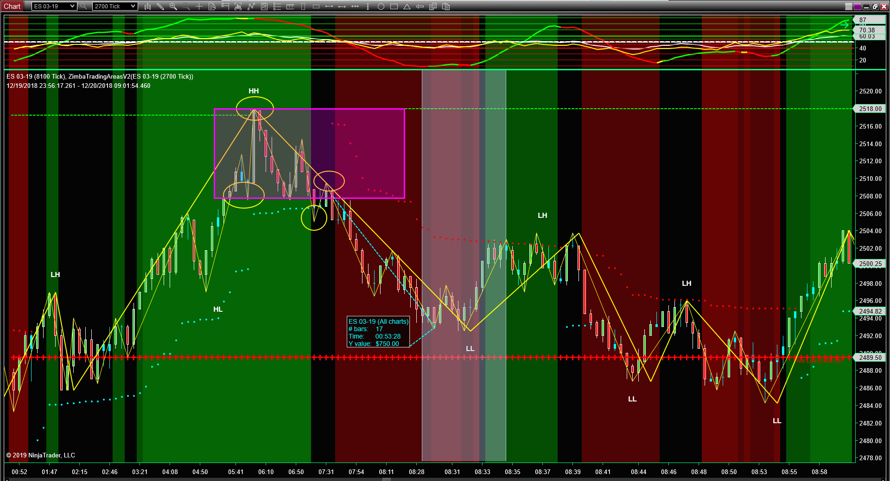

Slide 39
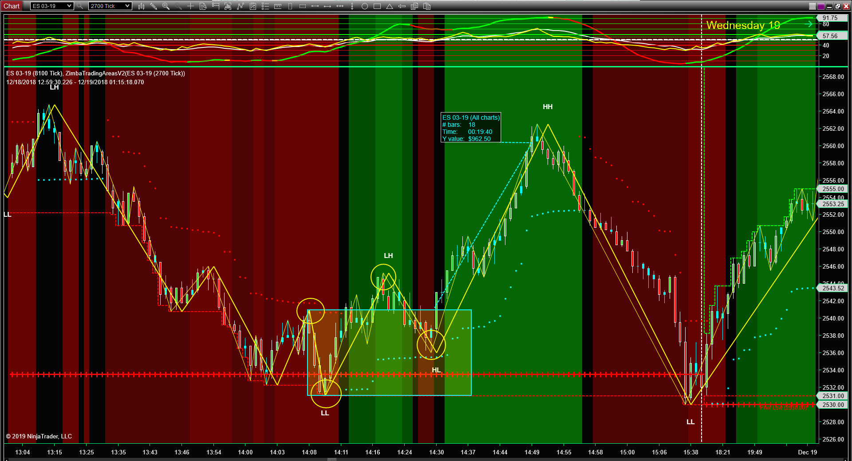

Slide 40
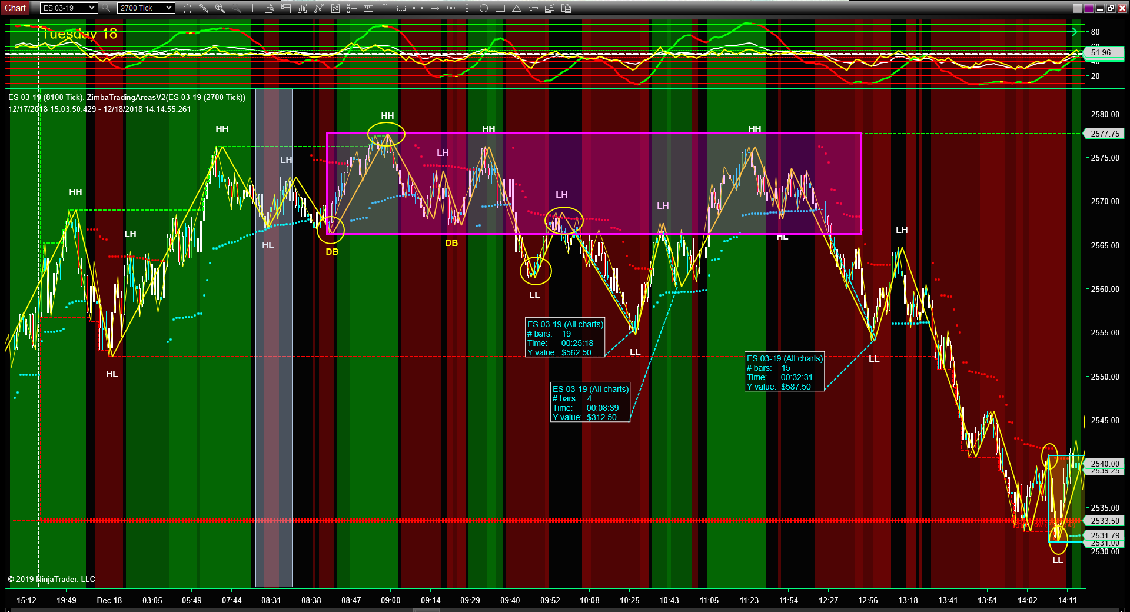

Slide 41
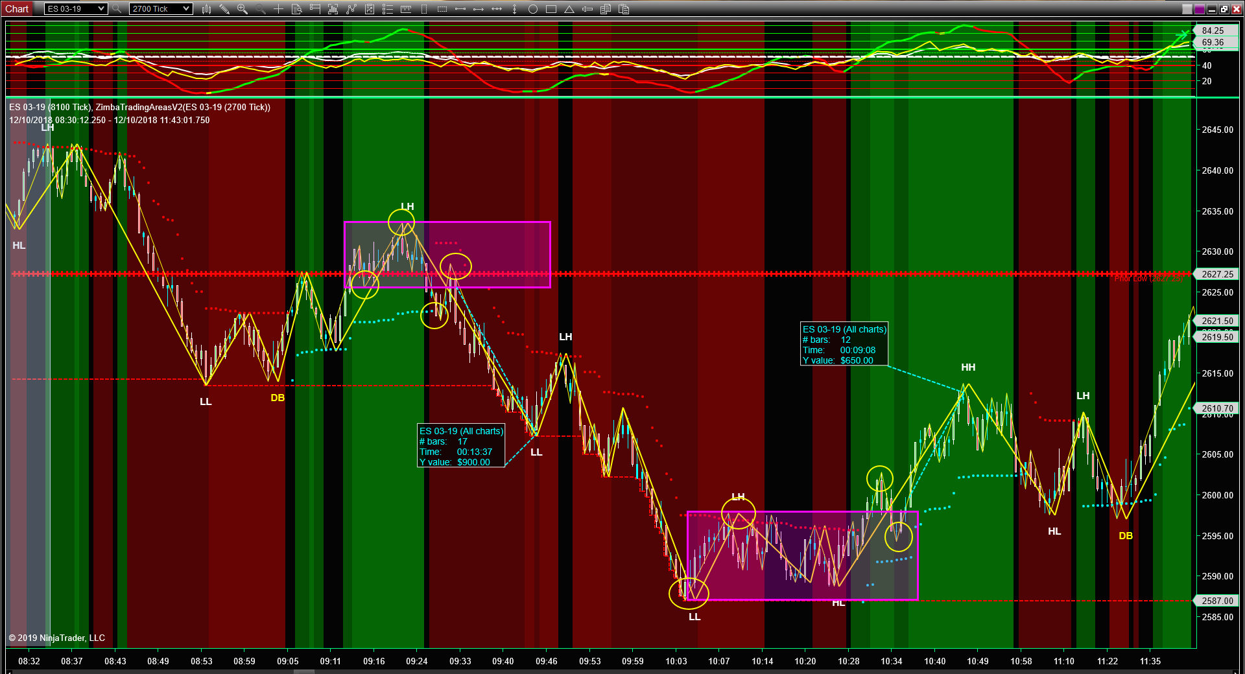

Slide 43
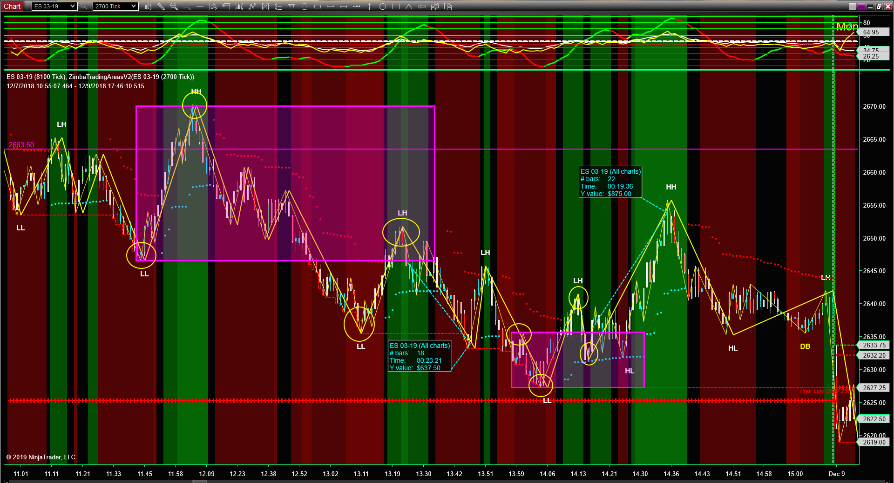

Slide 44
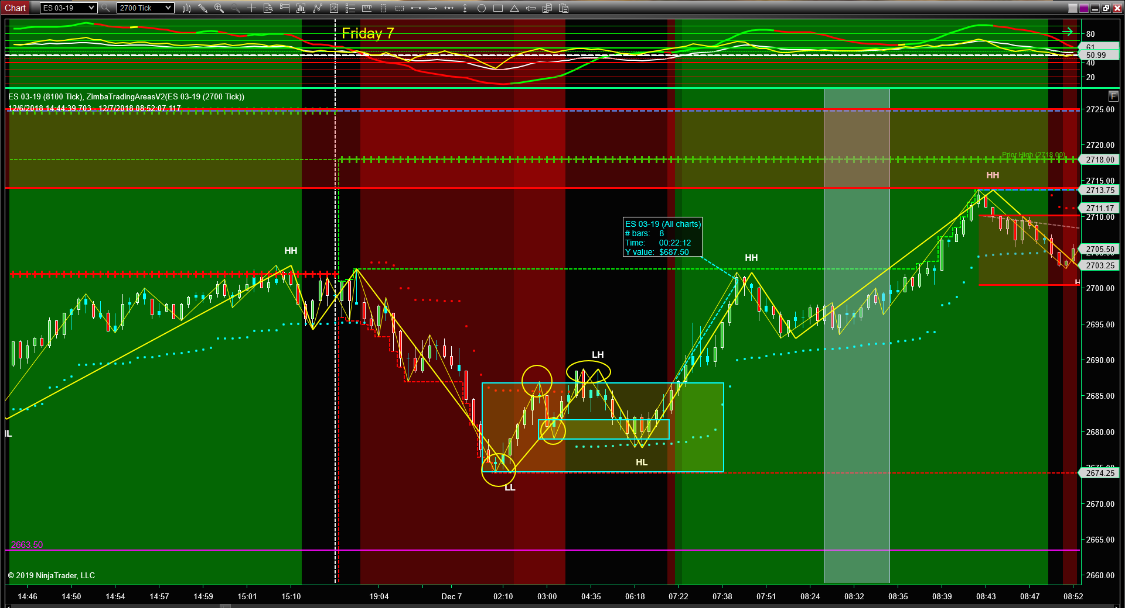

Slide 45
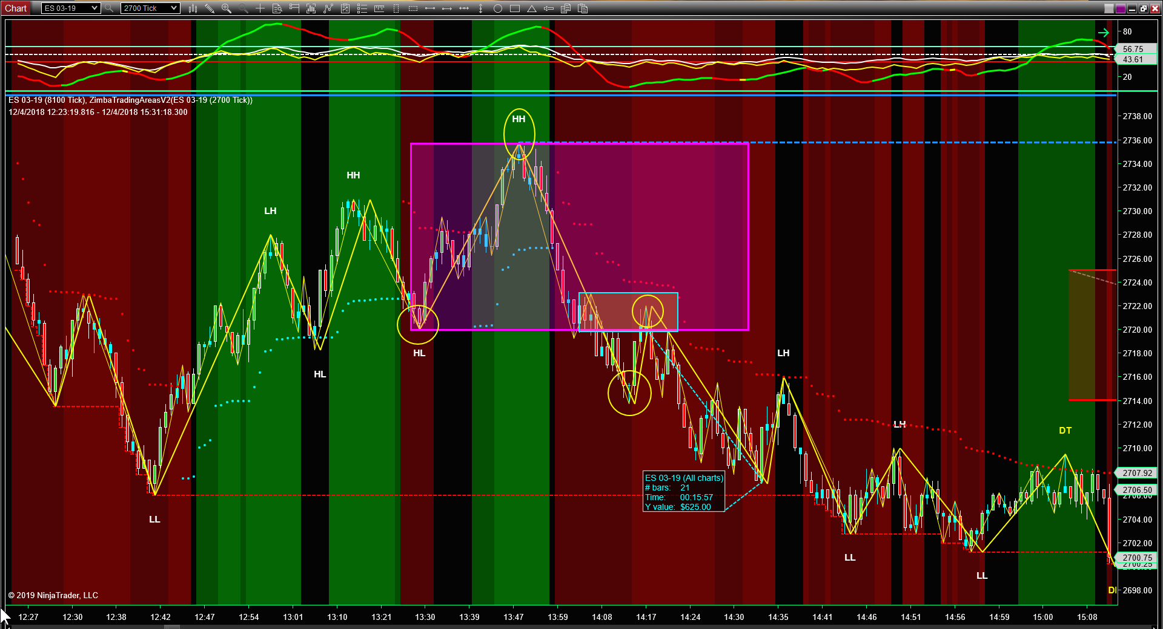

Slide 46
CL
REVERSAL AREA

Slide 47
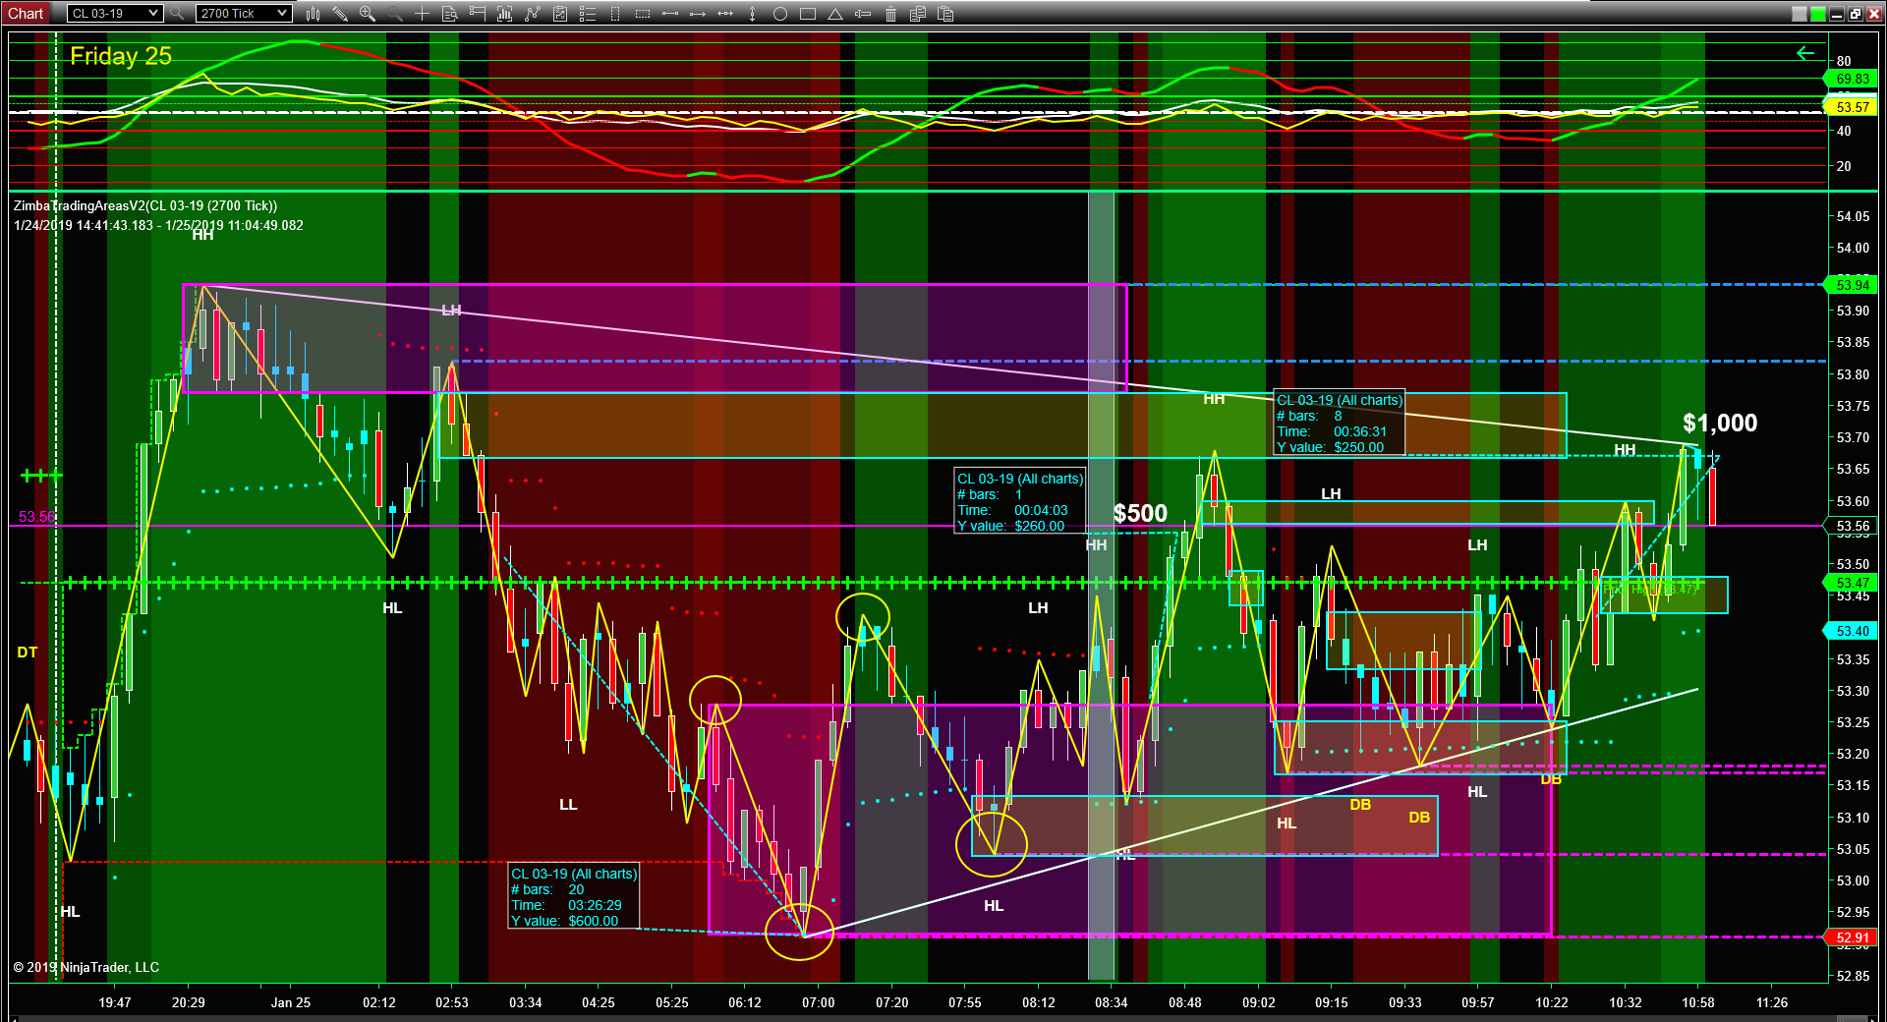

Slide 48
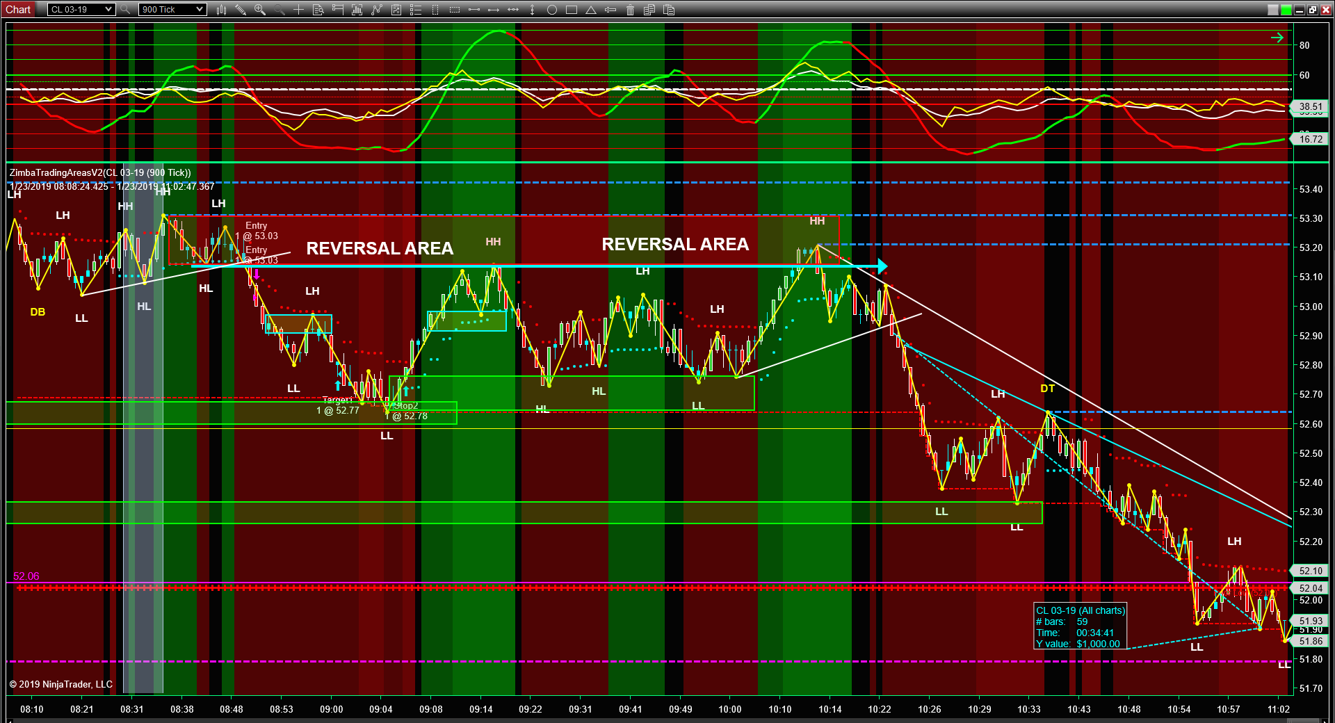

Slide 49
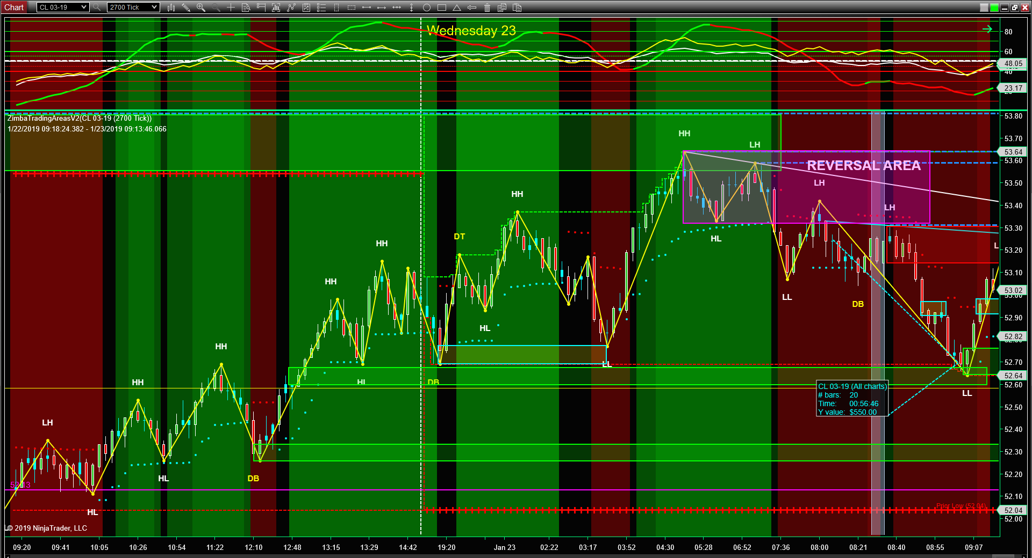

Slide 50
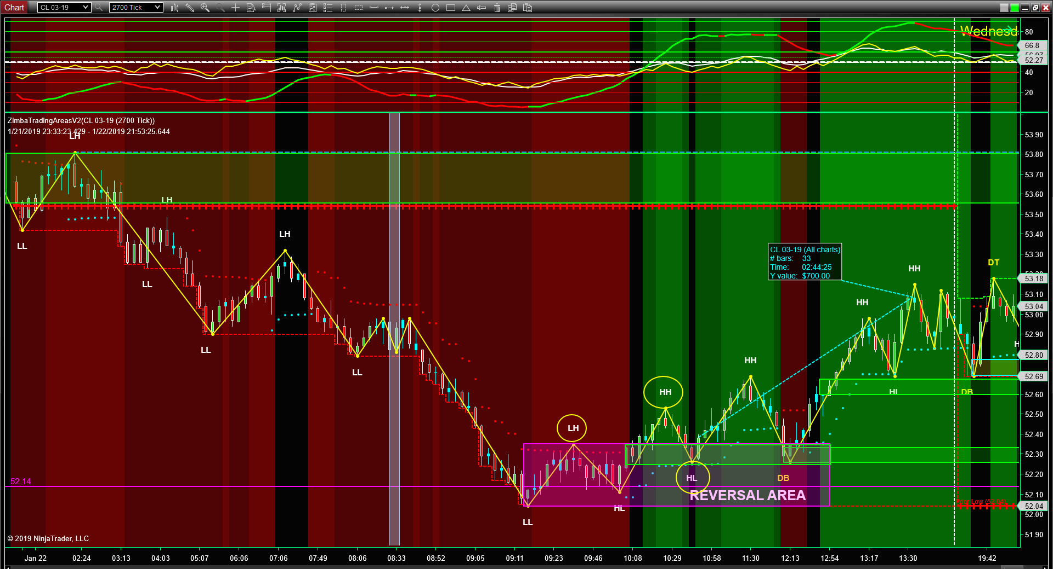

Slide 51
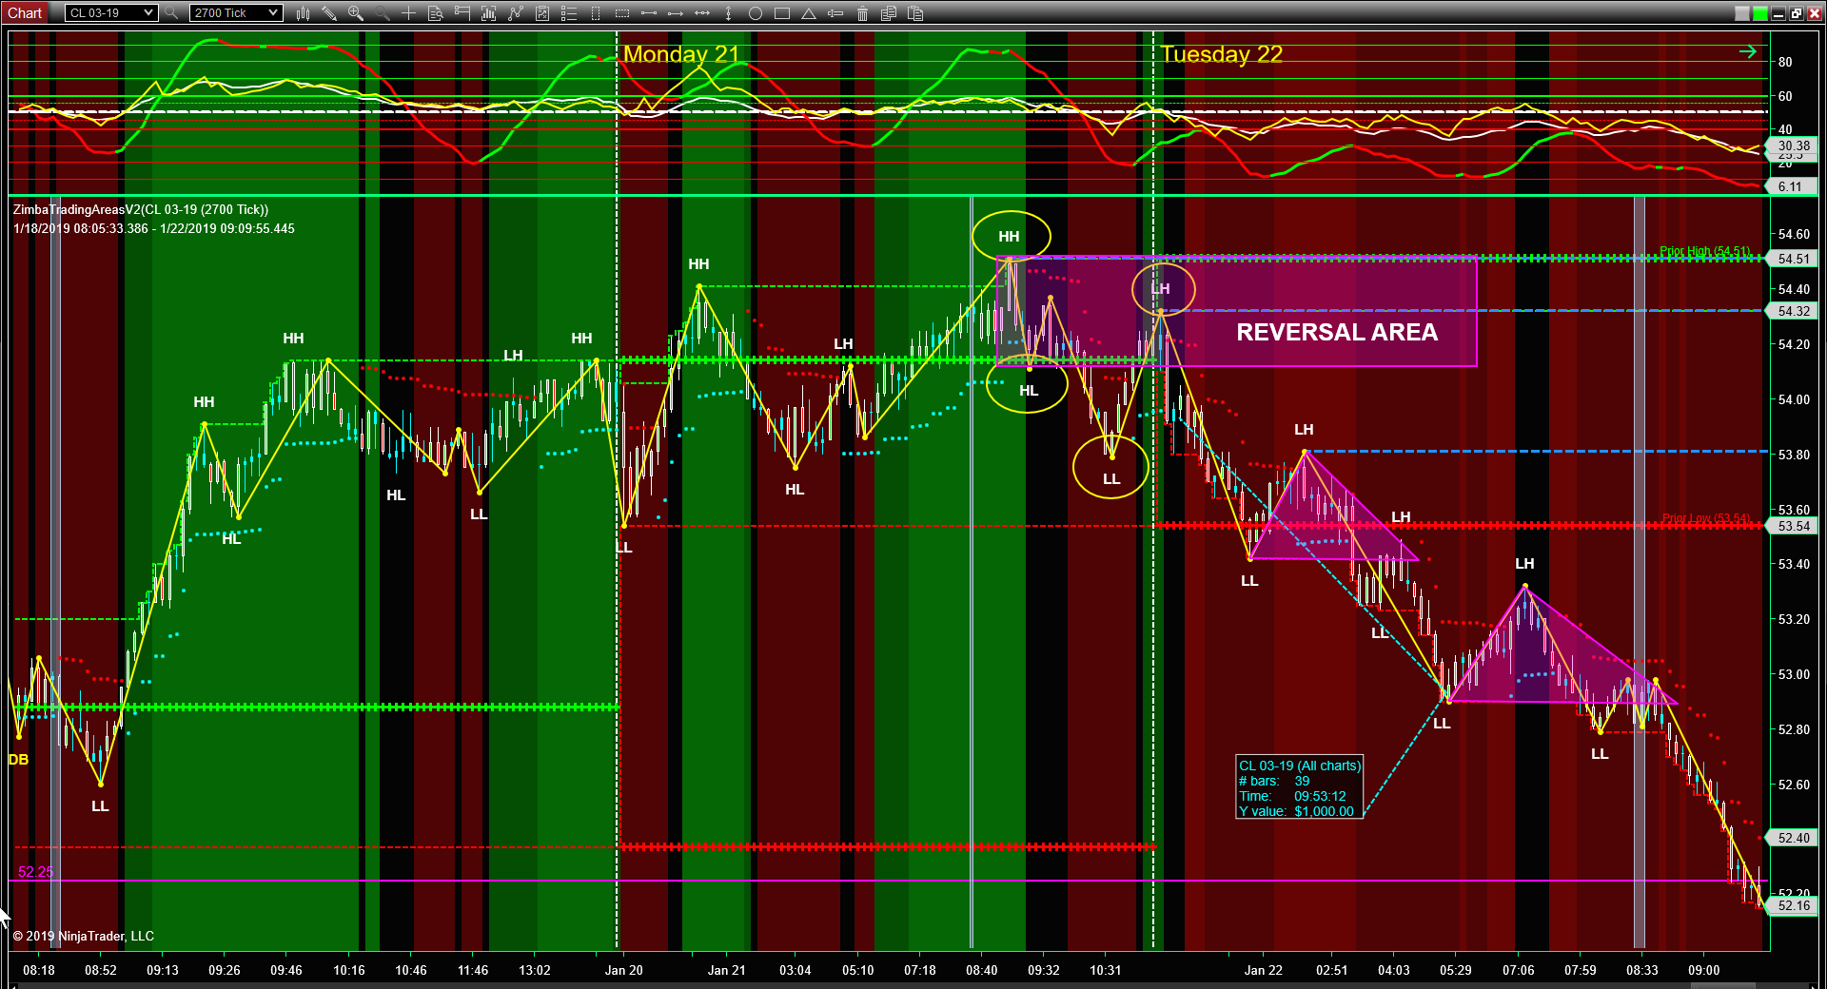

Slide 52
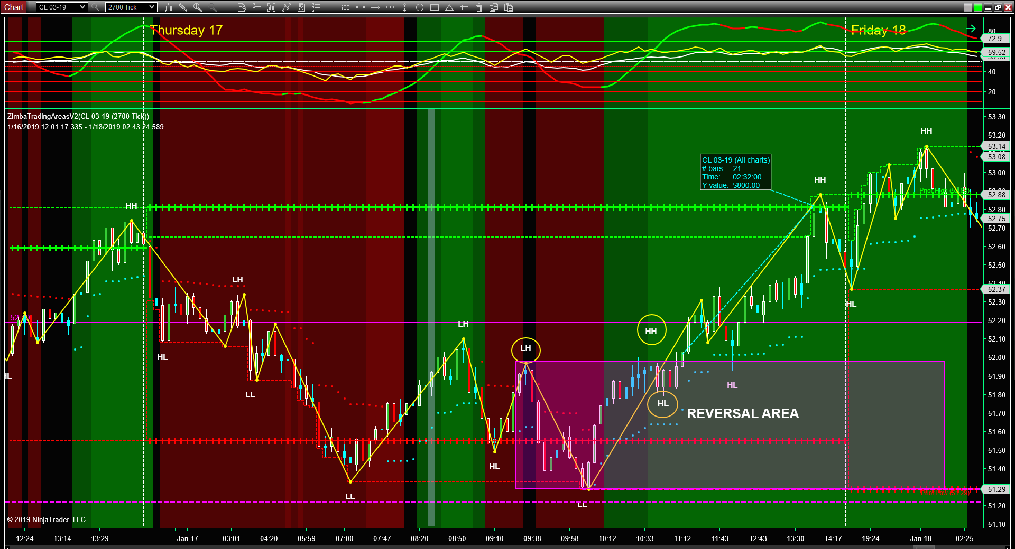

Slide 53
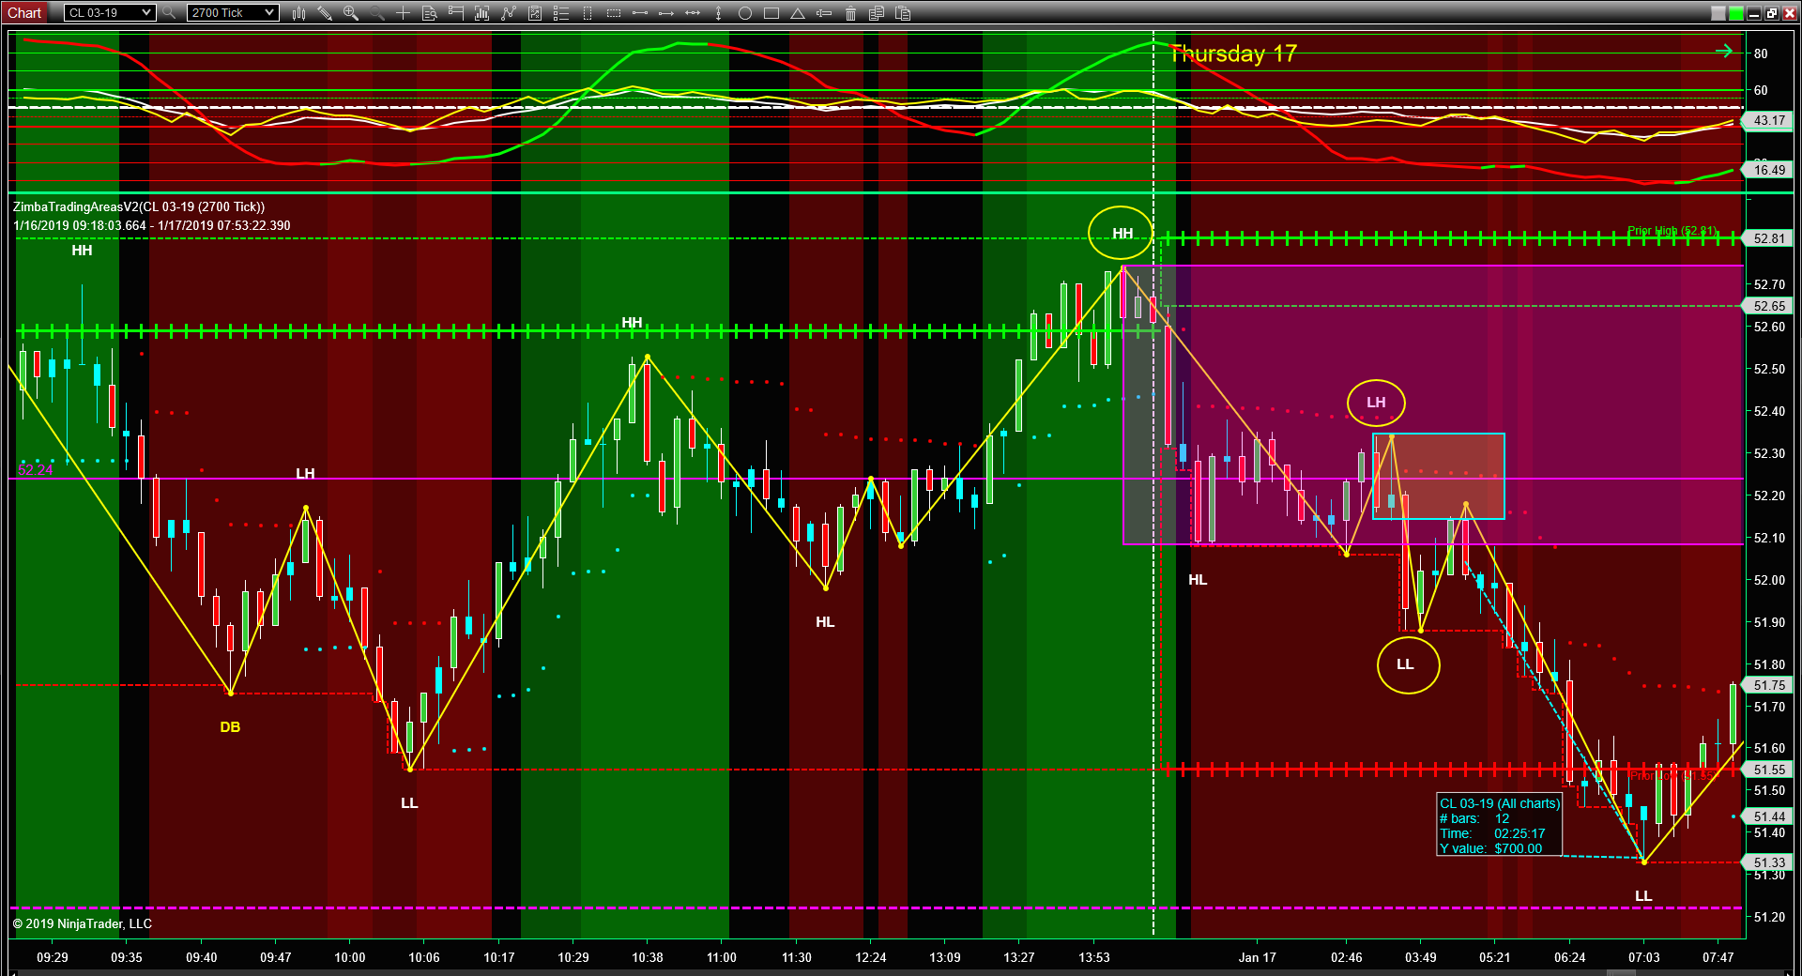

Slide 54


Slide 55


Slide 56


Slide 57


Slide 58


Slide 59


Slide 60


Slide 61


Slide 62


Slide 63


Slide 64


Slide 65


Slide 66


Slide 67


Slide 68


Slide 69


Slide 70


Slide 71


Slide 72


Slide 73


Slide 74


Slide 75


Slide 76


Slide 77


Slide 78


Slide 79


Slide 80


Slide 81
NQ
REVERSAL AREA

Slide 82


Slide 83


Slide 84


Slide 85


Slide 86


Slide 87


Slide 88


Slide 89


Slide 90


Slide 91


Slide 92


Slide 93


Slide 94


Slide 95


Slide 96


Slide 97


Slide 98


Slide 99


Slide 100


Slide 101


Slide 102


Slide 103


Slide 104


Slide 105


Slide 106


Slide 107


Slide 108


Slide 109


Slide 110


Slide 111


Slide 112


Slide 113


Slide 114


Slide 115


