Slide 1
ATMs

Slide 2
DISCLAIMER - ZimbaTrading.com IS AN EDUCATION SERVICE
The bottom line is that trading is a risky endeavor – if it were so easy, everyone would be doing it and making money. Please read this disclaimer very carefully and consult with your financial professional or adviser before making any trading or investment decision.
GOVERNMENT REGULATIONS REQUIRE DISCLOSURE OF THE FACT THAT WHILE THESE METHODS MAY HAVE WORKED IN THE PAST, PAST RESULTS ARE NOT NECESSARILY INDICATIVE OF FUTURE RESULTS. WHILE THERE IS A POTENTIAL FOR PROFITS THERE IS ALSO A RISK OF LOSS. A LOSS INCURRED IN CONNECTION WITH TRADING FUTURES CONTRACTS CAN BE SIGNIFICANT. YOU SHOULD THEREFORE CAREFULLY CONSIDER WHETHER SUCH TRADING IS SUITABLE FOR YOU IN LIGHT OF YOUR FINANCIAL CONDITION SINCE ALL SPECULATIVE TRADING IS INHERENTLY RISKY AND SHOULD ONLY BE UNDERTAKEN BY INDIVIDUALS WITH ADEQUATE RISK CAPITAL.
THERE IS SUBSTANTIAL RISK IN TRADING. A LOSS INCURRED IN CONNECTION WITH FUTURES TRADING CAN BE SIGNIFICANT. ZimbaTrading.com MAKES NO CLAIMS WHATSOEVER REGARDING PAST OR FUTURE PERFORMANCE. ALL EXAMPLES, DIAGRAMS, DISCUSSIONS, LESSONS, OR RECOMMENDATIONS ARE FOR EDUCATIONAL OR ENTERTAINMENT PURPOSES ONLY.
Any trades or hedges you make are taken at your own risk for your own account. Past performance is no guarantee of future results. While there is great potential for reward trading commodity futures, stocks, ETFs, options, and FOREX, there is also substantial risk of loss in all types of market trading. You must decide your own suitability to trade. Future trading results can never be guaranteed. This is not an offer to buy or sell futures, options or commodity interests. Neither ZimbaTrading.com nor members are a licensed investment adviser or commodity trading adviser nor is licensed as such with any federal or state regulatory agency.
ZimbaTrading.com IS AN EDUCATION SERVICE, not an advisory or stock recommendation service. At times, ZimbaTrading.com will analyze the technical structure (chart) of various stocks or financial markets, but he is in no way compensated by the companies he analyzes either in reports or daily commentaries. All examples are provided for educational purposes.
ZimbaTrading.com and members relies upon the “publisher’s exclusion” from the definition of “investment adviser” as provided under Section 202(a)(11) of the Investment Advisers Act of 1940 and corresponding state securities laws. To the extent any of the content published on the website including e-mail transmissions, faxes, recorded voice messages, and any other associated messages/media (hereinafter collectively referred to as “Information”) may be deemed to be investment advice, such information is impersonal and not tailored to the investment needs of any specific person. The information contained within this Web site, including e-mail transmissions, faxes, recorded voice messages, and any other associated messages/media (hereinafter collectively referred to as “Information”) is provided for informational and educational purposes only. The Information should not be construed as investment/trading advice and is not meant to be a solicitation or recommendation to buy, sell, or hold any securities mentioned. A portion of text is hereby included from the Securities and Exchange Commissions description of “Newsletters:” However, expressly excluded from the definition is “the publisher of bona fide newspaper, news magazine or business or financial publication of general and regular circulation.”

Slide 3
Descargo de Responsabilidad
ZimbaTrading.com ES UN SERVICIO EDUCACIONAL
La conclusión es que el “TRADING” es un negocio muy arriesgado: si fuera tan fácil, todos lo harían y ganarían dinero. Lea este descargo de responsabilidad con mucho cuidado y consulte a su profesional financiero o asesor antes de tomar cualquier decisión comercial o de inversión.
LAS REGULACIONES GUBERNAMENTALES REQUIEREN LA DIVULGACIÓN DEL HECHO DE QUE, AUNQUE ESTOS MÉTODOS PUEDAN HABER FUNCIONADO EN EL PASADO, LOS RESULTADOS ANTERIORES NO SON NECESARIAMENTE INDICATIVOS DE RESULTADOS FUTUROS. MIENTRAS HAY UN POTENCIAL DE GANANCIAS, TAMBIÉN EXISTE UN RIESGO DE PÉRDIDA. UNA PÉRDIDA INCURRIDA EN RELACIÓN CON LOS CONTRATOS DE FUTUROS COMERCIALES PUEDE SER SIGNIFICATIVA. POR CONSIGUIENTE, DEBE CONSIDERAR CUIDADOSAMENTE SI DICHO COMERCIO ES ADECUADO PARA USTED A LA LUZ DE SU CONDICIÓN FINANCIERA, YA QUE TODA OPERACIÓN ESPECULATIVA ES INHERENTEMENTE RIESGOSA Y SOLO DEBERÁ SER REALIZADA POR INDIVIDUOS CON EL CAPITAL DE RIESGO ADECUADO.
HAY RIESGO SUSTANCIAL EN EL “TRADING”. UNA PÉRDIDA INCURRIDA EN RELACIÓN CON FUTUROS COMERCIALES PUEDE SER SIGNIFICATIVA. ZimbaTrading.com NO SE HACE NINGUNA RECLAMACIÓN CON RESPECTO AL RENDIMIENTO PASADO O FUTURO.
TODOS LOS EJEMPLOS, DIAGRAMAS, DISCUSIONES, LECCIONES O RECOMENDACIONES SON SÓLO PARA FINES EDUCATIVOS O DE ENTRETENIMIENTO.
Cualquier operación o cobertura que haga se tomará bajo su propio riesgo para su propia cuenta. El rendimiento pasado no es garantía de resultados futuros. Si bien existe un gran potencial de negociación de futuros de materias primas, acciones, ETF, opciones y FOREX, también existe un riesgo sustancial de pérdida en todos los tipos de negociación en el mercado. Los resultados comerciales futuros nunca pueden ser garantizados. Esta no es una oferta para comprar o vender futuros, opciones o intereses de productos básicos. Ni ZimbaTrading.com ni sus miembros son asesores de inversiones autorizados ni asesores de comercio de materias primas, ni tienen licencia como tal en ninguna agencia reguladora federal o estatal.
ZimbaTrading.com ES UN SERVICIO DE EDUCACIÓN, no un servicio de asesoría o recomendación de acciones. En ocasiones, ZimbaTrading.com analizará la estructura técnica (gráfico) de diversas acciones o mercados financieros, pero las compañías que analiza no lo compensa de ninguna manera ni en los informes ni en los comentarios diarios. Todos los ejemplos se proporcionan con fines educativos.

Slide 4
NQ

Slide 5
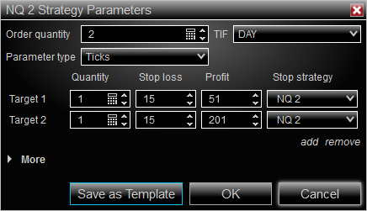
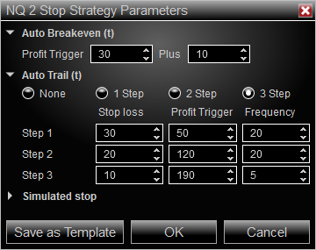
NQ

Slide 6
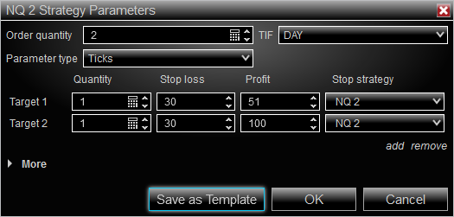
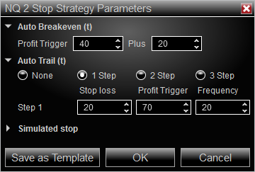
NQ – Risk 1 : Reward 2.5

Slide 7
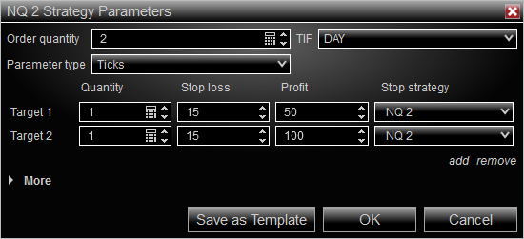
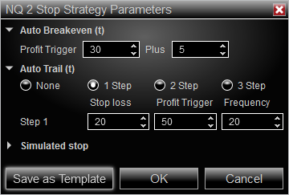
NQ – Risk 1 : Reward 5

Slide 8
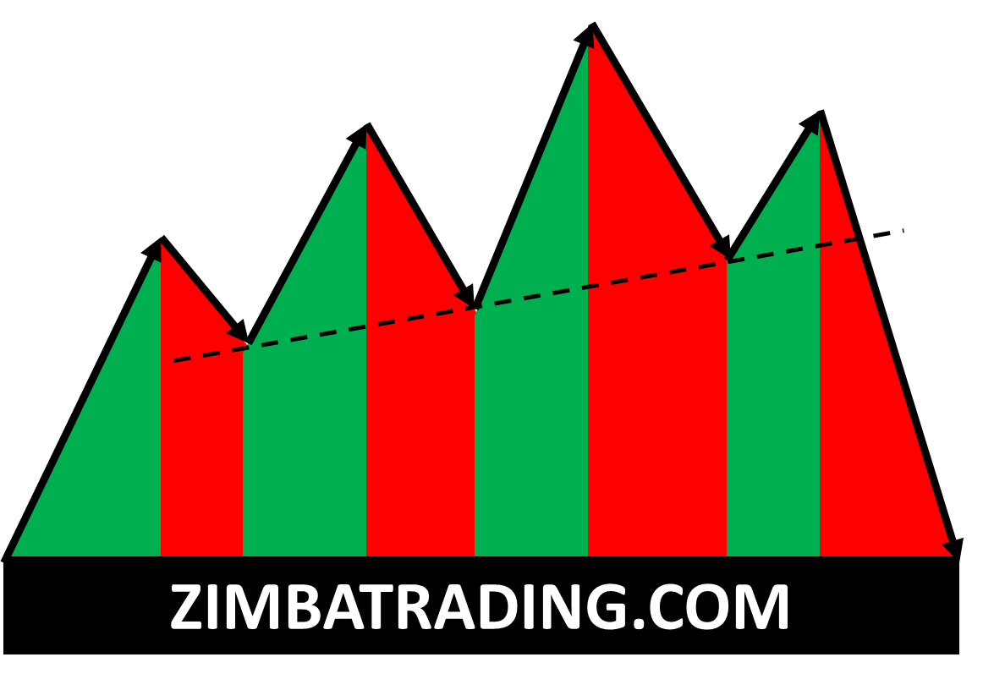
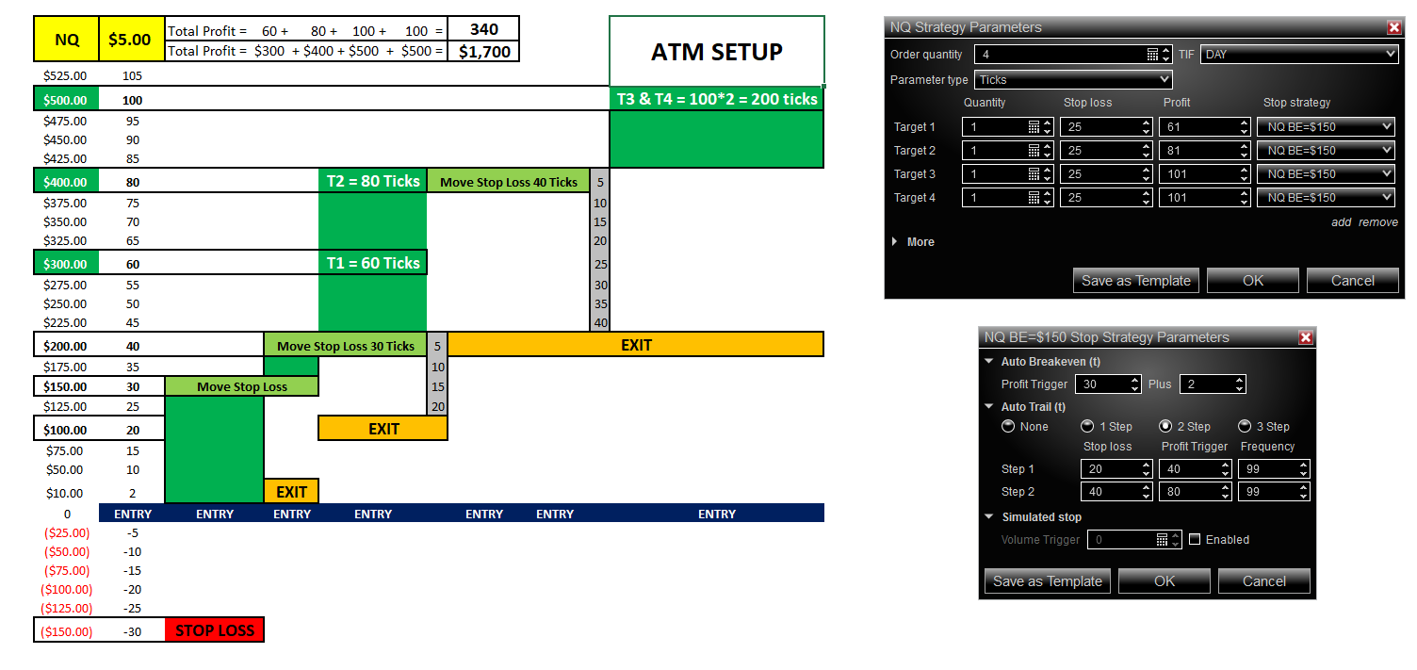
NQ - A T M

Slide 9
ES

Slide 10
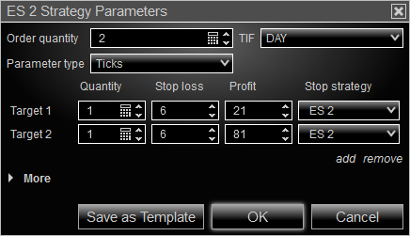

ES

Slide 11
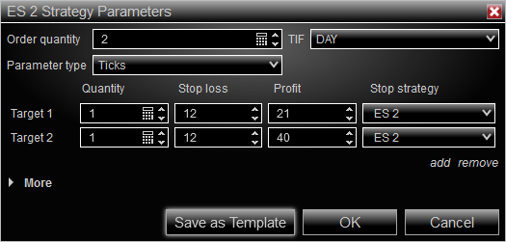

ES – Risk 1 : Reward 2.5

Slide 12
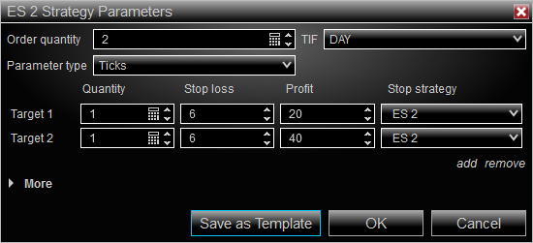

ES – Risk 1 : Reward 2.5

Slide 13
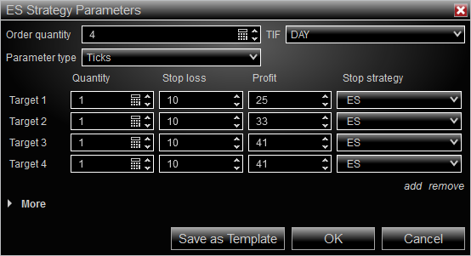
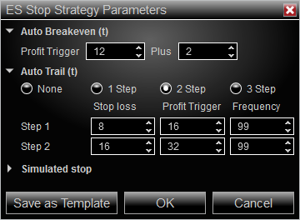
ES - A T M

Slide 14
CL & GC & NG

Slide 15
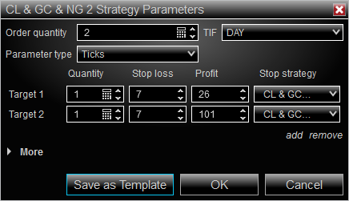
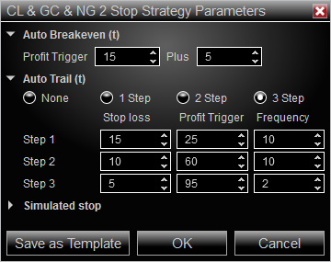
CL & GC & NG

Slide 16
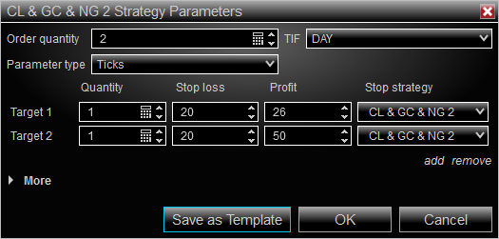
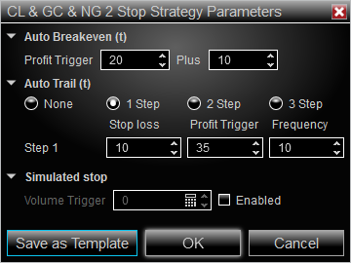
CL – Risk 1 : Reward 2.5

Slide 17
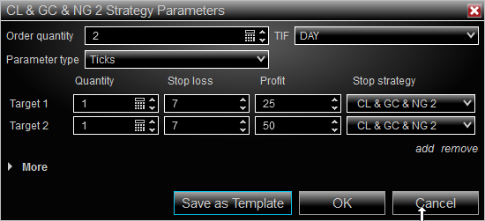
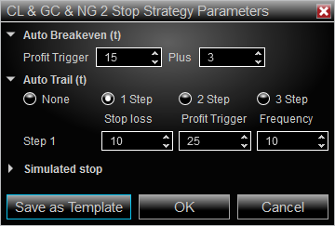
CL – Risk 1 : Reward 2.5

Slide 18
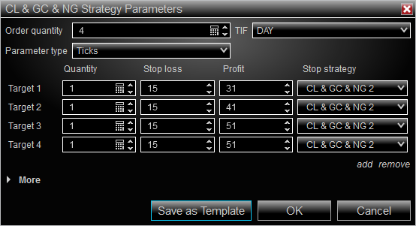
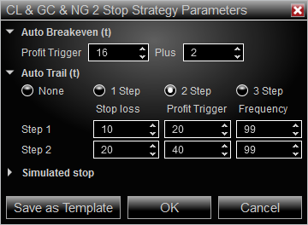
GC - A T M

Slide 19
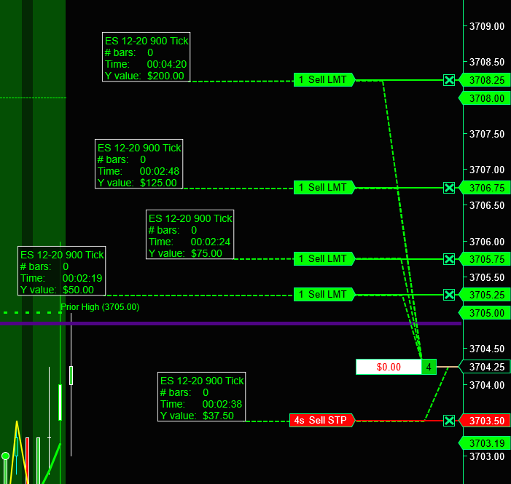
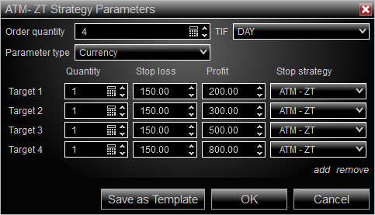
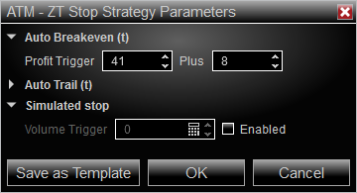
ATM
Advance Trade Management

Slide 20
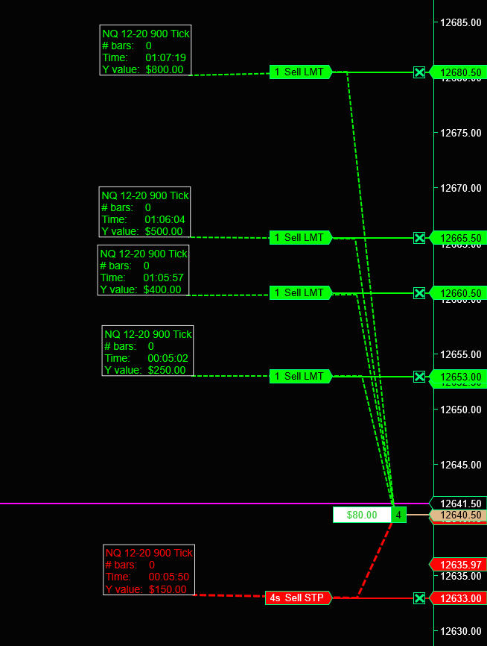
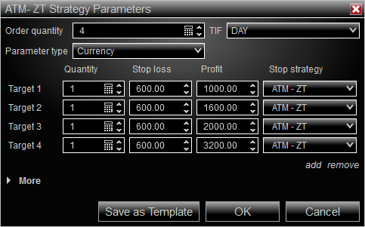
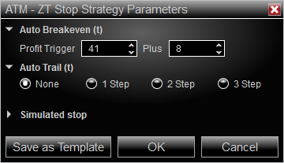
ATM
Advance Trade Management
T1 = $250
T2= $400
T3 = $500
T4 = $800
Total = $1950
BE = 41 Ticks
NQ = 41 * 5 = $205
ES = 41 * 5 = $512
CL & GC = 41* $10 = $410
SL = $150

Slide 21
END

