Slide 1
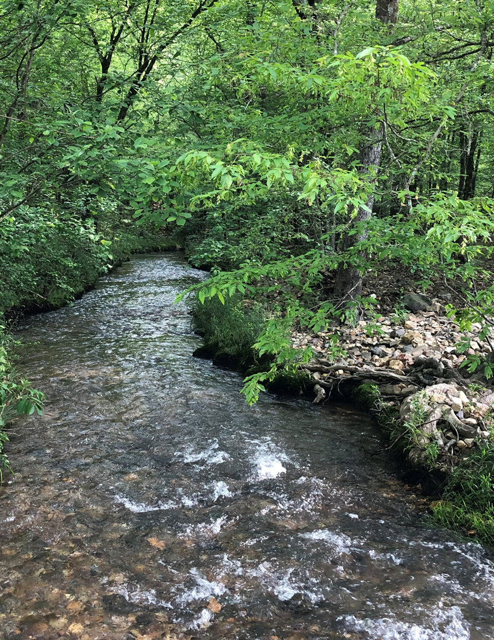
FSTOA Annual Meeting
Welcome FSTOA Members

Slide 2
Today’s agenda
Welcome and Introductions
Anti-Trust Discussion
FSTOA Staff
Wildflower Project – Amanda Malcolm – Love Creek Nursery
Prescribed Burning and Wildlife Habitat Improvement – Clint Harris – The Nature Conservancy
2023 Audit and Findings
2024 Outlook
Questions

Slide 3
Wildflower Project – Amanda Malcolm
Photo from Clemson University

Slide 4
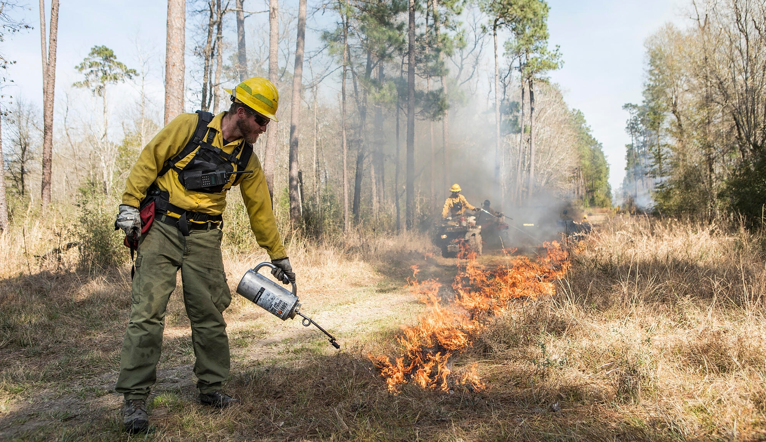
Prescribe Burning and wildlife habitat improvement - Clint Harris
Photo by The Nature Conservancy

Slide 5
2023 Audit and findings
2023 Audit Criteria
Principle 1 – Compliance With Laws and FSC Principles
Forest management shall respect all applicable laws of the country in which they occur, and international treaties and agreements to which the country is a signatory and comply with all FSC Principles and Criteria.
Indicators – 1.1, 1.2, 1.3, 1.4, 1.5 and 1.6
Principle 2 – Tenure and Use Rights and Responsibilities
Long-term tenure and use rights to the land and forest resources shall be clearly defined, documented and legally established.
Indicator – 2.3
Principle 3 – Indigenous Peoples’ Rights
The legal and customary rights of indigenous peoples to own, use and manage their lands, territories and resources shall be recognized and respected.
Indicators – 3.1, 3.2, 3.3 and 3.4
Principle 4 – Community Relations and Worker’s Rights
Forest management operations shall maintain or enhance the long-term social and economic well-being of forest workers and local communities.
Indicators – 4.2, 4.4

Slide 6
2023 Audit and findings
Principle 5 - Benefits From The Forest
Forest management operations shall encourage the efficient use of the forest’s multiple products and services to ensure economic viability and a wide range of environmental and social benefits.
Indicator – 5.6
Principle 6 – Environmental Impact
Forest management shall conserve biological diversity and its associated values, water resources, soils, and unique and fragile ecosystems and landscapes, and, by so doing, maintain the ecological functions and the integrity of the forest.
Indicators – 6.1, 6.2, 6.3, 6.5 and 6.7
Principle 7 – Management Plan
A management plan – appropriate to the scale and intensity of the operations – shall be written, implemented and kept up to date. The long-term objectives of management, and the means of achieving them, shall be clearly stated.
Indicator – 7.2
Principle 8 – Monitoring and Assessment
Monitoring shall be conducted – appropriate to the scale and intensity of forest management – to asses the condition of the forest, yields of forests products, chain of custody, management activities and their social and environmental impacts.
Indicator – 8.2

Slide 7
2023 Audit Findings
Principle 9 – Maintenance of High Conservation Value Forests
Management activities in high conservation value forests shall maintain or enhance the attributes which define such forests. Decisions regarding high conservation value forests shall always be considered in the context of a precautionary approach.
Indicator – 9.4
Pesticide Policy
Chain of Custody
Forest Management Groups

Slide 8
Non-conformances for 2023
Indicator 6.5.b – Forest operations meet or exceed Best Management Practices (BMP) that address components of the Criterion where the operation takes place.
Creek crossing on a tract had stream bank damage due to the tract getting too wet to properly pull out the creek crossing.
Indicator 8.2.d.1 – Monitoring is conducted to ensure that site specific plans and operations are properly implemented, environmental impacts of site disturbing operations are minimized, and that harvest prescriptions and guidelines are effective.
Observation had to do with monitoring of a logging job – paperwork stated site was incompliance and checked and still needed some work.
Indicator 1.5 (Forest Management Groups) – The Group Entity shall make sure all actors in the group demonstrate sufficient knowledge to fulfill their corresponding responsibilities with the group.
Pertained to the Environmental and Social Risk Assessments (ESRA’s).
Indicator 3.3.1 (Forest Management Groups) – The Resource Manager of an RMU shall assume the responsibility to conform with the applicable Forest Stewardship Standard and to follow the Group Rules on behalf of all members within their RMU.
Making sure all landowners in the FSTOA group are on an updated list.
Indicator 5.2 (Forest Management Groups) – The Group Entity shall develop a group management system that allows the continuous and effective management of all members of the group.
Making sure we have enough personnel to manage the group.
Indicator 11.4 & 11.5 (Forest Management Groups) – The minimum sample of management units to be visited annually for internal monitoring shall be calculated according to a specific table. (X = $\sqrt{y}$)
Monitored over 170 tracts but did not use this formula for the resource managers properties – monitored as the whole group.

Slide 9
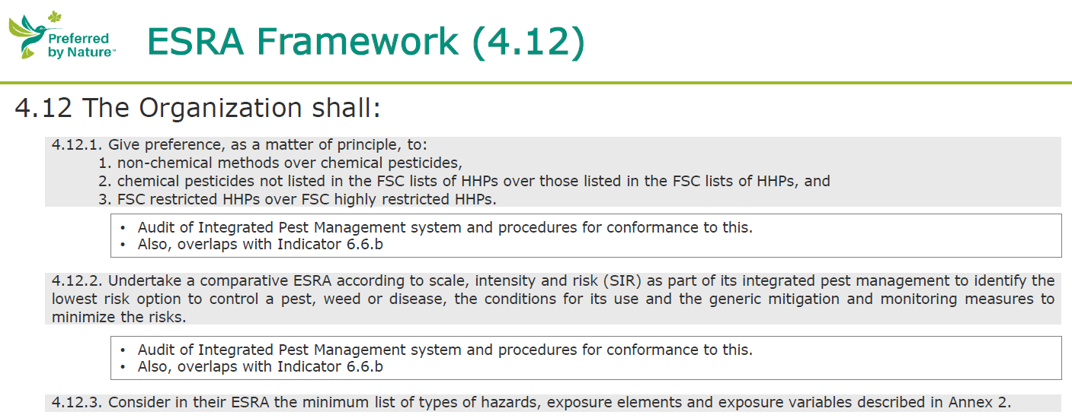
FSC Pesticide Policy
Highly Hazardous Pesticides (HHPs)
Environmental & Social Risk Assessments

Slide 10
FSC Pesticide Policy

Slide 11
FSC PESTICIDE POLICY

Slide 12
FSC Pesticide Policy

Slide 13
FSC Pesticide policy
ESRA’s on FSTOA Website
Aminopyralid
Fluroxypyr
Glyphosate
Imazapyr
Imidacloprid
MSM
SFM
Triclopyr

Slide 14
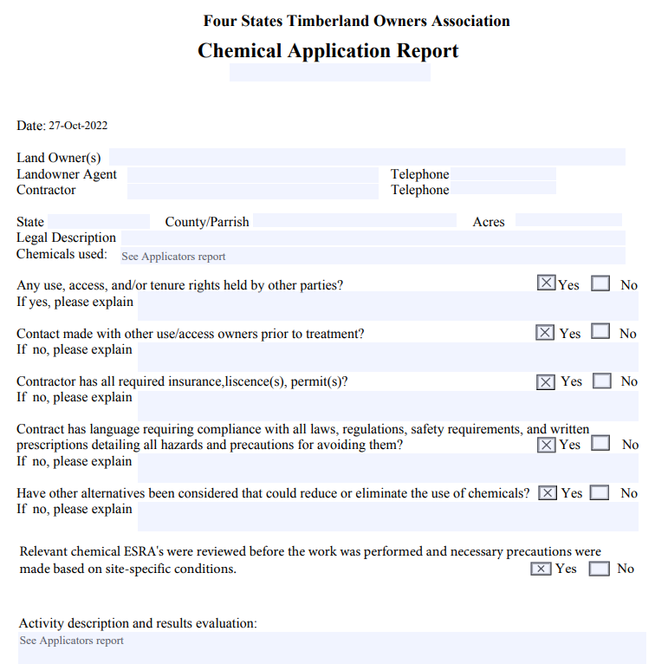
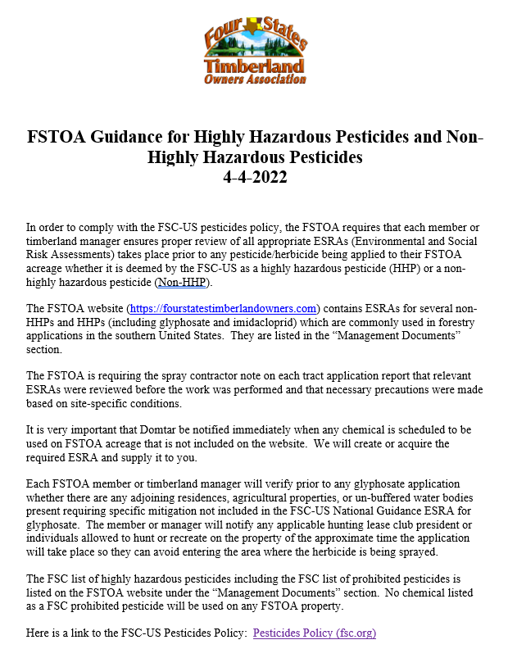
FSC Pesticide Policy

Slide 15
Print United Alliance Seedling Project
dropbox.com

Slide 16
2024 Outlook
Customer Visit / Landowner Tour
More challenges with the FSC Standard and how do we achieve what we need/want to achieve.
Further promotion of the FSTOA group and sustainable forestry.
Audit prep for our 2024 annual audit
Updating management plans, stand data, etc.
How do we meet the needs of our landowners and be more efficient.

