Slide 1
Four States Timberland Owners Association Forest Stewardship Certification Group
Programs and Resources Available to Assist Private Landowners Manage Their Property
Ricky Chastain, Private Land Biologist
Notes:
Joey Wallace, Chapter President, provided the opportunity to speak today. Appreciate the opportunity to speak with this group of forest landowners and share some ideas on enhancing existing forest management to further benefit a broad range of wildlife species.

Slide 2
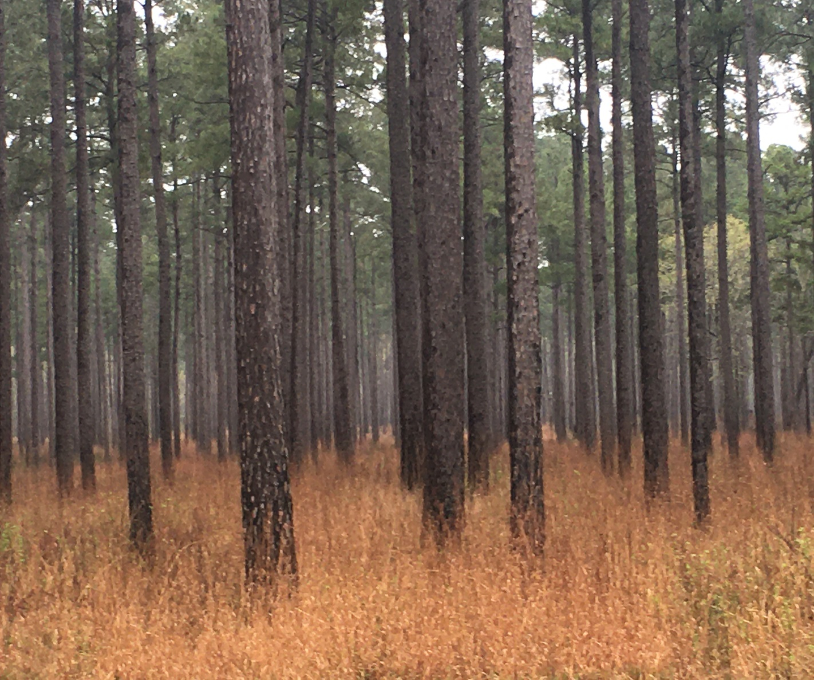
ARKANSAS GAME AND FISH COMMISSION PRIVATE LAND SECTION
Quick Stats:
10 Private Land Biologists
1 Statewide Program Coordinator
1 Assistant Program Coordinator
PLB will cover 4-9 counties
Work with many partners
Primary goal is to provide
technical assistance
Notes:
A quick overview of the Private Land Program. Most important thought: We are a resource for private landowners for technical assistance.

Slide 3
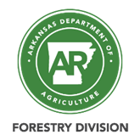
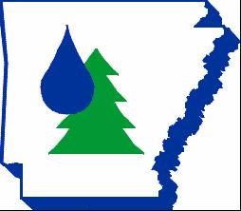
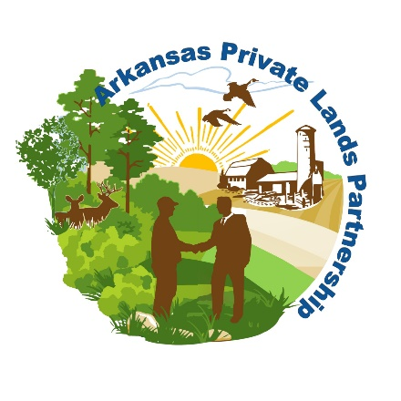
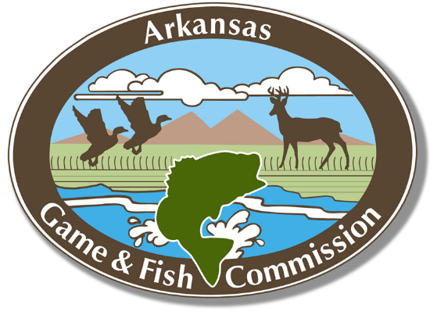
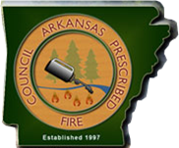
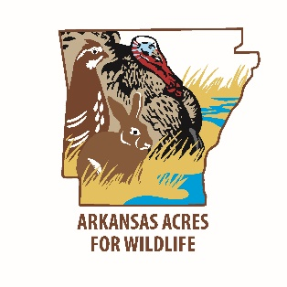
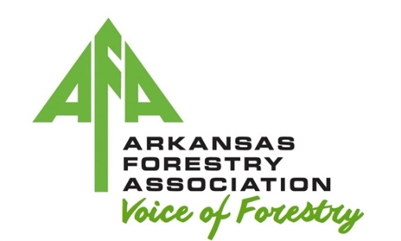
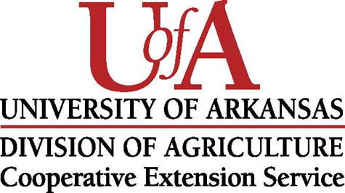
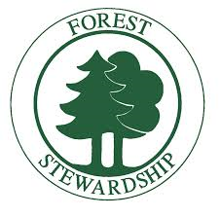
The Value of Partnerships
Notes:
Private Land Biologists work closely with a wide range of partners and programs. This provides lots of opportunity to find a program that can help landowners, both with technical issues and monetary assistance.

Slide 4
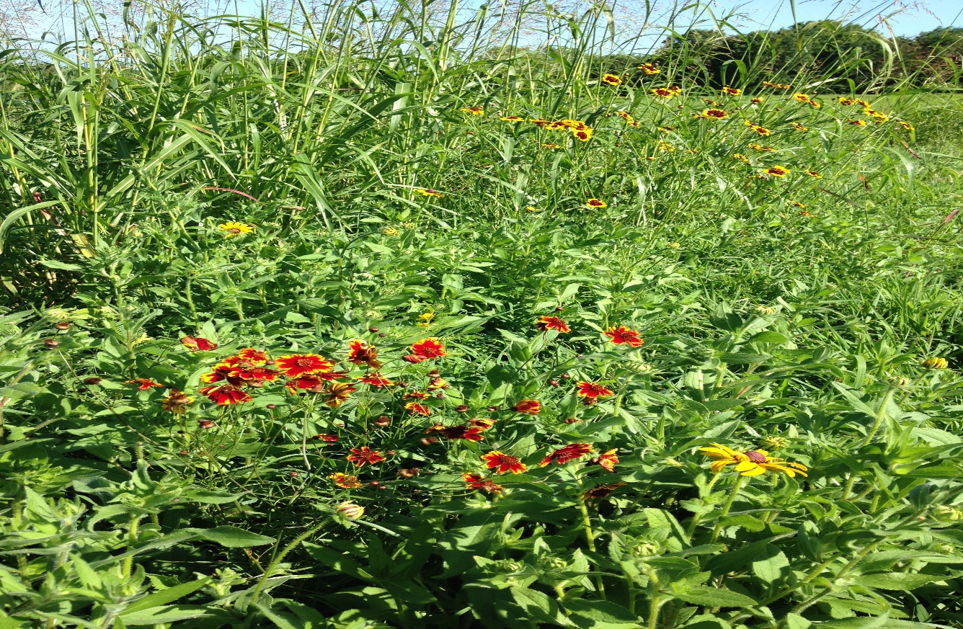
Acres for Wildlife Program
The Acres for Wildlife Program began in July 1972. There are private land acres enrolled in the program from all 75 counties. There have been many changes to the program over the years. The program began as a food plot and tree seedling program. In 2011, the program shifted the priority to establishing native warm season grass (NWSG)/pollinator cover. The AGFC provides herbicide and seed free of charge to landowners willing to set aside, site prep, and seed a minimum of 5 acres to NWSGs. Consistent throughout the history of the program has been the efforts of Private Land Biologists to develop and provide a written habitat management plan for private landowners.
Notes:
The Acres for Wildlife Program is an AGFC internal program. Excellent tool to add transitional buffers along the edges of timber stands and access roads. Heavy content of forbs which provide browse for deer. Provides nesting and brood rearing habitat for turkey and quail. Easily maintained with periodic burning.

Slide 5
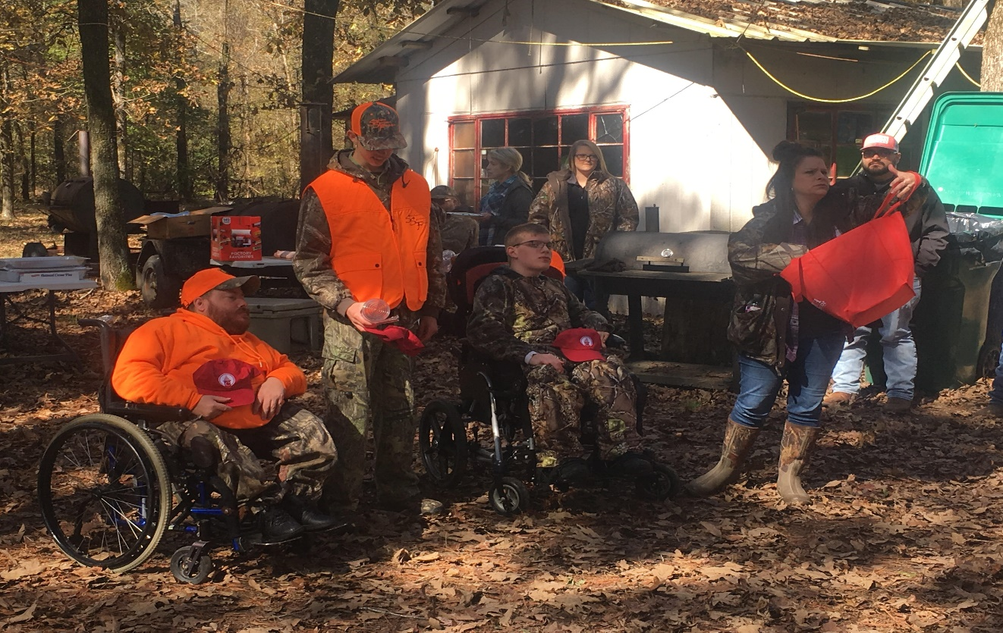
Deer Management Assistance Program
The Deer Management Assistance Program provides technical assistance to landowners and hunting clubs to improve deer populations. Biologists work with land managers to assess habitat quality and the potential to support a healthy, well-balanced deer herd. They evaluate historic, present and future deer management efforts and meet with clubs and land managers to explain options and expected results. They also train club members to correctly collect data on harvested and observed deer.
To enroll, a minimum of 500 contiguous acres of land is required. Adjacent landowners can form cooperatives in order to make the minimum acreage. Biologists will make management recommendations for those landowners who can’t make the minimum acreage even if they can’t participate in DMAP.
AGFC Biologists provide materials and training needed to collect quality data. Each club is provided a written harvest analysis of the previous year’s hunting efforts, and a written management plan to guide the club’s harvest goals for the next hunting season.
Notes:
The DMAP program is also an internal AGFC program. Whether you lease your property out to hunters, or hunt your land yourself, DMAP provides technical assistance from professional biologists to manage the deer herd according to the management objectives of the landowner. Deer hunting remains the number one type of sport hunting in Arkansas and a properly managed deer herd can provide an additional income stream on your forest lands. Participation does require effort. That effort provides the data needed to drive any/all management decisions.

Slide 6
Feral Hog Control
AGFC biologists will assist landowners with the trapping/removal of feral hogs on their property.
Biologist will assist the landowner in determining a suitable site for establishing a baited area.
Landowner will provide bait, placement of bait, and initial monitoring of bait site until feral hogs have revisited the site for 2-3 consecutive nights. Landowner will then notify the AGFC contact.
AGFC biologist will set up trap and monitor the trap. AGFC biologist responsible for tripping the trap at the appropriate time with the goal being to catch the entire sounder.
Once hogs are trapped, the landowner is responsible for shooting the hogs and disposing of the carcasses.
No charge for services.
Available Resources:
Private Land Biologist – will assist on any private land
Regional Biologist – primarily assist on private land adjacent to WMA where trapping is already occurring
USDA/APHIS/WS – technician assigned to Tier I (Sevier, Howard, Hempstead) and Tier II (Pike, Clark, Nevada) counties (501) 835-2318
Notes:
I think most all of us are aware of how destructive feral hogs can be. Estimated $19M damage in Arkansas annually. Can carry minimum of 45 animal diseases and parasites. It is important to make an effort on a landscape scale to control their numbers.

Slide 7
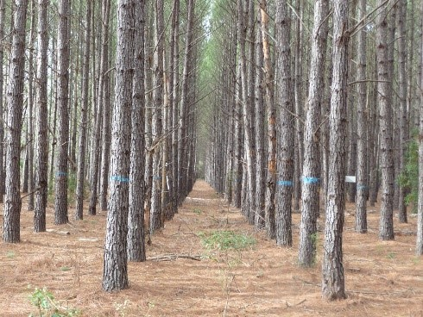
Forest Stewardship Program
The Forest Stewardship Program (FSP) is administered by the Arkansas Department of Agriculture – Division of Forestry. The Forest Stewardship Program recognizes and rewards landowners that are managing their forestlands according to a multiple-use concept. The Program is also a means by which a landowner has access to resource professionals to assist them in obtaining a written forest management plan addressing multiple-use management.
Benefits to the Landowner:
A prepared management plan at no cost to a landowner.
Improved income opportunities.
Recognition of your efforts with a certificate and sign.
Knowledge about natural resource management and assistance for many management practices.
Enhancement of wildlife through habitat protection and improvements.
Protection against soil erosion and pro­tection of water quality.
Conservation of water and soil resources for now and the future.
Assurance of a future supply of timber for forest products.
Restoration and management of wetlands.
Recreational opportunities.
Notes:
Highlighted Benefit: If the landowner lists wildlife as a number one or number two priority, then generally a PLB is asked to review the forestry plan and make recommendations to enhance wildlife benefits. There are limited funding resources through the Division of Forestry – Southern Pine Beetle Program can incentivize landowners to conduct first thinning to enhance forest health/insect resistance.

Slide 8
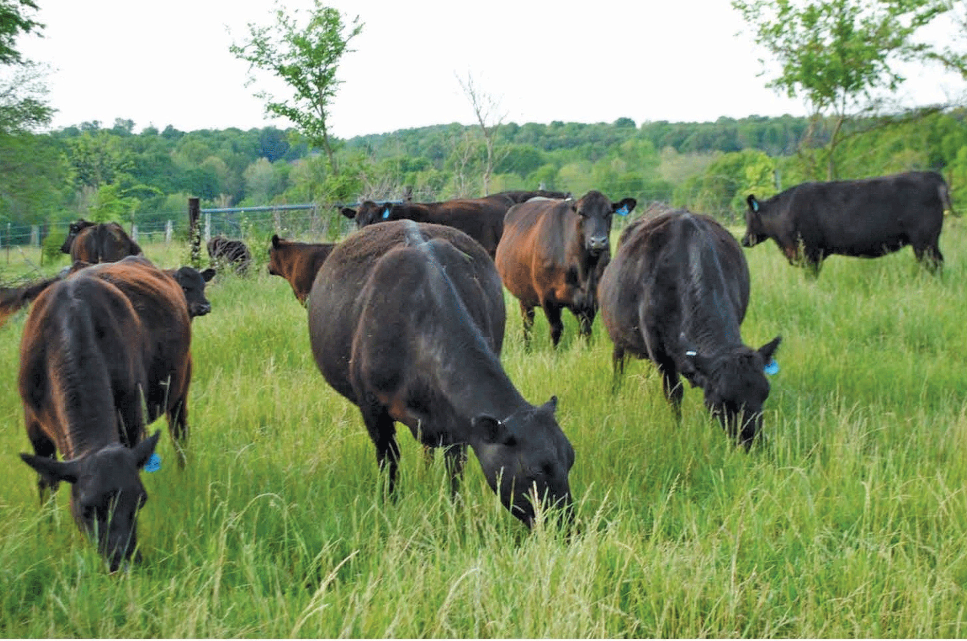
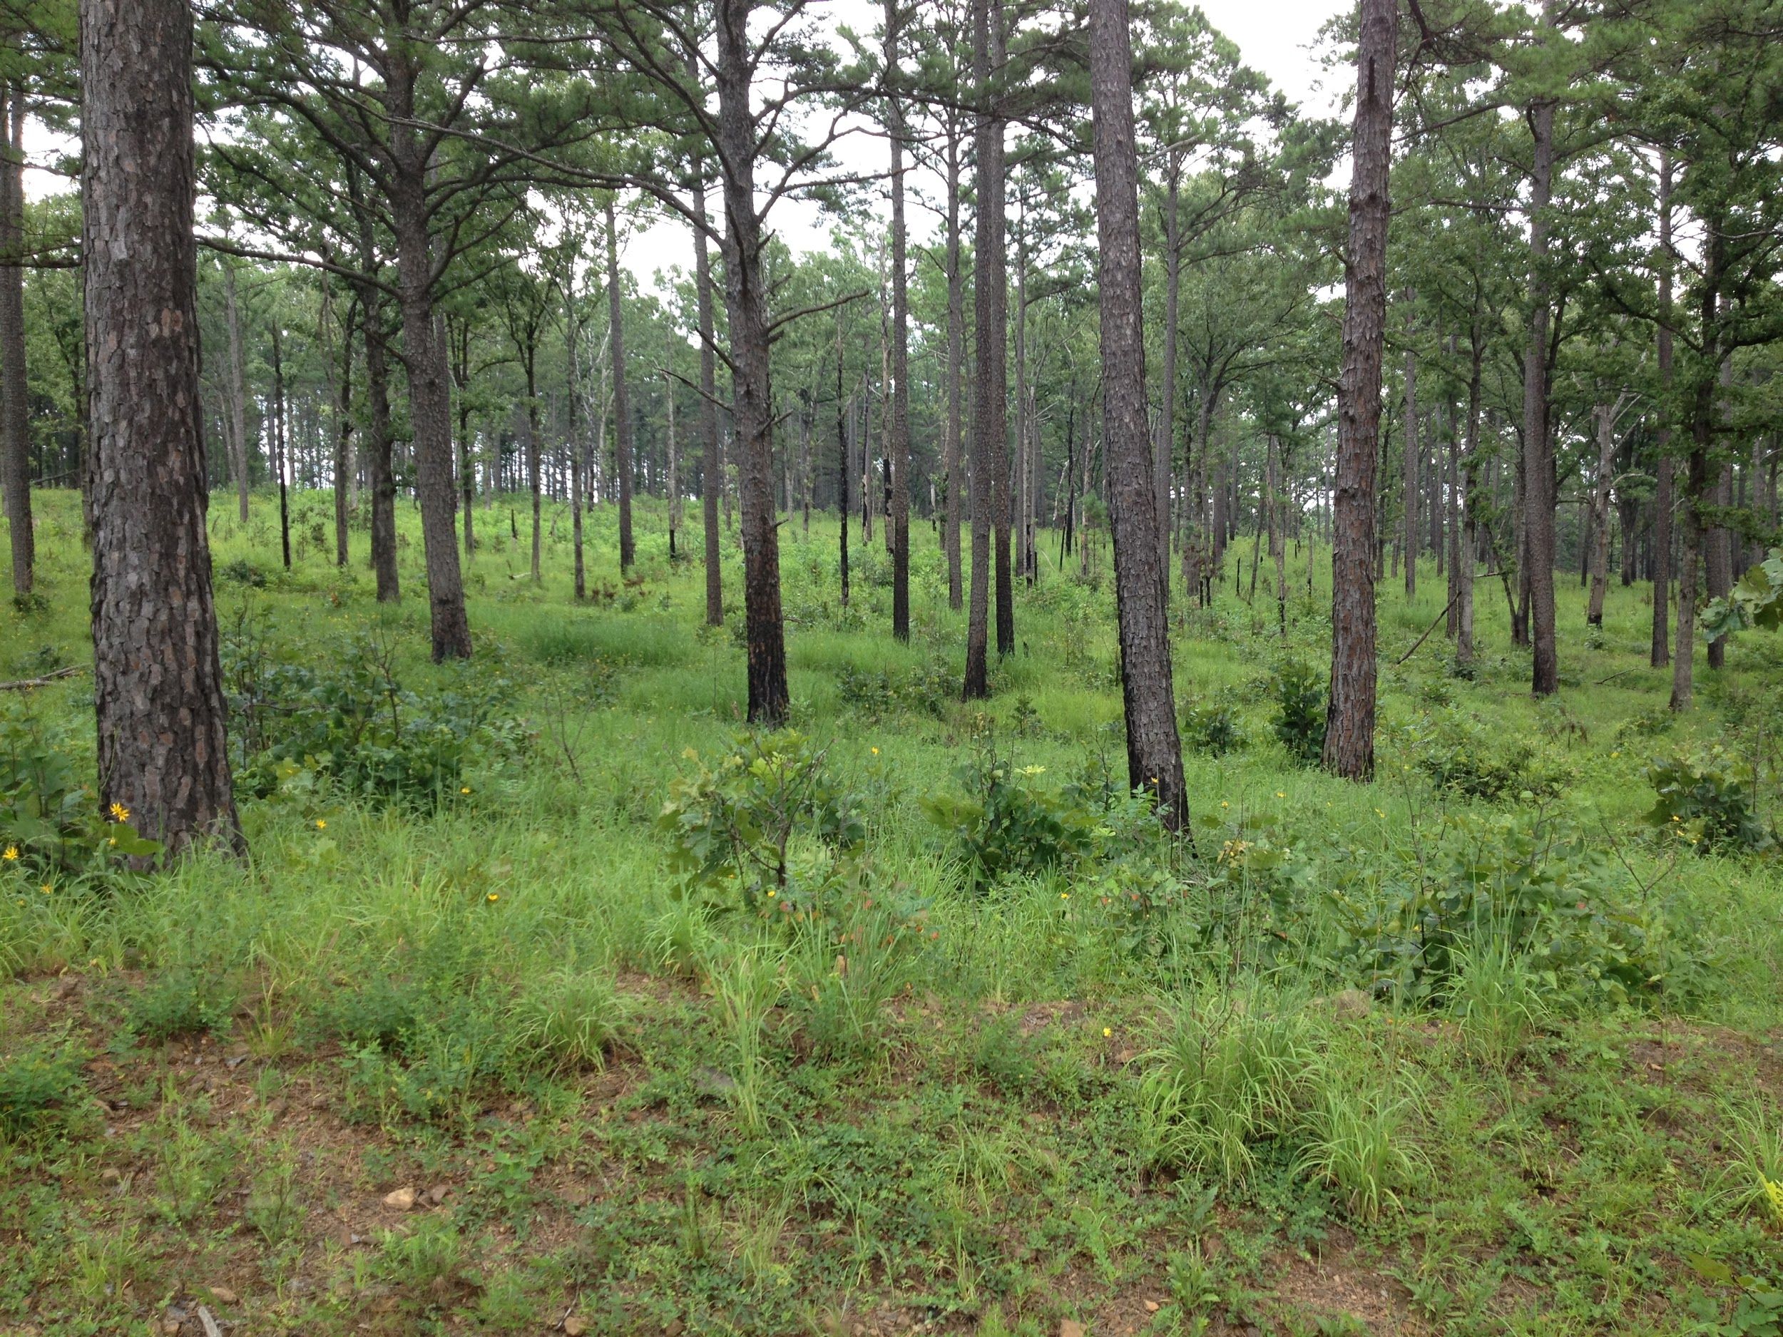
Federal Farm Bill Programs
The NRCS and its funding source counterpart, Farm Services Agency, provide a wide array of conservation programs to private landowners.
EQIP (Environmental Quality Incentives Program) EQIP provides financial and technical assistance to agricultural producers in order to address natural resource concerns. Eligible land includes non-industrial private forestlands.
WLFW (Working Lands for Wildlife) NRCS provides technical and financial assistance to participants who voluntarily make improvements to their working lands while the US Fish and Wildlife Service (FWS) provides participants with regulatory predictability.
CSP (Conservation Stewardship Program) CSP helps private landowners build on existing conservation efforts while strengthening ongoing operations in order to attain higher stewardship levels in an environmentally beneficial and cost-effective manner.
RCPP (Regional Conservation Partnership Program) RCPP is a new, comprehensive and flexible program that uses partnerships to stretch and multiply conservation investments and reach conservation goals on a regional or watershed scale.
WRP (Wetland Reserve Program) WRP is a voluntary program that provides technical and financial assistance to eligible landowners to address wetland, wildlife habitat, soil, water, and related natural resource concerns on private lands in an environmentally beneficial and cost-effective manner.
Notes:
PLBs work with Farm Bill Programs, in large part, due to the funding available in these programs to assist landowners. EQIP – potential to help fund fire lane development, conduct prescribed buning, initiate mid-story removal or invasive specie control. A cost-share program. Other programs are easement type programs. Mention new RCPP - $6.9 M for forest management in 8 AR. counties. WLFW only in certain counties. CSP is “next level” stewardship. RCPP within project areas and focuses on partnerships. WRP is an easement program to set aside marginal farm lands.

Slide 9
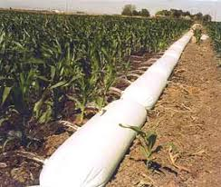
Federal Farm Bill Programs
CRP (Conservation Reserve Program) CRP is a voluntary program available to agricultural producers to help them use environmentally sensitive land for conservation benefits.
CCRP (Continuous Conservation Reserve Program) CCRP provides mainly small high environmental value acreage to be enrolled anytime when implementing high priority conservation practices.
CREP (Conservation Reserve Enhancement Program) CREP targets high-priority conservation concerns identified by a State, and federal funds are supplemented with non-federal funds to address those concerns.
PFWP (Partners for Fish and Wildlife Program – USFWS) PfFW Program works with voluntary habitat improvement projects on private lands for the benefit of federal trust resources, such as endangered or threatened species and at-risk species.
Notes:
CRP easement type program – set aside acres for row crop acres. CCRP for small acres with high environmental value in restoration. CREP works on localized project areas to address specific conservation threats. PFFW small program administered by USFWS to address endangered and T&E species.

Slide 10
Wildlife Enhancements on Forest Lands; What Does That Look Like? How Do I Get There?
Be prepared to implement prescribed fire following first thinning. Used to control invasive mid-story woody stems.
Burn on 2-3 year intervals. Used to control invasive mid-story woody stems. Maintains high quality browse. Provides better nesting and brood-rearing habitat.
Monitor tree growth and be prepared to harvest again in 6-7 years (depending on site index). Try to maintain no more than 50-60% crown closure. Sunlight drives the growth of a herbaceous understory.
Utilize “edge-feathering” to create a softer transition zone along the edge of timber stands. Thin the outside 150-200 ft. of each stand down to <60 B.A. Daylight roads to aid in drying them out and plant natives along roads as an additional buffer.
Continue to burn on 2-3 year intervals.
Notes:
Fire suppression is one of the most important, landscape level causes of habitat degradation in forest lands across the SE. Fire can control woody mid-story development which shades out sunlight. Sunlight stimulates the growth of grasses and forbs that produce browse for deer and the herbaceous ground cover necessary for quality nesting and brood-rearing habitat for turkey and quail. Prescribed fire is the most economical and versatile tool in the conservation tool box.

Slide 11
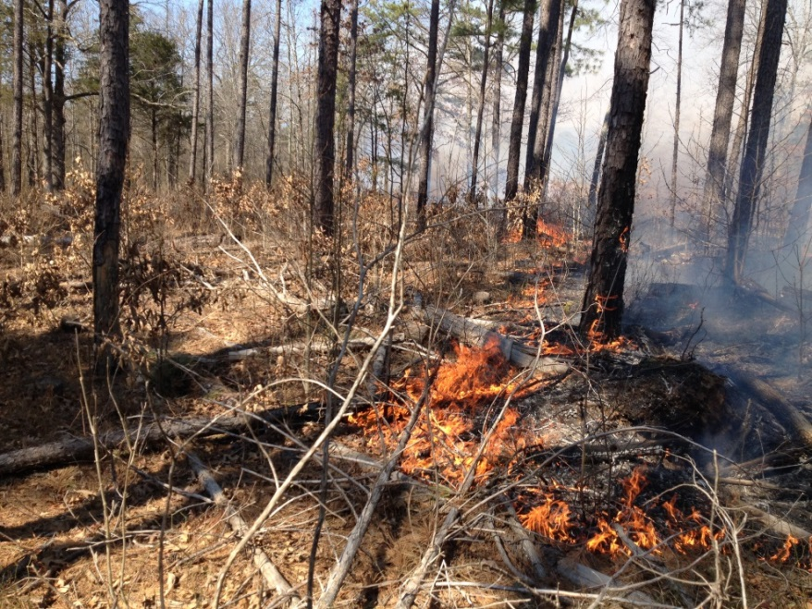
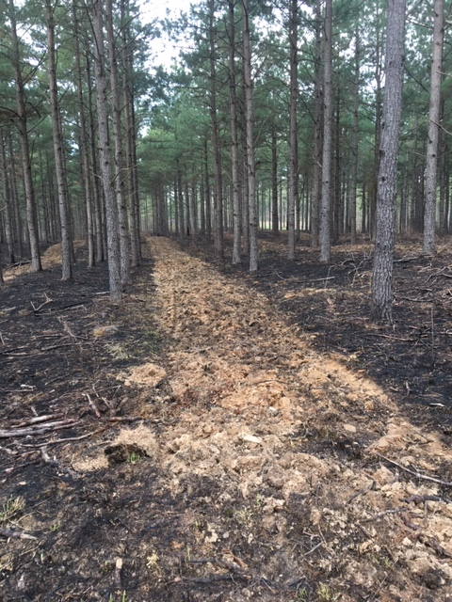
Wildlife Enhancements on Forest Lands; What Does That Look Like? How Do I Get There?
Be prepared to alter seasonality of burns. Dormant season burns (Dec. – Feb.) are generally maintenance burns. Growing season burns (March –mid-April: Sept. – Nov.) are used to top kill wood stems and control mid-story development.
Utilize fallow disking to further diversify the herbaceous ground cover. Disked strips in early spring favors annual weeds and creates excellent brood-rearing habitat and a diverse insect abundance. Burn on 2-3 year intervals. Used to control invasive mid-story woody stems. Maintains high quality browse. Provides better nesting and brood-rearing habitat.
Develop food plots as a supplemental food source to compliment the natural browse created through the herbaceous understory. Food plots with diverse mixtures are preferred over single forage plots. Food plots should be evenly split between spring/summer and fall/winter plots. Must test soils and insure ph is properly adjusted for maximum forage production.
Keep good records of your management actions. Keep the good and discard the bad. Change things up.
Continue to burn on 2-3 year intervals.
Notes:
Text is best notes here.

Slide 12
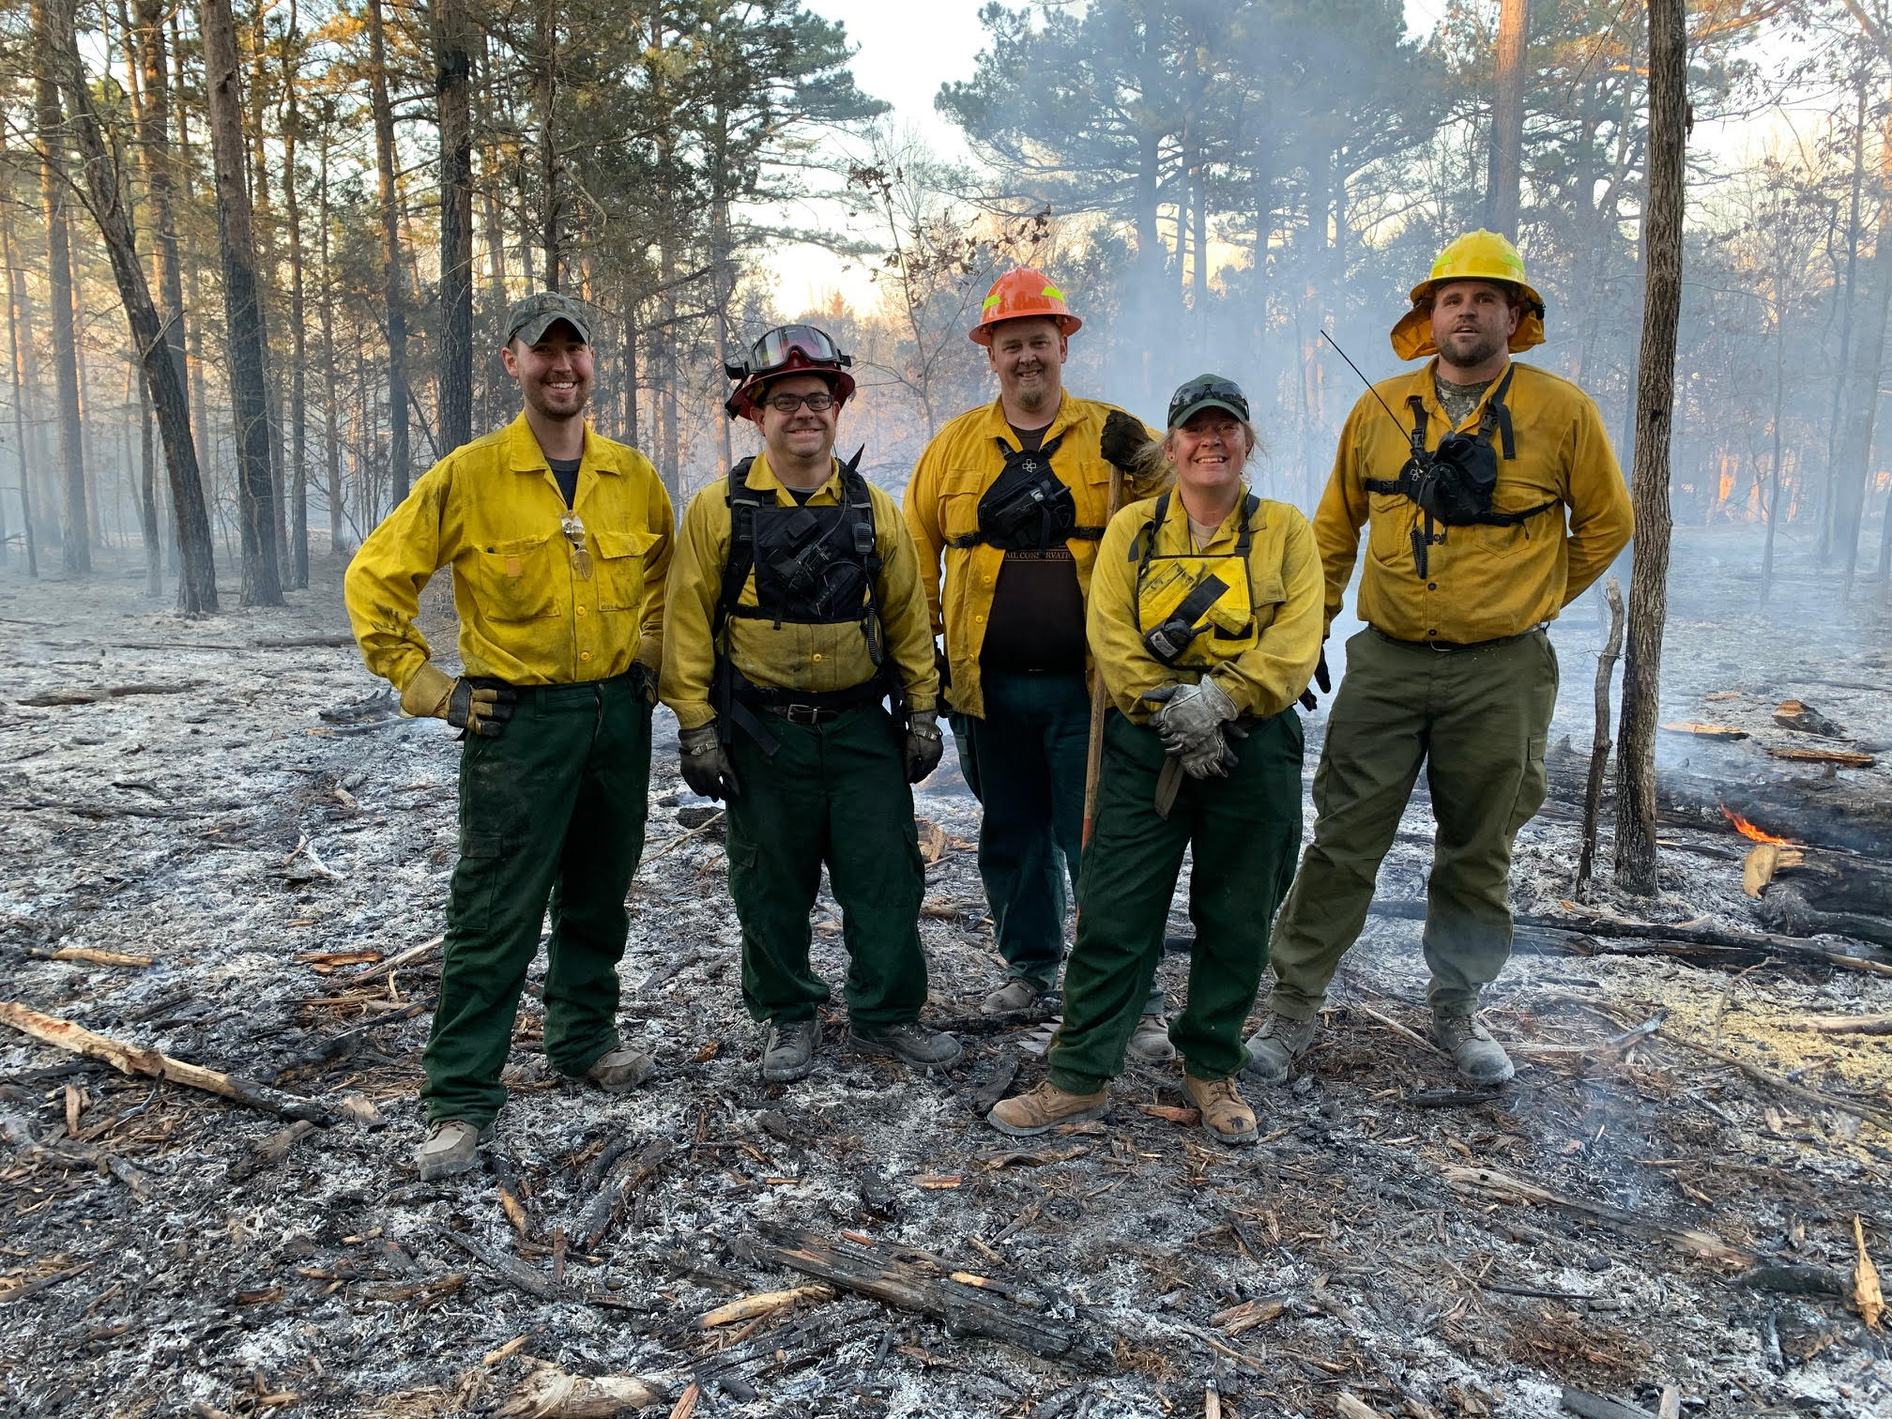
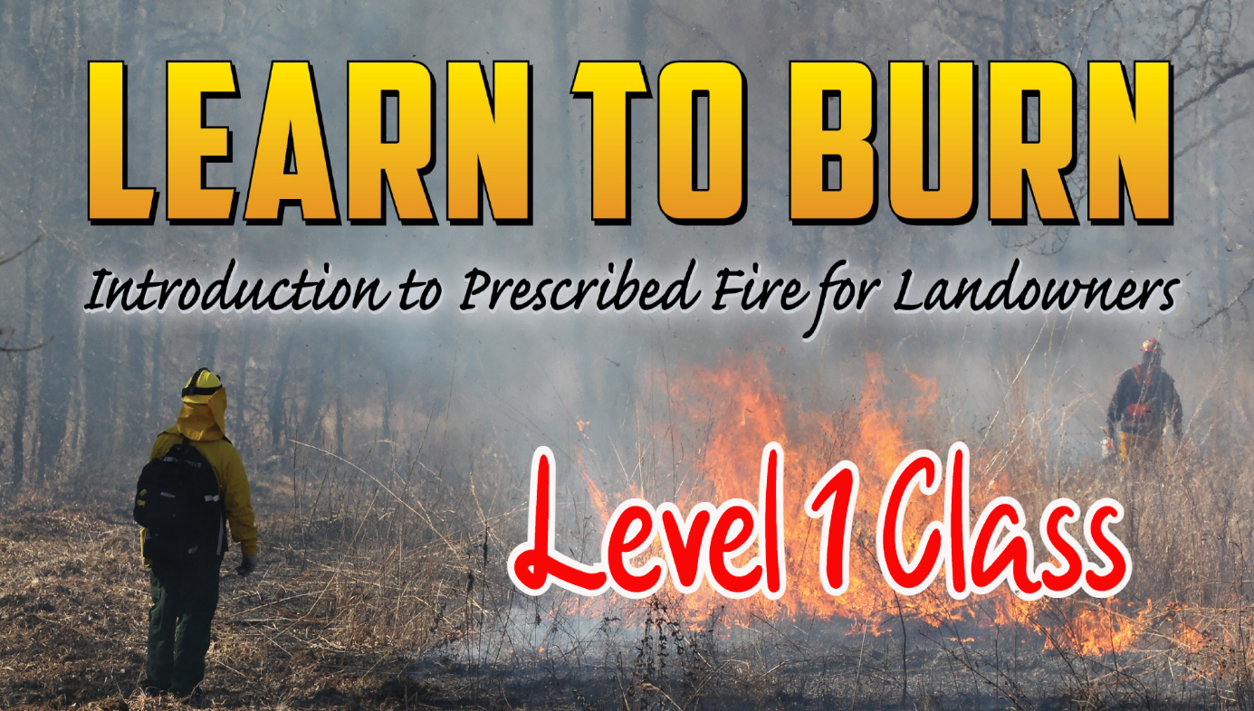
Wildlife Enhancements on Forest Lands; What Does That Look Like? How Do I Get There?
Get Help. It is available.
PLBs teach Learn to Burn workshops around the state to educate landowners on how to safely implement prescribed burns.
PLBs can provide contact information for contractors that burn, do TSI, mulching and other habitat enhancement work.
PLBs can assist landowners with initial burns.
PLBs are actively trying to build Prescribed Burn Associations across the state. These associations are neighbor helping neighbor with conducting prescribed burns.
Have a written management plan that is comprehensive and covers both forest management and wildlife management.
Notes:
Text is best notes here.

Slide 13
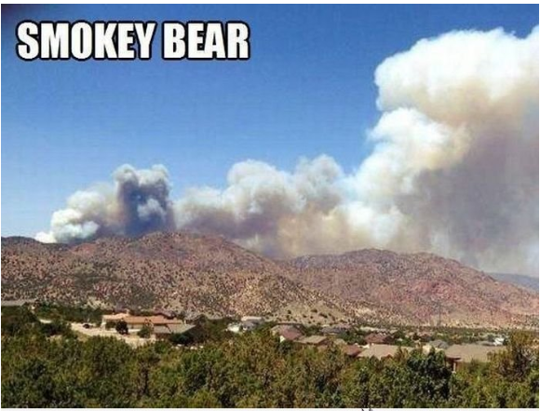
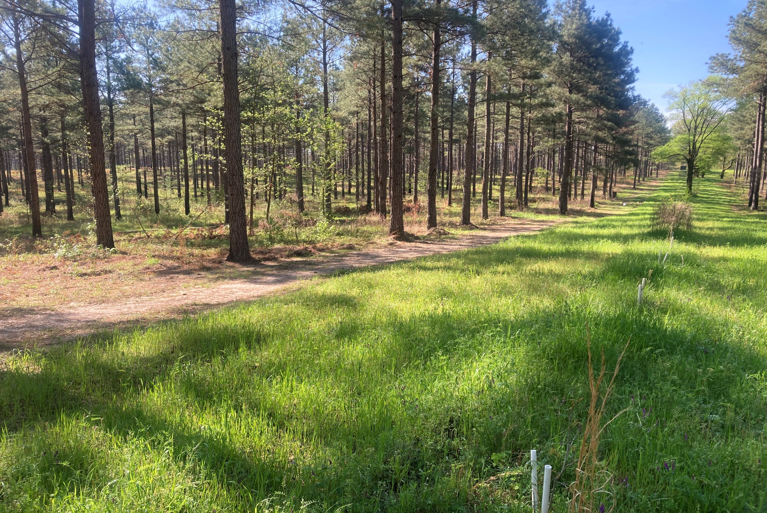
Questions?
https://www.facebook.com/groups/arkplb
Notes:
Note the new PLB facebook page. Can join and keep up on new stuff on private land conservation.

