Slide 1
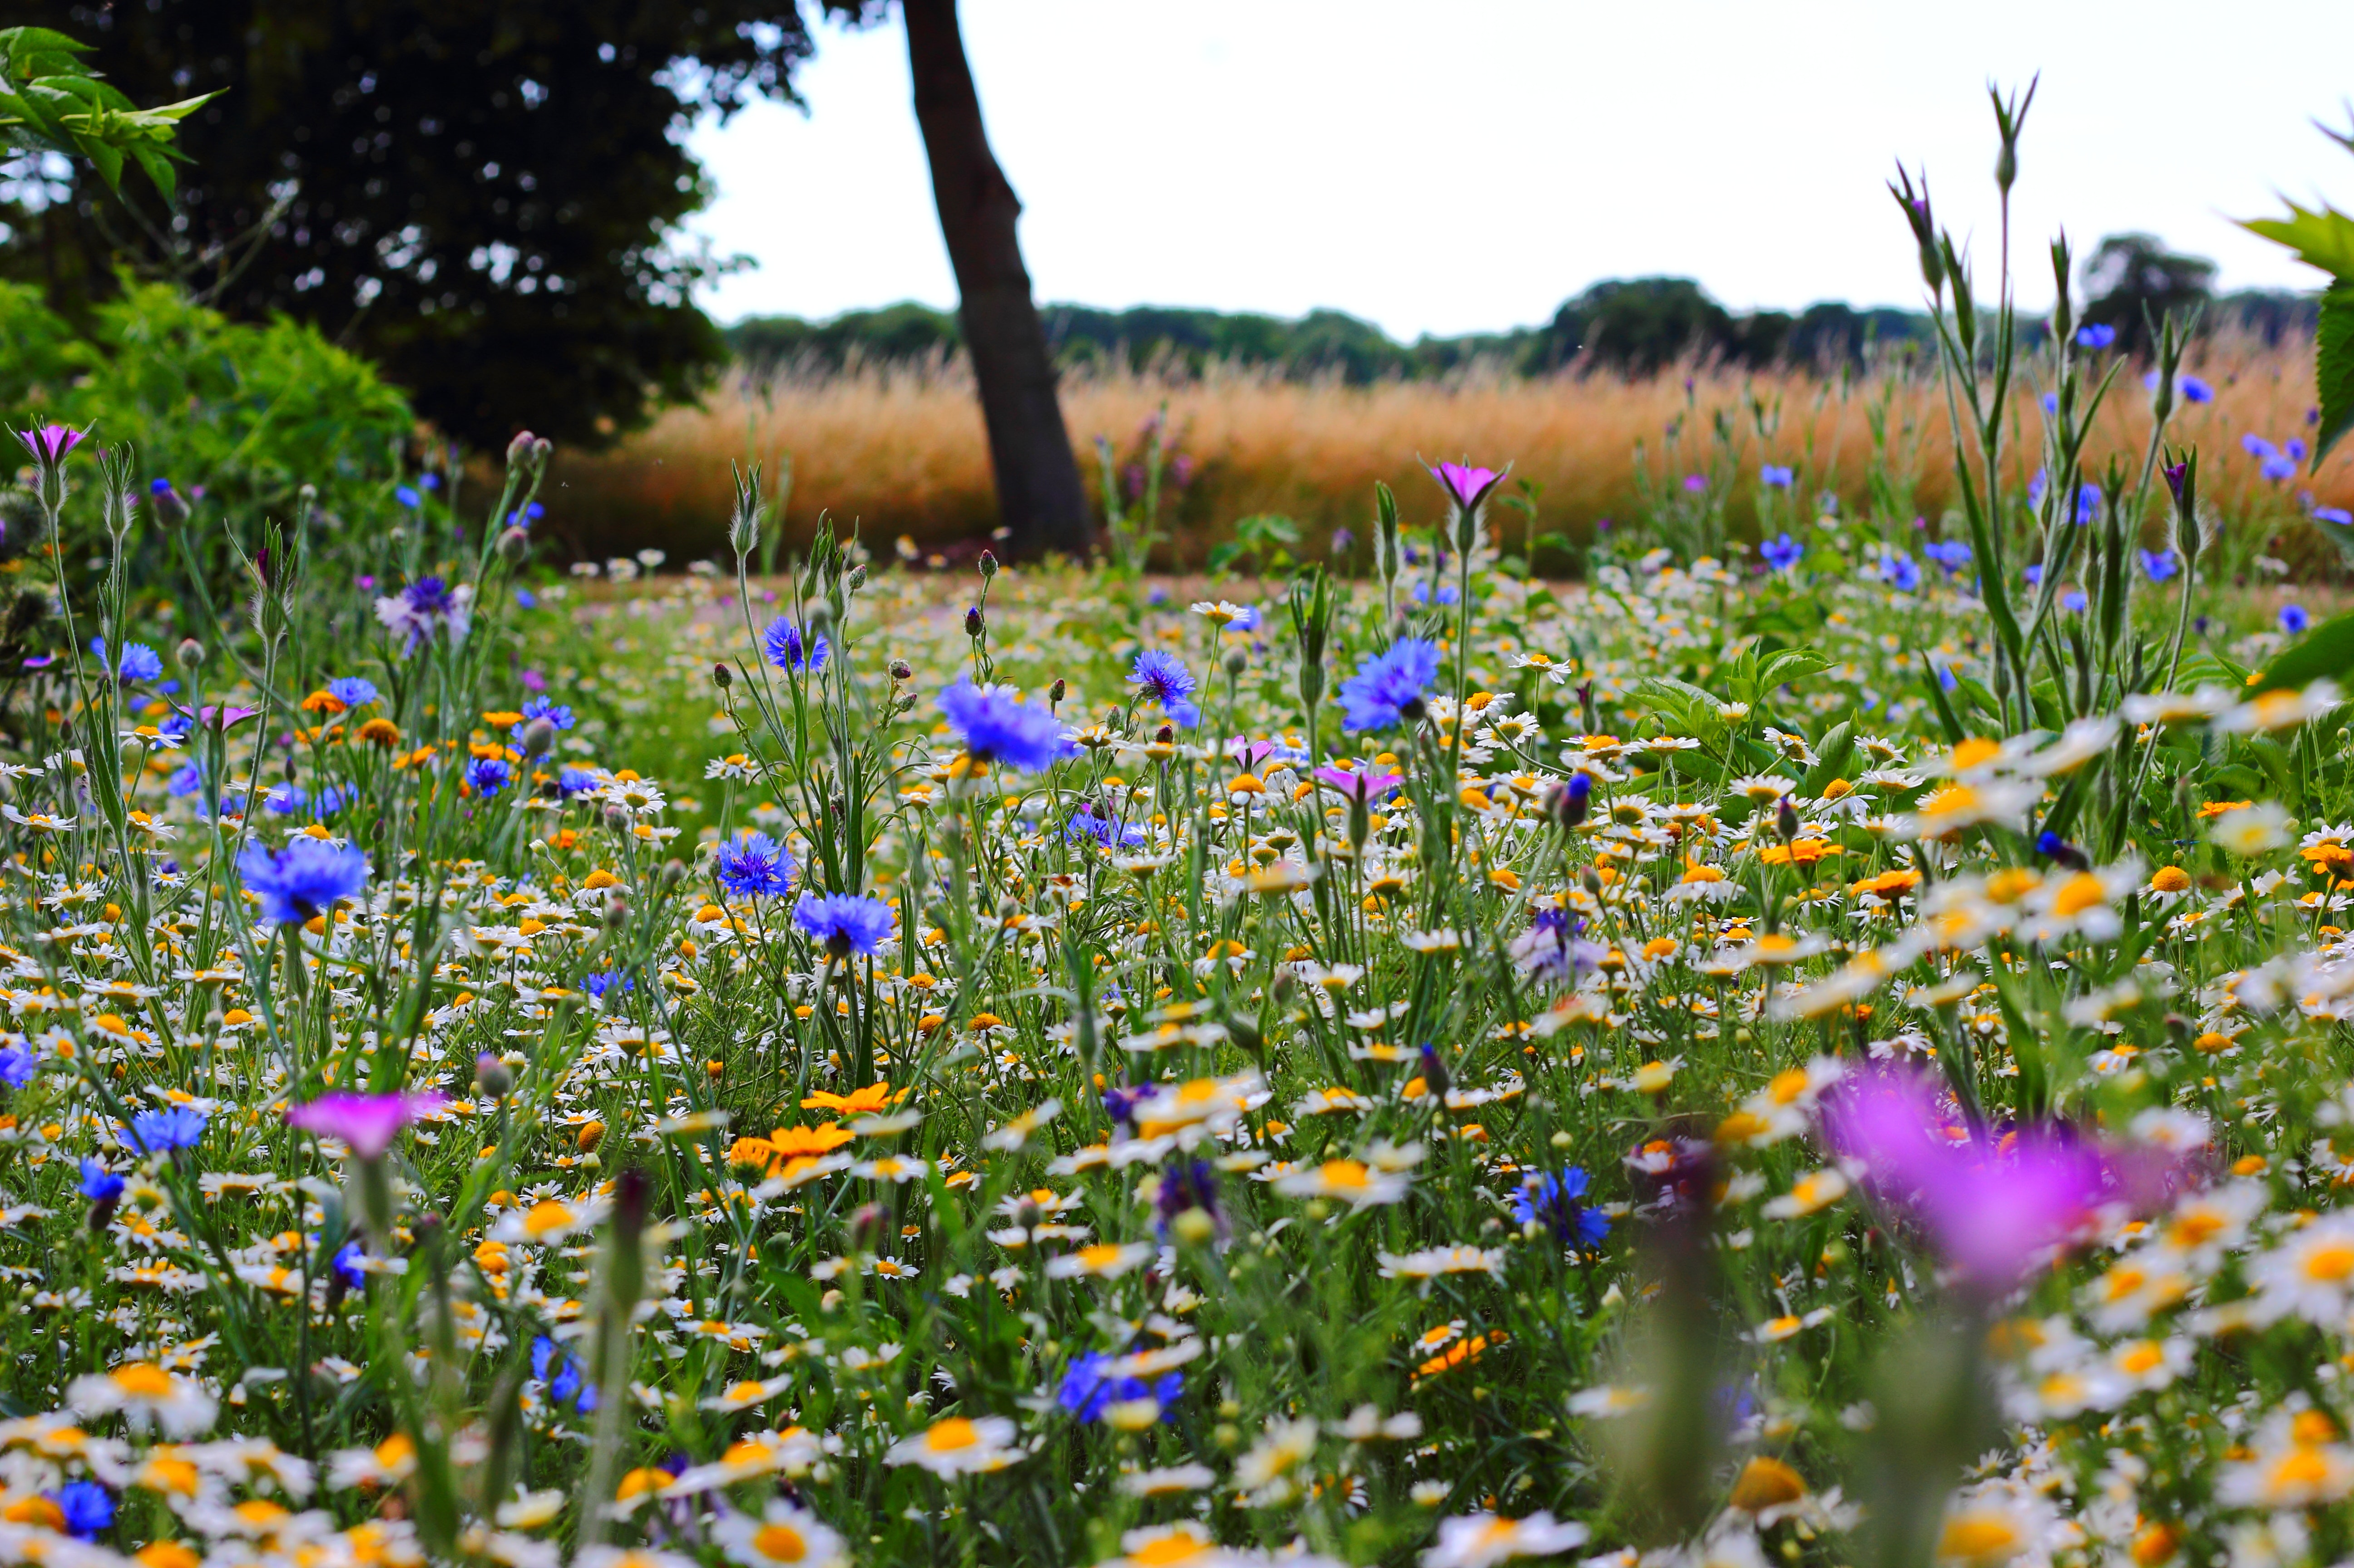
Welcome
Four States Timberland Owners Association
Members and Guests

Slide 2
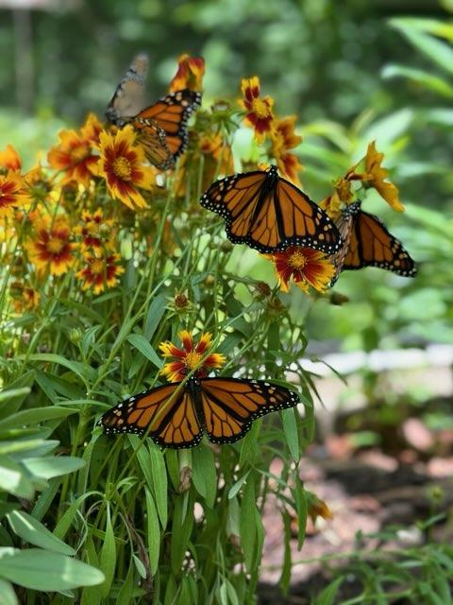

Slide 3
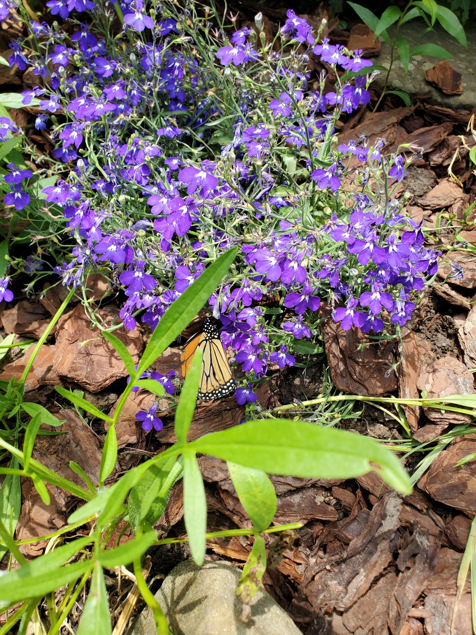
2023 Activities
Annual Audit – October
Wildflower Project
Tree Planting Project
Annual Meeting

Slide 4
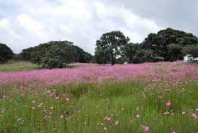
Thank you
For
Attending
If we can be
of any assistance
Please let us know.

